Slide 1
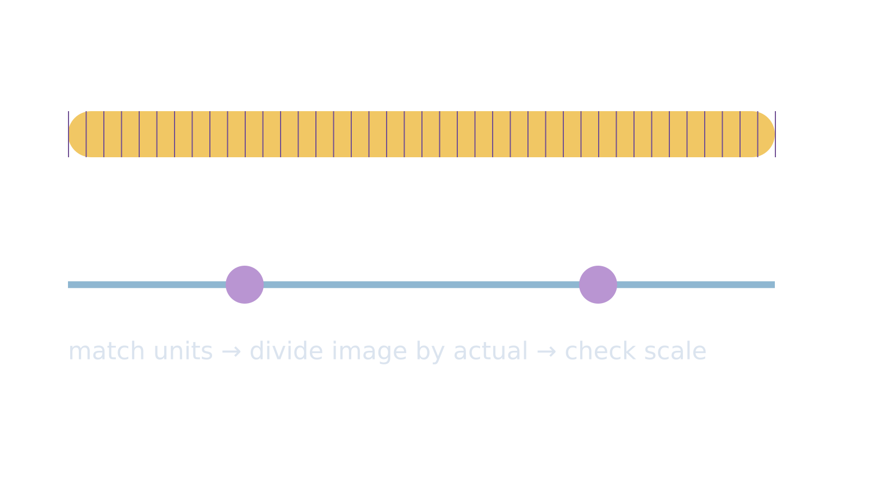
LAUNCH SCIENCE / W3L2
Arrival · 3 min
Calculating magnification
I can use the magnification relationship, convert units and judge whether an answer is plausible.
Notice. Recall. Be ready to explain.
1
Write the relationship between image size, actual size and magnification.
2
How many micrometres are in 1 millimetre?
Retrieval answers
Arrival
Starter
I Do
We Do
I Do 2
We Do 2
Independent
Exit
Resources
Notes:
Stage: Arrival, 3 minutes. Monday / Wednesday / Friday P1, 09:30–10:10. Use reveals within this slot; appendix slides are not added time.
Retrieval answers: M = I ÷ A (also I = M × A). | 1000 µm. | So the ratio compares like units; otherwise a scale factor remains hidden.
Core explanation: Name the unknown, match the units, select the relationship, substitute, then check. Magnification is a ratio: write ×200, not 200 mm.
Watch for: 50 µm is 0.05 mm, not 50 mm. A correct final value is not evidence that the unit route was understood.
Least help first: Ask which two values are known and whether their units match before discussing arithmetic.
Support cue: 1. Name the missing value. 2. Match the units. 3. Choose M = I ÷ A, I = M × A or A = I ÷ M. 4. Show each line of working.
[Sources]
User-supplied LAUNCH W3–W7 pack: W3 worksheet Tasks 1–3 and W3 slides 6–9.
Made by Matt LAUNCH Science draft, lesson-content.json, W3L2; existing illustrative diagrams reused, active-transport direction corrected to lower → higher.
Pearson Edexcel GCSE Biology specification, sections 1.1–1.6 and 1.15–1.17: https://qualifications.pearson.com/content/dam/pdf/GCSE/Science/2016/Specification/gcse-biology-spec.pdf
Optional concept video: freesciencelessons, Microscopy, https://www.youtube.com/watch?v=L5StAE_uuxM (link located 5 September 2026).
[/Sources]
[Sources]
Source editable lesson: Original LAUNCH Science OneDrive pack, 5 September 2026, W3L2. Source teaching content preserved. Current HTML reference: https://madebymatt.uk/Lessons/Science_Teesside/Launch/. Native diagrams restate the source explanation and are not experimental measurements.
[/Sources]

Slide 2
LAUNCH SCIENCE / W3L2
Starter · 4 min
Make a prediction
A cell is 50 µm long but its image measures 50 mm. Is the magnification ×1, ×100 or ×1000? Commit before converting.
A ×1
B ×100
C ×1000
Commit, then check
Arrival
Starter
I Do
We Do
I Do 2
We Do 2
Independent
Exit
Resources
Notes:
Stage: Starter, 4 minutes. Monday / Wednesday / Friday P1, 09:30–10:10. Use reveals within this slot; appendix slides are not added time.
Correct: ×1000. Ask for the reason, then return to the original prediction.
Core explanation: Name the unknown, match the units, select the relationship, substitute, then check. Magnification is a ratio: write ×200, not 200 mm.
Watch for: 50 µm is 0.05 mm, not 50 mm. A correct final value is not evidence that the unit route was understood.
Least help first: Ask which two values are known and whether their units match before discussing arithmetic.
Support cue: 1. Name the missing value. 2. Match the units. 3. Choose M = I ÷ A, I = M × A or A = I ÷ M. 4. Show each line of working.
[Sources]
User-supplied LAUNCH W3–W7 pack: W3 worksheet Tasks 1–3 and W3 slides 6–9.
Made by Matt LAUNCH Science draft, lesson-content.json, W3L2; existing illustrative diagrams reused, active-transport direction corrected to lower → higher.
Pearson Edexcel GCSE Biology specification, sections 1.1–1.6 and 1.15–1.17: https://qualifications.pearson.com/content/dam/pdf/GCSE/Science/2016/Specification/gcse-biology-spec.pdf
Optional concept video: freesciencelessons, Microscopy, https://www.youtube.com/watch?v=L5StAE_uuxM (link located 5 September 2026).
[/Sources]
[Sources]
Source editable lesson: Original LAUNCH Science OneDrive pack, 5 September 2026, W3L2. Source teaching content preserved. Current HTML reference: https://madebymatt.uk/Lessons/Science_Teesside/Launch/. Native diagrams restate the source explanation and are not experimental measurements.
[/Sources]

Slide 3
LAUNCH SCIENCE / W3L2
I Do · 5 min
Watch the model
1
Circle the known quantities and name the unknown.
Use matching units
IMAGE SIZE
2
Convert both lengths into the same unit before substituting.
I
M =
A
3
Use magnification = image size ÷ actual size, then check whether the scale makes sense.
ACTUAL SIZE
View labelled diagram
Optional video
Arrival
Starter
I Do
We Do
I Do 2
We Do 2
Independent
Exit
Resources
Notes:
Stage: I Do, 5 minutes. Monday / Wednesday / Friday P1, 09:30–10:10. Use reveals within this slot; appendix slides are not added time.
The scale strip makes the 1000-fold difference between millimetres and micrometres visible.
Model limit: The strip is a simplified scale comparison; real cell images may include scale bars, uncertainty and imperfect edges.
Video replaces up to 90 seconds of explanation; use the still diagram if unavailable.
Core explanation: Name the unknown, match the units, select the relationship, substitute, then check. Magnification is a ratio: write ×200, not 200 mm.
Watch for: 50 µm is 0.05 mm, not 50 mm. A correct final value is not evidence that the unit route was understood.
Least help first: Ask which two values are known and whether their units match before discussing arithmetic.
Support cue: 1. Name the missing value. 2. Match the units. 3. Choose M = I ÷ A, I = M × A or A = I ÷ M. 4. Show each line of working.
[Sources]
User-supplied LAUNCH W3–W7 pack: W3 worksheet Tasks 1–3 and W3 slides 6–9.
Made by Matt LAUNCH Science draft, lesson-content.json, W3L2; existing illustrative diagrams reused, active-transport direction corrected to lower → higher.
Pearson Edexcel GCSE Biology specification, sections 1.1–1.6 and 1.15–1.17: https://qualifications.pearson.com/content/dam/pdf/GCSE/Science/2016/Specification/gcse-biology-spec.pdf
Optional concept video: freesciencelessons, Microscopy, https://www.youtube.com/watch?v=L5StAE_uuxM (link located 5 September 2026).
[/Sources]
[Sources]
Source editable lesson: Original LAUNCH Science OneDrive pack, 5 September 2026, W3L2. Source teaching content preserved. Current HTML reference: https://madebymatt.uk/Lessons/Science_Teesside/Launch/. Native diagrams restate the source explanation and are not experimental measurements.
[/Sources]

Slide 4
LAUNCH SCIENCE / W3L2
We Do · 5 min
Choose and justify
An image is 24 mm and the actual cell is 60 µm. Which conversion is useful?
A 24 mm = 24 µm
B 24 mm = 240 µm
C 24 mm = 24,000 µm
D 60 µm = 60,000 mm
Give the deciding clue before checking.
Check the reasoning
Arrival
Starter
I Do
We Do
I Do 2
We Do 2
Independent
Exit
Resources
Notes:
Stage: We Do, 5 minutes. Monday / Wednesday / Friday P1, 09:30–10:10. Use reveals within this slot; appendix slides are not added time.
A: 24 mm = 24 µm — The units have changed but the number has not. That cannot preserve the length.
B: 24 mm = 240 µm — Check the factor: milli to micro is ×1000, not ×10.
C: 24 mm = 24,000 µm — Correct. Now divide 24,000 µm by 60 µm.
D: 60 µm = 60,000 mm — This conversion reverses both the unit and the scale.
Core explanation: Name the unknown, match the units, select the relationship, substitute, then check. Magnification is a ratio: write ×200, not 200 mm.
Watch for: 50 µm is 0.05 mm, not 50 mm. A correct final value is not evidence that the unit route was understood.
Least help first: Ask which two values are known and whether their units match before discussing arithmetic.
Support cue: 1. Name the missing value. 2. Match the units. 3. Choose M = I ÷ A, I = M × A or A = I ÷ M. 4. Show each line of working.
[Sources]
User-supplied LAUNCH W3–W7 pack: W3 worksheet Tasks 1–3 and W3 slides 6–9.
Made by Matt LAUNCH Science draft, lesson-content.json, W3L2; existing illustrative diagrams reused, active-transport direction corrected to lower → higher.
Pearson Edexcel GCSE Biology specification, sections 1.1–1.6 and 1.15–1.17: https://qualifications.pearson.com/content/dam/pdf/GCSE/Science/2016/Specification/gcse-biology-spec.pdf
Optional concept video: freesciencelessons, Microscopy, https://www.youtube.com/watch?v=L5StAE_uuxM (link located 5 September 2026).
[/Sources]
[Sources]
Source editable lesson: Original LAUNCH Science OneDrive pack, 5 September 2026, W3L2. Source teaching content preserved. Current HTML reference: https://madebymatt.uk/Lessons/Science_Teesside/Launch/. Native diagrams restate the source explanation and are not experimental measurements.
[/Sources]

Slide 5
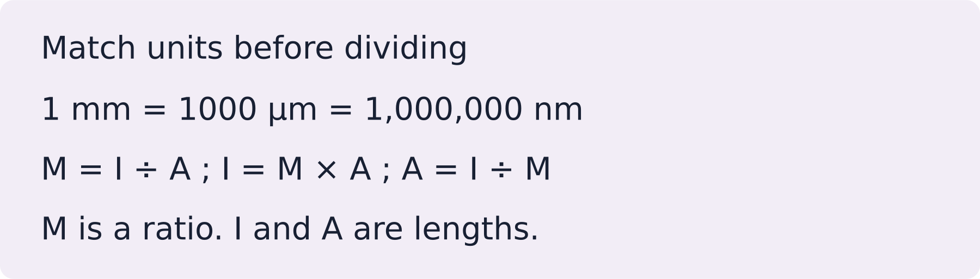
LAUNCH SCIENCE / W3L2
I Do 2 · 4 min
Connect the science
1
Rearrange only after naming the unknown.
2
Keep units beside substitutions so a mismatch stays visible.
3
A plausibility check asks whether the image is much larger than the actual cell.
Arrival
Starter
I Do
We Do
I Do 2
We Do 2
Independent
Exit
Resources
Notes:
Stage: I Do 2, 4 minutes. Monday / Wednesday / Friday P1, 09:30–10:10. Use reveals within this slot; appendix slides are not added time.
The strip is a simplified scale comparison; real cell images may include scale bars, uncertainty and imperfect edges.
Core explanation: Name the unknown, match the units, select the relationship, substitute, then check. Magnification is a ratio: write ×200, not 200 mm.
Watch for: 50 µm is 0.05 mm, not 50 mm. A correct final value is not evidence that the unit route was understood.
Least help first: Ask which two values are known and whether their units match before discussing arithmetic.
Support cue: 1. Name the missing value. 2. Match the units. 3. Choose M = I ÷ A, I = M × A or A = I ÷ M. 4. Show each line of working.
[Sources]
User-supplied LAUNCH W3–W7 pack: W3 worksheet Tasks 1–3 and W3 slides 6–9.
Made by Matt LAUNCH Science draft, lesson-content.json, W3L2; existing illustrative diagrams reused, active-transport direction corrected to lower → higher.
Pearson Edexcel GCSE Biology specification, sections 1.1–1.6 and 1.15–1.17: https://qualifications.pearson.com/content/dam/pdf/GCSE/Science/2016/Specification/gcse-biology-spec.pdf
Optional concept video: freesciencelessons, Microscopy, https://www.youtube.com/watch?v=L5StAE_uuxM (link located 5 September 2026).
[/Sources]
[Sources]
Source editable lesson: Original LAUNCH Science OneDrive pack, 5 September 2026, W3L2. Source teaching content preserved. Current HTML reference: https://madebymatt.uk/Lessons/Science_Teesside/Launch/. Native diagrams restate the source explanation and are not experimental measurements.
[/Sources]

Slide 6
LAUNCH SCIENCE / W3L2
We Do 2 · Task · 6 min
Choose the relationship
Work in pairs: one chooses the formula; one checks the units. Swap.
1
A Image 20 mm; actual 0.1 mm. Find M.
2
B Image 50 mm; actual 0.5 mm. Find M.
3
C M = ×400; actual 0.05 mm. Find image size.
Reveal shared reasoning
Arrival
Starter
I Do
We Do
I Do 2
We Do 2
Independent
Exit
Resources
Notes:
Stage: We Do 2 · Task, 6 minutes. Monday / Wednesday / Friday P1, 09:30–10:10. Use reveals within this slot; appendix slides are not added time.
A: 20 ÷ 0.1 = ×200.
B: 50 ÷ 0.5 = ×100.
C: 400 × 0.05 = 20 mm.
Keep units for lengths; magnification is a ratio.
Run the printed activity or this board; one route is enough.
Core explanation: Name the unknown, match the units, select the relationship, substitute, then check. Magnification is a ratio: write ×200, not 200 mm.
Watch for: 50 µm is 0.05 mm, not 50 mm. A correct final value is not evidence that the unit route was understood.
Least help first: Ask which two values are known and whether their units match before discussing arithmetic.
Support cue: 1. Name the missing value. 2. Match the units. 3. Choose M = I ÷ A, I = M × A or A = I ÷ M. 4. Show each line of working.
[Sources]
User-supplied LAUNCH W3–W7 pack: W3 worksheet Tasks 1–3 and W3 slides 6–9.
Made by Matt LAUNCH Science draft, lesson-content.json, W3L2; existing illustrative diagrams reused, active-transport direction corrected to lower → higher.
Pearson Edexcel GCSE Biology specification, sections 1.1–1.6 and 1.15–1.17: https://qualifications.pearson.com/content/dam/pdf/GCSE/Science/2016/Specification/gcse-biology-spec.pdf
Optional concept video: freesciencelessons, Microscopy, https://www.youtube.com/watch?v=L5StAE_uuxM (link located 5 September 2026).
[/Sources]
[Sources]
Source editable lesson: Original LAUNCH Science OneDrive pack, 5 September 2026, W3L2. Source teaching content preserved. Current HTML reference: https://madebymatt.uk/Lessons/Science_Teesside/Launch/. Native diagrams restate the source explanation and are not experimental measurements.
[/Sources]

Slide 7
LAUNCH SCIENCE / W3L2
Independent Task · 10 min
Your independent evidence
A micrograph of a cell measures 36 mm. The cell’s actual length is 90 µm. Calculate the magnification and explain one check that shows your answer is plausible.
Optional support
1. Name the missing value. 2. Match the units. 3. Choose M = I ÷ A, I = M × A or A = I ÷ M. 4. Show each line of working.
Make one precise correction to the same work after feedback.
Open worksheet pages
Model after first attempt
Arrival
Starter
I Do
We Do
I Do 2
We Do 2
Independent
Exit
Resources
Notes:
Stage: Independent Task, 10 minutes. Monday / Wednesday / Friday P1, 09:30–10:10. Use reveals within this slot; appendix slides are not added time.
Model answer: 36 mm = 36,000 µm. Magnification = image size ÷ actual size = 36,000 ÷ 90 = ×400. This is plausible because the measured image is hundreds of times larger than the actual cell.
Select only questions that fit the ten-minute slot. W7L3: Q2, Q3 and Q5 total 11 marks. The full paper needs a separate 25-minute slot.
Core explanation: Name the unknown, match the units, select the relationship, substitute, then check. Magnification is a ratio: write ×200, not 200 mm.
Watch for: 50 µm is 0.05 mm, not 50 mm. A correct final value is not evidence that the unit route was understood.
Least help first: Ask which two values are known and whether their units match before discussing arithmetic.
Support cue: 1. Name the missing value. 2. Match the units. 3. Choose M = I ÷ A, I = M × A or A = I ÷ M. 4. Show each line of working.
[Sources]
User-supplied LAUNCH W3–W7 pack: W3 worksheet Tasks 1–3 and W3 slides 6–9.
Made by Matt LAUNCH Science draft, lesson-content.json, W3L2; existing illustrative diagrams reused, active-transport direction corrected to lower → higher.
Pearson Edexcel GCSE Biology specification, sections 1.1–1.6 and 1.15–1.17: https://qualifications.pearson.com/content/dam/pdf/GCSE/Science/2016/Specification/gcse-biology-spec.pdf
Optional concept video: freesciencelessons, Microscopy, https://www.youtube.com/watch?v=L5StAE_uuxM (link located 5 September 2026).
[/Sources]
[Sources]
Source editable lesson: Original LAUNCH Science OneDrive pack, 5 September 2026, W3L2. Source teaching content preserved. Current HTML reference: https://madebymatt.uk/Lessons/Science_Teesside/Launch/. Native diagrams restate the source explanation and are not experimental measurements.
[/Sources]

Slide 8
LAUNCH SCIENCE / W3L2
Exit · 3 min
What changed in your thinking?
What single check should happen before dividing one length by another?
1
Point to one improvement in your work.
2
Choose what you want to revisit.
3
Tell your teacher; agree the next step together.
Arrival
Starter
I Do
We Do
I Do 2
We Do 2
Independent
Exit
Resources
Notes:
Stage: Exit, 3 minutes. Monday / Wednesday / Friday P1, 09:30–10:10. Use reveals within this slot; appendix slides are not added time.
Exit answer: Convert image and actual size to the same unit before dividing.
Receive the request, record the agreed next action and check it next lesson. Keep responses private when requested.
Core explanation: Name the unknown, match the units, select the relationship, substitute, then check. Magnification is a ratio: write ×200, not 200 mm.
Watch for: 50 µm is 0.05 mm, not 50 mm. A correct final value is not evidence that the unit route was understood.
Least help first: Ask which two values are known and whether their units match before discussing arithmetic.
Support cue: 1. Name the missing value. 2. Match the units. 3. Choose M = I ÷ A, I = M × A or A = I ÷ M. 4. Show each line of working.
[Sources]
User-supplied LAUNCH W3–W7 pack: W3 worksheet Tasks 1–3 and W3 slides 6–9.
Made by Matt LAUNCH Science draft, lesson-content.json, W3L2; existing illustrative diagrams reused, active-transport direction corrected to lower → higher.
Pearson Edexcel GCSE Biology specification, sections 1.1–1.6 and 1.15–1.17: https://qualifications.pearson.com/content/dam/pdf/GCSE/Science/2016/Specification/gcse-biology-spec.pdf
Optional concept video: freesciencelessons, Microscopy, https://www.youtube.com/watch?v=L5StAE_uuxM (link located 5 September 2026).
[/Sources]
[Sources]
Source editable lesson: Original LAUNCH Science OneDrive pack, 5 September 2026, W3L2. Source teaching content preserved. Current HTML reference: https://madebymatt.uk/Lessons/Science_Teesside/Launch/. Native diagrams restate the source explanation and are not experimental measurements.
[/Sources]

Slide 9
LAUNCH SCIENCE / W3L2
Resources
Retrieval and prediction check
1
M = I ÷ A (also I = M × A).
2
1000 µm.
×1000
Return to Starter
Arrival
Starter
I Do
We Do
I Do 2
We Do 2
Independent
Exit
Resources
Notes:
Read only after an attempt; retain the pupil’s first view.
Core explanation: Name the unknown, match the units, select the relationship, substitute, then check. Magnification is a ratio: write ×200, not 200 mm.
Watch for: 50 µm is 0.05 mm, not 50 mm. A correct final value is not evidence that the unit route was understood.
Least help first: Ask which two values are known and whether their units match before discussing arithmetic.
Support cue: 1. Name the missing value. 2. Match the units. 3. Choose M = I ÷ A, I = M × A or A = I ÷ M. 4. Show each line of working.
[Sources]
User-supplied LAUNCH W3–W7 pack: W3 worksheet Tasks 1–3 and W3 slides 6–9.
Made by Matt LAUNCH Science draft, lesson-content.json, W3L2; existing illustrative diagrams reused, active-transport direction corrected to lower → higher.
Pearson Edexcel GCSE Biology specification, sections 1.1–1.6 and 1.15–1.17: https://qualifications.pearson.com/content/dam/pdf/GCSE/Science/2016/Specification/gcse-biology-spec.pdf
Optional concept video: freesciencelessons, Microscopy, https://www.youtube.com/watch?v=L5StAE_uuxM (link located 5 September 2026).
[/Sources]
[Sources]
Source editable lesson: Original LAUNCH Science OneDrive pack, 5 September 2026, W3L2. Source teaching content preserved. Current HTML reference: https://madebymatt.uk/Lessons/Science_Teesside/Launch/. Native diagrams restate the source explanation and are not experimental measurements.
[/Sources]

Slide 10
LAUNCH SCIENCE / W3L2
Resources
Check the deciding clue
24 mm = 24,000 µm
Correct. Now divide 24,000 µm by 60 µm.
Compare your reason. Correct one step if needed.
Return to We Do
Arrival
Starter
I Do
We Do
I Do 2
We Do 2
Independent
Exit
Resources
Notes:
The units have changed but the number has not. That cannot preserve the length.
Check the factor: milli to micro is ×1000, not ×10.
Correct. Now divide 24,000 µm by 60 µm.
This conversion reverses both the unit and the scale.
Core explanation: Name the unknown, match the units, select the relationship, substitute, then check. Magnification is a ratio: write ×200, not 200 mm.
Watch for: 50 µm is 0.05 mm, not 50 mm. A correct final value is not evidence that the unit route was understood.
Least help first: Ask which two values are known and whether their units match before discussing arithmetic.
Support cue: 1. Name the missing value. 2. Match the units. 3. Choose M = I ÷ A, I = M × A or A = I ÷ M. 4. Show each line of working.
[Sources]
User-supplied LAUNCH W3–W7 pack: W3 worksheet Tasks 1–3 and W3 slides 6–9.
Made by Matt LAUNCH Science draft, lesson-content.json, W3L2; existing illustrative diagrams reused, active-transport direction corrected to lower → higher.
Pearson Edexcel GCSE Biology specification, sections 1.1–1.6 and 1.15–1.17: https://qualifications.pearson.com/content/dam/pdf/GCSE/Science/2016/Specification/gcse-biology-spec.pdf
Optional concept video: freesciencelessons, Microscopy, https://www.youtube.com/watch?v=L5StAE_uuxM (link located 5 September 2026).
[/Sources]
[Sources]
Source editable lesson: Original LAUNCH Science OneDrive pack, 5 September 2026, W3L2. Source teaching content preserved. Current HTML reference: https://madebymatt.uk/Lessons/Science_Teesside/Launch/. Native diagrams restate the source explanation and are not experimental measurements.
[/Sources]

Slide 11
LAUNCH SCIENCE / W3L2
Resources
Our shared reasoning
A: 20 ÷ 0.1 = ×200.
B: 50 ÷ 0.5 = ×100.
C: 400 × 0.05 = 20 mm.
Keep units for lengths; magnification is a ratio.
Return to shared task
Arrival
Starter
I Do
We Do
I Do 2
We Do 2
Independent
Exit
Resources
Notes:
Pupils should justify, compare and revise rather than copy a complete answer before trying.
Core explanation: Name the unknown, match the units, select the relationship, substitute, then check. Magnification is a ratio: write ×200, not 200 mm.
Watch for: 50 µm is 0.05 mm, not 50 mm. A correct final value is not evidence that the unit route was understood.
Least help first: Ask which two values are known and whether their units match before discussing arithmetic.
Support cue: 1. Name the missing value. 2. Match the units. 3. Choose M = I ÷ A, I = M × A or A = I ÷ M. 4. Show each line of working.
[Sources]
User-supplied LAUNCH W3–W7 pack: W3 worksheet Tasks 1–3 and W3 slides 6–9.
Made by Matt LAUNCH Science draft, lesson-content.json, W3L2; existing illustrative diagrams reused, active-transport direction corrected to lower → higher.
Pearson Edexcel GCSE Biology specification, sections 1.1–1.6 and 1.15–1.17: https://qualifications.pearson.com/content/dam/pdf/GCSE/Science/2016/Specification/gcse-biology-spec.pdf
Optional concept video: freesciencelessons, Microscopy, https://www.youtube.com/watch?v=L5StAE_uuxM (link located 5 September 2026).
[/Sources]
[Sources]
Source editable lesson: Original LAUNCH Science OneDrive pack, 5 September 2026, W3L2. Source teaching content preserved. Current HTML reference: https://madebymatt.uk/Lessons/Science_Teesside/Launch/. Native diagrams restate the source explanation and are not experimental measurements.
[/Sources]

Slide 12
LAUNCH SCIENCE / W3L2
Resources
Compare after your first attempt
36 mm = 36,000 µm. Magnification = image size ÷ actual size = 36,000 ÷ 90 = ×400. This is plausible because the measured image is hundreds of times larger than the actual cell.
Use the model to improve your explanation in your own words.
Return to independent task
Arrival
Starter
I Do
We Do
I Do 2
We Do 2
Independent
Exit
Resources
Notes:
Staff guide includes question-by-question answers. Do not distribute this presentation as a secure assessment paper.
Core explanation: Name the unknown, match the units, select the relationship, substitute, then check. Magnification is a ratio: write ×200, not 200 mm.
Watch for: 50 µm is 0.05 mm, not 50 mm. A correct final value is not evidence that the unit route was understood.
Least help first: Ask which two values are known and whether their units match before discussing arithmetic.
Support cue: 1. Name the missing value. 2. Match the units. 3. Choose M = I ÷ A, I = M × A or A = I ÷ M. 4. Show each line of working.
[Sources]
User-supplied LAUNCH W3–W7 pack: W3 worksheet Tasks 1–3 and W3 slides 6–9.
Made by Matt LAUNCH Science draft, lesson-content.json, W3L2; existing illustrative diagrams reused, active-transport direction corrected to lower → higher.
Pearson Edexcel GCSE Biology specification, sections 1.1–1.6 and 1.15–1.17: https://qualifications.pearson.com/content/dam/pdf/GCSE/Science/2016/Specification/gcse-biology-spec.pdf
Optional concept video: freesciencelessons, Microscopy, https://www.youtube.com/watch?v=L5StAE_uuxM (link located 5 September 2026).
[/Sources]
[Sources]
Source editable lesson: Original LAUNCH Science OneDrive pack, 5 September 2026, W3L2. Source teaching content preserved. Current HTML reference: https://madebymatt.uk/Lessons/Science_Teesside/Launch/. Native diagrams restate the source explanation and are not experimental measurements.
[/Sources]

Slide 13
LAUNCH SCIENCE / W3L2
Resources
Your lesson resources
Worksheet pages are stored inside this PowerPoint.
Worksheet · page 1
Worksheet · page 2
Standard PDF
Supported PDF
Depth PDF
Editable Word worksheet
Open online lesson / model
Named files are in this week’s folder. Online lesson and video need internet.
Optional concept video
Arrival
Starter
I Do
We Do
I Do 2
We Do 2
Independent
Exit
Resources
Notes:
File buttons use relative links for downloaded/synced folders. OneDrive preview may not resolve relative links. Use the embedded pages or open the named file in the week folder.
Core explanation: Name the unknown, match the units, select the relationship, substitute, then check. Magnification is a ratio: write ×200, not 200 mm.
Watch for: 50 µm is 0.05 mm, not 50 mm. A correct final value is not evidence that the unit route was understood.
Least help first: Ask which two values are known and whether their units match before discussing arithmetic.
Support cue: 1. Name the missing value. 2. Match the units. 3. Choose M = I ÷ A, I = M × A or A = I ÷ M. 4. Show each line of working.
[Sources]
User-supplied LAUNCH W3–W7 pack: W3 worksheet Tasks 1–3 and W3 slides 6–9.
Made by Matt LAUNCH Science draft, lesson-content.json, W3L2; existing illustrative diagrams reused, active-transport direction corrected to lower → higher.
Pearson Edexcel GCSE Biology specification, sections 1.1–1.6 and 1.15–1.17: https://qualifications.pearson.com/content/dam/pdf/GCSE/Science/2016/Specification/gcse-biology-spec.pdf
Optional concept video: freesciencelessons, Microscopy, https://www.youtube.com/watch?v=L5StAE_uuxM (link located 5 September 2026).
[/Sources]
[Sources]
Source editable lesson: Original LAUNCH Science OneDrive pack, 5 September 2026, W3L2. Source teaching content preserved. Current HTML reference: https://madebymatt.uk/Lessons/Science_Teesside/Launch/. Native diagrams restate the source explanation and are not experimental measurements.
[/Sources]

Slide 14
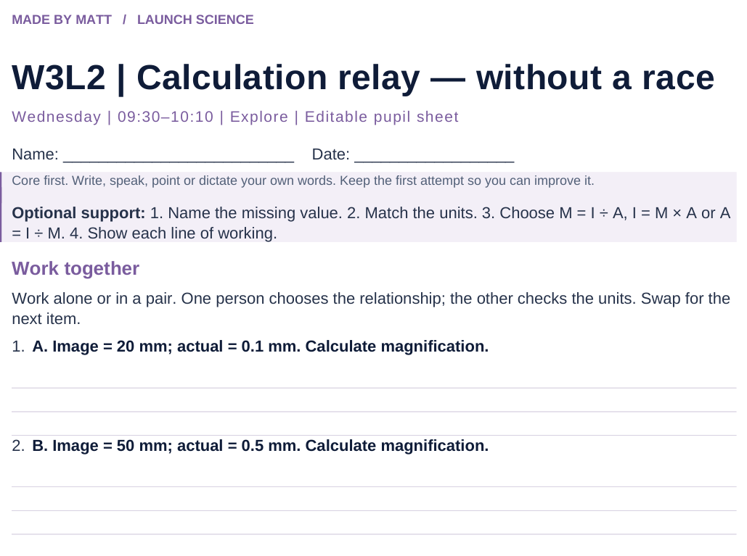
LAUNCH SCIENCE / W3L2
Resources
Worksheet · page 1
Use your printed copy.
Keep the first attempt.
Return to task
Arrival
Starter
I Do
We Do
I Do 2
We Do 2
Independent
Exit
Resources
Notes:
Embedded worksheet reference; print the separate PDF at A4 for writable space.
Core explanation: Name the unknown, match the units, select the relationship, substitute, then check. Magnification is a ratio: write ×200, not 200 mm.
Watch for: 50 µm is 0.05 mm, not 50 mm. A correct final value is not evidence that the unit route was understood.
Least help first: Ask which two values are known and whether their units match before discussing arithmetic.
Support cue: 1. Name the missing value. 2. Match the units. 3. Choose M = I ÷ A, I = M × A or A = I ÷ M. 4. Show each line of working.
[Sources]
User-supplied LAUNCH W3–W7 pack: W3 worksheet Tasks 1–3 and W3 slides 6–9.
Made by Matt LAUNCH Science draft, lesson-content.json, W3L2; existing illustrative diagrams reused, active-transport direction corrected to lower → higher.
Pearson Edexcel GCSE Biology specification, sections 1.1–1.6 and 1.15–1.17: https://qualifications.pearson.com/content/dam/pdf/GCSE/Science/2016/Specification/gcse-biology-spec.pdf
Optional concept video: freesciencelessons, Microscopy, https://www.youtube.com/watch?v=L5StAE_uuxM (link located 5 September 2026).
[/Sources]
[Sources]
Source editable lesson: Original LAUNCH Science OneDrive pack, 5 September 2026, W3L2. Source teaching content preserved. Current HTML reference: https://madebymatt.uk/Lessons/Science_Teesside/Launch/. Native diagrams restate the source explanation and are not experimental measurements.
[/Sources]

Slide 15
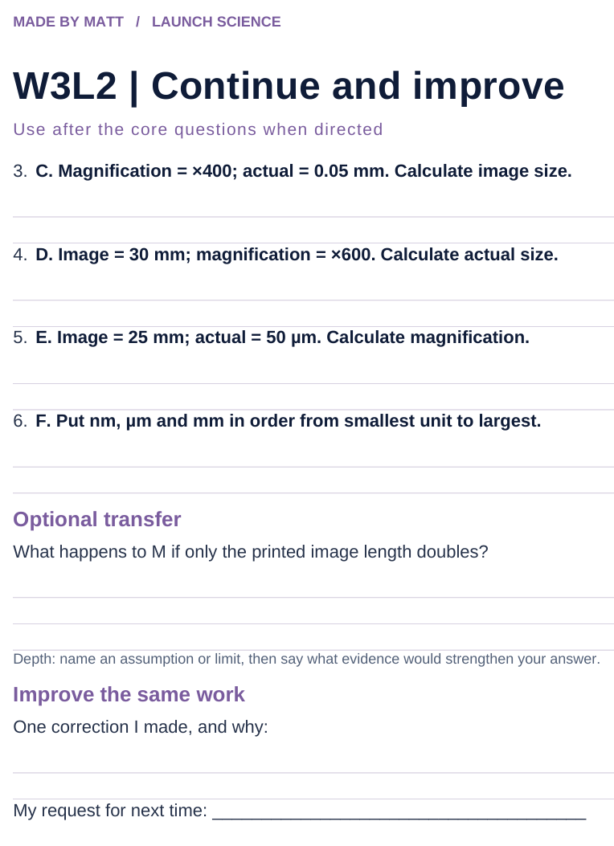
LAUNCH SCIENCE / W3L2
Resources
Worksheet · page 2
Continuation is optional.
Improve the same work.
Return to task
Arrival
Starter
I Do
We Do
I Do 2
We Do 2
Independent
Exit
Resources
Notes:
Embedded worksheet reference; print the separate PDF at A4 for writable space.
Core explanation: Name the unknown, match the units, select the relationship, substitute, then check. Magnification is a ratio: write ×200, not 200 mm.
Watch for: 50 µm is 0.05 mm, not 50 mm. A correct final value is not evidence that the unit route was understood.
Least help first: Ask which two values are known and whether their units match before discussing arithmetic.
Support cue: 1. Name the missing value. 2. Match the units. 3. Choose M = I ÷ A, I = M × A or A = I ÷ M. 4. Show each line of working.
[Sources]
User-supplied LAUNCH W3–W7 pack: W3 worksheet Tasks 1–3 and W3 slides 6–9.
Made by Matt LAUNCH Science draft, lesson-content.json, W3L2; existing illustrative diagrams reused, active-transport direction corrected to lower → higher.
Pearson Edexcel GCSE Biology specification, sections 1.1–1.6 and 1.15–1.17: https://qualifications.pearson.com/content/dam/pdf/GCSE/Science/2016/Specification/gcse-biology-spec.pdf
Optional concept video: freesciencelessons, Microscopy, https://www.youtube.com/watch?v=L5StAE_uuxM (link located 5 September 2026).
[/Sources]
[Sources]
Source editable lesson: Original LAUNCH Science OneDrive pack, 5 September 2026, W3L2. Source teaching content preserved. Current HTML reference: https://madebymatt.uk/Lessons/Science_Teesside/Launch/. Native diagrams restate the source explanation and are not experimental measurements.
[/Sources]

Slide 16
LAUNCH SCIENCE / W3L2
Resources
Watch, pause and explain
Microscopy
What is the difference between making an image bigger and resolving more detail?
Play freesciencelessons video
No connection? Use the still model and explain the same question.
Arrival
Starter
I Do
We Do
I Do 2
We Do 2
Independent
Exit
Resources
Notes:
Use at most 90 seconds within I Do. Pause on the first relevant example; ask for a reason. This is an optional concept clip, not evidence of practical completion.
Core explanation: Name the unknown, match the units, select the relationship, substitute, then check. Magnification is a ratio: write ×200, not 200 mm.
Watch for: 50 µm is 0.05 mm, not 50 mm. A correct final value is not evidence that the unit route was understood.
Least help first: Ask which two values are known and whether their units match before discussing arithmetic.
Support cue: 1. Name the missing value. 2. Match the units. 3. Choose M = I ÷ A, I = M × A or A = I ÷ M. 4. Show each line of working.
[Sources]
User-supplied LAUNCH W3–W7 pack: W3 worksheet Tasks 1–3 and W3 slides 6–9.
Made by Matt LAUNCH Science draft, lesson-content.json, W3L2; existing illustrative diagrams reused, active-transport direction corrected to lower → higher.
Pearson Edexcel GCSE Biology specification, sections 1.1–1.6 and 1.15–1.17: https://qualifications.pearson.com/content/dam/pdf/GCSE/Science/2016/Specification/gcse-biology-spec.pdf
Optional concept video: freesciencelessons, Microscopy, https://www.youtube.com/watch?v=L5StAE_uuxM (link located 5 September 2026).
[/Sources]
[Sources]
Source editable lesson: Original LAUNCH Science OneDrive pack, 5 September 2026, W3L2. Source teaching content preserved. Current HTML reference: https://madebymatt.uk/Lessons/Science_Teesside/Launch/. Native diagrams restate the source explanation and are not experimental measurements.
[/Sources]

Slide 17
LAUNCH SCIENCE / W3L2
Resources
Look closely at the model
The magnification triangle
mm ↔ μm conversion
×1000
mm
μm
IMAGE
÷1000
MAGNIF.
×
ACTUAL
match the units BEFORE you divide
cover the one you want, read the rest
A model illustration: use the stated data for calculations.
Return to I Do
Arrival
Starter
I Do
We Do
I Do 2
We Do 2
Independent
Exit
Resources
Notes:
Source image: https://madebymatt.uk/Lessons/Science_Teesside/Launch/SCI_L_W3_L2_Magnification.html; existing vector illustration embedded for offline use.
Core explanation: Name the unknown, match the units, select the relationship, substitute, then check. Magnification is a ratio: write ×200, not 200 mm.
Watch for: 50 µm is 0.05 mm, not 50 mm. A correct final value is not evidence that the unit route was understood.
Least help first: Ask which two values are known and whether their units match before discussing arithmetic.
Support cue: 1. Name the missing value. 2. Match the units. 3. Choose M = I ÷ A, I = M × A or A = I ÷ M. 4. Show each line of working.
[Sources]
User-supplied LAUNCH W3–W7 pack: W3 worksheet Tasks 1–3 and W3 slides 6–9.
Made by Matt LAUNCH Science draft, lesson-content.json, W3L2; existing illustrative diagrams reused, active-transport direction corrected to lower → higher.
Pearson Edexcel GCSE Biology specification, sections 1.1–1.6 and 1.15–1.17: https://qualifications.pearson.com/content/dam/pdf/GCSE/Science/2016/Specification/gcse-biology-spec.pdf
Optional concept video: freesciencelessons, Microscopy, https://www.youtube.com/watch?v=L5StAE_uuxM (link located 5 September 2026).
[/Sources]
[Sources]
Diagram labels and particle counts retained from the original editable LAUNCH Science pack, slide17. Recreated as editable shapes to separate labels from triangle edges and boundary lines.
[/Sources]
[Sources]
Source editable lesson: Original LAUNCH Science OneDrive pack, 5 September 2026, W3L2. Source teaching content preserved. Current HTML reference: https://madebymatt.uk/Lessons/Science_Teesside/Launch/. Native diagrams restate the source explanation and are not experimental measurements.
[/Sources]

