Slide 1
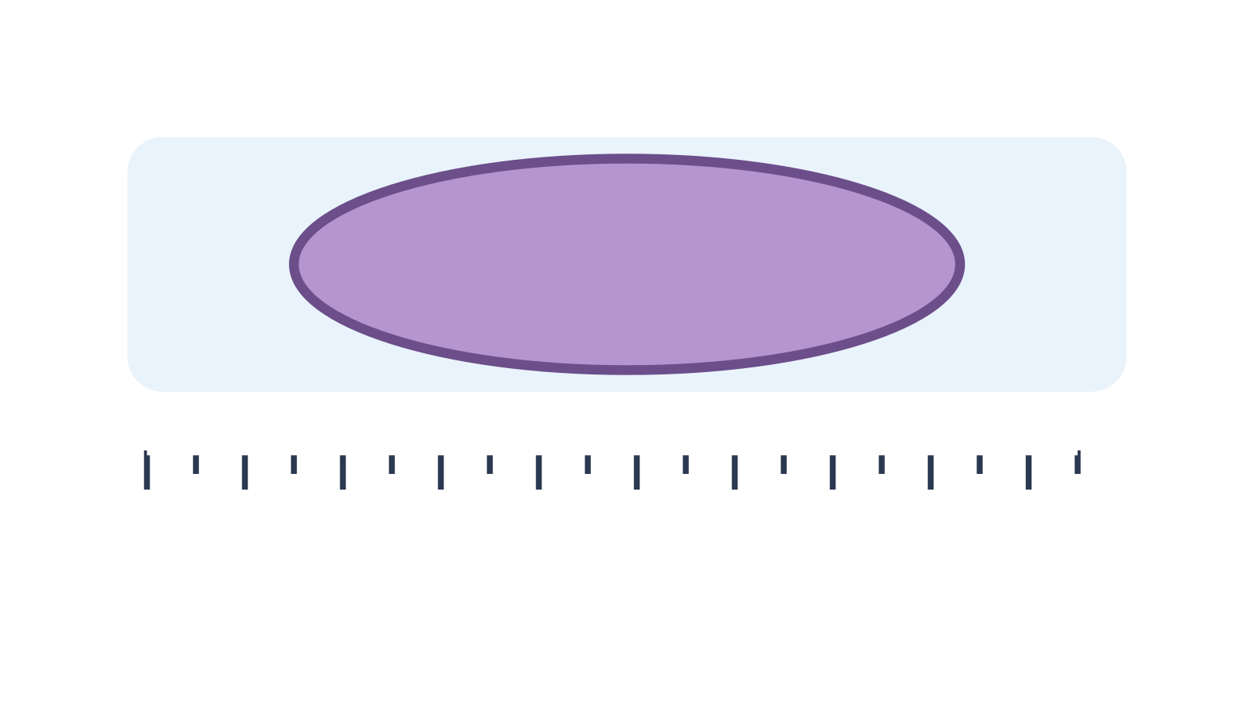
LAUNCH SCIENCE / W3L3
Arrival · 3 min
Reading scale bars
I can independently measure, calculate and correct a magnification problem.
Notice. Recall. Be ready to explain.
1
Convert 0.08 mm to micrometres.
2
Rearrange the relationship to find actual size.
Retrieval answers
Arrival
Starter
I Do
We Do
I Do 2
We Do 2
Independent
Exit
Resources
Notes:
Stage: Arrival, 3 minutes. Monday / Wednesday / Friday P1, 09:30–10:10. Use reveals within this slot; appendix slides are not added time.
Retrieval answers: 80 µm. | A = I ÷ M. | Fuzzy edge, ruler alignment, scale-bar measurement or image resizing.
Core explanation: A ruler measurement changes if a picture is resized. A scale bar stays useful if the image and bar are resized together.
Watch for: Do not claim pupils measured a real cell if they used stated lengths or a model. A precise-looking number is not automatically an accurate measurement.
Least help first: Do not repair the whole calculation. Ask the pupil to name the error type and change one step.
Support cue: Check the units first. Then check the calculation. For a scale bar, count how many bar lengths fit the cell image.
[Sources]
User-supplied LAUNCH W3–W7 pack: W3 worksheet estimation and exam-style task; W3 slides 8–10.
Made by Matt LAUNCH Science draft, lesson-content.json, W3L3; existing illustrative diagrams reused, active-transport direction corrected to lower → higher.
Pearson Edexcel GCSE Biology specification, sections 1.1–1.6 and 1.15–1.17: https://qualifications.pearson.com/content/dam/pdf/GCSE/Science/2016/Specification/gcse-biology-spec.pdf
Optional concept video: freesciencelessons, Microscopy, https://www.youtube.com/watch?v=L5StAE_uuxM (link located 5 September 2026).
[/Sources]
[Sources]
Source editable lesson: Original LAUNCH Science OneDrive pack, 5 September 2026, W3L3. Source teaching content preserved. Current HTML reference: https://madebymatt.uk/Lessons/Science_Teesside/Launch/. Native diagrams restate the source explanation and are not experimental measurements.
[/Sources]

Slide 2
LAUNCH SCIENCE / W3L3
Starter · 4 min
Make a prediction
Two pupils get ×60 and ×600 from the same image. Which evidence would help locate the error?
A Only the final number
B Their units and working
C The colour of the image
Commit, then check
Arrival
Starter
I Do
We Do
I Do 2
We Do 2
Independent
Exit
Resources
Notes:
Stage: Starter, 4 minutes. Monday / Wednesday / Friday P1, 09:30–10:10. Use reveals within this slot; appendix slides are not added time.
Correct: Their units and working. Ask for the reason, then return to the original prediction.
Core explanation: A ruler measurement changes if a picture is resized. A scale bar stays useful if the image and bar are resized together.
Watch for: Do not claim pupils measured a real cell if they used stated lengths or a model. A precise-looking number is not automatically an accurate measurement.
Least help first: Do not repair the whole calculation. Ask the pupil to name the error type and change one step.
Support cue: Check the units first. Then check the calculation. For a scale bar, count how many bar lengths fit the cell image.
[Sources]
User-supplied LAUNCH W3–W7 pack: W3 worksheet estimation and exam-style task; W3 slides 8–10.
Made by Matt LAUNCH Science draft, lesson-content.json, W3L3; existing illustrative diagrams reused, active-transport direction corrected to lower → higher.
Pearson Edexcel GCSE Biology specification, sections 1.1–1.6 and 1.15–1.17: https://qualifications.pearson.com/content/dam/pdf/GCSE/Science/2016/Specification/gcse-biology-spec.pdf
Optional concept video: freesciencelessons, Microscopy, https://www.youtube.com/watch?v=L5StAE_uuxM (link located 5 September 2026).
[/Sources]
[Sources]
Source editable lesson: Original LAUNCH Science OneDrive pack, 5 September 2026, W3L3. Source teaching content preserved. Current HTML reference: https://madebymatt.uk/Lessons/Science_Teesside/Launch/. Native diagrams restate the source explanation and are not experimental measurements.
[/Sources]

Slide 3
LAUNCH SCIENCE / W3L3
I Do · 5 min
Watch the model
1
Place the zero mark at the first clear edge and read the second edge once.
Read the scale carefully
IMAGE SIZE
2
Keep the measured image length and stated actual length in matching units.
I
M =
A
3
Classify an error as measurement, unit, rearrangement or arithmetic before repairing it.
ACTUAL SIZE
View labelled diagram
Optional video
Arrival
Starter
I Do
We Do
I Do 2
We Do 2
Independent
Exit
Resources
Notes:
Stage: I Do, 5 minutes. Monday / Wednesday / Friday P1, 09:30–10:10. Use reveals within this slot; appendix slides are not added time.
The on-screen ruler exposes where measurement begins and ends.
Model limit: A fixed digital edge is cleaner than many real micrographs, so real measurement uncertainty may be greater.
Video replaces up to 90 seconds of explanation; use the still diagram if unavailable.
Core explanation: A ruler measurement changes if a picture is resized. A scale bar stays useful if the image and bar are resized together.
Watch for: Do not claim pupils measured a real cell if they used stated lengths or a model. A precise-looking number is not automatically an accurate measurement.
Least help first: Do not repair the whole calculation. Ask the pupil to name the error type and change one step.
Support cue: Check the units first. Then check the calculation. For a scale bar, count how many bar lengths fit the cell image.
[Sources]
User-supplied LAUNCH W3–W7 pack: W3 worksheet estimation and exam-style task; W3 slides 8–10.
Made by Matt LAUNCH Science draft, lesson-content.json, W3L3; existing illustrative diagrams reused, active-transport direction corrected to lower → higher.
Pearson Edexcel GCSE Biology specification, sections 1.1–1.6 and 1.15–1.17: https://qualifications.pearson.com/content/dam/pdf/GCSE/Science/2016/Specification/gcse-biology-spec.pdf
Optional concept video: freesciencelessons, Microscopy, https://www.youtube.com/watch?v=L5StAE_uuxM (link located 5 September 2026).
[/Sources]
[Sources]
Source editable lesson: Original LAUNCH Science OneDrive pack, 5 September 2026, W3L3. Source teaching content preserved. Current HTML reference: https://madebymatt.uk/Lessons/Science_Teesside/Launch/. Native diagrams restate the source explanation and are not experimental measurements.
[/Sources]

Slide 4
LAUNCH SCIENCE / W3L3
We Do · 5 min
Choose and justify
A pupil divides actual size by image size and gets ×0.002. What type of error is this?
A Measurement
B Unit conversion
C Rearrangement/relationship
D Rounding
Give the deciding clue before checking.
Check the reasoning
Arrival
Starter
I Do
We Do
I Do 2
We Do 2
Independent
Exit
Resources
Notes:
Stage: We Do, 5 minutes. Monday / Wednesday / Friday P1, 09:30–10:10. Use reveals within this slot; appendix slides are not added time.
A: Measurement — No measurement evidence points to the ruler here.
B: Unit conversion — Units may still matter, but the described action reverses the relationship.
C: Rearrangement/relationship — Correct diagnosis. Magnification uses image size divided by actual size.
D: Rounding — Rounding cannot explain a relationship below one for a visibly enlarged image.
Core explanation: A ruler measurement changes if a picture is resized. A scale bar stays useful if the image and bar are resized together.
Watch for: Do not claim pupils measured a real cell if they used stated lengths or a model. A precise-looking number is not automatically an accurate measurement.
Least help first: Do not repair the whole calculation. Ask the pupil to name the error type and change one step.
Support cue: Check the units first. Then check the calculation. For a scale bar, count how many bar lengths fit the cell image.
[Sources]
User-supplied LAUNCH W3–W7 pack: W3 worksheet estimation and exam-style task; W3 slides 8–10.
Made by Matt LAUNCH Science draft, lesson-content.json, W3L3; existing illustrative diagrams reused, active-transport direction corrected to lower → higher.
Pearson Edexcel GCSE Biology specification, sections 1.1–1.6 and 1.15–1.17: https://qualifications.pearson.com/content/dam/pdf/GCSE/Science/2016/Specification/gcse-biology-spec.pdf
Optional concept video: freesciencelessons, Microscopy, https://www.youtube.com/watch?v=L5StAE_uuxM (link located 5 September 2026).
[/Sources]
[Sources]
Source editable lesson: Original LAUNCH Science OneDrive pack, 5 September 2026, W3L3. Source teaching content preserved. Current HTML reference: https://madebymatt.uk/Lessons/Science_Teesside/Launch/. Native diagrams restate the source explanation and are not experimental measurements.
[/Sources]

Slide 5
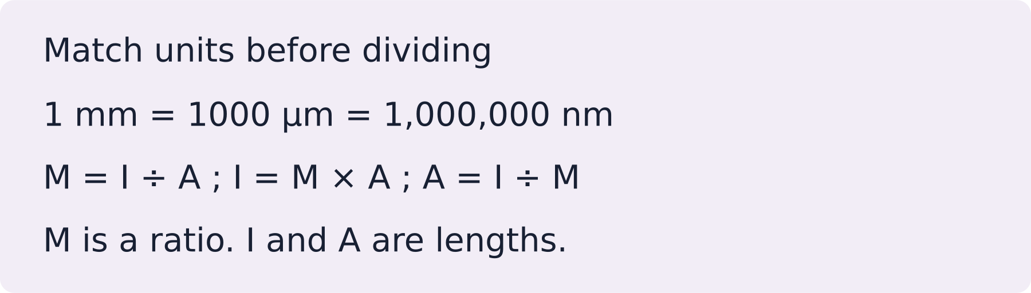
LAUNCH SCIENCE / W3L3
I Do 2 · 4 min
Connect the science
1
Do not erase the first route; annotate the point where it became invalid.
2
Use the error type to choose one repair, not a full restart.
3
Compare the repaired answer with the image scale.
Arrival
Starter
I Do
We Do
I Do 2
We Do 2
Independent
Exit
Resources
Notes:
Stage: I Do 2, 4 minutes. Monday / Wednesday / Friday P1, 09:30–10:10. Use reveals within this slot; appendix slides are not added time.
A fixed digital edge is cleaner than many real micrographs, so real measurement uncertainty may be greater.
Core explanation: A ruler measurement changes if a picture is resized. A scale bar stays useful if the image and bar are resized together.
Watch for: Do not claim pupils measured a real cell if they used stated lengths or a model. A precise-looking number is not automatically an accurate measurement.
Least help first: Do not repair the whole calculation. Ask the pupil to name the error type and change one step.
Support cue: Check the units first. Then check the calculation. For a scale bar, count how many bar lengths fit the cell image.
[Sources]
User-supplied LAUNCH W3–W7 pack: W3 worksheet estimation and exam-style task; W3 slides 8–10.
Made by Matt LAUNCH Science draft, lesson-content.json, W3L3; existing illustrative diagrams reused, active-transport direction corrected to lower → higher.
Pearson Edexcel GCSE Biology specification, sections 1.1–1.6 and 1.15–1.17: https://qualifications.pearson.com/content/dam/pdf/GCSE/Science/2016/Specification/gcse-biology-spec.pdf
Optional concept video: freesciencelessons, Microscopy, https://www.youtube.com/watch?v=L5StAE_uuxM (link located 5 September 2026).
[/Sources]
[Sources]
Source editable lesson: Original LAUNCH Science OneDrive pack, 5 September 2026, W3L3. Source teaching content preserved. Current HTML reference: https://madebymatt.uk/Lessons/Science_Teesside/Launch/. Native diagrams restate the source explanation and are not experimental measurements.
[/Sources]

Slide 6
LAUNCH SCIENCE / W3L3
We Do 2 · Task · 6 min
Find the first faulty step
Image length = 32 mm. Actual length = 80 µm.
1
Sam writes: 32 ÷ 80 = ×0.4
2
Point to the first problem.
3
Repair it, keeping the first attempt visible.
Reveal shared reasoning
Arrival
Starter
I Do
We Do
I Do 2
We Do 2
Independent
Exit
Resources
Notes:
Stage: We Do 2 · Task, 6 minutes. Monday / Wednesday / Friday P1, 09:30–10:10. Use reveals within this slot; appendix slides are not added time.
The units do not match.
32 mm = 32,000 µm.
M = 32,000 ÷ 80 = ×400.
Check units before arithmetic.
Run the printed activity or this board; one route is enough.
Core explanation: A ruler measurement changes if a picture is resized. A scale bar stays useful if the image and bar are resized together.
Watch for: Do not claim pupils measured a real cell if they used stated lengths or a model. A precise-looking number is not automatically an accurate measurement.
Least help first: Do not repair the whole calculation. Ask the pupil to name the error type and change one step.
Support cue: Check the units first. Then check the calculation. For a scale bar, count how many bar lengths fit the cell image.
[Sources]
User-supplied LAUNCH W3–W7 pack: W3 worksheet estimation and exam-style task; W3 slides 8–10.
Made by Matt LAUNCH Science draft, lesson-content.json, W3L3; existing illustrative diagrams reused, active-transport direction corrected to lower → higher.
Pearson Edexcel GCSE Biology specification, sections 1.1–1.6 and 1.15–1.17: https://qualifications.pearson.com/content/dam/pdf/GCSE/Science/2016/Specification/gcse-biology-spec.pdf
Optional concept video: freesciencelessons, Microscopy, https://www.youtube.com/watch?v=L5StAE_uuxM (link located 5 September 2026).
[/Sources]
[Sources]
Source editable lesson: Original LAUNCH Science OneDrive pack, 5 September 2026, W3L3. Source teaching content preserved. Current HTML reference: https://madebymatt.uk/Lessons/Science_Teesside/Launch/. Native diagrams restate the source explanation and are not experimental measurements.
[/Sources]

Slide 7
LAUNCH SCIENCE / W3L3
Independent Task · 10 min
Your independent evidence
A specimen image measures 48 mm. Its actual width is 80 µm. Calculate the magnification. Then explain how you would distinguish a unit error from a measurement error if another pupil obtained ×60.
Optional support
Check the units first. Then check the calculation. For a scale bar, count how many bar lengths fit the cell image.
Make one precise correction to the same work after feedback.
Open worksheet pages
Model after first attempt
Arrival
Starter
I Do
We Do
I Do 2
We Do 2
Independent
Exit
Resources
Notes:
Stage: Independent Task, 10 minutes. Monday / Wednesday / Friday P1, 09:30–10:10. Use reveals within this slot; appendix slides are not added time.
Model answer: 48 mm = 48,000 µm. Magnification = 48,000 ÷ 80 = ×600. A unit error would be visible if millimetres and micrometres were divided directly or converted by the wrong factor. A measurement error would be checked by realigning the ruler with the specimen edges and measuring again.
Select only questions that fit the ten-minute slot. W7L3: Q2, Q3 and Q5 total 11 marks. The full paper needs a separate 25-minute slot.
Core explanation: A ruler measurement changes if a picture is resized. A scale bar stays useful if the image and bar are resized together.
Watch for: Do not claim pupils measured a real cell if they used stated lengths or a model. A precise-looking number is not automatically an accurate measurement.
Least help first: Do not repair the whole calculation. Ask the pupil to name the error type and change one step.
Support cue: Check the units first. Then check the calculation. For a scale bar, count how many bar lengths fit the cell image.
[Sources]
User-supplied LAUNCH W3–W7 pack: W3 worksheet estimation and exam-style task; W3 slides 8–10.
Made by Matt LAUNCH Science draft, lesson-content.json, W3L3; existing illustrative diagrams reused, active-transport direction corrected to lower → higher.
Pearson Edexcel GCSE Biology specification, sections 1.1–1.6 and 1.15–1.17: https://qualifications.pearson.com/content/dam/pdf/GCSE/Science/2016/Specification/gcse-biology-spec.pdf
Optional concept video: freesciencelessons, Microscopy, https://www.youtube.com/watch?v=L5StAE_uuxM (link located 5 September 2026).
[/Sources]
[Sources]
Source editable lesson: Original LAUNCH Science OneDrive pack, 5 September 2026, W3L3. Source teaching content preserved. Current HTML reference: https://madebymatt.uk/Lessons/Science_Teesside/Launch/. Native diagrams restate the source explanation and are not experimental measurements.
[/Sources]

Slide 8
LAUNCH SCIENCE / W3L3
Exit · 3 min
What changed in your thinking?
Name the error type you would check first when an answer is exactly ten or one thousand times too large.
1
Point to one improvement in your work.
2
Choose what you want to revisit.
3
Tell your teacher; agree the next step together.
Arrival
Starter
I Do
We Do
I Do 2
We Do 2
Independent
Exit
Resources
Notes:
Stage: Exit, 3 minutes. Monday / Wednesday / Friday P1, 09:30–10:10. Use reveals within this slot; appendix slides are not added time.
Exit answer: Check unit conversion and powers of ten first; then check the measurement and arithmetic.
Receive the request, record the agreed next action and check it next lesson. Keep responses private when requested.
Core explanation: A ruler measurement changes if a picture is resized. A scale bar stays useful if the image and bar are resized together.
Watch for: Do not claim pupils measured a real cell if they used stated lengths or a model. A precise-looking number is not automatically an accurate measurement.
Least help first: Do not repair the whole calculation. Ask the pupil to name the error type and change one step.
Support cue: Check the units first. Then check the calculation. For a scale bar, count how many bar lengths fit the cell image.
[Sources]
User-supplied LAUNCH W3–W7 pack: W3 worksheet estimation and exam-style task; W3 slides 8–10.
Made by Matt LAUNCH Science draft, lesson-content.json, W3L3; existing illustrative diagrams reused, active-transport direction corrected to lower → higher.
Pearson Edexcel GCSE Biology specification, sections 1.1–1.6 and 1.15–1.17: https://qualifications.pearson.com/content/dam/pdf/GCSE/Science/2016/Specification/gcse-biology-spec.pdf
Optional concept video: freesciencelessons, Microscopy, https://www.youtube.com/watch?v=L5StAE_uuxM (link located 5 September 2026).
[/Sources]
[Sources]
Source editable lesson: Original LAUNCH Science OneDrive pack, 5 September 2026, W3L3. Source teaching content preserved. Current HTML reference: https://madebymatt.uk/Lessons/Science_Teesside/Launch/. Native diagrams restate the source explanation and are not experimental measurements.
[/Sources]

Slide 9
LAUNCH SCIENCE / W3L3
Resources
Retrieval and prediction check
1
80 µm.
2
A = I ÷ M.
Their units and working
Return to Starter
Arrival
Starter
I Do
We Do
I Do 2
We Do 2
Independent
Exit
Resources
Notes:
Read only after an attempt; retain the pupil’s first view.
Core explanation: A ruler measurement changes if a picture is resized. A scale bar stays useful if the image and bar are resized together.
Watch for: Do not claim pupils measured a real cell if they used stated lengths or a model. A precise-looking number is not automatically an accurate measurement.
Least help first: Do not repair the whole calculation. Ask the pupil to name the error type and change one step.
Support cue: Check the units first. Then check the calculation. For a scale bar, count how many bar lengths fit the cell image.
[Sources]
User-supplied LAUNCH W3–W7 pack: W3 worksheet estimation and exam-style task; W3 slides 8–10.
Made by Matt LAUNCH Science draft, lesson-content.json, W3L3; existing illustrative diagrams reused, active-transport direction corrected to lower → higher.
Pearson Edexcel GCSE Biology specification, sections 1.1–1.6 and 1.15–1.17: https://qualifications.pearson.com/content/dam/pdf/GCSE/Science/2016/Specification/gcse-biology-spec.pdf
Optional concept video: freesciencelessons, Microscopy, https://www.youtube.com/watch?v=L5StAE_uuxM (link located 5 September 2026).
[/Sources]
[Sources]
Source editable lesson: Original LAUNCH Science OneDrive pack, 5 September 2026, W3L3. Source teaching content preserved. Current HTML reference: https://madebymatt.uk/Lessons/Science_Teesside/Launch/. Native diagrams restate the source explanation and are not experimental measurements.
[/Sources]

Slide 10
LAUNCH SCIENCE / W3L3
Resources
Check the deciding clue
Rearrangement/relationship
Correct diagnosis. Magnification uses image size divided by actual size.
Compare your reason. Correct one step if needed.
Return to We Do
Arrival
Starter
I Do
We Do
I Do 2
We Do 2
Independent
Exit
Resources
Notes:
No measurement evidence points to the ruler here.
Units may still matter, but the described action reverses the relationship.
Correct diagnosis. Magnification uses image size divided by actual size.
Rounding cannot explain a relationship below one for a visibly enlarged image.
Core explanation: A ruler measurement changes if a picture is resized. A scale bar stays useful if the image and bar are resized together.
Watch for: Do not claim pupils measured a real cell if they used stated lengths or a model. A precise-looking number is not automatically an accurate measurement.
Least help first: Do not repair the whole calculation. Ask the pupil to name the error type and change one step.
Support cue: Check the units first. Then check the calculation. For a scale bar, count how many bar lengths fit the cell image.
[Sources]
User-supplied LAUNCH W3–W7 pack: W3 worksheet estimation and exam-style task; W3 slides 8–10.
Made by Matt LAUNCH Science draft, lesson-content.json, W3L3; existing illustrative diagrams reused, active-transport direction corrected to lower → higher.
Pearson Edexcel GCSE Biology specification, sections 1.1–1.6 and 1.15–1.17: https://qualifications.pearson.com/content/dam/pdf/GCSE/Science/2016/Specification/gcse-biology-spec.pdf
Optional concept video: freesciencelessons, Microscopy, https://www.youtube.com/watch?v=L5StAE_uuxM (link located 5 September 2026).
[/Sources]
[Sources]
Source editable lesson: Original LAUNCH Science OneDrive pack, 5 September 2026, W3L3. Source teaching content preserved. Current HTML reference: https://madebymatt.uk/Lessons/Science_Teesside/Launch/. Native diagrams restate the source explanation and are not experimental measurements.
[/Sources]

Slide 11
LAUNCH SCIENCE / W3L3
Resources
Our shared reasoning
The units do not match.
32 mm = 32,000 µm.
M = 32,000 ÷ 80 = ×400.
Check units before arithmetic.
Return to shared task
Arrival
Starter
I Do
We Do
I Do 2
We Do 2
Independent
Exit
Resources
Notes:
Pupils should justify, compare and revise rather than copy a complete answer before trying.
Core explanation: A ruler measurement changes if a picture is resized. A scale bar stays useful if the image and bar are resized together.
Watch for: Do not claim pupils measured a real cell if they used stated lengths or a model. A precise-looking number is not automatically an accurate measurement.
Least help first: Do not repair the whole calculation. Ask the pupil to name the error type and change one step.
Support cue: Check the units first. Then check the calculation. For a scale bar, count how many bar lengths fit the cell image.
[Sources]
User-supplied LAUNCH W3–W7 pack: W3 worksheet estimation and exam-style task; W3 slides 8–10.
Made by Matt LAUNCH Science draft, lesson-content.json, W3L3; existing illustrative diagrams reused, active-transport direction corrected to lower → higher.
Pearson Edexcel GCSE Biology specification, sections 1.1–1.6 and 1.15–1.17: https://qualifications.pearson.com/content/dam/pdf/GCSE/Science/2016/Specification/gcse-biology-spec.pdf
Optional concept video: freesciencelessons, Microscopy, https://www.youtube.com/watch?v=L5StAE_uuxM (link located 5 September 2026).
[/Sources]
[Sources]
Source editable lesson: Original LAUNCH Science OneDrive pack, 5 September 2026, W3L3. Source teaching content preserved. Current HTML reference: https://madebymatt.uk/Lessons/Science_Teesside/Launch/. Native diagrams restate the source explanation and are not experimental measurements.
[/Sources]

Slide 12
LAUNCH SCIENCE / W3L3
Resources
Compare after your first attempt
48 mm = 48,000 µm. Magnification = 48,000 ÷ 80 = ×600. A unit error would be visible if millimetres and micrometres were divided directly or converted by the wrong factor. A measurement error would be checked by realigning the ruler with the specimen edges and measuring again.
Use the model to improve your explanation in your own words.
Return to independent task
Arrival
Starter
I Do
We Do
I Do 2
We Do 2
Independent
Exit
Resources
Notes:
Staff guide includes question-by-question answers. Do not distribute this presentation as a secure assessment paper.
Core explanation: A ruler measurement changes if a picture is resized. A scale bar stays useful if the image and bar are resized together.
Watch for: Do not claim pupils measured a real cell if they used stated lengths or a model. A precise-looking number is not automatically an accurate measurement.
Least help first: Do not repair the whole calculation. Ask the pupil to name the error type and change one step.
Support cue: Check the units first. Then check the calculation. For a scale bar, count how many bar lengths fit the cell image.
[Sources]
User-supplied LAUNCH W3–W7 pack: W3 worksheet estimation and exam-style task; W3 slides 8–10.
Made by Matt LAUNCH Science draft, lesson-content.json, W3L3; existing illustrative diagrams reused, active-transport direction corrected to lower → higher.
Pearson Edexcel GCSE Biology specification, sections 1.1–1.6 and 1.15–1.17: https://qualifications.pearson.com/content/dam/pdf/GCSE/Science/2016/Specification/gcse-biology-spec.pdf
Optional concept video: freesciencelessons, Microscopy, https://www.youtube.com/watch?v=L5StAE_uuxM (link located 5 September 2026).
[/Sources]
[Sources]
Source editable lesson: Original LAUNCH Science OneDrive pack, 5 September 2026, W3L3. Source teaching content preserved. Current HTML reference: https://madebymatt.uk/Lessons/Science_Teesside/Launch/. Native diagrams restate the source explanation and are not experimental measurements.
[/Sources]

Slide 13
LAUNCH SCIENCE / W3L3
Resources
Your lesson resources
Worksheet pages are stored inside this PowerPoint.
Worksheet · page 1
Worksheet · page 2
Standard PDF
Supported PDF
Depth PDF
Editable Word worksheet
Open online lesson / model
Named files are in this week’s folder. Online lesson and video need internet.
Optional concept video
Arrival
Starter
I Do
We Do
I Do 2
We Do 2
Independent
Exit
Resources
Notes:
File buttons use relative links for downloaded/synced folders. OneDrive preview may not resolve relative links. Use the embedded pages or open the named file in the week folder.
Core explanation: A ruler measurement changes if a picture is resized. A scale bar stays useful if the image and bar are resized together.
Watch for: Do not claim pupils measured a real cell if they used stated lengths or a model. A precise-looking number is not automatically an accurate measurement.
Least help first: Do not repair the whole calculation. Ask the pupil to name the error type and change one step.
Support cue: Check the units first. Then check the calculation. For a scale bar, count how many bar lengths fit the cell image.
[Sources]
User-supplied LAUNCH W3–W7 pack: W3 worksheet estimation and exam-style task; W3 slides 8–10.
Made by Matt LAUNCH Science draft, lesson-content.json, W3L3; existing illustrative diagrams reused, active-transport direction corrected to lower → higher.
Pearson Edexcel GCSE Biology specification, sections 1.1–1.6 and 1.15–1.17: https://qualifications.pearson.com/content/dam/pdf/GCSE/Science/2016/Specification/gcse-biology-spec.pdf
Optional concept video: freesciencelessons, Microscopy, https://www.youtube.com/watch?v=L5StAE_uuxM (link located 5 September 2026).
[/Sources]
[Sources]
Source editable lesson: Original LAUNCH Science OneDrive pack, 5 September 2026, W3L3. Source teaching content preserved. Current HTML reference: https://madebymatt.uk/Lessons/Science_Teesside/Launch/. Native diagrams restate the source explanation and are not experimental measurements.
[/Sources]

Slide 14
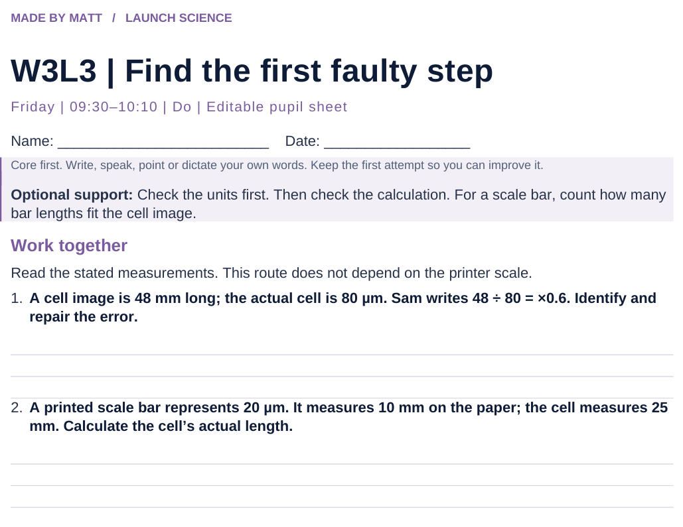
LAUNCH SCIENCE / W3L3
Resources
Worksheet · page 1
Use your printed copy.
Keep the first attempt.
Return to task
Arrival
Starter
I Do
We Do
I Do 2
We Do 2
Independent
Exit
Resources
Notes:
Embedded worksheet reference; print the separate PDF at A4 for writable space.
Core explanation: A ruler measurement changes if a picture is resized. A scale bar stays useful if the image and bar are resized together.
Watch for: Do not claim pupils measured a real cell if they used stated lengths or a model. A precise-looking number is not automatically an accurate measurement.
Least help first: Do not repair the whole calculation. Ask the pupil to name the error type and change one step.
Support cue: Check the units first. Then check the calculation. For a scale bar, count how many bar lengths fit the cell image.
[Sources]
User-supplied LAUNCH W3–W7 pack: W3 worksheet estimation and exam-style task; W3 slides 8–10.
Made by Matt LAUNCH Science draft, lesson-content.json, W3L3; existing illustrative diagrams reused, active-transport direction corrected to lower → higher.
Pearson Edexcel GCSE Biology specification, sections 1.1–1.6 and 1.15–1.17: https://qualifications.pearson.com/content/dam/pdf/GCSE/Science/2016/Specification/gcse-biology-spec.pdf
Optional concept video: freesciencelessons, Microscopy, https://www.youtube.com/watch?v=L5StAE_uuxM (link located 5 September 2026).
[/Sources]
[Sources]
Source editable lesson: Original LAUNCH Science OneDrive pack, 5 September 2026, W3L3. Source teaching content preserved. Current HTML reference: https://madebymatt.uk/Lessons/Science_Teesside/Launch/. Native diagrams restate the source explanation and are not experimental measurements.
[/Sources]

Slide 15
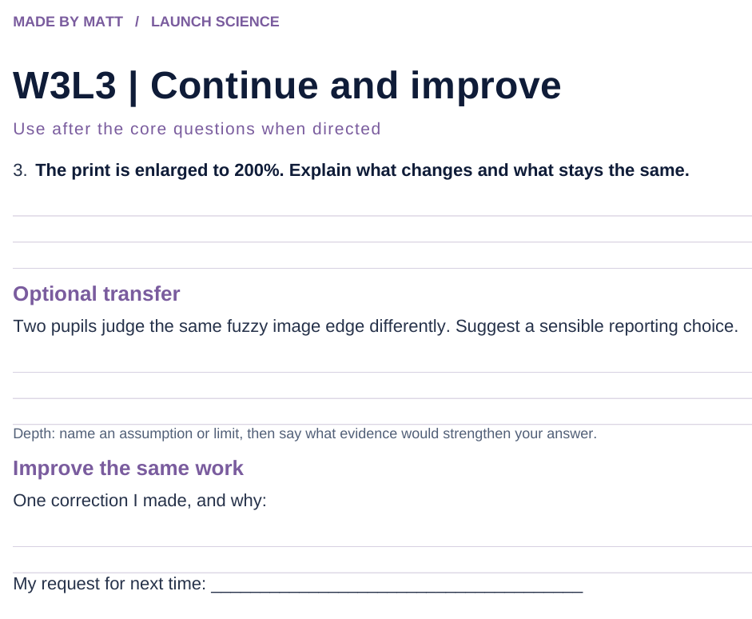
LAUNCH SCIENCE / W3L3
Resources
Worksheet · page 2
Continuation is optional.
Improve the same work.
Return to task
Arrival
Starter
I Do
We Do
I Do 2
We Do 2
Independent
Exit
Resources
Notes:
Embedded worksheet reference; print the separate PDF at A4 for writable space.
Core explanation: A ruler measurement changes if a picture is resized. A scale bar stays useful if the image and bar are resized together.
Watch for: Do not claim pupils measured a real cell if they used stated lengths or a model. A precise-looking number is not automatically an accurate measurement.
Least help first: Do not repair the whole calculation. Ask the pupil to name the error type and change one step.
Support cue: Check the units first. Then check the calculation. For a scale bar, count how many bar lengths fit the cell image.
[Sources]
User-supplied LAUNCH W3–W7 pack: W3 worksheet estimation and exam-style task; W3 slides 8–10.
Made by Matt LAUNCH Science draft, lesson-content.json, W3L3; existing illustrative diagrams reused, active-transport direction corrected to lower → higher.
Pearson Edexcel GCSE Biology specification, sections 1.1–1.6 and 1.15–1.17: https://qualifications.pearson.com/content/dam/pdf/GCSE/Science/2016/Specification/gcse-biology-spec.pdf
Optional concept video: freesciencelessons, Microscopy, https://www.youtube.com/watch?v=L5StAE_uuxM (link located 5 September 2026).
[/Sources]
[Sources]
Source editable lesson: Original LAUNCH Science OneDrive pack, 5 September 2026, W3L3. Source teaching content preserved. Current HTML reference: https://madebymatt.uk/Lessons/Science_Teesside/Launch/. Native diagrams restate the source explanation and are not experimental measurements.
[/Sources]

Slide 16
LAUNCH SCIENCE / W3L3
Resources
Watch, pause and explain
Microscopy
What is the difference between making an image bigger and resolving more detail?
Play freesciencelessons video
No connection? Use the still model and explain the same question.
Arrival
Starter
I Do
We Do
I Do 2
We Do 2
Independent
Exit
Resources
Notes:
Use at most 90 seconds within I Do. Pause on the first relevant example; ask for a reason. This is an optional concept clip, not evidence of practical completion.
Core explanation: A ruler measurement changes if a picture is resized. A scale bar stays useful if the image and bar are resized together.
Watch for: Do not claim pupils measured a real cell if they used stated lengths or a model. A precise-looking number is not automatically an accurate measurement.
Least help first: Do not repair the whole calculation. Ask the pupil to name the error type and change one step.
Support cue: Check the units first. Then check the calculation. For a scale bar, count how many bar lengths fit the cell image.
[Sources]
User-supplied LAUNCH W3–W7 pack: W3 worksheet estimation and exam-style task; W3 slides 8–10.
Made by Matt LAUNCH Science draft, lesson-content.json, W3L3; existing illustrative diagrams reused, active-transport direction corrected to lower → higher.
Pearson Edexcel GCSE Biology specification, sections 1.1–1.6 and 1.15–1.17: https://qualifications.pearson.com/content/dam/pdf/GCSE/Science/2016/Specification/gcse-biology-spec.pdf
Optional concept video: freesciencelessons, Microscopy, https://www.youtube.com/watch?v=L5StAE_uuxM (link located 5 September 2026).
[/Sources]
[Sources]
Source editable lesson: Original LAUNCH Science OneDrive pack, 5 September 2026, W3L3. Source teaching content preserved. Current HTML reference: https://madebymatt.uk/Lessons/Science_Teesside/Launch/. Native diagrams restate the source explanation and are not experimental measurements.
[/Sources]

Slide 17
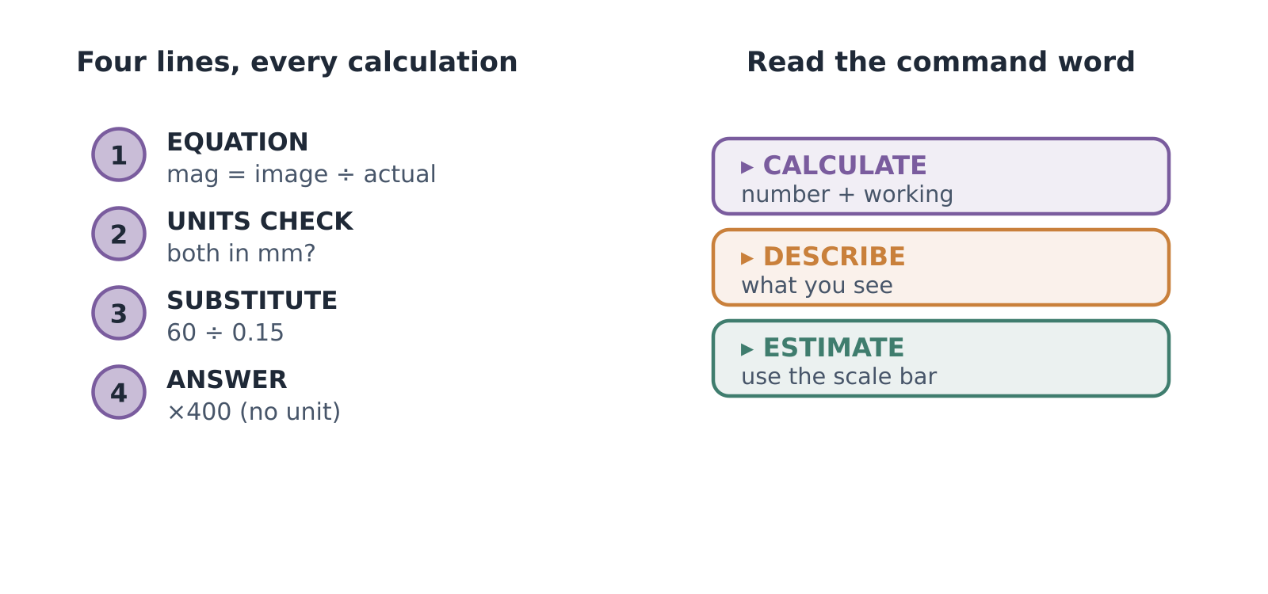
LAUNCH SCIENCE / W3L3
Resources
Look closely at the model
A model illustration: use the stated data for calculations.
Return to I Do
Arrival
Starter
I Do
We Do
I Do 2
We Do 2
Independent
Exit
Resources
Notes:
Source image: https://madebymatt.uk/Lessons/Science_Teesside/Launch/SCI_L_W3_L3_ExamSkills.html; existing vector illustration embedded for offline use.
Core explanation: A ruler measurement changes if a picture is resized. A scale bar stays useful if the image and bar are resized together.
Watch for: Do not claim pupils measured a real cell if they used stated lengths or a model. A precise-looking number is not automatically an accurate measurement.
Least help first: Do not repair the whole calculation. Ask the pupil to name the error type and change one step.
Support cue: Check the units first. Then check the calculation. For a scale bar, count how many bar lengths fit the cell image.
[Sources]
User-supplied LAUNCH W3–W7 pack: W3 worksheet estimation and exam-style task; W3 slides 8–10.
Made by Matt LAUNCH Science draft, lesson-content.json, W3L3; existing illustrative diagrams reused, active-transport direction corrected to lower → higher.
Pearson Edexcel GCSE Biology specification, sections 1.1–1.6 and 1.15–1.17: https://qualifications.pearson.com/content/dam/pdf/GCSE/Science/2016/Specification/gcse-biology-spec.pdf
Optional concept video: freesciencelessons, Microscopy, https://www.youtube.com/watch?v=L5StAE_uuxM (link located 5 September 2026).
[/Sources]
[Sources]
Source editable lesson: Original LAUNCH Science OneDrive pack, 5 September 2026, W3L3. Source teaching content preserved. Current HTML reference: https://madebymatt.uk/Lessons/Science_Teesside/Launch/. Native diagrams restate the source explanation and are not experimental measurements.
[/Sources]

