Slide 1
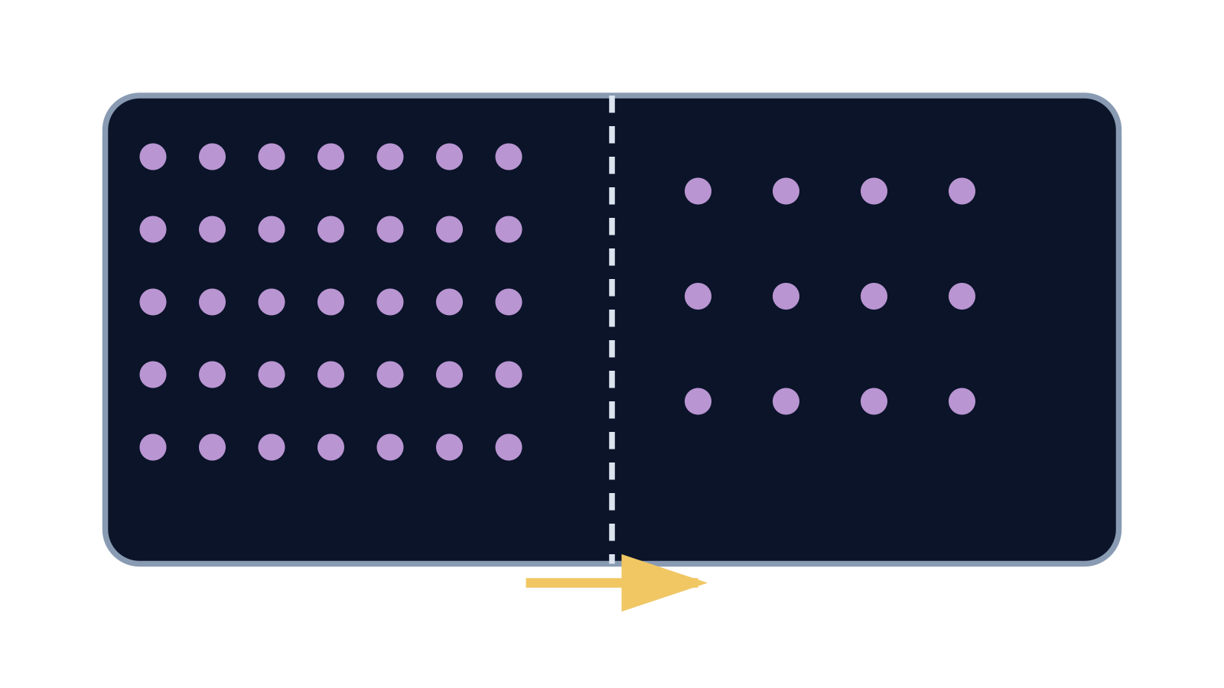
LAUNCH SCIENCE / W4L1
Arrival · 3 min
Diffusion
I can explain diffusion as net movement down a concentration gradient and use evidence to compare rates.
Notice. Recall. Be ready to explain.
1
What does concentration describe?
2
What is a gradient?
Retrieval answers
Arrival
Starter
I Do
We Do
I Do 2
We Do 2
Independent
Exit
Resources
Notes:
Stage: Arrival, 3 minutes. Monday / Wednesday / Friday P1, 09:30–10:10. Use reveals within this slot; appendix slides are not added time.
Retrieval answers: Amount of a substance per unit volume. | A difference/change in concentration across a distance. | More particles on one side produce more crossings from that side on average.
Core explanation: Particles move randomly in both directions. Net movement is the difference between those two movements, not a rule obeyed by every particle.
Watch for: Passive means no energy supplied by respiration is needed. It does not mean particles have no kinetic energy.
Least help first: Ask the pupil to compare starting counts on both sides before discussing direction.
Support cue: Net movement = crossings one way minus crossings the other way. Start: “More particles move from ___ to ___ because…”
[Sources]
User-supplied LAUNCH W3–W7 pack: W4 Diffusion worksheet particle model and exam task; no W4 PPTX was supplied.
Made by Matt LAUNCH Science draft, lesson-content.json, W4L1; existing illustrative diagrams reused, active-transport direction corrected to lower → higher.
Pearson Edexcel GCSE Biology specification, sections 1.1–1.6 and 1.15–1.17: https://qualifications.pearson.com/content/dam/pdf/GCSE/Science/2016/Specification/gcse-biology-spec.pdf
Optional concept video: freesciencelessons, Diffusion, https://www.youtube.com/watch?v=O965gA4goVI (link located 5 September 2026).
[/Sources]
[Sources]
Source editable lesson: Original LAUNCH Science OneDrive pack, 5 September 2026, W4L1. Source teaching content preserved. Current HTML reference: https://madebymatt.uk/Lessons/Science_Teesside/Launch/. Native diagrams restate the source explanation and are not experimental measurements.
[/Sources]

Slide 2
LAUNCH SCIENCE / W4L1
Starter · 4 min
Make a prediction
Particles move randomly in both directions. Can there still be net movement from high to low concentration?
A No — random means no pattern
B Yes — more particles begin on the high side
C Only if every particle moves one way
Commit, then check
Arrival
Starter
I Do
We Do
I Do 2
We Do 2
Independent
Exit
Resources
Notes:
Stage: Starter, 4 minutes. Monday / Wednesday / Friday P1, 09:30–10:10. Use reveals within this slot; appendix slides are not added time.
Correct: Yes — more particles begin on the high side. Ask for the reason, then return to the original prediction.
Core explanation: Particles move randomly in both directions. Net movement is the difference between those two movements, not a rule obeyed by every particle.
Watch for: Passive means no energy supplied by respiration is needed. It does not mean particles have no kinetic energy.
Least help first: Ask the pupil to compare starting counts on both sides before discussing direction.
Support cue: Net movement = crossings one way minus crossings the other way. Start: “More particles move from ___ to ___ because…”
[Sources]
User-supplied LAUNCH W3–W7 pack: W4 Diffusion worksheet particle model and exam task; no W4 PPTX was supplied.
Made by Matt LAUNCH Science draft, lesson-content.json, W4L1; existing illustrative diagrams reused, active-transport direction corrected to lower → higher.
Pearson Edexcel GCSE Biology specification, sections 1.1–1.6 and 1.15–1.17: https://qualifications.pearson.com/content/dam/pdf/GCSE/Science/2016/Specification/gcse-biology-spec.pdf
Optional concept video: freesciencelessons, Diffusion, https://www.youtube.com/watch?v=O965gA4goVI (link located 5 September 2026).
[/Sources]
[Sources]
Source editable lesson: Original LAUNCH Science OneDrive pack, 5 September 2026, W4L1. Source teaching content preserved. Current HTML reference: https://madebymatt.uk/Lessons/Science_Teesside/Launch/. Native diagrams restate the source explanation and are not experimental measurements.
[/Sources]

Slide 3
LAUNCH SCIENCE / W4L1
I Do · 5 min
Watch the model
1
Individual particles move randomly in every direction.
Particles keep moving
2
More particles start in the high-concentration region, so more crossing events begin there.
Higher
Lower
3
Net movement is the overall difference between movements in opposite directions.
concentration
View labelled diagram
Optional video
Arrival
Starter
I Do
We Do
I Do 2
We Do 2
Independent
Exit
Resources
Notes:
Stage: I Do, 5 minutes. Monday / Wednesday / Friday P1, 09:30–10:10. Use reveals within this slot; appendix slides are not added time.
The chamber shows individual random paths and separate left-to-right and right-to-left crossing counts.
Model limit: The digital particles are a simplified two-dimensional sample and do not model every collision in a real material.
Video replaces up to 90 seconds of explanation; use the still diagram if unavailable.
Core explanation: Particles move randomly in both directions. Net movement is the difference between those two movements, not a rule obeyed by every particle.
Watch for: Passive means no energy supplied by respiration is needed. It does not mean particles have no kinetic energy.
Least help first: Ask the pupil to compare starting counts on both sides before discussing direction.
Support cue: Net movement = crossings one way minus crossings the other way. Start: “More particles move from ___ to ___ because…”
[Sources]
User-supplied LAUNCH W3–W7 pack: W4 Diffusion worksheet particle model and exam task; no W4 PPTX was supplied.
Made by Matt LAUNCH Science draft, lesson-content.json, W4L1; existing illustrative diagrams reused, active-transport direction corrected to lower → higher.
Pearson Edexcel GCSE Biology specification, sections 1.1–1.6 and 1.15–1.17: https://qualifications.pearson.com/content/dam/pdf/GCSE/Science/2016/Specification/gcse-biology-spec.pdf
Optional concept video: freesciencelessons, Diffusion, https://www.youtube.com/watch?v=O965gA4goVI (link located 5 September 2026).
[/Sources]
[Sources]
Source editable lesson: Original LAUNCH Science OneDrive pack, 5 September 2026, W4L1. Source teaching content preserved. Current HTML reference: https://madebymatt.uk/Lessons/Science_Teesside/Launch/. Native diagrams restate the source explanation and are not experimental measurements.
[/Sources]

Slide 4
LAUNCH SCIENCE / W4L1
We Do · 5 min
Choose and justify
Which statement is scientifically accurate during diffusion?
A All particles move from high to low
B Particles stop when concentrations match
C Particles move randomly, with net movement down the gradient
D Low-concentration particles pull high-concentration particles
Give the deciding clue before checking.
Check the reasoning
Arrival
Starter
I Do
We Do
I Do 2
We Do 2
Independent
Exit
Resources
Notes:
Stage: We Do, 5 minutes. Monday / Wednesday / Friday P1, 09:30–10:10. Use reveals within this slot; appendix slides are not added time.
A: All particles move from high to low — This removes random movement and creates a one-way misconception.
B: Particles stop when concentrations match — Particles continue moving at equilibrium; only the net change becomes zero.
C: Particles move randomly, with net movement down the gradient — Accurate. Use crossing counts to justify the net direction.
D: Low-concentration particles pull high-concentration particles — Diffusion does not require particles to pull or choose.
Core explanation: Particles move randomly in both directions. Net movement is the difference between those two movements, not a rule obeyed by every particle.
Watch for: Passive means no energy supplied by respiration is needed. It does not mean particles have no kinetic energy.
Least help first: Ask the pupil to compare starting counts on both sides before discussing direction.
Support cue: Net movement = crossings one way minus crossings the other way. Start: “More particles move from ___ to ___ because…”
[Sources]
User-supplied LAUNCH W3–W7 pack: W4 Diffusion worksheet particle model and exam task; no W4 PPTX was supplied.
Made by Matt LAUNCH Science draft, lesson-content.json, W4L1; existing illustrative diagrams reused, active-transport direction corrected to lower → higher.
Pearson Edexcel GCSE Biology specification, sections 1.1–1.6 and 1.15–1.17: https://qualifications.pearson.com/content/dam/pdf/GCSE/Science/2016/Specification/gcse-biology-spec.pdf
Optional concept video: freesciencelessons, Diffusion, https://www.youtube.com/watch?v=O965gA4goVI (link located 5 September 2026).
[/Sources]
[Sources]
Source editable lesson: Original LAUNCH Science OneDrive pack, 5 September 2026, W4L1. Source teaching content preserved. Current HTML reference: https://madebymatt.uk/Lessons/Science_Teesside/Launch/. Native diagrams restate the source explanation and are not experimental measurements.
[/Sources]

Slide 5
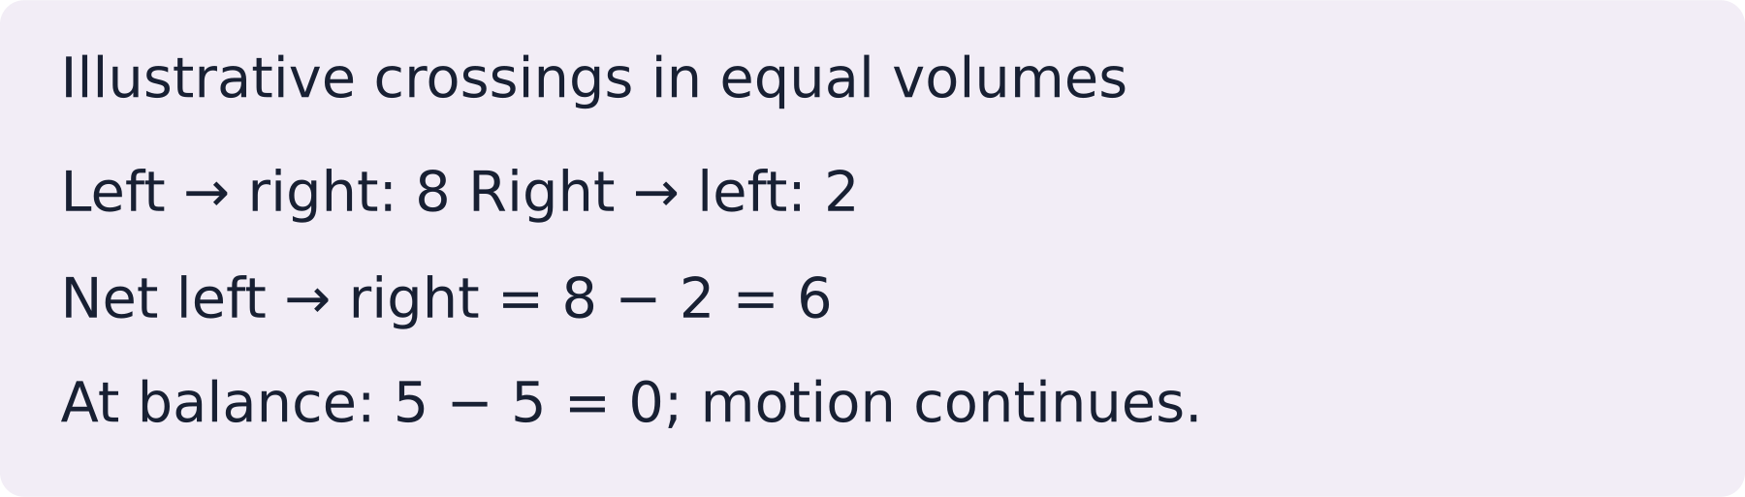
LAUNCH SCIENCE / W4L1
I Do 2 · 4 min
Connect the science
1
A steeper concentration difference usually increases the net rate.
2
Higher temperature increases particle kinetic energy and movement rate.
3
A longer diffusion distance reduces the rate of exchange.
Arrival
Starter
I Do
We Do
I Do 2
We Do 2
Independent
Exit
Resources
Notes:
Stage: I Do 2, 4 minutes. Monday / Wednesday / Friday P1, 09:30–10:10. Use reveals within this slot; appendix slides are not added time.
The digital particles are a simplified two-dimensional sample and do not model every collision in a real material.
Core explanation: Particles move randomly in both directions. Net movement is the difference between those two movements, not a rule obeyed by every particle.
Watch for: Passive means no energy supplied by respiration is needed. It does not mean particles have no kinetic energy.
Least help first: Ask the pupil to compare starting counts on both sides before discussing direction.
Support cue: Net movement = crossings one way minus crossings the other way. Start: “More particles move from ___ to ___ because…”
[Sources]
User-supplied LAUNCH W3–W7 pack: W4 Diffusion worksheet particle model and exam task; no W4 PPTX was supplied.
Made by Matt LAUNCH Science draft, lesson-content.json, W4L1; existing illustrative diagrams reused, active-transport direction corrected to lower → higher.
Pearson Edexcel GCSE Biology specification, sections 1.1–1.6 and 1.15–1.17: https://qualifications.pearson.com/content/dam/pdf/GCSE/Science/2016/Specification/gcse-biology-spec.pdf
Optional concept video: freesciencelessons, Diffusion, https://www.youtube.com/watch?v=O965gA4goVI (link located 5 September 2026).
[/Sources]
[Sources]
Source editable lesson: Original LAUNCH Science OneDrive pack, 5 September 2026, W4L1. Source teaching content preserved. Current HTML reference: https://madebymatt.uk/Lessons/Science_Teesside/Launch/. Native diagrams restate the source explanation and are not experimental measurements.
[/Sources]

Slide 6
LAUNCH SCIENCE / W4L1
We Do 2 · Task · 6 min
Count both directions
Equal volumes: 12 particles on the left, 3 on the right. Predict the initial net direction.
Interval | Left → right | Right → left
Early | 8 | 2
At balance | 5 | 5
Find the net crossing count for each interval. What keeps happening at balance?
Reveal shared reasoning
Arrival
Starter
I Do
We Do
I Do 2
We Do 2
Independent
Exit
Resources
Notes:
Stage: We Do 2 · Task, 6 minutes. Monday / Wednesday / Friday P1, 09:30–10:10. Use reveals within this slot; appendix slides are not added time.
Early: 8 − 2 = 6 net left to right.
At balance: 5 − 5 = 0 net.
Particles still move randomly and cross both ways. These are illustrative model counts.
Run the printed activity or this board; one route is enough.
Core explanation: Particles move randomly in both directions. Net movement is the difference between those two movements, not a rule obeyed by every particle.
Watch for: Passive means no energy supplied by respiration is needed. It does not mean particles have no kinetic energy.
Least help first: Ask the pupil to compare starting counts on both sides before discussing direction.
Support cue: Net movement = crossings one way minus crossings the other way. Start: “More particles move from ___ to ___ because…”
[Sources]
User-supplied LAUNCH W3–W7 pack: W4 Diffusion worksheet particle model and exam task; no W4 PPTX was supplied.
Made by Matt LAUNCH Science draft, lesson-content.json, W4L1; existing illustrative diagrams reused, active-transport direction corrected to lower → higher.
Pearson Edexcel GCSE Biology specification, sections 1.1–1.6 and 1.15–1.17: https://qualifications.pearson.com/content/dam/pdf/GCSE/Science/2016/Specification/gcse-biology-spec.pdf
Optional concept video: freesciencelessons, Diffusion, https://www.youtube.com/watch?v=O965gA4goVI (link located 5 September 2026).
[/Sources]
[Sources]
Source editable lesson: Original LAUNCH Science OneDrive pack, 5 September 2026, W4L1. Source teaching content preserved. Current HTML reference: https://madebymatt.uk/Lessons/Science_Teesside/Launch/. Native diagrams restate the source explanation and are not experimental measurements.
[/Sources]

Slide 7
LAUNCH SCIENCE / W4L1
Independent Task · 10 min
Your independent evidence
Equal-volume chambers have the same temperature and diffusion distance. A starts with 80 particles left, 20 right; B has 60 left, 40 right. Which has faster initial net diffusion? Explain using random motion and the gradient.
Optional support
Net movement = crossings one way minus crossings the other way. Start: “More particles move from ___ to ___ because…”
Make one precise correction to the same work after feedback.
Open worksheet pages
Model after first attempt
Arrival
Starter
I Do
We Do
I Do 2
We Do 2
Independent
Exit
Resources
Notes:
Stage: Independent Task, 10 minutes. Monday / Wednesday / Friday P1, 09:30–10:10. Use reveals within this slot; appendix slides are not added time.
Model answer: Chamber A has the faster initial net diffusion because its concentration difference is larger. Particles move randomly in both directions, but more particles begin on the left in A, so more left-to-right crossings occur at first. This produces a greater net movement down the concentration gradient.
Select only questions that fit the ten-minute slot. W7L3: Q2, Q3 and Q5 total 11 marks. The full paper needs a separate 25-minute slot.
Core explanation: Particles move randomly in both directions. Net movement is the difference between those two movements, not a rule obeyed by every particle.
Watch for: Passive means no energy supplied by respiration is needed. It does not mean particles have no kinetic energy.
Least help first: Ask the pupil to compare starting counts on both sides before discussing direction.
Support cue: Net movement = crossings one way minus crossings the other way. Start: “More particles move from ___ to ___ because…”
[Sources]
User-supplied LAUNCH W3–W7 pack: W4 Diffusion worksheet particle model and exam task; no W4 PPTX was supplied.
Made by Matt LAUNCH Science draft, lesson-content.json, W4L1; existing illustrative diagrams reused, active-transport direction corrected to lower → higher.
Pearson Edexcel GCSE Biology specification, sections 1.1–1.6 and 1.15–1.17: https://qualifications.pearson.com/content/dam/pdf/GCSE/Science/2016/Specification/gcse-biology-spec.pdf
Optional concept video: freesciencelessons, Diffusion, https://www.youtube.com/watch?v=O965gA4goVI (link located 5 September 2026).
[/Sources]
[Sources]
Source editable lesson: Original LAUNCH Science OneDrive pack, 5 September 2026, W4L1. Source teaching content preserved. Current HTML reference: https://madebymatt.uk/Lessons/Science_Teesside/Launch/. Native diagrams restate the source explanation and are not experimental measurements.
[/Sources]

Slide 8
LAUNCH SCIENCE / W4L1
Exit · 3 min
What changed in your thinking?
What continues at equilibrium even though net movement is zero?
1
Point to one improvement in your work.
2
Choose what you want to revisit.
3
Tell your teacher; agree the next step together.
Arrival
Starter
I Do
We Do
I Do 2
We Do 2
Independent
Exit
Resources
Notes:
Stage: Exit, 3 minutes. Monday / Wednesday / Friday P1, 09:30–10:10. Use reveals within this slot; appendix slides are not added time.
Exit answer: Random particle movement and crossings continue at equilibrium.
Receive the request, record the agreed next action and check it next lesson. Keep responses private when requested.
Core explanation: Particles move randomly in both directions. Net movement is the difference between those two movements, not a rule obeyed by every particle.
Watch for: Passive means no energy supplied by respiration is needed. It does not mean particles have no kinetic energy.
Least help first: Ask the pupil to compare starting counts on both sides before discussing direction.
Support cue: Net movement = crossings one way minus crossings the other way. Start: “More particles move from ___ to ___ because…”
[Sources]
User-supplied LAUNCH W3–W7 pack: W4 Diffusion worksheet particle model and exam task; no W4 PPTX was supplied.
Made by Matt LAUNCH Science draft, lesson-content.json, W4L1; existing illustrative diagrams reused, active-transport direction corrected to lower → higher.
Pearson Edexcel GCSE Biology specification, sections 1.1–1.6 and 1.15–1.17: https://qualifications.pearson.com/content/dam/pdf/GCSE/Science/2016/Specification/gcse-biology-spec.pdf
Optional concept video: freesciencelessons, Diffusion, https://www.youtube.com/watch?v=O965gA4goVI (link located 5 September 2026).
[/Sources]
[Sources]
Source editable lesson: Original LAUNCH Science OneDrive pack, 5 September 2026, W4L1. Source teaching content preserved. Current HTML reference: https://madebymatt.uk/Lessons/Science_Teesside/Launch/. Native diagrams restate the source explanation and are not experimental measurements.
[/Sources]

Slide 9
LAUNCH SCIENCE / W4L1
Resources
Retrieval and prediction check
1
Amount of a substance per unit volume.
2
A difference/change in concentration across a distance.
Yes — more particles begin on the high side
Return to Starter
Arrival
Starter
I Do
We Do
I Do 2
We Do 2
Independent
Exit
Resources
Notes:
Read only after an attempt; retain the pupil’s first view.
Core explanation: Particles move randomly in both directions. Net movement is the difference between those two movements, not a rule obeyed by every particle.
Watch for: Passive means no energy supplied by respiration is needed. It does not mean particles have no kinetic energy.
Least help first: Ask the pupil to compare starting counts on both sides before discussing direction.
Support cue: Net movement = crossings one way minus crossings the other way. Start: “More particles move from ___ to ___ because…”
[Sources]
User-supplied LAUNCH W3–W7 pack: W4 Diffusion worksheet particle model and exam task; no W4 PPTX was supplied.
Made by Matt LAUNCH Science draft, lesson-content.json, W4L1; existing illustrative diagrams reused, active-transport direction corrected to lower → higher.
Pearson Edexcel GCSE Biology specification, sections 1.1–1.6 and 1.15–1.17: https://qualifications.pearson.com/content/dam/pdf/GCSE/Science/2016/Specification/gcse-biology-spec.pdf
Optional concept video: freesciencelessons, Diffusion, https://www.youtube.com/watch?v=O965gA4goVI (link located 5 September 2026).
[/Sources]
[Sources]
Source editable lesson: Original LAUNCH Science OneDrive pack, 5 September 2026, W4L1. Source teaching content preserved. Current HTML reference: https://madebymatt.uk/Lessons/Science_Teesside/Launch/. Native diagrams restate the source explanation and are not experimental measurements.
[/Sources]

Slide 10
LAUNCH SCIENCE / W4L1
Resources
Check the deciding clue
Particles move randomly, with net movement down the gradient
Accurate. Use crossing counts to justify the net direction.
Compare your reason. Correct one step if needed.
Return to We Do
Arrival
Starter
I Do
We Do
I Do 2
We Do 2
Independent
Exit
Resources
Notes:
This removes random movement and creates a one-way misconception.
Particles continue moving at equilibrium; only the net change becomes zero.
Accurate. Use crossing counts to justify the net direction.
Diffusion does not require particles to pull or choose.
Core explanation: Particles move randomly in both directions. Net movement is the difference between those two movements, not a rule obeyed by every particle.
Watch for: Passive means no energy supplied by respiration is needed. It does not mean particles have no kinetic energy.
Least help first: Ask the pupil to compare starting counts on both sides before discussing direction.
Support cue: Net movement = crossings one way minus crossings the other way. Start: “More particles move from ___ to ___ because…”
[Sources]
User-supplied LAUNCH W3–W7 pack: W4 Diffusion worksheet particle model and exam task; no W4 PPTX was supplied.
Made by Matt LAUNCH Science draft, lesson-content.json, W4L1; existing illustrative diagrams reused, active-transport direction corrected to lower → higher.
Pearson Edexcel GCSE Biology specification, sections 1.1–1.6 and 1.15–1.17: https://qualifications.pearson.com/content/dam/pdf/GCSE/Science/2016/Specification/gcse-biology-spec.pdf
Optional concept video: freesciencelessons, Diffusion, https://www.youtube.com/watch?v=O965gA4goVI (link located 5 September 2026).
[/Sources]
[Sources]
Source editable lesson: Original LAUNCH Science OneDrive pack, 5 September 2026, W4L1. Source teaching content preserved. Current HTML reference: https://madebymatt.uk/Lessons/Science_Teesside/Launch/. Native diagrams restate the source explanation and are not experimental measurements.
[/Sources]

Slide 11
LAUNCH SCIENCE / W4L1
Resources
Our shared reasoning
Early: 8 − 2 = 6 net left to right.
At balance: 5 − 5 = 0 net.
Particles still move randomly and cross both ways. These are illustrative model counts.
Return to shared task
Arrival
Starter
I Do
We Do
I Do 2
We Do 2
Independent
Exit
Resources
Notes:
Pupils should justify, compare and revise rather than copy a complete answer before trying.
Core explanation: Particles move randomly in both directions. Net movement is the difference between those two movements, not a rule obeyed by every particle.
Watch for: Passive means no energy supplied by respiration is needed. It does not mean particles have no kinetic energy.
Least help first: Ask the pupil to compare starting counts on both sides before discussing direction.
Support cue: Net movement = crossings one way minus crossings the other way. Start: “More particles move from ___ to ___ because…”
[Sources]
User-supplied LAUNCH W3–W7 pack: W4 Diffusion worksheet particle model and exam task; no W4 PPTX was supplied.
Made by Matt LAUNCH Science draft, lesson-content.json, W4L1; existing illustrative diagrams reused, active-transport direction corrected to lower → higher.
Pearson Edexcel GCSE Biology specification, sections 1.1–1.6 and 1.15–1.17: https://qualifications.pearson.com/content/dam/pdf/GCSE/Science/2016/Specification/gcse-biology-spec.pdf
Optional concept video: freesciencelessons, Diffusion, https://www.youtube.com/watch?v=O965gA4goVI (link located 5 September 2026).
[/Sources]
[Sources]
Source editable lesson: Original LAUNCH Science OneDrive pack, 5 September 2026, W4L1. Source teaching content preserved. Current HTML reference: https://madebymatt.uk/Lessons/Science_Teesside/Launch/. Native diagrams restate the source explanation and are not experimental measurements.
[/Sources]

Slide 12
LAUNCH SCIENCE / W4L1
Resources
Compare after your first attempt
Chamber A has the faster initial net diffusion because its concentration difference is larger. Particles move randomly in both directions, but more particles begin on the left in A, so more left-to-right crossings occur at first. This produces a greater net movement down the concentration gradient.
Use the model to improve your explanation in your own words.
Return to independent task
Arrival
Starter
I Do
We Do
I Do 2
We Do 2
Independent
Exit
Resources
Notes:
Staff guide includes question-by-question answers. Do not distribute this presentation as a secure assessment paper.
Core explanation: Particles move randomly in both directions. Net movement is the difference between those two movements, not a rule obeyed by every particle.
Watch for: Passive means no energy supplied by respiration is needed. It does not mean particles have no kinetic energy.
Least help first: Ask the pupil to compare starting counts on both sides before discussing direction.
Support cue: Net movement = crossings one way minus crossings the other way. Start: “More particles move from ___ to ___ because…”
[Sources]
User-supplied LAUNCH W3–W7 pack: W4 Diffusion worksheet particle model and exam task; no W4 PPTX was supplied.
Made by Matt LAUNCH Science draft, lesson-content.json, W4L1; existing illustrative diagrams reused, active-transport direction corrected to lower → higher.
Pearson Edexcel GCSE Biology specification, sections 1.1–1.6 and 1.15–1.17: https://qualifications.pearson.com/content/dam/pdf/GCSE/Science/2016/Specification/gcse-biology-spec.pdf
Optional concept video: freesciencelessons, Diffusion, https://www.youtube.com/watch?v=O965gA4goVI (link located 5 September 2026).
[/Sources]
[Sources]
Source editable lesson: Original LAUNCH Science OneDrive pack, 5 September 2026, W4L1. Source teaching content preserved. Current HTML reference: https://madebymatt.uk/Lessons/Science_Teesside/Launch/. Native diagrams restate the source explanation and are not experimental measurements.
[/Sources]

Slide 13
LAUNCH SCIENCE / W4L1
Resources
Your lesson resources
Worksheet pages are stored inside this PowerPoint.
Worksheet · page 1
Worksheet · page 2
Standard PDF
Supported PDF
Depth PDF
Editable Word worksheet
Open online lesson / model
Named files are in this week’s folder. Online lesson and video need internet.
Optional concept video
Arrival
Starter
I Do
We Do
I Do 2
We Do 2
Independent
Exit
Resources
Notes:
File buttons use relative links for downloaded/synced folders. OneDrive preview may not resolve relative links. Use the embedded pages or open the named file in the week folder.
Core explanation: Particles move randomly in both directions. Net movement is the difference between those two movements, not a rule obeyed by every particle.
Watch for: Passive means no energy supplied by respiration is needed. It does not mean particles have no kinetic energy.
Least help first: Ask the pupil to compare starting counts on both sides before discussing direction.
Support cue: Net movement = crossings one way minus crossings the other way. Start: “More particles move from ___ to ___ because…”
[Sources]
User-supplied LAUNCH W3–W7 pack: W4 Diffusion worksheet particle model and exam task; no W4 PPTX was supplied.
Made by Matt LAUNCH Science draft, lesson-content.json, W4L1; existing illustrative diagrams reused, active-transport direction corrected to lower → higher.
Pearson Edexcel GCSE Biology specification, sections 1.1–1.6 and 1.15–1.17: https://qualifications.pearson.com/content/dam/pdf/GCSE/Science/2016/Specification/gcse-biology-spec.pdf
Optional concept video: freesciencelessons, Diffusion, https://www.youtube.com/watch?v=O965gA4goVI (link located 5 September 2026).
[/Sources]
[Sources]
Source editable lesson: Original LAUNCH Science OneDrive pack, 5 September 2026, W4L1. Source teaching content preserved. Current HTML reference: https://madebymatt.uk/Lessons/Science_Teesside/Launch/. Native diagrams restate the source explanation and are not experimental measurements.
[/Sources]

Slide 14
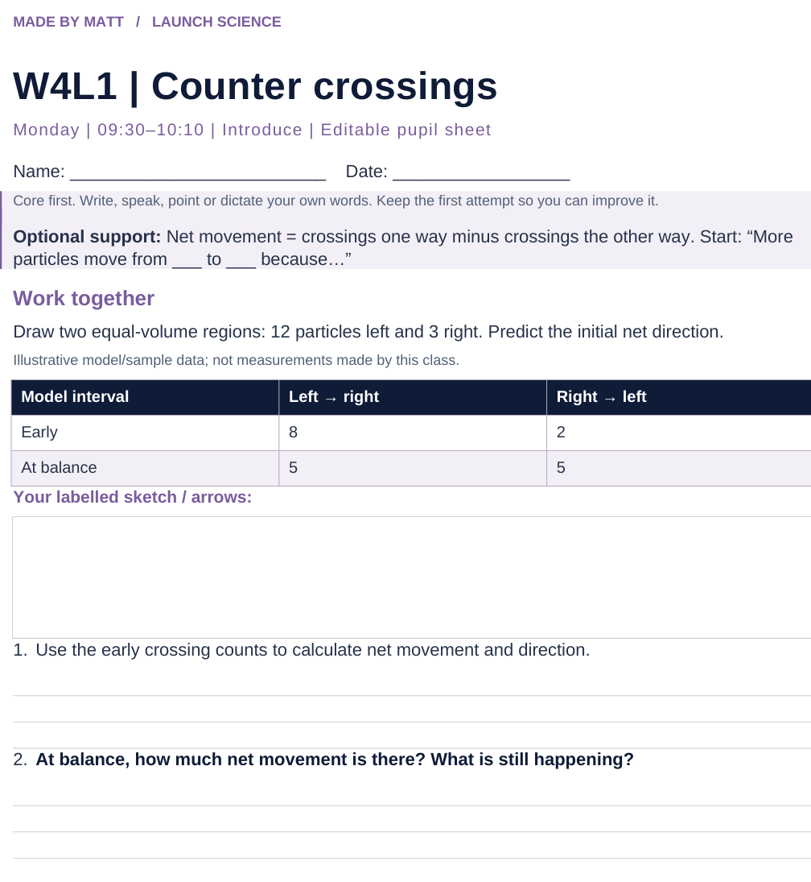
LAUNCH SCIENCE / W4L1
Resources
Worksheet · page 1
Use your printed copy.
Keep the first attempt.
Return to task
Arrival
Starter
I Do
We Do
I Do 2
We Do 2
Independent
Exit
Resources
Notes:
Embedded worksheet reference; print the separate PDF at A4 for writable space.
Core explanation: Particles move randomly in both directions. Net movement is the difference between those two movements, not a rule obeyed by every particle.
Watch for: Passive means no energy supplied by respiration is needed. It does not mean particles have no kinetic energy.
Least help first: Ask the pupil to compare starting counts on both sides before discussing direction.
Support cue: Net movement = crossings one way minus crossings the other way. Start: “More particles move from ___ to ___ because…”
[Sources]
User-supplied LAUNCH W3–W7 pack: W4 Diffusion worksheet particle model and exam task; no W4 PPTX was supplied.
Made by Matt LAUNCH Science draft, lesson-content.json, W4L1; existing illustrative diagrams reused, active-transport direction corrected to lower → higher.
Pearson Edexcel GCSE Biology specification, sections 1.1–1.6 and 1.15–1.17: https://qualifications.pearson.com/content/dam/pdf/GCSE/Science/2016/Specification/gcse-biology-spec.pdf
Optional concept video: freesciencelessons, Diffusion, https://www.youtube.com/watch?v=O965gA4goVI (link located 5 September 2026).
[/Sources]
[Sources]
Source editable lesson: Original LAUNCH Science OneDrive pack, 5 September 2026, W4L1. Source teaching content preserved. Current HTML reference: https://madebymatt.uk/Lessons/Science_Teesside/Launch/. Native diagrams restate the source explanation and are not experimental measurements.
[/Sources]

Slide 15
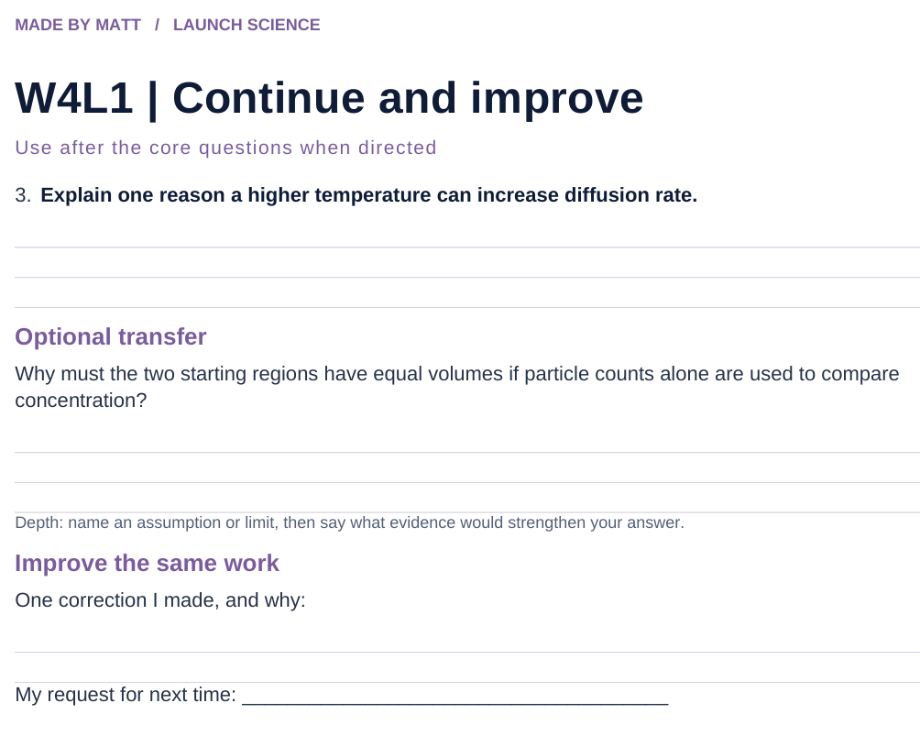
LAUNCH SCIENCE / W4L1
Resources
Worksheet · page 2
Continuation is optional.
Improve the same work.
Return to task
Arrival
Starter
I Do
We Do
I Do 2
We Do 2
Independent
Exit
Resources
Notes:
Embedded worksheet reference; print the separate PDF at A4 for writable space.
Core explanation: Particles move randomly in both directions. Net movement is the difference between those two movements, not a rule obeyed by every particle.
Watch for: Passive means no energy supplied by respiration is needed. It does not mean particles have no kinetic energy.
Least help first: Ask the pupil to compare starting counts on both sides before discussing direction.
Support cue: Net movement = crossings one way minus crossings the other way. Start: “More particles move from ___ to ___ because…”
[Sources]
User-supplied LAUNCH W3–W7 pack: W4 Diffusion worksheet particle model and exam task; no W4 PPTX was supplied.
Made by Matt LAUNCH Science draft, lesson-content.json, W4L1; existing illustrative diagrams reused, active-transport direction corrected to lower → higher.
Pearson Edexcel GCSE Biology specification, sections 1.1–1.6 and 1.15–1.17: https://qualifications.pearson.com/content/dam/pdf/GCSE/Science/2016/Specification/gcse-biology-spec.pdf
Optional concept video: freesciencelessons, Diffusion, https://www.youtube.com/watch?v=O965gA4goVI (link located 5 September 2026).
[/Sources]
[Sources]
Source editable lesson: Original LAUNCH Science OneDrive pack, 5 September 2026, W4L1. Source teaching content preserved. Current HTML reference: https://madebymatt.uk/Lessons/Science_Teesside/Launch/. Native diagrams restate the source explanation and are not experimental measurements.
[/Sources]

Slide 16
LAUNCH SCIENCE / W4L1
Resources
Watch, pause and explain
Diffusion
What keeps happening when there is no net movement?
Play freesciencelessons video
No connection? Use the still model and explain the same question.
Arrival
Starter
I Do
We Do
I Do 2
We Do 2
Independent
Exit
Resources
Notes:
Use at most 90 seconds within I Do. Pause on the first relevant example; ask for a reason. This is an optional concept clip, not evidence of practical completion.
Core explanation: Particles move randomly in both directions. Net movement is the difference between those two movements, not a rule obeyed by every particle.
Watch for: Passive means no energy supplied by respiration is needed. It does not mean particles have no kinetic energy.
Least help first: Ask the pupil to compare starting counts on both sides before discussing direction.
Support cue: Net movement = crossings one way minus crossings the other way. Start: “More particles move from ___ to ___ because…”
[Sources]
User-supplied LAUNCH W3–W7 pack: W4 Diffusion worksheet particle model and exam task; no W4 PPTX was supplied.
Made by Matt LAUNCH Science draft, lesson-content.json, W4L1; existing illustrative diagrams reused, active-transport direction corrected to lower → higher.
Pearson Edexcel GCSE Biology specification, sections 1.1–1.6 and 1.15–1.17: https://qualifications.pearson.com/content/dam/pdf/GCSE/Science/2016/Specification/gcse-biology-spec.pdf
Optional concept video: freesciencelessons, Diffusion, https://www.youtube.com/watch?v=O965gA4goVI (link located 5 September 2026).
[/Sources]
[Sources]
Source editable lesson: Original LAUNCH Science OneDrive pack, 5 September 2026, W4L1. Source teaching content preserved. Current HTML reference: https://madebymatt.uk/Lessons/Science_Teesside/Launch/. Native diagrams restate the source explanation and are not experimental measurements.
[/Sources]

Slide 17
LAUNCH SCIENCE / W4L1
Resources
Look closely at the model
● HIGH CONCENTRATION
○ LOW CONCENTRATION
NET MOVEMENT
↑ STEEPER GRADIENT
↑ HIGHER TEMPERATURE
↑ MORE SURFACE AREA
A model illustration: use the stated data for calculations.
Return to I Do
Arrival
Starter
I Do
We Do
I Do 2
We Do 2
Independent
Exit
Resources
Notes:
Source image: https://madebymatt.uk/Lessons/Science_Teesside/Launch/SCI_L_W4_L1_Diffusion.html; existing vector illustration embedded for offline use.
Core explanation: Particles move randomly in both directions. Net movement is the difference between those two movements, not a rule obeyed by every particle.
Watch for: Passive means no energy supplied by respiration is needed. It does not mean particles have no kinetic energy.
Least help first: Ask the pupil to compare starting counts on both sides before discussing direction.
Support cue: Net movement = crossings one way minus crossings the other way. Start: “More particles move from ___ to ___ because…”
[Sources]
User-supplied LAUNCH W3–W7 pack: W4 Diffusion worksheet particle model and exam task; no W4 PPTX was supplied.
Made by Matt LAUNCH Science draft, lesson-content.json, W4L1; existing illustrative diagrams reused, active-transport direction corrected to lower → higher.
Pearson Edexcel GCSE Biology specification, sections 1.1–1.6 and 1.15–1.17: https://qualifications.pearson.com/content/dam/pdf/GCSE/Science/2016/Specification/gcse-biology-spec.pdf
Optional concept video: freesciencelessons, Diffusion, https://www.youtube.com/watch?v=O965gA4goVI (link located 5 September 2026).
[/Sources]
[Sources]
Diagram labels and particle counts retained from the original editable LAUNCH Science pack, slide17. Recreated as editable shapes to separate labels from triangle edges and boundary lines.
[/Sources]
[Sources]
Source editable lesson: Original LAUNCH Science OneDrive pack, 5 September 2026, W4L1. Source teaching content preserved. Current HTML reference: https://madebymatt.uk/Lessons/Science_Teesside/Launch/. Native diagrams restate the source explanation and are not experimental measurements.
[/Sources]

