Slide 1
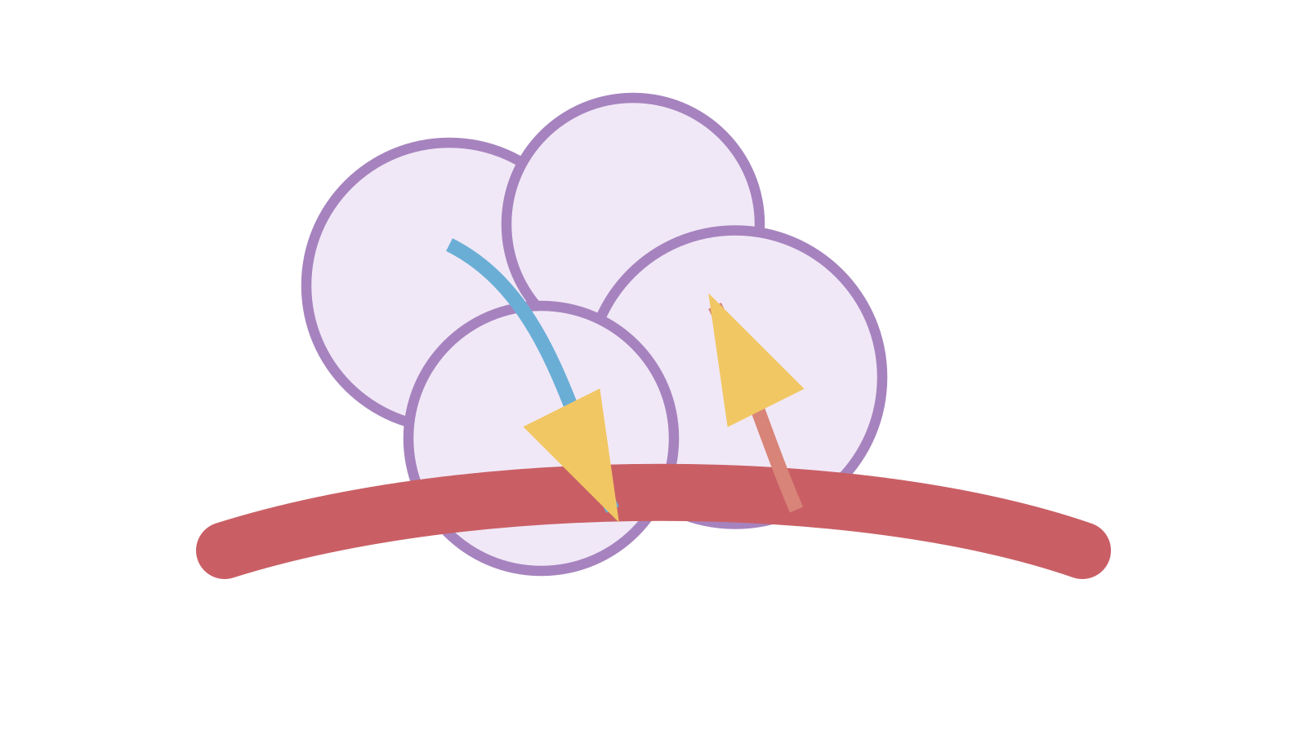
LAUNCH SCIENCE / W4L2
Arrival · 3 min
Gas exchange
I can link alveolus features to rapid gas exchange using concentration gradients and diffusion distance.
Notice. Recall. Be ready to explain.
1
In which direction does oxygen diffuse at an alveolus?
2
In which direction does carbon dioxide diffuse?
Retrieval answers
Arrival
Starter
I Do
We Do
I Do 2
We Do 2
Independent
Exit
Resources
Notes:
Stage: Arrival, 3 minutes. Monday / Wednesday / Friday P1, 09:30–10:10. Use reveals within this slot; appendix slides are not added time.
Retrieval answers: Alveolar air into arriving blood, down its oxygen gradient. | Arriving blood into alveolar air, down its CO₂ gradient. | Temperature, concentration gradient, distance or surface area.
Core explanation: For each feature, say what it changes physically and why that affects diffusion. “Good lungs” is not an explanation.
Watch for: Both alveolar and capillary walls contribute to the diffusion path. Do not describe oxygen as choosing a destination.
Least help first: Ask for the feature, then its physical effect, then the diffusion consequence; do not jump straight to ‘more efficient’.
Support cue: Use three parts: the feature, what it changes, and how that affects diffusion. Start: “Thin walls help because…”
[Sources]
User-supplied LAUNCH W3–W7 pack: W4 worksheet oxygen/CO₂ context, expanded through the existing lungs lesson.
Made by Matt LAUNCH Science draft, lesson-content.json, W4L2; existing illustrative diagrams reused, active-transport direction corrected to lower → higher.
Pearson Edexcel GCSE Biology specification, sections 1.1–1.6 and 1.15–1.17: https://qualifications.pearson.com/content/dam/pdf/GCSE/Science/2016/Specification/gcse-biology-spec.pdf
Optional concept video: freesciencelessons, Gas exchange in the lungs, https://www.youtube.com/watch?v=aPUPfzsqDgs (link located 5 September 2026).
[/Sources]
[Sources]
Source editable lesson: Original LAUNCH Science OneDrive pack, 5 September 2026, W4L2. Source teaching content preserved. Current HTML reference: https://madebymatt.uk/Lessons/Science_Teesside/Launch/. Native diagrams restate the source explanation and are not experimental measurements.
[/Sources]

Slide 2
LAUNCH SCIENCE / W4L2
Starter · 4 min
Make a prediction
Which change would most directly shorten the distance that oxygen must diffuse: more alveoli, a thinner wall or faster ventilation?
A More alveoli
B A thinner wall
C Faster ventilation
Commit, then check
Arrival
Starter
I Do
We Do
I Do 2
We Do 2
Independent
Exit
Resources
Notes:
Stage: Starter, 4 minutes. Monday / Wednesday / Friday P1, 09:30–10:10. Use reveals within this slot; appendix slides are not added time.
Correct: A thinner wall. Ask for the reason, then return to the original prediction.
Core explanation: For each feature, say what it changes physically and why that affects diffusion. “Good lungs” is not an explanation.
Watch for: Both alveolar and capillary walls contribute to the diffusion path. Do not describe oxygen as choosing a destination.
Least help first: Ask for the feature, then its physical effect, then the diffusion consequence; do not jump straight to ‘more efficient’.
Support cue: Use three parts: the feature, what it changes, and how that affects diffusion. Start: “Thin walls help because…”
[Sources]
User-supplied LAUNCH W3–W7 pack: W4 worksheet oxygen/CO₂ context, expanded through the existing lungs lesson.
Made by Matt LAUNCH Science draft, lesson-content.json, W4L2; existing illustrative diagrams reused, active-transport direction corrected to lower → higher.
Pearson Edexcel GCSE Biology specification, sections 1.1–1.6 and 1.15–1.17: https://qualifications.pearson.com/content/dam/pdf/GCSE/Science/2016/Specification/gcse-biology-spec.pdf
Optional concept video: freesciencelessons, Gas exchange in the lungs, https://www.youtube.com/watch?v=aPUPfzsqDgs (link located 5 September 2026).
[/Sources]
[Sources]
Source editable lesson: Original LAUNCH Science OneDrive pack, 5 September 2026, W4L2. Source teaching content preserved. Current HTML reference: https://madebymatt.uk/Lessons/Science_Teesside/Launch/. Native diagrams restate the source explanation and are not experimental measurements.
[/Sources]

Slide 3
LAUNCH SCIENCE / W4L2
I Do · 5 min
Watch the model
1
Ventilation refreshes alveolar air and helps maintain oxygen and carbon dioxide gradients.
A short diffusion distance
2
Blood flow carries gases away or brings them to the exchange surface, maintaining gradients.
Higher
Lower
3
A one-cell-thick exchange surface gives a short diffusion distance, while many alveoli give a large surface area.
concentration
View labelled diagram
Optional video
Arrival
Starter
I Do
We Do
I Do 2
We Do 2
Independent
Exit
Resources
Notes:
Stage: I Do, 5 minutes. Monday / Wednesday / Friday P1, 09:30–10:10. Use reveals within this slot; appendix slides are not added time.
The feature–effect–consequence builder forces each adaptation to connect to a diffusion reason.
Model limit: The relative exchange index is a classroom comparison, not a measured lung-function value or medical model.
Video replaces up to 90 seconds of explanation; use the still diagram if unavailable.
Core explanation: For each feature, say what it changes physically and why that affects diffusion. “Good lungs” is not an explanation.
Watch for: Both alveolar and capillary walls contribute to the diffusion path. Do not describe oxygen as choosing a destination.
Least help first: Ask for the feature, then its physical effect, then the diffusion consequence; do not jump straight to ‘more efficient’.
Support cue: Use three parts: the feature, what it changes, and how that affects diffusion. Start: “Thin walls help because…”
[Sources]
User-supplied LAUNCH W3–W7 pack: W4 worksheet oxygen/CO₂ context, expanded through the existing lungs lesson.
Made by Matt LAUNCH Science draft, lesson-content.json, W4L2; existing illustrative diagrams reused, active-transport direction corrected to lower → higher.
Pearson Edexcel GCSE Biology specification, sections 1.1–1.6 and 1.15–1.17: https://qualifications.pearson.com/content/dam/pdf/GCSE/Science/2016/Specification/gcse-biology-spec.pdf
Optional concept video: freesciencelessons, Gas exchange in the lungs, https://www.youtube.com/watch?v=aPUPfzsqDgs (link located 5 September 2026).
[/Sources]
[Sources]
Source editable lesson: Original LAUNCH Science OneDrive pack, 5 September 2026, W4L2. Source teaching content preserved. Current HTML reference: https://madebymatt.uk/Lessons/Science_Teesside/Launch/. Native diagrams restate the source explanation and are not experimental measurements.
[/Sources]

Slide 4
LAUNCH SCIENCE / W4L2
We Do · 5 min
Choose and justify
Why does a rich blood supply support oxygen diffusion into blood?
A It makes oxygen particles choose the blood
B It removes oxygenated blood and maintains a gradient
C It thickens the alveolus wall
D It stops carbon dioxide moving
Give the deciding clue before checking.
Check the reasoning
Arrival
Starter
I Do
We Do
I Do 2
We Do 2
Independent
Exit
Resources
Notes:
Stage: We Do, 5 minutes. Monday / Wednesday / Friday P1, 09:30–10:10. Use reveals within this slot; appendix slides are not added time.
A: It makes oxygen particles choose the blood — Avoid purposeful particle explanations.
B: It removes oxygenated blood and maintains a gradient — Correct. Link maintained gradient to continued net diffusion.
C: It thickens the alveolus wall — A thicker wall would increase diffusion distance.
D: It stops carbon dioxide moving — Both gases can diffuse in opposite net directions at the same exchange surface.
Core explanation: For each feature, say what it changes physically and why that affects diffusion. “Good lungs” is not an explanation.
Watch for: Both alveolar and capillary walls contribute to the diffusion path. Do not describe oxygen as choosing a destination.
Least help first: Ask for the feature, then its physical effect, then the diffusion consequence; do not jump straight to ‘more efficient’.
Support cue: Use three parts: the feature, what it changes, and how that affects diffusion. Start: “Thin walls help because…”
[Sources]
User-supplied LAUNCH W3–W7 pack: W4 worksheet oxygen/CO₂ context, expanded through the existing lungs lesson.
Made by Matt LAUNCH Science draft, lesson-content.json, W4L2; existing illustrative diagrams reused, active-transport direction corrected to lower → higher.
Pearson Edexcel GCSE Biology specification, sections 1.1–1.6 and 1.15–1.17: https://qualifications.pearson.com/content/dam/pdf/GCSE/Science/2016/Specification/gcse-biology-spec.pdf
Optional concept video: freesciencelessons, Gas exchange in the lungs, https://www.youtube.com/watch?v=aPUPfzsqDgs (link located 5 September 2026).
[/Sources]
[Sources]
Source editable lesson: Original LAUNCH Science OneDrive pack, 5 September 2026, W4L2. Source teaching content preserved. Current HTML reference: https://madebymatt.uk/Lessons/Science_Teesside/Launch/. Native diagrams restate the source explanation and are not experimental measurements.
[/Sources]

Slide 5

LAUNCH SCIENCE / W4L2
I Do 2 · 4 min
Connect the science
1
Feature: large surface area. Effect: more membrane available at once. Consequence: greater total diffusion.
2
Feature: thin wall. Effect: shorter diffusion distance. Consequence: faster exchange.
3
Feature: ventilation and blood flow. Effect: maintain gradients. Consequence: continued net movement.
Arrival
Starter
I Do
We Do
I Do 2
We Do 2
Independent
Exit
Resources
Notes:
Stage: I Do 2, 4 minutes. Monday / Wednesday / Friday P1, 09:30–10:10. Use reveals within this slot; appendix slides are not added time.
The relative exchange index is a classroom comparison, not a measured lung-function value or medical model.
Core explanation: For each feature, say what it changes physically and why that affects diffusion. “Good lungs” is not an explanation.
Watch for: Both alveolar and capillary walls contribute to the diffusion path. Do not describe oxygen as choosing a destination.
Least help first: Ask for the feature, then its physical effect, then the diffusion consequence; do not jump straight to ‘more efficient’.
Support cue: Use three parts: the feature, what it changes, and how that affects diffusion. Start: “Thin walls help because…”
[Sources]
User-supplied LAUNCH W3–W7 pack: W4 worksheet oxygen/CO₂ context, expanded through the existing lungs lesson.
Made by Matt LAUNCH Science draft, lesson-content.json, W4L2; existing illustrative diagrams reused, active-transport direction corrected to lower → higher.
Pearson Edexcel GCSE Biology specification, sections 1.1–1.6 and 1.15–1.17: https://qualifications.pearson.com/content/dam/pdf/GCSE/Science/2016/Specification/gcse-biology-spec.pdf
Optional concept video: freesciencelessons, Gas exchange in the lungs, https://www.youtube.com/watch?v=aPUPfzsqDgs (link located 5 September 2026).
[/Sources]
[Sources]
Source editable lesson: Original LAUNCH Science OneDrive pack, 5 September 2026, W4L2. Source teaching content preserved. Current HTML reference: https://madebymatt.uk/Lessons/Science_Teesside/Launch/. Native diagrams restate the source explanation and are not experimental measurements.
[/Sources]

Slide 6
LAUNCH SCIENCE / W4L2
We Do 2 · Task · 6 min
Build a linked explanation
Point to the net direction for each gas. Then explain one adaptation.
Gas | Alveolar air compared with arriving blood
Oxygen | Higher concentration
Carbon dioxide | Lower concentration
Thin walls → what physical effect? → how does this help diffusion?
Reveal shared reasoning
Arrival
Starter
I Do
We Do
I Do 2
We Do 2
Independent
Exit
Resources
Notes:
Stage: We Do 2 · Task, 6 minutes. Monday / Wednesday / Friday P1, 09:30–10:10. Use reveals within this slot; appendix slides are not added time.
Oxygen: air → blood. Carbon dioxide: blood → air.
Thin walls give a short diffusion distance, so gases cross more quickly down their gradients. Blood flow and ventilation help maintain gradients.
Run the printed activity or this board; one route is enough.
Core explanation: For each feature, say what it changes physically and why that affects diffusion. “Good lungs” is not an explanation.
Watch for: Both alveolar and capillary walls contribute to the diffusion path. Do not describe oxygen as choosing a destination.
Least help first: Ask for the feature, then its physical effect, then the diffusion consequence; do not jump straight to ‘more efficient’.
Support cue: Use three parts: the feature, what it changes, and how that affects diffusion. Start: “Thin walls help because…”
[Sources]
User-supplied LAUNCH W3–W7 pack: W4 worksheet oxygen/CO₂ context, expanded through the existing lungs lesson.
Made by Matt LAUNCH Science draft, lesson-content.json, W4L2; existing illustrative diagrams reused, active-transport direction corrected to lower → higher.
Pearson Edexcel GCSE Biology specification, sections 1.1–1.6 and 1.15–1.17: https://qualifications.pearson.com/content/dam/pdf/GCSE/Science/2016/Specification/gcse-biology-spec.pdf
Optional concept video: freesciencelessons, Gas exchange in the lungs, https://www.youtube.com/watch?v=aPUPfzsqDgs (link located 5 September 2026).
[/Sources]
[Sources]
Source editable lesson: Original LAUNCH Science OneDrive pack, 5 September 2026, W4L2. Source teaching content preserved. Current HTML reference: https://madebymatt.uk/Lessons/Science_Teesside/Launch/. Native diagrams restate the source explanation and are not experimental measurements.
[/Sources]

Slide 7
LAUNCH SCIENCE / W4L2
Independent Task · 10 min
Your independent evidence
A disease thickens the alveolar wall but does not initially change surface area. Explain how this affects oxygen uptake. Then state why increasing ventilation may not completely remove the problem.
Optional support
Use three parts: the feature, what it changes, and how that affects diffusion. Start: “Thin walls help because…”
Make one precise correction to the same work after feedback.
Open worksheet pages
Model after first attempt
Arrival
Starter
I Do
We Do
I Do 2
We Do 2
Independent
Exit
Resources
Notes:
Stage: Independent Task, 10 minutes. Monday / Wednesday / Friday P1, 09:30–10:10. Use reveals within this slot; appendix slides are not added time.
Model answer: A thicker alveolar wall increases the distance oxygen must diffuse, so the rate of oxygen movement into blood falls. Faster ventilation may maintain a steep oxygen concentration gradient, but it does not make the thickened exchange surface thinner, so the longer diffusion path remains.
Select only questions that fit the ten-minute slot. W7L3: Q2, Q3 and Q5 total 11 marks. The full paper needs a separate 25-minute slot.
Core explanation: For each feature, say what it changes physically and why that affects diffusion. “Good lungs” is not an explanation.
Watch for: Both alveolar and capillary walls contribute to the diffusion path. Do not describe oxygen as choosing a destination.
Least help first: Ask for the feature, then its physical effect, then the diffusion consequence; do not jump straight to ‘more efficient’.
Support cue: Use three parts: the feature, what it changes, and how that affects diffusion. Start: “Thin walls help because…”
[Sources]
User-supplied LAUNCH W3–W7 pack: W4 worksheet oxygen/CO₂ context, expanded through the existing lungs lesson.
Made by Matt LAUNCH Science draft, lesson-content.json, W4L2; existing illustrative diagrams reused, active-transport direction corrected to lower → higher.
Pearson Edexcel GCSE Biology specification, sections 1.1–1.6 and 1.15–1.17: https://qualifications.pearson.com/content/dam/pdf/GCSE/Science/2016/Specification/gcse-biology-spec.pdf
Optional concept video: freesciencelessons, Gas exchange in the lungs, https://www.youtube.com/watch?v=aPUPfzsqDgs (link located 5 September 2026).
[/Sources]
[Sources]
Source editable lesson: Original LAUNCH Science OneDrive pack, 5 September 2026, W4L2. Source teaching content preserved. Current HTML reference: https://madebymatt.uk/Lessons/Science_Teesside/Launch/. Native diagrams restate the source explanation and are not experimental measurements.
[/Sources]

Slide 8
LAUNCH SCIENCE / W4L2
Exit · 3 min
What changed in your thinking?
Complete: a thin exchange surface increases diffusion rate because…
1
Point to one improvement in your work.
2
Choose what you want to revisit.
3
Tell your teacher; agree the next step together.
Arrival
Starter
I Do
We Do
I Do 2
We Do 2
Independent
Exit
Resources
Notes:
Stage: Exit, 3 minutes. Monday / Wednesday / Friday P1, 09:30–10:10. Use reveals within this slot; appendix slides are not added time.
Exit answer: A thin exchange surface shortens the diffusion distance.
Receive the request, record the agreed next action and check it next lesson. Keep responses private when requested.
Core explanation: For each feature, say what it changes physically and why that affects diffusion. “Good lungs” is not an explanation.
Watch for: Both alveolar and capillary walls contribute to the diffusion path. Do not describe oxygen as choosing a destination.
Least help first: Ask for the feature, then its physical effect, then the diffusion consequence; do not jump straight to ‘more efficient’.
Support cue: Use three parts: the feature, what it changes, and how that affects diffusion. Start: “Thin walls help because…”
[Sources]
User-supplied LAUNCH W3–W7 pack: W4 worksheet oxygen/CO₂ context, expanded through the existing lungs lesson.
Made by Matt LAUNCH Science draft, lesson-content.json, W4L2; existing illustrative diagrams reused, active-transport direction corrected to lower → higher.
Pearson Edexcel GCSE Biology specification, sections 1.1–1.6 and 1.15–1.17: https://qualifications.pearson.com/content/dam/pdf/GCSE/Science/2016/Specification/gcse-biology-spec.pdf
Optional concept video: freesciencelessons, Gas exchange in the lungs, https://www.youtube.com/watch?v=aPUPfzsqDgs (link located 5 September 2026).
[/Sources]
[Sources]
Source editable lesson: Original LAUNCH Science OneDrive pack, 5 September 2026, W4L2. Source teaching content preserved. Current HTML reference: https://madebymatt.uk/Lessons/Science_Teesside/Launch/. Native diagrams restate the source explanation and are not experimental measurements.
[/Sources]

Slide 9
LAUNCH SCIENCE / W4L2
Resources
Retrieval and prediction check
1
Alveolar air into arriving blood, down its oxygen gradient.
2
Arriving blood into alveolar air, down its CO₂ gradient.
A thinner wall
Return to Starter
Arrival
Starter
I Do
We Do
I Do 2
We Do 2
Independent
Exit
Resources
Notes:
Read only after an attempt; retain the pupil’s first view.
Core explanation: For each feature, say what it changes physically and why that affects diffusion. “Good lungs” is not an explanation.
Watch for: Both alveolar and capillary walls contribute to the diffusion path. Do not describe oxygen as choosing a destination.
Least help first: Ask for the feature, then its physical effect, then the diffusion consequence; do not jump straight to ‘more efficient’.
Support cue: Use three parts: the feature, what it changes, and how that affects diffusion. Start: “Thin walls help because…”
[Sources]
User-supplied LAUNCH W3–W7 pack: W4 worksheet oxygen/CO₂ context, expanded through the existing lungs lesson.
Made by Matt LAUNCH Science draft, lesson-content.json, W4L2; existing illustrative diagrams reused, active-transport direction corrected to lower → higher.
Pearson Edexcel GCSE Biology specification, sections 1.1–1.6 and 1.15–1.17: https://qualifications.pearson.com/content/dam/pdf/GCSE/Science/2016/Specification/gcse-biology-spec.pdf
Optional concept video: freesciencelessons, Gas exchange in the lungs, https://www.youtube.com/watch?v=aPUPfzsqDgs (link located 5 September 2026).
[/Sources]
[Sources]
Source editable lesson: Original LAUNCH Science OneDrive pack, 5 September 2026, W4L2. Source teaching content preserved. Current HTML reference: https://madebymatt.uk/Lessons/Science_Teesside/Launch/. Native diagrams restate the source explanation and are not experimental measurements.
[/Sources]

Slide 10
LAUNCH SCIENCE / W4L2
Resources
Check the deciding clue
It removes oxygenated blood and maintains a gradient
Correct. Link maintained gradient to continued net diffusion.
Compare your reason. Correct one step if needed.
Return to We Do
Arrival
Starter
I Do
We Do
I Do 2
We Do 2
Independent
Exit
Resources
Notes:
Avoid purposeful particle explanations.
Correct. Link maintained gradient to continued net diffusion.
A thicker wall would increase diffusion distance.
Both gases can diffuse in opposite net directions at the same exchange surface.
Core explanation: For each feature, say what it changes physically and why that affects diffusion. “Good lungs” is not an explanation.
Watch for: Both alveolar and capillary walls contribute to the diffusion path. Do not describe oxygen as choosing a destination.
Least help first: Ask for the feature, then its physical effect, then the diffusion consequence; do not jump straight to ‘more efficient’.
Support cue: Use three parts: the feature, what it changes, and how that affects diffusion. Start: “Thin walls help because…”
[Sources]
User-supplied LAUNCH W3–W7 pack: W4 worksheet oxygen/CO₂ context, expanded through the existing lungs lesson.
Made by Matt LAUNCH Science draft, lesson-content.json, W4L2; existing illustrative diagrams reused, active-transport direction corrected to lower → higher.
Pearson Edexcel GCSE Biology specification, sections 1.1–1.6 and 1.15–1.17: https://qualifications.pearson.com/content/dam/pdf/GCSE/Science/2016/Specification/gcse-biology-spec.pdf
Optional concept video: freesciencelessons, Gas exchange in the lungs, https://www.youtube.com/watch?v=aPUPfzsqDgs (link located 5 September 2026).
[/Sources]
[Sources]
Source editable lesson: Original LAUNCH Science OneDrive pack, 5 September 2026, W4L2. Source teaching content preserved. Current HTML reference: https://madebymatt.uk/Lessons/Science_Teesside/Launch/. Native diagrams restate the source explanation and are not experimental measurements.
[/Sources]

Slide 11
LAUNCH SCIENCE / W4L2
Resources
Our shared reasoning
Oxygen: air → blood. Carbon dioxide: blood → air.
Thin walls give a short diffusion distance, so gases cross more quickly down their gradients. Blood flow and ventilation help maintain gradients.
Return to shared task
Arrival
Starter
I Do
We Do
I Do 2
We Do 2
Independent
Exit
Resources
Notes:
Pupils should justify, compare and revise rather than copy a complete answer before trying.
Core explanation: For each feature, say what it changes physically and why that affects diffusion. “Good lungs” is not an explanation.
Watch for: Both alveolar and capillary walls contribute to the diffusion path. Do not describe oxygen as choosing a destination.
Least help first: Ask for the feature, then its physical effect, then the diffusion consequence; do not jump straight to ‘more efficient’.
Support cue: Use three parts: the feature, what it changes, and how that affects diffusion. Start: “Thin walls help because…”
[Sources]
User-supplied LAUNCH W3–W7 pack: W4 worksheet oxygen/CO₂ context, expanded through the existing lungs lesson.
Made by Matt LAUNCH Science draft, lesson-content.json, W4L2; existing illustrative diagrams reused, active-transport direction corrected to lower → higher.
Pearson Edexcel GCSE Biology specification, sections 1.1–1.6 and 1.15–1.17: https://qualifications.pearson.com/content/dam/pdf/GCSE/Science/2016/Specification/gcse-biology-spec.pdf
Optional concept video: freesciencelessons, Gas exchange in the lungs, https://www.youtube.com/watch?v=aPUPfzsqDgs (link located 5 September 2026).
[/Sources]
[Sources]
Source editable lesson: Original LAUNCH Science OneDrive pack, 5 September 2026, W4L2. Source teaching content preserved. Current HTML reference: https://madebymatt.uk/Lessons/Science_Teesside/Launch/. Native diagrams restate the source explanation and are not experimental measurements.
[/Sources]

Slide 12
LAUNCH SCIENCE / W4L2
Resources
Compare after your first attempt
A thicker alveolar wall increases the distance oxygen must diffuse, so the rate of oxygen movement into blood falls. Faster ventilation may maintain a steep oxygen concentration gradient, but it does not make the thickened exchange surface thinner, so the longer diffusion path remains.
Use the model to improve your explanation in your own words.
Return to independent task
Arrival
Starter
I Do
We Do
I Do 2
We Do 2
Independent
Exit
Resources
Notes:
Staff guide includes question-by-question answers. Do not distribute this presentation as a secure assessment paper.
Core explanation: For each feature, say what it changes physically and why that affects diffusion. “Good lungs” is not an explanation.
Watch for: Both alveolar and capillary walls contribute to the diffusion path. Do not describe oxygen as choosing a destination.
Least help first: Ask for the feature, then its physical effect, then the diffusion consequence; do not jump straight to ‘more efficient’.
Support cue: Use three parts: the feature, what it changes, and how that affects diffusion. Start: “Thin walls help because…”
[Sources]
User-supplied LAUNCH W3–W7 pack: W4 worksheet oxygen/CO₂ context, expanded through the existing lungs lesson.
Made by Matt LAUNCH Science draft, lesson-content.json, W4L2; existing illustrative diagrams reused, active-transport direction corrected to lower → higher.
Pearson Edexcel GCSE Biology specification, sections 1.1–1.6 and 1.15–1.17: https://qualifications.pearson.com/content/dam/pdf/GCSE/Science/2016/Specification/gcse-biology-spec.pdf
Optional concept video: freesciencelessons, Gas exchange in the lungs, https://www.youtube.com/watch?v=aPUPfzsqDgs (link located 5 September 2026).
[/Sources]
[Sources]
Source editable lesson: Original LAUNCH Science OneDrive pack, 5 September 2026, W4L2. Source teaching content preserved. Current HTML reference: https://madebymatt.uk/Lessons/Science_Teesside/Launch/. Native diagrams restate the source explanation and are not experimental measurements.
[/Sources]

Slide 13
LAUNCH SCIENCE / W4L2
Resources
Your lesson resources
Worksheet pages are stored inside this PowerPoint.
Worksheet · page 1
Worksheet · page 2
Standard PDF
Supported PDF
Depth PDF
Editable Word worksheet
Open online lesson / model
Named files are in this week’s folder. Online lesson and video need internet.
Optional concept video
Arrival
Starter
I Do
We Do
I Do 2
We Do 2
Independent
Exit
Resources
Notes:
File buttons use relative links for downloaded/synced folders. OneDrive preview may not resolve relative links. Use the embedded pages or open the named file in the week folder.
Core explanation: For each feature, say what it changes physically and why that affects diffusion. “Good lungs” is not an explanation.
Watch for: Both alveolar and capillary walls contribute to the diffusion path. Do not describe oxygen as choosing a destination.
Least help first: Ask for the feature, then its physical effect, then the diffusion consequence; do not jump straight to ‘more efficient’.
Support cue: Use three parts: the feature, what it changes, and how that affects diffusion. Start: “Thin walls help because…”
[Sources]
User-supplied LAUNCH W3–W7 pack: W4 worksheet oxygen/CO₂ context, expanded through the existing lungs lesson.
Made by Matt LAUNCH Science draft, lesson-content.json, W4L2; existing illustrative diagrams reused, active-transport direction corrected to lower → higher.
Pearson Edexcel GCSE Biology specification, sections 1.1–1.6 and 1.15–1.17: https://qualifications.pearson.com/content/dam/pdf/GCSE/Science/2016/Specification/gcse-biology-spec.pdf
Optional concept video: freesciencelessons, Gas exchange in the lungs, https://www.youtube.com/watch?v=aPUPfzsqDgs (link located 5 September 2026).
[/Sources]
[Sources]
Source editable lesson: Original LAUNCH Science OneDrive pack, 5 September 2026, W4L2. Source teaching content preserved. Current HTML reference: https://madebymatt.uk/Lessons/Science_Teesside/Launch/. Native diagrams restate the source explanation and are not experimental measurements.
[/Sources]

Slide 14
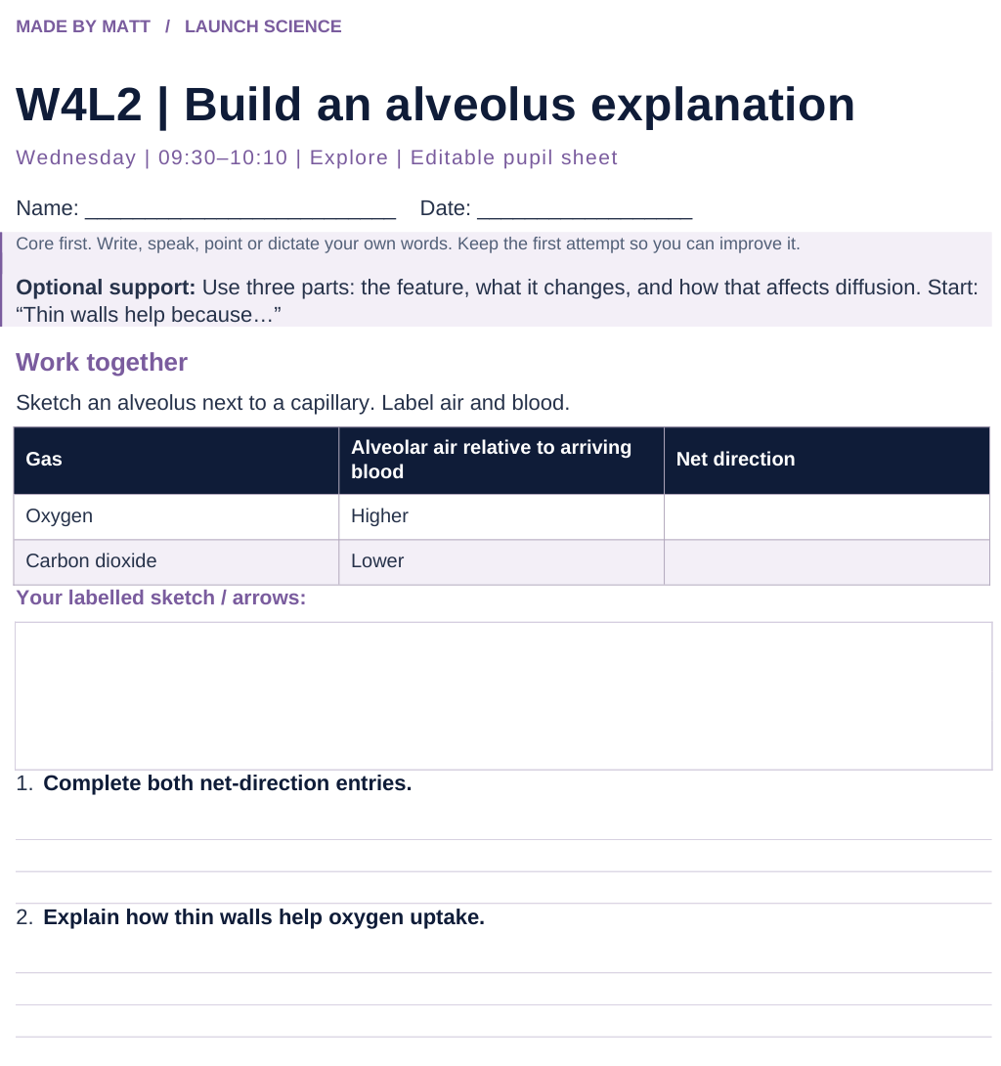
LAUNCH SCIENCE / W4L2
Resources
Worksheet · page 1
Use your printed copy.
Keep the first attempt.
Return to task
Arrival
Starter
I Do
We Do
I Do 2
We Do 2
Independent
Exit
Resources
Notes:
Embedded worksheet reference; print the separate PDF at A4 for writable space.
Core explanation: For each feature, say what it changes physically and why that affects diffusion. “Good lungs” is not an explanation.
Watch for: Both alveolar and capillary walls contribute to the diffusion path. Do not describe oxygen as choosing a destination.
Least help first: Ask for the feature, then its physical effect, then the diffusion consequence; do not jump straight to ‘more efficient’.
Support cue: Use three parts: the feature, what it changes, and how that affects diffusion. Start: “Thin walls help because…”
[Sources]
User-supplied LAUNCH W3–W7 pack: W4 worksheet oxygen/CO₂ context, expanded through the existing lungs lesson.
Made by Matt LAUNCH Science draft, lesson-content.json, W4L2; existing illustrative diagrams reused, active-transport direction corrected to lower → higher.
Pearson Edexcel GCSE Biology specification, sections 1.1–1.6 and 1.15–1.17: https://qualifications.pearson.com/content/dam/pdf/GCSE/Science/2016/Specification/gcse-biology-spec.pdf
Optional concept video: freesciencelessons, Gas exchange in the lungs, https://www.youtube.com/watch?v=aPUPfzsqDgs (link located 5 September 2026).
[/Sources]
[Sources]
Source editable lesson: Original LAUNCH Science OneDrive pack, 5 September 2026, W4L2. Source teaching content preserved. Current HTML reference: https://madebymatt.uk/Lessons/Science_Teesside/Launch/. Native diagrams restate the source explanation and are not experimental measurements.
[/Sources]

Slide 15
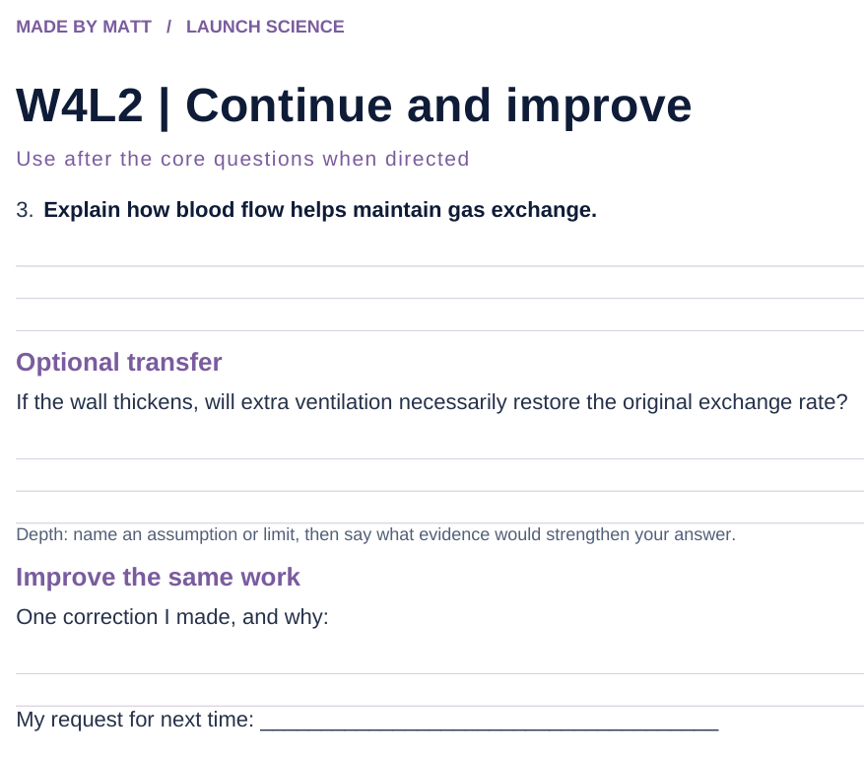
LAUNCH SCIENCE / W4L2
Resources
Worksheet · page 2
Continuation is optional.
Improve the same work.
Return to task
Arrival
Starter
I Do
We Do
I Do 2
We Do 2
Independent
Exit
Resources
Notes:
Embedded worksheet reference; print the separate PDF at A4 for writable space.
Core explanation: For each feature, say what it changes physically and why that affects diffusion. “Good lungs” is not an explanation.
Watch for: Both alveolar and capillary walls contribute to the diffusion path. Do not describe oxygen as choosing a destination.
Least help first: Ask for the feature, then its physical effect, then the diffusion consequence; do not jump straight to ‘more efficient’.
Support cue: Use three parts: the feature, what it changes, and how that affects diffusion. Start: “Thin walls help because…”
[Sources]
User-supplied LAUNCH W3–W7 pack: W4 worksheet oxygen/CO₂ context, expanded through the existing lungs lesson.
Made by Matt LAUNCH Science draft, lesson-content.json, W4L2; existing illustrative diagrams reused, active-transport direction corrected to lower → higher.
Pearson Edexcel GCSE Biology specification, sections 1.1–1.6 and 1.15–1.17: https://qualifications.pearson.com/content/dam/pdf/GCSE/Science/2016/Specification/gcse-biology-spec.pdf
Optional concept video: freesciencelessons, Gas exchange in the lungs, https://www.youtube.com/watch?v=aPUPfzsqDgs (link located 5 September 2026).
[/Sources]
[Sources]
Source editable lesson: Original LAUNCH Science OneDrive pack, 5 September 2026, W4L2. Source teaching content preserved. Current HTML reference: https://madebymatt.uk/Lessons/Science_Teesside/Launch/. Native diagrams restate the source explanation and are not experimental measurements.
[/Sources]

Slide 16
LAUNCH SCIENCE / W4L2
Resources
Watch, pause and explain
Gas exchange in the lungs
How does a thin wall help oxygen move into the blood?
Play freesciencelessons video
No connection? Use the still model and explain the same question.
Arrival
Starter
I Do
We Do
I Do 2
We Do 2
Independent
Exit
Resources
Notes:
Use at most 90 seconds within I Do. Pause on the first relevant example; ask for a reason. This is an optional concept clip, not evidence of practical completion.
Core explanation: For each feature, say what it changes physically and why that affects diffusion. “Good lungs” is not an explanation.
Watch for: Both alveolar and capillary walls contribute to the diffusion path. Do not describe oxygen as choosing a destination.
Least help first: Ask for the feature, then its physical effect, then the diffusion consequence; do not jump straight to ‘more efficient’.
Support cue: Use three parts: the feature, what it changes, and how that affects diffusion. Start: “Thin walls help because…”
[Sources]
User-supplied LAUNCH W3–W7 pack: W4 worksheet oxygen/CO₂ context, expanded through the existing lungs lesson.
Made by Matt LAUNCH Science draft, lesson-content.json, W4L2; existing illustrative diagrams reused, active-transport direction corrected to lower → higher.
Pearson Edexcel GCSE Biology specification, sections 1.1–1.6 and 1.15–1.17: https://qualifications.pearson.com/content/dam/pdf/GCSE/Science/2016/Specification/gcse-biology-spec.pdf
Optional concept video: freesciencelessons, Gas exchange in the lungs, https://www.youtube.com/watch?v=aPUPfzsqDgs (link located 5 September 2026).
[/Sources]
[Sources]
Source editable lesson: Original LAUNCH Science OneDrive pack, 5 September 2026, W4L2. Source teaching content preserved. Current HTML reference: https://madebymatt.uk/Lessons/Science_Teesside/Launch/. Native diagrams restate the source explanation and are not experimental measurements.
[/Sources]

Slide 17
LAUNCH SCIENCE / W4L2
Resources
Look closely at the model
Gas exchange in one alveolus
limewater test
O₂ → blood
alveolus
capillary
CO₂ → air
CLEAR
CLOUDY
■ LARGE SURFACE AREA
clear → cloudy = CO₂
■ WALL ONE CELL THICK
■ GOOD BLOOD SUPPLY
A model illustration: use the stated data for calculations.
Return to I Do
Arrival
Starter
I Do
We Do
I Do 2
We Do 2
Independent
Exit
Resources
Notes:
Source image: https://madebymatt.uk/Lessons/Science_Teesside/Launch/SCI_L_W4_L2_GasExchange.html; existing vector illustration embedded for offline use.
Core explanation: For each feature, say what it changes physically and why that affects diffusion. “Good lungs” is not an explanation.
Watch for: Both alveolar and capillary walls contribute to the diffusion path. Do not describe oxygen as choosing a destination.
Least help first: Ask for the feature, then its physical effect, then the diffusion consequence; do not jump straight to ‘more efficient’.
Support cue: Use three parts: the feature, what it changes, and how that affects diffusion. Start: “Thin walls help because…”
[Sources]
User-supplied LAUNCH W3–W7 pack: W4 worksheet oxygen/CO₂ context, expanded through the existing lungs lesson.
Made by Matt LAUNCH Science draft, lesson-content.json, W4L2; existing illustrative diagrams reused, active-transport direction corrected to lower → higher.
Pearson Edexcel GCSE Biology specification, sections 1.1–1.6 and 1.15–1.17: https://qualifications.pearson.com/content/dam/pdf/GCSE/Science/2016/Specification/gcse-biology-spec.pdf
Optional concept video: freesciencelessons, Gas exchange in the lungs, https://www.youtube.com/watch?v=aPUPfzsqDgs (link located 5 September 2026).
[/Sources]
[Sources]
Diagram labels retained from the original editable LAUNCH Science pack, slide17. Recreated as editable shapes to improve label spacing and connector clarity.
[/Sources]
[Sources]
Source editable lesson: Original LAUNCH Science OneDrive pack, 5 September 2026, W4L2. Source teaching content preserved. Current HTML reference: https://madebymatt.uk/Lessons/Science_Teesside/Launch/. Native diagrams restate the source explanation and are not experimental measurements.
[/Sources]

