Slide 1

LAUNCH SCIENCE / W4L3
Arrival · 3 min
Explaining diffusion
I can select evidence and improve a diffusion explanation in an unfamiliar context.
Notice. Recall. Be ready to explain.
1
Define diffusion using ‘net movement’.
2
What effect does a shorter diffusion distance have?
Retrieval answers
Arrival
Starter
I Do
We Do
I Do 2
We Do 2
Independent
Exit
Resources
Notes:
Stage: Arrival, 3 minutes. Monday / Wednesday / Friday P1, 09:30–10:10. Use reveals within this slot; appendix slides are not added time.
Retrieval answers: Net particle movement from higher to lower concentration, down a gradient. | A shorter distance increases exchange rate, other conditions unchanged. | Scientific cause linked to consequence.
Core explanation: Describe tells us the pattern. Explain links that pattern to a mechanism. Evaluation asks whether the evidence supports the conclusion.
Watch for: Dye spreading in warm water can include convection. Do not present an uncontrolled demonstration as proof of diffusion rate alone.
Least help first: Ask which evidence changes the gradient, distance or area; do not dictate a model answer.
Support cue: Describe: what changes in the numbers? Explain: why does it change? Start: “When the area doubles, ___ because…”
[Sources]
User-supplied LAUNCH W3–W7 pack: W4 worksheet rate-factor explanation task.
Made by Matt LAUNCH Science draft, lesson-content.json, W4L3; existing illustrative diagrams reused, active-transport direction corrected to lower → higher.
Pearson Edexcel GCSE Biology specification, sections 1.1–1.6 and 1.15–1.17: https://qualifications.pearson.com/content/dam/pdf/GCSE/Science/2016/Specification/gcse-biology-spec.pdf
Optional concept video: freesciencelessons, Diffusion, https://www.youtube.com/watch?v=O965gA4goVI (link located 5 September 2026).
[/Sources]
[Sources]
Source editable lesson: Original LAUNCH Science OneDrive pack, 5 September 2026, W4L3. Source teaching content preserved. Current HTML reference: https://madebymatt.uk/Lessons/Science_Teesside/Launch/. Native diagrams restate the source explanation and are not experimental measurements.
[/Sources]

Slide 2
LAUNCH SCIENCE / W4L3
Starter · 4 min
Make a prediction
A dye spreads through a gel cube faster when the cube is smaller. Which evidence matters most: colour, surface-area-to-volume relationship or the container label?
A Colour
B Surface area and distance
C Container label
Commit, then check
Arrival
Starter
I Do
We Do
I Do 2
We Do 2
Independent
Exit
Resources
Notes:
Stage: Starter, 4 minutes. Monday / Wednesday / Friday P1, 09:30–10:10. Use reveals within this slot; appendix slides are not added time.
Correct: Surface area and distance. Ask for the reason, then return to the original prediction.
Core explanation: Describe tells us the pattern. Explain links that pattern to a mechanism. Evaluation asks whether the evidence supports the conclusion.
Watch for: Dye spreading in warm water can include convection. Do not present an uncontrolled demonstration as proof of diffusion rate alone.
Least help first: Ask which evidence changes the gradient, distance or area; do not dictate a model answer.
Support cue: Describe: what changes in the numbers? Explain: why does it change? Start: “When the area doubles, ___ because…”
[Sources]
User-supplied LAUNCH W3–W7 pack: W4 worksheet rate-factor explanation task.
Made by Matt LAUNCH Science draft, lesson-content.json, W4L3; existing illustrative diagrams reused, active-transport direction corrected to lower → higher.
Pearson Edexcel GCSE Biology specification, sections 1.1–1.6 and 1.15–1.17: https://qualifications.pearson.com/content/dam/pdf/GCSE/Science/2016/Specification/gcse-biology-spec.pdf
Optional concept video: freesciencelessons, Diffusion, https://www.youtube.com/watch?v=O965gA4goVI (link located 5 September 2026).
[/Sources]
[Sources]
Source editable lesson: Original LAUNCH Science OneDrive pack, 5 September 2026, W4L3. Source teaching content preserved. Current HTML reference: https://madebymatt.uk/Lessons/Science_Teesside/Launch/. Native diagrams restate the source explanation and are not experimental measurements.
[/Sources]

Slide 3
LAUNCH SCIENCE / W4L3
I Do · 5 min
Watch the model
1
Read the unfamiliar context and identify where concentration is higher and lower.
Particles keep moving
2
Select only evidence that changes gradient, distance, surface area or particle movement.
Higher
Lower
3
Build the causal chain before adding context words.
concentration
View labelled diagram
Optional video
Arrival
Starter
I Do
We Do
I Do 2
We Do 2
Independent
Exit
Resources
Notes:
Stage: I Do, 5 minutes. Monday / Wednesday / Friday P1, 09:30–10:10. Use reveals within this slot; appendix slides are not added time.
Evidence cards reduce irrelevant detail and keep the scientific chain visible.
Model limit: A checklist can prompt missing reasoning, but it cannot judge every scientifically valid wording choice.
Video replaces up to 90 seconds of explanation; use the still diagram if unavailable.
Core explanation: Describe tells us the pattern. Explain links that pattern to a mechanism. Evaluation asks whether the evidence supports the conclusion.
Watch for: Dye spreading in warm water can include convection. Do not present an uncontrolled demonstration as proof of diffusion rate alone.
Least help first: Ask which evidence changes the gradient, distance or area; do not dictate a model answer.
Support cue: Describe: what changes in the numbers? Explain: why does it change? Start: “When the area doubles, ___ because…”
[Sources]
User-supplied LAUNCH W3–W7 pack: W4 worksheet rate-factor explanation task.
Made by Matt LAUNCH Science draft, lesson-content.json, W4L3; existing illustrative diagrams reused, active-transport direction corrected to lower → higher.
Pearson Edexcel GCSE Biology specification, sections 1.1–1.6 and 1.15–1.17: https://qualifications.pearson.com/content/dam/pdf/GCSE/Science/2016/Specification/gcse-biology-spec.pdf
Optional concept video: freesciencelessons, Diffusion, https://www.youtube.com/watch?v=O965gA4goVI (link located 5 September 2026).
[/Sources]
[Sources]
Source editable lesson: Original LAUNCH Science OneDrive pack, 5 September 2026, W4L3. Source teaching content preserved. Current HTML reference: https://madebymatt.uk/Lessons/Science_Teesside/Launch/. Native diagrams restate the source explanation and are not experimental measurements.
[/Sources]

Slide 4
LAUNCH SCIENCE / W4L3
We Do · 5 min
Choose and justify
Which sentence explains rather than only describes?
A The small cube changed colour first.
B The small cube had a shorter average diffusion distance, so dye reached its centre sooner.
C The cubes were different sizes.
D The result was better.
Give the deciding clue before checking.
Check the reasoning
Arrival
Starter
I Do
We Do
I Do 2
We Do 2
Independent
Exit
Resources
Notes:
Stage: We Do, 5 minutes. Monday / Wednesday / Friday P1, 09:30–10:10. Use reveals within this slot; appendix slides are not added time.
A: The small cube changed colour first. — This reports the pattern but does not give a cause.
B: The small cube had a shorter average diffusion distance, so dye reached its centre sooner. — Correct: evidence, scientific cause and consequence are linked.
C: The cubes were different sizes. — This repeats the setup only.
D: The result was better. — ‘Better’ is not a defined scientific outcome.
Core explanation: Describe tells us the pattern. Explain links that pattern to a mechanism. Evaluation asks whether the evidence supports the conclusion.
Watch for: Dye spreading in warm water can include convection. Do not present an uncontrolled demonstration as proof of diffusion rate alone.
Least help first: Ask which evidence changes the gradient, distance or area; do not dictate a model answer.
Support cue: Describe: what changes in the numbers? Explain: why does it change? Start: “When the area doubles, ___ because…”
[Sources]
User-supplied LAUNCH W3–W7 pack: W4 worksheet rate-factor explanation task.
Made by Matt LAUNCH Science draft, lesson-content.json, W4L3; existing illustrative diagrams reused, active-transport direction corrected to lower → higher.
Pearson Edexcel GCSE Biology specification, sections 1.1–1.6 and 1.15–1.17: https://qualifications.pearson.com/content/dam/pdf/GCSE/Science/2016/Specification/gcse-biology-spec.pdf
Optional concept video: freesciencelessons, Diffusion, https://www.youtube.com/watch?v=O965gA4goVI (link located 5 September 2026).
[/Sources]
[Sources]
Source editable lesson: Original LAUNCH Science OneDrive pack, 5 September 2026, W4L3. Source teaching content preserved. Current HTML reference: https://madebymatt.uk/Lessons/Science_Teesside/Launch/. Native diagrams restate the source explanation and are not experimental measurements.
[/Sources]

Slide 5
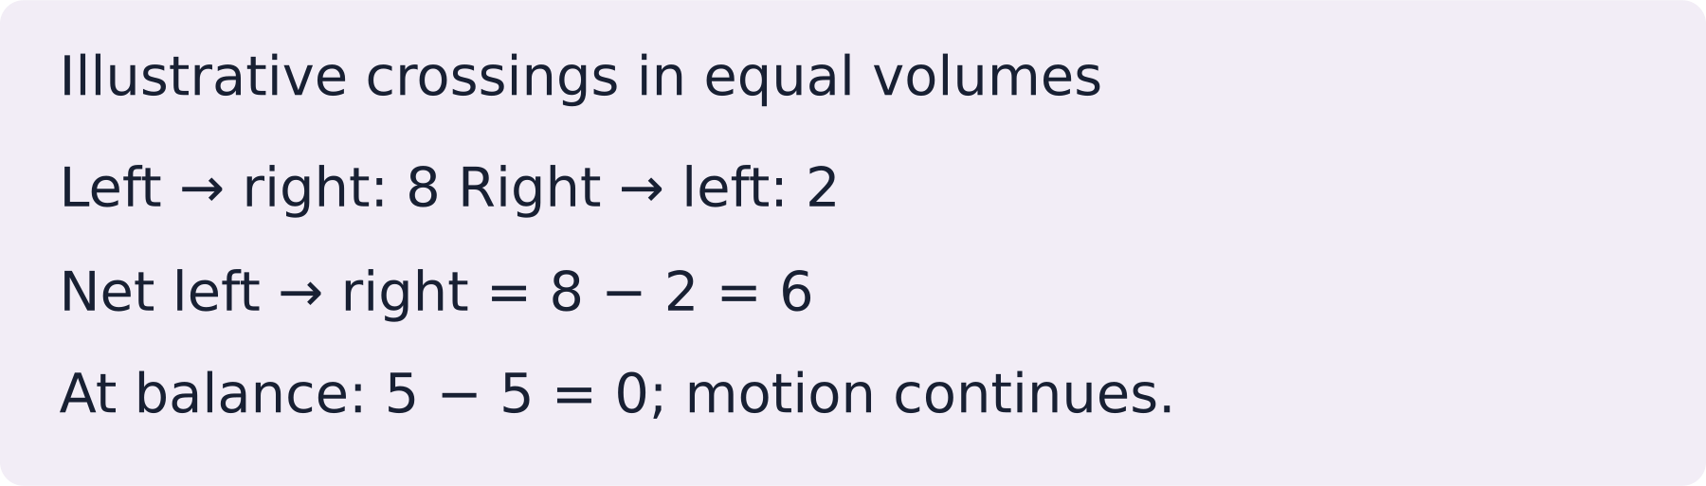
LAUNCH SCIENCE / W4L3
I Do 2 · 4 min
Connect the science
1
Evidence: smaller cube reached the centre sooner.
2
Science: shorter diffusion distance and greater surface area to volume ratio.
3
Consequence: dye reaches a larger proportion of the cube in the same time.
Arrival
Starter
I Do
We Do
I Do 2
We Do 2
Independent
Exit
Resources
Notes:
Stage: I Do 2, 4 minutes. Monday / Wednesday / Friday P1, 09:30–10:10. Use reveals within this slot; appendix slides are not added time.
A checklist can prompt missing reasoning, but it cannot judge every scientifically valid wording choice.
Core explanation: Describe tells us the pattern. Explain links that pattern to a mechanism. Evaluation asks whether the evidence supports the conclusion.
Watch for: Dye spreading in warm water can include convection. Do not present an uncontrolled demonstration as proof of diffusion rate alone.
Least help first: Ask which evidence changes the gradient, distance or area; do not dictate a model answer.
Support cue: Describe: what changes in the numbers? Explain: why does it change? Start: “When the area doubles, ___ because…”
[Sources]
User-supplied LAUNCH W3–W7 pack: W4 worksheet rate-factor explanation task.
Made by Matt LAUNCH Science draft, lesson-content.json, W4L3; existing illustrative diagrams reused, active-transport direction corrected to lower → higher.
Pearson Edexcel GCSE Biology specification, sections 1.1–1.6 and 1.15–1.17: https://qualifications.pearson.com/content/dam/pdf/GCSE/Science/2016/Specification/gcse-biology-spec.pdf
Optional concept video: freesciencelessons, Diffusion, https://www.youtube.com/watch?v=O965gA4goVI (link located 5 September 2026).
[/Sources]
[Sources]
Source editable lesson: Original LAUNCH Science OneDrive pack, 5 September 2026, W4L3. Source teaching content preserved. Current HTML reference: https://madebymatt.uk/Lessons/Science_Teesside/Launch/. Native diagrams restate the source explanation and are not experimental measurements.
[/Sources]

Slide 6
LAUNCH SCIENCE / W4L3
We Do 2 · Task · 6 min
Hold an evidence conference
Concentration difference, membrane and temperature are unchanged.
Model patch | Area / cm² | Transfer / units per minute
A | 10 | 4
B | 20 | 8
Choose a pattern, explain it, then name one limit of this model.
Reveal shared reasoning
Arrival
Starter
I Do
We Do
I Do 2
We Do 2
Independent
Exit
Resources
Notes:
Stage: We Do 2 · Task, 6 minutes. Monday / Wednesday / Friday P1, 09:30–10:10. Use reveals within this slot; appendix slides are not added time.
Area doubles, and transfer doubles in these model data. More surface allows more particles to cross at once. This does not establish real medicine doses or biological effects.
Run the printed activity or this board; one route is enough.
Core explanation: Describe tells us the pattern. Explain links that pattern to a mechanism. Evaluation asks whether the evidence supports the conclusion.
Watch for: Dye spreading in warm water can include convection. Do not present an uncontrolled demonstration as proof of diffusion rate alone.
Least help first: Ask which evidence changes the gradient, distance or area; do not dictate a model answer.
Support cue: Describe: what changes in the numbers? Explain: why does it change? Start: “When the area doubles, ___ because…”
[Sources]
User-supplied LAUNCH W3–W7 pack: W4 worksheet rate-factor explanation task.
Made by Matt LAUNCH Science draft, lesson-content.json, W4L3; existing illustrative diagrams reused, active-transport direction corrected to lower → higher.
Pearson Edexcel GCSE Biology specification, sections 1.1–1.6 and 1.15–1.17: https://qualifications.pearson.com/content/dam/pdf/GCSE/Science/2016/Specification/gcse-biology-spec.pdf
Optional concept video: freesciencelessons, Diffusion, https://www.youtube.com/watch?v=O965gA4goVI (link located 5 September 2026).
[/Sources]
[Sources]
Source editable lesson: Original LAUNCH Science OneDrive pack, 5 September 2026, W4L3. Source teaching content preserved. Current HTML reference: https://madebymatt.uk/Lessons/Science_Teesside/Launch/. Native diagrams restate the source explanation and are not experimental measurements.
[/Sources]

Slide 7
LAUNCH SCIENCE / W4L3
Independent Task · 10 min
Your independent evidence
A medicine patch releases particles through the skin. A redesigned patch has the same concentration but a larger contact area. Explain why more medicine may diffuse across the skin each minute. State one piece of extra evidence that would strengthen the conclusion.
Optional support
Describe: what changes in the numbers? Explain: why does it change? Start: “When the area doubles, ___ because…”
Make one precise correction to the same work after feedback.
Open worksheet pages
Model after first attempt
Arrival
Starter
I Do
We Do
I Do 2
We Do 2
Independent
Exit
Resources
Notes:
Stage: Independent Task, 10 minutes. Monday / Wednesday / Friday P1, 09:30–10:10. Use reveals within this slot; appendix slides are not added time.
Model answer: A larger contact area provides more surface through which particles can diffuse at the same time. If a concentration gradient is maintained, this can increase the total net movement of medicine across the skin each minute. Repeated measurements of mass released per minute for both patch designs would strengthen the conclusion.
Select only questions that fit the ten-minute slot. W7L3: Q2, Q3 and Q5 total 11 marks. The full paper needs a separate 25-minute slot.
Core explanation: Describe tells us the pattern. Explain links that pattern to a mechanism. Evaluation asks whether the evidence supports the conclusion.
Watch for: Dye spreading in warm water can include convection. Do not present an uncontrolled demonstration as proof of diffusion rate alone.
Least help first: Ask which evidence changes the gradient, distance or area; do not dictate a model answer.
Support cue: Describe: what changes in the numbers? Explain: why does it change? Start: “When the area doubles, ___ because…”
[Sources]
User-supplied LAUNCH W3–W7 pack: W4 worksheet rate-factor explanation task.
Made by Matt LAUNCH Science draft, lesson-content.json, W4L3; existing illustrative diagrams reused, active-transport direction corrected to lower → higher.
Pearson Edexcel GCSE Biology specification, sections 1.1–1.6 and 1.15–1.17: https://qualifications.pearson.com/content/dam/pdf/GCSE/Science/2016/Specification/gcse-biology-spec.pdf
Optional concept video: freesciencelessons, Diffusion, https://www.youtube.com/watch?v=O965gA4goVI (link located 5 September 2026).
[/Sources]
[Sources]
Source editable lesson: Original LAUNCH Science OneDrive pack, 5 September 2026, W4L3. Source teaching content preserved. Current HTML reference: https://madebymatt.uk/Lessons/Science_Teesside/Launch/. Native diagrams restate the source explanation and are not experimental measurements.
[/Sources]

Slide 8
LAUNCH SCIENCE / W4L3
Exit · 3 min
What changed in your thinking?
What is the difference between describing a diffusion pattern and explaining it?
1
Point to one improvement in your work.
2
Choose what you want to revisit.
3
Tell your teacher; agree the next step together.
Arrival
Starter
I Do
We Do
I Do 2
We Do 2
Independent
Exit
Resources
Notes:
Stage: Exit, 3 minutes. Monday / Wednesday / Friday P1, 09:30–10:10. Use reveals within this slot; appendix slides are not added time.
Exit answer: Description states what changed; explanation states why using the science.
Receive the request, record the agreed next action and check it next lesson. Keep responses private when requested.
Core explanation: Describe tells us the pattern. Explain links that pattern to a mechanism. Evaluation asks whether the evidence supports the conclusion.
Watch for: Dye spreading in warm water can include convection. Do not present an uncontrolled demonstration as proof of diffusion rate alone.
Least help first: Ask which evidence changes the gradient, distance or area; do not dictate a model answer.
Support cue: Describe: what changes in the numbers? Explain: why does it change? Start: “When the area doubles, ___ because…”
[Sources]
User-supplied LAUNCH W3–W7 pack: W4 worksheet rate-factor explanation task.
Made by Matt LAUNCH Science draft, lesson-content.json, W4L3; existing illustrative diagrams reused, active-transport direction corrected to lower → higher.
Pearson Edexcel GCSE Biology specification, sections 1.1–1.6 and 1.15–1.17: https://qualifications.pearson.com/content/dam/pdf/GCSE/Science/2016/Specification/gcse-biology-spec.pdf
Optional concept video: freesciencelessons, Diffusion, https://www.youtube.com/watch?v=O965gA4goVI (link located 5 September 2026).
[/Sources]
[Sources]
Source editable lesson: Original LAUNCH Science OneDrive pack, 5 September 2026, W4L3. Source teaching content preserved. Current HTML reference: https://madebymatt.uk/Lessons/Science_Teesside/Launch/. Native diagrams restate the source explanation and are not experimental measurements.
[/Sources]

Slide 9
LAUNCH SCIENCE / W4L3
Resources
Retrieval and prediction check
1
Net particle movement from higher to lower concentration, down a gradient.
2
A shorter distance increases exchange rate, other conditions unchanged.
Surface area and distance
Return to Starter
Arrival
Starter
I Do
We Do
I Do 2
We Do 2
Independent
Exit
Resources
Notes:
Read only after an attempt; retain the pupil’s first view.
Core explanation: Describe tells us the pattern. Explain links that pattern to a mechanism. Evaluation asks whether the evidence supports the conclusion.
Watch for: Dye spreading in warm water can include convection. Do not present an uncontrolled demonstration as proof of diffusion rate alone.
Least help first: Ask which evidence changes the gradient, distance or area; do not dictate a model answer.
Support cue: Describe: what changes in the numbers? Explain: why does it change? Start: “When the area doubles, ___ because…”
[Sources]
User-supplied LAUNCH W3–W7 pack: W4 worksheet rate-factor explanation task.
Made by Matt LAUNCH Science draft, lesson-content.json, W4L3; existing illustrative diagrams reused, active-transport direction corrected to lower → higher.
Pearson Edexcel GCSE Biology specification, sections 1.1–1.6 and 1.15–1.17: https://qualifications.pearson.com/content/dam/pdf/GCSE/Science/2016/Specification/gcse-biology-spec.pdf
Optional concept video: freesciencelessons, Diffusion, https://www.youtube.com/watch?v=O965gA4goVI (link located 5 September 2026).
[/Sources]
[Sources]
Source editable lesson: Original LAUNCH Science OneDrive pack, 5 September 2026, W4L3. Source teaching content preserved. Current HTML reference: https://madebymatt.uk/Lessons/Science_Teesside/Launch/. Native diagrams restate the source explanation and are not experimental measurements.
[/Sources]

Slide 10
LAUNCH SCIENCE / W4L3
Resources
Check the deciding clue
The small cube had a shorter average diffusion distance, so dye reached its centre sooner.
Correct: evidence, scientific cause and consequence are linked.
Compare your reason. Correct one step if needed.
Return to We Do
Arrival
Starter
I Do
We Do
I Do 2
We Do 2
Independent
Exit
Resources
Notes:
This reports the pattern but does not give a cause.
Correct: evidence, scientific cause and consequence are linked.
This repeats the setup only.
‘Better’ is not a defined scientific outcome.
Core explanation: Describe tells us the pattern. Explain links that pattern to a mechanism. Evaluation asks whether the evidence supports the conclusion.
Watch for: Dye spreading in warm water can include convection. Do not present an uncontrolled demonstration as proof of diffusion rate alone.
Least help first: Ask which evidence changes the gradient, distance or area; do not dictate a model answer.
Support cue: Describe: what changes in the numbers? Explain: why does it change? Start: “When the area doubles, ___ because…”
[Sources]
User-supplied LAUNCH W3–W7 pack: W4 worksheet rate-factor explanation task.
Made by Matt LAUNCH Science draft, lesson-content.json, W4L3; existing illustrative diagrams reused, active-transport direction corrected to lower → higher.
Pearson Edexcel GCSE Biology specification, sections 1.1–1.6 and 1.15–1.17: https://qualifications.pearson.com/content/dam/pdf/GCSE/Science/2016/Specification/gcse-biology-spec.pdf
Optional concept video: freesciencelessons, Diffusion, https://www.youtube.com/watch?v=O965gA4goVI (link located 5 September 2026).
[/Sources]
[Sources]
Source editable lesson: Original LAUNCH Science OneDrive pack, 5 September 2026, W4L3. Source teaching content preserved. Current HTML reference: https://madebymatt.uk/Lessons/Science_Teesside/Launch/. Native diagrams restate the source explanation and are not experimental measurements.
[/Sources]

Slide 11
LAUNCH SCIENCE / W4L3
Resources
Our shared reasoning
Area doubles, and transfer doubles in these model data. More surface allows more particles to cross at once. This does not establish real medicine doses or biological effects.
Return to shared task
Arrival
Starter
I Do
We Do
I Do 2
We Do 2
Independent
Exit
Resources
Notes:
Pupils should justify, compare and revise rather than copy a complete answer before trying.
Core explanation: Describe tells us the pattern. Explain links that pattern to a mechanism. Evaluation asks whether the evidence supports the conclusion.
Watch for: Dye spreading in warm water can include convection. Do not present an uncontrolled demonstration as proof of diffusion rate alone.
Least help first: Ask which evidence changes the gradient, distance or area; do not dictate a model answer.
Support cue: Describe: what changes in the numbers? Explain: why does it change? Start: “When the area doubles, ___ because…”
[Sources]
User-supplied LAUNCH W3–W7 pack: W4 worksheet rate-factor explanation task.
Made by Matt LAUNCH Science draft, lesson-content.json, W4L3; existing illustrative diagrams reused, active-transport direction corrected to lower → higher.
Pearson Edexcel GCSE Biology specification, sections 1.1–1.6 and 1.15–1.17: https://qualifications.pearson.com/content/dam/pdf/GCSE/Science/2016/Specification/gcse-biology-spec.pdf
Optional concept video: freesciencelessons, Diffusion, https://www.youtube.com/watch?v=O965gA4goVI (link located 5 September 2026).
[/Sources]
[Sources]
Source editable lesson: Original LAUNCH Science OneDrive pack, 5 September 2026, W4L3. Source teaching content preserved. Current HTML reference: https://madebymatt.uk/Lessons/Science_Teesside/Launch/. Native diagrams restate the source explanation and are not experimental measurements.
[/Sources]

Slide 12
LAUNCH SCIENCE / W4L3
Resources
Compare after your first attempt
A larger contact area provides more surface through which particles can diffuse at the same time. If a concentration gradient is maintained, this can increase the total net movement of medicine across the skin each minute. Repeated measurements of mass released per minute for both patch designs would strengthen the conclusion.
Use the model to improve your explanation in your own words.
Return to independent task
Arrival
Starter
I Do
We Do
I Do 2
We Do 2
Independent
Exit
Resources
Notes:
Staff guide includes question-by-question answers. Do not distribute this presentation as a secure assessment paper.
Core explanation: Describe tells us the pattern. Explain links that pattern to a mechanism. Evaluation asks whether the evidence supports the conclusion.
Watch for: Dye spreading in warm water can include convection. Do not present an uncontrolled demonstration as proof of diffusion rate alone.
Least help first: Ask which evidence changes the gradient, distance or area; do not dictate a model answer.
Support cue: Describe: what changes in the numbers? Explain: why does it change? Start: “When the area doubles, ___ because…”
[Sources]
User-supplied LAUNCH W3–W7 pack: W4 worksheet rate-factor explanation task.
Made by Matt LAUNCH Science draft, lesson-content.json, W4L3; existing illustrative diagrams reused, active-transport direction corrected to lower → higher.
Pearson Edexcel GCSE Biology specification, sections 1.1–1.6 and 1.15–1.17: https://qualifications.pearson.com/content/dam/pdf/GCSE/Science/2016/Specification/gcse-biology-spec.pdf
Optional concept video: freesciencelessons, Diffusion, https://www.youtube.com/watch?v=O965gA4goVI (link located 5 September 2026).
[/Sources]
[Sources]
Source editable lesson: Original LAUNCH Science OneDrive pack, 5 September 2026, W4L3. Source teaching content preserved. Current HTML reference: https://madebymatt.uk/Lessons/Science_Teesside/Launch/. Native diagrams restate the source explanation and are not experimental measurements.
[/Sources]

Slide 13
LAUNCH SCIENCE / W4L3
Resources
Your lesson resources
Worksheet pages are stored inside this PowerPoint.
Worksheet · page 1
Worksheet · page 2
Standard PDF
Supported PDF
Depth PDF
Editable Word worksheet
Open online lesson / model
Named files are in this week’s folder. Online lesson and video need internet.
Optional concept video
Arrival
Starter
I Do
We Do
I Do 2
We Do 2
Independent
Exit
Resources
Notes:
File buttons use relative links for downloaded/synced folders. OneDrive preview may not resolve relative links. Use the embedded pages or open the named file in the week folder.
Core explanation: Describe tells us the pattern. Explain links that pattern to a mechanism. Evaluation asks whether the evidence supports the conclusion.
Watch for: Dye spreading in warm water can include convection. Do not present an uncontrolled demonstration as proof of diffusion rate alone.
Least help first: Ask which evidence changes the gradient, distance or area; do not dictate a model answer.
Support cue: Describe: what changes in the numbers? Explain: why does it change? Start: “When the area doubles, ___ because…”
[Sources]
User-supplied LAUNCH W3–W7 pack: W4 worksheet rate-factor explanation task.
Made by Matt LAUNCH Science draft, lesson-content.json, W4L3; existing illustrative diagrams reused, active-transport direction corrected to lower → higher.
Pearson Edexcel GCSE Biology specification, sections 1.1–1.6 and 1.15–1.17: https://qualifications.pearson.com/content/dam/pdf/GCSE/Science/2016/Specification/gcse-biology-spec.pdf
Optional concept video: freesciencelessons, Diffusion, https://www.youtube.com/watch?v=O965gA4goVI (link located 5 September 2026).
[/Sources]
[Sources]
Source editable lesson: Original LAUNCH Science OneDrive pack, 5 September 2026, W4L3. Source teaching content preserved. Current HTML reference: https://madebymatt.uk/Lessons/Science_Teesside/Launch/. Native diagrams restate the source explanation and are not experimental measurements.
[/Sources]

Slide 14
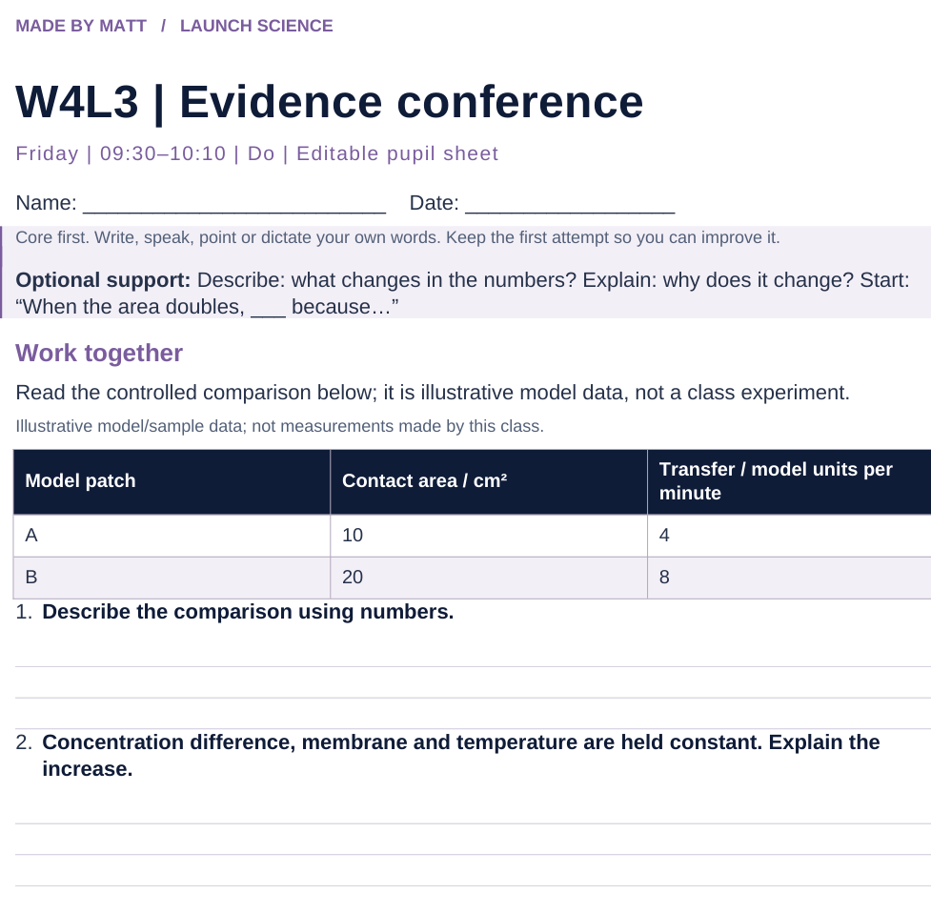
LAUNCH SCIENCE / W4L3
Resources
Worksheet · page 1
Use your printed copy.
Keep the first attempt.
Return to task
Arrival
Starter
I Do
We Do
I Do 2
We Do 2
Independent
Exit
Resources
Notes:
Embedded worksheet reference; print the separate PDF at A4 for writable space.
Core explanation: Describe tells us the pattern. Explain links that pattern to a mechanism. Evaluation asks whether the evidence supports the conclusion.
Watch for: Dye spreading in warm water can include convection. Do not present an uncontrolled demonstration as proof of diffusion rate alone.
Least help first: Ask which evidence changes the gradient, distance or area; do not dictate a model answer.
Support cue: Describe: what changes in the numbers? Explain: why does it change? Start: “When the area doubles, ___ because…”
[Sources]
User-supplied LAUNCH W3–W7 pack: W4 worksheet rate-factor explanation task.
Made by Matt LAUNCH Science draft, lesson-content.json, W4L3; existing illustrative diagrams reused, active-transport direction corrected to lower → higher.
Pearson Edexcel GCSE Biology specification, sections 1.1–1.6 and 1.15–1.17: https://qualifications.pearson.com/content/dam/pdf/GCSE/Science/2016/Specification/gcse-biology-spec.pdf
Optional concept video: freesciencelessons, Diffusion, https://www.youtube.com/watch?v=O965gA4goVI (link located 5 September 2026).
[/Sources]
[Sources]
Source editable lesson: Original LAUNCH Science OneDrive pack, 5 September 2026, W4L3. Source teaching content preserved. Current HTML reference: https://madebymatt.uk/Lessons/Science_Teesside/Launch/. Native diagrams restate the source explanation and are not experimental measurements.
[/Sources]

Slide 15
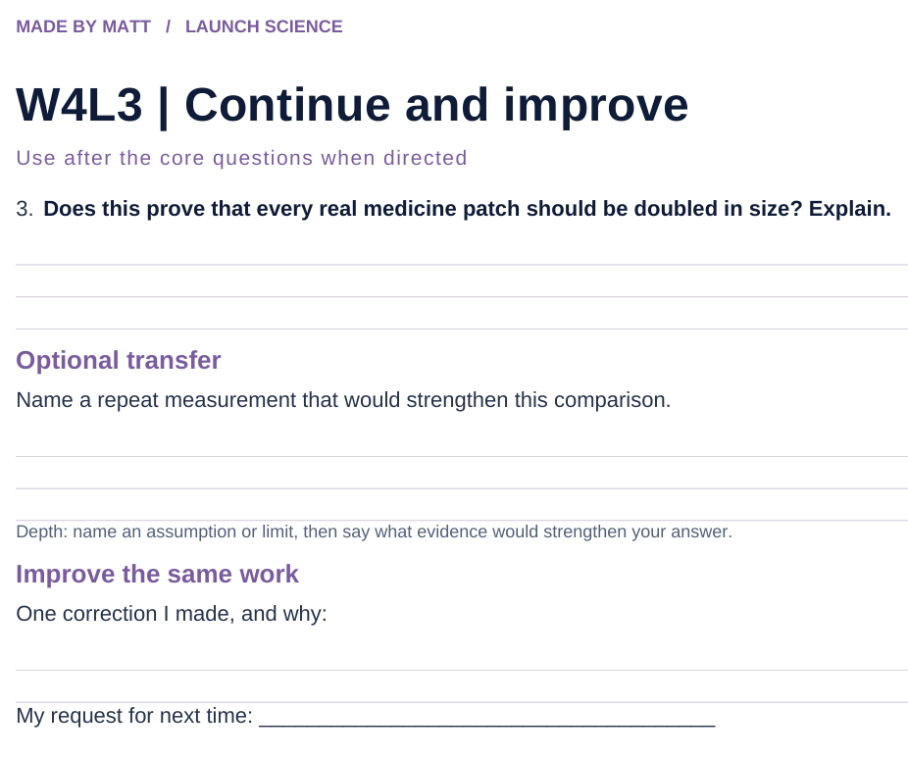
LAUNCH SCIENCE / W4L3
Resources
Worksheet · page 2
Continuation is optional.
Improve the same work.
Return to task
Arrival
Starter
I Do
We Do
I Do 2
We Do 2
Independent
Exit
Resources
Notes:
Embedded worksheet reference; print the separate PDF at A4 for writable space.
Core explanation: Describe tells us the pattern. Explain links that pattern to a mechanism. Evaluation asks whether the evidence supports the conclusion.
Watch for: Dye spreading in warm water can include convection. Do not present an uncontrolled demonstration as proof of diffusion rate alone.
Least help first: Ask which evidence changes the gradient, distance or area; do not dictate a model answer.
Support cue: Describe: what changes in the numbers? Explain: why does it change? Start: “When the area doubles, ___ because…”
[Sources]
User-supplied LAUNCH W3–W7 pack: W4 worksheet rate-factor explanation task.
Made by Matt LAUNCH Science draft, lesson-content.json, W4L3; existing illustrative diagrams reused, active-transport direction corrected to lower → higher.
Pearson Edexcel GCSE Biology specification, sections 1.1–1.6 and 1.15–1.17: https://qualifications.pearson.com/content/dam/pdf/GCSE/Science/2016/Specification/gcse-biology-spec.pdf
Optional concept video: freesciencelessons, Diffusion, https://www.youtube.com/watch?v=O965gA4goVI (link located 5 September 2026).
[/Sources]
[Sources]
Source editable lesson: Original LAUNCH Science OneDrive pack, 5 September 2026, W4L3. Source teaching content preserved. Current HTML reference: https://madebymatt.uk/Lessons/Science_Teesside/Launch/. Native diagrams restate the source explanation and are not experimental measurements.
[/Sources]

Slide 16
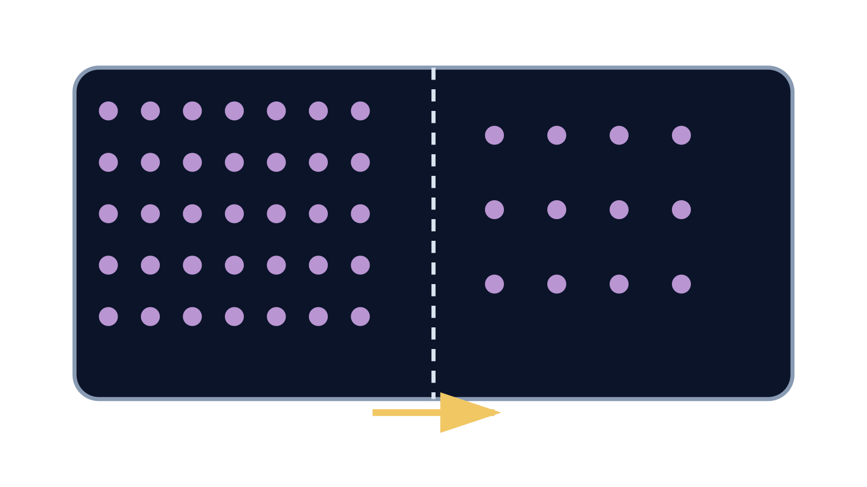
LAUNCH SCIENCE / W4L3
Resources
Watch, pause and explain
Diffusion
What keeps happening when there is no net movement?
Play freesciencelessons video
No connection? Use the still model and explain the same question.
Arrival
Starter
I Do
We Do
I Do 2
We Do 2
Independent
Exit
Resources
Notes:
Use at most 90 seconds within I Do. Pause on the first relevant example; ask for a reason. This is an optional concept clip, not evidence of practical completion.
Core explanation: Describe tells us the pattern. Explain links that pattern to a mechanism. Evaluation asks whether the evidence supports the conclusion.
Watch for: Dye spreading in warm water can include convection. Do not present an uncontrolled demonstration as proof of diffusion rate alone.
Least help first: Ask which evidence changes the gradient, distance or area; do not dictate a model answer.
Support cue: Describe: what changes in the numbers? Explain: why does it change? Start: “When the area doubles, ___ because…”
[Sources]
User-supplied LAUNCH W3–W7 pack: W4 worksheet rate-factor explanation task.
Made by Matt LAUNCH Science draft, lesson-content.json, W4L3; existing illustrative diagrams reused, active-transport direction corrected to lower → higher.
Pearson Edexcel GCSE Biology specification, sections 1.1–1.6 and 1.15–1.17: https://qualifications.pearson.com/content/dam/pdf/GCSE/Science/2016/Specification/gcse-biology-spec.pdf
Optional concept video: freesciencelessons, Diffusion, https://www.youtube.com/watch?v=O965gA4goVI (link located 5 September 2026).
[/Sources]
[Sources]
Source editable lesson: Original LAUNCH Science OneDrive pack, 5 September 2026, W4L3. Source teaching content preserved. Current HTML reference: https://madebymatt.uk/Lessons/Science_Teesside/Launch/. Native diagrams restate the source explanation and are not experimental measurements.
[/Sources]

Slide 17
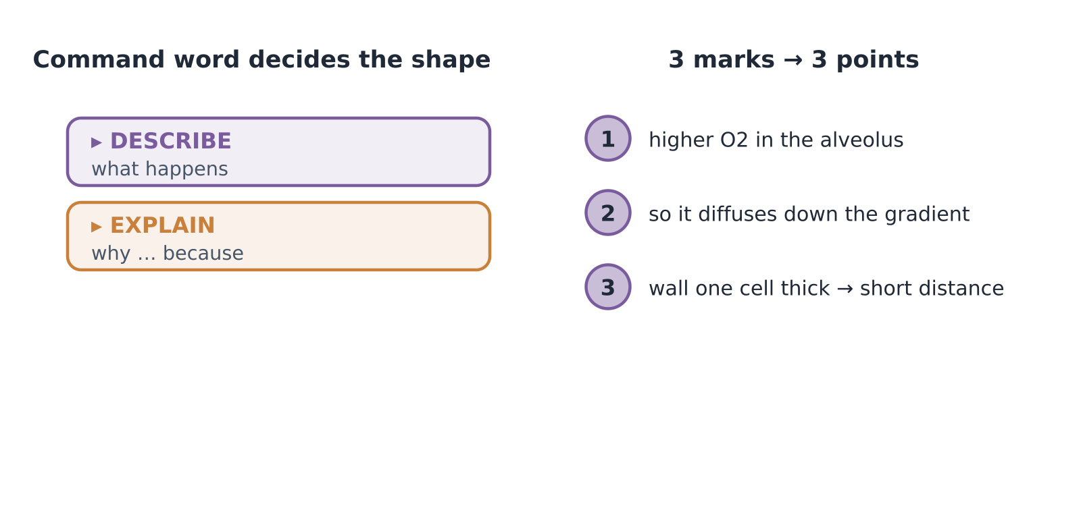
LAUNCH SCIENCE / W4L3
Resources
Look closely at the model
A model illustration: use the stated data for calculations.
Return to I Do
Arrival
Starter
I Do
We Do
I Do 2
We Do 2
Independent
Exit
Resources
Notes:
Source image: https://madebymatt.uk/Lessons/Science_Teesside/Launch/SCI_L_W4_L3_ExamSkills.html; existing vector illustration embedded for offline use.
Core explanation: Describe tells us the pattern. Explain links that pattern to a mechanism. Evaluation asks whether the evidence supports the conclusion.
Watch for: Dye spreading in warm water can include convection. Do not present an uncontrolled demonstration as proof of diffusion rate alone.
Least help first: Ask which evidence changes the gradient, distance or area; do not dictate a model answer.
Support cue: Describe: what changes in the numbers? Explain: why does it change? Start: “When the area doubles, ___ because…”
[Sources]
User-supplied LAUNCH W3–W7 pack: W4 worksheet rate-factor explanation task.
Made by Matt LAUNCH Science draft, lesson-content.json, W4L3; existing illustrative diagrams reused, active-transport direction corrected to lower → higher.
Pearson Edexcel GCSE Biology specification, sections 1.1–1.6 and 1.15–1.17: https://qualifications.pearson.com/content/dam/pdf/GCSE/Science/2016/Specification/gcse-biology-spec.pdf
Optional concept video: freesciencelessons, Diffusion, https://www.youtube.com/watch?v=O965gA4goVI (link located 5 September 2026).
[/Sources]
[Sources]
Source editable lesson: Original LAUNCH Science OneDrive pack, 5 September 2026, W4L3. Source teaching content preserved. Current HTML reference: https://madebymatt.uk/Lessons/Science_Teesside/Launch/. Native diagrams restate the source explanation and are not experimental measurements.
[/Sources]

