Slide 1
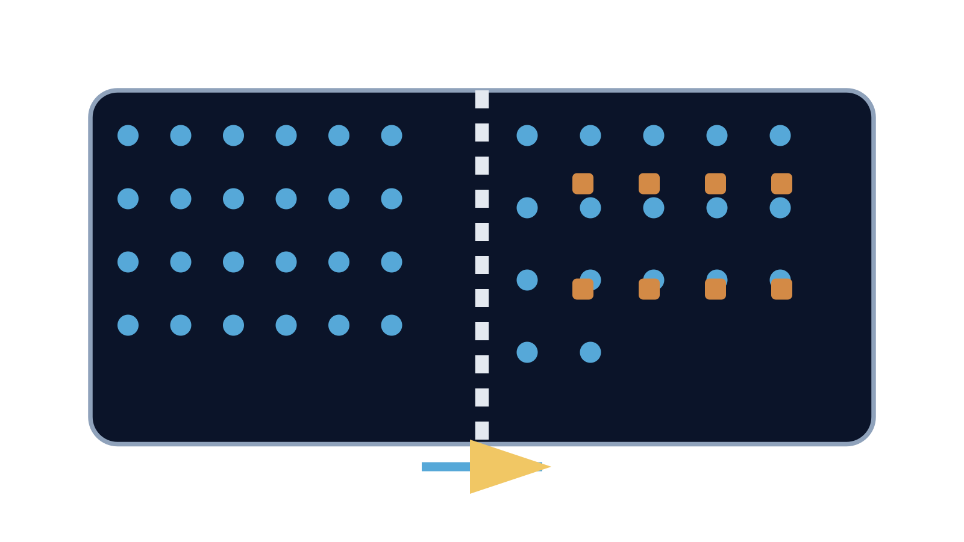
LAUNCH SCIENCE / W5L1
Arrival · 3 min
Osmosis
I can define osmosis and predict net water movement through a partially permeable membrane.
Notice. Recall. Be ready to explain.
1
What does net movement mean?
2
What can a membrane control?
Retrieval answers
Arrival
Starter
I Do
We Do
I Do 2
We Do 2
Independent
Exit
Resources
Notes:
Stage: Arrival, 3 minutes. Monday / Wednesday / Friday P1, 09:30–10:10. Use reveals within this slot; appendix slides are not added time.
Retrieval answers: The overall difference between movements in opposite directions. | Which substances can pass into or out of a cell. | No; random movement continues both ways.
Core explanation: Osmosis is net water movement through a partially permeable membrane from a more dilute to a more concentrated solution.
Watch for: The potato is tissue, not a single membrane. Its cells have membranes. “Concentrated” must be relative to the solution on the other side.
Least help first: Ask what can cross the membrane and compare the solutions before giving any direction cue.
Support cue: Name the substance that moves. Check which solution is more dilute. Add the membrane and net direction. Start: “Water moves…”
[Sources]
User-supplied LAUNCH W3–W7 pack: W5 Osmosis slides 5–7 and worksheet Task 1.
Made by Matt LAUNCH Science draft, lesson-content.json, W5L1; existing illustrative diagrams reused, active-transport direction corrected to lower → higher.
Pearson Edexcel GCSE Biology specification, sections 1.1–1.6 and 1.15–1.17: https://qualifications.pearson.com/content/dam/pdf/GCSE/Science/2016/Specification/gcse-biology-spec.pdf
Optional concept video: freesciencelessons, Osmosis, https://www.youtube.com/watch?v=B0cH91joZwA (link located 5 September 2026).
[/Sources]
[Sources]
Source editable lesson: Original LAUNCH Science OneDrive pack, 5 September 2026, W5L1. Source teaching content preserved. Current HTML reference: https://madebymatt.uk/Lessons/Science_Teesside/Launch/. Native diagrams restate the source explanation and are not experimental measurements.
[/Sources]

Slide 2
LAUNCH SCIENCE / W5L1
Starter · 4 min
Make a prediction
A membrane lets water through but blocks large solute particles. Which substance can show osmosis in this model?
A Only the solute
B Water
C Both must cross together
Commit, then check
Arrival
Starter
I Do
We Do
I Do 2
We Do 2
Independent
Exit
Resources
Notes:
Stage: Starter, 4 minutes. Monday / Wednesday / Friday P1, 09:30–10:10. Use reveals within this slot; appendix slides are not added time.
Correct: Water. Ask for the reason, then return to the original prediction.
Core explanation: Osmosis is net water movement through a partially permeable membrane from a more dilute to a more concentrated solution.
Watch for: The potato is tissue, not a single membrane. Its cells have membranes. “Concentrated” must be relative to the solution on the other side.
Least help first: Ask what can cross the membrane and compare the solutions before giving any direction cue.
Support cue: Name the substance that moves. Check which solution is more dilute. Add the membrane and net direction. Start: “Water moves…”
[Sources]
User-supplied LAUNCH W3–W7 pack: W5 Osmosis slides 5–7 and worksheet Task 1.
Made by Matt LAUNCH Science draft, lesson-content.json, W5L1; existing illustrative diagrams reused, active-transport direction corrected to lower → higher.
Pearson Edexcel GCSE Biology specification, sections 1.1–1.6 and 1.15–1.17: https://qualifications.pearson.com/content/dam/pdf/GCSE/Science/2016/Specification/gcse-biology-spec.pdf
Optional concept video: freesciencelessons, Osmosis, https://www.youtube.com/watch?v=B0cH91joZwA (link located 5 September 2026).
[/Sources]
[Sources]
Source editable lesson: Original LAUNCH Science OneDrive pack, 5 September 2026, W5L1. Source teaching content preserved. Current HTML reference: https://madebymatt.uk/Lessons/Science_Teesside/Launch/. Native diagrams restate the source explanation and are not experimental measurements.
[/Sources]

Slide 3
LAUNCH SCIENCE / W5L1
I Do · 5 min
Watch the model
1
Water particles move randomly on both sides of the membrane.
Water crosses the membrane
2
The partially permeable membrane allows water through but blocks the represented solute.
3
Net water movement is from the more dilute solution to the more concentrated solution in this model.
● Water
● Solute
View labelled diagram
Optional video
Arrival
Starter
I Do
We Do
I Do 2
We Do 2
Independent
Exit
Resources
Notes:
Stage: I Do, 5 minutes. Monday / Wednesday / Friday P1, 09:30–10:10. Use reveals within this slot; appendix slides are not added time.
The model keeps water and solute visually distinct and counts water crossings in both directions.
Model limit: Dots do not show the full molecular interactions or water potential used in more advanced Biology.
Video replaces up to 90 seconds of explanation; use the still diagram if unavailable.
Core explanation: Osmosis is net water movement through a partially permeable membrane from a more dilute to a more concentrated solution.
Watch for: The potato is tissue, not a single membrane. Its cells have membranes. “Concentrated” must be relative to the solution on the other side.
Least help first: Ask what can cross the membrane and compare the solutions before giving any direction cue.
Support cue: Name the substance that moves. Check which solution is more dilute. Add the membrane and net direction. Start: “Water moves…”
[Sources]
User-supplied LAUNCH W3–W7 pack: W5 Osmosis slides 5–7 and worksheet Task 1.
Made by Matt LAUNCH Science draft, lesson-content.json, W5L1; existing illustrative diagrams reused, active-transport direction corrected to lower → higher.
Pearson Edexcel GCSE Biology specification, sections 1.1–1.6 and 1.15–1.17: https://qualifications.pearson.com/content/dam/pdf/GCSE/Science/2016/Specification/gcse-biology-spec.pdf
Optional concept video: freesciencelessons, Osmosis, https://www.youtube.com/watch?v=B0cH91joZwA (link located 5 September 2026).
[/Sources]
[Sources]
Source editable lesson: Original LAUNCH Science OneDrive pack, 5 September 2026, W5L1. Source teaching content preserved. Current HTML reference: https://madebymatt.uk/Lessons/Science_Teesside/Launch/. Native diagrams restate the source explanation and are not experimental measurements.
[/Sources]

Slide 4
LAUNCH SCIENCE / W5L1
We Do · 5 min
Choose and justify
Which definition is specific to osmosis?
A Movement of any particles from high to low concentration
B Net movement of water through a partially permeable membrane from a more dilute to a more concentrated solution
C Movement against a gradient using energy
D Water moving because it wants to dilute solute
Give the deciding clue before checking.
Check the reasoning
Arrival
Starter
I Do
We Do
I Do 2
We Do 2
Independent
Exit
Resources
Notes:
Stage: We Do, 5 minutes. Monday / Wednesday / Friday P1, 09:30–10:10. Use reveals within this slot; appendix slides are not added time.
A: Movement of any particles from high to low concentration — This describes diffusion generally and does not specify water or the membrane.
B: Net movement of water through a partially permeable membrane from a more dilute to a more concentrated solution — Accurate GCSE phrasing for this course.
C: Movement against a gradient using energy — This describes active transport.
D: Water moving because it wants to dilute solute — Avoid purposeful language; use random motion and net movement.
Core explanation: Osmosis is net water movement through a partially permeable membrane from a more dilute to a more concentrated solution.
Watch for: The potato is tissue, not a single membrane. Its cells have membranes. “Concentrated” must be relative to the solution on the other side.
Least help first: Ask what can cross the membrane and compare the solutions before giving any direction cue.
Support cue: Name the substance that moves. Check which solution is more dilute. Add the membrane and net direction. Start: “Water moves…”
[Sources]
User-supplied LAUNCH W3–W7 pack: W5 Osmosis slides 5–7 and worksheet Task 1.
Made by Matt LAUNCH Science draft, lesson-content.json, W5L1; existing illustrative diagrams reused, active-transport direction corrected to lower → higher.
Pearson Edexcel GCSE Biology specification, sections 1.1–1.6 and 1.15–1.17: https://qualifications.pearson.com/content/dam/pdf/GCSE/Science/2016/Specification/gcse-biology-spec.pdf
Optional concept video: freesciencelessons, Osmosis, https://www.youtube.com/watch?v=B0cH91joZwA (link located 5 September 2026).
[/Sources]
[Sources]
Source editable lesson: Original LAUNCH Science OneDrive pack, 5 September 2026, W5L1. Source teaching content preserved. Current HTML reference: https://madebymatt.uk/Lessons/Science_Teesside/Launch/. Native diagrams restate the source explanation and are not experimental measurements.
[/Sources]

Slide 5
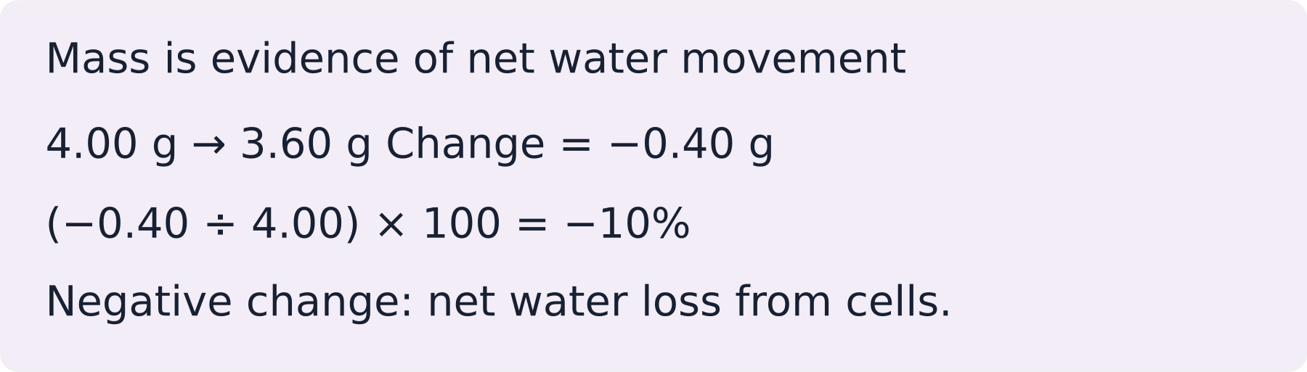
LAUNCH SCIENCE / W5L1
I Do 2 · 4 min
Connect the science
1
A more dilute solution has a higher concentration of water in the simplified GCSE model.
2
Water can move both ways, but the net movement follows the difference between sides.
3
Cells and tissues gain or lose water depending on the surrounding solution.
Arrival
Starter
I Do
We Do
I Do 2
We Do 2
Independent
Exit
Resources
Notes:
Stage: I Do 2, 4 minutes. Monday / Wednesday / Friday P1, 09:30–10:10. Use reveals within this slot; appendix slides are not added time.
Dots do not show the full molecular interactions or water potential used in more advanced Biology.
Core explanation: Osmosis is net water movement through a partially permeable membrane from a more dilute to a more concentrated solution.
Watch for: The potato is tissue, not a single membrane. Its cells have membranes. “Concentrated” must be relative to the solution on the other side.
Least help first: Ask what can cross the membrane and compare the solutions before giving any direction cue.
Support cue: Name the substance that moves. Check which solution is more dilute. Add the membrane and net direction. Start: “Water moves…”
[Sources]
User-supplied LAUNCH W3–W7 pack: W5 Osmosis slides 5–7 and worksheet Task 1.
Made by Matt LAUNCH Science draft, lesson-content.json, W5L1; existing illustrative diagrams reused, active-transport direction corrected to lower → higher.
Pearson Edexcel GCSE Biology specification, sections 1.1–1.6 and 1.15–1.17: https://qualifications.pearson.com/content/dam/pdf/GCSE/Science/2016/Specification/gcse-biology-spec.pdf
Optional concept video: freesciencelessons, Osmosis, https://www.youtube.com/watch?v=B0cH91joZwA (link located 5 September 2026).
[/Sources]
[Sources]
Source editable lesson: Original LAUNCH Science OneDrive pack, 5 September 2026, W5L1. Source teaching content preserved. Current HTML reference: https://madebymatt.uk/Lessons/Science_Teesside/Launch/. Native diagrams restate the source explanation and are not experimental measurements.
[/Sources]

Slide 6
LAUNCH SCIENCE / W5L1
We Do 2 · Task · 6 min
Make a membrane decision
Predict net water movement. State which solution you are comparing with the cell solution.
1
A Surroundings are more dilute.
2
B Surroundings have equal concentration.
3
C Surroundings are more concentrated.
Reveal shared reasoning
Arrival
Starter
I Do
We Do
I Do 2
We Do 2
Independent
Exit
Resources
Notes:
Stage: We Do 2 · Task, 6 minutes. Monday / Wednesday / Friday P1, 09:30–10:10. Use reveals within this slot; appendix slides are not added time.
A: net water movement into the cell.
B: no net movement; water still moves both ways.
C: net water movement out of the cell.
Osmosis needs a partially permeable membrane.
Run the printed activity or this board; one route is enough.
Core explanation: Osmosis is net water movement through a partially permeable membrane from a more dilute to a more concentrated solution.
Watch for: The potato is tissue, not a single membrane. Its cells have membranes. “Concentrated” must be relative to the solution on the other side.
Least help first: Ask what can cross the membrane and compare the solutions before giving any direction cue.
Support cue: Name the substance that moves. Check which solution is more dilute. Add the membrane and net direction. Start: “Water moves…”
[Sources]
User-supplied LAUNCH W3–W7 pack: W5 Osmosis slides 5–7 and worksheet Task 1.
Made by Matt LAUNCH Science draft, lesson-content.json, W5L1; existing illustrative diagrams reused, active-transport direction corrected to lower → higher.
Pearson Edexcel GCSE Biology specification, sections 1.1–1.6 and 1.15–1.17: https://qualifications.pearson.com/content/dam/pdf/GCSE/Science/2016/Specification/gcse-biology-spec.pdf
Optional concept video: freesciencelessons, Osmosis, https://www.youtube.com/watch?v=B0cH91joZwA (link located 5 September 2026).
[/Sources]
[Sources]
Source editable lesson: Original LAUNCH Science OneDrive pack, 5 September 2026, W5L1. Source teaching content preserved. Current HTML reference: https://madebymatt.uk/Lessons/Science_Teesside/Launch/. Native diagrams restate the source explanation and are not experimental measurements.
[/Sources]

Slide 7
LAUNCH SCIENCE / W5L1
Independent Task · 10 min
Your independent evidence
A plant cell is placed in sugar solution more concentrated than its cell solution. Explain the net movement of water and why the solute representation does not cross the membrane in this model. Then distinguish the process from active transport.
Optional support
Name the substance that moves. Check which solution is more dilute. Add the membrane and net direction. Start: “Water moves…”
Make one precise correction to the same work after feedback.
Open worksheet pages
Model after first attempt
Arrival
Starter
I Do
We Do
I Do 2
We Do 2
Independent
Exit
Resources
Notes:
Stage: Independent Task, 10 minutes. Monday / Wednesday / Friday P1, 09:30–10:10. Use reveals within this slot; appendix slides are not added time.
Model answer: Water moves out of the plant cell by osmosis because the surrounding sugar solution is more concentrated and the cell membrane is partially permeable. Water can cross the membrane in the model, but the larger solute particles are blocked. Unlike active transport, osmosis does not move solute against a concentration gradient using cellular energy.
Select only questions that fit the ten-minute slot. W7L3: Q2, Q3 and Q5 total 11 marks. The full paper needs a separate 25-minute slot.
Core explanation: Osmosis is net water movement through a partially permeable membrane from a more dilute to a more concentrated solution.
Watch for: The potato is tissue, not a single membrane. Its cells have membranes. “Concentrated” must be relative to the solution on the other side.
Least help first: Ask what can cross the membrane and compare the solutions before giving any direction cue.
Support cue: Name the substance that moves. Check which solution is more dilute. Add the membrane and net direction. Start: “Water moves…”
[Sources]
User-supplied LAUNCH W3–W7 pack: W5 Osmosis slides 5–7 and worksheet Task 1.
Made by Matt LAUNCH Science draft, lesson-content.json, W5L1; existing illustrative diagrams reused, active-transport direction corrected to lower → higher.
Pearson Edexcel GCSE Biology specification, sections 1.1–1.6 and 1.15–1.17: https://qualifications.pearson.com/content/dam/pdf/GCSE/Science/2016/Specification/gcse-biology-spec.pdf
Optional concept video: freesciencelessons, Osmosis, https://www.youtube.com/watch?v=B0cH91joZwA (link located 5 September 2026).
[/Sources]
[Sources]
Source editable lesson: Original LAUNCH Science OneDrive pack, 5 September 2026, W5L1. Source teaching content preserved. Current HTML reference: https://madebymatt.uk/Lessons/Science_Teesside/Launch/. Native diagrams restate the source explanation and are not experimental measurements.
[/Sources]

Slide 8
LAUNCH SCIENCE / W5L1
Exit · 3 min
What changed in your thinking?
Which substance and membrane condition distinguish osmosis?
1
Point to one improvement in your work.
2
Choose what you want to revisit.
3
Tell your teacher; agree the next step together.
Arrival
Starter
I Do
We Do
I Do 2
We Do 2
Independent
Exit
Resources
Notes:
Stage: Exit, 3 minutes. Monday / Wednesday / Friday P1, 09:30–10:10. Use reveals within this slot; appendix slides are not added time.
Exit answer: Water and a partially permeable membrane; also state the correct net direction.
Receive the request, record the agreed next action and check it next lesson. Keep responses private when requested.
Core explanation: Osmosis is net water movement through a partially permeable membrane from a more dilute to a more concentrated solution.
Watch for: The potato is tissue, not a single membrane. Its cells have membranes. “Concentrated” must be relative to the solution on the other side.
Least help first: Ask what can cross the membrane and compare the solutions before giving any direction cue.
Support cue: Name the substance that moves. Check which solution is more dilute. Add the membrane and net direction. Start: “Water moves…”
[Sources]
User-supplied LAUNCH W3–W7 pack: W5 Osmosis slides 5–7 and worksheet Task 1.
Made by Matt LAUNCH Science draft, lesson-content.json, W5L1; existing illustrative diagrams reused, active-transport direction corrected to lower → higher.
Pearson Edexcel GCSE Biology specification, sections 1.1–1.6 and 1.15–1.17: https://qualifications.pearson.com/content/dam/pdf/GCSE/Science/2016/Specification/gcse-biology-spec.pdf
Optional concept video: freesciencelessons, Osmosis, https://www.youtube.com/watch?v=B0cH91joZwA (link located 5 September 2026).
[/Sources]
[Sources]
Source editable lesson: Original LAUNCH Science OneDrive pack, 5 September 2026, W5L1. Source teaching content preserved. Current HTML reference: https://madebymatt.uk/Lessons/Science_Teesside/Launch/. Native diagrams restate the source explanation and are not experimental measurements.
[/Sources]

Slide 9
LAUNCH SCIENCE / W5L1
Resources
Retrieval and prediction check
1
The overall difference between movements in opposite directions.
2
Which substances can pass into or out of a cell.
Water
Return to Starter
Arrival
Starter
I Do
We Do
I Do 2
We Do 2
Independent
Exit
Resources
Notes:
Read only after an attempt; retain the pupil’s first view.
Core explanation: Osmosis is net water movement through a partially permeable membrane from a more dilute to a more concentrated solution.
Watch for: The potato is tissue, not a single membrane. Its cells have membranes. “Concentrated” must be relative to the solution on the other side.
Least help first: Ask what can cross the membrane and compare the solutions before giving any direction cue.
Support cue: Name the substance that moves. Check which solution is more dilute. Add the membrane and net direction. Start: “Water moves…”
[Sources]
User-supplied LAUNCH W3–W7 pack: W5 Osmosis slides 5–7 and worksheet Task 1.
Made by Matt LAUNCH Science draft, lesson-content.json, W5L1; existing illustrative diagrams reused, active-transport direction corrected to lower → higher.
Pearson Edexcel GCSE Biology specification, sections 1.1–1.6 and 1.15–1.17: https://qualifications.pearson.com/content/dam/pdf/GCSE/Science/2016/Specification/gcse-biology-spec.pdf
Optional concept video: freesciencelessons, Osmosis, https://www.youtube.com/watch?v=B0cH91joZwA (link located 5 September 2026).
[/Sources]
[Sources]
Source editable lesson: Original LAUNCH Science OneDrive pack, 5 September 2026, W5L1. Source teaching content preserved. Current HTML reference: https://madebymatt.uk/Lessons/Science_Teesside/Launch/. Native diagrams restate the source explanation and are not experimental measurements.
[/Sources]

Slide 10
LAUNCH SCIENCE / W5L1
Resources
Check the deciding clue
Net movement of water through a partially permeable membrane from a more dilute to a more concentrated solution
Accurate GCSE phrasing for this course.
Compare your reason. Correct one step if needed.
Return to We Do
Arrival
Starter
I Do
We Do
I Do 2
We Do 2
Independent
Exit
Resources
Notes:
This describes diffusion generally and does not specify water or the membrane.
Accurate GCSE phrasing for this course.
This describes active transport.
Avoid purposeful language; use random motion and net movement.
Core explanation: Osmosis is net water movement through a partially permeable membrane from a more dilute to a more concentrated solution.
Watch for: The potato is tissue, not a single membrane. Its cells have membranes. “Concentrated” must be relative to the solution on the other side.
Least help first: Ask what can cross the membrane and compare the solutions before giving any direction cue.
Support cue: Name the substance that moves. Check which solution is more dilute. Add the membrane and net direction. Start: “Water moves…”
[Sources]
User-supplied LAUNCH W3–W7 pack: W5 Osmosis slides 5–7 and worksheet Task 1.
Made by Matt LAUNCH Science draft, lesson-content.json, W5L1; existing illustrative diagrams reused, active-transport direction corrected to lower → higher.
Pearson Edexcel GCSE Biology specification, sections 1.1–1.6 and 1.15–1.17: https://qualifications.pearson.com/content/dam/pdf/GCSE/Science/2016/Specification/gcse-biology-spec.pdf
Optional concept video: freesciencelessons, Osmosis, https://www.youtube.com/watch?v=B0cH91joZwA (link located 5 September 2026).
[/Sources]
[Sources]
Source editable lesson: Original LAUNCH Science OneDrive pack, 5 September 2026, W5L1. Source teaching content preserved. Current HTML reference: https://madebymatt.uk/Lessons/Science_Teesside/Launch/. Native diagrams restate the source explanation and are not experimental measurements.
[/Sources]

Slide 11
LAUNCH SCIENCE / W5L1
Resources
Our shared reasoning
A: net water movement into the cell.
B: no net movement; water still moves both ways.
C: net water movement out of the cell.
Osmosis needs a partially permeable membrane.
Return to shared task
Arrival
Starter
I Do
We Do
I Do 2
We Do 2
Independent
Exit
Resources
Notes:
Pupils should justify, compare and revise rather than copy a complete answer before trying.
Core explanation: Osmosis is net water movement through a partially permeable membrane from a more dilute to a more concentrated solution.
Watch for: The potato is tissue, not a single membrane. Its cells have membranes. “Concentrated” must be relative to the solution on the other side.
Least help first: Ask what can cross the membrane and compare the solutions before giving any direction cue.
Support cue: Name the substance that moves. Check which solution is more dilute. Add the membrane and net direction. Start: “Water moves…”
[Sources]
User-supplied LAUNCH W3–W7 pack: W5 Osmosis slides 5–7 and worksheet Task 1.
Made by Matt LAUNCH Science draft, lesson-content.json, W5L1; existing illustrative diagrams reused, active-transport direction corrected to lower → higher.
Pearson Edexcel GCSE Biology specification, sections 1.1–1.6 and 1.15–1.17: https://qualifications.pearson.com/content/dam/pdf/GCSE/Science/2016/Specification/gcse-biology-spec.pdf
Optional concept video: freesciencelessons, Osmosis, https://www.youtube.com/watch?v=B0cH91joZwA (link located 5 September 2026).
[/Sources]
[Sources]
Source editable lesson: Original LAUNCH Science OneDrive pack, 5 September 2026, W5L1. Source teaching content preserved. Current HTML reference: https://madebymatt.uk/Lessons/Science_Teesside/Launch/. Native diagrams restate the source explanation and are not experimental measurements.
[/Sources]

Slide 12
LAUNCH SCIENCE / W5L1
Resources
Compare after your first attempt
Water moves out of the plant cell by osmosis because the surrounding sugar solution is more concentrated and the cell membrane is partially permeable. Water can cross the membrane in the model, but the larger solute particles are blocked. Unlike active transport, osmosis does not move solute against a concentration gradient using cellular energy.
Use the model to improve your explanation in your own words.
Return to independent task
Arrival
Starter
I Do
We Do
I Do 2
We Do 2
Independent
Exit
Resources
Notes:
Staff guide includes question-by-question answers. Do not distribute this presentation as a secure assessment paper.
Core explanation: Osmosis is net water movement through a partially permeable membrane from a more dilute to a more concentrated solution.
Watch for: The potato is tissue, not a single membrane. Its cells have membranes. “Concentrated” must be relative to the solution on the other side.
Least help first: Ask what can cross the membrane and compare the solutions before giving any direction cue.
Support cue: Name the substance that moves. Check which solution is more dilute. Add the membrane and net direction. Start: “Water moves…”
[Sources]
User-supplied LAUNCH W3–W7 pack: W5 Osmosis slides 5–7 and worksheet Task 1.
Made by Matt LAUNCH Science draft, lesson-content.json, W5L1; existing illustrative diagrams reused, active-transport direction corrected to lower → higher.
Pearson Edexcel GCSE Biology specification, sections 1.1–1.6 and 1.15–1.17: https://qualifications.pearson.com/content/dam/pdf/GCSE/Science/2016/Specification/gcse-biology-spec.pdf
Optional concept video: freesciencelessons, Osmosis, https://www.youtube.com/watch?v=B0cH91joZwA (link located 5 September 2026).
[/Sources]
[Sources]
Source editable lesson: Original LAUNCH Science OneDrive pack, 5 September 2026, W5L1. Source teaching content preserved. Current HTML reference: https://madebymatt.uk/Lessons/Science_Teesside/Launch/. Native diagrams restate the source explanation and are not experimental measurements.
[/Sources]

Slide 13
LAUNCH SCIENCE / W5L1
Resources
Your lesson resources
Worksheet pages are stored inside this PowerPoint.
Worksheet · page 1
Worksheet · page 2
Standard PDF
Supported PDF
Depth PDF
Editable Word worksheet
Open online lesson / model
Named files are in this week’s folder. Online lesson and video need internet.
Optional concept video
Arrival
Starter
I Do
We Do
I Do 2
We Do 2
Independent
Exit
Resources
Notes:
File buttons use relative links for downloaded/synced folders. OneDrive preview may not resolve relative links. Use the embedded pages or open the named file in the week folder.
Core explanation: Osmosis is net water movement through a partially permeable membrane from a more dilute to a more concentrated solution.
Watch for: The potato is tissue, not a single membrane. Its cells have membranes. “Concentrated” must be relative to the solution on the other side.
Least help first: Ask what can cross the membrane and compare the solutions before giving any direction cue.
Support cue: Name the substance that moves. Check which solution is more dilute. Add the membrane and net direction. Start: “Water moves…”
[Sources]
User-supplied LAUNCH W3–W7 pack: W5 Osmosis slides 5–7 and worksheet Task 1.
Made by Matt LAUNCH Science draft, lesson-content.json, W5L1; existing illustrative diagrams reused, active-transport direction corrected to lower → higher.
Pearson Edexcel GCSE Biology specification, sections 1.1–1.6 and 1.15–1.17: https://qualifications.pearson.com/content/dam/pdf/GCSE/Science/2016/Specification/gcse-biology-spec.pdf
Optional concept video: freesciencelessons, Osmosis, https://www.youtube.com/watch?v=B0cH91joZwA (link located 5 September 2026).
[/Sources]
[Sources]
Source editable lesson: Original LAUNCH Science OneDrive pack, 5 September 2026, W5L1. Source teaching content preserved. Current HTML reference: https://madebymatt.uk/Lessons/Science_Teesside/Launch/. Native diagrams restate the source explanation and are not experimental measurements.
[/Sources]

Slide 14
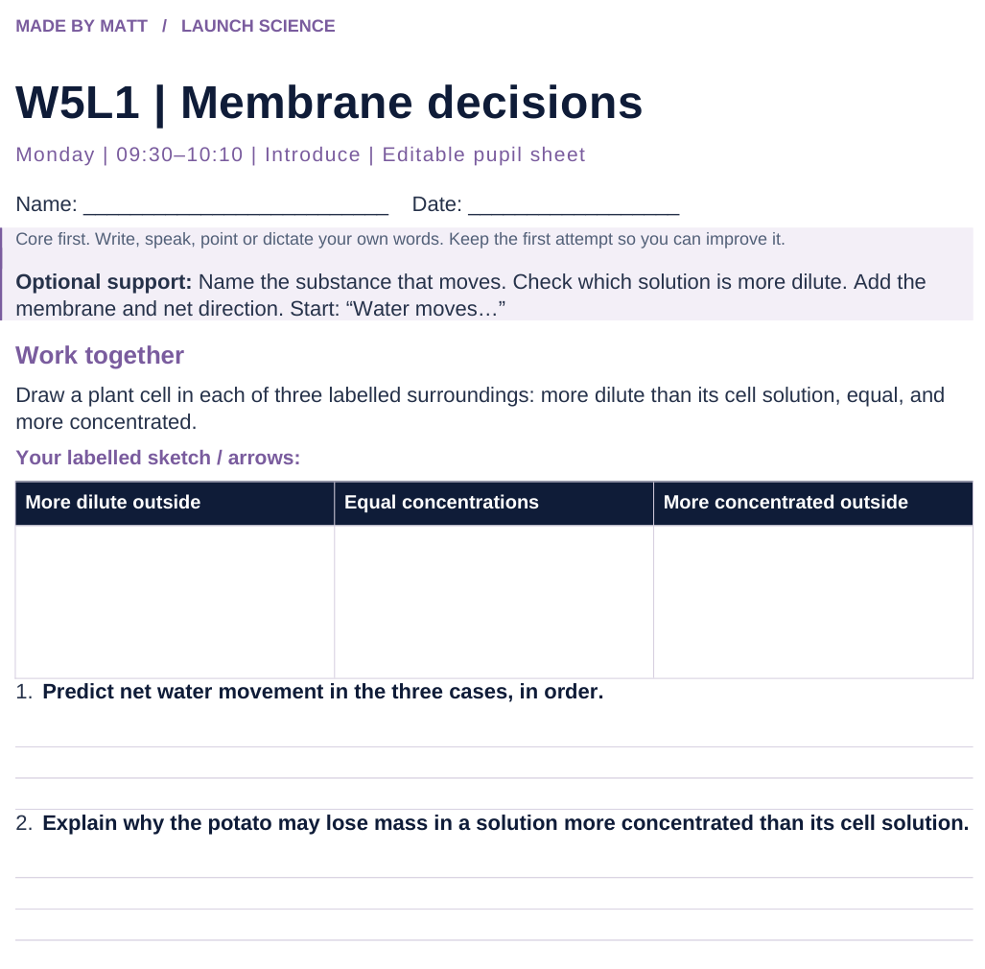
LAUNCH SCIENCE / W5L1
Resources
Worksheet · page 1
Use your printed copy.
Keep the first attempt.
Return to task
Arrival
Starter
I Do
We Do
I Do 2
We Do 2
Independent
Exit
Resources
Notes:
Embedded worksheet reference; print the separate PDF at A4 for writable space.
Core explanation: Osmosis is net water movement through a partially permeable membrane from a more dilute to a more concentrated solution.
Watch for: The potato is tissue, not a single membrane. Its cells have membranes. “Concentrated” must be relative to the solution on the other side.
Least help first: Ask what can cross the membrane and compare the solutions before giving any direction cue.
Support cue: Name the substance that moves. Check which solution is more dilute. Add the membrane and net direction. Start: “Water moves…”
[Sources]
User-supplied LAUNCH W3–W7 pack: W5 Osmosis slides 5–7 and worksheet Task 1.
Made by Matt LAUNCH Science draft, lesson-content.json, W5L1; existing illustrative diagrams reused, active-transport direction corrected to lower → higher.
Pearson Edexcel GCSE Biology specification, sections 1.1–1.6 and 1.15–1.17: https://qualifications.pearson.com/content/dam/pdf/GCSE/Science/2016/Specification/gcse-biology-spec.pdf
Optional concept video: freesciencelessons, Osmosis, https://www.youtube.com/watch?v=B0cH91joZwA (link located 5 September 2026).
[/Sources]
[Sources]
Source editable lesson: Original LAUNCH Science OneDrive pack, 5 September 2026, W5L1. Source teaching content preserved. Current HTML reference: https://madebymatt.uk/Lessons/Science_Teesside/Launch/. Native diagrams restate the source explanation and are not experimental measurements.
[/Sources]

Slide 15
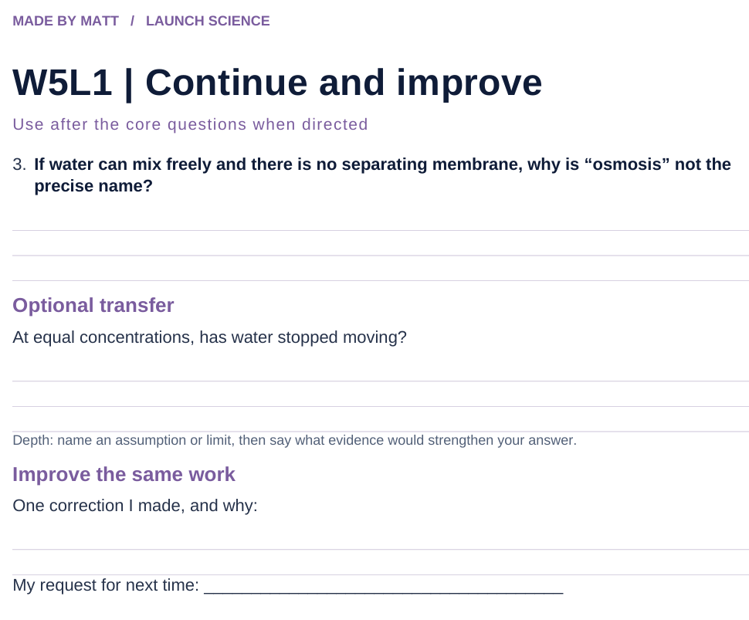
LAUNCH SCIENCE / W5L1
Resources
Worksheet · page 2
Continuation is optional.
Improve the same work.
Return to task
Arrival
Starter
I Do
We Do
I Do 2
We Do 2
Independent
Exit
Resources
Notes:
Embedded worksheet reference; print the separate PDF at A4 for writable space.
Core explanation: Osmosis is net water movement through a partially permeable membrane from a more dilute to a more concentrated solution.
Watch for: The potato is tissue, not a single membrane. Its cells have membranes. “Concentrated” must be relative to the solution on the other side.
Least help first: Ask what can cross the membrane and compare the solutions before giving any direction cue.
Support cue: Name the substance that moves. Check which solution is more dilute. Add the membrane and net direction. Start: “Water moves…”
[Sources]
User-supplied LAUNCH W3–W7 pack: W5 Osmosis slides 5–7 and worksheet Task 1.
Made by Matt LAUNCH Science draft, lesson-content.json, W5L1; existing illustrative diagrams reused, active-transport direction corrected to lower → higher.
Pearson Edexcel GCSE Biology specification, sections 1.1–1.6 and 1.15–1.17: https://qualifications.pearson.com/content/dam/pdf/GCSE/Science/2016/Specification/gcse-biology-spec.pdf
Optional concept video: freesciencelessons, Osmosis, https://www.youtube.com/watch?v=B0cH91joZwA (link located 5 September 2026).
[/Sources]
[Sources]
Source editable lesson: Original LAUNCH Science OneDrive pack, 5 September 2026, W5L1. Source teaching content preserved. Current HTML reference: https://madebymatt.uk/Lessons/Science_Teesside/Launch/. Native diagrams restate the source explanation and are not experimental measurements.
[/Sources]

Slide 16
LAUNCH SCIENCE / W5L1
Resources
Watch, pause and explain
Osmosis
Which substance moves, through what, and in which net direction?
Play freesciencelessons video
No connection? Use the still model and explain the same question.
Arrival
Starter
I Do
We Do
I Do 2
We Do 2
Independent
Exit
Resources
Notes:
Use at most 90 seconds within I Do. Pause on the first relevant example; ask for a reason. This is an optional concept clip, not evidence of practical completion.
Core explanation: Osmosis is net water movement through a partially permeable membrane from a more dilute to a more concentrated solution.
Watch for: The potato is tissue, not a single membrane. Its cells have membranes. “Concentrated” must be relative to the solution on the other side.
Least help first: Ask what can cross the membrane and compare the solutions before giving any direction cue.
Support cue: Name the substance that moves. Check which solution is more dilute. Add the membrane and net direction. Start: “Water moves…”
[Sources]
User-supplied LAUNCH W3–W7 pack: W5 Osmosis slides 5–7 and worksheet Task 1.
Made by Matt LAUNCH Science draft, lesson-content.json, W5L1; existing illustrative diagrams reused, active-transport direction corrected to lower → higher.
Pearson Edexcel GCSE Biology specification, sections 1.1–1.6 and 1.15–1.17: https://qualifications.pearson.com/content/dam/pdf/GCSE/Science/2016/Specification/gcse-biology-spec.pdf
Optional concept video: freesciencelessons, Osmosis, https://www.youtube.com/watch?v=B0cH91joZwA (link located 5 September 2026).
[/Sources]
[Sources]
Source editable lesson: Original LAUNCH Science OneDrive pack, 5 September 2026, W5L1. Source teaching content preserved. Current HTML reference: https://madebymatt.uk/Lessons/Science_Teesside/Launch/. Native diagrams restate the source explanation and are not experimental measurements.
[/Sources]

Slide 17
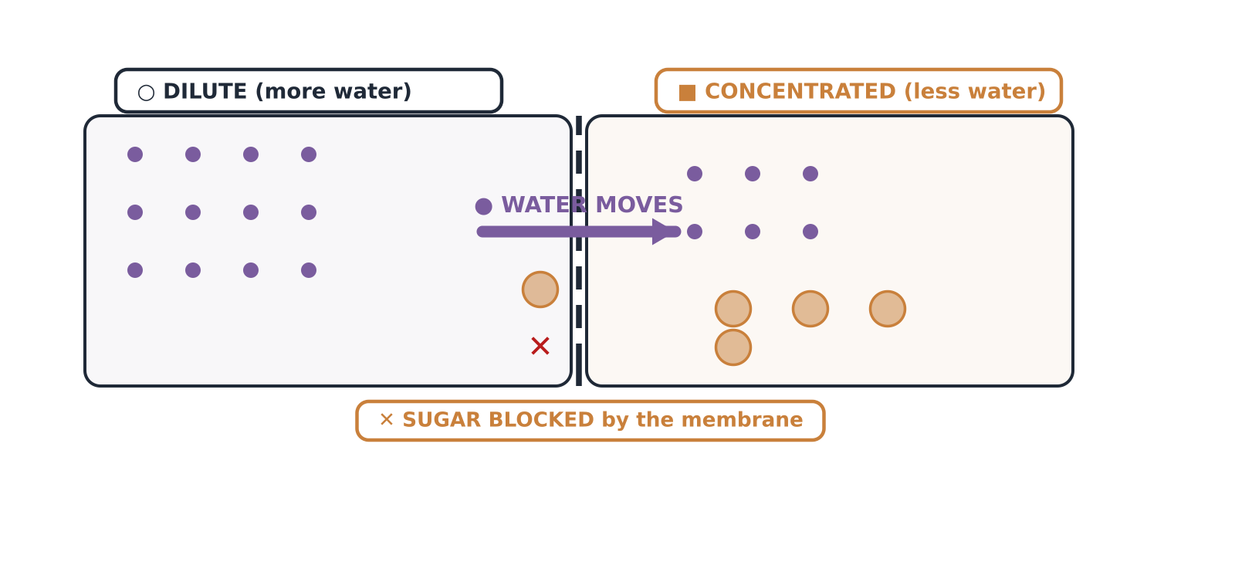
LAUNCH SCIENCE / W5L1
Resources
Look closely at the model
A model illustration: use the stated data for calculations.
Return to I Do
Arrival
Starter
I Do
We Do
I Do 2
We Do 2
Independent
Exit
Resources
Notes:
Source image: https://madebymatt.uk/Lessons/Science_Teesside/Launch/SCI_L_W5_L1_Osmosis.html; existing vector illustration embedded for offline use.
Core explanation: Osmosis is net water movement through a partially permeable membrane from a more dilute to a more concentrated solution.
Watch for: The potato is tissue, not a single membrane. Its cells have membranes. “Concentrated” must be relative to the solution on the other side.
Least help first: Ask what can cross the membrane and compare the solutions before giving any direction cue.
Support cue: Name the substance that moves. Check which solution is more dilute. Add the membrane and net direction. Start: “Water moves…”
[Sources]
User-supplied LAUNCH W3–W7 pack: W5 Osmosis slides 5–7 and worksheet Task 1.
Made by Matt LAUNCH Science draft, lesson-content.json, W5L1; existing illustrative diagrams reused, active-transport direction corrected to lower → higher.
Pearson Edexcel GCSE Biology specification, sections 1.1–1.6 and 1.15–1.17: https://qualifications.pearson.com/content/dam/pdf/GCSE/Science/2016/Specification/gcse-biology-spec.pdf
Optional concept video: freesciencelessons, Osmosis, https://www.youtube.com/watch?v=B0cH91joZwA (link located 5 September 2026).
[/Sources]
[Sources]
Source editable lesson: Original LAUNCH Science OneDrive pack, 5 September 2026, W5L1. Source teaching content preserved. Current HTML reference: https://madebymatt.uk/Lessons/Science_Teesside/Launch/. Native diagrams restate the source explanation and are not experimental measurements.
[/Sources]

