Slide 1
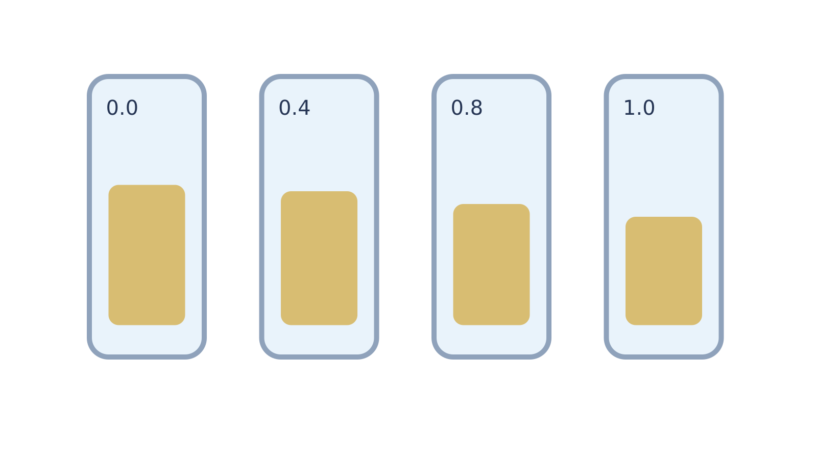
LAUNCH SCIENCE / W5L2
Arrival · 3 min
Planning osmosis
I can plan a potato osmosis investigation, calculate percentage change from sample data and evaluate the controls.
Notice. Recall. Be ready to explain.
1
State the independent variable in a potato osmosis investigation.
2
Write the percentage-change equation.
Retrieval answers
Arrival
Starter
I Do
We Do
I Do 2
We Do 2
Independent
Exit
Resources
Notes:
Stage: Arrival, 3 minutes. Monday / Wednesday / Friday P1, 09:30–10:10. Use reveals within this slot; appendix slides are not added time.
Retrieval answers: Solution/sucrose concentration. | (Final mass − initial mass) ÷ initial mass × 100. | To avoid different amounts of surface solution distorting final mass.
Core explanation: Today’s default cover route is planning and sample-data analysis. A full soak, repeated measurements and graph do not fit inside a six-minute shared-task slot.
Watch for: Only record practical completion for pupils who actually carry out the approved practical. Sample data and pre-soaked staff samples are not proof of that completion.
Least help first: Ask what must stay the same and what the named problem could do to the measured mass before suggesting an improvement.
Support cue: Change = final mass minus initial mass. Percentage change = change ÷ initial mass × 100. Keep the + or - sign.
[Sources]
User-supplied LAUNCH W3–W7 pack: W5 slides 8–10 and worksheet results/evaluation task.
Made by Matt LAUNCH Science draft, lesson-content.json, W5L2; existing illustrative diagrams reused, active-transport direction corrected to lower → higher.
Pearson Edexcel GCSE Biology specification, sections 1.1–1.6 and 1.15–1.17: https://qualifications.pearson.com/content/dam/pdf/GCSE/Science/2016/Specification/gcse-biology-spec.pdf
Optional concept video: freesciencelessons, Osmosis, https://www.youtube.com/watch?v=B0cH91joZwA (link located 5 September 2026).
[/Sources]
[Sources]
Source editable lesson: Original LAUNCH Science OneDrive pack, 5 September 2026, W5L2. Source teaching content preserved. Current HTML reference: https://madebymatt.uk/Lessons/Science_Teesside/Launch/. Native diagrams restate the source explanation and are not experimental measurements.
[/Sources]

Slide 2
LAUNCH SCIENCE / W5L2
Starter · 4 min
Make a prediction
Two identical potato cylinders start at 3.00 g. Which result would be strongest evidence of net water movement: colour change, final mass or beaker position?
A Colour change
B Final mass compared with initial mass
C Beaker position
Commit, then check
Arrival
Starter
I Do
We Do
I Do 2
We Do 2
Independent
Exit
Resources
Notes:
Stage: Starter, 4 minutes. Monday / Wednesday / Friday P1, 09:30–10:10. Use reveals within this slot; appendix slides are not added time.
Correct: Final mass compared with initial mass. Ask for the reason, then return to the original prediction.
Core explanation: Today’s default cover route is planning and sample-data analysis. A full soak, repeated measurements and graph do not fit inside a six-minute shared-task slot.
Watch for: Only record practical completion for pupils who actually carry out the approved practical. Sample data and pre-soaked staff samples are not proof of that completion.
Least help first: Ask what must stay the same and what the named problem could do to the measured mass before suggesting an improvement.
Support cue: Change = final mass minus initial mass. Percentage change = change ÷ initial mass × 100. Keep the + or - sign.
[Sources]
User-supplied LAUNCH W3–W7 pack: W5 slides 8–10 and worksheet results/evaluation task.
Made by Matt LAUNCH Science draft, lesson-content.json, W5L2; existing illustrative diagrams reused, active-transport direction corrected to lower → higher.
Pearson Edexcel GCSE Biology specification, sections 1.1–1.6 and 1.15–1.17: https://qualifications.pearson.com/content/dam/pdf/GCSE/Science/2016/Specification/gcse-biology-spec.pdf
Optional concept video: freesciencelessons, Osmosis, https://www.youtube.com/watch?v=B0cH91joZwA (link located 5 September 2026).
[/Sources]
[Sources]
Source editable lesson: Original LAUNCH Science OneDrive pack, 5 September 2026, W5L2. Source teaching content preserved. Current HTML reference: https://madebymatt.uk/Lessons/Science_Teesside/Launch/. Native diagrams restate the source explanation and are not experimental measurements.
[/Sources]

Slide 3
LAUNCH SCIENCE / W5L2
I Do · 5 min
Watch the model
1
Change solution concentration and measure the potato cylinder’s mass change.
Plan a fair comparison
CHANGE
Concentration
2
Control potato source, dimensions, solution volume, time, temperature and blotting method.
MEASURE
Mass change
KEEP SAME
Other conditions
3
Use repeats where possible and keep every raw value, including an unusual result.
View labelled diagram
Optional video
Arrival
Starter
I Do
We Do
I Do 2
We Do 2
Independent
Exit
Resources
Notes:
Stage: I Do, 5 minutes. Monday / Wednesday / Friday P1, 09:30–10:10. Use reveals within this slot; appendix slides are not added time.
The method planner shows how each choice affects a fair test or the measurement.
Model limit: The sample data include variation. They cannot copy real handling, equipment limits or differences between potato pieces.
Video replaces up to 90 seconds of explanation; use the still diagram if unavailable.
Core explanation: Today’s default cover route is planning and sample-data analysis. A full soak, repeated measurements and graph do not fit inside a six-minute shared-task slot.
Watch for: Only record practical completion for pupils who actually carry out the approved practical. Sample data and pre-soaked staff samples are not proof of that completion.
Least help first: Ask what must stay the same and what the named problem could do to the measured mass before suggesting an improvement.
Support cue: Change = final mass minus initial mass. Percentage change = change ÷ initial mass × 100. Keep the + or - sign.
[Sources]
User-supplied LAUNCH W3–W7 pack: W5 slides 8–10 and worksheet results/evaluation task.
Made by Matt LAUNCH Science draft, lesson-content.json, W5L2; existing illustrative diagrams reused, active-transport direction corrected to lower → higher.
Pearson Edexcel GCSE Biology specification, sections 1.1–1.6 and 1.15–1.17: https://qualifications.pearson.com/content/dam/pdf/GCSE/Science/2016/Specification/gcse-biology-spec.pdf
Optional concept video: freesciencelessons, Osmosis, https://www.youtube.com/watch?v=B0cH91joZwA (link located 5 September 2026).
[/Sources]
[Sources]
Source editable lesson: Original LAUNCH Science OneDrive pack, 5 September 2026, W5L2. Source teaching content preserved. Current HTML reference: https://madebymatt.uk/Lessons/Science_Teesside/Launch/. Native diagrams restate the source explanation and are not experimental measurements.
[/Sources]

Slide 4
LAUNCH SCIENCE / W5L2
We Do · 5 min
Choose and justify
Why is percentage change more useful than mass change alone when starting masses differ?
A It removes all uncertainty
B It compares the change with the starting value
C It makes every trend linear
D It deletes anomalies
Give the deciding clue before checking.
Check the reasoning
Arrival
Starter
I Do
We Do
I Do 2
We Do 2
Independent
Exit
Resources
Notes:
Stage: We Do, 5 minutes. Monday / Wednesday / Friday P1, 09:30–10:10. Use reveals within this slot; appendix slides are not added time.
A: It removes all uncertainty — A calculation cannot remove all measurement or biological uncertainty.
B: It compares the change with the starting value — Correct. Dividing by initial mass makes different starting masses more comparable.
C: It makes every trend linear — Percentage change does not guarantee a straight-line relationship.
D: It deletes anomalies — Raw anomalous values must remain visible even if excluded from a mean.
Core explanation: Today’s default cover route is planning and sample-data analysis. A full soak, repeated measurements and graph do not fit inside a six-minute shared-task slot.
Watch for: Only record practical completion for pupils who actually carry out the approved practical. Sample data and pre-soaked staff samples are not proof of that completion.
Least help first: Ask what must stay the same and what the named problem could do to the measured mass before suggesting an improvement.
Support cue: Change = final mass minus initial mass. Percentage change = change ÷ initial mass × 100. Keep the + or - sign.
[Sources]
User-supplied LAUNCH W3–W7 pack: W5 slides 8–10 and worksheet results/evaluation task.
Made by Matt LAUNCH Science draft, lesson-content.json, W5L2; existing illustrative diagrams reused, active-transport direction corrected to lower → higher.
Pearson Edexcel GCSE Biology specification, sections 1.1–1.6 and 1.15–1.17: https://qualifications.pearson.com/content/dam/pdf/GCSE/Science/2016/Specification/gcse-biology-spec.pdf
Optional concept video: freesciencelessons, Osmosis, https://www.youtube.com/watch?v=B0cH91joZwA (link located 5 September 2026).
[/Sources]
[Sources]
Source editable lesson: Original LAUNCH Science OneDrive pack, 5 September 2026, W5L2. Source teaching content preserved. Current HTML reference: https://madebymatt.uk/Lessons/Science_Teesside/Launch/. Native diagrams restate the source explanation and are not experimental measurements.
[/Sources]

Slide 5
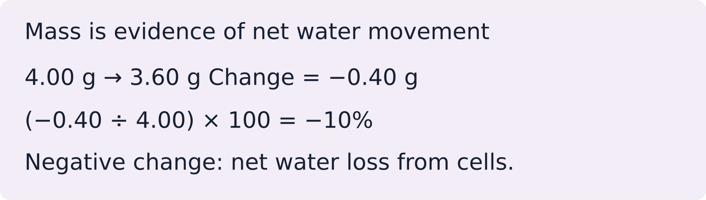
LAUNCH SCIENCE / W5L2
I Do 2 · 4 min
Connect the science
1
Percentage change = (final mass − initial mass) ÷ initial mass × 100.
2
A positive result means mass gain; a negative result means mass loss.
3
Link each weakness to its effect on the result and a clear improvement.
Arrival
Starter
I Do
We Do
I Do 2
We Do 2
Independent
Exit
Resources
Notes:
Stage: I Do 2, 4 minutes. Monday / Wednesday / Friday P1, 09:30–10:10. Use reveals within this slot; appendix slides are not added time.
The sample data include variation. They cannot copy real handling, equipment limits or differences between potato pieces.
Core explanation: Today’s default cover route is planning and sample-data analysis. A full soak, repeated measurements and graph do not fit inside a six-minute shared-task slot.
Watch for: Only record practical completion for pupils who actually carry out the approved practical. Sample data and pre-soaked staff samples are not proof of that completion.
Least help first: Ask what must stay the same and what the named problem could do to the measured mass before suggesting an improvement.
Support cue: Change = final mass minus initial mass. Percentage change = change ÷ initial mass × 100. Keep the + or - sign.
[Sources]
User-supplied LAUNCH W3–W7 pack: W5 slides 8–10 and worksheet results/evaluation task.
Made by Matt LAUNCH Science draft, lesson-content.json, W5L2; existing illustrative diagrams reused, active-transport direction corrected to lower → higher.
Pearson Edexcel GCSE Biology specification, sections 1.1–1.6 and 1.15–1.17: https://qualifications.pearson.com/content/dam/pdf/GCSE/Science/2016/Specification/gcse-biology-spec.pdf
Optional concept video: freesciencelessons, Osmosis, https://www.youtube.com/watch?v=B0cH91joZwA (link located 5 September 2026).
[/Sources]
[Sources]
Source editable lesson: Original LAUNCH Science OneDrive pack, 5 September 2026, W5L2. Source teaching content preserved. Current HTML reference: https://madebymatt.uk/Lessons/Science_Teesside/Launch/. Native diagrams restate the source explanation and are not experimental measurements.
[/Sources]

Slide 6
LAUNCH SCIENCE / W5L2
We Do 2 · Task · 6 min
Plan a fair comparison
Sample data. Calculate signed change, then choose a control.
Solution | Initial / g | Final / g
Water | 4.00 | 4.40
0.4 mol dm⁻³ sucrose | 4.00 | 4.00
0.8 mol dm⁻³ sucrose | 4.00 | 3.60
What should stay the same? What would inconsistent blotting do?
Reveal shared reasoning
Arrival
Starter
I Do
We Do
I Do 2
We Do 2
Independent
Exit
Resources
Notes:
Stage: We Do 2 · Task, 6 minutes. Monday / Wednesday / Friday P1, 09:30–10:10. Use reveals within this slot; appendix slides are not added time.
Water: +0.40 g, +10%.
0.4 mol dm⁻³: 0 g, 0%.
0.8 mol dm⁻³: −0.40 g, −10%.
Standardise blotting: surface liquid changes the measured final mass.
Run the printed activity or this board; one route is enough.
Core explanation: Today’s default cover route is planning and sample-data analysis. A full soak, repeated measurements and graph do not fit inside a six-minute shared-task slot.
Watch for: Only record practical completion for pupils who actually carry out the approved practical. Sample data and pre-soaked staff samples are not proof of that completion.
Least help first: Ask what must stay the same and what the named problem could do to the measured mass before suggesting an improvement.
Support cue: Change = final mass minus initial mass. Percentage change = change ÷ initial mass × 100. Keep the + or - sign.
[Sources]
User-supplied LAUNCH W3–W7 pack: W5 slides 8–10 and worksheet results/evaluation task.
Made by Matt LAUNCH Science draft, lesson-content.json, W5L2; existing illustrative diagrams reused, active-transport direction corrected to lower → higher.
Pearson Edexcel GCSE Biology specification, sections 1.1–1.6 and 1.15–1.17: https://qualifications.pearson.com/content/dam/pdf/GCSE/Science/2016/Specification/gcse-biology-spec.pdf
Optional concept video: freesciencelessons, Osmosis, https://www.youtube.com/watch?v=B0cH91joZwA (link located 5 September 2026).
[/Sources]
[Sources]
Source editable lesson: Original LAUNCH Science OneDrive pack, 5 September 2026, W5L2. Source teaching content preserved. Current HTML reference: https://madebymatt.uk/Lessons/Science_Teesside/Launch/. Native diagrams restate the source explanation and are not experimental measurements.
[/Sources]

Slide 7
LAUNCH SCIENCE / W5L2
Independent Task · 10 min
Your independent evidence
Potato diameters differ, and blotting varies from 2 to 10 seconds. Explain each problem, its effect on results and one improvement. Then explain what a negative percentage mass change means for osmosis.
Optional support
Change = final mass minus initial mass. Percentage change = change ÷ initial mass × 100. Keep the + or - sign.
Make one precise correction to the same work after feedback.
Open worksheet pages
Model after first attempt
Arrival
Starter
I Do
We Do
I Do 2
We Do 2
Independent
Exit
Resources
Notes:
Stage: Independent Task, 10 minutes. Monday / Wednesday / Friday P1, 09:30–10:10. Use reveals within this slot; appendix slides are not added time.
Model answer: Different cylinder diameters change surface area and the amount of potato tissue, so concentration may not be the only cause of different percentage changes. Use a cork borer and cut equal lengths. Unequal blotting leaves different amounts of solution on the surface, changing the measured final mass; use the same blotting method and time. A negative percentage change means the potato lost mass because net water movement was out of its cells by osmosis.
Select only questions that fit the ten-minute slot. W7L3: Q2, Q3 and Q5 total 11 marks. The full paper needs a separate 25-minute slot.
Core explanation: Today’s default cover route is planning and sample-data analysis. A full soak, repeated measurements and graph do not fit inside a six-minute shared-task slot.
Watch for: Only record practical completion for pupils who actually carry out the approved practical. Sample data and pre-soaked staff samples are not proof of that completion.
Least help first: Ask what must stay the same and what the named problem could do to the measured mass before suggesting an improvement.
Support cue: Change = final mass minus initial mass. Percentage change = change ÷ initial mass × 100. Keep the + or - sign.
[Sources]
User-supplied LAUNCH W3–W7 pack: W5 slides 8–10 and worksheet results/evaluation task.
Made by Matt LAUNCH Science draft, lesson-content.json, W5L2; existing illustrative diagrams reused, active-transport direction corrected to lower → higher.
Pearson Edexcel GCSE Biology specification, sections 1.1–1.6 and 1.15–1.17: https://qualifications.pearson.com/content/dam/pdf/GCSE/Science/2016/Specification/gcse-biology-spec.pdf
Optional concept video: freesciencelessons, Osmosis, https://www.youtube.com/watch?v=B0cH91joZwA (link located 5 September 2026).
[/Sources]
[Sources]
Source editable lesson: Original LAUNCH Science OneDrive pack, 5 September 2026, W5L2. Source teaching content preserved. Current HTML reference: https://madebymatt.uk/Lessons/Science_Teesside/Launch/. Native diagrams restate the source explanation and are not experimental measurements.
[/Sources]

Slide 8
LAUNCH SCIENCE / W5L2
Exit · 3 min
What changed in your thinking?
Why is ‘repeat it’ incomplete as an evaluation unless you explain what repeats improve?
1
Point to one improvement in your work.
2
Choose what you want to revisit.
3
Tell your teacher; agree the next step together.
Arrival
Starter
I Do
We Do
I Do 2
We Do 2
Independent
Exit
Resources
Notes:
Stage: Exit, 3 minutes. Monday / Wednesday / Friday P1, 09:30–10:10. Use reveals within this slot; appendix slides are not added time.
Exit answer: Repeats show variation and can reduce random effects in a mean; they do not correct a systematic method error.
Receive the request, record the agreed next action and check it next lesson. Keep responses private when requested.
Core explanation: Today’s default cover route is planning and sample-data analysis. A full soak, repeated measurements and graph do not fit inside a six-minute shared-task slot.
Watch for: Only record practical completion for pupils who actually carry out the approved practical. Sample data and pre-soaked staff samples are not proof of that completion.
Least help first: Ask what must stay the same and what the named problem could do to the measured mass before suggesting an improvement.
Support cue: Change = final mass minus initial mass. Percentage change = change ÷ initial mass × 100. Keep the + or - sign.
[Sources]
User-supplied LAUNCH W3–W7 pack: W5 slides 8–10 and worksheet results/evaluation task.
Made by Matt LAUNCH Science draft, lesson-content.json, W5L2; existing illustrative diagrams reused, active-transport direction corrected to lower → higher.
Pearson Edexcel GCSE Biology specification, sections 1.1–1.6 and 1.15–1.17: https://qualifications.pearson.com/content/dam/pdf/GCSE/Science/2016/Specification/gcse-biology-spec.pdf
Optional concept video: freesciencelessons, Osmosis, https://www.youtube.com/watch?v=B0cH91joZwA (link located 5 September 2026).
[/Sources]
[Sources]
Source editable lesson: Original LAUNCH Science OneDrive pack, 5 September 2026, W5L2. Source teaching content preserved. Current HTML reference: https://madebymatt.uk/Lessons/Science_Teesside/Launch/. Native diagrams restate the source explanation and are not experimental measurements.
[/Sources]

Slide 9
LAUNCH SCIENCE / W5L2
Resources
Retrieval and prediction check
1
Solution/sucrose concentration.
2
(Final mass − initial mass) ÷ initial mass × 100.
Final mass compared with initial mass
Return to Starter
Arrival
Starter
I Do
We Do
I Do 2
We Do 2
Independent
Exit
Resources
Notes:
Read only after an attempt; retain the pupil’s first view.
Core explanation: Today’s default cover route is planning and sample-data analysis. A full soak, repeated measurements and graph do not fit inside a six-minute shared-task slot.
Watch for: Only record practical completion for pupils who actually carry out the approved practical. Sample data and pre-soaked staff samples are not proof of that completion.
Least help first: Ask what must stay the same and what the named problem could do to the measured mass before suggesting an improvement.
Support cue: Change = final mass minus initial mass. Percentage change = change ÷ initial mass × 100. Keep the + or - sign.
[Sources]
User-supplied LAUNCH W3–W7 pack: W5 slides 8–10 and worksheet results/evaluation task.
Made by Matt LAUNCH Science draft, lesson-content.json, W5L2; existing illustrative diagrams reused, active-transport direction corrected to lower → higher.
Pearson Edexcel GCSE Biology specification, sections 1.1–1.6 and 1.15–1.17: https://qualifications.pearson.com/content/dam/pdf/GCSE/Science/2016/Specification/gcse-biology-spec.pdf
Optional concept video: freesciencelessons, Osmosis, https://www.youtube.com/watch?v=B0cH91joZwA (link located 5 September 2026).
[/Sources]
[Sources]
Source editable lesson: Original LAUNCH Science OneDrive pack, 5 September 2026, W5L2. Source teaching content preserved. Current HTML reference: https://madebymatt.uk/Lessons/Science_Teesside/Launch/. Native diagrams restate the source explanation and are not experimental measurements.
[/Sources]

Slide 10
LAUNCH SCIENCE / W5L2
Resources
Check the deciding clue
It compares the change with the starting value
Correct. Dividing by initial mass makes different starting masses more comparable.
Compare your reason. Correct one step if needed.
Return to We Do
Arrival
Starter
I Do
We Do
I Do 2
We Do 2
Independent
Exit
Resources
Notes:
A calculation cannot remove all measurement or biological uncertainty.
Correct. Dividing by initial mass makes different starting masses more comparable.
Percentage change does not guarantee a straight-line relationship.
Raw anomalous values must remain visible even if excluded from a mean.
Core explanation: Today’s default cover route is planning and sample-data analysis. A full soak, repeated measurements and graph do not fit inside a six-minute shared-task slot.
Watch for: Only record practical completion for pupils who actually carry out the approved practical. Sample data and pre-soaked staff samples are not proof of that completion.
Least help first: Ask what must stay the same and what the named problem could do to the measured mass before suggesting an improvement.
Support cue: Change = final mass minus initial mass. Percentage change = change ÷ initial mass × 100. Keep the + or - sign.
[Sources]
User-supplied LAUNCH W3–W7 pack: W5 slides 8–10 and worksheet results/evaluation task.
Made by Matt LAUNCH Science draft, lesson-content.json, W5L2; existing illustrative diagrams reused, active-transport direction corrected to lower → higher.
Pearson Edexcel GCSE Biology specification, sections 1.1–1.6 and 1.15–1.17: https://qualifications.pearson.com/content/dam/pdf/GCSE/Science/2016/Specification/gcse-biology-spec.pdf
Optional concept video: freesciencelessons, Osmosis, https://www.youtube.com/watch?v=B0cH91joZwA (link located 5 September 2026).
[/Sources]
[Sources]
Source editable lesson: Original LAUNCH Science OneDrive pack, 5 September 2026, W5L2. Source teaching content preserved. Current HTML reference: https://madebymatt.uk/Lessons/Science_Teesside/Launch/. Native diagrams restate the source explanation and are not experimental measurements.
[/Sources]

Slide 11
LAUNCH SCIENCE / W5L2
Resources
Our shared reasoning
Water: +0.40 g, +10%.
0.4 mol dm⁻³: 0 g, 0%.
0.8 mol dm⁻³: −0.40 g, −10%.
Standardise blotting: surface liquid changes the measured final mass.
Return to shared task
Arrival
Starter
I Do
We Do
I Do 2
We Do 2
Independent
Exit
Resources
Notes:
Pupils should justify, compare and revise rather than copy a complete answer before trying.
Core explanation: Today’s default cover route is planning and sample-data analysis. A full soak, repeated measurements and graph do not fit inside a six-minute shared-task slot.
Watch for: Only record practical completion for pupils who actually carry out the approved practical. Sample data and pre-soaked staff samples are not proof of that completion.
Least help first: Ask what must stay the same and what the named problem could do to the measured mass before suggesting an improvement.
Support cue: Change = final mass minus initial mass. Percentage change = change ÷ initial mass × 100. Keep the + or - sign.
[Sources]
User-supplied LAUNCH W3–W7 pack: W5 slides 8–10 and worksheet results/evaluation task.
Made by Matt LAUNCH Science draft, lesson-content.json, W5L2; existing illustrative diagrams reused, active-transport direction corrected to lower → higher.
Pearson Edexcel GCSE Biology specification, sections 1.1–1.6 and 1.15–1.17: https://qualifications.pearson.com/content/dam/pdf/GCSE/Science/2016/Specification/gcse-biology-spec.pdf
Optional concept video: freesciencelessons, Osmosis, https://www.youtube.com/watch?v=B0cH91joZwA (link located 5 September 2026).
[/Sources]
[Sources]
Source editable lesson: Original LAUNCH Science OneDrive pack, 5 September 2026, W5L2. Source teaching content preserved. Current HTML reference: https://madebymatt.uk/Lessons/Science_Teesside/Launch/. Native diagrams restate the source explanation and are not experimental measurements.
[/Sources]

Slide 12
LAUNCH SCIENCE / W5L2
Resources
Compare after your first attempt
Different cylinder diameters change surface area and the amount of potato tissue, so concentration may not be the only cause of different percentage changes. Use a cork borer and cut equal lengths. Unequal blotting leaves different amounts of solution on the surface, changing the measured final mass; use the same blotting method and time. A negative percentage change means the potato lost mass because net water movement was out of its cells by osmosis.
Use the model to improve your explanation in your own words.
Return to independent task
Arrival
Starter
I Do
We Do
I Do 2
We Do 2
Independent
Exit
Resources
Notes:
Staff guide includes question-by-question answers. Do not distribute this presentation as a secure assessment paper.
Core explanation: Today’s default cover route is planning and sample-data analysis. A full soak, repeated measurements and graph do not fit inside a six-minute shared-task slot.
Watch for: Only record practical completion for pupils who actually carry out the approved practical. Sample data and pre-soaked staff samples are not proof of that completion.
Least help first: Ask what must stay the same and what the named problem could do to the measured mass before suggesting an improvement.
Support cue: Change = final mass minus initial mass. Percentage change = change ÷ initial mass × 100. Keep the + or - sign.
[Sources]
User-supplied LAUNCH W3–W7 pack: W5 slides 8–10 and worksheet results/evaluation task.
Made by Matt LAUNCH Science draft, lesson-content.json, W5L2; existing illustrative diagrams reused, active-transport direction corrected to lower → higher.
Pearson Edexcel GCSE Biology specification, sections 1.1–1.6 and 1.15–1.17: https://qualifications.pearson.com/content/dam/pdf/GCSE/Science/2016/Specification/gcse-biology-spec.pdf
Optional concept video: freesciencelessons, Osmosis, https://www.youtube.com/watch?v=B0cH91joZwA (link located 5 September 2026).
[/Sources]
[Sources]
Source editable lesson: Original LAUNCH Science OneDrive pack, 5 September 2026, W5L2. Source teaching content preserved. Current HTML reference: https://madebymatt.uk/Lessons/Science_Teesside/Launch/. Native diagrams restate the source explanation and are not experimental measurements.
[/Sources]

Slide 13
LAUNCH SCIENCE / W5L2
Resources
Your lesson resources
Worksheet pages are stored inside this PowerPoint.
Worksheet · page 1
Worksheet · page 2
Standard PDF
Supported PDF
Depth PDF
Editable Word worksheet
Open online lesson / model
Named files are in this week’s folder. Online lesson and video need internet.
Optional concept video
Arrival
Starter
I Do
We Do
I Do 2
We Do 2
Independent
Exit
Resources
Notes:
File buttons use relative links for downloaded/synced folders. OneDrive preview may not resolve relative links. Use the embedded pages or open the named file in the week folder.
Core explanation: Today’s default cover route is planning and sample-data analysis. A full soak, repeated measurements and graph do not fit inside a six-minute shared-task slot.
Watch for: Only record practical completion for pupils who actually carry out the approved practical. Sample data and pre-soaked staff samples are not proof of that completion.
Least help first: Ask what must stay the same and what the named problem could do to the measured mass before suggesting an improvement.
Support cue: Change = final mass minus initial mass. Percentage change = change ÷ initial mass × 100. Keep the + or - sign.
[Sources]
User-supplied LAUNCH W3–W7 pack: W5 slides 8–10 and worksheet results/evaluation task.
Made by Matt LAUNCH Science draft, lesson-content.json, W5L2; existing illustrative diagrams reused, active-transport direction corrected to lower → higher.
Pearson Edexcel GCSE Biology specification, sections 1.1–1.6 and 1.15–1.17: https://qualifications.pearson.com/content/dam/pdf/GCSE/Science/2016/Specification/gcse-biology-spec.pdf
Optional concept video: freesciencelessons, Osmosis, https://www.youtube.com/watch?v=B0cH91joZwA (link located 5 September 2026).
[/Sources]
[Sources]
Source editable lesson: Original LAUNCH Science OneDrive pack, 5 September 2026, W5L2. Source teaching content preserved. Current HTML reference: https://madebymatt.uk/Lessons/Science_Teesside/Launch/. Native diagrams restate the source explanation and are not experimental measurements.
[/Sources]

Slide 14
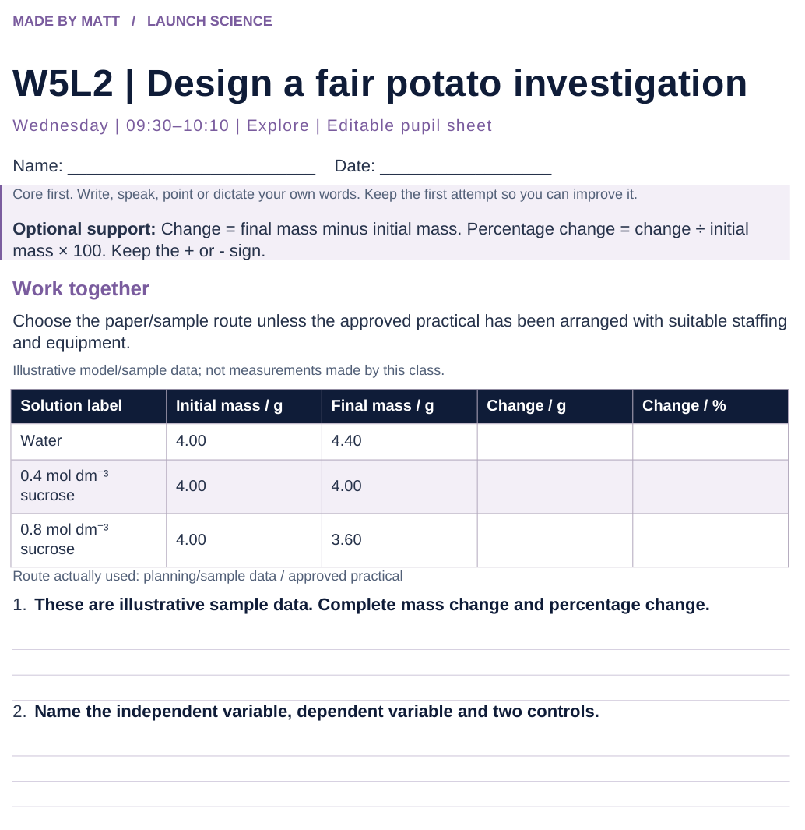
LAUNCH SCIENCE / W5L2
Resources
Worksheet · page 1
Use your printed copy.
Keep the first attempt.
Return to task
Arrival
Starter
I Do
We Do
I Do 2
We Do 2
Independent
Exit
Resources
Notes:
Embedded worksheet reference; print the separate PDF at A4 for writable space.
Core explanation: Today’s default cover route is planning and sample-data analysis. A full soak, repeated measurements and graph do not fit inside a six-minute shared-task slot.
Watch for: Only record practical completion for pupils who actually carry out the approved practical. Sample data and pre-soaked staff samples are not proof of that completion.
Least help first: Ask what must stay the same and what the named problem could do to the measured mass before suggesting an improvement.
Support cue: Change = final mass minus initial mass. Percentage change = change ÷ initial mass × 100. Keep the + or - sign.
[Sources]
User-supplied LAUNCH W3–W7 pack: W5 slides 8–10 and worksheet results/evaluation task.
Made by Matt LAUNCH Science draft, lesson-content.json, W5L2; existing illustrative diagrams reused, active-transport direction corrected to lower → higher.
Pearson Edexcel GCSE Biology specification, sections 1.1–1.6 and 1.15–1.17: https://qualifications.pearson.com/content/dam/pdf/GCSE/Science/2016/Specification/gcse-biology-spec.pdf
Optional concept video: freesciencelessons, Osmosis, https://www.youtube.com/watch?v=B0cH91joZwA (link located 5 September 2026).
[/Sources]
[Sources]
Source editable lesson: Original LAUNCH Science OneDrive pack, 5 September 2026, W5L2. Source teaching content preserved. Current HTML reference: https://madebymatt.uk/Lessons/Science_Teesside/Launch/. Native diagrams restate the source explanation and are not experimental measurements.
[/Sources]

Slide 15
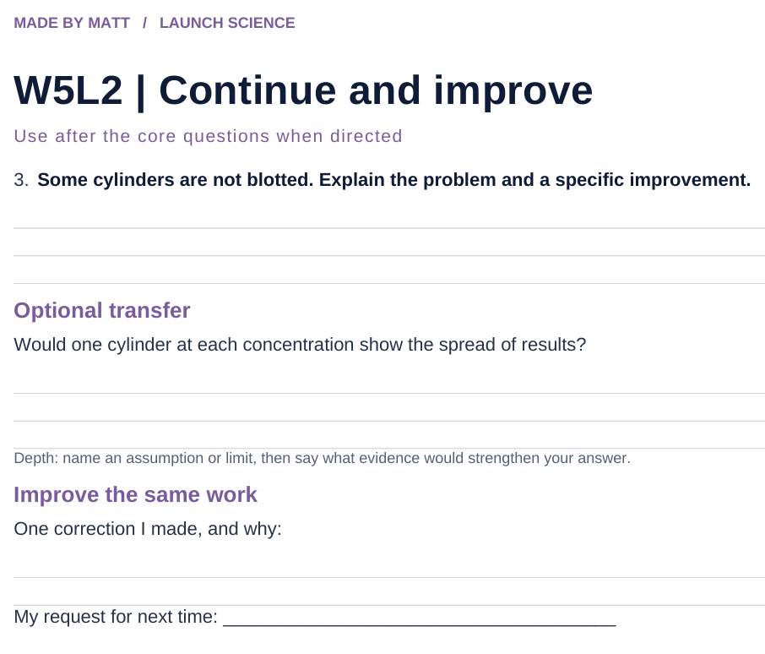
LAUNCH SCIENCE / W5L2
Resources
Worksheet · page 2
Continuation is optional.
Improve the same work.
Return to task
Arrival
Starter
I Do
We Do
I Do 2
We Do 2
Independent
Exit
Resources
Notes:
Embedded worksheet reference; print the separate PDF at A4 for writable space.
Core explanation: Today’s default cover route is planning and sample-data analysis. A full soak, repeated measurements and graph do not fit inside a six-minute shared-task slot.
Watch for: Only record practical completion for pupils who actually carry out the approved practical. Sample data and pre-soaked staff samples are not proof of that completion.
Least help first: Ask what must stay the same and what the named problem could do to the measured mass before suggesting an improvement.
Support cue: Change = final mass minus initial mass. Percentage change = change ÷ initial mass × 100. Keep the + or - sign.
[Sources]
User-supplied LAUNCH W3–W7 pack: W5 slides 8–10 and worksheet results/evaluation task.
Made by Matt LAUNCH Science draft, lesson-content.json, W5L2; existing illustrative diagrams reused, active-transport direction corrected to lower → higher.
Pearson Edexcel GCSE Biology specification, sections 1.1–1.6 and 1.15–1.17: https://qualifications.pearson.com/content/dam/pdf/GCSE/Science/2016/Specification/gcse-biology-spec.pdf
Optional concept video: freesciencelessons, Osmosis, https://www.youtube.com/watch?v=B0cH91joZwA (link located 5 September 2026).
[/Sources]
[Sources]
Source editable lesson: Original LAUNCH Science OneDrive pack, 5 September 2026, W5L2. Source teaching content preserved. Current HTML reference: https://madebymatt.uk/Lessons/Science_Teesside/Launch/. Native diagrams restate the source explanation and are not experimental measurements.
[/Sources]

Slide 16
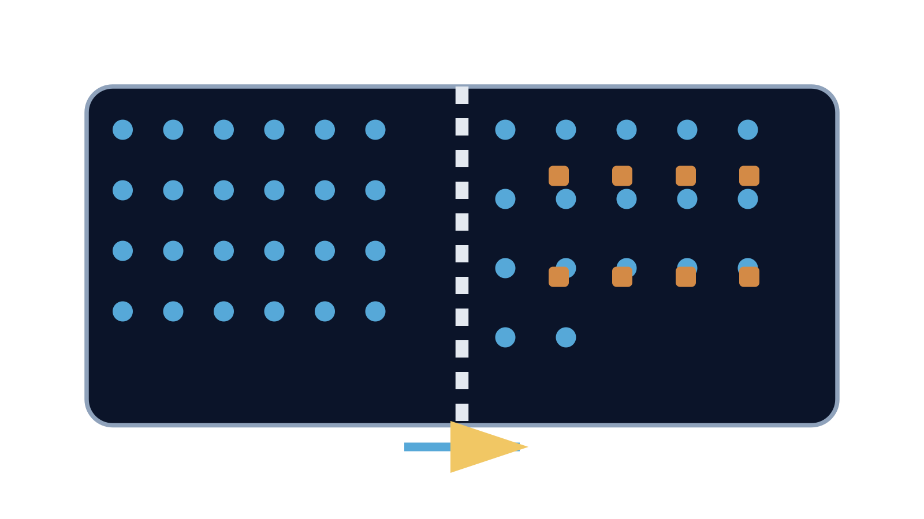
LAUNCH SCIENCE / W5L2
Resources
Watch, pause and explain
Osmosis
Which substance moves, through what, and in which net direction?
Play freesciencelessons video
No connection? Use the still model and explain the same question.
Arrival
Starter
I Do
We Do
I Do 2
We Do 2
Independent
Exit
Resources
Notes:
Use at most 90 seconds within I Do. Pause on the first relevant example; ask for a reason. This is an optional concept clip, not evidence of practical completion.
Core explanation: Today’s default cover route is planning and sample-data analysis. A full soak, repeated measurements and graph do not fit inside a six-minute shared-task slot.
Watch for: Only record practical completion for pupils who actually carry out the approved practical. Sample data and pre-soaked staff samples are not proof of that completion.
Least help first: Ask what must stay the same and what the named problem could do to the measured mass before suggesting an improvement.
Support cue: Change = final mass minus initial mass. Percentage change = change ÷ initial mass × 100. Keep the + or - sign.
[Sources]
User-supplied LAUNCH W3–W7 pack: W5 slides 8–10 and worksheet results/evaluation task.
Made by Matt LAUNCH Science draft, lesson-content.json, W5L2; existing illustrative diagrams reused, active-transport direction corrected to lower → higher.
Pearson Edexcel GCSE Biology specification, sections 1.1–1.6 and 1.15–1.17: https://qualifications.pearson.com/content/dam/pdf/GCSE/Science/2016/Specification/gcse-biology-spec.pdf
Optional concept video: freesciencelessons, Osmosis, https://www.youtube.com/watch?v=B0cH91joZwA (link located 5 September 2026).
[/Sources]
[Sources]
Source editable lesson: Original LAUNCH Science OneDrive pack, 5 September 2026, W5L2. Source teaching content preserved. Current HTML reference: https://madebymatt.uk/Lessons/Science_Teesside/Launch/. Native diagrams restate the source explanation and are not experimental measurements.
[/Sources]

Slide 17
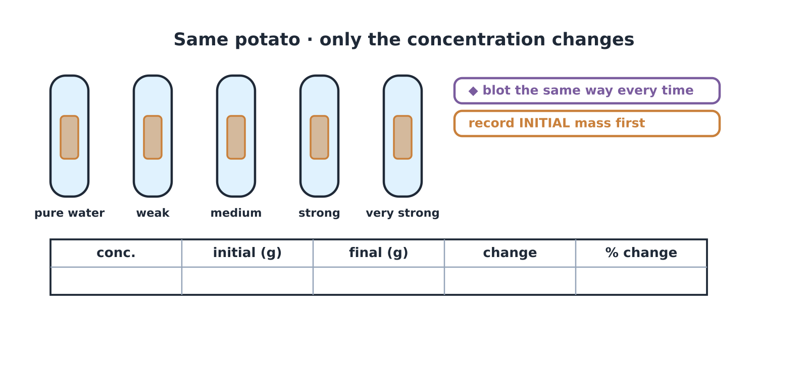
LAUNCH SCIENCE / W5L2
Resources
Look closely at the model
A model illustration: use the stated data for calculations.
Return to I Do
Arrival
Starter
I Do
We Do
I Do 2
We Do 2
Independent
Exit
Resources
Notes:
Source image: https://madebymatt.uk/Lessons/Science_Teesside/Launch/SCI_L_W5_L2_OsmosisCP.html; existing vector illustration embedded for offline use.
Core explanation: Today’s default cover route is planning and sample-data analysis. A full soak, repeated measurements and graph do not fit inside a six-minute shared-task slot.
Watch for: Only record practical completion for pupils who actually carry out the approved practical. Sample data and pre-soaked staff samples are not proof of that completion.
Least help first: Ask what must stay the same and what the named problem could do to the measured mass before suggesting an improvement.
Support cue: Change = final mass minus initial mass. Percentage change = change ÷ initial mass × 100. Keep the + or - sign.
[Sources]
User-supplied LAUNCH W3–W7 pack: W5 slides 8–10 and worksheet results/evaluation task.
Made by Matt LAUNCH Science draft, lesson-content.json, W5L2; existing illustrative diagrams reused, active-transport direction corrected to lower → higher.
Pearson Edexcel GCSE Biology specification, sections 1.1–1.6 and 1.15–1.17: https://qualifications.pearson.com/content/dam/pdf/GCSE/Science/2016/Specification/gcse-biology-spec.pdf
Optional concept video: freesciencelessons, Osmosis, https://www.youtube.com/watch?v=B0cH91joZwA (link located 5 September 2026).
[/Sources]
[Sources]
Source editable lesson: Original LAUNCH Science OneDrive pack, 5 September 2026, W5L2. Source teaching content preserved. Current HTML reference: https://madebymatt.uk/Lessons/Science_Teesside/Launch/. Native diagrams restate the source explanation and are not experimental measurements.
[/Sources]

