Slide 1
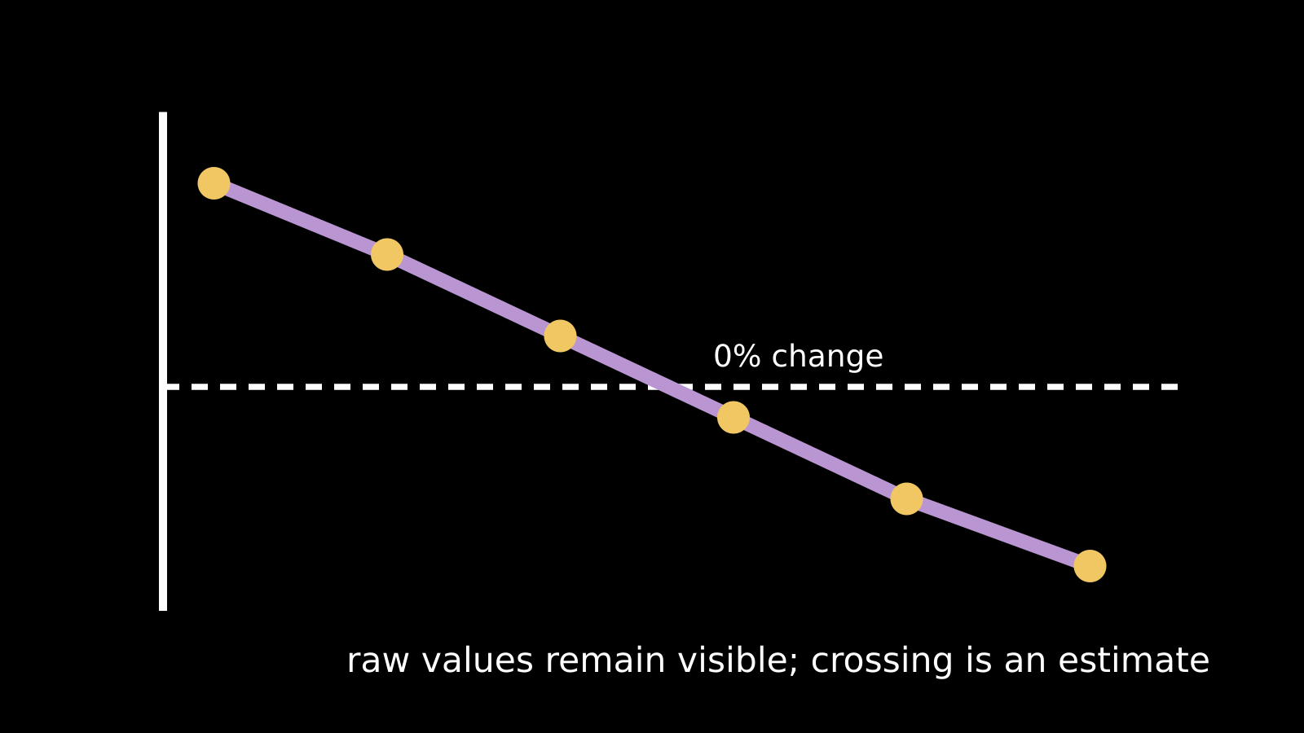
LAUNCH SCIENCE / W5L3
Arrival · 3 min
Reading osmosis data
I can calculate, graph and interpret osmosis data while keeping raw values and anomaly decisions visible.
Notice. Recall. Be ready to explain.
1
What does a negative percentage change mean?
2
Why keep an anomalous raw value?
Retrieval answers
Arrival
Starter
I Do
We Do
I Do 2
We Do 2
Independent
Exit
Resources
Notes:
Stage: Arrival, 3 minutes. Monday / Wednesday / Friday P1, 09:30–10:10. Use reveals within this slot; appendix slides are not added time.
Retrieval answers: Mass loss relative to starting mass. | To investigate it and justify a mean decision; unusual does not automatically mean wrong. | x: concentration / mol dm⁻³; y: mean percentage change in mass / %.
Core explanation: Keep the raw data visible. Flag unusual values and investigate. Never delete a value simply because the graph looks tidier without it.
Watch for: Between +12% at 0.2 and −8% at 0.6, straight-line interpolation gives 0.44 mol dm⁻³, not the midpoint 0.4.
Least help first: Ask what the data shows before asking what it means, and require a reason for any exclusion decision.
Support cue: Find each mean: add the repeats and divide by their number. Describe the trend. Keep unusual results visible and explain any choice to leave one out.
[Sources]
User-supplied LAUNCH W3–W7 pack: W5 percentage-change and evaluation tasks, extended with repeated data and graphing.
Made by Matt LAUNCH Science draft, lesson-content.json, W5L3; existing illustrative diagrams reused, active-transport direction corrected to lower → higher.
Pearson Edexcel GCSE Biology specification, sections 1.1–1.6 and 1.15–1.17: https://qualifications.pearson.com/content/dam/pdf/GCSE/Science/2016/Specification/gcse-biology-spec.pdf
Optional concept video: freesciencelessons, Osmosis, https://www.youtube.com/watch?v=B0cH91joZwA (link located 5 September 2026).
[/Sources]
[Sources]
Source editable lesson: Original LAUNCH Science OneDrive pack, 5 September 2026, W5L3. Source teaching content preserved. Current HTML reference: https://madebymatt.uk/Lessons/Science_Teesside/Launch/. Native diagrams restate the source explanation and are not experimental measurements.
[/Sources]

Slide 2
LAUNCH SCIENCE / W5L3
Starter · 4 min
Make a prediction
One repeat is very different from two others. Should it be erased, automatically excluded or investigated and kept visible?
A Erase it
B Automatically exclude it
C Keep it visible and investigate before deciding
Commit, then check
Arrival
Starter
I Do
We Do
I Do 2
We Do 2
Independent
Exit
Resources
Notes:
Stage: Starter, 4 minutes. Monday / Wednesday / Friday P1, 09:30–10:10. Use reveals within this slot; appendix slides are not added time.
Correct: Keep it visible and investigate before deciding. Ask for the reason, then return to the original prediction.
Core explanation: Keep the raw data visible. Flag unusual values and investigate. Never delete a value simply because the graph looks tidier without it.
Watch for: Between +12% at 0.2 and −8% at 0.6, straight-line interpolation gives 0.44 mol dm⁻³, not the midpoint 0.4.
Least help first: Ask what the data shows before asking what it means, and require a reason for any exclusion decision.
Support cue: Find each mean: add the repeats and divide by their number. Describe the trend. Keep unusual results visible and explain any choice to leave one out.
[Sources]
User-supplied LAUNCH W3–W7 pack: W5 percentage-change and evaluation tasks, extended with repeated data and graphing.
Made by Matt LAUNCH Science draft, lesson-content.json, W5L3; existing illustrative diagrams reused, active-transport direction corrected to lower → higher.
Pearson Edexcel GCSE Biology specification, sections 1.1–1.6 and 1.15–1.17: https://qualifications.pearson.com/content/dam/pdf/GCSE/Science/2016/Specification/gcse-biology-spec.pdf
Optional concept video: freesciencelessons, Osmosis, https://www.youtube.com/watch?v=B0cH91joZwA (link located 5 September 2026).
[/Sources]
[Sources]
Source editable lesson: Original LAUNCH Science OneDrive pack, 5 September 2026, W5L3. Source teaching content preserved. Current HTML reference: https://madebymatt.uk/Lessons/Science_Teesside/Launch/. Native diagrams restate the source explanation and are not experimental measurements.
[/Sources]

Slide 3
LAUNCH SCIENCE / W5L3
I Do · 5 min
Watch the model
1
Show every raw result before calculating a mean.
Keep every raw result
Raw values
Mean
2
Flag an unusual value and record whether it is included, with a reason.
Mean % mass change
3
Plot concentration on the x-axis and mean percentage change in mass on the y-axis with units.
Concentration →
View labelled diagram
Optional video
Arrival
Starter
I Do
We Do
I Do 2
We Do 2
Independent
Exit
Resources
Notes:
Stage: I Do, 5 minutes. Monday / Wednesday / Friday P1, 09:30–10:10. Use reveals within this slot; appendix slides are not added time.
The Studio redraws the graph when inclusion decisions change but never removes the raw measurement.
Model limit: A fitted trend and zero crossing are estimates; sparse or variable data do not justify false precision.
Video replaces up to 90 seconds of explanation; use the still diagram if unavailable.
Core explanation: Keep the raw data visible. Flag unusual values and investigate. Never delete a value simply because the graph looks tidier without it.
Watch for: Between +12% at 0.2 and −8% at 0.6, straight-line interpolation gives 0.44 mol dm⁻³, not the midpoint 0.4.
Least help first: Ask what the data shows before asking what it means, and require a reason for any exclusion decision.
Support cue: Find each mean: add the repeats and divide by their number. Describe the trend. Keep unusual results visible and explain any choice to leave one out.
[Sources]
User-supplied LAUNCH W3–W7 pack: W5 percentage-change and evaluation tasks, extended with repeated data and graphing.
Made by Matt LAUNCH Science draft, lesson-content.json, W5L3; existing illustrative diagrams reused, active-transport direction corrected to lower → higher.
Pearson Edexcel GCSE Biology specification, sections 1.1–1.6 and 1.15–1.17: https://qualifications.pearson.com/content/dam/pdf/GCSE/Science/2016/Specification/gcse-biology-spec.pdf
Optional concept video: freesciencelessons, Osmosis, https://www.youtube.com/watch?v=B0cH91joZwA (link located 5 September 2026).
[/Sources]
[Sources]
Source editable lesson: Original LAUNCH Science OneDrive pack, 5 September 2026, W5L3. Source teaching content preserved. Current HTML reference: https://madebymatt.uk/Lessons/Science_Teesside/Launch/. Native diagrams restate the source explanation and are not experimental measurements.
[/Sources]

Slide 4
LAUNCH SCIENCE / W5L3
We Do · 5 min
Choose and justify
What does a graph crossing near 0% mass change suggest?
A Osmosis has stopped everywhere
B The tested tissue and solution had little or no net water movement under those conditions
C The potato contains no water
D Every repeat must equal zero
Give the deciding clue before checking.
Check the reasoning
Arrival
Starter
I Do
We Do
I Do 2
We Do 2
Independent
Exit
Resources
Notes:
Stage: We Do, 5 minutes. Monday / Wednesday / Friday P1, 09:30–10:10. Use reveals within this slot; appendix slides are not added time.
A: Osmosis has stopped everywhere — Particles still move; the claim concerns net change under the tested conditions.
B: The tested tissue and solution had little or no net water movement under those conditions — Accurate and appropriately cautious.
C: The potato contains no water — Biological tissue contains water; the graph does not support this claim.
D: Every repeat must equal zero — Variation means individual repeats need not all be exactly zero.
Core explanation: Keep the raw data visible. Flag unusual values and investigate. Never delete a value simply because the graph looks tidier without it.
Watch for: Between +12% at 0.2 and −8% at 0.6, straight-line interpolation gives 0.44 mol dm⁻³, not the midpoint 0.4.
Least help first: Ask what the data shows before asking what it means, and require a reason for any exclusion decision.
Support cue: Find each mean: add the repeats and divide by their number. Describe the trend. Keep unusual results visible and explain any choice to leave one out.
[Sources]
User-supplied LAUNCH W3–W7 pack: W5 percentage-change and evaluation tasks, extended with repeated data and graphing.
Made by Matt LAUNCH Science draft, lesson-content.json, W5L3; existing illustrative diagrams reused, active-transport direction corrected to lower → higher.
Pearson Edexcel GCSE Biology specification, sections 1.1–1.6 and 1.15–1.17: https://qualifications.pearson.com/content/dam/pdf/GCSE/Science/2016/Specification/gcse-biology-spec.pdf
Optional concept video: freesciencelessons, Osmosis, https://www.youtube.com/watch?v=B0cH91joZwA (link located 5 September 2026).
[/Sources]
[Sources]
Source editable lesson: Original LAUNCH Science OneDrive pack, 5 September 2026, W5L3. Source teaching content preserved. Current HTML reference: https://madebymatt.uk/Lessons/Science_Teesside/Launch/. Native diagrams restate the source explanation and are not experimental measurements.
[/Sources]

Slide 5
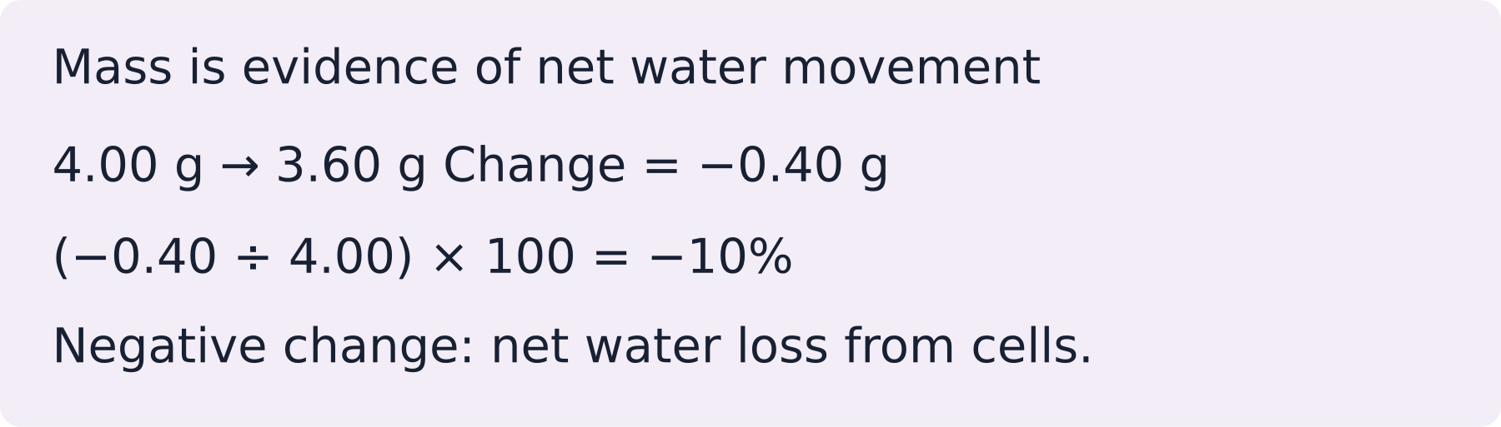
LAUNCH SCIENCE / W5L3
I Do 2 · 4 min
Connect the science
1
Description states the pattern in the plotted data.
2
Inference links the pattern to osmosis and the tested tissue.
3
Evaluation states how method or data could make the inference more secure.
Arrival
Starter
I Do
We Do
I Do 2
We Do 2
Independent
Exit
Resources
Notes:
Stage: I Do 2, 4 minutes. Monday / Wednesday / Friday P1, 09:30–10:10. Use reveals within this slot; appendix slides are not added time.
A fitted trend and zero crossing are estimates; sparse or variable data do not justify false precision.
Core explanation: Keep the raw data visible. Flag unusual values and investigate. Never delete a value simply because the graph looks tidier without it.
Watch for: Between +12% at 0.2 and −8% at 0.6, straight-line interpolation gives 0.44 mol dm⁻³, not the midpoint 0.4.
Least help first: Ask what the data shows before asking what it means, and require a reason for any exclusion decision.
Support cue: Find each mean: add the repeats and divide by their number. Describe the trend. Keep unusual results visible and explain any choice to leave one out.
[Sources]
User-supplied LAUNCH W3–W7 pack: W5 percentage-change and evaluation tasks, extended with repeated data and graphing.
Made by Matt LAUNCH Science draft, lesson-content.json, W5L3; existing illustrative diagrams reused, active-transport direction corrected to lower → higher.
Pearson Edexcel GCSE Biology specification, sections 1.1–1.6 and 1.15–1.17: https://qualifications.pearson.com/content/dam/pdf/GCSE/Science/2016/Specification/gcse-biology-spec.pdf
Optional concept video: freesciencelessons, Osmosis, https://www.youtube.com/watch?v=B0cH91joZwA (link located 5 September 2026).
[/Sources]
[Sources]
Source editable lesson: Original LAUNCH Science OneDrive pack, 5 September 2026, W5L3. Source teaching content preserved. Current HTML reference: https://madebymatt.uk/Lessons/Science_Teesside/Launch/. Native diagrams restate the source explanation and are not experimental measurements.
[/Sources]

Slide 6
LAUNCH SCIENCE / W5L3
We Do 2 · Task · 6 min
Keep the unusual result
Illustrative samples. Calculate the means; estimate where change is zero.
Sucrose / mol dm⁻³ | Repeat 1 / % | Repeat 2 / % | Repeat 3 / %
0.0 | 18 | 20 | 22
0.2 | 10 | 12 | 14
0.4 | 0 | 2 | 4
0.6 | −10 | −8 | −6
0.8 | −18 | −20 | −22
An extra repeat at 0.6 gives +9%. What should happen before excluding it?
Reveal shared reasoning
Arrival
Starter
I Do
We Do
I Do 2
We Do 2
Independent
Exit
Resources
Notes:
Stage: We Do 2 · Task, 6 minutes. Monday / Wednesday / Friday P1, 09:30–10:10. Use reveals within this slot; appendix slides are not added time.
Means: +20, +12, +2, −8, −20%.
Nearest crossing: 0.4 + (2 ÷ 10) × 0.2 ≈ 0.44 mol dm⁻³.
Retain and flag +9%; check the record and method before deciding. With it, the 0.6 mean is −3.75%.
Run the printed activity or this board; one route is enough.
Core explanation: Keep the raw data visible. Flag unusual values and investigate. Never delete a value simply because the graph looks tidier without it.
Watch for: Between +12% at 0.2 and −8% at 0.6, straight-line interpolation gives 0.44 mol dm⁻³, not the midpoint 0.4.
Least help first: Ask what the data shows before asking what it means, and require a reason for any exclusion decision.
Support cue: Find each mean: add the repeats and divide by their number. Describe the trend. Keep unusual results visible and explain any choice to leave one out.
[Sources]
User-supplied LAUNCH W3–W7 pack: W5 percentage-change and evaluation tasks, extended with repeated data and graphing.
Made by Matt LAUNCH Science draft, lesson-content.json, W5L3; existing illustrative diagrams reused, active-transport direction corrected to lower → higher.
Pearson Edexcel GCSE Biology specification, sections 1.1–1.6 and 1.15–1.17: https://qualifications.pearson.com/content/dam/pdf/GCSE/Science/2016/Specification/gcse-biology-spec.pdf
Optional concept video: freesciencelessons, Osmosis, https://www.youtube.com/watch?v=B0cH91joZwA (link located 5 September 2026).
[/Sources]
[Sources]
Source editable lesson: Original LAUNCH Science OneDrive pack, 5 September 2026, W5L3. Source teaching content preserved. Current HTML reference: https://madebymatt.uk/Lessons/Science_Teesside/Launch/. Native diagrams restate the source explanation and are not experimental measurements.
[/Sources]

Slide 7
LAUNCH SCIENCE / W5L3
Independent Task · 10 min
Your independent evidence
The mean percentage change falls from +12% at 0.2 mol dm⁻³ to −8% at 0.6 mol dm⁻³. Estimate the concentration where change may be zero and explain why the estimate should be reported as approximate. Suggest one additional data point that would improve it.
Optional support
Find each mean: add the repeats and divide by their number. Describe the trend. Keep unusual results visible and explain any choice to leave one out.
Make one precise correction to the same work after feedback.
Open worksheet pages
Model after first attempt
Arrival
Starter
I Do
We Do
I Do 2
We Do 2
Independent
Exit
Resources
Notes:
Stage: Independent Task, 10 minutes. Monday / Wednesday / Friday P1, 09:30–10:10. Use reveals within this slot; appendix slides are not added time.
Model answer: Assuming a straight line between the two means: 0.2 + (12 ÷ 20) × 0.4 = 0.44 mol dm⁻³. This is approximate because the real curve may not be straight and repeats vary. Test extra concentrations around 0.44 mol dm⁻³ with repeats.
Select only questions that fit the ten-minute slot. W7L3: Q2, Q3 and Q5 total 11 marks. The full paper needs a separate 25-minute slot.
Core explanation: Keep the raw data visible. Flag unusual values and investigate. Never delete a value simply because the graph looks tidier without it.
Watch for: Between +12% at 0.2 and −8% at 0.6, straight-line interpolation gives 0.44 mol dm⁻³, not the midpoint 0.4.
Least help first: Ask what the data shows before asking what it means, and require a reason for any exclusion decision.
Support cue: Find each mean: add the repeats and divide by their number. Describe the trend. Keep unusual results visible and explain any choice to leave one out.
[Sources]
User-supplied LAUNCH W3–W7 pack: W5 percentage-change and evaluation tasks, extended with repeated data and graphing.
Made by Matt LAUNCH Science draft, lesson-content.json, W5L3; existing illustrative diagrams reused, active-transport direction corrected to lower → higher.
Pearson Edexcel GCSE Biology specification, sections 1.1–1.6 and 1.15–1.17: https://qualifications.pearson.com/content/dam/pdf/GCSE/Science/2016/Specification/gcse-biology-spec.pdf
Optional concept video: freesciencelessons, Osmosis, https://www.youtube.com/watch?v=B0cH91joZwA (link located 5 September 2026).
[/Sources]
[Sources]
Source editable lesson: Original LAUNCH Science OneDrive pack, 5 September 2026, W5L3. Source teaching content preserved. Current HTML reference: https://madebymatt.uk/Lessons/Science_Teesside/Launch/. Native diagrams restate the source explanation and are not experimental measurements.
[/Sources]

Slide 8
LAUNCH SCIENCE / W5L3
Exit · 3 min
What changed in your thinking?
Complete: an anomaly is not automatically wrong because…
1
Point to one improvement in your work.
2
Choose what you want to revisit.
3
Tell your teacher; agree the next step together.
Arrival
Starter
I Do
We Do
I Do 2
We Do 2
Independent
Exit
Resources
Notes:
Stage: Exit, 3 minutes. Monday / Wednesday / Friday P1, 09:30–10:10. Use reveals within this slot; appendix slides are not added time.
Exit answer: An unusual result can be genuine variation or error; investigate before deciding.
Receive the request, record the agreed next action and check it next lesson. Keep responses private when requested.
Core explanation: Keep the raw data visible. Flag unusual values and investigate. Never delete a value simply because the graph looks tidier without it.
Watch for: Between +12% at 0.2 and −8% at 0.6, straight-line interpolation gives 0.44 mol dm⁻³, not the midpoint 0.4.
Least help first: Ask what the data shows before asking what it means, and require a reason for any exclusion decision.
Support cue: Find each mean: add the repeats and divide by their number. Describe the trend. Keep unusual results visible and explain any choice to leave one out.
[Sources]
User-supplied LAUNCH W3–W7 pack: W5 percentage-change and evaluation tasks, extended with repeated data and graphing.
Made by Matt LAUNCH Science draft, lesson-content.json, W5L3; existing illustrative diagrams reused, active-transport direction corrected to lower → higher.
Pearson Edexcel GCSE Biology specification, sections 1.1–1.6 and 1.15–1.17: https://qualifications.pearson.com/content/dam/pdf/GCSE/Science/2016/Specification/gcse-biology-spec.pdf
Optional concept video: freesciencelessons, Osmosis, https://www.youtube.com/watch?v=B0cH91joZwA (link located 5 September 2026).
[/Sources]
[Sources]
Source editable lesson: Original LAUNCH Science OneDrive pack, 5 September 2026, W5L3. Source teaching content preserved. Current HTML reference: https://madebymatt.uk/Lessons/Science_Teesside/Launch/. Native diagrams restate the source explanation and are not experimental measurements.
[/Sources]

Slide 9
LAUNCH SCIENCE / W5L3
Resources
Retrieval and prediction check
1
Mass loss relative to starting mass.
2
To investigate it and justify a mean decision; unusual does not automatically mean wrong.
Keep it visible and investigate before deciding
Return to Starter
Arrival
Starter
I Do
We Do
I Do 2
We Do 2
Independent
Exit
Resources
Notes:
Read only after an attempt; retain the pupil’s first view.
Core explanation: Keep the raw data visible. Flag unusual values and investigate. Never delete a value simply because the graph looks tidier without it.
Watch for: Between +12% at 0.2 and −8% at 0.6, straight-line interpolation gives 0.44 mol dm⁻³, not the midpoint 0.4.
Least help first: Ask what the data shows before asking what it means, and require a reason for any exclusion decision.
Support cue: Find each mean: add the repeats and divide by their number. Describe the trend. Keep unusual results visible and explain any choice to leave one out.
[Sources]
User-supplied LAUNCH W3–W7 pack: W5 percentage-change and evaluation tasks, extended with repeated data and graphing.
Made by Matt LAUNCH Science draft, lesson-content.json, W5L3; existing illustrative diagrams reused, active-transport direction corrected to lower → higher.
Pearson Edexcel GCSE Biology specification, sections 1.1–1.6 and 1.15–1.17: https://qualifications.pearson.com/content/dam/pdf/GCSE/Science/2016/Specification/gcse-biology-spec.pdf
Optional concept video: freesciencelessons, Osmosis, https://www.youtube.com/watch?v=B0cH91joZwA (link located 5 September 2026).
[/Sources]
[Sources]
Source editable lesson: Original LAUNCH Science OneDrive pack, 5 September 2026, W5L3. Source teaching content preserved. Current HTML reference: https://madebymatt.uk/Lessons/Science_Teesside/Launch/. Native diagrams restate the source explanation and are not experimental measurements.
[/Sources]

Slide 10
LAUNCH SCIENCE / W5L3
Resources
Check the deciding clue
The tested tissue and solution had little or no net water movement under those conditions
Accurate and appropriately cautious.
Compare your reason. Correct one step if needed.
Return to We Do
Arrival
Starter
I Do
We Do
I Do 2
We Do 2
Independent
Exit
Resources
Notes:
Particles still move; the claim concerns net change under the tested conditions.
Accurate and appropriately cautious.
Biological tissue contains water; the graph does not support this claim.
Variation means individual repeats need not all be exactly zero.
Core explanation: Keep the raw data visible. Flag unusual values and investigate. Never delete a value simply because the graph looks tidier without it.
Watch for: Between +12% at 0.2 and −8% at 0.6, straight-line interpolation gives 0.44 mol dm⁻³, not the midpoint 0.4.
Least help first: Ask what the data shows before asking what it means, and require a reason for any exclusion decision.
Support cue: Find each mean: add the repeats and divide by their number. Describe the trend. Keep unusual results visible and explain any choice to leave one out.
[Sources]
User-supplied LAUNCH W3–W7 pack: W5 percentage-change and evaluation tasks, extended with repeated data and graphing.
Made by Matt LAUNCH Science draft, lesson-content.json, W5L3; existing illustrative diagrams reused, active-transport direction corrected to lower → higher.
Pearson Edexcel GCSE Biology specification, sections 1.1–1.6 and 1.15–1.17: https://qualifications.pearson.com/content/dam/pdf/GCSE/Science/2016/Specification/gcse-biology-spec.pdf
Optional concept video: freesciencelessons, Osmosis, https://www.youtube.com/watch?v=B0cH91joZwA (link located 5 September 2026).
[/Sources]
[Sources]
Source editable lesson: Original LAUNCH Science OneDrive pack, 5 September 2026, W5L3. Source teaching content preserved. Current HTML reference: https://madebymatt.uk/Lessons/Science_Teesside/Launch/. Native diagrams restate the source explanation and are not experimental measurements.
[/Sources]

Slide 11
LAUNCH SCIENCE / W5L3
Resources
Our shared reasoning
Means: +20, +12, +2, −8, −20%.
Nearest crossing: 0.4 + (2 ÷ 10) × 0.2 ≈ 0.44 mol dm⁻³.
Retain and flag +9%; check the record and method before deciding. With it, the 0.6 mean is −3.75%.
Return to shared task
Arrival
Starter
I Do
We Do
I Do 2
We Do 2
Independent
Exit
Resources
Notes:
Pupils should justify, compare and revise rather than copy a complete answer before trying.
Core explanation: Keep the raw data visible. Flag unusual values and investigate. Never delete a value simply because the graph looks tidier without it.
Watch for: Between +12% at 0.2 and −8% at 0.6, straight-line interpolation gives 0.44 mol dm⁻³, not the midpoint 0.4.
Least help first: Ask what the data shows before asking what it means, and require a reason for any exclusion decision.
Support cue: Find each mean: add the repeats and divide by their number. Describe the trend. Keep unusual results visible and explain any choice to leave one out.
[Sources]
User-supplied LAUNCH W3–W7 pack: W5 percentage-change and evaluation tasks, extended with repeated data and graphing.
Made by Matt LAUNCH Science draft, lesson-content.json, W5L3; existing illustrative diagrams reused, active-transport direction corrected to lower → higher.
Pearson Edexcel GCSE Biology specification, sections 1.1–1.6 and 1.15–1.17: https://qualifications.pearson.com/content/dam/pdf/GCSE/Science/2016/Specification/gcse-biology-spec.pdf
Optional concept video: freesciencelessons, Osmosis, https://www.youtube.com/watch?v=B0cH91joZwA (link located 5 September 2026).
[/Sources]
[Sources]
Source editable lesson: Original LAUNCH Science OneDrive pack, 5 September 2026, W5L3. Source teaching content preserved. Current HTML reference: https://madebymatt.uk/Lessons/Science_Teesside/Launch/. Native diagrams restate the source explanation and are not experimental measurements.
[/Sources]

Slide 12
LAUNCH SCIENCE / W5L3
Resources
Compare after your first attempt
Assuming a straight line between the two means: 0.2 + (12 ÷ 20) × 0.4 = 0.44 mol dm⁻³. This is approximate because the real curve may not be straight and repeats vary. Test extra concentrations around 0.44 mol dm⁻³ with repeats.
Use the model to improve your explanation in your own words.
Return to independent task
Arrival
Starter
I Do
We Do
I Do 2
We Do 2
Independent
Exit
Resources
Notes:
Staff guide includes question-by-question answers. Do not distribute this presentation as a secure assessment paper.
Core explanation: Keep the raw data visible. Flag unusual values and investigate. Never delete a value simply because the graph looks tidier without it.
Watch for: Between +12% at 0.2 and −8% at 0.6, straight-line interpolation gives 0.44 mol dm⁻³, not the midpoint 0.4.
Least help first: Ask what the data shows before asking what it means, and require a reason for any exclusion decision.
Support cue: Find each mean: add the repeats and divide by their number. Describe the trend. Keep unusual results visible and explain any choice to leave one out.
[Sources]
User-supplied LAUNCH W3–W7 pack: W5 percentage-change and evaluation tasks, extended with repeated data and graphing.
Made by Matt LAUNCH Science draft, lesson-content.json, W5L3; existing illustrative diagrams reused, active-transport direction corrected to lower → higher.
Pearson Edexcel GCSE Biology specification, sections 1.1–1.6 and 1.15–1.17: https://qualifications.pearson.com/content/dam/pdf/GCSE/Science/2016/Specification/gcse-biology-spec.pdf
Optional concept video: freesciencelessons, Osmosis, https://www.youtube.com/watch?v=B0cH91joZwA (link located 5 September 2026).
[/Sources]
[Sources]
Source editable lesson: Original LAUNCH Science OneDrive pack, 5 September 2026, W5L3. Source teaching content preserved. Current HTML reference: https://madebymatt.uk/Lessons/Science_Teesside/Launch/. Native diagrams restate the source explanation and are not experimental measurements.
[/Sources]

Slide 13
LAUNCH SCIENCE / W5L3
Resources
Your lesson resources
Worksheet pages are stored inside this PowerPoint.
Worksheet · page 1
Worksheet · page 2
Standard PDF
Supported PDF
Depth PDF
Editable Word worksheet
Open online lesson / model
Named files are in this week’s folder. Online lesson and video need internet.
Optional concept video
Arrival
Starter
I Do
We Do
I Do 2
We Do 2
Independent
Exit
Resources
Notes:
File buttons use relative links for downloaded/synced folders. OneDrive preview may not resolve relative links. Use the embedded pages or open the named file in the week folder.
Core explanation: Keep the raw data visible. Flag unusual values and investigate. Never delete a value simply because the graph looks tidier without it.
Watch for: Between +12% at 0.2 and −8% at 0.6, straight-line interpolation gives 0.44 mol dm⁻³, not the midpoint 0.4.
Least help first: Ask what the data shows before asking what it means, and require a reason for any exclusion decision.
Support cue: Find each mean: add the repeats and divide by their number. Describe the trend. Keep unusual results visible and explain any choice to leave one out.
[Sources]
User-supplied LAUNCH W3–W7 pack: W5 percentage-change and evaluation tasks, extended with repeated data and graphing.
Made by Matt LAUNCH Science draft, lesson-content.json, W5L3; existing illustrative diagrams reused, active-transport direction corrected to lower → higher.
Pearson Edexcel GCSE Biology specification, sections 1.1–1.6 and 1.15–1.17: https://qualifications.pearson.com/content/dam/pdf/GCSE/Science/2016/Specification/gcse-biology-spec.pdf
Optional concept video: freesciencelessons, Osmosis, https://www.youtube.com/watch?v=B0cH91joZwA (link located 5 September 2026).
[/Sources]
[Sources]
Source editable lesson: Original LAUNCH Science OneDrive pack, 5 September 2026, W5L3. Source teaching content preserved. Current HTML reference: https://madebymatt.uk/Lessons/Science_Teesside/Launch/. Native diagrams restate the source explanation and are not experimental measurements.
[/Sources]

Slide 14
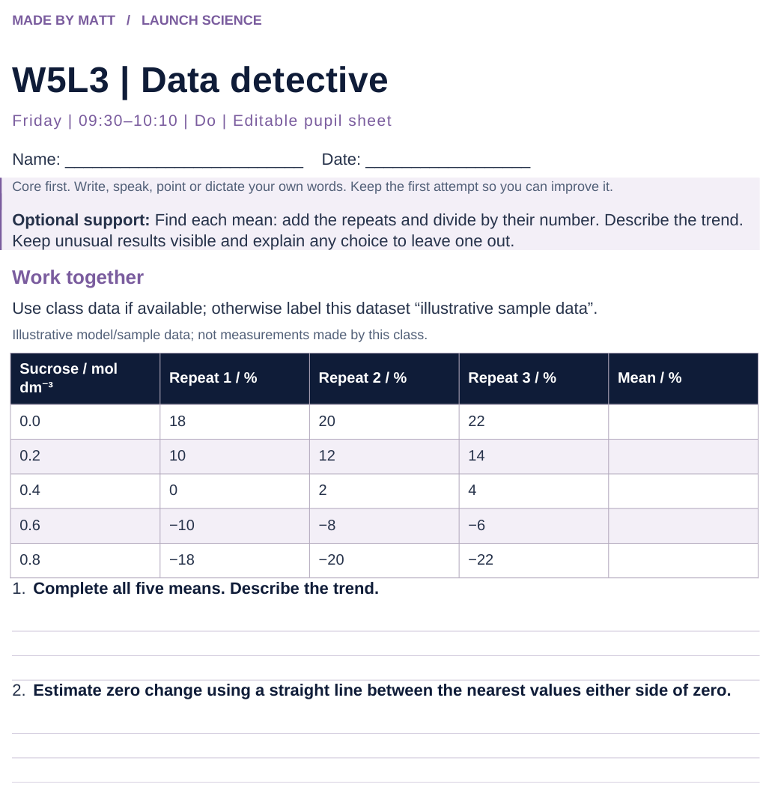
LAUNCH SCIENCE / W5L3
Resources
Worksheet · page 1
Use your printed copy.
Keep the first attempt.
Return to task
Arrival
Starter
I Do
We Do
I Do 2
We Do 2
Independent
Exit
Resources
Notes:
Embedded worksheet reference; print the separate PDF at A4 for writable space.
Core explanation: Keep the raw data visible. Flag unusual values and investigate. Never delete a value simply because the graph looks tidier without it.
Watch for: Between +12% at 0.2 and −8% at 0.6, straight-line interpolation gives 0.44 mol dm⁻³, not the midpoint 0.4.
Least help first: Ask what the data shows before asking what it means, and require a reason for any exclusion decision.
Support cue: Find each mean: add the repeats and divide by their number. Describe the trend. Keep unusual results visible and explain any choice to leave one out.
[Sources]
User-supplied LAUNCH W3–W7 pack: W5 percentage-change and evaluation tasks, extended with repeated data and graphing.
Made by Matt LAUNCH Science draft, lesson-content.json, W5L3; existing illustrative diagrams reused, active-transport direction corrected to lower → higher.
Pearson Edexcel GCSE Biology specification, sections 1.1–1.6 and 1.15–1.17: https://qualifications.pearson.com/content/dam/pdf/GCSE/Science/2016/Specification/gcse-biology-spec.pdf
Optional concept video: freesciencelessons, Osmosis, https://www.youtube.com/watch?v=B0cH91joZwA (link located 5 September 2026).
[/Sources]
[Sources]
Source editable lesson: Original LAUNCH Science OneDrive pack, 5 September 2026, W5L3. Source teaching content preserved. Current HTML reference: https://madebymatt.uk/Lessons/Science_Teesside/Launch/. Native diagrams restate the source explanation and are not experimental measurements.
[/Sources]

Slide 15
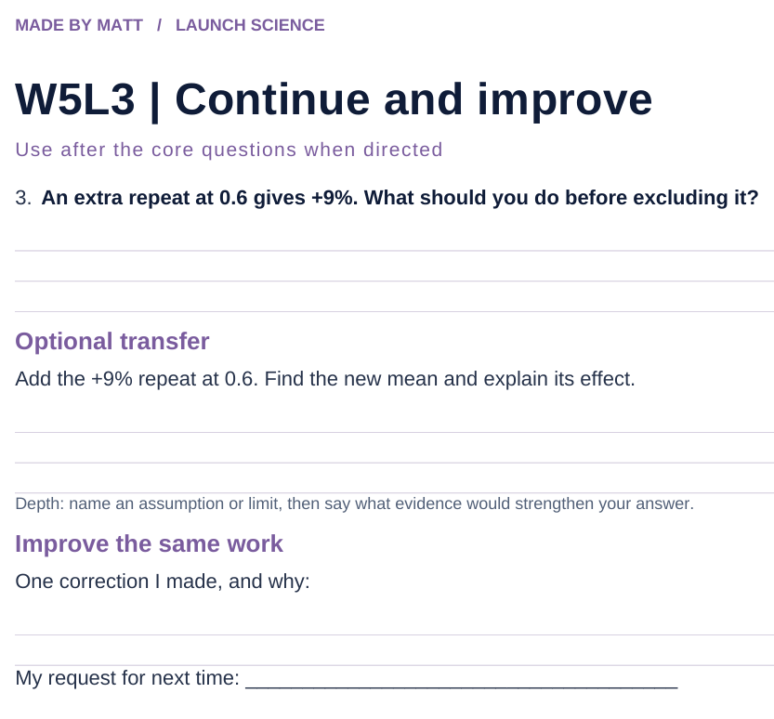
LAUNCH SCIENCE / W5L3
Resources
Worksheet · page 2
Continuation is optional.
Improve the same work.
Return to task
Arrival
Starter
I Do
We Do
I Do 2
We Do 2
Independent
Exit
Resources
Notes:
Embedded worksheet reference; print the separate PDF at A4 for writable space.
Core explanation: Keep the raw data visible. Flag unusual values and investigate. Never delete a value simply because the graph looks tidier without it.
Watch for: Between +12% at 0.2 and −8% at 0.6, straight-line interpolation gives 0.44 mol dm⁻³, not the midpoint 0.4.
Least help first: Ask what the data shows before asking what it means, and require a reason for any exclusion decision.
Support cue: Find each mean: add the repeats and divide by their number. Describe the trend. Keep unusual results visible and explain any choice to leave one out.
[Sources]
User-supplied LAUNCH W3–W7 pack: W5 percentage-change and evaluation tasks, extended with repeated data and graphing.
Made by Matt LAUNCH Science draft, lesson-content.json, W5L3; existing illustrative diagrams reused, active-transport direction corrected to lower → higher.
Pearson Edexcel GCSE Biology specification, sections 1.1–1.6 and 1.15–1.17: https://qualifications.pearson.com/content/dam/pdf/GCSE/Science/2016/Specification/gcse-biology-spec.pdf
Optional concept video: freesciencelessons, Osmosis, https://www.youtube.com/watch?v=B0cH91joZwA (link located 5 September 2026).
[/Sources]
[Sources]
Source editable lesson: Original LAUNCH Science OneDrive pack, 5 September 2026, W5L3. Source teaching content preserved. Current HTML reference: https://madebymatt.uk/Lessons/Science_Teesside/Launch/. Native diagrams restate the source explanation and are not experimental measurements.
[/Sources]

Slide 16
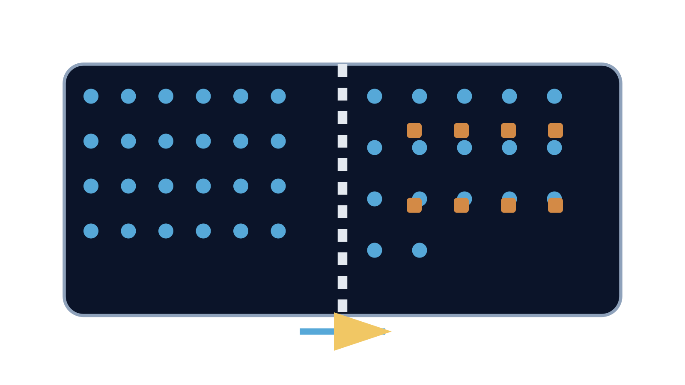
LAUNCH SCIENCE / W5L3
Resources
Watch, pause and explain
Osmosis
Which substance moves, through what, and in which net direction?
Play freesciencelessons video
No connection? Use the still model and explain the same question.
Arrival
Starter
I Do
We Do
I Do 2
We Do 2
Independent
Exit
Resources
Notes:
Use at most 90 seconds within I Do. Pause on the first relevant example; ask for a reason. This is an optional concept clip, not evidence of practical completion.
Core explanation: Keep the raw data visible. Flag unusual values and investigate. Never delete a value simply because the graph looks tidier without it.
Watch for: Between +12% at 0.2 and −8% at 0.6, straight-line interpolation gives 0.44 mol dm⁻³, not the midpoint 0.4.
Least help first: Ask what the data shows before asking what it means, and require a reason for any exclusion decision.
Support cue: Find each mean: add the repeats and divide by their number. Describe the trend. Keep unusual results visible and explain any choice to leave one out.
[Sources]
User-supplied LAUNCH W3–W7 pack: W5 percentage-change and evaluation tasks, extended with repeated data and graphing.
Made by Matt LAUNCH Science draft, lesson-content.json, W5L3; existing illustrative diagrams reused, active-transport direction corrected to lower → higher.
Pearson Edexcel GCSE Biology specification, sections 1.1–1.6 and 1.15–1.17: https://qualifications.pearson.com/content/dam/pdf/GCSE/Science/2016/Specification/gcse-biology-spec.pdf
Optional concept video: freesciencelessons, Osmosis, https://www.youtube.com/watch?v=B0cH91joZwA (link located 5 September 2026).
[/Sources]
[Sources]
Source editable lesson: Original LAUNCH Science OneDrive pack, 5 September 2026, W5L3. Source teaching content preserved. Current HTML reference: https://madebymatt.uk/Lessons/Science_Teesside/Launch/. Native diagrams restate the source explanation and are not experimental measurements.
[/Sources]

Slide 17
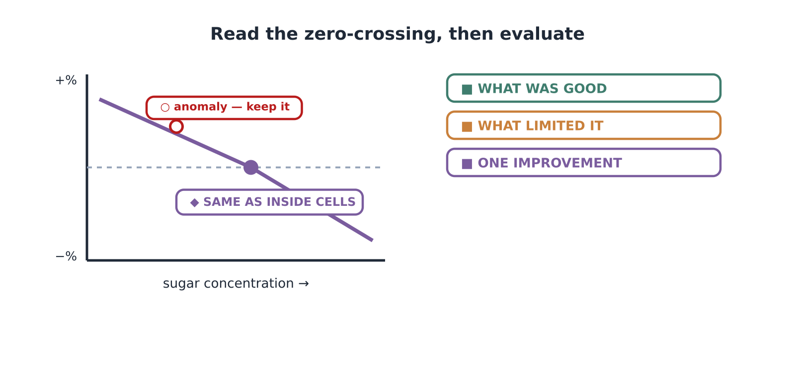
LAUNCH SCIENCE / W5L3
Resources
Look closely at the model
A model illustration: use the stated data for calculations.
Return to I Do
Arrival
Starter
I Do
We Do
I Do 2
We Do 2
Independent
Exit
Resources
Notes:
Source image: https://madebymatt.uk/Lessons/Science_Teesside/Launch/SCI_L_W5_L3_Evaluate.html; existing vector illustration embedded for offline use.
Core explanation: Keep the raw data visible. Flag unusual values and investigate. Never delete a value simply because the graph looks tidier without it.
Watch for: Between +12% at 0.2 and −8% at 0.6, straight-line interpolation gives 0.44 mol dm⁻³, not the midpoint 0.4.
Least help first: Ask what the data shows before asking what it means, and require a reason for any exclusion decision.
Support cue: Find each mean: add the repeats and divide by their number. Describe the trend. Keep unusual results visible and explain any choice to leave one out.
[Sources]
User-supplied LAUNCH W3–W7 pack: W5 percentage-change and evaluation tasks, extended with repeated data and graphing.
Made by Matt LAUNCH Science draft, lesson-content.json, W5L3; existing illustrative diagrams reused, active-transport direction corrected to lower → higher.
Pearson Edexcel GCSE Biology specification, sections 1.1–1.6 and 1.15–1.17: https://qualifications.pearson.com/content/dam/pdf/GCSE/Science/2016/Specification/gcse-biology-spec.pdf
Optional concept video: freesciencelessons, Osmosis, https://www.youtube.com/watch?v=B0cH91joZwA (link located 5 September 2026).
[/Sources]
[Sources]
Source editable lesson: Original LAUNCH Science OneDrive pack, 5 September 2026, W5L3. Source teaching content preserved. Current HTML reference: https://madebymatt.uk/Lessons/Science_Teesside/Launch/. Native diagrams restate the source explanation and are not experimental measurements.
[/Sources]

