Slide 1
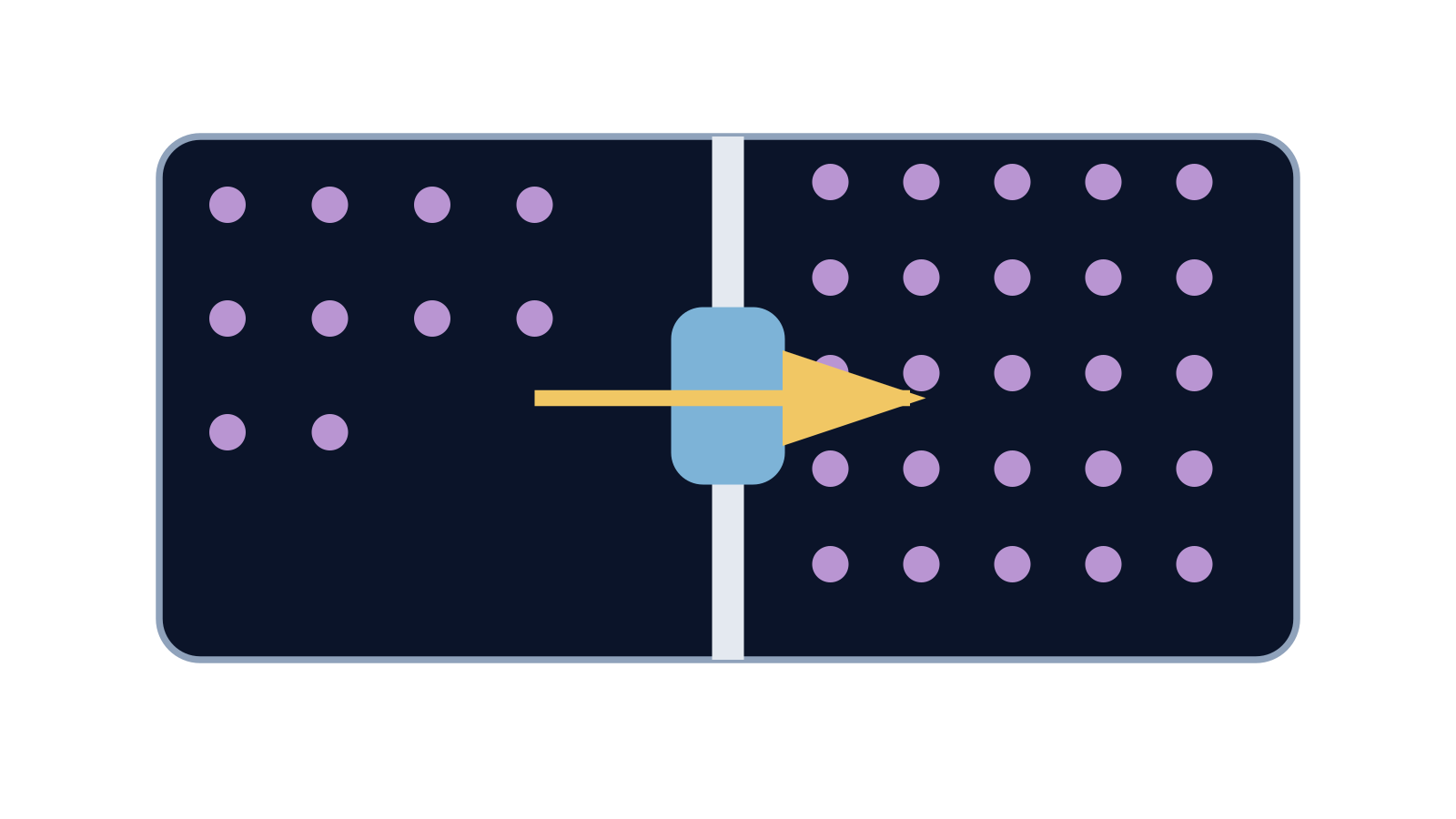
LAUNCH SCIENCE / W6L1
Arrival · 3 min
Active transport
I can explain how active transport moves substances against a concentration gradient and needs energy from respiration.
Notice. Recall. Be ready to explain.
1
What does ‘down a concentration gradient’ mean?
2
What substance moves in osmosis?
Retrieval answers
Arrival
Starter
I Do
We Do
I Do 2
We Do 2
Independent
Exit
Resources
Notes:
Stage: Arrival, 3 minutes. Monday / Wednesday / Friday P1, 09:30–10:10. Use reveals within this slot; appendix slides are not added time.
Retrieval answers: Net movement from higher to lower concentration of that substance. | Water. | Diffusion and osmosis. Either is acceptable for the singular question.
Core explanation: Active transport uses energy released by respiration to move a substance against its concentration gradient through membrane transport proteins.
Watch for: Diffusion is random at particle level. The contrast is net movement down a gradient versus energy-dependent movement against it, not “diffusion never moves backwards”.
Least help first: Ask the pupil to compare concentrations and trace the movement arrow before naming the process.
Support cue: Compare the concentration outside and inside. Add an inward arrow. Start: “The ions move from ___ to ___. This needs…”
[Sources]
User-supplied LAUNCH W3–W7 pack: W6 slides 5–8 and worksheet Task 1.
Made by Matt LAUNCH Science draft, lesson-content.json, W6L1; existing illustrative diagrams reused, active-transport direction corrected to lower → higher.
Pearson Edexcel GCSE Biology specification, sections 1.1–1.6 and 1.15–1.17: https://qualifications.pearson.com/content/dam/pdf/GCSE/Science/2016/Specification/gcse-biology-spec.pdf
Optional concept video: freesciencelessons, Active transport, https://www.youtube.com/watch?v=ECldVkp6Rw0 (link located 5 September 2026).
[/Sources]
[Sources]
Source editable lesson: Original LAUNCH Science OneDrive pack, 5 September 2026, W6L1. Source teaching content preserved. Current HTML reference: https://madebymatt.uk/Lessons/Science_Teesside/Launch/. Native diagrams restate the source explanation and are not experimental measurements.
[/Sources]

Slide 2
LAUNCH SCIENCE / W6L1
Starter · 4 min
Make a prediction
Mineral ions enter a root hair cell even when their concentration is already higher inside. Can diffusion alone explain this?
A Yes — diffusion can move against any gradient
B No — movement against the gradient needs another mechanism
C Only water can explain it
Commit, then check
Arrival
Starter
I Do
We Do
I Do 2
We Do 2
Independent
Exit
Resources
Notes:
Stage: Starter, 4 minutes. Monday / Wednesday / Friday P1, 09:30–10:10. Use reveals within this slot; appendix slides are not added time.
Correct: No — movement against the gradient needs another mechanism. Ask for the reason, then return to the original prediction.
Core explanation: Active transport uses energy released by respiration to move a substance against its concentration gradient through membrane transport proteins.
Watch for: Diffusion is random at particle level. The contrast is net movement down a gradient versus energy-dependent movement against it, not “diffusion never moves backwards”.
Least help first: Ask the pupil to compare concentrations and trace the movement arrow before naming the process.
Support cue: Compare the concentration outside and inside. Add an inward arrow. Start: “The ions move from ___ to ___. This needs…”
[Sources]
User-supplied LAUNCH W3–W7 pack: W6 slides 5–8 and worksheet Task 1.
Made by Matt LAUNCH Science draft, lesson-content.json, W6L1; existing illustrative diagrams reused, active-transport direction corrected to lower → higher.
Pearson Edexcel GCSE Biology specification, sections 1.1–1.6 and 1.15–1.17: https://qualifications.pearson.com/content/dam/pdf/GCSE/Science/2016/Specification/gcse-biology-spec.pdf
Optional concept video: freesciencelessons, Active transport, https://www.youtube.com/watch?v=ECldVkp6Rw0 (link located 5 September 2026).
[/Sources]
[Sources]
Source editable lesson: Original LAUNCH Science OneDrive pack, 5 September 2026, W6L1. Source teaching content preserved. Current HTML reference: https://madebymatt.uk/Lessons/Science_Teesside/Launch/. Native diagrams restate the source explanation and are not experimental measurements.
[/Sources]

Slide 3
LAUNCH SCIENCE / W6L1
I Do · 5 min
Watch the model
1
The observed movement is from lower concentration outside to higher concentration inside.
Movement needs energy
2
That direction is against the concentration gradient, so diffusion cannot be the full explanation.
Lower
Higher
3
Membrane proteins use energy from respiration to move the substance.
Energy from respiration
View labelled diagram
Optional video
Arrival
Starter
I Do
We Do
I Do 2
We Do 2
Independent
Exit
Resources
Notes:
Stage: I Do, 5 minutes. Monday / Wednesday / Friday P1, 09:30–10:10. Use reveals within this slot; appendix slides are not added time.
The pump model shows gradient direction and energy status separately.
Model limit: The pump symbol stands for membrane proteins. It does not show every molecular step.
Video replaces up to 90 seconds of explanation; use the still diagram if unavailable.
Core explanation: Active transport uses energy released by respiration to move a substance against its concentration gradient through membrane transport proteins.
Watch for: Diffusion is random at particle level. The contrast is net movement down a gradient versus energy-dependent movement against it, not “diffusion never moves backwards”.
Least help first: Ask the pupil to compare concentrations and trace the movement arrow before naming the process.
Support cue: Compare the concentration outside and inside. Add an inward arrow. Start: “The ions move from ___ to ___. This needs…”
[Sources]
User-supplied LAUNCH W3–W7 pack: W6 slides 5–8 and worksheet Task 1.
Made by Matt LAUNCH Science draft, lesson-content.json, W6L1; existing illustrative diagrams reused, active-transport direction corrected to lower → higher.
Pearson Edexcel GCSE Biology specification, sections 1.1–1.6 and 1.15–1.17: https://qualifications.pearson.com/content/dam/pdf/GCSE/Science/2016/Specification/gcse-biology-spec.pdf
Optional concept video: freesciencelessons, Active transport, https://www.youtube.com/watch?v=ECldVkp6Rw0 (link located 5 September 2026).
[/Sources]
[Sources]
Source editable lesson: Original LAUNCH Science OneDrive pack, 5 September 2026, W6L1. Source teaching content preserved. Current HTML reference: https://madebymatt.uk/Lessons/Science_Teesside/Launch/. Native diagrams restate the source explanation and are not experimental measurements.
[/Sources]

Slide 4
LAUNCH SCIENCE / W6L1
We Do · 5 min
Choose and justify
Which combination identifies active transport?
A Water only, down a gradient, no energy
B Any particles, random movement, no membrane
C A substance moved against its concentration gradient and needed energy
D All fast movement across a membrane
Give the deciding clue before checking.
Check the reasoning
Arrival
Starter
I Do
We Do
I Do 2
We Do 2
Independent
Exit
Resources
Notes:
Stage: We Do, 5 minutes. Monday / Wednesday / Friday P1, 09:30–10:10. Use reveals within this slot; appendix slides are not added time.
A: Water only, down a gradient, no energy — This describes osmosis only partly and lacks the membrane condition.
B: Any particles, random movement, no membrane — This describes random motion, not an active membrane process.
C: A substance moved against its concentration gradient and needed energy — Correct. Now state that respiration supplies the energy.
D: All fast movement across a membrane — Speed alone does not define active transport.
Core explanation: Active transport uses energy released by respiration to move a substance against its concentration gradient through membrane transport proteins.
Watch for: Diffusion is random at particle level. The contrast is net movement down a gradient versus energy-dependent movement against it, not “diffusion never moves backwards”.
Least help first: Ask the pupil to compare concentrations and trace the movement arrow before naming the process.
Support cue: Compare the concentration outside and inside. Add an inward arrow. Start: “The ions move from ___ to ___. This needs…”
[Sources]
User-supplied LAUNCH W3–W7 pack: W6 slides 5–8 and worksheet Task 1.
Made by Matt LAUNCH Science draft, lesson-content.json, W6L1; existing illustrative diagrams reused, active-transport direction corrected to lower → higher.
Pearson Edexcel GCSE Biology specification, sections 1.1–1.6 and 1.15–1.17: https://qualifications.pearson.com/content/dam/pdf/GCSE/Science/2016/Specification/gcse-biology-spec.pdf
Optional concept video: freesciencelessons, Active transport, https://www.youtube.com/watch?v=ECldVkp6Rw0 (link located 5 September 2026).
[/Sources]
[Sources]
Source editable lesson: Original LAUNCH Science OneDrive pack, 5 September 2026, W6L1. Source teaching content preserved. Current HTML reference: https://madebymatt.uk/Lessons/Science_Teesside/Launch/. Native diagrams restate the source explanation and are not experimental measurements.
[/Sources]

Slide 5
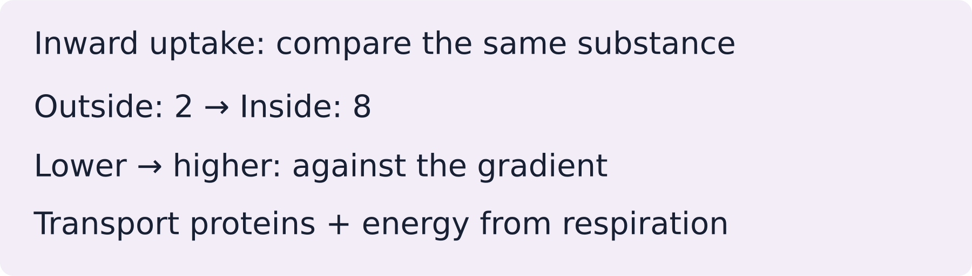
LAUNCH SCIENCE / W6L1
I Do 2 · 4 min
Connect the science
1
Diffusion: net particle movement is down a concentration gradient. It does not need energy from respiration.
2
Osmosis: water moves through a partially permeable membrane. It does not need energy from respiration.
3
Active transport: a substance moves against its concentration gradient using energy from respiration.
Arrival
Starter
I Do
We Do
I Do 2
We Do 2
Independent
Exit
Resources
Notes:
Stage: I Do 2, 4 minutes. Monday / Wednesday / Friday P1, 09:30–10:10. Use reveals within this slot; appendix slides are not added time.
The pump symbol stands for membrane proteins. It does not show every molecular step.
Core explanation: Active transport uses energy released by respiration to move a substance against its concentration gradient through membrane transport proteins.
Watch for: Diffusion is random at particle level. The contrast is net movement down a gradient versus energy-dependent movement against it, not “diffusion never moves backwards”.
Least help first: Ask the pupil to compare concentrations and trace the movement arrow before naming the process.
Support cue: Compare the concentration outside and inside. Add an inward arrow. Start: “The ions move from ___ to ___. This needs…”
[Sources]
User-supplied LAUNCH W3–W7 pack: W6 slides 5–8 and worksheet Task 1.
Made by Matt LAUNCH Science draft, lesson-content.json, W6L1; existing illustrative diagrams reused, active-transport direction corrected to lower → higher.
Pearson Edexcel GCSE Biology specification, sections 1.1–1.6 and 1.15–1.17: https://qualifications.pearson.com/content/dam/pdf/GCSE/Science/2016/Specification/gcse-biology-spec.pdf
Optional concept video: freesciencelessons, Active transport, https://www.youtube.com/watch?v=ECldVkp6Rw0 (link located 5 September 2026).
[/Sources]
[Sources]
Source editable lesson: Original LAUNCH Science OneDrive pack, 5 September 2026, W6L1. Source teaching content preserved. Current HTML reference: https://madebymatt.uk/Lessons/Science_Teesside/Launch/. Native diagrams restate the source explanation and are not experimental measurements.
[/Sources]

Slide 6
LAUNCH SCIENCE / W6L1
We Do 2 · Task · 6 min
Predict the energy effect
Equal-volume regions: 2 nitrate ions outside, 8 inside. Net movement of nitrate ions is inwards.
1
Which way is movement relative to the gradient?
2
What does the membrane transport protein need?
3
Predict what happens if respiration is reduced.
Reveal shared reasoning
Arrival
Starter
I Do
We Do
I Do 2
We Do 2
Independent
Exit
Resources
Notes:
Stage: We Do 2 · Task, 6 minutes. Monday / Wednesday / Friday P1, 09:30–10:10. Use reveals within this slot; appendix slides are not added time.
Inward movement is lower → higher: against the gradient. Active transport needs energy released by respiration. Less available energy reduces uptake. An instant on/off model simplifies a real cell.
Run the printed activity or this board; one route is enough.
Core explanation: Active transport uses energy released by respiration to move a substance against its concentration gradient through membrane transport proteins.
Watch for: Diffusion is random at particle level. The contrast is net movement down a gradient versus energy-dependent movement against it, not “diffusion never moves backwards”.
Least help first: Ask the pupil to compare concentrations and trace the movement arrow before naming the process.
Support cue: Compare the concentration outside and inside. Add an inward arrow. Start: “The ions move from ___ to ___. This needs…”
[Sources]
User-supplied LAUNCH W3–W7 pack: W6 slides 5–8 and worksheet Task 1.
Made by Matt LAUNCH Science draft, lesson-content.json, W6L1; existing illustrative diagrams reused, active-transport direction corrected to lower → higher.
Pearson Edexcel GCSE Biology specification, sections 1.1–1.6 and 1.15–1.17: https://qualifications.pearson.com/content/dam/pdf/GCSE/Science/2016/Specification/gcse-biology-spec.pdf
Optional concept video: freesciencelessons, Active transport, https://www.youtube.com/watch?v=ECldVkp6Rw0 (link located 5 September 2026).
[/Sources]
[Sources]
Source editable lesson: Original LAUNCH Science OneDrive pack, 5 September 2026, W6L1. Source teaching content preserved. Current HTML reference: https://madebymatt.uk/Lessons/Science_Teesside/Launch/. Native diagrams restate the source explanation and are not experimental measurements.
[/Sources]

Slide 7
LAUNCH SCIENCE / W6L1
Independent Task · 10 min
Your independent evidence
A cell keeps taking in nitrate ions when their concentration is lower outside than inside. Explain why active transport is needed. Predict what happens if respiration falls.
Optional support
Compare the concentration outside and inside. Add an inward arrow. Start: “The ions move from ___ to ___. This needs…”
Make one precise correction to the same work after feedback.
Open worksheet pages
Model after first attempt
Arrival
Starter
I Do
We Do
I Do 2
We Do 2
Independent
Exit
Resources
Notes:
Stage: Independent Task, 10 minutes. Monday / Wednesday / Friday P1, 09:30–10:10. Use reveals within this slot; appendix slides are not added time.
Model answer: Nitrate ions move from a lower concentration outside the cell to a higher concentration inside, which is against the concentration gradient. Active transport is therefore required and uses energy supplied by respiration through membrane transport proteins. If respiration is strongly reduced, less energy is available and nitrate uptake will slow or stop.
Select only questions that fit the ten-minute slot. W7L3: Q2, Q3 and Q5 total 11 marks. The full paper needs a separate 25-minute slot.
Core explanation: Active transport uses energy released by respiration to move a substance against its concentration gradient through membrane transport proteins.
Watch for: Diffusion is random at particle level. The contrast is net movement down a gradient versus energy-dependent movement against it, not “diffusion never moves backwards”.
Least help first: Ask the pupil to compare concentrations and trace the movement arrow before naming the process.
Support cue: Compare the concentration outside and inside. Add an inward arrow. Start: “The ions move from ___ to ___. This needs…”
[Sources]
User-supplied LAUNCH W3–W7 pack: W6 slides 5–8 and worksheet Task 1.
Made by Matt LAUNCH Science draft, lesson-content.json, W6L1; existing illustrative diagrams reused, active-transport direction corrected to lower → higher.
Pearson Edexcel GCSE Biology specification, sections 1.1–1.6 and 1.15–1.17: https://qualifications.pearson.com/content/dam/pdf/GCSE/Science/2016/Specification/gcse-biology-spec.pdf
Optional concept video: freesciencelessons, Active transport, https://www.youtube.com/watch?v=ECldVkp6Rw0 (link located 5 September 2026).
[/Sources]
[Sources]
Source editable lesson: Original LAUNCH Science OneDrive pack, 5 September 2026, W6L1. Source teaching content preserved. Current HTML reference: https://madebymatt.uk/Lessons/Science_Teesside/Launch/. Native diagrams restate the source explanation and are not experimental measurements.
[/Sources]

Slide 8
LAUNCH SCIENCE / W6L1
Exit · 3 min
What changed in your thinking?
Why is ‘active transport is fast diffusion’ scientifically wrong?
1
Point to one improvement in your work.
2
Choose what you want to revisit.
3
Tell your teacher; agree the next step together.
Arrival
Starter
I Do
We Do
I Do 2
We Do 2
Independent
Exit
Resources
Notes:
Stage: Exit, 3 minutes. Monday / Wednesday / Friday P1, 09:30–10:10. Use reveals within this slot; appendix slides are not added time.
Exit answer: Active transport is energy-dependent movement against a gradient, not a fast version of net diffusion.
Receive the request, record the agreed next action and check it next lesson. Keep responses private when requested.
Core explanation: Active transport uses energy released by respiration to move a substance against its concentration gradient through membrane transport proteins.
Watch for: Diffusion is random at particle level. The contrast is net movement down a gradient versus energy-dependent movement against it, not “diffusion never moves backwards”.
Least help first: Ask the pupil to compare concentrations and trace the movement arrow before naming the process.
Support cue: Compare the concentration outside and inside. Add an inward arrow. Start: “The ions move from ___ to ___. This needs…”
[Sources]
User-supplied LAUNCH W3–W7 pack: W6 slides 5–8 and worksheet Task 1.
Made by Matt LAUNCH Science draft, lesson-content.json, W6L1; existing illustrative diagrams reused, active-transport direction corrected to lower → higher.
Pearson Edexcel GCSE Biology specification, sections 1.1–1.6 and 1.15–1.17: https://qualifications.pearson.com/content/dam/pdf/GCSE/Science/2016/Specification/gcse-biology-spec.pdf
Optional concept video: freesciencelessons, Active transport, https://www.youtube.com/watch?v=ECldVkp6Rw0 (link located 5 September 2026).
[/Sources]
[Sources]
Source editable lesson: Original LAUNCH Science OneDrive pack, 5 September 2026, W6L1. Source teaching content preserved. Current HTML reference: https://madebymatt.uk/Lessons/Science_Teesside/Launch/. Native diagrams restate the source explanation and are not experimental measurements.
[/Sources]

Slide 9
LAUNCH SCIENCE / W6L1
Resources
Retrieval and prediction check
1
Net movement from higher to lower concentration of that substance.
2
Water.
No — movement against the gradient needs another mechanism
Return to Starter
Arrival
Starter
I Do
We Do
I Do 2
We Do 2
Independent
Exit
Resources
Notes:
Read only after an attempt; retain the pupil’s first view.
Core explanation: Active transport uses energy released by respiration to move a substance against its concentration gradient through membrane transport proteins.
Watch for: Diffusion is random at particle level. The contrast is net movement down a gradient versus energy-dependent movement against it, not “diffusion never moves backwards”.
Least help first: Ask the pupil to compare concentrations and trace the movement arrow before naming the process.
Support cue: Compare the concentration outside and inside. Add an inward arrow. Start: “The ions move from ___ to ___. This needs…”
[Sources]
User-supplied LAUNCH W3–W7 pack: W6 slides 5–8 and worksheet Task 1.
Made by Matt LAUNCH Science draft, lesson-content.json, W6L1; existing illustrative diagrams reused, active-transport direction corrected to lower → higher.
Pearson Edexcel GCSE Biology specification, sections 1.1–1.6 and 1.15–1.17: https://qualifications.pearson.com/content/dam/pdf/GCSE/Science/2016/Specification/gcse-biology-spec.pdf
Optional concept video: freesciencelessons, Active transport, https://www.youtube.com/watch?v=ECldVkp6Rw0 (link located 5 September 2026).
[/Sources]
[Sources]
Source editable lesson: Original LAUNCH Science OneDrive pack, 5 September 2026, W6L1. Source teaching content preserved. Current HTML reference: https://madebymatt.uk/Lessons/Science_Teesside/Launch/. Native diagrams restate the source explanation and are not experimental measurements.
[/Sources]

Slide 10
LAUNCH SCIENCE / W6L1
Resources
Check the deciding clue
A substance moved against its concentration gradient and needed energy
Correct. Now state that respiration supplies the energy.
Compare your reason. Correct one step if needed.
Return to We Do
Arrival
Starter
I Do
We Do
I Do 2
We Do 2
Independent
Exit
Resources
Notes:
This describes osmosis only partly and lacks the membrane condition.
This describes random motion, not an active membrane process.
Correct. Now state that respiration supplies the energy.
Speed alone does not define active transport.
Core explanation: Active transport uses energy released by respiration to move a substance against its concentration gradient through membrane transport proteins.
Watch for: Diffusion is random at particle level. The contrast is net movement down a gradient versus energy-dependent movement against it, not “diffusion never moves backwards”.
Least help first: Ask the pupil to compare concentrations and trace the movement arrow before naming the process.
Support cue: Compare the concentration outside and inside. Add an inward arrow. Start: “The ions move from ___ to ___. This needs…”
[Sources]
User-supplied LAUNCH W3–W7 pack: W6 slides 5–8 and worksheet Task 1.
Made by Matt LAUNCH Science draft, lesson-content.json, W6L1; existing illustrative diagrams reused, active-transport direction corrected to lower → higher.
Pearson Edexcel GCSE Biology specification, sections 1.1–1.6 and 1.15–1.17: https://qualifications.pearson.com/content/dam/pdf/GCSE/Science/2016/Specification/gcse-biology-spec.pdf
Optional concept video: freesciencelessons, Active transport, https://www.youtube.com/watch?v=ECldVkp6Rw0 (link located 5 September 2026).
[/Sources]
[Sources]
Source editable lesson: Original LAUNCH Science OneDrive pack, 5 September 2026, W6L1. Source teaching content preserved. Current HTML reference: https://madebymatt.uk/Lessons/Science_Teesside/Launch/. Native diagrams restate the source explanation and are not experimental measurements.
[/Sources]

Slide 11
LAUNCH SCIENCE / W6L1
Resources
Our shared reasoning
Inward movement is lower → higher: against the gradient. Active transport needs energy released by respiration. Less available energy reduces uptake. An instant on/off model simplifies a real cell.
Return to shared task
Arrival
Starter
I Do
We Do
I Do 2
We Do 2
Independent
Exit
Resources
Notes:
Pupils should justify, compare and revise rather than copy a complete answer before trying.
Core explanation: Active transport uses energy released by respiration to move a substance against its concentration gradient through membrane transport proteins.
Watch for: Diffusion is random at particle level. The contrast is net movement down a gradient versus energy-dependent movement against it, not “diffusion never moves backwards”.
Least help first: Ask the pupil to compare concentrations and trace the movement arrow before naming the process.
Support cue: Compare the concentration outside and inside. Add an inward arrow. Start: “The ions move from ___ to ___. This needs…”
[Sources]
User-supplied LAUNCH W3–W7 pack: W6 slides 5–8 and worksheet Task 1.
Made by Matt LAUNCH Science draft, lesson-content.json, W6L1; existing illustrative diagrams reused, active-transport direction corrected to lower → higher.
Pearson Edexcel GCSE Biology specification, sections 1.1–1.6 and 1.15–1.17: https://qualifications.pearson.com/content/dam/pdf/GCSE/Science/2016/Specification/gcse-biology-spec.pdf
Optional concept video: freesciencelessons, Active transport, https://www.youtube.com/watch?v=ECldVkp6Rw0 (link located 5 September 2026).
[/Sources]
[Sources]
Source editable lesson: Original LAUNCH Science OneDrive pack, 5 September 2026, W6L1. Source teaching content preserved. Current HTML reference: https://madebymatt.uk/Lessons/Science_Teesside/Launch/. Native diagrams restate the source explanation and are not experimental measurements.
[/Sources]

Slide 12
LAUNCH SCIENCE / W6L1
Resources
Compare after your first attempt
Nitrate ions move from a lower concentration outside the cell to a higher concentration inside, which is against the concentration gradient. Active transport is therefore required and uses energy supplied by respiration through membrane transport proteins. If respiration is strongly reduced, less energy is available and nitrate uptake will slow or stop.
Use the model to improve your explanation in your own words.
Return to independent task
Arrival
Starter
I Do
We Do
I Do 2
We Do 2
Independent
Exit
Resources
Notes:
Staff guide includes question-by-question answers. Do not distribute this presentation as a secure assessment paper.
Core explanation: Active transport uses energy released by respiration to move a substance against its concentration gradient through membrane transport proteins.
Watch for: Diffusion is random at particle level. The contrast is net movement down a gradient versus energy-dependent movement against it, not “diffusion never moves backwards”.
Least help first: Ask the pupil to compare concentrations and trace the movement arrow before naming the process.
Support cue: Compare the concentration outside and inside. Add an inward arrow. Start: “The ions move from ___ to ___. This needs…”
[Sources]
User-supplied LAUNCH W3–W7 pack: W6 slides 5–8 and worksheet Task 1.
Made by Matt LAUNCH Science draft, lesson-content.json, W6L1; existing illustrative diagrams reused, active-transport direction corrected to lower → higher.
Pearson Edexcel GCSE Biology specification, sections 1.1–1.6 and 1.15–1.17: https://qualifications.pearson.com/content/dam/pdf/GCSE/Science/2016/Specification/gcse-biology-spec.pdf
Optional concept video: freesciencelessons, Active transport, https://www.youtube.com/watch?v=ECldVkp6Rw0 (link located 5 September 2026).
[/Sources]
[Sources]
Source editable lesson: Original LAUNCH Science OneDrive pack, 5 September 2026, W6L1. Source teaching content preserved. Current HTML reference: https://madebymatt.uk/Lessons/Science_Teesside/Launch/. Native diagrams restate the source explanation and are not experimental measurements.
[/Sources]

Slide 13
LAUNCH SCIENCE / W6L1
Resources
Your lesson resources
Worksheet pages are stored inside this PowerPoint.
Worksheet · page 1
Worksheet · page 2
Standard PDF
Supported PDF
Depth PDF
Editable Word worksheet
Open online lesson / model
Named files are in this week’s folder. Online lesson and video need internet.
Optional concept video
Arrival
Starter
I Do
We Do
I Do 2
We Do 2
Independent
Exit
Resources
Notes:
File buttons use relative links for downloaded/synced folders. OneDrive preview may not resolve relative links. Use the embedded pages or open the named file in the week folder.
Core explanation: Active transport uses energy released by respiration to move a substance against its concentration gradient through membrane transport proteins.
Watch for: Diffusion is random at particle level. The contrast is net movement down a gradient versus energy-dependent movement against it, not “diffusion never moves backwards”.
Least help first: Ask the pupil to compare concentrations and trace the movement arrow before naming the process.
Support cue: Compare the concentration outside and inside. Add an inward arrow. Start: “The ions move from ___ to ___. This needs…”
[Sources]
User-supplied LAUNCH W3–W7 pack: W6 slides 5–8 and worksheet Task 1.
Made by Matt LAUNCH Science draft, lesson-content.json, W6L1; existing illustrative diagrams reused, active-transport direction corrected to lower → higher.
Pearson Edexcel GCSE Biology specification, sections 1.1–1.6 and 1.15–1.17: https://qualifications.pearson.com/content/dam/pdf/GCSE/Science/2016/Specification/gcse-biology-spec.pdf
Optional concept video: freesciencelessons, Active transport, https://www.youtube.com/watch?v=ECldVkp6Rw0 (link located 5 September 2026).
[/Sources]
[Sources]
Source editable lesson: Original LAUNCH Science OneDrive pack, 5 September 2026, W6L1. Source teaching content preserved. Current HTML reference: https://madebymatt.uk/Lessons/Science_Teesside/Launch/. Native diagrams restate the source explanation and are not experimental measurements.
[/Sources]

Slide 14
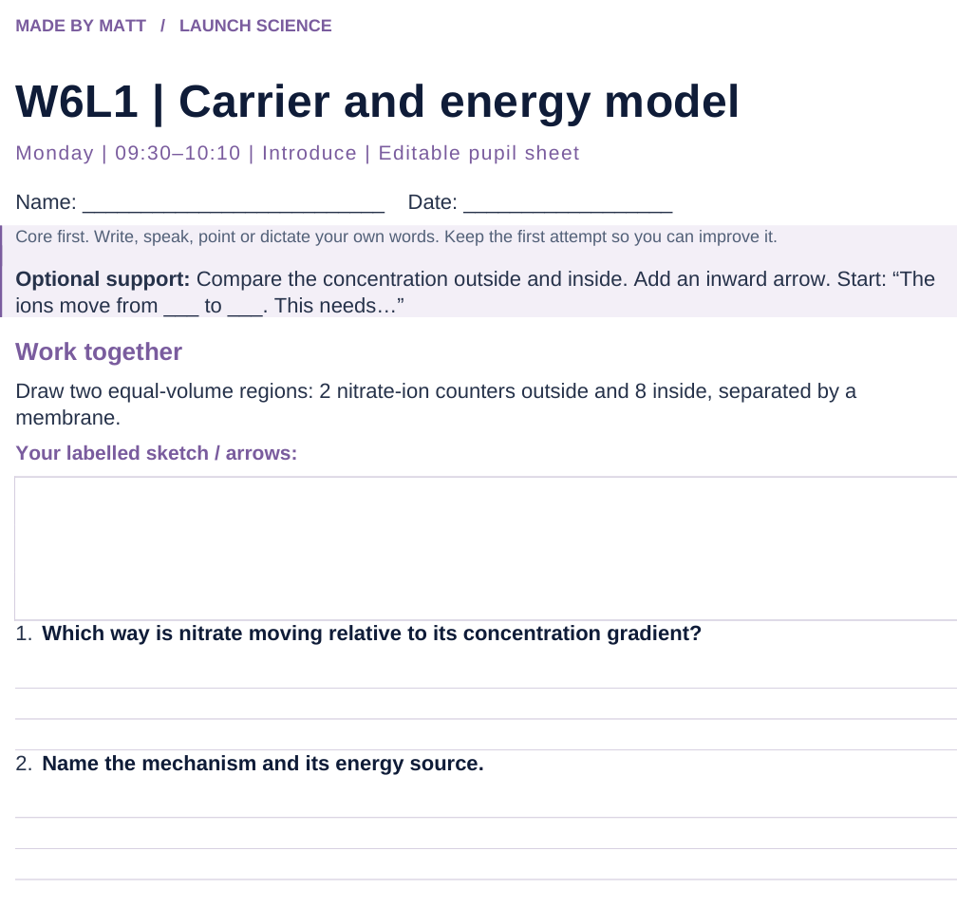
LAUNCH SCIENCE / W6L1
Resources
Worksheet · page 1
Use your printed copy.
Keep the first attempt.
Return to task
Arrival
Starter
I Do
We Do
I Do 2
We Do 2
Independent
Exit
Resources
Notes:
Embedded worksheet reference; print the separate PDF at A4 for writable space.
Core explanation: Active transport uses energy released by respiration to move a substance against its concentration gradient through membrane transport proteins.
Watch for: Diffusion is random at particle level. The contrast is net movement down a gradient versus energy-dependent movement against it, not “diffusion never moves backwards”.
Least help first: Ask the pupil to compare concentrations and trace the movement arrow before naming the process.
Support cue: Compare the concentration outside and inside. Add an inward arrow. Start: “The ions move from ___ to ___. This needs…”
[Sources]
User-supplied LAUNCH W3–W7 pack: W6 slides 5–8 and worksheet Task 1.
Made by Matt LAUNCH Science draft, lesson-content.json, W6L1; existing illustrative diagrams reused, active-transport direction corrected to lower → higher.
Pearson Edexcel GCSE Biology specification, sections 1.1–1.6 and 1.15–1.17: https://qualifications.pearson.com/content/dam/pdf/GCSE/Science/2016/Specification/gcse-biology-spec.pdf
Optional concept video: freesciencelessons, Active transport, https://www.youtube.com/watch?v=ECldVkp6Rw0 (link located 5 September 2026).
[/Sources]
[Sources]
Source editable lesson: Original LAUNCH Science OneDrive pack, 5 September 2026, W6L1. Source teaching content preserved. Current HTML reference: https://madebymatt.uk/Lessons/Science_Teesside/Launch/. Native diagrams restate the source explanation and are not experimental measurements.
[/Sources]

Slide 15
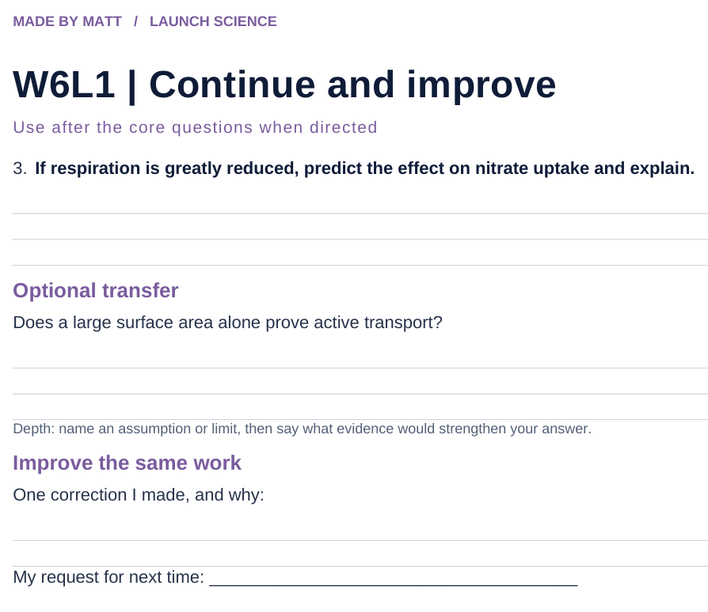
LAUNCH SCIENCE / W6L1
Resources
Worksheet · page 2
Continuation is optional.
Improve the same work.
Return to task
Arrival
Starter
I Do
We Do
I Do 2
We Do 2
Independent
Exit
Resources
Notes:
Embedded worksheet reference; print the separate PDF at A4 for writable space.
Core explanation: Active transport uses energy released by respiration to move a substance against its concentration gradient through membrane transport proteins.
Watch for: Diffusion is random at particle level. The contrast is net movement down a gradient versus energy-dependent movement against it, not “diffusion never moves backwards”.
Least help first: Ask the pupil to compare concentrations and trace the movement arrow before naming the process.
Support cue: Compare the concentration outside and inside. Add an inward arrow. Start: “The ions move from ___ to ___. This needs…”
[Sources]
User-supplied LAUNCH W3–W7 pack: W6 slides 5–8 and worksheet Task 1.
Made by Matt LAUNCH Science draft, lesson-content.json, W6L1; existing illustrative diagrams reused, active-transport direction corrected to lower → higher.
Pearson Edexcel GCSE Biology specification, sections 1.1–1.6 and 1.15–1.17: https://qualifications.pearson.com/content/dam/pdf/GCSE/Science/2016/Specification/gcse-biology-spec.pdf
Optional concept video: freesciencelessons, Active transport, https://www.youtube.com/watch?v=ECldVkp6Rw0 (link located 5 September 2026).
[/Sources]
[Sources]
Source editable lesson: Original LAUNCH Science OneDrive pack, 5 September 2026, W6L1. Source teaching content preserved. Current HTML reference: https://madebymatt.uk/Lessons/Science_Teesside/Launch/. Native diagrams restate the source explanation and are not experimental measurements.
[/Sources]

Slide 16
LAUNCH SCIENCE / W6L1
Resources
Watch, pause and explain
Active transport
What two clues distinguish active transport from diffusion?
Play freesciencelessons video
No connection? Use the still model and explain the same question.
Arrival
Starter
I Do
We Do
I Do 2
We Do 2
Independent
Exit
Resources
Notes:
Use at most 90 seconds within I Do. Pause on the first relevant example; ask for a reason. This is an optional concept clip, not evidence of practical completion.
Core explanation: Active transport uses energy released by respiration to move a substance against its concentration gradient through membrane transport proteins.
Watch for: Diffusion is random at particle level. The contrast is net movement down a gradient versus energy-dependent movement against it, not “diffusion never moves backwards”.
Least help first: Ask the pupil to compare concentrations and trace the movement arrow before naming the process.
Support cue: Compare the concentration outside and inside. Add an inward arrow. Start: “The ions move from ___ to ___. This needs…”
[Sources]
User-supplied LAUNCH W3–W7 pack: W6 slides 5–8 and worksheet Task 1.
Made by Matt LAUNCH Science draft, lesson-content.json, W6L1; existing illustrative diagrams reused, active-transport direction corrected to lower → higher.
Pearson Edexcel GCSE Biology specification, sections 1.1–1.6 and 1.15–1.17: https://qualifications.pearson.com/content/dam/pdf/GCSE/Science/2016/Specification/gcse-biology-spec.pdf
Optional concept video: freesciencelessons, Active transport, https://www.youtube.com/watch?v=ECldVkp6Rw0 (link located 5 September 2026).
[/Sources]
[Sources]
Source editable lesson: Original LAUNCH Science OneDrive pack, 5 September 2026, W6L1. Source teaching content preserved. Current HTML reference: https://madebymatt.uk/Lessons/Science_Teesside/Launch/. Native diagrams restate the source explanation and are not experimental measurements.
[/Sources]

Slide 17
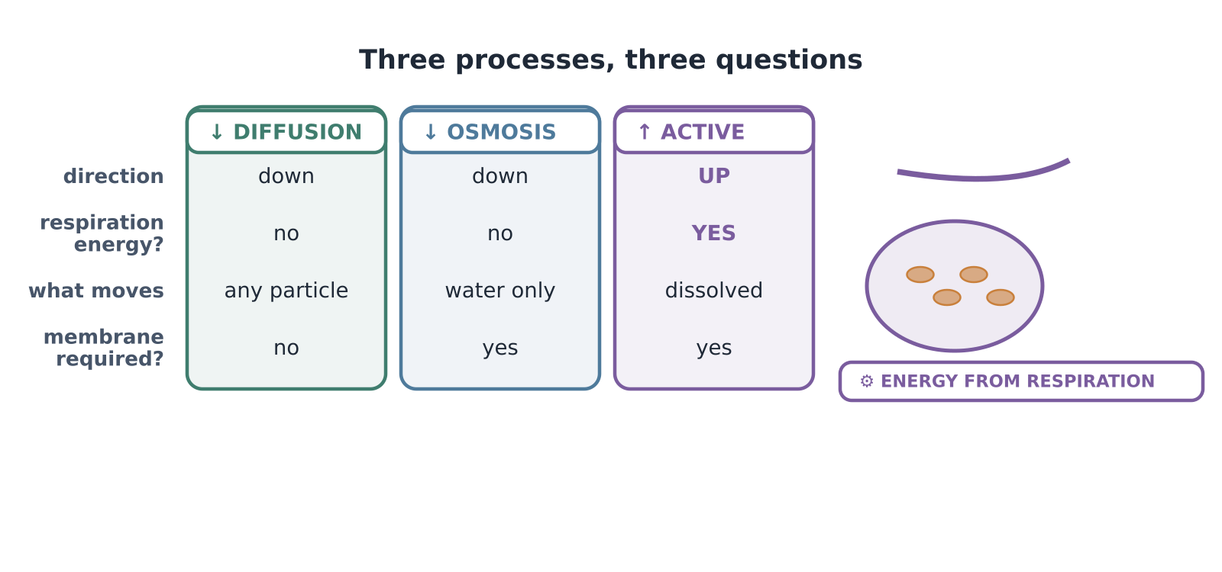
LAUNCH SCIENCE / W6L1
Resources
Look closely at the model
A model illustration: use the stated data for calculations.
Return to I Do
Arrival
Starter
I Do
We Do
I Do 2
We Do 2
Independent
Exit
Resources
Notes:
Source image: https://madebymatt.uk/Lessons/Science_Teesside/Launch/SCI_L_W6_L1_ActiveTransport.html; existing vector illustration embedded for offline use.
Core explanation: Active transport uses energy released by respiration to move a substance against its concentration gradient through membrane transport proteins.
Watch for: Diffusion is random at particle level. The contrast is net movement down a gradient versus energy-dependent movement against it, not “diffusion never moves backwards”.
Least help first: Ask the pupil to compare concentrations and trace the movement arrow before naming the process.
Support cue: Compare the concentration outside and inside. Add an inward arrow. Start: “The ions move from ___ to ___. This needs…”
[Sources]
User-supplied LAUNCH W3–W7 pack: W6 slides 5–8 and worksheet Task 1.
Made by Matt LAUNCH Science draft, lesson-content.json, W6L1; existing illustrative diagrams reused, active-transport direction corrected to lower → higher.
Pearson Edexcel GCSE Biology specification, sections 1.1–1.6 and 1.15–1.17: https://qualifications.pearson.com/content/dam/pdf/GCSE/Science/2016/Specification/gcse-biology-spec.pdf
Optional concept video: freesciencelessons, Active transport, https://www.youtube.com/watch?v=ECldVkp6Rw0 (link located 5 September 2026).
[/Sources]
[Sources]
Source editable lesson: Original LAUNCH Science OneDrive pack, 5 September 2026, W6L1. Source teaching content preserved. Current HTML reference: https://madebymatt.uk/Lessons/Science_Teesside/Launch/. Native diagrams restate the source explanation and are not experimental measurements.
[/Sources]

