Slide 1
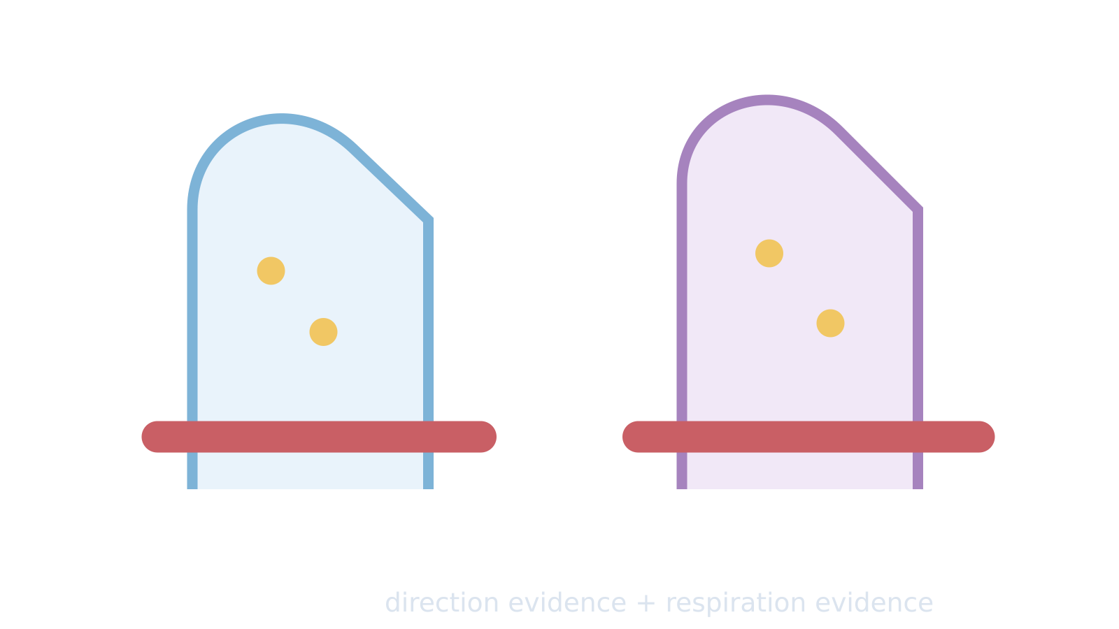
LAUNCH SCIENCE / W6L2
Arrival · 3 min
Root hairs and the gut
I can use concentration and respiration evidence to decide when diffusion alone cannot explain uptake.
Notice. Recall. Be ready to explain.
1
Why can root hairs need active transport?
2
What does a larger surface area allow?
Retrieval answers
Arrival
Starter
I Do
We Do
I Do 2
We Do 2
Independent
Exit
Resources
Notes:
Stage: Arrival, 3 minutes. Monday / Wednesday / Friday P1, 09:30–10:10. Use reveals within this slot; appendix slides are not added time.
Retrieval answers: To take up mineral ions when their concentration is lower outside than inside. | More membrane area for exchange/uptake at the same time. | Against-gradient uptake falls when respiration is inhibited, with suitable controls.
Core explanation: Use two clues: direction relative to the gradient and dependence on respiration. “Root hair” or “gut” alone does not determine every transport mechanism.
Watch for: The gut can use more than one transport mechanism. Here the stated against-gradient uptake and energy evidence support active transport.
Least help first: Ask whether concentration evidence alone is enough, then prompt for a second clue about energy or respiration.
Support cue: Use two clues: direction compared with the gradient, and what happens when respiration is reduced. Start: “This suggests ___ because…”
[Sources]
User-supplied LAUNCH W3–W7 pack: W6 slides 6–9 and root-hair explanation task.
Made by Matt LAUNCH Science draft, lesson-content.json, W6L2; existing illustrative diagrams reused, active-transport direction corrected to lower → higher.
Pearson Edexcel GCSE Biology specification, sections 1.1–1.6 and 1.15–1.17: https://qualifications.pearson.com/content/dam/pdf/GCSE/Science/2016/Specification/gcse-biology-spec.pdf
Optional concept video: freesciencelessons, Active transport, https://www.youtube.com/watch?v=ECldVkp6Rw0 (link located 5 September 2026).
[/Sources]
[Sources]
Source editable lesson: Original LAUNCH Science OneDrive pack, 5 September 2026, W6L2. Source teaching content preserved. Current HTML reference: https://madebymatt.uk/Lessons/Science_Teesside/Launch/. Native diagrams restate the source explanation and are not experimental measurements.
[/Sources]

Slide 2
LAUNCH SCIENCE / W6L2
Starter · 4 min
Make a prediction
Mineral uptake falls when root cells receive less oxygen. Which explanation should be investigated first?
A Oxygen provides colour
B Less respiration means less energy for active transport
C Diffusion always speeds up without oxygen
Commit, then check
Arrival
Starter
I Do
We Do
I Do 2
We Do 2
Independent
Exit
Resources
Notes:
Stage: Starter, 4 minutes. Monday / Wednesday / Friday P1, 09:30–10:10. Use reveals within this slot; appendix slides are not added time.
Correct: Less respiration means less energy for active transport. Ask for the reason, then return to the original prediction.
Core explanation: Use two clues: direction relative to the gradient and dependence on respiration. “Root hair” or “gut” alone does not determine every transport mechanism.
Watch for: The gut can use more than one transport mechanism. Here the stated against-gradient uptake and energy evidence support active transport.
Least help first: Ask whether concentration evidence alone is enough, then prompt for a second clue about energy or respiration.
Support cue: Use two clues: direction compared with the gradient, and what happens when respiration is reduced. Start: “This suggests ___ because…”
[Sources]
User-supplied LAUNCH W3–W7 pack: W6 slides 6–9 and root-hair explanation task.
Made by Matt LAUNCH Science draft, lesson-content.json, W6L2; existing illustrative diagrams reused, active-transport direction corrected to lower → higher.
Pearson Edexcel GCSE Biology specification, sections 1.1–1.6 and 1.15–1.17: https://qualifications.pearson.com/content/dam/pdf/GCSE/Science/2016/Specification/gcse-biology-spec.pdf
Optional concept video: freesciencelessons, Active transport, https://www.youtube.com/watch?v=ECldVkp6Rw0 (link located 5 September 2026).
[/Sources]
[Sources]
Source editable lesson: Original LAUNCH Science OneDrive pack, 5 September 2026, W6L2. Source teaching content preserved. Current HTML reference: https://madebymatt.uk/Lessons/Science_Teesside/Launch/. Native diagrams restate the source explanation and are not experimental measurements.
[/Sources]

Slide 3
LAUNCH SCIENCE / W6L2
I Do · 5 min
Watch the model
1
Root hair cells contact soil water across a large surface area and may take up mineral ions against a gradient.
Movement needs energy
2
Small-intestine cells absorb digested food. Diffusion can help, but active transport can keep uptake going against the gradient.
Lower
Higher
3
Evidence that uptake falls when respiration is inhibited supports an energy-dependent mechanism.
Energy from respiration
View labelled diagram
Optional video
Arrival
Starter
I Do
We Do
I Do 2
We Do 2
Independent
Exit
Resources
Notes:
Stage: I Do, 5 minutes. Monday / Wednesday / Friday P1, 09:30–10:10. Use reveals within this slot; appendix slides are not added time.
The Lab compares concentration data with oxygen/inhibitor evidence in two biological contexts.
Model limit: Class data may support a process. They do not show every transporter or process in a real organism.
Video replaces up to 90 seconds of explanation; use the still diagram if unavailable.
Core explanation: Use two clues: direction relative to the gradient and dependence on respiration. “Root hair” or “gut” alone does not determine every transport mechanism.
Watch for: The gut can use more than one transport mechanism. Here the stated against-gradient uptake and energy evidence support active transport.
Least help first: Ask whether concentration evidence alone is enough, then prompt for a second clue about energy or respiration.
Support cue: Use two clues: direction compared with the gradient, and what happens when respiration is reduced. Start: “This suggests ___ because…”
[Sources]
User-supplied LAUNCH W3–W7 pack: W6 slides 6–9 and root-hair explanation task.
Made by Matt LAUNCH Science draft, lesson-content.json, W6L2; existing illustrative diagrams reused, active-transport direction corrected to lower → higher.
Pearson Edexcel GCSE Biology specification, sections 1.1–1.6 and 1.15–1.17: https://qualifications.pearson.com/content/dam/pdf/GCSE/Science/2016/Specification/gcse-biology-spec.pdf
Optional concept video: freesciencelessons, Active transport, https://www.youtube.com/watch?v=ECldVkp6Rw0 (link located 5 September 2026).
[/Sources]
[Sources]
Source editable lesson: Original LAUNCH Science OneDrive pack, 5 September 2026, W6L2. Source teaching content preserved. Current HTML reference: https://madebymatt.uk/Lessons/Science_Teesside/Launch/. Native diagrams restate the source explanation and are not experimental measurements.
[/Sources]

Slide 4
LAUNCH SCIENCE / W6L2
We Do · 5 min
Choose and justify
Which evidence most strongly supports active transport rather than diffusion alone?
A Uptake occurs only when outside concentration is higher
B Uptake continues against the gradient and falls when respiration is inhibited
C The cell has a membrane
D The substance is small
Give the deciding clue before checking.
Check the reasoning
Arrival
Starter
I Do
We Do
I Do 2
We Do 2
Independent
Exit
Resources
Notes:
Stage: We Do, 5 minutes. Monday / Wednesday / Friday P1, 09:30–10:10. Use reveals within this slot; appendix slides are not added time.
A: Uptake occurs only when outside concentration is higher — This could be consistent with diffusion and does not require active transport.
B: Uptake continues against the gradient and falls when respiration is inhibited — Correct: both direction and energy dependence support active transport.
C: The cell has a membrane — All cells have membranes; this is not enough evidence.
D: The substance is small — Particle size alone does not identify the energy mechanism.
Core explanation: Use two clues: direction relative to the gradient and dependence on respiration. “Root hair” or “gut” alone does not determine every transport mechanism.
Watch for: The gut can use more than one transport mechanism. Here the stated against-gradient uptake and energy evidence support active transport.
Least help first: Ask whether concentration evidence alone is enough, then prompt for a second clue about energy or respiration.
Support cue: Use two clues: direction compared with the gradient, and what happens when respiration is reduced. Start: “This suggests ___ because…”
[Sources]
User-supplied LAUNCH W3–W7 pack: W6 slides 6–9 and root-hair explanation task.
Made by Matt LAUNCH Science draft, lesson-content.json, W6L2; existing illustrative diagrams reused, active-transport direction corrected to lower → higher.
Pearson Edexcel GCSE Biology specification, sections 1.1–1.6 and 1.15–1.17: https://qualifications.pearson.com/content/dam/pdf/GCSE/Science/2016/Specification/gcse-biology-spec.pdf
Optional concept video: freesciencelessons, Active transport, https://www.youtube.com/watch?v=ECldVkp6Rw0 (link located 5 September 2026).
[/Sources]
[Sources]
Source editable lesson: Original LAUNCH Science OneDrive pack, 5 September 2026, W6L2. Source teaching content preserved. Current HTML reference: https://madebymatt.uk/Lessons/Science_Teesside/Launch/. Native diagrams restate the source explanation and are not experimental measurements.
[/Sources]

Slide 5
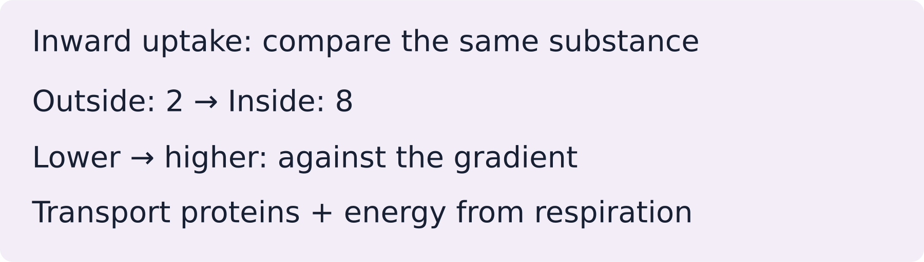
LAUNCH SCIENCE / W6L2
I Do 2 · 4 min
Connect the science
1
Evidence 1: direction against the concentration gradient.
2
Evidence 2: uptake changes when respiration or energy supply changes.
3
Large surface area and many transport proteins allow more uptake. Energy released by respiration supports active uptake.
Arrival
Starter
I Do
We Do
I Do 2
We Do 2
Independent
Exit
Resources
Notes:
Stage: I Do 2, 4 minutes. Monday / Wednesday / Friday P1, 09:30–10:10. Use reveals within this slot; appendix slides are not added time.
Class data may support a process. They do not show every transporter or process in a real organism.
Core explanation: Use two clues: direction relative to the gradient and dependence on respiration. “Root hair” or “gut” alone does not determine every transport mechanism.
Watch for: The gut can use more than one transport mechanism. Here the stated against-gradient uptake and energy evidence support active transport.
Least help first: Ask whether concentration evidence alone is enough, then prompt for a second clue about energy or respiration.
Support cue: Use two clues: direction compared with the gradient, and what happens when respiration is reduced. Start: “This suggests ___ because…”
[Sources]
User-supplied LAUNCH W3–W7 pack: W6 slides 6–9 and root-hair explanation task.
Made by Matt LAUNCH Science draft, lesson-content.json, W6L2; existing illustrative diagrams reused, active-transport direction corrected to lower → higher.
Pearson Edexcel GCSE Biology specification, sections 1.1–1.6 and 1.15–1.17: https://qualifications.pearson.com/content/dam/pdf/GCSE/Science/2016/Specification/gcse-biology-spec.pdf
Optional concept video: freesciencelessons, Active transport, https://www.youtube.com/watch?v=ECldVkp6Rw0 (link located 5 September 2026).
[/Sources]
[Sources]
Source editable lesson: Original LAUNCH Science OneDrive pack, 5 September 2026, W6L2. Source teaching content preserved. Current HTML reference: https://madebymatt.uk/Lessons/Science_Teesside/Launch/. Native diagrams restate the source explanation and are not experimental measurements.
[/Sources]

Slide 6
LAUNCH SCIENCE / W6L2
We Do 2 · Task · 6 min
Use two clues
Model values use the same concentration units. Uptake is inwards.
Context | Outside | Inside | Normal uptake | Inhibited uptake
Root nitrate | 2 | 8 | 100 | 15
Gut glucose | 3 | 9 | 100 | 20
Use direction and energy evidence. Does the cell’s location alone prove the mechanism?
Reveal shared reasoning
Arrival
Starter
I Do
We Do
I Do 2
We Do 2
Independent
Exit
Resources
Notes:
Stage: We Do 2 · Task, 6 minutes. Monday / Wednesday / Friday P1, 09:30–10:10. Use reveals within this slot; appendix slides are not added time.
Both movements are against the gradient; uptake falls when respiration is inhibited. Together these support active transport. Root hair or gut alone does not determine every transport mechanism.
Run the printed activity or this board; one route is enough.
Core explanation: Use two clues: direction relative to the gradient and dependence on respiration. “Root hair” or “gut” alone does not determine every transport mechanism.
Watch for: The gut can use more than one transport mechanism. Here the stated against-gradient uptake and energy evidence support active transport.
Least help first: Ask whether concentration evidence alone is enough, then prompt for a second clue about energy or respiration.
Support cue: Use two clues: direction compared with the gradient, and what happens when respiration is reduced. Start: “This suggests ___ because…”
[Sources]
User-supplied LAUNCH W3–W7 pack: W6 slides 6–9 and root-hair explanation task.
Made by Matt LAUNCH Science draft, lesson-content.json, W6L2; existing illustrative diagrams reused, active-transport direction corrected to lower → higher.
Pearson Edexcel GCSE Biology specification, sections 1.1–1.6 and 1.15–1.17: https://qualifications.pearson.com/content/dam/pdf/GCSE/Science/2016/Specification/gcse-biology-spec.pdf
Optional concept video: freesciencelessons, Active transport, https://www.youtube.com/watch?v=ECldVkp6Rw0 (link located 5 September 2026).
[/Sources]
[Sources]
Source editable lesson: Original LAUNCH Science OneDrive pack, 5 September 2026, W6L2. Source teaching content preserved. Current HTML reference: https://madebymatt.uk/Lessons/Science_Teesside/Launch/. Native diagrams restate the source explanation and are not experimental measurements.
[/Sources]

Slide 7
LAUNCH SCIENCE / W6L2
Independent Task · 10 min
Your independent evidence
Glucose concentration in the small intestine becomes lower than in an epithelial cell, but glucose uptake continues. Uptake falls when respiration is inhibited. Explain the mechanism and link one cell adaptation to its function.
Optional support
Use two clues: direction compared with the gradient, and what happens when respiration is reduced. Start: “This suggests ___ because…”
Make one precise correction to the same work after feedback.
Open worksheet pages
Model after first attempt
Arrival
Starter
I Do
We Do
I Do 2
We Do 2
Independent
Exit
Resources
Notes:
Stage: Independent Task, 10 minutes. Monday / Wednesday / Friday P1, 09:30–10:10. Use reveals within this slot; appendix slides are not added time.
Model answer: Glucose is moving from a lower concentration in the intestine to a higher concentration inside the epithelial cell, so diffusion alone cannot explain continued uptake. The fall when respiration is inhibited shows that the process needs cellular energy, supporting active transport. A large folded surface and membrane transport proteins increase opportunities for uptake; mitochondria support the energy demand.
Select only questions that fit the ten-minute slot. W7L3: Q2, Q3 and Q5 total 11 marks. The full paper needs a separate 25-minute slot.
Core explanation: Use two clues: direction relative to the gradient and dependence on respiration. “Root hair” or “gut” alone does not determine every transport mechanism.
Watch for: The gut can use more than one transport mechanism. Here the stated against-gradient uptake and energy evidence support active transport.
Least help first: Ask whether concentration evidence alone is enough, then prompt for a second clue about energy or respiration.
Support cue: Use two clues: direction compared with the gradient, and what happens when respiration is reduced. Start: “This suggests ___ because…”
[Sources]
User-supplied LAUNCH W3–W7 pack: W6 slides 6–9 and root-hair explanation task.
Made by Matt LAUNCH Science draft, lesson-content.json, W6L2; existing illustrative diagrams reused, active-transport direction corrected to lower → higher.
Pearson Edexcel GCSE Biology specification, sections 1.1–1.6 and 1.15–1.17: https://qualifications.pearson.com/content/dam/pdf/GCSE/Science/2016/Specification/gcse-biology-spec.pdf
Optional concept video: freesciencelessons, Active transport, https://www.youtube.com/watch?v=ECldVkp6Rw0 (link located 5 September 2026).
[/Sources]
[Sources]
Source editable lesson: Original LAUNCH Science OneDrive pack, 5 September 2026, W6L2. Source teaching content preserved. Current HTML reference: https://madebymatt.uk/Lessons/Science_Teesside/Launch/. Native diagrams restate the source explanation and are not experimental measurements.
[/Sources]

Slide 8
LAUNCH SCIENCE / W6L2
Exit · 3 min
What changed in your thinking?
Why is ‘root hair cells have a large surface area’ incomplete without a function link?
1
Point to one improvement in your work.
2
Choose what you want to revisit.
3
Tell your teacher; agree the next step together.
Arrival
Starter
I Do
We Do
I Do 2
We Do 2
Independent
Exit
Resources
Notes:
Stage: Exit, 3 minutes. Monday / Wednesday / Friday P1, 09:30–10:10. Use reveals within this slot; appendix slides are not added time.
Exit answer: Add how the feature changes area, transport capacity or energy supply, and how this affects uptake.
Receive the request, record the agreed next action and check it next lesson. Keep responses private when requested.
Core explanation: Use two clues: direction relative to the gradient and dependence on respiration. “Root hair” or “gut” alone does not determine every transport mechanism.
Watch for: The gut can use more than one transport mechanism. Here the stated against-gradient uptake and energy evidence support active transport.
Least help first: Ask whether concentration evidence alone is enough, then prompt for a second clue about energy or respiration.
Support cue: Use two clues: direction compared with the gradient, and what happens when respiration is reduced. Start: “This suggests ___ because…”
[Sources]
User-supplied LAUNCH W3–W7 pack: W6 slides 6–9 and root-hair explanation task.
Made by Matt LAUNCH Science draft, lesson-content.json, W6L2; existing illustrative diagrams reused, active-transport direction corrected to lower → higher.
Pearson Edexcel GCSE Biology specification, sections 1.1–1.6 and 1.15–1.17: https://qualifications.pearson.com/content/dam/pdf/GCSE/Science/2016/Specification/gcse-biology-spec.pdf
Optional concept video: freesciencelessons, Active transport, https://www.youtube.com/watch?v=ECldVkp6Rw0 (link located 5 September 2026).
[/Sources]
[Sources]
Source editable lesson: Original LAUNCH Science OneDrive pack, 5 September 2026, W6L2. Source teaching content preserved. Current HTML reference: https://madebymatt.uk/Lessons/Science_Teesside/Launch/. Native diagrams restate the source explanation and are not experimental measurements.
[/Sources]

Slide 9
LAUNCH SCIENCE / W6L2
Resources
Retrieval and prediction check
1
To take up mineral ions when their concentration is lower outside than inside.
2
More membrane area for exchange/uptake at the same time.
Less respiration means less energy for active transport
Return to Starter
Arrival
Starter
I Do
We Do
I Do 2
We Do 2
Independent
Exit
Resources
Notes:
Read only after an attempt; retain the pupil’s first view.
Core explanation: Use two clues: direction relative to the gradient and dependence on respiration. “Root hair” or “gut” alone does not determine every transport mechanism.
Watch for: The gut can use more than one transport mechanism. Here the stated against-gradient uptake and energy evidence support active transport.
Least help first: Ask whether concentration evidence alone is enough, then prompt for a second clue about energy or respiration.
Support cue: Use two clues: direction compared with the gradient, and what happens when respiration is reduced. Start: “This suggests ___ because…”
[Sources]
User-supplied LAUNCH W3–W7 pack: W6 slides 6–9 and root-hair explanation task.
Made by Matt LAUNCH Science draft, lesson-content.json, W6L2; existing illustrative diagrams reused, active-transport direction corrected to lower → higher.
Pearson Edexcel GCSE Biology specification, sections 1.1–1.6 and 1.15–1.17: https://qualifications.pearson.com/content/dam/pdf/GCSE/Science/2016/Specification/gcse-biology-spec.pdf
Optional concept video: freesciencelessons, Active transport, https://www.youtube.com/watch?v=ECldVkp6Rw0 (link located 5 September 2026).
[/Sources]
[Sources]
Source editable lesson: Original LAUNCH Science OneDrive pack, 5 September 2026, W6L2. Source teaching content preserved. Current HTML reference: https://madebymatt.uk/Lessons/Science_Teesside/Launch/. Native diagrams restate the source explanation and are not experimental measurements.
[/Sources]

Slide 10
LAUNCH SCIENCE / W6L2
Resources
Check the deciding clue
Uptake continues against the gradient and falls when respiration is inhibited
Correct: both direction and energy dependence support active transport.
Compare your reason. Correct one step if needed.
Return to We Do
Arrival
Starter
I Do
We Do
I Do 2
We Do 2
Independent
Exit
Resources
Notes:
This could be consistent with diffusion and does not require active transport.
Correct: both direction and energy dependence support active transport.
All cells have membranes; this is not enough evidence.
Particle size alone does not identify the energy mechanism.
Core explanation: Use two clues: direction relative to the gradient and dependence on respiration. “Root hair” or “gut” alone does not determine every transport mechanism.
Watch for: The gut can use more than one transport mechanism. Here the stated against-gradient uptake and energy evidence support active transport.
Least help first: Ask whether concentration evidence alone is enough, then prompt for a second clue about energy or respiration.
Support cue: Use two clues: direction compared with the gradient, and what happens when respiration is reduced. Start: “This suggests ___ because…”
[Sources]
User-supplied LAUNCH W3–W7 pack: W6 slides 6–9 and root-hair explanation task.
Made by Matt LAUNCH Science draft, lesson-content.json, W6L2; existing illustrative diagrams reused, active-transport direction corrected to lower → higher.
Pearson Edexcel GCSE Biology specification, sections 1.1–1.6 and 1.15–1.17: https://qualifications.pearson.com/content/dam/pdf/GCSE/Science/2016/Specification/gcse-biology-spec.pdf
Optional concept video: freesciencelessons, Active transport, https://www.youtube.com/watch?v=ECldVkp6Rw0 (link located 5 September 2026).
[/Sources]
[Sources]
Source editable lesson: Original LAUNCH Science OneDrive pack, 5 September 2026, W6L2. Source teaching content preserved. Current HTML reference: https://madebymatt.uk/Lessons/Science_Teesside/Launch/. Native diagrams restate the source explanation and are not experimental measurements.
[/Sources]

Slide 11
LAUNCH SCIENCE / W6L2
Resources
Our shared reasoning
Both movements are against the gradient; uptake falls when respiration is inhibited. Together these support active transport. Root hair or gut alone does not determine every transport mechanism.
Return to shared task
Arrival
Starter
I Do
We Do
I Do 2
We Do 2
Independent
Exit
Resources
Notes:
Pupils should justify, compare and revise rather than copy a complete answer before trying.
Core explanation: Use two clues: direction relative to the gradient and dependence on respiration. “Root hair” or “gut” alone does not determine every transport mechanism.
Watch for: The gut can use more than one transport mechanism. Here the stated against-gradient uptake and energy evidence support active transport.
Least help first: Ask whether concentration evidence alone is enough, then prompt for a second clue about energy or respiration.
Support cue: Use two clues: direction compared with the gradient, and what happens when respiration is reduced. Start: “This suggests ___ because…”
[Sources]
User-supplied LAUNCH W3–W7 pack: W6 slides 6–9 and root-hair explanation task.
Made by Matt LAUNCH Science draft, lesson-content.json, W6L2; existing illustrative diagrams reused, active-transport direction corrected to lower → higher.
Pearson Edexcel GCSE Biology specification, sections 1.1–1.6 and 1.15–1.17: https://qualifications.pearson.com/content/dam/pdf/GCSE/Science/2016/Specification/gcse-biology-spec.pdf
Optional concept video: freesciencelessons, Active transport, https://www.youtube.com/watch?v=ECldVkp6Rw0 (link located 5 September 2026).
[/Sources]
[Sources]
Source editable lesson: Original LAUNCH Science OneDrive pack, 5 September 2026, W6L2. Source teaching content preserved. Current HTML reference: https://madebymatt.uk/Lessons/Science_Teesside/Launch/. Native diagrams restate the source explanation and are not experimental measurements.
[/Sources]

Slide 12
LAUNCH SCIENCE / W6L2
Resources
Compare after your first attempt
Glucose is moving from a lower concentration in the intestine to a higher concentration inside the epithelial cell, so diffusion alone cannot explain continued uptake. The fall when respiration is inhibited shows that the process needs cellular energy, supporting active transport. A large folded surface and membrane transport proteins increase opportunities for uptake; mitochondria support the energy demand.
Use the model to improve your explanation in your own words.
Return to independent task
Arrival
Starter
I Do
We Do
I Do 2
We Do 2
Independent
Exit
Resources
Notes:
Staff guide includes question-by-question answers. Do not distribute this presentation as a secure assessment paper.
Core explanation: Use two clues: direction relative to the gradient and dependence on respiration. “Root hair” or “gut” alone does not determine every transport mechanism.
Watch for: The gut can use more than one transport mechanism. Here the stated against-gradient uptake and energy evidence support active transport.
Least help first: Ask whether concentration evidence alone is enough, then prompt for a second clue about energy or respiration.
Support cue: Use two clues: direction compared with the gradient, and what happens when respiration is reduced. Start: “This suggests ___ because…”
[Sources]
User-supplied LAUNCH W3–W7 pack: W6 slides 6–9 and root-hair explanation task.
Made by Matt LAUNCH Science draft, lesson-content.json, W6L2; existing illustrative diagrams reused, active-transport direction corrected to lower → higher.
Pearson Edexcel GCSE Biology specification, sections 1.1–1.6 and 1.15–1.17: https://qualifications.pearson.com/content/dam/pdf/GCSE/Science/2016/Specification/gcse-biology-spec.pdf
Optional concept video: freesciencelessons, Active transport, https://www.youtube.com/watch?v=ECldVkp6Rw0 (link located 5 September 2026).
[/Sources]
[Sources]
Source editable lesson: Original LAUNCH Science OneDrive pack, 5 September 2026, W6L2. Source teaching content preserved. Current HTML reference: https://madebymatt.uk/Lessons/Science_Teesside/Launch/. Native diagrams restate the source explanation and are not experimental measurements.
[/Sources]

Slide 13
LAUNCH SCIENCE / W6L2
Resources
Your lesson resources
Worksheet pages are stored inside this PowerPoint.
Worksheet · page 1
Worksheet · page 2
Standard PDF
Supported PDF
Depth PDF
Editable Word worksheet
Open online lesson / model
Named files are in this week’s folder. Online lesson and video need internet.
Optional concept video
Arrival
Starter
I Do
We Do
I Do 2
We Do 2
Independent
Exit
Resources
Notes:
File buttons use relative links for downloaded/synced folders. OneDrive preview may not resolve relative links. Use the embedded pages or open the named file in the week folder.
Core explanation: Use two clues: direction relative to the gradient and dependence on respiration. “Root hair” or “gut” alone does not determine every transport mechanism.
Watch for: The gut can use more than one transport mechanism. Here the stated against-gradient uptake and energy evidence support active transport.
Least help first: Ask whether concentration evidence alone is enough, then prompt for a second clue about energy or respiration.
Support cue: Use two clues: direction compared with the gradient, and what happens when respiration is reduced. Start: “This suggests ___ because…”
[Sources]
User-supplied LAUNCH W3–W7 pack: W6 slides 6–9 and root-hair explanation task.
Made by Matt LAUNCH Science draft, lesson-content.json, W6L2; existing illustrative diagrams reused, active-transport direction corrected to lower → higher.
Pearson Edexcel GCSE Biology specification, sections 1.1–1.6 and 1.15–1.17: https://qualifications.pearson.com/content/dam/pdf/GCSE/Science/2016/Specification/gcse-biology-spec.pdf
Optional concept video: freesciencelessons, Active transport, https://www.youtube.com/watch?v=ECldVkp6Rw0 (link located 5 September 2026).
[/Sources]
[Sources]
Source editable lesson: Original LAUNCH Science OneDrive pack, 5 September 2026, W6L2. Source teaching content preserved. Current HTML reference: https://madebymatt.uk/Lessons/Science_Teesside/Launch/. Native diagrams restate the source explanation and are not experimental measurements.
[/Sources]

Slide 14
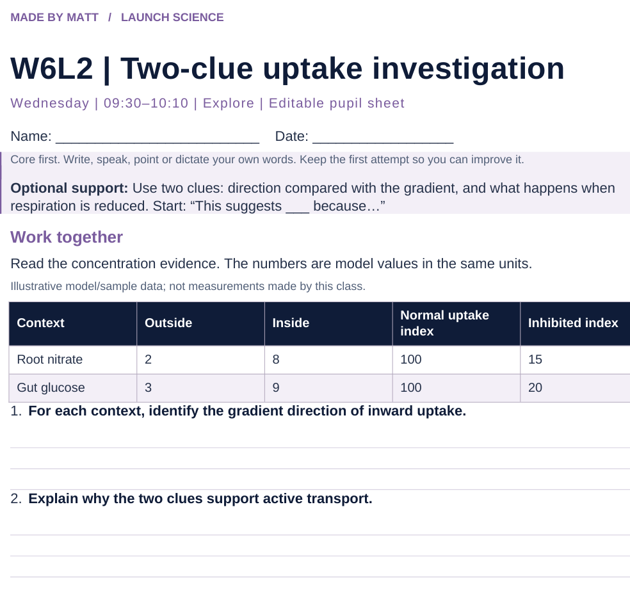
LAUNCH SCIENCE / W6L2
Resources
Worksheet · page 1
Use your printed copy.
Keep the first attempt.
Return to task
Arrival
Starter
I Do
We Do
I Do 2
We Do 2
Independent
Exit
Resources
Notes:
Embedded worksheet reference; print the separate PDF at A4 for writable space.
Core explanation: Use two clues: direction relative to the gradient and dependence on respiration. “Root hair” or “gut” alone does not determine every transport mechanism.
Watch for: The gut can use more than one transport mechanism. Here the stated against-gradient uptake and energy evidence support active transport.
Least help first: Ask whether concentration evidence alone is enough, then prompt for a second clue about energy or respiration.
Support cue: Use two clues: direction compared with the gradient, and what happens when respiration is reduced. Start: “This suggests ___ because…”
[Sources]
User-supplied LAUNCH W3–W7 pack: W6 slides 6–9 and root-hair explanation task.
Made by Matt LAUNCH Science draft, lesson-content.json, W6L2; existing illustrative diagrams reused, active-transport direction corrected to lower → higher.
Pearson Edexcel GCSE Biology specification, sections 1.1–1.6 and 1.15–1.17: https://qualifications.pearson.com/content/dam/pdf/GCSE/Science/2016/Specification/gcse-biology-spec.pdf
Optional concept video: freesciencelessons, Active transport, https://www.youtube.com/watch?v=ECldVkp6Rw0 (link located 5 September 2026).
[/Sources]
[Sources]
Source editable lesson: Original LAUNCH Science OneDrive pack, 5 September 2026, W6L2. Source teaching content preserved. Current HTML reference: https://madebymatt.uk/Lessons/Science_Teesside/Launch/. Native diagrams restate the source explanation and are not experimental measurements.
[/Sources]

Slide 15
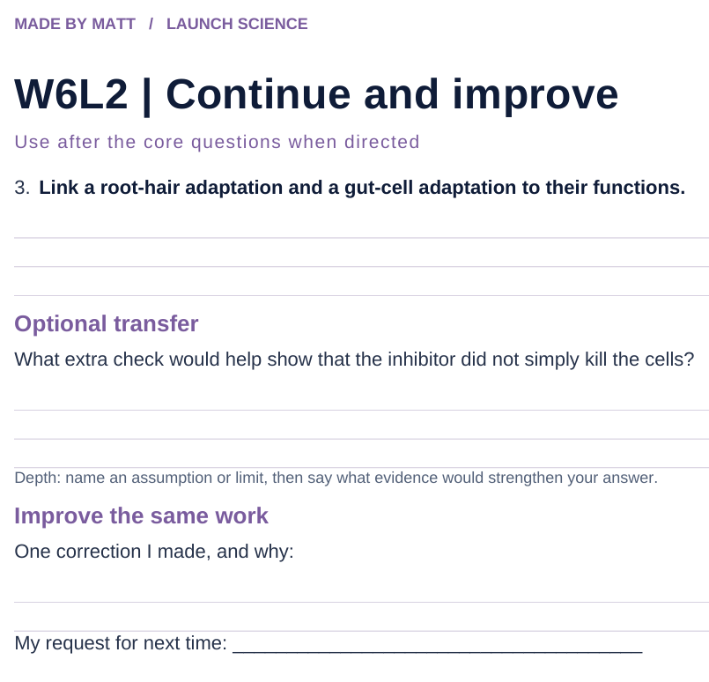
LAUNCH SCIENCE / W6L2
Resources
Worksheet · page 2
Continuation is optional.
Improve the same work.
Return to task
Arrival
Starter
I Do
We Do
I Do 2
We Do 2
Independent
Exit
Resources
Notes:
Embedded worksheet reference; print the separate PDF at A4 for writable space.
Core explanation: Use two clues: direction relative to the gradient and dependence on respiration. “Root hair” or “gut” alone does not determine every transport mechanism.
Watch for: The gut can use more than one transport mechanism. Here the stated against-gradient uptake and energy evidence support active transport.
Least help first: Ask whether concentration evidence alone is enough, then prompt for a second clue about energy or respiration.
Support cue: Use two clues: direction compared with the gradient, and what happens when respiration is reduced. Start: “This suggests ___ because…”
[Sources]
User-supplied LAUNCH W3–W7 pack: W6 slides 6–9 and root-hair explanation task.
Made by Matt LAUNCH Science draft, lesson-content.json, W6L2; existing illustrative diagrams reused, active-transport direction corrected to lower → higher.
Pearson Edexcel GCSE Biology specification, sections 1.1–1.6 and 1.15–1.17: https://qualifications.pearson.com/content/dam/pdf/GCSE/Science/2016/Specification/gcse-biology-spec.pdf
Optional concept video: freesciencelessons, Active transport, https://www.youtube.com/watch?v=ECldVkp6Rw0 (link located 5 September 2026).
[/Sources]
[Sources]
Source editable lesson: Original LAUNCH Science OneDrive pack, 5 September 2026, W6L2. Source teaching content preserved. Current HTML reference: https://madebymatt.uk/Lessons/Science_Teesside/Launch/. Native diagrams restate the source explanation and are not experimental measurements.
[/Sources]

Slide 16
LAUNCH SCIENCE / W6L2
Resources
Watch, pause and explain
Active transport
What two clues distinguish active transport from diffusion?
Play freesciencelessons video
No connection? Use the still model and explain the same question.
Arrival
Starter
I Do
We Do
I Do 2
We Do 2
Independent
Exit
Resources
Notes:
Use at most 90 seconds within I Do. Pause on the first relevant example; ask for a reason. This is an optional concept clip, not evidence of practical completion.
Core explanation: Use two clues: direction relative to the gradient and dependence on respiration. “Root hair” or “gut” alone does not determine every transport mechanism.
Watch for: The gut can use more than one transport mechanism. Here the stated against-gradient uptake and energy evidence support active transport.
Least help first: Ask whether concentration evidence alone is enough, then prompt for a second clue about energy or respiration.
Support cue: Use two clues: direction compared with the gradient, and what happens when respiration is reduced. Start: “This suggests ___ because…”
[Sources]
User-supplied LAUNCH W3–W7 pack: W6 slides 6–9 and root-hair explanation task.
Made by Matt LAUNCH Science draft, lesson-content.json, W6L2; existing illustrative diagrams reused, active-transport direction corrected to lower → higher.
Pearson Edexcel GCSE Biology specification, sections 1.1–1.6 and 1.15–1.17: https://qualifications.pearson.com/content/dam/pdf/GCSE/Science/2016/Specification/gcse-biology-spec.pdf
Optional concept video: freesciencelessons, Active transport, https://www.youtube.com/watch?v=ECldVkp6Rw0 (link located 5 September 2026).
[/Sources]
[Sources]
Source editable lesson: Original LAUNCH Science OneDrive pack, 5 September 2026, W6L2. Source teaching content preserved. Current HTML reference: https://madebymatt.uk/Lessons/Science_Teesside/Launch/. Native diagrams restate the source explanation and are not experimental measurements.
[/Sources]

Slide 17
LAUNCH SCIENCE / W6L2
Resources
Look closely at the model
Root hair
Gut villi
uptake vs O2
soil (dilute)
uptake
↑ AGAINST THE GRADIENT
↓ GLUCOSE IN
oxygen →
MANY MITOCHONDRIA
A model illustration: use the stated data for calculations.
Return to I Do
Arrival
Starter
I Do
We Do
I Do 2
We Do 2
Independent
Exit
Resources
Notes:
Source image: https://madebymatt.uk/Lessons/Science_Teesside/Launch/SCI_L_W6_L2_RootAndGut.html; existing vector illustration embedded for offline use.
Core explanation: Use two clues: direction relative to the gradient and dependence on respiration. “Root hair” or “gut” alone does not determine every transport mechanism.
Watch for: The gut can use more than one transport mechanism. Here the stated against-gradient uptake and energy evidence support active transport.
Least help first: Ask whether concentration evidence alone is enough, then prompt for a second clue about energy or respiration.
Support cue: Use two clues: direction compared with the gradient, and what happens when respiration is reduced. Start: “This suggests ___ because…”
[Sources]
User-supplied LAUNCH W3–W7 pack: W6 slides 6–9 and root-hair explanation task.
Made by Matt LAUNCH Science draft, lesson-content.json, W6L2; existing illustrative diagrams reused, active-transport direction corrected to lower → higher.
Pearson Edexcel GCSE Biology specification, sections 1.1–1.6 and 1.15–1.17: https://qualifications.pearson.com/content/dam/pdf/GCSE/Science/2016/Specification/gcse-biology-spec.pdf
Optional concept video: freesciencelessons, Active transport, https://www.youtube.com/watch?v=ECldVkp6Rw0 (link located 5 September 2026).
[/Sources]
[Sources]
All model labels and the qualitative uptake-versus-oxygen graph retained from the original LAUNCH Science W6L2 slide17. Recreated as editable native shapes. Glucose uptake arrow corrected to point into a villus; the matching label arrow now points down.
[/Sources]
[Sources]
Source editable lesson: Original LAUNCH Science OneDrive pack, 5 September 2026, W6L2. Source teaching content preserved. Current HTML reference: https://madebymatt.uk/Lessons/Science_Teesside/Launch/. Native diagrams restate the source explanation and are not experimental measurements.
[/Sources]

