Slide 1
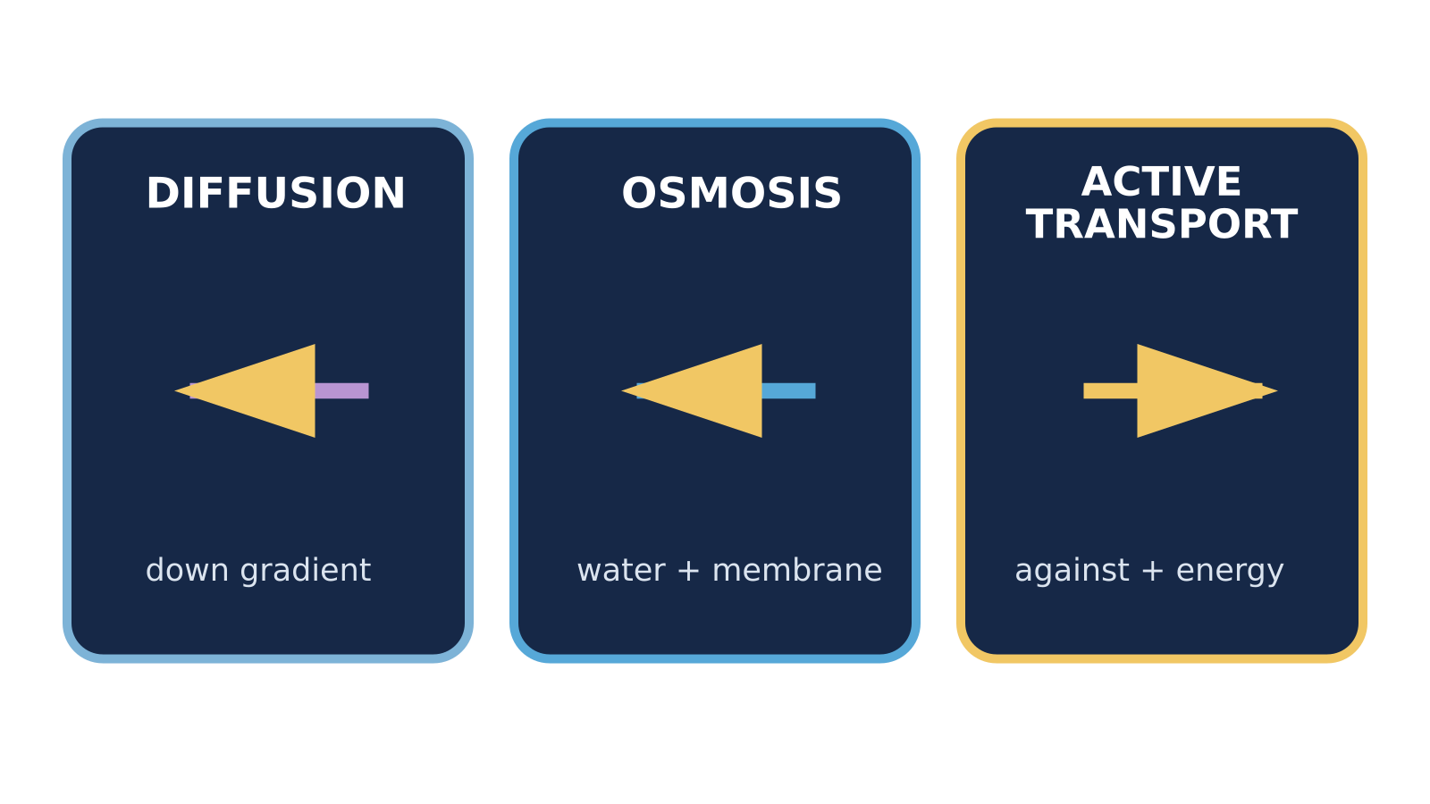
LAUNCH SCIENCE / W6L3
Arrival · 3 min
Comparing transport
I can select and justify the correct transport process in unfamiliar biological scenarios.
Notice. Recall. Be ready to explain.
1
Which process moves water only?
2
Which process moves against a concentration gradient?
Retrieval answers
Arrival
Starter
I Do
We Do
I Do 2
We Do 2
Independent
Exit
Resources
Notes:
Stage: Arrival, 3 minutes. Monday / Wednesday / Friday P1, 09:30–10:10. Use reveals within this slot; appendix slides are not added time.
Retrieval answers: Osmosis, through a partially permeable membrane. | Active transport, using cellular energy. | Diffusion and osmosis need no energy supplied by respiration.
Core explanation: Read the evidence before naming the process. Some statements belong to more than one process; some scenarios do not contain enough information.
Watch for: “Water only” points to osmosis, but the membrane and relative solutions still matter. Movement through a membrane alone does not prove active transport.
Least help first: Ask for the deciding clue before accepting a process label; then ask for one linked comparison.
Support cue: Ask: what moves, which way compared with the gradient, and is cellular energy needed? If a clue is missing, say what more you need to know.
[Sources]
User-supplied LAUNCH W3–W7 pack: W6 missing sort cards, comparison table and exam-style comparison.
Made by Matt LAUNCH Science draft, lesson-content.json, W6L3; existing illustrative diagrams reused, active-transport direction corrected to lower → higher.
Pearson Edexcel GCSE Biology specification, sections 1.1–1.6 and 1.15–1.17: https://qualifications.pearson.com/content/dam/pdf/GCSE/Science/2016/Specification/gcse-biology-spec.pdf
Optional concept video: freesciencelessons, Active transport, https://www.youtube.com/watch?v=ECldVkp6Rw0 (link located 5 September 2026).
[/Sources]
[Sources]
Source editable lesson: Original LAUNCH Science OneDrive pack, 5 September 2026, W6L3. Source teaching content preserved. Current HTML reference: https://madebymatt.uk/Lessons/Science_Teesside/Launch/. Native diagrams restate the source explanation and are not experimental measurements.
[/Sources]

Slide 2
LAUNCH SCIENCE / W6L3
Starter · 4 min
Make a prediction
Water enters a plant cell through a partially permeable membrane. Which single clue should decide the process first?
A The cell is green
B The moving substance is water and the membrane is partially permeable
C The process is fast
Commit, then check
Arrival
Starter
I Do
We Do
I Do 2
We Do 2
Independent
Exit
Resources
Notes:
Stage: Starter, 4 minutes. Monday / Wednesday / Friday P1, 09:30–10:10. Use reveals within this slot; appendix slides are not added time.
Correct: The moving substance is water and the membrane is partially permeable. Ask for the reason, then return to the original prediction.
Core explanation: Read the evidence before naming the process. Some statements belong to more than one process; some scenarios do not contain enough information.
Watch for: “Water only” points to osmosis, but the membrane and relative solutions still matter. Movement through a membrane alone does not prove active transport.
Least help first: Ask for the deciding clue before accepting a process label; then ask for one linked comparison.
Support cue: Ask: what moves, which way compared with the gradient, and is cellular energy needed? If a clue is missing, say what more you need to know.
[Sources]
User-supplied LAUNCH W3–W7 pack: W6 missing sort cards, comparison table and exam-style comparison.
Made by Matt LAUNCH Science draft, lesson-content.json, W6L3; existing illustrative diagrams reused, active-transport direction corrected to lower → higher.
Pearson Edexcel GCSE Biology specification, sections 1.1–1.6 and 1.15–1.17: https://qualifications.pearson.com/content/dam/pdf/GCSE/Science/2016/Specification/gcse-biology-spec.pdf
Optional concept video: freesciencelessons, Active transport, https://www.youtube.com/watch?v=ECldVkp6Rw0 (link located 5 September 2026).
[/Sources]
[Sources]
Source editable lesson: Original LAUNCH Science OneDrive pack, 5 September 2026, W6L3. Source teaching content preserved. Current HTML reference: https://madebymatt.uk/Lessons/Science_Teesside/Launch/. Native diagrams restate the source explanation and are not experimental measurements.
[/Sources]

Slide 3
LAUNCH SCIENCE / W6L3
I Do · 5 min
Watch the model
1
Ask what substance moves: water only or another substance.
Use three deciding clues
01
What moves?
2
Ask whether movement is down or against the relevant concentration gradient.
02
Which direction?
03
Is energy needed?
3
Ask whether a partially permeable membrane and cellular energy are part of the evidence.
View labelled diagram
Optional video
Arrival
Starter
I Do
We Do
I Do 2
We Do 2
Independent
Exit
Resources
Notes:
Stage: I Do, 5 minutes. Monday / Wednesday / Friday P1, 09:30–10:10. Use reveals within this slot; appendix slides are not added time.
The decision grid keeps the four discriminating clues visible.
Model limit: Real biological transport can involve more than one process at once; each scenario asks for the process best supported by the stated evidence.
Video replaces up to 90 seconds of explanation; use the still diagram if unavailable.
Core explanation: Read the evidence before naming the process. Some statements belong to more than one process; some scenarios do not contain enough information.
Watch for: “Water only” points to osmosis, but the membrane and relative solutions still matter. Movement through a membrane alone does not prove active transport.
Least help first: Ask for the deciding clue before accepting a process label; then ask for one linked comparison.
Support cue: Ask: what moves, which way compared with the gradient, and is cellular energy needed? If a clue is missing, say what more you need to know.
[Sources]
User-supplied LAUNCH W3–W7 pack: W6 missing sort cards, comparison table and exam-style comparison.
Made by Matt LAUNCH Science draft, lesson-content.json, W6L3; existing illustrative diagrams reused, active-transport direction corrected to lower → higher.
Pearson Edexcel GCSE Biology specification, sections 1.1–1.6 and 1.15–1.17: https://qualifications.pearson.com/content/dam/pdf/GCSE/Science/2016/Specification/gcse-biology-spec.pdf
Optional concept video: freesciencelessons, Active transport, https://www.youtube.com/watch?v=ECldVkp6Rw0 (link located 5 September 2026).
[/Sources]
[Sources]
Source editable lesson: Original LAUNCH Science OneDrive pack, 5 September 2026, W6L3. Source teaching content preserved. Current HTML reference: https://madebymatt.uk/Lessons/Science_Teesside/Launch/. Native diagrams restate the source explanation and are not experimental measurements.
[/Sources]

Slide 4
LAUNCH SCIENCE / W6L3
We Do · 5 min
Choose and justify
Which sentence compares rather than lists?
A Diffusion moves particles. Active transport moves particles.
B Both can move substances across membranes, whereas only active transport can move against a concentration gradient using cellular energy.
C Osmosis is water.
D They are all transport.
Give the deciding clue before checking.
Check the reasoning
Arrival
Starter
I Do
We Do
I Do 2
We Do 2
Independent
Exit
Resources
Notes:
Stage: We Do, 5 minutes. Monday / Wednesday / Friday P1, 09:30–10:10. Use reveals within this slot; appendix slides are not added time.
A: Diffusion moves particles. Active transport moves particles. — This lists two statements without a linked similarity or difference.
B: Both can move substances across membranes, whereas only active transport can move against a concentration gradient using cellular energy. — Correct comparison using both/whereas/only.
C: Osmosis is water. — This is incomplete and not a comparison.
D: They are all transport. — This is too general to distinguish mechanisms.
Core explanation: Read the evidence before naming the process. Some statements belong to more than one process; some scenarios do not contain enough information.
Watch for: “Water only” points to osmosis, but the membrane and relative solutions still matter. Movement through a membrane alone does not prove active transport.
Least help first: Ask for the deciding clue before accepting a process label; then ask for one linked comparison.
Support cue: Ask: what moves, which way compared with the gradient, and is cellular energy needed? If a clue is missing, say what more you need to know.
[Sources]
User-supplied LAUNCH W3–W7 pack: W6 missing sort cards, comparison table and exam-style comparison.
Made by Matt LAUNCH Science draft, lesson-content.json, W6L3; existing illustrative diagrams reused, active-transport direction corrected to lower → higher.
Pearson Edexcel GCSE Biology specification, sections 1.1–1.6 and 1.15–1.17: https://qualifications.pearson.com/content/dam/pdf/GCSE/Science/2016/Specification/gcse-biology-spec.pdf
Optional concept video: freesciencelessons, Active transport, https://www.youtube.com/watch?v=ECldVkp6Rw0 (link located 5 September 2026).
[/Sources]
[Sources]
Source editable lesson: Original LAUNCH Science OneDrive pack, 5 September 2026, W6L3. Source teaching content preserved. Current HTML reference: https://madebymatt.uk/Lessons/Science_Teesside/Launch/. Native diagrams restate the source explanation and are not experimental measurements.
[/Sources]

Slide 5
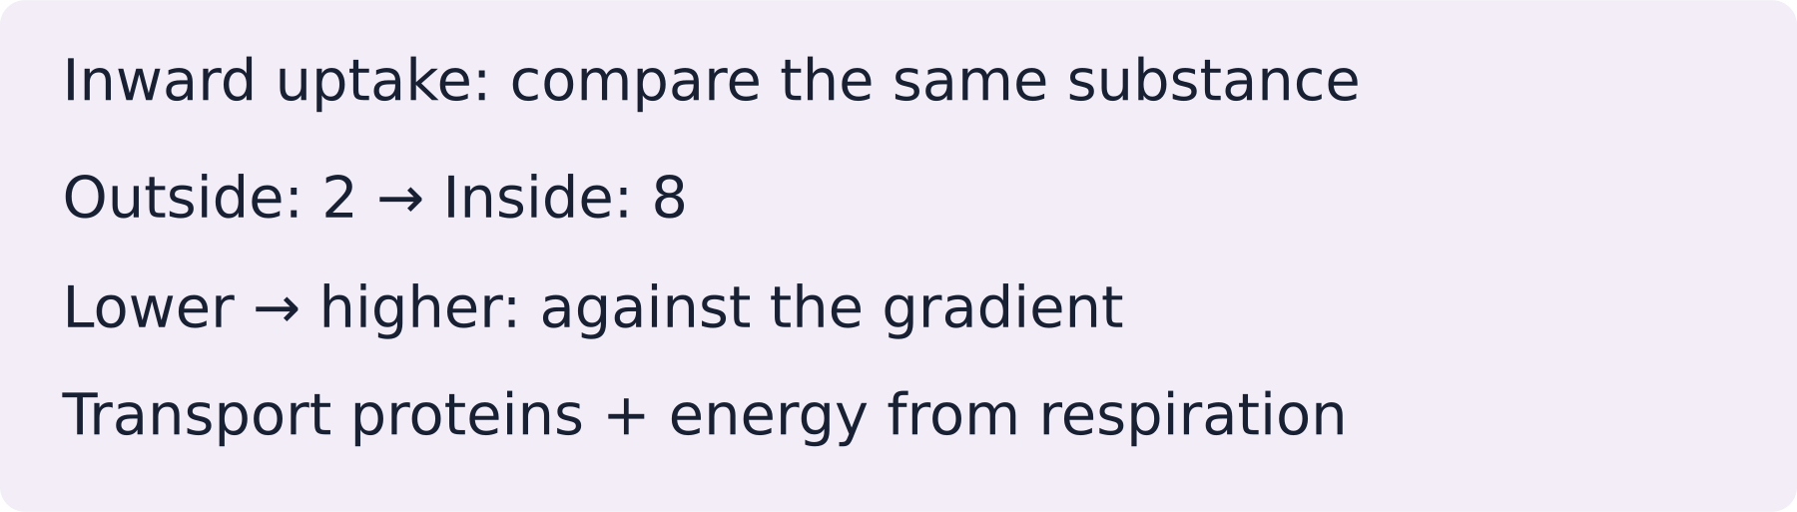
LAUNCH SCIENCE / W6L3
I Do 2 · 4 min
Connect the science
1
Both diffusion and active transport can move solutes across cell membranes.
2
Whereas diffusion is net movement down a concentration gradient, active transport can move against it.
3
Only active transport requires cellular energy; osmosis specifically concerns water through a partially permeable membrane.
Arrival
Starter
I Do
We Do
I Do 2
We Do 2
Independent
Exit
Resources
Notes:
Stage: I Do 2, 4 minutes. Monday / Wednesday / Friday P1, 09:30–10:10. Use reveals within this slot; appendix slides are not added time.
Real biological transport can involve more than one process at once; each scenario asks for the process best supported by the stated evidence.
Core explanation: Read the evidence before naming the process. Some statements belong to more than one process; some scenarios do not contain enough information.
Watch for: “Water only” points to osmosis, but the membrane and relative solutions still matter. Movement through a membrane alone does not prove active transport.
Least help first: Ask for the deciding clue before accepting a process label; then ask for one linked comparison.
Support cue: Ask: what moves, which way compared with the gradient, and is cellular energy needed? If a clue is missing, say what more you need to know.
[Sources]
User-supplied LAUNCH W3–W7 pack: W6 missing sort cards, comparison table and exam-style comparison.
Made by Matt LAUNCH Science draft, lesson-content.json, W6L3; existing illustrative diagrams reused, active-transport direction corrected to lower → higher.
Pearson Edexcel GCSE Biology specification, sections 1.1–1.6 and 1.15–1.17: https://qualifications.pearson.com/content/dam/pdf/GCSE/Science/2016/Specification/gcse-biology-spec.pdf
Optional concept video: freesciencelessons, Active transport, https://www.youtube.com/watch?v=ECldVkp6Rw0 (link located 5 September 2026).
[/Sources]
[Sources]
Source editable lesson: Original LAUNCH Science OneDrive pack, 5 September 2026, W6L3. Source teaching content preserved. Current HTML reference: https://madebymatt.uk/Lessons/Science_Teesside/Launch/. Native diagrams restate the source explanation and are not experimental measurements.
[/Sources]

Slide 6
LAUNCH SCIENCE / W6L3
We Do 2 · Task · 6 min
Sort the transport clues
Choose diffusion, osmosis, active transport or need more evidence. Give the deciding clue.
1
A Oxygen moves from higher concentration in air into blood.
2
B Water crosses a partially permeable membrane from a solution more dilute than the cell contents.
3
C Ions enter against their gradient using energy from respiration.
4
D A substance crosses a membrane. No other clue is given.
Reveal shared reasoning
Arrival
Starter
I Do
We Do
I Do 2
We Do 2
Independent
Exit
Resources
Notes:
Stage: We Do 2 · Task, 6 minutes. Monday / Wednesday / Friday P1, 09:30–10:10. Use reveals within this slot; appendix slides are not added time.
A: diffusion — down the oxygen gradient.
B: osmosis — water, membrane, dilute to concentrated.
C: active transport — against gradient using cellular energy.
D: insufficient evidence — ask what moves, which gradient and whether energy is needed.
Run the printed activity or this board; one route is enough.
Core explanation: Read the evidence before naming the process. Some statements belong to more than one process; some scenarios do not contain enough information.
Watch for: “Water only” points to osmosis, but the membrane and relative solutions still matter. Movement through a membrane alone does not prove active transport.
Least help first: Ask for the deciding clue before accepting a process label; then ask for one linked comparison.
Support cue: Ask: what moves, which way compared with the gradient, and is cellular energy needed? If a clue is missing, say what more you need to know.
[Sources]
User-supplied LAUNCH W3–W7 pack: W6 missing sort cards, comparison table and exam-style comparison.
Made by Matt LAUNCH Science draft, lesson-content.json, W6L3; existing illustrative diagrams reused, active-transport direction corrected to lower → higher.
Pearson Edexcel GCSE Biology specification, sections 1.1–1.6 and 1.15–1.17: https://qualifications.pearson.com/content/dam/pdf/GCSE/Science/2016/Specification/gcse-biology-spec.pdf
Optional concept video: freesciencelessons, Active transport, https://www.youtube.com/watch?v=ECldVkp6Rw0 (link located 5 September 2026).
[/Sources]
[Sources]
Source editable lesson: Original LAUNCH Science OneDrive pack, 5 September 2026, W6L3. Source teaching content preserved. Current HTML reference: https://madebymatt.uk/Lessons/Science_Teesside/Launch/. Native diagrams restate the source explanation and are not experimental measurements.
[/Sources]

Slide 7
LAUNCH SCIENCE / W6L3
Independent Task · 10 min
Your independent evidence
Compare diffusion and active transport. Classify and justify: oxygen enters blood from alveoli; water enters a root hair through its partially permeable membrane; mineral ions enter a root hair against their gradient.
Optional support
Ask: what moves, which way compared with the gradient, and is cellular energy needed? If a clue is missing, say what more you need to know.
Make one precise correction to the same work after feedback.
Open worksheet pages
Model after first attempt
Arrival
Starter
I Do
We Do
I Do 2
We Do 2
Independent
Exit
Resources
Notes:
Stage: Independent Task, 10 minutes. Monday / Wednesday / Friday P1, 09:30–10:10. Use reveals within this slot; appendix slides are not added time.
Model answer: Both diffusion and active transport can move substances across cell membranes, whereas diffusion is net movement down a concentration gradient and active transport can move against it using cellular energy. Oxygen enters blood by diffusion down its concentration gradient. Water enters the root hair cell by osmosis through a partially permeable membrane. Mineral ions moving against their concentration gradient require active transport and energy from respiration.
Select only questions that fit the ten-minute slot. W7L3: Q2, Q3 and Q5 total 11 marks. The full paper needs a separate 25-minute slot.
Core explanation: Read the evidence before naming the process. Some statements belong to more than one process; some scenarios do not contain enough information.
Watch for: “Water only” points to osmosis, but the membrane and relative solutions still matter. Movement through a membrane alone does not prove active transport.
Least help first: Ask for the deciding clue before accepting a process label; then ask for one linked comparison.
Support cue: Ask: what moves, which way compared with the gradient, and is cellular energy needed? If a clue is missing, say what more you need to know.
[Sources]
User-supplied LAUNCH W3–W7 pack: W6 missing sort cards, comparison table and exam-style comparison.
Made by Matt LAUNCH Science draft, lesson-content.json, W6L3; existing illustrative diagrams reused, active-transport direction corrected to lower → higher.
Pearson Edexcel GCSE Biology specification, sections 1.1–1.6 and 1.15–1.17: https://qualifications.pearson.com/content/dam/pdf/GCSE/Science/2016/Specification/gcse-biology-spec.pdf
Optional concept video: freesciencelessons, Active transport, https://www.youtube.com/watch?v=ECldVkp6Rw0 (link located 5 September 2026).
[/Sources]
[Sources]
Source editable lesson: Original LAUNCH Science OneDrive pack, 5 September 2026, W6L3. Source teaching content preserved. Current HTML reference: https://madebymatt.uk/Lessons/Science_Teesside/Launch/. Native diagrams restate the source explanation and are not experimental measurements.
[/Sources]

Slide 8
LAUNCH SCIENCE / W6L3
Exit · 3 min
What changed in your thinking?
Complete with precision: only active transport…
1
Point to one improvement in your work.
2
Choose what you want to revisit.
3
Tell your teacher; agree the next step together.
Arrival
Starter
I Do
We Do
I Do 2
We Do 2
Independent
Exit
Resources
Notes:
Stage: Exit, 3 minutes. Monday / Wednesday / Friday P1, 09:30–10:10. Use reveals within this slot; appendix slides are not added time.
Exit answer: Among these three processes, only active transport uses cellular energy to move a substance against its gradient.
Receive the request, record the agreed next action and check it next lesson. Keep responses private when requested.
Core explanation: Read the evidence before naming the process. Some statements belong to more than one process; some scenarios do not contain enough information.
Watch for: “Water only” points to osmosis, but the membrane and relative solutions still matter. Movement through a membrane alone does not prove active transport.
Least help first: Ask for the deciding clue before accepting a process label; then ask for one linked comparison.
Support cue: Ask: what moves, which way compared with the gradient, and is cellular energy needed? If a clue is missing, say what more you need to know.
[Sources]
User-supplied LAUNCH W3–W7 pack: W6 missing sort cards, comparison table and exam-style comparison.
Made by Matt LAUNCH Science draft, lesson-content.json, W6L3; existing illustrative diagrams reused, active-transport direction corrected to lower → higher.
Pearson Edexcel GCSE Biology specification, sections 1.1–1.6 and 1.15–1.17: https://qualifications.pearson.com/content/dam/pdf/GCSE/Science/2016/Specification/gcse-biology-spec.pdf
Optional concept video: freesciencelessons, Active transport, https://www.youtube.com/watch?v=ECldVkp6Rw0 (link located 5 September 2026).
[/Sources]
[Sources]
Source editable lesson: Original LAUNCH Science OneDrive pack, 5 September 2026, W6L3. Source teaching content preserved. Current HTML reference: https://madebymatt.uk/Lessons/Science_Teesside/Launch/. Native diagrams restate the source explanation and are not experimental measurements.
[/Sources]

Slide 9
LAUNCH SCIENCE / W6L3
Resources
Retrieval and prediction check
1
Osmosis, through a partially permeable membrane.
2
Active transport, using cellular energy.
The moving substance is water and the membrane is partially permeable
Return to Starter
Arrival
Starter
I Do
We Do
I Do 2
We Do 2
Independent
Exit
Resources
Notes:
Read only after an attempt; retain the pupil’s first view.
Core explanation: Read the evidence before naming the process. Some statements belong to more than one process; some scenarios do not contain enough information.
Watch for: “Water only” points to osmosis, but the membrane and relative solutions still matter. Movement through a membrane alone does not prove active transport.
Least help first: Ask for the deciding clue before accepting a process label; then ask for one linked comparison.
Support cue: Ask: what moves, which way compared with the gradient, and is cellular energy needed? If a clue is missing, say what more you need to know.
[Sources]
User-supplied LAUNCH W3–W7 pack: W6 missing sort cards, comparison table and exam-style comparison.
Made by Matt LAUNCH Science draft, lesson-content.json, W6L3; existing illustrative diagrams reused, active-transport direction corrected to lower → higher.
Pearson Edexcel GCSE Biology specification, sections 1.1–1.6 and 1.15–1.17: https://qualifications.pearson.com/content/dam/pdf/GCSE/Science/2016/Specification/gcse-biology-spec.pdf
Optional concept video: freesciencelessons, Active transport, https://www.youtube.com/watch?v=ECldVkp6Rw0 (link located 5 September 2026).
[/Sources]
[Sources]
Source editable lesson: Original LAUNCH Science OneDrive pack, 5 September 2026, W6L3. Source teaching content preserved. Current HTML reference: https://madebymatt.uk/Lessons/Science_Teesside/Launch/. Native diagrams restate the source explanation and are not experimental measurements.
[/Sources]

Slide 10
LAUNCH SCIENCE / W6L3
Resources
Check the deciding clue
Both can move substances across membranes, whereas only active transport can move against a concentration gradient using cellular energy.
Correct comparison using both/whereas/only.
Compare your reason. Correct one step if needed.
Return to We Do
Arrival
Starter
I Do
We Do
I Do 2
We Do 2
Independent
Exit
Resources
Notes:
This lists two statements without a linked similarity or difference.
Correct comparison using both/whereas/only.
This is incomplete and not a comparison.
This is too general to distinguish mechanisms.
Core explanation: Read the evidence before naming the process. Some statements belong to more than one process; some scenarios do not contain enough information.
Watch for: “Water only” points to osmosis, but the membrane and relative solutions still matter. Movement through a membrane alone does not prove active transport.
Least help first: Ask for the deciding clue before accepting a process label; then ask for one linked comparison.
Support cue: Ask: what moves, which way compared with the gradient, and is cellular energy needed? If a clue is missing, say what more you need to know.
[Sources]
User-supplied LAUNCH W3–W7 pack: W6 missing sort cards, comparison table and exam-style comparison.
Made by Matt LAUNCH Science draft, lesson-content.json, W6L3; existing illustrative diagrams reused, active-transport direction corrected to lower → higher.
Pearson Edexcel GCSE Biology specification, sections 1.1–1.6 and 1.15–1.17: https://qualifications.pearson.com/content/dam/pdf/GCSE/Science/2016/Specification/gcse-biology-spec.pdf
Optional concept video: freesciencelessons, Active transport, https://www.youtube.com/watch?v=ECldVkp6Rw0 (link located 5 September 2026).
[/Sources]
[Sources]
Source editable lesson: Original LAUNCH Science OneDrive pack, 5 September 2026, W6L3. Source teaching content preserved. Current HTML reference: https://madebymatt.uk/Lessons/Science_Teesside/Launch/. Native diagrams restate the source explanation and are not experimental measurements.
[/Sources]

Slide 11
LAUNCH SCIENCE / W6L3
Resources
Our shared reasoning
A: diffusion — down the oxygen gradient.
B: osmosis — water, membrane, dilute to concentrated.
C: active transport — against gradient using cellular energy.
D: insufficient evidence — ask what moves, which gradient and whether energy is needed.
Return to shared task
Arrival
Starter
I Do
We Do
I Do 2
We Do 2
Independent
Exit
Resources
Notes:
Pupils should justify, compare and revise rather than copy a complete answer before trying.
Core explanation: Read the evidence before naming the process. Some statements belong to more than one process; some scenarios do not contain enough information.
Watch for: “Water only” points to osmosis, but the membrane and relative solutions still matter. Movement through a membrane alone does not prove active transport.
Least help first: Ask for the deciding clue before accepting a process label; then ask for one linked comparison.
Support cue: Ask: what moves, which way compared with the gradient, and is cellular energy needed? If a clue is missing, say what more you need to know.
[Sources]
User-supplied LAUNCH W3–W7 pack: W6 missing sort cards, comparison table and exam-style comparison.
Made by Matt LAUNCH Science draft, lesson-content.json, W6L3; existing illustrative diagrams reused, active-transport direction corrected to lower → higher.
Pearson Edexcel GCSE Biology specification, sections 1.1–1.6 and 1.15–1.17: https://qualifications.pearson.com/content/dam/pdf/GCSE/Science/2016/Specification/gcse-biology-spec.pdf
Optional concept video: freesciencelessons, Active transport, https://www.youtube.com/watch?v=ECldVkp6Rw0 (link located 5 September 2026).
[/Sources]
[Sources]
Source editable lesson: Original LAUNCH Science OneDrive pack, 5 September 2026, W6L3. Source teaching content preserved. Current HTML reference: https://madebymatt.uk/Lessons/Science_Teesside/Launch/. Native diagrams restate the source explanation and are not experimental measurements.
[/Sources]

Slide 12
LAUNCH SCIENCE / W6L3
Resources
Compare after your first attempt
Both diffusion and active transport can move substances across cell membranes, whereas diffusion is net movement down a concentration gradient and active transport can move against it using cellular energy. Oxygen enters blood by diffusion down its concentration gradient. Water enters the root hair cell by osmosis through a partially permeable membrane. Mineral ions moving against their concentration gradient require active transport and energy from respiration.
Use the model to improve your explanation in your own words.
Return to independent task
Arrival
Starter
I Do
We Do
I Do 2
We Do 2
Independent
Exit
Resources
Notes:
Staff guide includes question-by-question answers. Do not distribute this presentation as a secure assessment paper.
Core explanation: Read the evidence before naming the process. Some statements belong to more than one process; some scenarios do not contain enough information.
Watch for: “Water only” points to osmosis, but the membrane and relative solutions still matter. Movement through a membrane alone does not prove active transport.
Least help first: Ask for the deciding clue before accepting a process label; then ask for one linked comparison.
Support cue: Ask: what moves, which way compared with the gradient, and is cellular energy needed? If a clue is missing, say what more you need to know.
[Sources]
User-supplied LAUNCH W3–W7 pack: W6 missing sort cards, comparison table and exam-style comparison.
Made by Matt LAUNCH Science draft, lesson-content.json, W6L3; existing illustrative diagrams reused, active-transport direction corrected to lower → higher.
Pearson Edexcel GCSE Biology specification, sections 1.1–1.6 and 1.15–1.17: https://qualifications.pearson.com/content/dam/pdf/GCSE/Science/2016/Specification/gcse-biology-spec.pdf
Optional concept video: freesciencelessons, Active transport, https://www.youtube.com/watch?v=ECldVkp6Rw0 (link located 5 September 2026).
[/Sources]
[Sources]
Source editable lesson: Original LAUNCH Science OneDrive pack, 5 September 2026, W6L3. Source teaching content preserved. Current HTML reference: https://madebymatt.uk/Lessons/Science_Teesside/Launch/. Native diagrams restate the source explanation and are not experimental measurements.
[/Sources]

Slide 13
LAUNCH SCIENCE / W6L3
Resources
Your lesson resources
Worksheet pages are stored inside this PowerPoint.
Worksheet · page 1
Worksheet · page 2
Standard PDF
Supported PDF
Depth PDF
Editable Word worksheet
Open online lesson / model
Named files are in this week’s folder. Online lesson and video need internet.
Optional concept video
Open scenario cards
Arrival
Starter
I Do
We Do
I Do 2
We Do 2
Independent
Exit
Resources
Notes:
File buttons use relative links for downloaded/synced folders. OneDrive preview may not resolve relative links. Use the embedded pages or open the named file in the week folder.
Core explanation: Read the evidence before naming the process. Some statements belong to more than one process; some scenarios do not contain enough information.
Watch for: “Water only” points to osmosis, but the membrane and relative solutions still matter. Movement through a membrane alone does not prove active transport.
Least help first: Ask for the deciding clue before accepting a process label; then ask for one linked comparison.
Support cue: Ask: what moves, which way compared with the gradient, and is cellular energy needed? If a clue is missing, say what more you need to know.
[Sources]
User-supplied LAUNCH W3–W7 pack: W6 missing sort cards, comparison table and exam-style comparison.
Made by Matt LAUNCH Science draft, lesson-content.json, W6L3; existing illustrative diagrams reused, active-transport direction corrected to lower → higher.
Pearson Edexcel GCSE Biology specification, sections 1.1–1.6 and 1.15–1.17: https://qualifications.pearson.com/content/dam/pdf/GCSE/Science/2016/Specification/gcse-biology-spec.pdf
Optional concept video: freesciencelessons, Active transport, https://www.youtube.com/watch?v=ECldVkp6Rw0 (link located 5 September 2026).
[/Sources]
[Sources]
Source editable lesson: Original LAUNCH Science OneDrive pack, 5 September 2026, W6L3. Source teaching content preserved. Current HTML reference: https://madebymatt.uk/Lessons/Science_Teesside/Launch/. Native diagrams restate the source explanation and are not experimental measurements.
[/Sources]

Slide 14
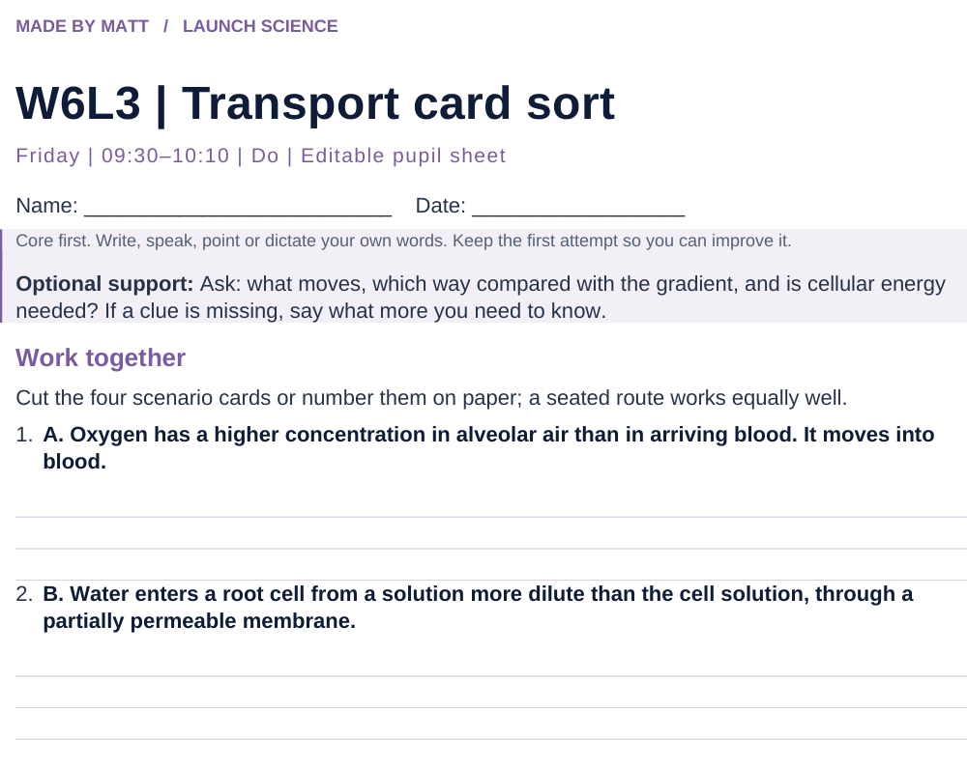
LAUNCH SCIENCE / W6L3
Resources
Worksheet · page 1
Use your printed copy.
Keep the first attempt.
Return to task
Arrival
Starter
I Do
We Do
I Do 2
We Do 2
Independent
Exit
Resources
Notes:
Embedded worksheet reference; print the separate PDF at A4 for writable space.
Core explanation: Read the evidence before naming the process. Some statements belong to more than one process; some scenarios do not contain enough information.
Watch for: “Water only” points to osmosis, but the membrane and relative solutions still matter. Movement through a membrane alone does not prove active transport.
Least help first: Ask for the deciding clue before accepting a process label; then ask for one linked comparison.
Support cue: Ask: what moves, which way compared with the gradient, and is cellular energy needed? If a clue is missing, say what more you need to know.
[Sources]
User-supplied LAUNCH W3–W7 pack: W6 missing sort cards, comparison table and exam-style comparison.
Made by Matt LAUNCH Science draft, lesson-content.json, W6L3; existing illustrative diagrams reused, active-transport direction corrected to lower → higher.
Pearson Edexcel GCSE Biology specification, sections 1.1–1.6 and 1.15–1.17: https://qualifications.pearson.com/content/dam/pdf/GCSE/Science/2016/Specification/gcse-biology-spec.pdf
Optional concept video: freesciencelessons, Active transport, https://www.youtube.com/watch?v=ECldVkp6Rw0 (link located 5 September 2026).
[/Sources]
[Sources]
Source editable lesson: Original LAUNCH Science OneDrive pack, 5 September 2026, W6L3. Source teaching content preserved. Current HTML reference: https://madebymatt.uk/Lessons/Science_Teesside/Launch/. Native diagrams restate the source explanation and are not experimental measurements.
[/Sources]

Slide 15
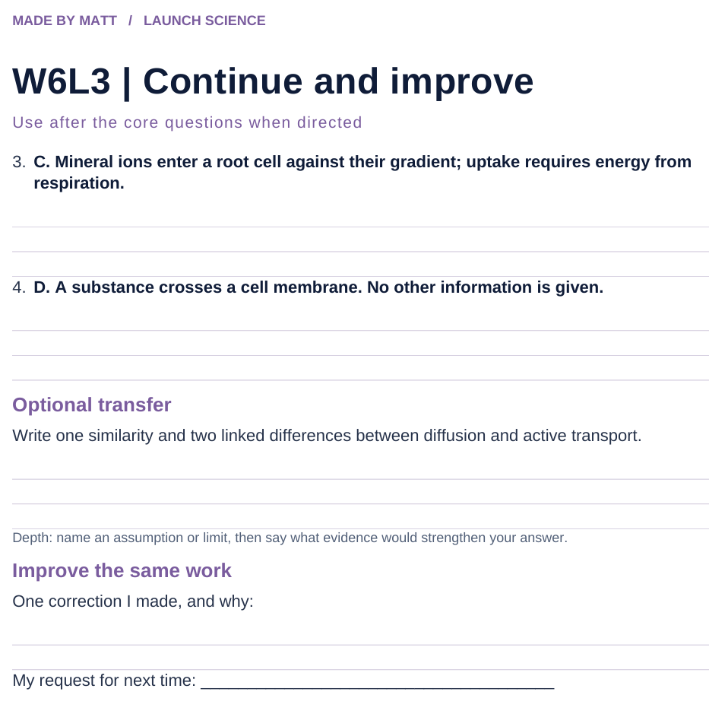
LAUNCH SCIENCE / W6L3
Resources
Worksheet · page 2
Continuation is optional.
Improve the same work.
Return to task
Arrival
Starter
I Do
We Do
I Do 2
We Do 2
Independent
Exit
Resources
Notes:
Embedded worksheet reference; print the separate PDF at A4 for writable space.
Core explanation: Read the evidence before naming the process. Some statements belong to more than one process; some scenarios do not contain enough information.
Watch for: “Water only” points to osmosis, but the membrane and relative solutions still matter. Movement through a membrane alone does not prove active transport.
Least help first: Ask for the deciding clue before accepting a process label; then ask for one linked comparison.
Support cue: Ask: what moves, which way compared with the gradient, and is cellular energy needed? If a clue is missing, say what more you need to know.
[Sources]
User-supplied LAUNCH W3–W7 pack: W6 missing sort cards, comparison table and exam-style comparison.
Made by Matt LAUNCH Science draft, lesson-content.json, W6L3; existing illustrative diagrams reused, active-transport direction corrected to lower → higher.
Pearson Edexcel GCSE Biology specification, sections 1.1–1.6 and 1.15–1.17: https://qualifications.pearson.com/content/dam/pdf/GCSE/Science/2016/Specification/gcse-biology-spec.pdf
Optional concept video: freesciencelessons, Active transport, https://www.youtube.com/watch?v=ECldVkp6Rw0 (link located 5 September 2026).
[/Sources]
[Sources]
Source editable lesson: Original LAUNCH Science OneDrive pack, 5 September 2026, W6L3. Source teaching content preserved. Current HTML reference: https://madebymatt.uk/Lessons/Science_Teesside/Launch/. Native diagrams restate the source explanation and are not experimental measurements.
[/Sources]

Slide 16
LAUNCH SCIENCE / W6L3
Resources
Watch, pause and explain
Active transport
What two clues distinguish active transport from diffusion?
Play freesciencelessons video
No connection? Use the still model and explain the same question.
Arrival
Starter
I Do
We Do
I Do 2
We Do 2
Independent
Exit
Resources
Notes:
Use at most 90 seconds within I Do. Pause on the first relevant example; ask for a reason. This is an optional concept clip, not evidence of practical completion.
Core explanation: Read the evidence before naming the process. Some statements belong to more than one process; some scenarios do not contain enough information.
Watch for: “Water only” points to osmosis, but the membrane and relative solutions still matter. Movement through a membrane alone does not prove active transport.
Least help first: Ask for the deciding clue before accepting a process label; then ask for one linked comparison.
Support cue: Ask: what moves, which way compared with the gradient, and is cellular energy needed? If a clue is missing, say what more you need to know.
[Sources]
User-supplied LAUNCH W3–W7 pack: W6 missing sort cards, comparison table and exam-style comparison.
Made by Matt LAUNCH Science draft, lesson-content.json, W6L3; existing illustrative diagrams reused, active-transport direction corrected to lower → higher.
Pearson Edexcel GCSE Biology specification, sections 1.1–1.6 and 1.15–1.17: https://qualifications.pearson.com/content/dam/pdf/GCSE/Science/2016/Specification/gcse-biology-spec.pdf
Optional concept video: freesciencelessons, Active transport, https://www.youtube.com/watch?v=ECldVkp6Rw0 (link located 5 September 2026).
[/Sources]
[Sources]
Source editable lesson: Original LAUNCH Science OneDrive pack, 5 September 2026, W6L3. Source teaching content preserved. Current HTML reference: https://madebymatt.uk/Lessons/Science_Teesside/Launch/. Native diagrams restate the source explanation and are not experimental measurements.
[/Sources]

Slide 17
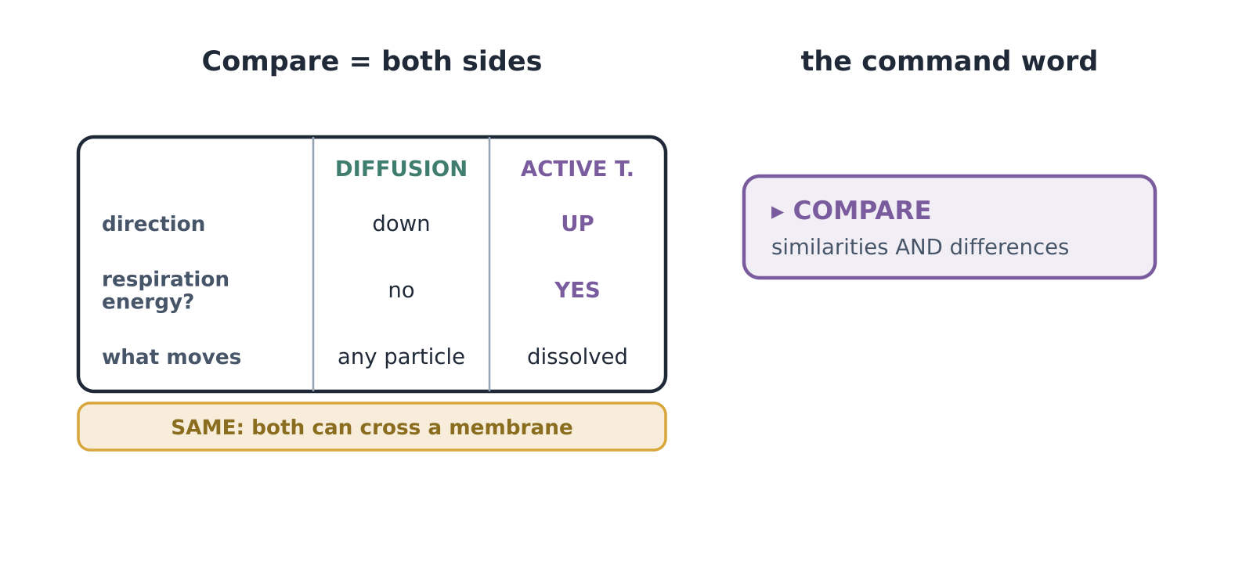
LAUNCH SCIENCE / W6L3
Resources
Look closely at the model
A model illustration: use the stated data for calculations.
Return to I Do
Arrival
Starter
I Do
We Do
I Do 2
We Do 2
Independent
Exit
Resources
Notes:
Source image: https://madebymatt.uk/Lessons/Science_Teesside/Launch/SCI_L_W6_L3_Compare.html; existing vector illustration embedded for offline use.
Core explanation: Read the evidence before naming the process. Some statements belong to more than one process; some scenarios do not contain enough information.
Watch for: “Water only” points to osmosis, but the membrane and relative solutions still matter. Movement through a membrane alone does not prove active transport.
Least help first: Ask for the deciding clue before accepting a process label; then ask for one linked comparison.
Support cue: Ask: what moves, which way compared with the gradient, and is cellular energy needed? If a clue is missing, say what more you need to know.
[Sources]
User-supplied LAUNCH W3–W7 pack: W6 missing sort cards, comparison table and exam-style comparison.
Made by Matt LAUNCH Science draft, lesson-content.json, W6L3; existing illustrative diagrams reused, active-transport direction corrected to lower → higher.
Pearson Edexcel GCSE Biology specification, sections 1.1–1.6 and 1.15–1.17: https://qualifications.pearson.com/content/dam/pdf/GCSE/Science/2016/Specification/gcse-biology-spec.pdf
Optional concept video: freesciencelessons, Active transport, https://www.youtube.com/watch?v=ECldVkp6Rw0 (link located 5 September 2026).
[/Sources]
[Sources]
Source editable lesson: Original LAUNCH Science OneDrive pack, 5 September 2026, W6L3. Source teaching content preserved. Current HTML reference: https://madebymatt.uk/Lessons/Science_Teesside/Launch/. Native diagrams restate the source explanation and are not experimental measurements.
[/Sources]

Slide 18
LAUNCH SCIENCE / W6L3
Resources
Transport scenario cards
Place, number or point; cutting is optional
Sort into diffusion, osmosis, active transport or need more evidence. Give the deciding clue.
Sort each card. Give the deciding clue before naming the process.
Diffusion
Osmosis
Active transport
Need more evidence
A. Oxygen has a higher concentration in alveolar air than in arriving blood. It moves into blood.
B. Water enters a root cell from a solution more dilute than the cell solution, through a partially permeable membrane.
C. Mineral ions enter a root cell against their gradient; uptake requires energy from respiration.
D. A substance crosses a cell membrane. No other information is given.
My deciding clues
Return to card sort
Arrival
Starter
I Do
We Do
I Do 2
We Do 2
Independent
Exit
Resources
Notes:
Cards can be cut, numbered or pointed to.
Core explanation: Read the evidence before naming the process. Some statements belong to more than one process; some scenarios do not contain enough information.
Watch for: “Water only” points to osmosis, but the membrane and relative solutions still matter. Movement through a membrane alone does not prove active transport.
Least help first: Ask for the deciding clue before accepting a process label; then ask for one linked comparison.
Support cue: Ask: what moves, which way compared with the gradient, and is cellular energy needed? If a clue is missing, say what more you need to know.
[Sources]
User-supplied LAUNCH W3–W7 pack: W6 missing sort cards, comparison table and exam-style comparison.
Made by Matt LAUNCH Science draft, lesson-content.json, W6L3; existing illustrative diagrams reused, active-transport direction corrected to lower → higher.
Pearson Edexcel GCSE Biology specification, sections 1.1–1.6 and 1.15–1.17: https://qualifications.pearson.com/content/dam/pdf/GCSE/Science/2016/Specification/gcse-biology-spec.pdf
Optional concept video: freesciencelessons, Active transport, https://www.youtube.com/watch?v=ECldVkp6Rw0 (link located 5 September 2026).
[/Sources]
[Sources]
Source editable lesson: Original LAUNCH Science OneDrive pack, 5 September 2026, W6L3. Source teaching content preserved. Current HTML reference: https://madebymatt.uk/Lessons/Science_Teesside/Launch/. Native diagrams restate the source explanation and are not experimental measurements.
[/Sources]

