Slide 1
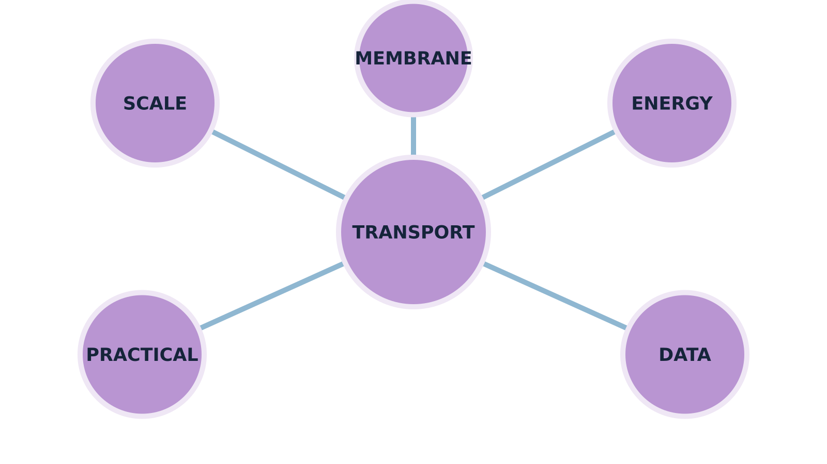
LAUNCH SCIENCE / W7L1
Arrival · 3 min
Connect your knowledge
I can retrieve and connect microscopy, transport, practical and data ideas before choosing what to revisit.
Notice. Recall. Be ready to explain.
1
Write the magnification relationship.
2
State one difference between osmosis and active transport.
Retrieval answers
Arrival
Starter
I Do
We Do
I Do 2
We Do 2
Independent
Exit
Resources
Notes:
Stage: Arrival, 3 minutes. Monday / Wednesday / Friday P1, 09:30–10:10. Use reveals within this slot; appendix slides are not added time.
Retrieval answers: M = I ÷ A. | Osmosis: water through a partially permeable membrane without energy from respiration. Active transport: against-gradient movement using that energy. | Solution/sucrose concentration.
Core explanation: This reviews cells, microscopy and transport taught so far. It is not a claim that every part of GCSE Topic 1, including enzymes, has been completed.
Watch for: Do not turn confidence colours into public rankings. Ask for a piece of work or a corrected explanation to support a review choice.
Least help first: Ask for the reason connecting two ideas; do not turn the map into rapid-fire recall or a public score.
Support cue: Choose two ideas. Link them with “because” or “whereas”. For a cell adaptation, name the feature and what it helps the cell do.
[Sources]
User-supplied LAUNCH W3–W7 pack: W7 slides 3–6 and review worksheet; specialised cells are taught before being assessed.
Made by Matt LAUNCH Science draft, lesson-content.json, W7L1; existing illustrative diagrams reused, active-transport direction corrected to lower → higher.
Pearson Edexcel GCSE Biology specification, sections 1.1–1.6 and 1.15–1.17: https://qualifications.pearson.com/content/dam/pdf/GCSE/Science/2016/Specification/gcse-biology-spec.pdf
Optional concept video: freesciencelessons, Microscopy, https://www.youtube.com/watch?v=L5StAE_uuxM (link located 5 September 2026).
[/Sources]
[Sources]
Source editable lesson: Original LAUNCH Science OneDrive pack, 5 September 2026, W7L1. Source teaching content preserved. Current HTML reference: https://madebymatt.uk/Lessons/Science_Teesside/Launch/. Native diagrams restate the source explanation and are not experimental measurements.
[/Sources]

Slide 2
LAUNCH SCIENCE / W7L1
Starter · 4 min
Make a prediction
Which link is strongest: magnification ↔ unit conversion, osmosis ↔ percentage change in mass, or active transport ↔ respiration?
A Only the first
B Only the second
C Only the third
D All three are valid links
Commit, then check
Arrival
Starter
I Do
We Do
I Do 2
We Do 2
Independent
Exit
Resources
Notes:
Stage: Starter, 4 minutes. Monday / Wednesday / Friday P1, 09:30–10:10. Use reveals within this slot; appendix slides are not added time.
Correct: All three are valid links. Ask for the reason, then return to the original prediction.
Core explanation: This reviews cells, microscopy and transport taught so far. It is not a claim that every part of GCSE Topic 1, including enzymes, has been completed.
Watch for: Do not turn confidence colours into public rankings. Ask for a piece of work or a corrected explanation to support a review choice.
Least help first: Ask for the reason connecting two ideas; do not turn the map into rapid-fire recall or a public score.
Support cue: Choose two ideas. Link them with “because” or “whereas”. For a cell adaptation, name the feature and what it helps the cell do.
[Sources]
User-supplied LAUNCH W3–W7 pack: W7 slides 3–6 and review worksheet; specialised cells are taught before being assessed.
Made by Matt LAUNCH Science draft, lesson-content.json, W7L1; existing illustrative diagrams reused, active-transport direction corrected to lower → higher.
Pearson Edexcel GCSE Biology specification, sections 1.1–1.6 and 1.15–1.17: https://qualifications.pearson.com/content/dam/pdf/GCSE/Science/2016/Specification/gcse-biology-spec.pdf
Optional concept video: freesciencelessons, Microscopy, https://www.youtube.com/watch?v=L5StAE_uuxM (link located 5 September 2026).
[/Sources]
[Sources]
Source editable lesson: Original LAUNCH Science OneDrive pack, 5 September 2026, W7L1. Source teaching content preserved. Current HTML reference: https://madebymatt.uk/Lessons/Science_Teesside/Launch/. Native diagrams restate the source explanation and are not experimental measurements.
[/Sources]

Slide 3
LAUNCH SCIENCE / W7L1
I Do · 5 min
Watch the model
1
Retrieve an idea before opening its support card.
Build a connected explanation
Recall
Name the idea
2
Link concepts using a reason, not only a line between labels.
Connect
Give a reason
Improve
Repair one step
3
Use any mistake to choose what to practise next.
View labelled diagram
Optional video
Arrival
Starter
I Do
We Do
I Do 2
We Do 2
Independent
Exit
Resources
Notes:
Stage: I Do, 5 minutes. Monday / Wednesday / Friday P1, 09:30–10:10. Use reveals within this slot; appendix slides are not added time.
The map suggests a next item from missed categories during the current session only.
Model limit: Session patterns are not a diagnosis, grade or persistent profile and disappear on reset or reload.
Video replaces up to 90 seconds of explanation; use the still diagram if unavailable.
Core explanation: This reviews cells, microscopy and transport taught so far. It is not a claim that every part of GCSE Topic 1, including enzymes, has been completed.
Watch for: Do not turn confidence colours into public rankings. Ask for a piece of work or a corrected explanation to support a review choice.
Least help first: Ask for the reason connecting two ideas; do not turn the map into rapid-fire recall or a public score.
Support cue: Choose two ideas. Link them with “because” or “whereas”. For a cell adaptation, name the feature and what it helps the cell do.
[Sources]
User-supplied LAUNCH W3–W7 pack: W7 slides 3–6 and review worksheet; specialised cells are taught before being assessed.
Made by Matt LAUNCH Science draft, lesson-content.json, W7L1; existing illustrative diagrams reused, active-transport direction corrected to lower → higher.
Pearson Edexcel GCSE Biology specification, sections 1.1–1.6 and 1.15–1.17: https://qualifications.pearson.com/content/dam/pdf/GCSE/Science/2016/Specification/gcse-biology-spec.pdf
Optional concept video: freesciencelessons, Microscopy, https://www.youtube.com/watch?v=L5StAE_uuxM (link located 5 September 2026).
[/Sources]
[Sources]
Source editable lesson: Original LAUNCH Science OneDrive pack, 5 September 2026, W7L1. Source teaching content preserved. Current HTML reference: https://madebymatt.uk/Lessons/Science_Teesside/Launch/. Native diagrams restate the source explanation and are not experimental measurements.
[/Sources]

Slide 4
LAUNCH SCIENCE / W7L1
We Do · 5 min
Choose and justify
Which connection is scientifically justified?
A A thinner alveolar wall shortens diffusion distance
B Higher magnification always increases resolution
C An anomaly must be deleted
D Active transport is fast osmosis
Give the deciding clue before checking.
Check the reasoning
Arrival
Starter
I Do
We Do
I Do 2
We Do 2
Independent
Exit
Resources
Notes:
Stage: We Do, 5 minutes. Monday / Wednesday / Friday P1, 09:30–10:10. Use reveals within this slot; appendix slides are not added time.
A: A thinner alveolar wall shortens diffusion distance — Correct causal link.
B: Higher magnification always increases resolution — Magnification and resolution are separate properties.
C: An anomaly must be deleted — Keep the raw value and investigate before deciding on inclusion.
D: Active transport is fast osmosis — The processes differ in substance, direction, membrane and energy.
Core explanation: This reviews cells, microscopy and transport taught so far. It is not a claim that every part of GCSE Topic 1, including enzymes, has been completed.
Watch for: Do not turn confidence colours into public rankings. Ask for a piece of work or a corrected explanation to support a review choice.
Least help first: Ask for the reason connecting two ideas; do not turn the map into rapid-fire recall or a public score.
Support cue: Choose two ideas. Link them with “because” or “whereas”. For a cell adaptation, name the feature and what it helps the cell do.
[Sources]
User-supplied LAUNCH W3–W7 pack: W7 slides 3–6 and review worksheet; specialised cells are taught before being assessed.
Made by Matt LAUNCH Science draft, lesson-content.json, W7L1; existing illustrative diagrams reused, active-transport direction corrected to lower → higher.
Pearson Edexcel GCSE Biology specification, sections 1.1–1.6 and 1.15–1.17: https://qualifications.pearson.com/content/dam/pdf/GCSE/Science/2016/Specification/gcse-biology-spec.pdf
Optional concept video: freesciencelessons, Microscopy, https://www.youtube.com/watch?v=L5StAE_uuxM (link located 5 September 2026).
[/Sources]
[Sources]
Source editable lesson: Original LAUNCH Science OneDrive pack, 5 September 2026, W7L1. Source teaching content preserved. Current HTML reference: https://madebymatt.uk/Lessons/Science_Teesside/Launch/. Native diagrams restate the source explanation and are not experimental measurements.
[/Sources]

Slide 5
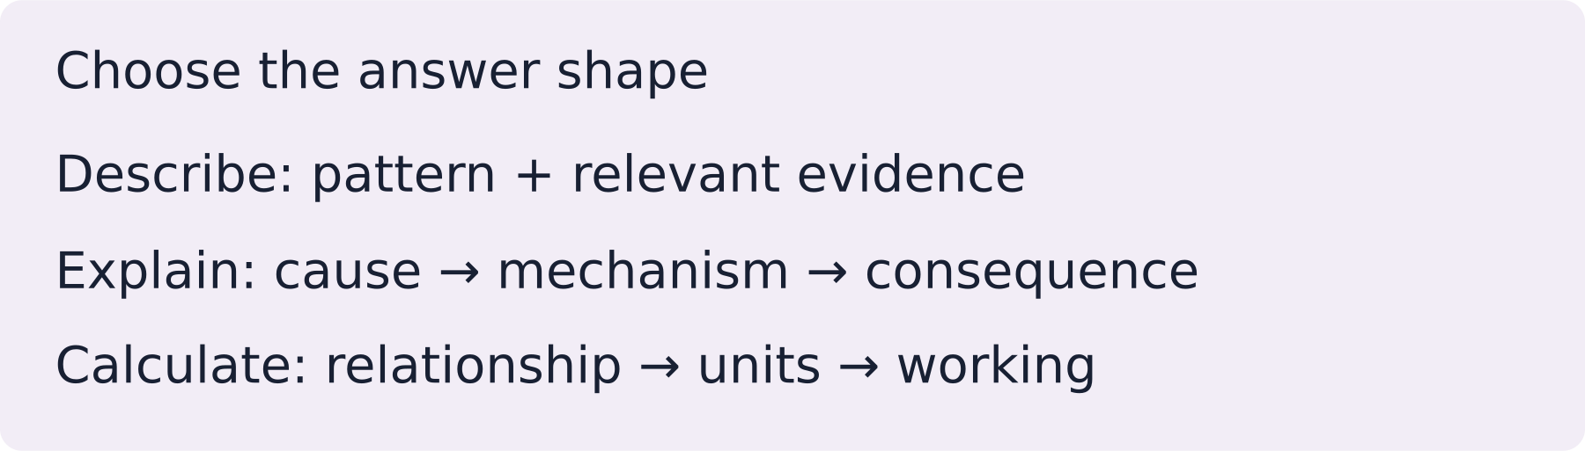
LAUNCH SCIENCE / W7L1
I Do 2 · 4 min
Connect the science
1
Microscopy links to magnification, units, scale and measurement uncertainty.
2
Transport links to gradients, membranes, surface area, distance and energy.
3
Practicals link variables to raw data, calculations, graphs, conclusions and evaluation.
Arrival
Starter
I Do
We Do
I Do 2
We Do 2
Independent
Exit
Resources
Notes:
Stage: I Do 2, 4 minutes. Monday / Wednesday / Friday P1, 09:30–10:10. Use reveals within this slot; appendix slides are not added time.
Session patterns are not a diagnosis, grade or persistent profile and disappear on reset or reload.
Core explanation: This reviews cells, microscopy and transport taught so far. It is not a claim that every part of GCSE Topic 1, including enzymes, has been completed.
Watch for: Do not turn confidence colours into public rankings. Ask for a piece of work or a corrected explanation to support a review choice.
Least help first: Ask for the reason connecting two ideas; do not turn the map into rapid-fire recall or a public score.
Support cue: Choose two ideas. Link them with “because” or “whereas”. For a cell adaptation, name the feature and what it helps the cell do.
[Sources]
User-supplied LAUNCH W3–W7 pack: W7 slides 3–6 and review worksheet; specialised cells are taught before being assessed.
Made by Matt LAUNCH Science draft, lesson-content.json, W7L1; existing illustrative diagrams reused, active-transport direction corrected to lower → higher.
Pearson Edexcel GCSE Biology specification, sections 1.1–1.6 and 1.15–1.17: https://qualifications.pearson.com/content/dam/pdf/GCSE/Science/2016/Specification/gcse-biology-spec.pdf
Optional concept video: freesciencelessons, Microscopy, https://www.youtube.com/watch?v=L5StAE_uuxM (link located 5 September 2026).
[/Sources]
[Sources]
Source editable lesson: Original LAUNCH Science OneDrive pack, 5 September 2026, W7L1. Source teaching content preserved. Current HTML reference: https://madebymatt.uk/Lessons/Science_Teesside/Launch/. Native diagrams restate the source explanation and are not experimental measurements.
[/Sources]

Slide 6
LAUNCH SCIENCE / W7L1
We Do 2 · Task · 6 min
Repair the knowledge map
Choose two ideas. Connect them using because or whereas. Your partner checks the science.
1
Magnification Units Resolution
2
Osmosis Membrane Percentage change
3
Active transport Respiration Uptake
Reveal shared reasoning
Arrival
Starter
I Do
We Do
I Do 2
We Do 2
Independent
Exit
Resources
Notes:
Stage: We Do 2 · Task, 6 minutes. Monday / Wednesday / Friday P1, 09:30–10:10. Use reveals within this slot; appendix slides are not added time.
Matching units makes a magnification ratio valid.
Mass change can provide evidence of net water movement by osmosis.
Respiration releases energy for active transport.
Accept other accurate, explained links.
Run the printed activity or this board; one route is enough.
Core explanation: This reviews cells, microscopy and transport taught so far. It is not a claim that every part of GCSE Topic 1, including enzymes, has been completed.
Watch for: Do not turn confidence colours into public rankings. Ask for a piece of work or a corrected explanation to support a review choice.
Least help first: Ask for the reason connecting two ideas; do not turn the map into rapid-fire recall or a public score.
Support cue: Choose two ideas. Link them with “because” or “whereas”. For a cell adaptation, name the feature and what it helps the cell do.
[Sources]
User-supplied LAUNCH W3–W7 pack: W7 slides 3–6 and review worksheet; specialised cells are taught before being assessed.
Made by Matt LAUNCH Science draft, lesson-content.json, W7L1; existing illustrative diagrams reused, active-transport direction corrected to lower → higher.
Pearson Edexcel GCSE Biology specification, sections 1.1–1.6 and 1.15–1.17: https://qualifications.pearson.com/content/dam/pdf/GCSE/Science/2016/Specification/gcse-biology-spec.pdf
Optional concept video: freesciencelessons, Microscopy, https://www.youtube.com/watch?v=L5StAE_uuxM (link located 5 September 2026).
[/Sources]
[Sources]
Source editable lesson: Original LAUNCH Science OneDrive pack, 5 September 2026, W7L1. Source teaching content preserved. Current HTML reference: https://madebymatt.uk/Lessons/Science_Teesside/Launch/. Native diagrams restate the source explanation and are not experimental measurements.
[/Sources]

Slide 7
LAUNCH SCIENCE / W7L1
Independent Task · 10 min
Your independent evidence
Create a connected explanation using at least five of these ideas: magnification, micrometre, diffusion, concentration gradient, osmosis, percentage change, active transport, respiration, anomaly and control variable. Explain each link rather than listing terms.
Optional support
Choose two ideas. Link them with “because” or “whereas”. For a cell adaptation, name the feature and what it helps the cell do.
Make one precise correction to the same work after feedback.
Open worksheet pages
Model after first attempt
Arrival
Starter
I Do
We Do
I Do 2
We Do 2
Independent
Exit
Resources
Notes:
Stage: Independent Task, 10 minutes. Monday / Wednesday / Friday P1, 09:30–10:10. Use reveals within this slot; appendix slides are not added time.
Model answer: Magnification calculations require image and actual size in matching units, often millimetres and micrometres. Diffusion is net movement down a concentration gradient, while osmosis is net water movement through a partially permeable membrane. Potato mass percentage change provides evidence about osmosis when control variables are kept constant. Active transport can move substances against a gradient using energy from respiration. An anomalous result should remain visible and be investigated before deciding whether to include it in a mean.
Select only questions that fit the ten-minute slot. W7L3: Q2, Q3 and Q5 total 11 marks. The full paper needs a separate 25-minute slot.
Core explanation: This reviews cells, microscopy and transport taught so far. It is not a claim that every part of GCSE Topic 1, including enzymes, has been completed.
Watch for: Do not turn confidence colours into public rankings. Ask for a piece of work or a corrected explanation to support a review choice.
Least help first: Ask for the reason connecting two ideas; do not turn the map into rapid-fire recall or a public score.
Support cue: Choose two ideas. Link them with “because” or “whereas”. For a cell adaptation, name the feature and what it helps the cell do.
[Sources]
User-supplied LAUNCH W3–W7 pack: W7 slides 3–6 and review worksheet; specialised cells are taught before being assessed.
Made by Matt LAUNCH Science draft, lesson-content.json, W7L1; existing illustrative diagrams reused, active-transport direction corrected to lower → higher.
Pearson Edexcel GCSE Biology specification, sections 1.1–1.6 and 1.15–1.17: https://qualifications.pearson.com/content/dam/pdf/GCSE/Science/2016/Specification/gcse-biology-spec.pdf
Optional concept video: freesciencelessons, Microscopy, https://www.youtube.com/watch?v=L5StAE_uuxM (link located 5 September 2026).
[/Sources]
[Sources]
Source editable lesson: Original LAUNCH Science OneDrive pack, 5 September 2026, W7L1. Source teaching content preserved. Current HTML reference: https://madebymatt.uk/Lessons/Science_Teesside/Launch/. Native diagrams restate the source explanation and are not experimental measurements.
[/Sources]

Slide 8
LAUNCH SCIENCE / W7L1
Exit · 3 min
What changed in your thinking?
Which single connection do you now need to practise next, and what evidence led you to choose it?
1
Point to one improvement in your work.
2
Choose what you want to revisit.
3
Tell your teacher; agree the next step together.
Arrival
Starter
I Do
We Do
I Do 2
We Do 2
Independent
Exit
Resources
Notes:
Stage: Exit, 3 minutes. Monday / Wednesday / Friday P1, 09:30–10:10. Use reveals within this slot; appendix slides are not added time.
Exit answer: Accept an evidence-backed learning choice. The adult records the next action, not a public grade.
Receive the request, record the agreed next action and check it next lesson. Keep responses private when requested.
Core explanation: This reviews cells, microscopy and transport taught so far. It is not a claim that every part of GCSE Topic 1, including enzymes, has been completed.
Watch for: Do not turn confidence colours into public rankings. Ask for a piece of work or a corrected explanation to support a review choice.
Least help first: Ask for the reason connecting two ideas; do not turn the map into rapid-fire recall or a public score.
Support cue: Choose two ideas. Link them with “because” or “whereas”. For a cell adaptation, name the feature and what it helps the cell do.
[Sources]
User-supplied LAUNCH W3–W7 pack: W7 slides 3–6 and review worksheet; specialised cells are taught before being assessed.
Made by Matt LAUNCH Science draft, lesson-content.json, W7L1; existing illustrative diagrams reused, active-transport direction corrected to lower → higher.
Pearson Edexcel GCSE Biology specification, sections 1.1–1.6 and 1.15–1.17: https://qualifications.pearson.com/content/dam/pdf/GCSE/Science/2016/Specification/gcse-biology-spec.pdf
Optional concept video: freesciencelessons, Microscopy, https://www.youtube.com/watch?v=L5StAE_uuxM (link located 5 September 2026).
[/Sources]
[Sources]
Source editable lesson: Original LAUNCH Science OneDrive pack, 5 September 2026, W7L1. Source teaching content preserved. Current HTML reference: https://madebymatt.uk/Lessons/Science_Teesside/Launch/. Native diagrams restate the source explanation and are not experimental measurements.
[/Sources]

Slide 9
LAUNCH SCIENCE / W7L1
Resources
Retrieval and prediction check
1
M = I ÷ A.
2
Osmosis: water through a partially permeable membrane without energy from respiration. Active transport: against-gradient movement using that energy.
All three are valid links
Return to Starter
Arrival
Starter
I Do
We Do
I Do 2
We Do 2
Independent
Exit
Resources
Notes:
Read only after an attempt; retain the pupil’s first view.
Core explanation: This reviews cells, microscopy and transport taught so far. It is not a claim that every part of GCSE Topic 1, including enzymes, has been completed.
Watch for: Do not turn confidence colours into public rankings. Ask for a piece of work or a corrected explanation to support a review choice.
Least help first: Ask for the reason connecting two ideas; do not turn the map into rapid-fire recall or a public score.
Support cue: Choose two ideas. Link them with “because” or “whereas”. For a cell adaptation, name the feature and what it helps the cell do.
[Sources]
User-supplied LAUNCH W3–W7 pack: W7 slides 3–6 and review worksheet; specialised cells are taught before being assessed.
Made by Matt LAUNCH Science draft, lesson-content.json, W7L1; existing illustrative diagrams reused, active-transport direction corrected to lower → higher.
Pearson Edexcel GCSE Biology specification, sections 1.1–1.6 and 1.15–1.17: https://qualifications.pearson.com/content/dam/pdf/GCSE/Science/2016/Specification/gcse-biology-spec.pdf
Optional concept video: freesciencelessons, Microscopy, https://www.youtube.com/watch?v=L5StAE_uuxM (link located 5 September 2026).
[/Sources]
[Sources]
Source editable lesson: Original LAUNCH Science OneDrive pack, 5 September 2026, W7L1. Source teaching content preserved. Current HTML reference: https://madebymatt.uk/Lessons/Science_Teesside/Launch/. Native diagrams restate the source explanation and are not experimental measurements.
[/Sources]

Slide 10
LAUNCH SCIENCE / W7L1
Resources
Check the deciding clue
A thinner alveolar wall shortens diffusion distance
Correct causal link.
Compare your reason. Correct one step if needed.
Return to We Do
Arrival
Starter
I Do
We Do
I Do 2
We Do 2
Independent
Exit
Resources
Notes:
Correct causal link.
Magnification and resolution are separate properties.
Keep the raw value and investigate before deciding on inclusion.
The processes differ in substance, direction, membrane and energy.
Core explanation: This reviews cells, microscopy and transport taught so far. It is not a claim that every part of GCSE Topic 1, including enzymes, has been completed.
Watch for: Do not turn confidence colours into public rankings. Ask for a piece of work or a corrected explanation to support a review choice.
Least help first: Ask for the reason connecting two ideas; do not turn the map into rapid-fire recall or a public score.
Support cue: Choose two ideas. Link them with “because” or “whereas”. For a cell adaptation, name the feature and what it helps the cell do.
[Sources]
User-supplied LAUNCH W3–W7 pack: W7 slides 3–6 and review worksheet; specialised cells are taught before being assessed.
Made by Matt LAUNCH Science draft, lesson-content.json, W7L1; existing illustrative diagrams reused, active-transport direction corrected to lower → higher.
Pearson Edexcel GCSE Biology specification, sections 1.1–1.6 and 1.15–1.17: https://qualifications.pearson.com/content/dam/pdf/GCSE/Science/2016/Specification/gcse-biology-spec.pdf
Optional concept video: freesciencelessons, Microscopy, https://www.youtube.com/watch?v=L5StAE_uuxM (link located 5 September 2026).
[/Sources]
[Sources]
Source editable lesson: Original LAUNCH Science OneDrive pack, 5 September 2026, W7L1. Source teaching content preserved. Current HTML reference: https://madebymatt.uk/Lessons/Science_Teesside/Launch/. Native diagrams restate the source explanation and are not experimental measurements.
[/Sources]

Slide 11
LAUNCH SCIENCE / W7L1
Resources
Our shared reasoning
Matching units makes a magnification ratio valid.
Mass change can provide evidence of net water movement by osmosis.
Respiration releases energy for active transport.
Accept other accurate, explained links.
Return to shared task
Arrival
Starter
I Do
We Do
I Do 2
We Do 2
Independent
Exit
Resources
Notes:
Pupils should justify, compare and revise rather than copy a complete answer before trying.
Core explanation: This reviews cells, microscopy and transport taught so far. It is not a claim that every part of GCSE Topic 1, including enzymes, has been completed.
Watch for: Do not turn confidence colours into public rankings. Ask for a piece of work or a corrected explanation to support a review choice.
Least help first: Ask for the reason connecting two ideas; do not turn the map into rapid-fire recall or a public score.
Support cue: Choose two ideas. Link them with “because” or “whereas”. For a cell adaptation, name the feature and what it helps the cell do.
[Sources]
User-supplied LAUNCH W3–W7 pack: W7 slides 3–6 and review worksheet; specialised cells are taught before being assessed.
Made by Matt LAUNCH Science draft, lesson-content.json, W7L1; existing illustrative diagrams reused, active-transport direction corrected to lower → higher.
Pearson Edexcel GCSE Biology specification, sections 1.1–1.6 and 1.15–1.17: https://qualifications.pearson.com/content/dam/pdf/GCSE/Science/2016/Specification/gcse-biology-spec.pdf
Optional concept video: freesciencelessons, Microscopy, https://www.youtube.com/watch?v=L5StAE_uuxM (link located 5 September 2026).
[/Sources]
[Sources]
Source editable lesson: Original LAUNCH Science OneDrive pack, 5 September 2026, W7L1. Source teaching content preserved. Current HTML reference: https://madebymatt.uk/Lessons/Science_Teesside/Launch/. Native diagrams restate the source explanation and are not experimental measurements.
[/Sources]

Slide 12
LAUNCH SCIENCE / W7L1
Resources
Compare after your first attempt
Magnification calculations require image and actual size in matching units, often millimetres and micrometres. Diffusion is net movement down a concentration gradient, while osmosis is net water movement through a partially permeable membrane. Potato mass percentage change provides evidence about osmosis when control variables are kept constant. Active transport can move substances against a gradient using energy from respiration. An anomalous result should remain visible and be investigated before deciding whether to include it in a mean.
Use the model to improve your explanation in your own words.
Return to independent task
Arrival
Starter
I Do
We Do
I Do 2
We Do 2
Independent
Exit
Resources
Notes:
Staff guide includes question-by-question answers. Do not distribute this presentation as a secure assessment paper.
Core explanation: This reviews cells, microscopy and transport taught so far. It is not a claim that every part of GCSE Topic 1, including enzymes, has been completed.
Watch for: Do not turn confidence colours into public rankings. Ask for a piece of work or a corrected explanation to support a review choice.
Least help first: Ask for the reason connecting two ideas; do not turn the map into rapid-fire recall or a public score.
Support cue: Choose two ideas. Link them with “because” or “whereas”. For a cell adaptation, name the feature and what it helps the cell do.
[Sources]
User-supplied LAUNCH W3–W7 pack: W7 slides 3–6 and review worksheet; specialised cells are taught before being assessed.
Made by Matt LAUNCH Science draft, lesson-content.json, W7L1; existing illustrative diagrams reused, active-transport direction corrected to lower → higher.
Pearson Edexcel GCSE Biology specification, sections 1.1–1.6 and 1.15–1.17: https://qualifications.pearson.com/content/dam/pdf/GCSE/Science/2016/Specification/gcse-biology-spec.pdf
Optional concept video: freesciencelessons, Microscopy, https://www.youtube.com/watch?v=L5StAE_uuxM (link located 5 September 2026).
[/Sources]
[Sources]
Source editable lesson: Original LAUNCH Science OneDrive pack, 5 September 2026, W7L1. Source teaching content preserved. Current HTML reference: https://madebymatt.uk/Lessons/Science_Teesside/Launch/. Native diagrams restate the source explanation and are not experimental measurements.
[/Sources]

Slide 13
LAUNCH SCIENCE / W7L1
Resources
Your lesson resources
Worksheet pages are stored inside this PowerPoint.
Worksheet · page 1
Worksheet · page 2
Standard PDF
Supported PDF
Depth PDF
Editable Word worksheet
Open online lesson / model
Named files are in this week’s folder. Online lesson and video need internet.
Optional concept video
Arrival
Starter
I Do
We Do
I Do 2
We Do 2
Independent
Exit
Resources
Notes:
File buttons use relative links for downloaded/synced folders. OneDrive preview may not resolve relative links. Use the embedded pages or open the named file in the week folder.
Core explanation: This reviews cells, microscopy and transport taught so far. It is not a claim that every part of GCSE Topic 1, including enzymes, has been completed.
Watch for: Do not turn confidence colours into public rankings. Ask for a piece of work or a corrected explanation to support a review choice.
Least help first: Ask for the reason connecting two ideas; do not turn the map into rapid-fire recall or a public score.
Support cue: Choose two ideas. Link them with “because” or “whereas”. For a cell adaptation, name the feature and what it helps the cell do.
[Sources]
User-supplied LAUNCH W3–W7 pack: W7 slides 3–6 and review worksheet; specialised cells are taught before being assessed.
Made by Matt LAUNCH Science draft, lesson-content.json, W7L1; existing illustrative diagrams reused, active-transport direction corrected to lower → higher.
Pearson Edexcel GCSE Biology specification, sections 1.1–1.6 and 1.15–1.17: https://qualifications.pearson.com/content/dam/pdf/GCSE/Science/2016/Specification/gcse-biology-spec.pdf
Optional concept video: freesciencelessons, Microscopy, https://www.youtube.com/watch?v=L5StAE_uuxM (link located 5 September 2026).
[/Sources]
[Sources]
Source editable lesson: Original LAUNCH Science OneDrive pack, 5 September 2026, W7L1. Source teaching content preserved. Current HTML reference: https://madebymatt.uk/Lessons/Science_Teesside/Launch/. Native diagrams restate the source explanation and are not experimental measurements.
[/Sources]

Slide 14
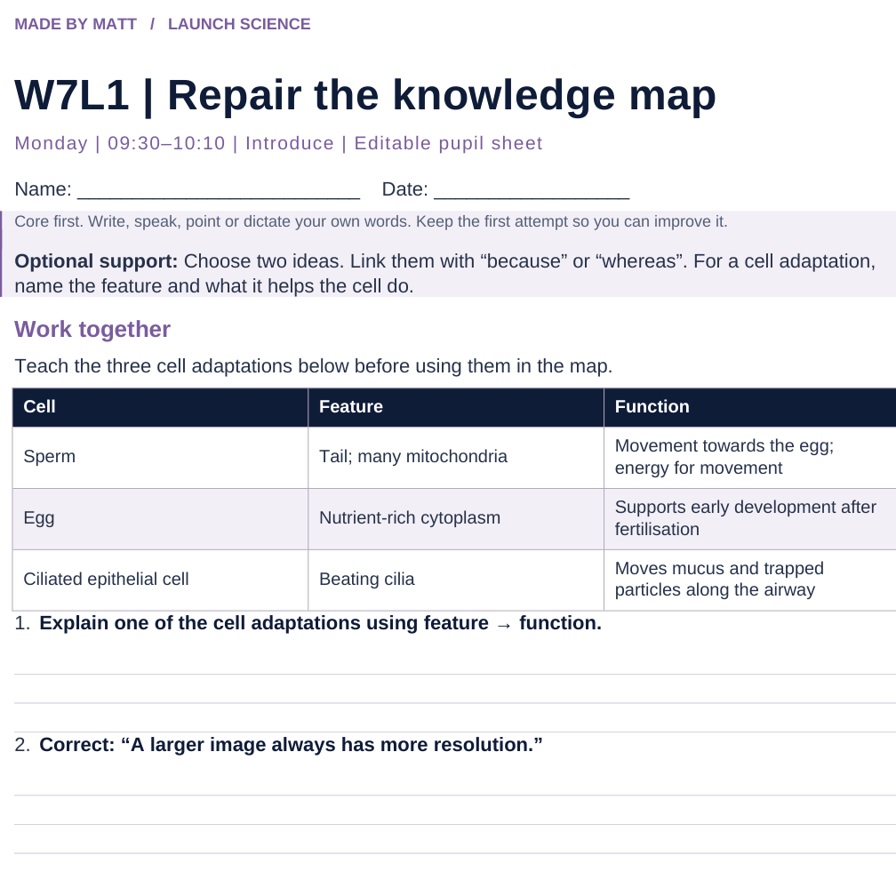
LAUNCH SCIENCE / W7L1
Resources
Worksheet · page 1
Use your printed copy.
Keep the first attempt.
Return to task
Arrival
Starter
I Do
We Do
I Do 2
We Do 2
Independent
Exit
Resources
Notes:
Embedded worksheet reference; print the separate PDF at A4 for writable space.
Core explanation: This reviews cells, microscopy and transport taught so far. It is not a claim that every part of GCSE Topic 1, including enzymes, has been completed.
Watch for: Do not turn confidence colours into public rankings. Ask for a piece of work or a corrected explanation to support a review choice.
Least help first: Ask for the reason connecting two ideas; do not turn the map into rapid-fire recall or a public score.
Support cue: Choose two ideas. Link them with “because” or “whereas”. For a cell adaptation, name the feature and what it helps the cell do.
[Sources]
User-supplied LAUNCH W3–W7 pack: W7 slides 3–6 and review worksheet; specialised cells are taught before being assessed.
Made by Matt LAUNCH Science draft, lesson-content.json, W7L1; existing illustrative diagrams reused, active-transport direction corrected to lower → higher.
Pearson Edexcel GCSE Biology specification, sections 1.1–1.6 and 1.15–1.17: https://qualifications.pearson.com/content/dam/pdf/GCSE/Science/2016/Specification/gcse-biology-spec.pdf
Optional concept video: freesciencelessons, Microscopy, https://www.youtube.com/watch?v=L5StAE_uuxM (link located 5 September 2026).
[/Sources]
[Sources]
Source editable lesson: Original LAUNCH Science OneDrive pack, 5 September 2026, W7L1. Source teaching content preserved. Current HTML reference: https://madebymatt.uk/Lessons/Science_Teesside/Launch/. Native diagrams restate the source explanation and are not experimental measurements.
[/Sources]

Slide 15
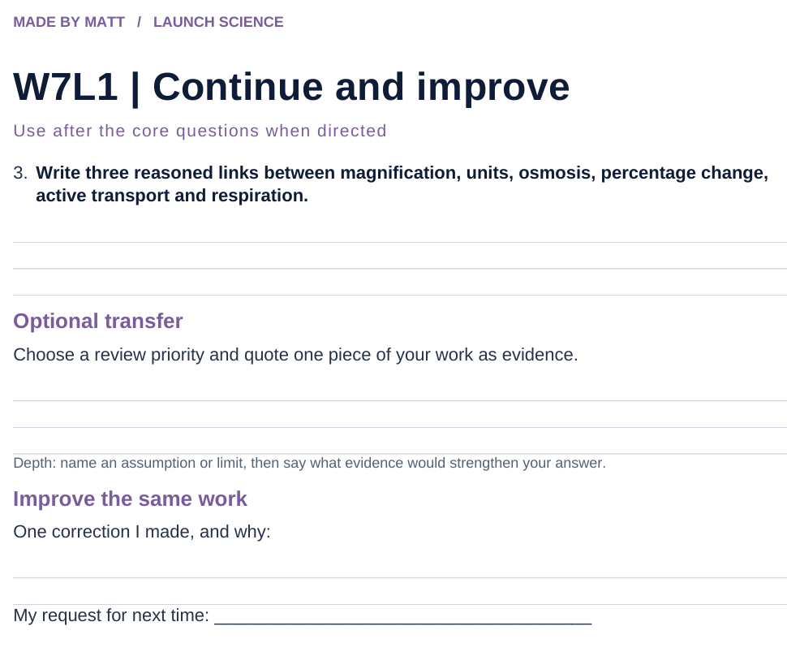
LAUNCH SCIENCE / W7L1
Resources
Worksheet · page 2
Continuation is optional.
Improve the same work.
Return to task
Arrival
Starter
I Do
We Do
I Do 2
We Do 2
Independent
Exit
Resources
Notes:
Embedded worksheet reference; print the separate PDF at A4 for writable space.
Core explanation: This reviews cells, microscopy and transport taught so far. It is not a claim that every part of GCSE Topic 1, including enzymes, has been completed.
Watch for: Do not turn confidence colours into public rankings. Ask for a piece of work or a corrected explanation to support a review choice.
Least help first: Ask for the reason connecting two ideas; do not turn the map into rapid-fire recall or a public score.
Support cue: Choose two ideas. Link them with “because” or “whereas”. For a cell adaptation, name the feature and what it helps the cell do.
[Sources]
User-supplied LAUNCH W3–W7 pack: W7 slides 3–6 and review worksheet; specialised cells are taught before being assessed.
Made by Matt LAUNCH Science draft, lesson-content.json, W7L1; existing illustrative diagrams reused, active-transport direction corrected to lower → higher.
Pearson Edexcel GCSE Biology specification, sections 1.1–1.6 and 1.15–1.17: https://qualifications.pearson.com/content/dam/pdf/GCSE/Science/2016/Specification/gcse-biology-spec.pdf
Optional concept video: freesciencelessons, Microscopy, https://www.youtube.com/watch?v=L5StAE_uuxM (link located 5 September 2026).
[/Sources]
[Sources]
Source editable lesson: Original LAUNCH Science OneDrive pack, 5 September 2026, W7L1. Source teaching content preserved. Current HTML reference: https://madebymatt.uk/Lessons/Science_Teesside/Launch/. Native diagrams restate the source explanation and are not experimental measurements.
[/Sources]

Slide 16
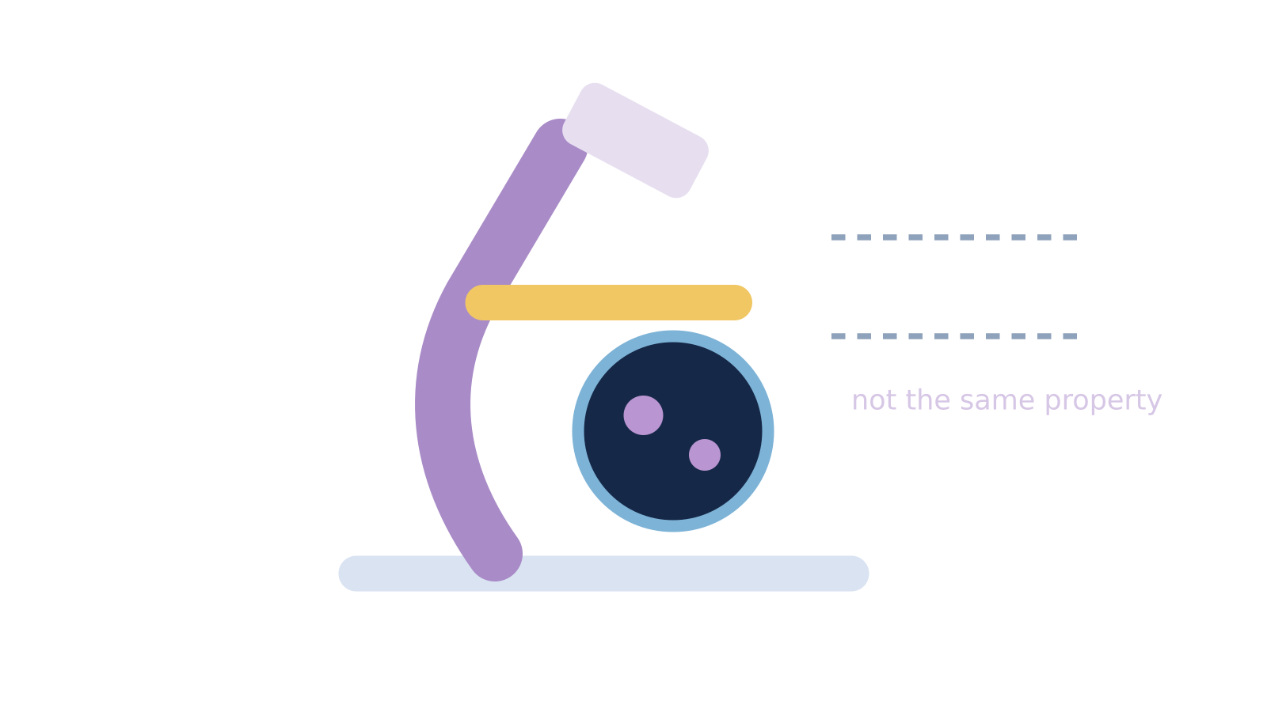
LAUNCH SCIENCE / W7L1
Resources
Watch, pause and explain
Microscopy
What is the difference between making an image bigger and resolving more detail?
Play freesciencelessons video
No connection? Use the still model and explain the same question.
Arrival
Starter
I Do
We Do
I Do 2
We Do 2
Independent
Exit
Resources
Notes:
Use at most 90 seconds within I Do. Pause on the first relevant example; ask for a reason. This is an optional concept clip, not evidence of practical completion.
Core explanation: This reviews cells, microscopy and transport taught so far. It is not a claim that every part of GCSE Topic 1, including enzymes, has been completed.
Watch for: Do not turn confidence colours into public rankings. Ask for a piece of work or a corrected explanation to support a review choice.
Least help first: Ask for the reason connecting two ideas; do not turn the map into rapid-fire recall or a public score.
Support cue: Choose two ideas. Link them with “because” or “whereas”. For a cell adaptation, name the feature and what it helps the cell do.
[Sources]
User-supplied LAUNCH W3–W7 pack: W7 slides 3–6 and review worksheet; specialised cells are taught before being assessed.
Made by Matt LAUNCH Science draft, lesson-content.json, W7L1; existing illustrative diagrams reused, active-transport direction corrected to lower → higher.
Pearson Edexcel GCSE Biology specification, sections 1.1–1.6 and 1.15–1.17: https://qualifications.pearson.com/content/dam/pdf/GCSE/Science/2016/Specification/gcse-biology-spec.pdf
Optional concept video: freesciencelessons, Microscopy, https://www.youtube.com/watch?v=L5StAE_uuxM (link located 5 September 2026).
[/Sources]
[Sources]
Source editable lesson: Original LAUNCH Science OneDrive pack, 5 September 2026, W7L1. Source teaching content preserved. Current HTML reference: https://madebymatt.uk/Lessons/Science_Teesside/Launch/. Native diagrams restate the source explanation and are not experimental measurements.
[/Sources]

Slide 17
LAUNCH SCIENCE / W7L1
Resources
Look closely at the model
Cells, scale and transport
● MAGNIFICATION
↓ DIFFUSION
image ÷ actual
down gradient
no respiration energy
the
cell
○ OSMOSIS
↑ ACTIVE TRANSPORT
water · membrane
no respiration energy
against gradient
needs respiration energy
A model illustration: use the stated data for calculations.
Return to I Do
Arrival
Starter
I Do
We Do
I Do 2
We Do 2
Independent
Exit
Resources
Notes:
Source image: https://madebymatt.uk/Lessons/Science_Teesside/Launch/SCI_L_W7_L1_RoundUp.html; existing vector illustration embedded for offline use.
Core explanation: This reviews cells, microscopy and transport taught so far. It is not a claim that every part of GCSE Topic 1, including enzymes, has been completed.
Watch for: Do not turn confidence colours into public rankings. Ask for a piece of work or a corrected explanation to support a review choice.
Least help first: Ask for the reason connecting two ideas; do not turn the map into rapid-fire recall or a public score.
Support cue: Choose two ideas. Link them with “because” or “whereas”. For a cell adaptation, name the feature and what it helps the cell do.
[Sources]
User-supplied LAUNCH W3–W7 pack: W7 slides 3–6 and review worksheet; specialised cells are taught before being assessed.
Made by Matt LAUNCH Science draft, lesson-content.json, W7L1; existing illustrative diagrams reused, active-transport direction corrected to lower → higher.
Pearson Edexcel GCSE Biology specification, sections 1.1–1.6 and 1.15–1.17: https://qualifications.pearson.com/content/dam/pdf/GCSE/Science/2016/Specification/gcse-biology-spec.pdf
Optional concept video: freesciencelessons, Microscopy, https://www.youtube.com/watch?v=L5StAE_uuxM (link located 5 September 2026).
[/Sources]
[Sources]
Diagram labels retained from the original editable LAUNCH Science pack, slide17. Recreated as editable shapes to improve label spacing and connector clarity.
[/Sources]
[Sources]
Source editable lesson: Original LAUNCH Science OneDrive pack, 5 September 2026, W7L1. Source teaching content preserved. Current HTML reference: https://madebymatt.uk/Lessons/Science_Teesside/Launch/. Native diagrams restate the source explanation and are not experimental measurements.
[/Sources]

