Slide 1
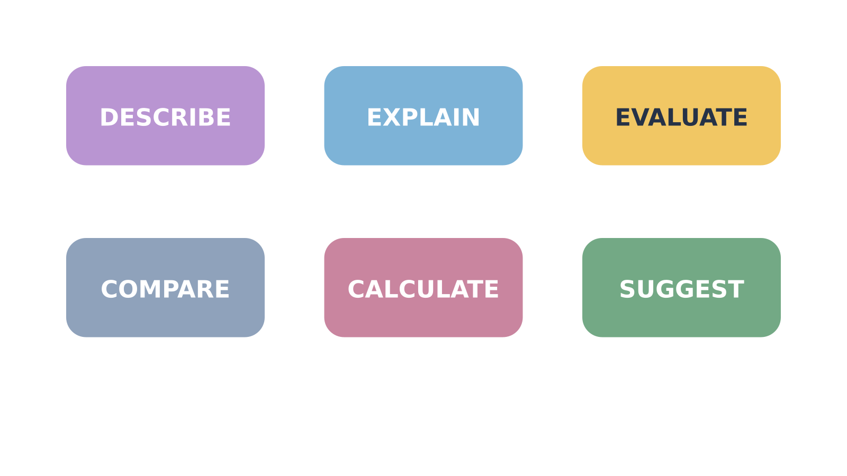
LAUNCH SCIENCE / W7L2
Arrival · 3 min
Command words
I can decode a command word, select the required answer shape and improve a Biology response.
Notice. Recall. Be ready to explain.
1
What does ‘describe’ ask you to do with data?
2
What extra link makes an answer an explanation?
Retrieval answers
Arrival
Starter
I Do
We Do
I Do 2
We Do 2
Independent
Exit
Resources
Notes:
Stage: Arrival, 3 minutes. Monday / Wednesday / Friday P1, 09:30–10:10. Use reveals within this slot; appendix slides are not added time.
Retrieval answers: State the pattern/features, using relevant values. | A scientific cause/reason linked to the observed consequence. | For a method limitation: issue, effect on evidence, justified improvement; weigh strengths/limits if asked.
Core explanation: The command word tells you the kind of answer. Marks depend on the question and its mark scheme, not magic words such as “whereas”.
Watch for: “Evaluate” is more than listing improvements: weigh relevant evidence or method strengths/limits and make a supported judgement where asked.
Least help first: Ask which command word sets the answer shape before prompting Biology content.
Support cue: Describe = say what happens. Explain = say why. Compare = link a similarity or difference. Calculate = show working. Evaluate = judge using evidence.
[Sources]
User-supplied LAUNCH W3–W7 pack: W7 test/review preparation, expanded into a full Explore lesson.
Made by Matt LAUNCH Science draft, lesson-content.json, W7L2; existing illustrative diagrams reused, active-transport direction corrected to lower → higher.
Pearson Edexcel GCSE Biology specification, sections 1.1–1.6 and 1.15–1.17: https://qualifications.pearson.com/content/dam/pdf/GCSE/Science/2016/Specification/gcse-biology-spec.pdf
Optional concept video: freesciencelessons, Gas exchange in the lungs, https://www.youtube.com/watch?v=aPUPfzsqDgs (link located 5 September 2026).
[/Sources]
[Sources]
Source editable lesson: Original LAUNCH Science OneDrive pack, 5 September 2026, W7L2. Source teaching content preserved. Current HTML reference: https://madebymatt.uk/Lessons/Science_Teesside/Launch/. Native diagrams restate the source explanation and are not experimental measurements.
[/Sources]

Slide 2
LAUNCH SCIENCE / W7L2
Starter · 4 min
Make a prediction
A response says ‘The potato lost mass.’ Which command word could this satisfy most directly: state, explain or evaluate?
A State
B Explain
C Evaluate
Commit, then check
Arrival
Starter
I Do
We Do
I Do 2
We Do 2
Independent
Exit
Resources
Notes:
Stage: Starter, 4 minutes. Monday / Wednesday / Friday P1, 09:30–10:10. Use reveals within this slot; appendix slides are not added time.
Correct: State. Ask for the reason, then return to the original prediction.
Core explanation: The command word tells you the kind of answer. Marks depend on the question and its mark scheme, not magic words such as “whereas”.
Watch for: “Evaluate” is more than listing improvements: weigh relevant evidence or method strengths/limits and make a supported judgement where asked.
Least help first: Ask which command word sets the answer shape before prompting Biology content.
Support cue: Describe = say what happens. Explain = say why. Compare = link a similarity or difference. Calculate = show working. Evaluate = judge using evidence.
[Sources]
User-supplied LAUNCH W3–W7 pack: W7 test/review preparation, expanded into a full Explore lesson.
Made by Matt LAUNCH Science draft, lesson-content.json, W7L2; existing illustrative diagrams reused, active-transport direction corrected to lower → higher.
Pearson Edexcel GCSE Biology specification, sections 1.1–1.6 and 1.15–1.17: https://qualifications.pearson.com/content/dam/pdf/GCSE/Science/2016/Specification/gcse-biology-spec.pdf
Optional concept video: freesciencelessons, Gas exchange in the lungs, https://www.youtube.com/watch?v=aPUPfzsqDgs (link located 5 September 2026).
[/Sources]
[Sources]
Source editable lesson: Original LAUNCH Science OneDrive pack, 5 September 2026, W7L2. Source teaching content preserved. Current HTML reference: https://madebymatt.uk/Lessons/Science_Teesside/Launch/. Native diagrams restate the source explanation and are not experimental measurements.
[/Sources]

Slide 3
LAUNCH SCIENCE / W7L2
I Do · 5 min
Watch the model
1
Underline the command word and identify the answer shape before retrieving content.
Match the answer to the task
Describe
State what happens
2
Use the data or context evidence named in the question.
Explain
Say how or why
Calculate
Show steps and units
3
Add only the reasoning demanded: explanation, comparison, calculation steps or evaluation chain.
View labelled diagram
Optional video
Arrival
Starter
I Do
We Do
I Do 2
We Do 2
Independent
Exit
Resources
Notes:
Stage: I Do, 5 minutes. Monday / Wednesday / Friday P1, 09:30–10:10. Use reveals within this slot; appendix slides are not added time.
The Decoder contrasts short exemplars and highlights what changes when the command word changes.
Model limit: Answer-shape prompts are teaching scaffolds, not awarding-body mark schemes or guaranteed marks.
Video replaces up to 90 seconds of explanation; use the still diagram if unavailable.
Core explanation: The command word tells you the kind of answer. Marks depend on the question and its mark scheme, not magic words such as “whereas”.
Watch for: “Evaluate” is more than listing improvements: weigh relevant evidence or method strengths/limits and make a supported judgement where asked.
Least help first: Ask which command word sets the answer shape before prompting Biology content.
Support cue: Describe = say what happens. Explain = say why. Compare = link a similarity or difference. Calculate = show working. Evaluate = judge using evidence.
[Sources]
User-supplied LAUNCH W3–W7 pack: W7 test/review preparation, expanded into a full Explore lesson.
Made by Matt LAUNCH Science draft, lesson-content.json, W7L2; existing illustrative diagrams reused, active-transport direction corrected to lower → higher.
Pearson Edexcel GCSE Biology specification, sections 1.1–1.6 and 1.15–1.17: https://qualifications.pearson.com/content/dam/pdf/GCSE/Science/2016/Specification/gcse-biology-spec.pdf
Optional concept video: freesciencelessons, Gas exchange in the lungs, https://www.youtube.com/watch?v=aPUPfzsqDgs (link located 5 September 2026).
[/Sources]
[Sources]
Source editable lesson: Original LAUNCH Science OneDrive pack, 5 September 2026, W7L2. Source teaching content preserved. Current HTML reference: https://madebymatt.uk/Lessons/Science_Teesside/Launch/. Native diagrams restate the source explanation and are not experimental measurements.
[/Sources]

Slide 4
LAUNCH SCIENCE / W7L2
We Do · 5 min
Choose and justify
Which answer best fits ‘evaluate the method’?
A The mass decreased.
B Osmosis moved water out.
C Unequal cylinder diameter changes surface area, so concentration is not the only cause; use equal diameters.
D Use potatoes.
Give the deciding clue before checking.
Check the reasoning
Arrival
Starter
I Do
We Do
I Do 2
We Do 2
Independent
Exit
Resources
Notes:
Stage: We Do, 5 minutes. Monday / Wednesday / Friday P1, 09:30–10:10. Use reveals within this slot; appendix slides are not added time.
A: The mass decreased. — This describes a result, not the method quality.
B: Osmosis moved water out. — This explains science but does not evaluate the method.
C: Unequal cylinder diameter changes surface area, so concentration is not the only cause; use equal diameters. — Correct weakness → consequence → improvement chain.
D: Use potatoes. — This does not identify or justify a method change.
Core explanation: The command word tells you the kind of answer. Marks depend on the question and its mark scheme, not magic words such as “whereas”.
Watch for: “Evaluate” is more than listing improvements: weigh relevant evidence or method strengths/limits and make a supported judgement where asked.
Least help first: Ask which command word sets the answer shape before prompting Biology content.
Support cue: Describe = say what happens. Explain = say why. Compare = link a similarity or difference. Calculate = show working. Evaluate = judge using evidence.
[Sources]
User-supplied LAUNCH W3–W7 pack: W7 test/review preparation, expanded into a full Explore lesson.
Made by Matt LAUNCH Science draft, lesson-content.json, W7L2; existing illustrative diagrams reused, active-transport direction corrected to lower → higher.
Pearson Edexcel GCSE Biology specification, sections 1.1–1.6 and 1.15–1.17: https://qualifications.pearson.com/content/dam/pdf/GCSE/Science/2016/Specification/gcse-biology-spec.pdf
Optional concept video: freesciencelessons, Gas exchange in the lungs, https://www.youtube.com/watch?v=aPUPfzsqDgs (link located 5 September 2026).
[/Sources]
[Sources]
Source editable lesson: Original LAUNCH Science OneDrive pack, 5 September 2026, W7L2. Source teaching content preserved. Current HTML reference: https://madebymatt.uk/Lessons/Science_Teesside/Launch/. Native diagrams restate the source explanation and are not experimental measurements.
[/Sources]

Slide 5
LAUNCH SCIENCE / W7L2
I Do 2 · 4 min
Connect the science
State: give a concise fact or value.
Calculate: show the formula, substitution, working and unit.
Describe: identify a pattern or feature in the evidence.
Evaluate: judge strengths and limits using evidence. Justify an improvement.
Explain: link scientific cause to consequence.
Suggest: propose a scientifically plausible response.
Compare: link relevant similarities and differences.
Arrival
Starter
I Do
We Do
I Do 2
We Do 2
Independent
Exit
Resources
Notes:
Stage: I Do 2, 4 minutes. Monday / Wednesday / Friday P1, 09:30–10:10. Use reveals within this slot; appendix slides are not added time.
Answer-shape prompts are teaching scaffolds, not awarding-body mark schemes or guaranteed marks.
Core explanation: The command word tells you the kind of answer. Marks depend on the question and its mark scheme, not magic words such as “whereas”.
Watch for: “Evaluate” is more than listing improvements: weigh relevant evidence or method strengths/limits and make a supported judgement where asked.
Least help first: Ask which command word sets the answer shape before prompting Biology content.
Support cue: Describe = say what happens. Explain = say why. Compare = link a similarity or difference. Calculate = show working. Evaluate = judge using evidence.
[Sources]
User-supplied LAUNCH W3–W7 pack: W7 test/review preparation, expanded into a full Explore lesson.
Made by Matt LAUNCH Science draft, lesson-content.json, W7L2; existing illustrative diagrams reused, active-transport direction corrected to lower → higher.
Pearson Edexcel GCSE Biology specification, sections 1.1–1.6 and 1.15–1.17: https://qualifications.pearson.com/content/dam/pdf/GCSE/Science/2016/Specification/gcse-biology-spec.pdf
Optional concept video: freesciencelessons, Gas exchange in the lungs, https://www.youtube.com/watch?v=aPUPfzsqDgs (link located 5 September 2026).
[/Sources]
[Sources]
Source editable lesson: Original LAUNCH Science OneDrive pack, 5 September 2026, W7L2. Source teaching content preserved. Current HTML reference: https://madebymatt.uk/Lessons/Science_Teesside/Launch/. Native diagrams restate the source explanation and are not experimental measurements.
[/Sources]

Slide 6
LAUNCH SCIENCE / W7L2
We Do 2 · Task · 6 min
Run a command-word clinic
Sample graph: sucrose 0.2 → 0.6 mol dm⁻³; mass change +12% → −8%. Improve each answer.
1
Describe: “The graph changes.”
2
Explain: “The alveolar wall is thin.”
3
Evaluate: “We should repeat it.”
Reveal shared reasoning
Arrival
Starter
I Do
We Do
I Do 2
We Do 2
Independent
Exit
Resources
Notes:
Stage: We Do 2 · Task, 6 minutes. Monday / Wednesday / Friday P1, 09:30–10:10. Use reveals within this slot; appendix slides are not added time.
Describe a numerical pattern.
Explain: thin walls → short diffusion distance → faster exchange.
Evaluate: repeat each concentration to measure spread and calculate a mean; also standardise blotting. Repeats alone do not fix a systematic error.
Run the printed activity or this board; one route is enough.
Core explanation: The command word tells you the kind of answer. Marks depend on the question and its mark scheme, not magic words such as “whereas”.
Watch for: “Evaluate” is more than listing improvements: weigh relevant evidence or method strengths/limits and make a supported judgement where asked.
Least help first: Ask which command word sets the answer shape before prompting Biology content.
Support cue: Describe = say what happens. Explain = say why. Compare = link a similarity or difference. Calculate = show working. Evaluate = judge using evidence.
[Sources]
User-supplied LAUNCH W3–W7 pack: W7 test/review preparation, expanded into a full Explore lesson.
Made by Matt LAUNCH Science draft, lesson-content.json, W7L2; existing illustrative diagrams reused, active-transport direction corrected to lower → higher.
Pearson Edexcel GCSE Biology specification, sections 1.1–1.6 and 1.15–1.17: https://qualifications.pearson.com/content/dam/pdf/GCSE/Science/2016/Specification/gcse-biology-spec.pdf
Optional concept video: freesciencelessons, Gas exchange in the lungs, https://www.youtube.com/watch?v=aPUPfzsqDgs (link located 5 September 2026).
[/Sources]
[Sources]
Source editable lesson: Original LAUNCH Science OneDrive pack, 5 September 2026, W7L2. Source teaching content preserved. Current HTML reference: https://madebymatt.uk/Lessons/Science_Teesside/Launch/. Native diagrams restate the source explanation and are not experimental measurements.
[/Sources]

Slide 7
LAUNCH SCIENCE / W7L2
Independent Task · 10 min
Your independent evidence
Write a first sentence or calculation line for each task:
Describe the osmosis trend; explain thin alveolar walls; compare diffusion and active transport; evaluate uneven blotting; calculate magnification: image 30 mm, actual 75 µm.
Optional support
Describe = say what happens. Explain = say why. Compare = link a similarity or difference. Calculate = show working. Evaluate = judge using evidence.
Make one precise correction to the same work after feedback.
Open worksheet pages
Model after first attempt
Arrival
Starter
I Do
We Do
I Do 2
We Do 2
Independent
Exit
Resources
Notes:
Stage: Independent Task, 10 minutes. Monday / Wednesday / Friday P1, 09:30–10:10. Use reveals within this slot; appendix slides are not added time.
Model answer: Describe: percentage change becomes less positive and then negative as concentration increases. Explain: a thin alveolar wall shortens diffusion distance, so oxygen reaches blood faster. Compare: both processes can move substances across membranes, whereas only active transport can move against a gradient using cellular energy. Evaluate: inconsistent blotting leaves different surface solution masses; standardise the blotting method and time. Calculate: 30 mm = 30,000 µm; magnification = 30,000 ÷ 75 = ×400.
Select only questions that fit the ten-minute slot. W7L3: Q2, Q3 and Q5 total 11 marks. The full paper needs a separate 25-minute slot.
Core explanation: The command word tells you the kind of answer. Marks depend on the question and its mark scheme, not magic words such as “whereas”.
Watch for: “Evaluate” is more than listing improvements: weigh relevant evidence or method strengths/limits and make a supported judgement where asked.
Least help first: Ask which command word sets the answer shape before prompting Biology content.
Support cue: Describe = say what happens. Explain = say why. Compare = link a similarity or difference. Calculate = show working. Evaluate = judge using evidence.
[Sources]
User-supplied LAUNCH W3–W7 pack: W7 test/review preparation, expanded into a full Explore lesson.
Made by Matt LAUNCH Science draft, lesson-content.json, W7L2; existing illustrative diagrams reused, active-transport direction corrected to lower → higher.
Pearson Edexcel GCSE Biology specification, sections 1.1–1.6 and 1.15–1.17: https://qualifications.pearson.com/content/dam/pdf/GCSE/Science/2016/Specification/gcse-biology-spec.pdf
Optional concept video: freesciencelessons, Gas exchange in the lungs, https://www.youtube.com/watch?v=aPUPfzsqDgs (link located 5 September 2026).
[/Sources]
[Sources]
Source editable lesson: Original LAUNCH Science OneDrive pack, 5 September 2026, W7L2. Source teaching content preserved. Current HTML reference: https://madebymatt.uk/Lessons/Science_Teesside/Launch/. Native diagrams restate the source explanation and are not experimental measurements.
[/Sources]

Slide 8
LAUNCH SCIENCE / W7L2
Exit · 3 min
What changed in your thinking?
Which command word most often needs a scientific ‘because’ link, and why?
1
Point to one improvement in your work.
2
Choose what you want to revisit.
3
Tell your teacher; agree the next step together.
Arrival
Starter
I Do
We Do
I Do 2
We Do 2
Independent
Exit
Resources
Notes:
Stage: Exit, 3 minutes. Monday / Wednesday / Friday P1, 09:30–10:10. Use reveals within this slot; appendix slides are not added time.
Exit answer: Explain usually needs a scientific cause linked to a consequence; the actual wording still controls the answer.
Receive the request, record the agreed next action and check it next lesson. Keep responses private when requested.
Core explanation: The command word tells you the kind of answer. Marks depend on the question and its mark scheme, not magic words such as “whereas”.
Watch for: “Evaluate” is more than listing improvements: weigh relevant evidence or method strengths/limits and make a supported judgement where asked.
Least help first: Ask which command word sets the answer shape before prompting Biology content.
Support cue: Describe = say what happens. Explain = say why. Compare = link a similarity or difference. Calculate = show working. Evaluate = judge using evidence.
[Sources]
User-supplied LAUNCH W3–W7 pack: W7 test/review preparation, expanded into a full Explore lesson.
Made by Matt LAUNCH Science draft, lesson-content.json, W7L2; existing illustrative diagrams reused, active-transport direction corrected to lower → higher.
Pearson Edexcel GCSE Biology specification, sections 1.1–1.6 and 1.15–1.17: https://qualifications.pearson.com/content/dam/pdf/GCSE/Science/2016/Specification/gcse-biology-spec.pdf
Optional concept video: freesciencelessons, Gas exchange in the lungs, https://www.youtube.com/watch?v=aPUPfzsqDgs (link located 5 September 2026).
[/Sources]
[Sources]
Source editable lesson: Original LAUNCH Science OneDrive pack, 5 September 2026, W7L2. Source teaching content preserved. Current HTML reference: https://madebymatt.uk/Lessons/Science_Teesside/Launch/. Native diagrams restate the source explanation and are not experimental measurements.
[/Sources]

Slide 9
LAUNCH SCIENCE / W7L2
Resources
Retrieval and prediction check
1
State the pattern/features, using relevant values.
2
A scientific cause/reason linked to the observed consequence.
State
Return to Starter
Arrival
Starter
I Do
We Do
I Do 2
We Do 2
Independent
Exit
Resources
Notes:
Read only after an attempt; retain the pupil’s first view.
Core explanation: The command word tells you the kind of answer. Marks depend on the question and its mark scheme, not magic words such as “whereas”.
Watch for: “Evaluate” is more than listing improvements: weigh relevant evidence or method strengths/limits and make a supported judgement where asked.
Least help first: Ask which command word sets the answer shape before prompting Biology content.
Support cue: Describe = say what happens. Explain = say why. Compare = link a similarity or difference. Calculate = show working. Evaluate = judge using evidence.
[Sources]
User-supplied LAUNCH W3–W7 pack: W7 test/review preparation, expanded into a full Explore lesson.
Made by Matt LAUNCH Science draft, lesson-content.json, W7L2; existing illustrative diagrams reused, active-transport direction corrected to lower → higher.
Pearson Edexcel GCSE Biology specification, sections 1.1–1.6 and 1.15–1.17: https://qualifications.pearson.com/content/dam/pdf/GCSE/Science/2016/Specification/gcse-biology-spec.pdf
Optional concept video: freesciencelessons, Gas exchange in the lungs, https://www.youtube.com/watch?v=aPUPfzsqDgs (link located 5 September 2026).
[/Sources]
[Sources]
Source editable lesson: Original LAUNCH Science OneDrive pack, 5 September 2026, W7L2. Source teaching content preserved. Current HTML reference: https://madebymatt.uk/Lessons/Science_Teesside/Launch/. Native diagrams restate the source explanation and are not experimental measurements.
[/Sources]

Slide 10
LAUNCH SCIENCE / W7L2
Resources
Check the deciding clue
Unequal cylinder diameter changes surface area, so concentration is not the only cause; use equal diameters.
Correct weakness → consequence → improvement chain.
Compare your reason. Correct one step if needed.
Return to We Do
Arrival
Starter
I Do
We Do
I Do 2
We Do 2
Independent
Exit
Resources
Notes:
This describes a result, not the method quality.
This explains science but does not evaluate the method.
Correct weakness → consequence → improvement chain.
This does not identify or justify a method change.
Core explanation: The command word tells you the kind of answer. Marks depend on the question and its mark scheme, not magic words such as “whereas”.
Watch for: “Evaluate” is more than listing improvements: weigh relevant evidence or method strengths/limits and make a supported judgement where asked.
Least help first: Ask which command word sets the answer shape before prompting Biology content.
Support cue: Describe = say what happens. Explain = say why. Compare = link a similarity or difference. Calculate = show working. Evaluate = judge using evidence.
[Sources]
User-supplied LAUNCH W3–W7 pack: W7 test/review preparation, expanded into a full Explore lesson.
Made by Matt LAUNCH Science draft, lesson-content.json, W7L2; existing illustrative diagrams reused, active-transport direction corrected to lower → higher.
Pearson Edexcel GCSE Biology specification, sections 1.1–1.6 and 1.15–1.17: https://qualifications.pearson.com/content/dam/pdf/GCSE/Science/2016/Specification/gcse-biology-spec.pdf
Optional concept video: freesciencelessons, Gas exchange in the lungs, https://www.youtube.com/watch?v=aPUPfzsqDgs (link located 5 September 2026).
[/Sources]
[Sources]
Source editable lesson: Original LAUNCH Science OneDrive pack, 5 September 2026, W7L2. Source teaching content preserved. Current HTML reference: https://madebymatt.uk/Lessons/Science_Teesside/Launch/. Native diagrams restate the source explanation and are not experimental measurements.
[/Sources]

Slide 11
LAUNCH SCIENCE / W7L2
Resources
Our shared reasoning
Describe a numerical pattern.
Explain: thin walls → short diffusion distance → faster exchange.
Evaluate: repeat each concentration to measure spread and calculate a mean; also standardise blotting. Repeats alone do not fix a systematic error.
Return to shared task
Arrival
Starter
I Do
We Do
I Do 2
We Do 2
Independent
Exit
Resources
Notes:
Pupils should justify, compare and revise rather than copy a complete answer before trying.
Core explanation: The command word tells you the kind of answer. Marks depend on the question and its mark scheme, not magic words such as “whereas”.
Watch for: “Evaluate” is more than listing improvements: weigh relevant evidence or method strengths/limits and make a supported judgement where asked.
Least help first: Ask which command word sets the answer shape before prompting Biology content.
Support cue: Describe = say what happens. Explain = say why. Compare = link a similarity or difference. Calculate = show working. Evaluate = judge using evidence.
[Sources]
User-supplied LAUNCH W3–W7 pack: W7 test/review preparation, expanded into a full Explore lesson.
Made by Matt LAUNCH Science draft, lesson-content.json, W7L2; existing illustrative diagrams reused, active-transport direction corrected to lower → higher.
Pearson Edexcel GCSE Biology specification, sections 1.1–1.6 and 1.15–1.17: https://qualifications.pearson.com/content/dam/pdf/GCSE/Science/2016/Specification/gcse-biology-spec.pdf
Optional concept video: freesciencelessons, Gas exchange in the lungs, https://www.youtube.com/watch?v=aPUPfzsqDgs (link located 5 September 2026).
[/Sources]
[Sources]
Source editable lesson: Original LAUNCH Science OneDrive pack, 5 September 2026, W7L2. Source teaching content preserved. Current HTML reference: https://madebymatt.uk/Lessons/Science_Teesside/Launch/. Native diagrams restate the source explanation and are not experimental measurements.
[/Sources]

Slide 12
LAUNCH SCIENCE / W7L2
Resources
Compare after your first attempt
Describe: percentage change becomes less positive and then negative as concentration increases. Explain: a thin alveolar wall shortens diffusion distance, so oxygen reaches blood faster. Compare: both processes can move substances across membranes, whereas only active transport can move against a gradient using cellular energy. Evaluate: inconsistent blotting leaves different surface solution masses; standardise the blotting method and time. Calculate: 30 mm = 30,000 µm; magnification = 30,000 ÷ 75 = ×400.
Use the model to improve your explanation in your own words.
Return to independent task
Arrival
Starter
I Do
We Do
I Do 2
We Do 2
Independent
Exit
Resources
Notes:
Staff guide includes question-by-question answers. Do not distribute this presentation as a secure assessment paper.
Core explanation: The command word tells you the kind of answer. Marks depend on the question and its mark scheme, not magic words such as “whereas”.
Watch for: “Evaluate” is more than listing improvements: weigh relevant evidence or method strengths/limits and make a supported judgement where asked.
Least help first: Ask which command word sets the answer shape before prompting Biology content.
Support cue: Describe = say what happens. Explain = say why. Compare = link a similarity or difference. Calculate = show working. Evaluate = judge using evidence.
[Sources]
User-supplied LAUNCH W3–W7 pack: W7 test/review preparation, expanded into a full Explore lesson.
Made by Matt LAUNCH Science draft, lesson-content.json, W7L2; existing illustrative diagrams reused, active-transport direction corrected to lower → higher.
Pearson Edexcel GCSE Biology specification, sections 1.1–1.6 and 1.15–1.17: https://qualifications.pearson.com/content/dam/pdf/GCSE/Science/2016/Specification/gcse-biology-spec.pdf
Optional concept video: freesciencelessons, Gas exchange in the lungs, https://www.youtube.com/watch?v=aPUPfzsqDgs (link located 5 September 2026).
[/Sources]
[Sources]
Source editable lesson: Original LAUNCH Science OneDrive pack, 5 September 2026, W7L2. Source teaching content preserved. Current HTML reference: https://madebymatt.uk/Lessons/Science_Teesside/Launch/. Native diagrams restate the source explanation and are not experimental measurements.
[/Sources]

Slide 13
LAUNCH SCIENCE / W7L2
Resources
Your lesson resources
Worksheet pages are stored inside this PowerPoint.
Worksheet · page 1
Worksheet · page 2
Standard PDF
Supported PDF
Depth PDF
Editable Word worksheet
Open online lesson / model
Named files are in this week’s folder. Online lesson and video need internet.
Optional concept video
Arrival
Starter
I Do
We Do
I Do 2
We Do 2
Independent
Exit
Resources
Notes:
File buttons use relative links for downloaded/synced folders. OneDrive preview may not resolve relative links. Use the embedded pages or open the named file in the week folder.
Core explanation: The command word tells you the kind of answer. Marks depend on the question and its mark scheme, not magic words such as “whereas”.
Watch for: “Evaluate” is more than listing improvements: weigh relevant evidence or method strengths/limits and make a supported judgement where asked.
Least help first: Ask which command word sets the answer shape before prompting Biology content.
Support cue: Describe = say what happens. Explain = say why. Compare = link a similarity or difference. Calculate = show working. Evaluate = judge using evidence.
[Sources]
User-supplied LAUNCH W3–W7 pack: W7 test/review preparation, expanded into a full Explore lesson.
Made by Matt LAUNCH Science draft, lesson-content.json, W7L2; existing illustrative diagrams reused, active-transport direction corrected to lower → higher.
Pearson Edexcel GCSE Biology specification, sections 1.1–1.6 and 1.15–1.17: https://qualifications.pearson.com/content/dam/pdf/GCSE/Science/2016/Specification/gcse-biology-spec.pdf
Optional concept video: freesciencelessons, Gas exchange in the lungs, https://www.youtube.com/watch?v=aPUPfzsqDgs (link located 5 September 2026).
[/Sources]
[Sources]
Source editable lesson: Original LAUNCH Science OneDrive pack, 5 September 2026, W7L2. Source teaching content preserved. Current HTML reference: https://madebymatt.uk/Lessons/Science_Teesside/Launch/. Native diagrams restate the source explanation and are not experimental measurements.
[/Sources]

Slide 14
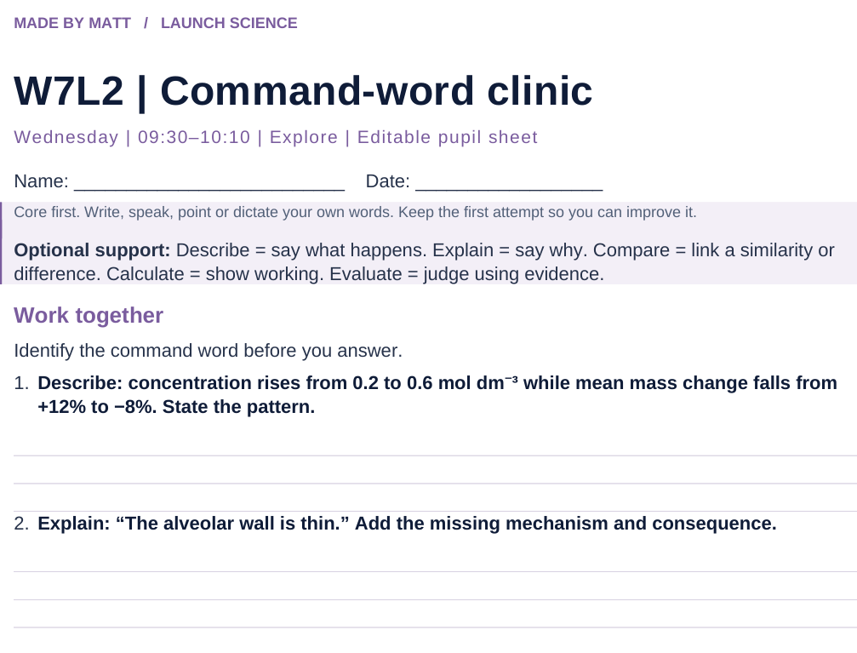
LAUNCH SCIENCE / W7L2
Resources
Worksheet · page 1
Use your printed copy.
Keep the first attempt.
Return to task
Arrival
Starter
I Do
We Do
I Do 2
We Do 2
Independent
Exit
Resources
Notes:
Embedded worksheet reference; print the separate PDF at A4 for writable space.
Core explanation: The command word tells you the kind of answer. Marks depend on the question and its mark scheme, not magic words such as “whereas”.
Watch for: “Evaluate” is more than listing improvements: weigh relevant evidence or method strengths/limits and make a supported judgement where asked.
Least help first: Ask which command word sets the answer shape before prompting Biology content.
Support cue: Describe = say what happens. Explain = say why. Compare = link a similarity or difference. Calculate = show working. Evaluate = judge using evidence.
[Sources]
User-supplied LAUNCH W3–W7 pack: W7 test/review preparation, expanded into a full Explore lesson.
Made by Matt LAUNCH Science draft, lesson-content.json, W7L2; existing illustrative diagrams reused, active-transport direction corrected to lower → higher.
Pearson Edexcel GCSE Biology specification, sections 1.1–1.6 and 1.15–1.17: https://qualifications.pearson.com/content/dam/pdf/GCSE/Science/2016/Specification/gcse-biology-spec.pdf
Optional concept video: freesciencelessons, Gas exchange in the lungs, https://www.youtube.com/watch?v=aPUPfzsqDgs (link located 5 September 2026).
[/Sources]
[Sources]
Source editable lesson: Original LAUNCH Science OneDrive pack, 5 September 2026, W7L2. Source teaching content preserved. Current HTML reference: https://madebymatt.uk/Lessons/Science_Teesside/Launch/. Native diagrams restate the source explanation and are not experimental measurements.
[/Sources]

Slide 15
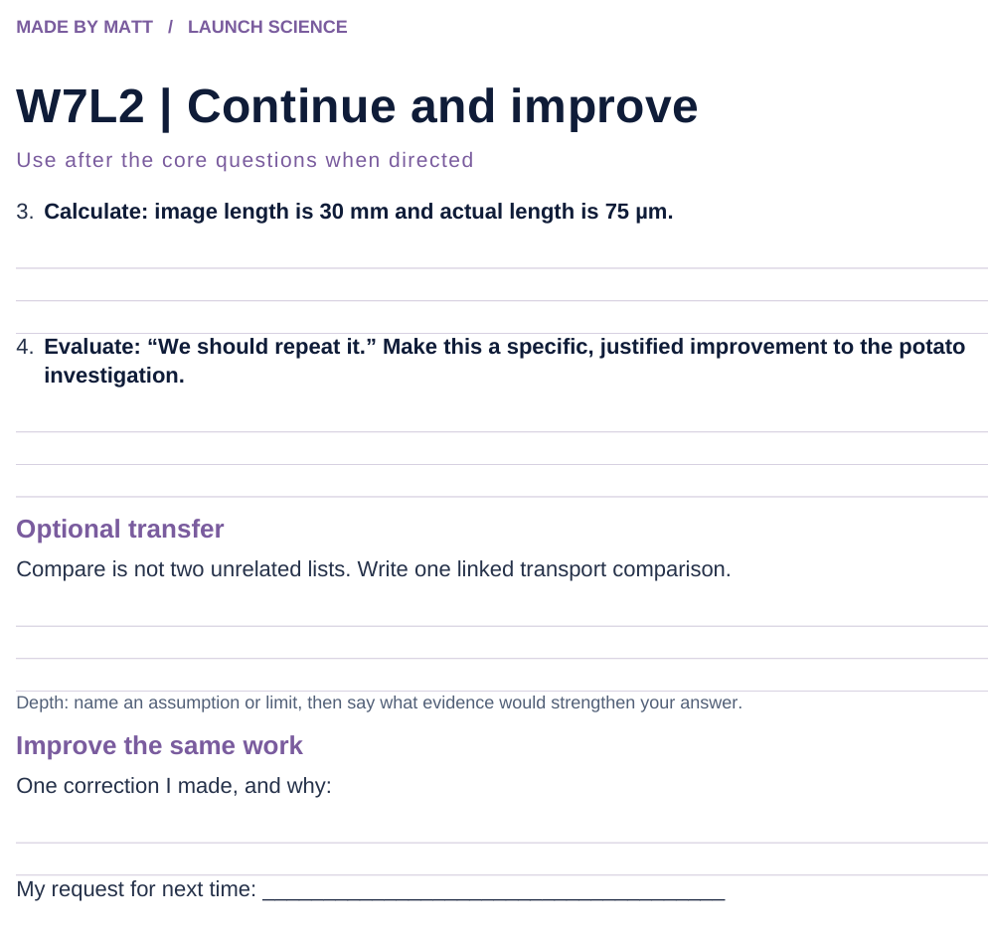
LAUNCH SCIENCE / W7L2
Resources
Worksheet · page 2
Continuation is optional.
Improve the same work.
Return to task
Arrival
Starter
I Do
We Do
I Do 2
We Do 2
Independent
Exit
Resources
Notes:
Embedded worksheet reference; print the separate PDF at A4 for writable space.
Core explanation: The command word tells you the kind of answer. Marks depend on the question and its mark scheme, not magic words such as “whereas”.
Watch for: “Evaluate” is more than listing improvements: weigh relevant evidence or method strengths/limits and make a supported judgement where asked.
Least help first: Ask which command word sets the answer shape before prompting Biology content.
Support cue: Describe = say what happens. Explain = say why. Compare = link a similarity or difference. Calculate = show working. Evaluate = judge using evidence.
[Sources]
User-supplied LAUNCH W3–W7 pack: W7 test/review preparation, expanded into a full Explore lesson.
Made by Matt LAUNCH Science draft, lesson-content.json, W7L2; existing illustrative diagrams reused, active-transport direction corrected to lower → higher.
Pearson Edexcel GCSE Biology specification, sections 1.1–1.6 and 1.15–1.17: https://qualifications.pearson.com/content/dam/pdf/GCSE/Science/2016/Specification/gcse-biology-spec.pdf
Optional concept video: freesciencelessons, Gas exchange in the lungs, https://www.youtube.com/watch?v=aPUPfzsqDgs (link located 5 September 2026).
[/Sources]
[Sources]
Source editable lesson: Original LAUNCH Science OneDrive pack, 5 September 2026, W7L2. Source teaching content preserved. Current HTML reference: https://madebymatt.uk/Lessons/Science_Teesside/Launch/. Native diagrams restate the source explanation and are not experimental measurements.
[/Sources]

Slide 16
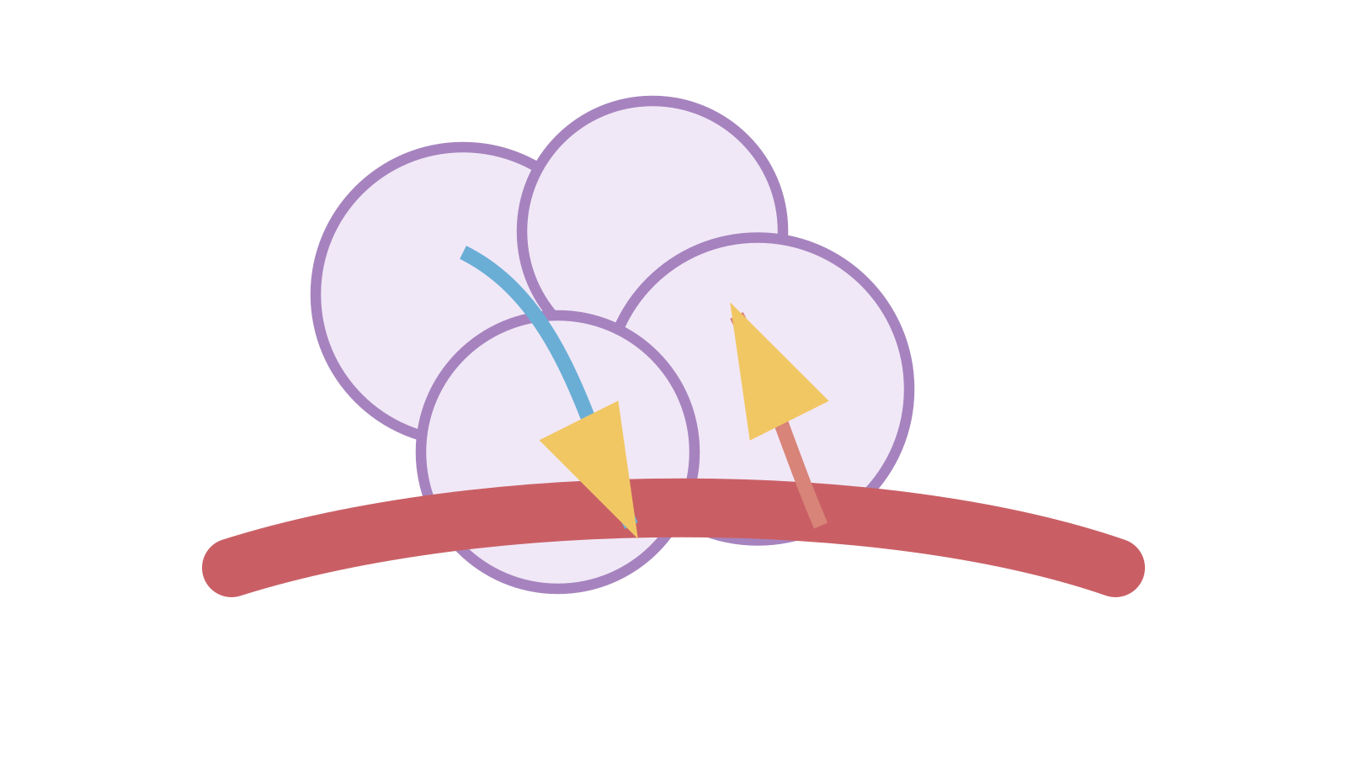
LAUNCH SCIENCE / W7L2
Resources
Watch, pause and explain
Gas exchange in the lungs
How does a thin wall help oxygen move into the blood?
Play freesciencelessons video
No connection? Use the still model and explain the same question.
Arrival
Starter
I Do
We Do
I Do 2
We Do 2
Independent
Exit
Resources
Notes:
Use at most 90 seconds within I Do. Pause on the first relevant example; ask for a reason. This is an optional concept clip, not evidence of practical completion.
Core explanation: The command word tells you the kind of answer. Marks depend on the question and its mark scheme, not magic words such as “whereas”.
Watch for: “Evaluate” is more than listing improvements: weigh relevant evidence or method strengths/limits and make a supported judgement where asked.
Least help first: Ask which command word sets the answer shape before prompting Biology content.
Support cue: Describe = say what happens. Explain = say why. Compare = link a similarity or difference. Calculate = show working. Evaluate = judge using evidence.
[Sources]
User-supplied LAUNCH W3–W7 pack: W7 test/review preparation, expanded into a full Explore lesson.
Made by Matt LAUNCH Science draft, lesson-content.json, W7L2; existing illustrative diagrams reused, active-transport direction corrected to lower → higher.
Pearson Edexcel GCSE Biology specification, sections 1.1–1.6 and 1.15–1.17: https://qualifications.pearson.com/content/dam/pdf/GCSE/Science/2016/Specification/gcse-biology-spec.pdf
Optional concept video: freesciencelessons, Gas exchange in the lungs, https://www.youtube.com/watch?v=aPUPfzsqDgs (link located 5 September 2026).
[/Sources]
[Sources]
Source editable lesson: Original LAUNCH Science OneDrive pack, 5 September 2026, W7L2. Source teaching content preserved. Current HTML reference: https://madebymatt.uk/Lessons/Science_Teesside/Launch/. Native diagrams restate the source explanation and are not experimental measurements.
[/Sources]

Slide 17
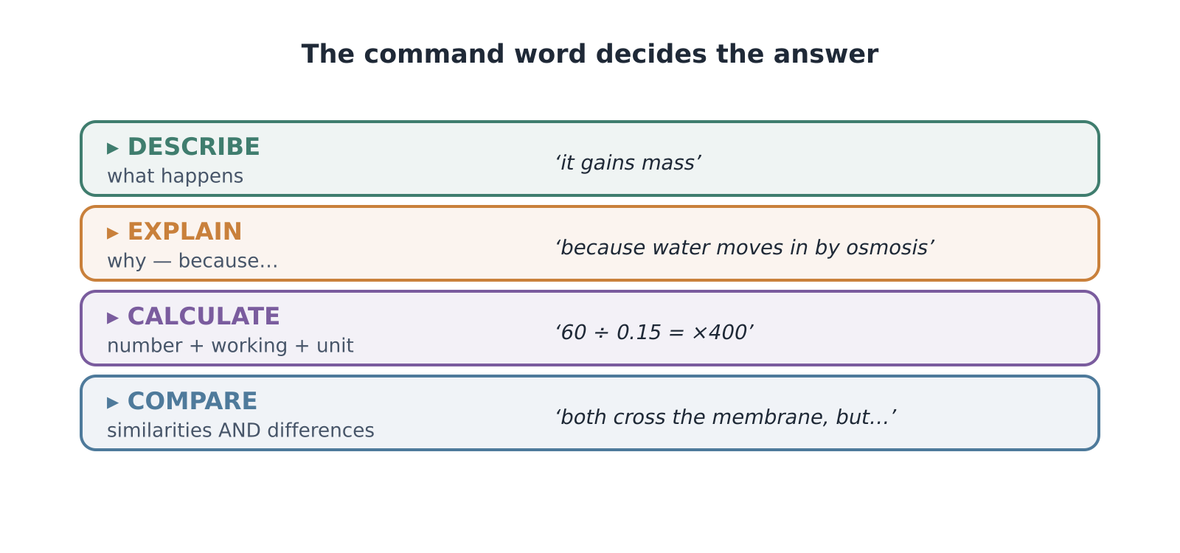
LAUNCH SCIENCE / W7L2
Resources
Look closely at the model
A model illustration: use the stated data for calculations.
Return to I Do
Arrival
Starter
I Do
We Do
I Do 2
We Do 2
Independent
Exit
Resources
Notes:
Source image: https://madebymatt.uk/Lessons/Science_Teesside/Launch/SCI_L_W7_L2_CommandWords.html; existing vector illustration embedded for offline use.
Core explanation: The command word tells you the kind of answer. Marks depend on the question and its mark scheme, not magic words such as “whereas”.
Watch for: “Evaluate” is more than listing improvements: weigh relevant evidence or method strengths/limits and make a supported judgement where asked.
Least help first: Ask which command word sets the answer shape before prompting Biology content.
Support cue: Describe = say what happens. Explain = say why. Compare = link a similarity or difference. Calculate = show working. Evaluate = judge using evidence.
[Sources]
User-supplied LAUNCH W3–W7 pack: W7 test/review preparation, expanded into a full Explore lesson.
Made by Matt LAUNCH Science draft, lesson-content.json, W7L2; existing illustrative diagrams reused, active-transport direction corrected to lower → higher.
Pearson Edexcel GCSE Biology specification, sections 1.1–1.6 and 1.15–1.17: https://qualifications.pearson.com/content/dam/pdf/GCSE/Science/2016/Specification/gcse-biology-spec.pdf
Optional concept video: freesciencelessons, Gas exchange in the lungs, https://www.youtube.com/watch?v=aPUPfzsqDgs (link located 5 September 2026).
[/Sources]
[Sources]
Source editable lesson: Original LAUNCH Science OneDrive pack, 5 September 2026, W7L2. Source teaching content preserved. Current HTML reference: https://madebymatt.uk/Lessons/Science_Teesside/Launch/. Native diagrams restate the source explanation and are not experimental measurements.
[/Sources]

