Slide 1
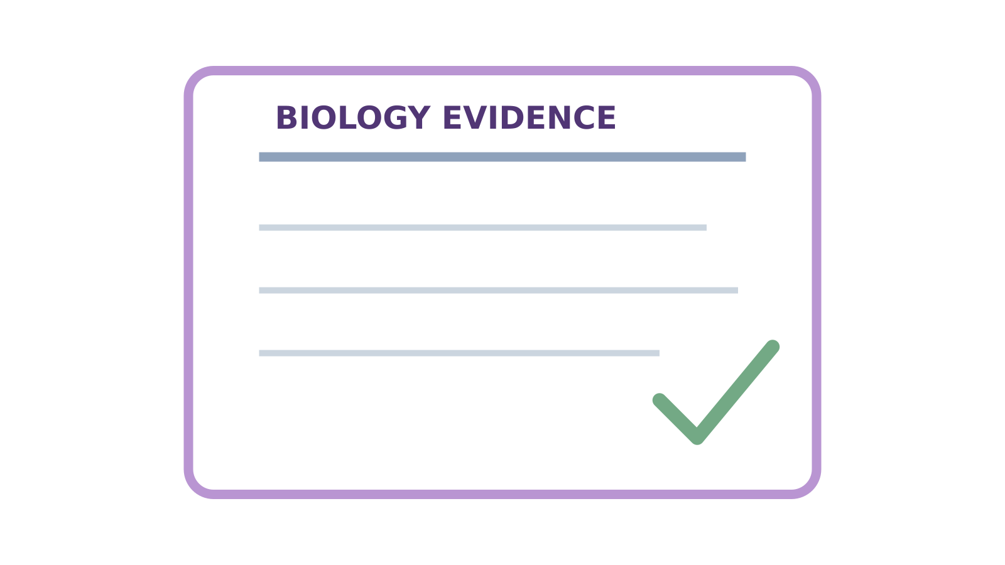
LAUNCH SCIENCE / W7L3
Arrival · 3 min
Show what you know
I can independently apply Topic 1 Biology, use answer-shape feedback and improve my original work.
Notice. Recall. Be ready to explain.
1
What should happen before opening an answer checklist?
2
Which unit conversion often appears in magnification?
Retrieval answers
Arrival
Starter
I Do
We Do
I Do 2
We Do 2
Independent
Exit
Resources
Notes:
Stage: Arrival, 3 minutes. Monday / Wednesday / Friday P1, 09:30–10:10. Use reveals within this slot; appendix slides are not added time.
Retrieval answers: Make a genuine first attempt using agreed access arrangements. | mm to µm: multiply by 1000; reverse: divide by 1000. | Name the method detail, its effect on the result and a justified improvement.
Core explanation: This is original low-stakes classroom assessment, not an official Pearson paper and not a grade predictor. Use agreed access arrangements and keep results private.
Watch for: A 25-minute paper cannot fit inside a 10-minute Independent Task. The main lesson uses a selected short set; the complete paper is a separately scheduled option.
Least help first: Ask which command word and answer-shape element is missing; preserve authorship and avoid dictating the final response.
Support cue: Choose one real answer. Underline the part you will improve. Write the change in your own words and say why it is clearer.
[Sources]
User-supplied LAUNCH W3–W7 pack: W7 slides 7–10 and reflection worksheet; the missing assessment and marking guidance are newly written.
Made by Matt LAUNCH Science draft, lesson-content.json, W7L3; existing illustrative diagrams reused, active-transport direction corrected to lower → higher.
Pearson Edexcel GCSE Biology specification, sections 1.1–1.6 and 1.15–1.17: https://qualifications.pearson.com/content/dam/pdf/GCSE/Science/2016/Specification/gcse-biology-spec.pdf
Optional concept video: freesciencelessons, Active transport, https://www.youtube.com/watch?v=ECldVkp6Rw0 (link located 5 September 2026).
[/Sources]
[Sources]
Source editable lesson: Original LAUNCH Science OneDrive pack, 5 September 2026, W7L3. Source teaching content preserved. Current HTML reference: https://madebymatt.uk/Lessons/Science_Teesside/Launch/. Native diagrams restate the source explanation and are not experimental measurements.
[/Sources]

Slide 2
LAUNCH SCIENCE / W7L3
Starter · 4 min
Make a prediction
Which mode best protects independence today: focus on one item, question-by-question, or full-paper mode? Choose and give a reason.
A Focus mode
B Question-by-question mode
C Full-paper mode
D Any mode can be valid when the reason fits the learning need
Commit, then check
Arrival
Starter
I Do
We Do
I Do 2
We Do 2
Independent
Exit
Resources
Notes:
Stage: Starter, 4 minutes. Monday / Wednesday / Friday P1, 09:30–10:10. Use reveals within this slot; appendix slides are not added time.
Correct: Any mode can be valid when the reason fits the learning need. Ask for the reason, then return to the original prediction.
Core explanation: This is original low-stakes classroom assessment, not an official Pearson paper and not a grade predictor. Use agreed access arrangements and keep results private.
Watch for: A 25-minute paper cannot fit inside a 10-minute Independent Task. The main lesson uses a selected short set; the complete paper is a separately scheduled option.
Least help first: Ask which command word and answer-shape element is missing; preserve authorship and avoid dictating the final response.
Support cue: Choose one real answer. Underline the part you will improve. Write the change in your own words and say why it is clearer.
[Sources]
User-supplied LAUNCH W3–W7 pack: W7 slides 7–10 and reflection worksheet; the missing assessment and marking guidance are newly written.
Made by Matt LAUNCH Science draft, lesson-content.json, W7L3; existing illustrative diagrams reused, active-transport direction corrected to lower → higher.
Pearson Edexcel GCSE Biology specification, sections 1.1–1.6 and 1.15–1.17: https://qualifications.pearson.com/content/dam/pdf/GCSE/Science/2016/Specification/gcse-biology-spec.pdf
Optional concept video: freesciencelessons, Active transport, https://www.youtube.com/watch?v=ECldVkp6Rw0 (link located 5 September 2026).
[/Sources]
[Sources]
Source editable lesson: Original LAUNCH Science OneDrive pack, 5 September 2026, W7L3. Source teaching content preserved. Current HTML reference: https://madebymatt.uk/Lessons/Science_Teesside/Launch/. Native diagrams restate the source explanation and are not experimental measurements.
[/Sources]

Slide 3
LAUNCH SCIENCE / W7L3
I Do · 5 min
Watch the model
1
Read the command word and evidence before writing.
Match the answer to the task
Describe
State what happens
2
Show calculation relationships, substitutions and units rather than a final number alone.
Explain
Say how or why
Calculate
Show steps and units
3
Commit the response before using a teaching checklist; then edit the same work.
View labelled diagram
Optional video
Arrival
Starter
I Do
We Do
I Do 2
We Do 2
Independent
Exit
Resources
Notes:
Stage: I Do, 5 minutes. Monday / Wednesday / Friday P1, 09:30–10:10. Use reveals within this slot; appendix slides are not added time.
The Paper offers three pacing modes and answer-shape checks without scores, grades or leaderboards.
Model limit: The questions are original and match this topic. They are not official exam-board questions or mark schemes.
Video replaces up to 90 seconds of explanation; use the still diagram if unavailable.
Core explanation: This is original low-stakes classroom assessment, not an official Pearson paper and not a grade predictor. Use agreed access arrangements and keep results private.
Watch for: A 25-minute paper cannot fit inside a 10-minute Independent Task. The main lesson uses a selected short set; the complete paper is a separately scheduled option.
Least help first: Ask which command word and answer-shape element is missing; preserve authorship and avoid dictating the final response.
Support cue: Choose one real answer. Underline the part you will improve. Write the change in your own words and say why it is clearer.
[Sources]
User-supplied LAUNCH W3–W7 pack: W7 slides 7–10 and reflection worksheet; the missing assessment and marking guidance are newly written.
Made by Matt LAUNCH Science draft, lesson-content.json, W7L3; existing illustrative diagrams reused, active-transport direction corrected to lower → higher.
Pearson Edexcel GCSE Biology specification, sections 1.1–1.6 and 1.15–1.17: https://qualifications.pearson.com/content/dam/pdf/GCSE/Science/2016/Specification/gcse-biology-spec.pdf
Optional concept video: freesciencelessons, Active transport, https://www.youtube.com/watch?v=ECldVkp6Rw0 (link located 5 September 2026).
[/Sources]
[Sources]
Source editable lesson: Original LAUNCH Science OneDrive pack, 5 September 2026, W7L3. Source teaching content preserved. Current HTML reference: https://madebymatt.uk/Lessons/Science_Teesside/Launch/. Native diagrams restate the source explanation and are not experimental measurements.
[/Sources]

Slide 4
LAUNCH SCIENCE / W7L3
We Do · 5 min
Choose and justify
After committing an explanation, what is the most useful next action?
A Delete it and copy a model
B Open the answer-shape checklist, identify one missing link and edit the same answer
C Ask for a public grade
D Move on without reading feedback
Give the deciding clue before checking.
Check the reasoning
Arrival
Starter
I Do
We Do
I Do 2
We Do 2
Independent
Exit
Resources
Notes:
Stage: We Do, 5 minutes. Monday / Wednesday / Friday P1, 09:30–10:10. Use reveals within this slot; appendix slides are not added time.
A: Delete it and copy a model — Copying removes evidence of the pupil’s reasoning and correction.
B: Open the answer-shape checklist, identify one missing link and edit the same answer — Correct improvement cycle.
C: Ask for a public grade — Public grades and comparison are deliberately absent.
D: Move on without reading feedback — Feedback has no value unless it changes a pupil action.
Core explanation: This is original low-stakes classroom assessment, not an official Pearson paper and not a grade predictor. Use agreed access arrangements and keep results private.
Watch for: A 25-minute paper cannot fit inside a 10-minute Independent Task. The main lesson uses a selected short set; the complete paper is a separately scheduled option.
Least help first: Ask which command word and answer-shape element is missing; preserve authorship and avoid dictating the final response.
Support cue: Choose one real answer. Underline the part you will improve. Write the change in your own words and say why it is clearer.
[Sources]
User-supplied LAUNCH W3–W7 pack: W7 slides 7–10 and reflection worksheet; the missing assessment and marking guidance are newly written.
Made by Matt LAUNCH Science draft, lesson-content.json, W7L3; existing illustrative diagrams reused, active-transport direction corrected to lower → higher.
Pearson Edexcel GCSE Biology specification, sections 1.1–1.6 and 1.15–1.17: https://qualifications.pearson.com/content/dam/pdf/GCSE/Science/2016/Specification/gcse-biology-spec.pdf
Optional concept video: freesciencelessons, Active transport, https://www.youtube.com/watch?v=ECldVkp6Rw0 (link located 5 September 2026).
[/Sources]
[Sources]
Source editable lesson: Original LAUNCH Science OneDrive pack, 5 September 2026, W7L3. Source teaching content preserved. Current HTML reference: https://madebymatt.uk/Lessons/Science_Teesside/Launch/. Native diagrams restate the source explanation and are not experimental measurements.
[/Sources]

Slide 5
LAUNCH SCIENCE / W7L3
I Do 2 · 4 min
Connect the science
1
Calculation item: relationship → unit conversion → working → plausible answer.
2
Data item: pattern → evidence values → cautious interpretation.
3
Explanation item: science idea → because → consequence.
4
Practical item: issue → result consequence → improvement.
5
Application item: select relevant evidence and transfer the process.
Arrival
Starter
I Do
We Do
I Do 2
We Do 2
Independent
Exit
Resources
Notes:
Stage: I Do 2, 4 minutes. Monday / Wednesday / Friday P1, 09:30–10:10. Use reveals within this slot; appendix slides are not added time.
The questions are original and match this topic. They are not official exam-board questions or mark schemes.
Core explanation: This is original low-stakes classroom assessment, not an official Pearson paper and not a grade predictor. Use agreed access arrangements and keep results private.
Watch for: A 25-minute paper cannot fit inside a 10-minute Independent Task. The main lesson uses a selected short set; the complete paper is a separately scheduled option.
Least help first: Ask which command word and answer-shape element is missing; preserve authorship and avoid dictating the final response.
Support cue: Choose one real answer. Underline the part you will improve. Write the change in your own words and say why it is clearer.
[Sources]
User-supplied LAUNCH W3–W7 pack: W7 slides 7–10 and reflection worksheet; the missing assessment and marking guidance are newly written.
Made by Matt LAUNCH Science draft, lesson-content.json, W7L3; existing illustrative diagrams reused, active-transport direction corrected to lower → higher.
Pearson Edexcel GCSE Biology specification, sections 1.1–1.6 and 1.15–1.17: https://qualifications.pearson.com/content/dam/pdf/GCSE/Science/2016/Specification/gcse-biology-spec.pdf
Optional concept video: freesciencelessons, Active transport, https://www.youtube.com/watch?v=ECldVkp6Rw0 (link located 5 September 2026).
[/Sources]
[Sources]
Source editable lesson: Original LAUNCH Science OneDrive pack, 5 September 2026, W7L3. Source teaching content preserved. Current HTML reference: https://madebymatt.uk/Lessons/Science_Teesside/Launch/. Native diagrams restate the source explanation and are not experimental measurements.
[/Sources]

Slide 6
LAUNCH SCIENCE / W7L3
We Do 2 · Task · 6 min
Rehearse the answer shape
This is practice. Keep assessment Q2, Q3 and Q5 for your own first attempt.
1
Explain why thin alveolar walls help gas exchange.
2
Name the command word.
3
Choose the cause and the consequence.
Reveal shared reasoning
Arrival
Starter
I Do
We Do
I Do 2
We Do 2
Independent
Exit
Resources
Notes:
Stage: We Do 2 · Task, 6 minutes. Monday / Wednesday / Friday P1, 09:30–10:10. Use reveals within this slot; appendix slides are not added time.
Explain needs a scientific cause linked to a consequence.
Thin walls give a short diffusion distance, so oxygen diffuses into blood more quickly down its gradient.
Now use your own reasoning for the independent questions.
Run the printed activity or this board; one route is enough.
Core explanation: This is original low-stakes classroom assessment, not an official Pearson paper and not a grade predictor. Use agreed access arrangements and keep results private.
Watch for: A 25-minute paper cannot fit inside a 10-minute Independent Task. The main lesson uses a selected short set; the complete paper is a separately scheduled option.
Least help first: Ask which command word and answer-shape element is missing; preserve authorship and avoid dictating the final response.
Support cue: Choose one real answer. Underline the part you will improve. Write the change in your own words and say why it is clearer.
[Sources]
User-supplied LAUNCH W3–W7 pack: W7 slides 7–10 and reflection worksheet; the missing assessment and marking guidance are newly written.
Made by Matt LAUNCH Science draft, lesson-content.json, W7L3; existing illustrative diagrams reused, active-transport direction corrected to lower → higher.
Pearson Edexcel GCSE Biology specification, sections 1.1–1.6 and 1.15–1.17: https://qualifications.pearson.com/content/dam/pdf/GCSE/Science/2016/Specification/gcse-biology-spec.pdf
Optional concept video: freesciencelessons, Active transport, https://www.youtube.com/watch?v=ECldVkp6Rw0 (link located 5 September 2026).
[/Sources]
[Sources]
Source editable lesson: Original LAUNCH Science OneDrive pack, 5 September 2026, W7L3. Source teaching content preserved. Current HTML reference: https://madebymatt.uk/Lessons/Science_Teesside/Launch/. Native diagrams restate the source explanation and are not experimental measurements.
[/Sources]

Slide 7
LAUNCH SCIENCE / W7L3
Independent Task · 10 min
Your independent evidence
Complete assessment Q2, Q3 and Q5 only. Keep your first attempt.
Optional support
Choose one real answer. Underline the part you will improve. Write the change in your own words and say why it is clearer.
Make one precise correction to the same work after feedback.
Open assessment questions
Model after first attempt
Arrival
Starter
I Do
We Do
I Do 2
We Do 2
Independent
Exit
Resources
Notes:
Stage: Independent Task, 10 minutes. Monday / Wednesday / Friday P1, 09:30–10:10. Use reveals within this slot; appendix slides are not added time.
Model answer: I improved the gas-exchange explanation item. My first answer described the thin wall but did not link it to diffusion. The checklist showed that an explain response needed a cause and consequence. I added that a thinner wall shortens diffusion distance, so oxygen reaches the blood faster. This makes the Biology clearer because it links the feature to the process and outcome.
Select only questions that fit the ten-minute slot. W7L3: Q2, Q3 and Q5 total 11 marks. The full paper needs a separate 25-minute slot.
Core explanation: This is original low-stakes classroom assessment, not an official Pearson paper and not a grade predictor. Use agreed access arrangements and keep results private.
Watch for: A 25-minute paper cannot fit inside a 10-minute Independent Task. The main lesson uses a selected short set; the complete paper is a separately scheduled option.
Least help first: Ask which command word and answer-shape element is missing; preserve authorship and avoid dictating the final response.
Support cue: Choose one real answer. Underline the part you will improve. Write the change in your own words and say why it is clearer.
[Sources]
User-supplied LAUNCH W3–W7 pack: W7 slides 7–10 and reflection worksheet; the missing assessment and marking guidance are newly written.
Made by Matt LAUNCH Science draft, lesson-content.json, W7L3; existing illustrative diagrams reused, active-transport direction corrected to lower → higher.
Pearson Edexcel GCSE Biology specification, sections 1.1–1.6 and 1.15–1.17: https://qualifications.pearson.com/content/dam/pdf/GCSE/Science/2016/Specification/gcse-biology-spec.pdf
Optional concept video: freesciencelessons, Active transport, https://www.youtube.com/watch?v=ECldVkp6Rw0 (link located 5 September 2026).
[/Sources]
[Sources]
Source editable lesson: Original LAUNCH Science OneDrive pack, 5 September 2026, W7L3. Source teaching content preserved. Current HTML reference: https://madebymatt.uk/Lessons/Science_Teesside/Launch/. Native diagrams restate the source explanation and are not experimental measurements.
[/Sources]

Slide 8
LAUNCH SCIENCE / W7L3
Exit · 3 min
What changed in your thinking?
What changed in your work because feedback was received, and what should happen next?
1
Point to one improvement in your work.
2
Choose what you want to revisit.
3
Tell your teacher; agree the next step together.
Arrival
Starter
I Do
We Do
I Do 2
We Do 2
Independent
Exit
Resources
Notes:
Stage: Exit, 3 minutes. Monday / Wednesday / Friday P1, 09:30–10:10. Use reveals within this slot; appendix slides are not added time.
Exit answer: Pupil identifies an actual correction and a specific next learning action.
Receive the request, record the agreed next action and check it next lesson. Keep responses private when requested.
Core explanation: This is original low-stakes classroom assessment, not an official Pearson paper and not a grade predictor. Use agreed access arrangements and keep results private.
Watch for: A 25-minute paper cannot fit inside a 10-minute Independent Task. The main lesson uses a selected short set; the complete paper is a separately scheduled option.
Least help first: Ask which command word and answer-shape element is missing; preserve authorship and avoid dictating the final response.
Support cue: Choose one real answer. Underline the part you will improve. Write the change in your own words and say why it is clearer.
[Sources]
User-supplied LAUNCH W3–W7 pack: W7 slides 7–10 and reflection worksheet; the missing assessment and marking guidance are newly written.
Made by Matt LAUNCH Science draft, lesson-content.json, W7L3; existing illustrative diagrams reused, active-transport direction corrected to lower → higher.
Pearson Edexcel GCSE Biology specification, sections 1.1–1.6 and 1.15–1.17: https://qualifications.pearson.com/content/dam/pdf/GCSE/Science/2016/Specification/gcse-biology-spec.pdf
Optional concept video: freesciencelessons, Active transport, https://www.youtube.com/watch?v=ECldVkp6Rw0 (link located 5 September 2026).
[/Sources]
[Sources]
Source editable lesson: Original LAUNCH Science OneDrive pack, 5 September 2026, W7L3. Source teaching content preserved. Current HTML reference: https://madebymatt.uk/Lessons/Science_Teesside/Launch/. Native diagrams restate the source explanation and are not experimental measurements.
[/Sources]

Slide 9
LAUNCH SCIENCE / W7L3
Resources
Retrieval and prediction check
1
Make a genuine first attempt using agreed access arrangements.
2
mm to µm: multiply by 1000; reverse: divide by 1000.
Any mode can be valid when the reason fits the learning need
Return to Starter
Arrival
Starter
I Do
We Do
I Do 2
We Do 2
Independent
Exit
Resources
Notes:
Read only after an attempt; retain the pupil’s first view.
Core explanation: This is original low-stakes classroom assessment, not an official Pearson paper and not a grade predictor. Use agreed access arrangements and keep results private.
Watch for: A 25-minute paper cannot fit inside a 10-minute Independent Task. The main lesson uses a selected short set; the complete paper is a separately scheduled option.
Least help first: Ask which command word and answer-shape element is missing; preserve authorship and avoid dictating the final response.
Support cue: Choose one real answer. Underline the part you will improve. Write the change in your own words and say why it is clearer.
[Sources]
User-supplied LAUNCH W3–W7 pack: W7 slides 7–10 and reflection worksheet; the missing assessment and marking guidance are newly written.
Made by Matt LAUNCH Science draft, lesson-content.json, W7L3; existing illustrative diagrams reused, active-transport direction corrected to lower → higher.
Pearson Edexcel GCSE Biology specification, sections 1.1–1.6 and 1.15–1.17: https://qualifications.pearson.com/content/dam/pdf/GCSE/Science/2016/Specification/gcse-biology-spec.pdf
Optional concept video: freesciencelessons, Active transport, https://www.youtube.com/watch?v=ECldVkp6Rw0 (link located 5 September 2026).
[/Sources]
[Sources]
Source editable lesson: Original LAUNCH Science OneDrive pack, 5 September 2026, W7L3. Source teaching content preserved. Current HTML reference: https://madebymatt.uk/Lessons/Science_Teesside/Launch/. Native diagrams restate the source explanation and are not experimental measurements.
[/Sources]

Slide 10
LAUNCH SCIENCE / W7L3
Resources
Check the deciding clue
Open the answer-shape checklist, identify one missing link and edit the same answer
Correct improvement cycle.
Compare your reason. Correct one step if needed.
Return to We Do
Arrival
Starter
I Do
We Do
I Do 2
We Do 2
Independent
Exit
Resources
Notes:
Copying removes evidence of the pupil’s reasoning and correction.
Correct improvement cycle.
Public grades and comparison are deliberately absent.
Feedback has no value unless it changes a pupil action.
Core explanation: This is original low-stakes classroom assessment, not an official Pearson paper and not a grade predictor. Use agreed access arrangements and keep results private.
Watch for: A 25-minute paper cannot fit inside a 10-minute Independent Task. The main lesson uses a selected short set; the complete paper is a separately scheduled option.
Least help first: Ask which command word and answer-shape element is missing; preserve authorship and avoid dictating the final response.
Support cue: Choose one real answer. Underline the part you will improve. Write the change in your own words and say why it is clearer.
[Sources]
User-supplied LAUNCH W3–W7 pack: W7 slides 7–10 and reflection worksheet; the missing assessment and marking guidance are newly written.
Made by Matt LAUNCH Science draft, lesson-content.json, W7L3; existing illustrative diagrams reused, active-transport direction corrected to lower → higher.
Pearson Edexcel GCSE Biology specification, sections 1.1–1.6 and 1.15–1.17: https://qualifications.pearson.com/content/dam/pdf/GCSE/Science/2016/Specification/gcse-biology-spec.pdf
Optional concept video: freesciencelessons, Active transport, https://www.youtube.com/watch?v=ECldVkp6Rw0 (link located 5 September 2026).
[/Sources]
[Sources]
Source editable lesson: Original LAUNCH Science OneDrive pack, 5 September 2026, W7L3. Source teaching content preserved. Current HTML reference: https://madebymatt.uk/Lessons/Science_Teesside/Launch/. Native diagrams restate the source explanation and are not experimental measurements.
[/Sources]

Slide 11
LAUNCH SCIENCE / W7L3
Resources
Our shared reasoning
Explain needs a scientific cause linked to a consequence.
Thin walls give a short diffusion distance, so oxygen diffuses into blood more quickly down its gradient.
Now use your own reasoning for the independent questions.
Return to shared task
Arrival
Starter
I Do
We Do
I Do 2
We Do 2
Independent
Exit
Resources
Notes:
Pupils should justify, compare and revise rather than copy a complete answer before trying.
Core explanation: This is original low-stakes classroom assessment, not an official Pearson paper and not a grade predictor. Use agreed access arrangements and keep results private.
Watch for: A 25-minute paper cannot fit inside a 10-minute Independent Task. The main lesson uses a selected short set; the complete paper is a separately scheduled option.
Least help first: Ask which command word and answer-shape element is missing; preserve authorship and avoid dictating the final response.
Support cue: Choose one real answer. Underline the part you will improve. Write the change in your own words and say why it is clearer.
[Sources]
User-supplied LAUNCH W3–W7 pack: W7 slides 7–10 and reflection worksheet; the missing assessment and marking guidance are newly written.
Made by Matt LAUNCH Science draft, lesson-content.json, W7L3; existing illustrative diagrams reused, active-transport direction corrected to lower → higher.
Pearson Edexcel GCSE Biology specification, sections 1.1–1.6 and 1.15–1.17: https://qualifications.pearson.com/content/dam/pdf/GCSE/Science/2016/Specification/gcse-biology-spec.pdf
Optional concept video: freesciencelessons, Active transport, https://www.youtube.com/watch?v=ECldVkp6Rw0 (link located 5 September 2026).
[/Sources]
[Sources]
Source editable lesson: Original LAUNCH Science OneDrive pack, 5 September 2026, W7L3. Source teaching content preserved. Current HTML reference: https://madebymatt.uk/Lessons/Science_Teesside/Launch/. Native diagrams restate the source explanation and are not experimental measurements.
[/Sources]

Slide 12
LAUNCH SCIENCE / W7L3
Resources
Compare after your first attempt
Use your teacher’s separate mark scheme for Q2, Q3 and Q5. Choose one real answer and improve the scientific relationship. Keep the original answer visible.
Assessment PDF
Assessment Word
Use the model to improve your explanation in your own words.
Return to independent task
Arrival
Starter
I Do
We Do
I Do 2
We Do 2
Independent
Exit
Resources
Notes:
Staff guide includes question-by-question answers. Do not distribute this presentation as a secure assessment paper.
Core explanation: This is original low-stakes classroom assessment, not an official Pearson paper and not a grade predictor. Use agreed access arrangements and keep results private.
Watch for: A 25-minute paper cannot fit inside a 10-minute Independent Task. The main lesson uses a selected short set; the complete paper is a separately scheduled option.
Least help first: Ask which command word and answer-shape element is missing; preserve authorship and avoid dictating the final response.
Support cue: Choose one real answer. Underline the part you will improve. Write the change in your own words and say why it is clearer.
[Sources]
User-supplied LAUNCH W3–W7 pack: W7 slides 7–10 and reflection worksheet; the missing assessment and marking guidance are newly written.
Made by Matt LAUNCH Science draft, lesson-content.json, W7L3; existing illustrative diagrams reused, active-transport direction corrected to lower → higher.
Pearson Edexcel GCSE Biology specification, sections 1.1–1.6 and 1.15–1.17: https://qualifications.pearson.com/content/dam/pdf/GCSE/Science/2016/Specification/gcse-biology-spec.pdf
Optional concept video: freesciencelessons, Active transport, https://www.youtube.com/watch?v=ECldVkp6Rw0 (link located 5 September 2026).
[/Sources]
[Sources]
Source editable lesson: Original LAUNCH Science OneDrive pack, 5 September 2026, W7L3. Source teaching content preserved. Current HTML reference: https://madebymatt.uk/Lessons/Science_Teesside/Launch/. Native diagrams restate the source explanation and are not experimental measurements.
[/Sources]

Slide 13
LAUNCH SCIENCE / W7L3
Resources
Your lesson resources
Worksheet pages are stored inside this PowerPoint.
Worksheet · page 1
Worksheet · page 2
Standard PDF
Supported PDF
Depth PDF
Editable Word worksheet
Open online lesson / model
Named files are in this week’s folder. Online lesson and video need internet.
Optional concept video
Assessment Q2 / Q3 / Q5
Arrival
Starter
I Do
We Do
I Do 2
We Do 2
Independent
Exit
Resources
Notes:
File buttons use relative links for downloaded/synced folders. OneDrive preview may not resolve relative links. Use the embedded pages or open the named file in the week folder.
Core explanation: This is original low-stakes classroom assessment, not an official Pearson paper and not a grade predictor. Use agreed access arrangements and keep results private.
Watch for: A 25-minute paper cannot fit inside a 10-minute Independent Task. The main lesson uses a selected short set; the complete paper is a separately scheduled option.
Least help first: Ask which command word and answer-shape element is missing; preserve authorship and avoid dictating the final response.
Support cue: Choose one real answer. Underline the part you will improve. Write the change in your own words and say why it is clearer.
[Sources]
User-supplied LAUNCH W3–W7 pack: W7 slides 7–10 and reflection worksheet; the missing assessment and marking guidance are newly written.
Made by Matt LAUNCH Science draft, lesson-content.json, W7L3; existing illustrative diagrams reused, active-transport direction corrected to lower → higher.
Pearson Edexcel GCSE Biology specification, sections 1.1–1.6 and 1.15–1.17: https://qualifications.pearson.com/content/dam/pdf/GCSE/Science/2016/Specification/gcse-biology-spec.pdf
Optional concept video: freesciencelessons, Active transport, https://www.youtube.com/watch?v=ECldVkp6Rw0 (link located 5 September 2026).
[/Sources]
[Sources]
Source editable lesson: Original LAUNCH Science OneDrive pack, 5 September 2026, W7L3. Source teaching content preserved. Current HTML reference: https://madebymatt.uk/Lessons/Science_Teesside/Launch/. Native diagrams restate the source explanation and are not experimental measurements.
[/Sources]

Slide 14
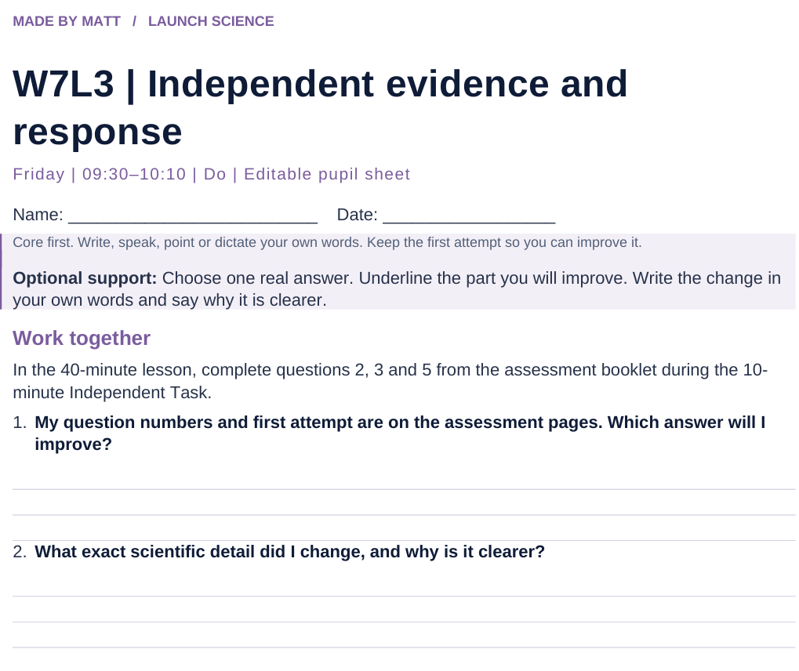
LAUNCH SCIENCE / W7L3
Resources
Worksheet · page 1
Use your printed copy.
Keep the first attempt.
Return to task
Arrival
Starter
I Do
We Do
I Do 2
We Do 2
Independent
Exit
Resources
Notes:
Embedded worksheet reference; print the separate PDF at A4 for writable space.
Core explanation: This is original low-stakes classroom assessment, not an official Pearson paper and not a grade predictor. Use agreed access arrangements and keep results private.
Watch for: A 25-minute paper cannot fit inside a 10-minute Independent Task. The main lesson uses a selected short set; the complete paper is a separately scheduled option.
Least help first: Ask which command word and answer-shape element is missing; preserve authorship and avoid dictating the final response.
Support cue: Choose one real answer. Underline the part you will improve. Write the change in your own words and say why it is clearer.
[Sources]
User-supplied LAUNCH W3–W7 pack: W7 slides 7–10 and reflection worksheet; the missing assessment and marking guidance are newly written.
Made by Matt LAUNCH Science draft, lesson-content.json, W7L3; existing illustrative diagrams reused, active-transport direction corrected to lower → higher.
Pearson Edexcel GCSE Biology specification, sections 1.1–1.6 and 1.15–1.17: https://qualifications.pearson.com/content/dam/pdf/GCSE/Science/2016/Specification/gcse-biology-spec.pdf
Optional concept video: freesciencelessons, Active transport, https://www.youtube.com/watch?v=ECldVkp6Rw0 (link located 5 September 2026).
[/Sources]
[Sources]
Source editable lesson: Original LAUNCH Science OneDrive pack, 5 September 2026, W7L3. Source teaching content preserved. Current HTML reference: https://madebymatt.uk/Lessons/Science_Teesside/Launch/. Native diagrams restate the source explanation and are not experimental measurements.
[/Sources]

Slide 15
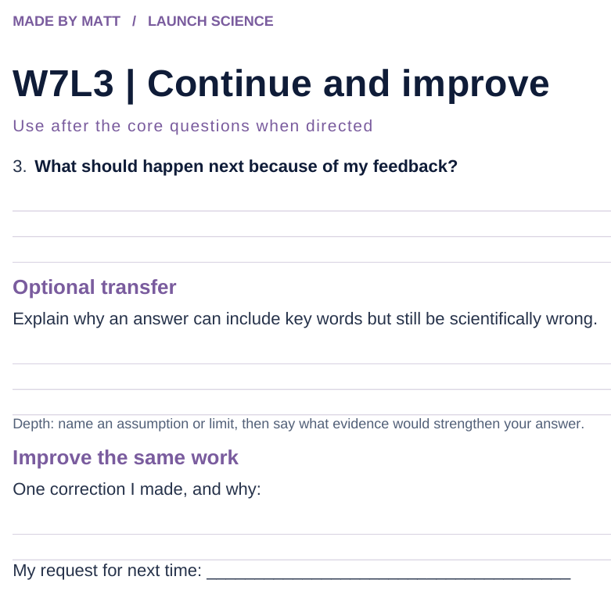
LAUNCH SCIENCE / W7L3
Resources
Worksheet · page 2
Continuation is optional.
Improve the same work.
Return to task
Arrival
Starter
I Do
We Do
I Do 2
We Do 2
Independent
Exit
Resources
Notes:
Embedded worksheet reference; print the separate PDF at A4 for writable space.
Core explanation: This is original low-stakes classroom assessment, not an official Pearson paper and not a grade predictor. Use agreed access arrangements and keep results private.
Watch for: A 25-minute paper cannot fit inside a 10-minute Independent Task. The main lesson uses a selected short set; the complete paper is a separately scheduled option.
Least help first: Ask which command word and answer-shape element is missing; preserve authorship and avoid dictating the final response.
Support cue: Choose one real answer. Underline the part you will improve. Write the change in your own words and say why it is clearer.
[Sources]
User-supplied LAUNCH W3–W7 pack: W7 slides 7–10 and reflection worksheet; the missing assessment and marking guidance are newly written.
Made by Matt LAUNCH Science draft, lesson-content.json, W7L3; existing illustrative diagrams reused, active-transport direction corrected to lower → higher.
Pearson Edexcel GCSE Biology specification, sections 1.1–1.6 and 1.15–1.17: https://qualifications.pearson.com/content/dam/pdf/GCSE/Science/2016/Specification/gcse-biology-spec.pdf
Optional concept video: freesciencelessons, Active transport, https://www.youtube.com/watch?v=ECldVkp6Rw0 (link located 5 September 2026).
[/Sources]
[Sources]
Source editable lesson: Original LAUNCH Science OneDrive pack, 5 September 2026, W7L3. Source teaching content preserved. Current HTML reference: https://madebymatt.uk/Lessons/Science_Teesside/Launch/. Native diagrams restate the source explanation and are not experimental measurements.
[/Sources]

Slide 16
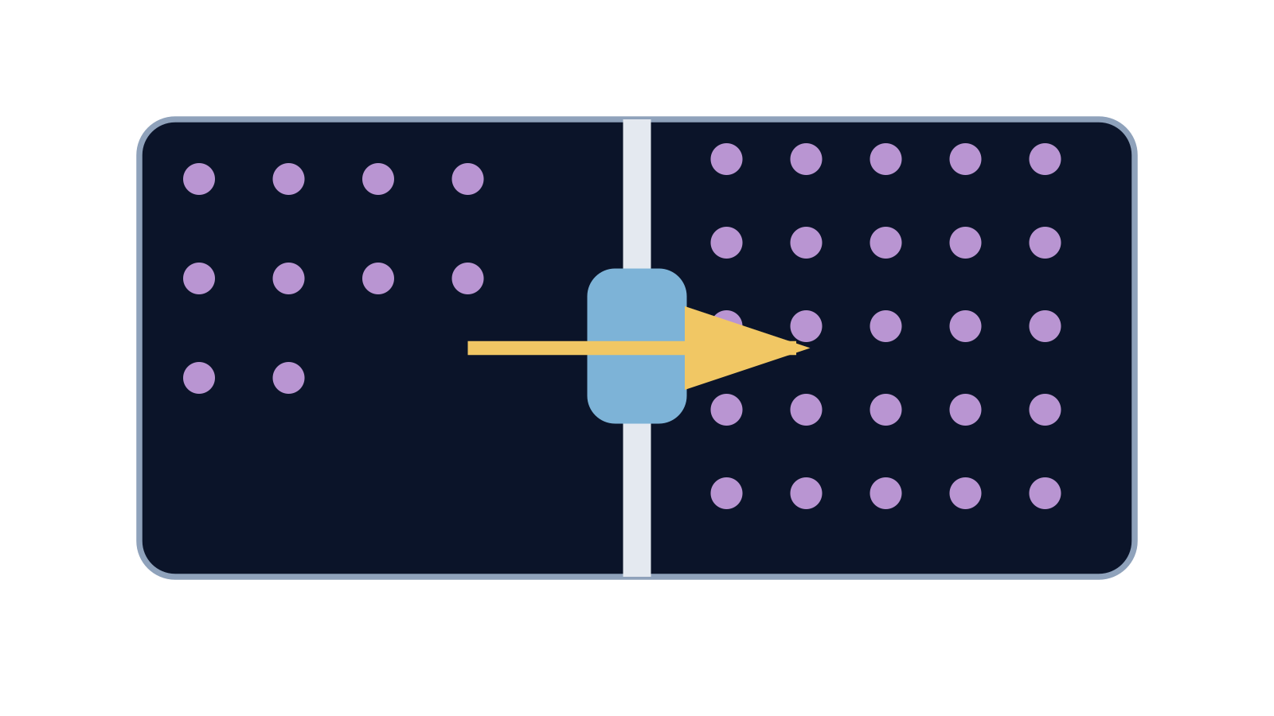
LAUNCH SCIENCE / W7L3
Resources
Watch, pause and explain
Active transport
What two clues distinguish active transport from diffusion?
Play freesciencelessons video
No connection? Use the still model and explain the same question.
Arrival
Starter
I Do
We Do
I Do 2
We Do 2
Independent
Exit
Resources
Notes:
Use at most 90 seconds within I Do. Pause on the first relevant example; ask for a reason. This is an optional concept clip, not evidence of practical completion.
Core explanation: This is original low-stakes classroom assessment, not an official Pearson paper and not a grade predictor. Use agreed access arrangements and keep results private.
Watch for: A 25-minute paper cannot fit inside a 10-minute Independent Task. The main lesson uses a selected short set; the complete paper is a separately scheduled option.
Least help first: Ask which command word and answer-shape element is missing; preserve authorship and avoid dictating the final response.
Support cue: Choose one real answer. Underline the part you will improve. Write the change in your own words and say why it is clearer.
[Sources]
User-supplied LAUNCH W3–W7 pack: W7 slides 7–10 and reflection worksheet; the missing assessment and marking guidance are newly written.
Made by Matt LAUNCH Science draft, lesson-content.json, W7L3; existing illustrative diagrams reused, active-transport direction corrected to lower → higher.
Pearson Edexcel GCSE Biology specification, sections 1.1–1.6 and 1.15–1.17: https://qualifications.pearson.com/content/dam/pdf/GCSE/Science/2016/Specification/gcse-biology-spec.pdf
Optional concept video: freesciencelessons, Active transport, https://www.youtube.com/watch?v=ECldVkp6Rw0 (link located 5 September 2026).
[/Sources]
[Sources]
Source editable lesson: Original LAUNCH Science OneDrive pack, 5 September 2026, W7L3. Source teaching content preserved. Current HTML reference: https://madebymatt.uk/Lessons/Science_Teesside/Launch/. Native diagrams restate the source explanation and are not experimental measurements.
[/Sources]

Slide 17
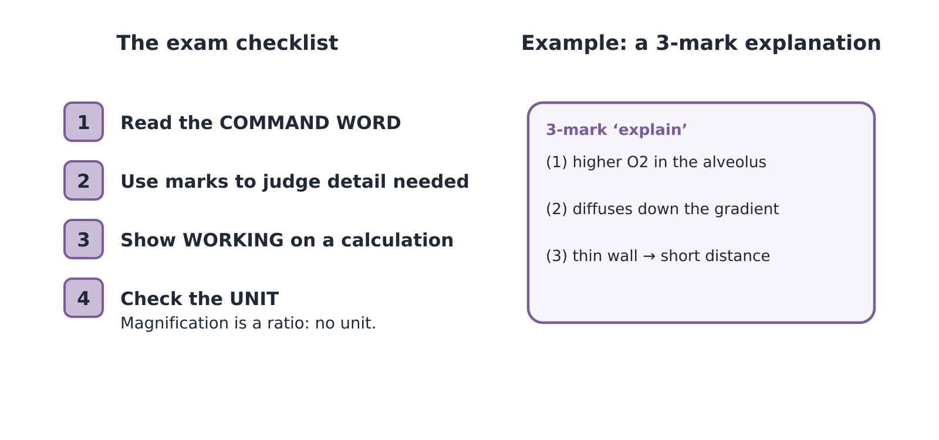
LAUNCH SCIENCE / W7L3
Resources
Look closely at the model
A model illustration: use the stated data for calculations.
Return to I Do
Arrival
Starter
I Do
We Do
I Do 2
We Do 2
Independent
Exit
Resources
Notes:
Source image: https://madebymatt.uk/Lessons/Science_Teesside/Launch/SCI_L_W7_L3_ExamPractice.html; existing vector illustration embedded for offline use.
Core explanation: This is original low-stakes classroom assessment, not an official Pearson paper and not a grade predictor. Use agreed access arrangements and keep results private.
Watch for: A 25-minute paper cannot fit inside a 10-minute Independent Task. The main lesson uses a selected short set; the complete paper is a separately scheduled option.
Least help first: Ask which command word and answer-shape element is missing; preserve authorship and avoid dictating the final response.
Support cue: Choose one real answer. Underline the part you will improve. Write the change in your own words and say why it is clearer.
[Sources]
User-supplied LAUNCH W3–W7 pack: W7 slides 7–10 and reflection worksheet; the missing assessment and marking guidance are newly written.
Made by Matt LAUNCH Science draft, lesson-content.json, W7L3; existing illustrative diagrams reused, active-transport direction corrected to lower → higher.
Pearson Edexcel GCSE Biology specification, sections 1.1–1.6 and 1.15–1.17: https://qualifications.pearson.com/content/dam/pdf/GCSE/Science/2016/Specification/gcse-biology-spec.pdf
Optional concept video: freesciencelessons, Active transport, https://www.youtube.com/watch?v=ECldVkp6Rw0 (link located 5 September 2026).
[/Sources]
[Sources]
Source editable lesson: Original LAUNCH Science OneDrive pack, 5 September 2026, W7L3. Source teaching content preserved. Current HTML reference: https://madebymatt.uk/Lessons/Science_Teesside/Launch/. Native diagrams restate the source explanation and are not experimental measurements.
[/Sources]

Slide 18
LAUNCH SCIENCE / W7L3
Resources
2. Magnification · 4 marks
An image of a cell measures 25 mm. Its actual length is 50 µm. Calculate the magnification. Show your working.
Write your own answer first. Keep your working and first attempt.
Q2 · Magnification
Q3 · Diffusion
Q5 · Active transport
Arrival
Starter
I Do
We Do
I Do 2
We Do 2
Independent
Exit
Resources
Notes:
Exact question from the accompanying assessment. Do not reveal the mark scheme until the first attempt. Total Q2 + Q3 + Q5 = 11 marks within the independent slot.
Core explanation: This is original low-stakes classroom assessment, not an official Pearson paper and not a grade predictor. Use agreed access arrangements and keep results private.
Watch for: A 25-minute paper cannot fit inside a 10-minute Independent Task. The main lesson uses a selected short set; the complete paper is a separately scheduled option.
Least help first: Ask which command word and answer-shape element is missing; preserve authorship and avoid dictating the final response.
Support cue: Choose one real answer. Underline the part you will improve. Write the change in your own words and say why it is clearer.
[Sources]
User-supplied LAUNCH W3–W7 pack: W7 slides 7–10 and reflection worksheet; the missing assessment and marking guidance are newly written.
Made by Matt LAUNCH Science draft, lesson-content.json, W7L3; existing illustrative diagrams reused, active-transport direction corrected to lower → higher.
Pearson Edexcel GCSE Biology specification, sections 1.1–1.6 and 1.15–1.17: https://qualifications.pearson.com/content/dam/pdf/GCSE/Science/2016/Specification/gcse-biology-spec.pdf
Optional concept video: freesciencelessons, Active transport, https://www.youtube.com/watch?v=ECldVkp6Rw0 (link located 5 September 2026).
[/Sources]
[Sources]
Source editable lesson: Original LAUNCH Science OneDrive pack, 5 September 2026, W7L3. Source teaching content preserved. Current HTML reference: https://madebymatt.uk/Lessons/Science_Teesside/Launch/. Native diagrams restate the source explanation and are not experimental measurements.
[/Sources]

Slide 19
LAUNCH SCIENCE / W7L3
Resources
3. Diffusion · 3 marks
In equal-volume regions, oxygen concentration is higher outside a cell than inside. Explain its initial net movement into the cell.
Write your own answer first. Keep your working and first attempt.
Q2 · Magnification
Q3 · Diffusion
Q5 · Active transport
Arrival
Starter
I Do
We Do
I Do 2
We Do 2
Independent
Exit
Resources
Notes:
Exact question from the accompanying assessment. Do not reveal the mark scheme until the first attempt. Total Q2 + Q3 + Q5 = 11 marks within the independent slot.
Core explanation: This is original low-stakes classroom assessment, not an official Pearson paper and not a grade predictor. Use agreed access arrangements and keep results private.
Watch for: A 25-minute paper cannot fit inside a 10-minute Independent Task. The main lesson uses a selected short set; the complete paper is a separately scheduled option.
Least help first: Ask which command word and answer-shape element is missing; preserve authorship and avoid dictating the final response.
Support cue: Choose one real answer. Underline the part you will improve. Write the change in your own words and say why it is clearer.
[Sources]
User-supplied LAUNCH W3–W7 pack: W7 slides 7–10 and reflection worksheet; the missing assessment and marking guidance are newly written.
Made by Matt LAUNCH Science draft, lesson-content.json, W7L3; existing illustrative diagrams reused, active-transport direction corrected to lower → higher.
Pearson Edexcel GCSE Biology specification, sections 1.1–1.6 and 1.15–1.17: https://qualifications.pearson.com/content/dam/pdf/GCSE/Science/2016/Specification/gcse-biology-spec.pdf
Optional concept video: freesciencelessons, Active transport, https://www.youtube.com/watch?v=ECldVkp6Rw0 (link located 5 September 2026).
[/Sources]
[Sources]
Source editable lesson: Original LAUNCH Science OneDrive pack, 5 September 2026, W7L3. Source teaching content preserved. Current HTML reference: https://madebymatt.uk/Lessons/Science_Teesside/Launch/. Native diagrams restate the source explanation and are not experimental measurements.
[/Sources]

Slide 20
LAUNCH SCIENCE / W7L3
Resources
5. Active transport · 4 marks
A root hair cell takes in mineral ions when their concentration is lower in soil water than inside the cell. Explain how it can do this.
Write your own answer first. Keep your working and first attempt.
Q2 · Magnification
Q3 · Diffusion
Q5 · Active transport
Arrival
Starter
I Do
We Do
I Do 2
We Do 2
Independent
Exit
Resources
Notes:
Exact question from the accompanying assessment. Do not reveal the mark scheme until the first attempt. Total Q2 + Q3 + Q5 = 11 marks within the independent slot.
Core explanation: This is original low-stakes classroom assessment, not an official Pearson paper and not a grade predictor. Use agreed access arrangements and keep results private.
Watch for: A 25-minute paper cannot fit inside a 10-minute Independent Task. The main lesson uses a selected short set; the complete paper is a separately scheduled option.
Least help first: Ask which command word and answer-shape element is missing; preserve authorship and avoid dictating the final response.
Support cue: Choose one real answer. Underline the part you will improve. Write the change in your own words and say why it is clearer.
[Sources]
User-supplied LAUNCH W3–W7 pack: W7 slides 7–10 and reflection worksheet; the missing assessment and marking guidance are newly written.
Made by Matt LAUNCH Science draft, lesson-content.json, W7L3; existing illustrative diagrams reused, active-transport direction corrected to lower → higher.
Pearson Edexcel GCSE Biology specification, sections 1.1–1.6 and 1.15–1.17: https://qualifications.pearson.com/content/dam/pdf/GCSE/Science/2016/Specification/gcse-biology-spec.pdf
Optional concept video: freesciencelessons, Active transport, https://www.youtube.com/watch?v=ECldVkp6Rw0 (link located 5 September 2026).
[/Sources]
[Sources]
Source editable lesson: Original LAUNCH Science OneDrive pack, 5 September 2026, W7L3. Source teaching content preserved. Current HTML reference: https://madebymatt.uk/Lessons/Science_Teesside/Launch/. Native diagrams restate the source explanation and are not experimental measurements.
[/Sources]

