Slide 1


MADE BY MATT / BASE SCIENCE
Building a balanced plate
Different foods. A shared set of groups.
I can sort foods and explain what this model can show.
SCIENCE · BASE
01
Notes:
Overview — 1 minutes within the source's 40-minute lesson.
This one-minute overview is included in the 40-minute lesson.

Slide 2
MADE BY MATT / BASE SCIENCE
Retrieve a food-job idea
Name or point to a food from last lesson.
What can it provide for a body?
Now we will group example foods.
SCIENCE · BASE
02
Notes:
Arrival Task — 4 minutes within the source's 40-minute lesson.
No pupil meal or diet disclosure. Supported points to a food label; standard names a job; stretch recognises overlap. Explain that this model is about broad groups, not judging any individual’s food.

Slide 3
MADE BY MATT / BASE SCIENCE
Three things we will do
Name the broad food groups.
Sort eight example cards.
Explain balance over a day or week.
SCIENCE · BASE
03
Notes:
Today at a Glance — 2 minutes within the source's 40-minute lesson.
Prepare eight source cards: rice, bread, carrot, apple, chicken, beans, milk, fortified soya alternative. The source model also names oils/spreads as a small group; do not imply the eight-card set itself shows every food needed.

Slide 4
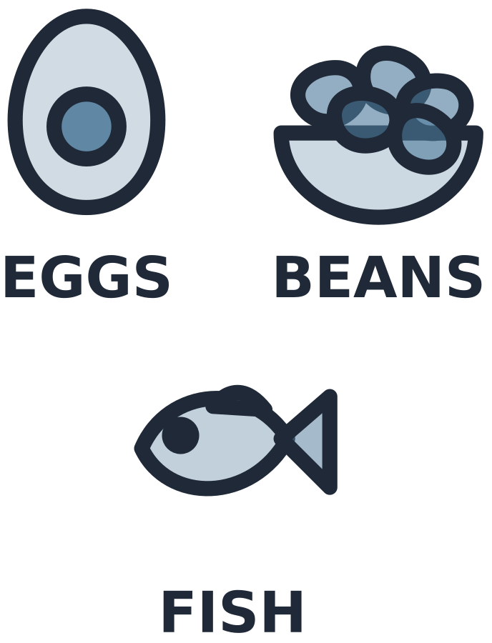
MADE BY MATT / BASE SCIENCE
Five broad food groups
TWO LARGE GROUPS
OTHER GROUPS
Fruit and vegetables
Starchy carbohydrate foods
Protein-source foods
Dairy and alternatives
Oils and spreads
SCIENCE · BASE
04
Notes:
I Do 1 — 5 minutes within the source's 40-minute lesson.
Name full protein group orally: beans, pulses, fish, eggs, meat and other protein. These are broad balanced plate groups; fats/sugars is not substituted as a fifth group. Oils/spreads form a small group in the guide. No exact area proportions or personal portion targets inferred from this text model.

Slide 5

MADE BY MATT / BASE SCIENCE
Place one food, explain its group
Pasta belongs with starchy carbohydrate foods, such as bread, rice and potatoes.
The group is about the food’s broad place in this model.
SCIENCE · BASE
05
Notes:
I Do 1b — 4 minutes within the source's 40-minute lesson.
Model evidence rather than preference. Potato is classed with starchy foods in balanced plate grouping, although botanically a plant food. A mixed dish may contain several groups; not every food has one exclusive nutrient role.

Slide 6
MADE BY MATT / BASE SCIENCE
Where do these four cards go?
Rice and bread
Carrot and apple
Choose the broad group for each pair.
SCIENCE · BASE
06
Notes:
We Do 1 — first sort — 3 minutes within the source's 40-minute lesson.
Collect choices before explanation. Rice/bread = starchy foods. Carrot/apple = fruit and vegetables. Pupil may point to the groups; colour is supplementary, words stay visible.

Slide 7

MADE BY MATT / BASE SCIENCE
Now place the other four cards
Chicken and beans
Milk and fortified soya alternative
Name the group; then check the labels.
SCIENCE · BASE
07
Notes:
We Do 1 — second sort — 3 minutes within the source's 40-minute lesson.
Chicken/beans = broad protein group. Milk/fortified soya alternative = dairy and alternatives. “Alternative” does not mean identical nutrient profile; chosen example is fortified soya. Check package evidence in real life, but use only paper cards here.

Slide 8
MADE BY MATT / BASE SCIENCE
What does balance mean?
THE MODEL HELPS SHOW
IT DOES NOT REQUIRE
A range across the groups.
Variety within the groups.
Patterns over a day or week.
Every meal to copy a diagram.
Exact portions from these cards.
Judging anyone’s real food.
SCIENCE · BASE
08
Notes:
We Do 1b — 4 minutes within the source's 40-minute lesson.
Ask which two groups are the largest in the balanced plate model: fruit/vegetables and starchy foods. State oils/spreads is small. The eight source cards omit an oil example; this is a limitation of a simplified activity, not a ban. Teacher may name olive oil as a reference example without requiring extra food.

Slide 9

MADE BY MATT / BASE SCIENCE
Explain it without a vague label
A balanced pattern includes a range of food groups over a day or week.
One plate of cards cannot show all a person’s food needs.
SCIENCE · BASE
09
Notes:
I Do 2 — 4 minutes within the source's 40-minute lesson.
The word healthy alone is not the scientific explanation. Model a specific explanation with variety, groups and time. Avoid “bad food”, banned food, weight or calorie discussion. Teacher follow individual support plan outside this lesson.

Slide 10
MADE BY MATT / BASE SCIENCE
Which claims need improving?
READ THE CLAIM
TEST IT WITH THE MODEL
Some from the different groups.
Only one group is needed.
Sometimes foods are banned.
What can a range provide?
Does a single group show variety?
Does the guide ban foods?
SCIENCE · BASE
10
Notes:
We Do 2 — sort — 5 minutes within the source's 40-minute lesson.
First claim fits broad concept; only one group is insufficient to represent balance; banned claim false. Foods high in fat/salt/sugar can be included less often/in smaller amounts in official general guide, but no individual targets or moral labels. Source false claim “chips are a bad food” is challenged rather than endorsed.

Slide 11
MADE BY MATT / BASE SCIENCE
Swap within a group and save
Swap rice for bread.
Swap chicken for beans.
Explain why the broad group still fits.
Save the labelled cards for this lesson.
SCIENCE · BASE
11
Notes:
We Do 2 — check and save — 5 minutes within the source's 40-minute lesson.
Five minutes completes source ten-minute stage. Swaps preserve broad group, not exact nutrient equivalence or portion. Each learner can point, sign or direct. A mixed-food example can be unpacked if offered; no personal eating disclosures.

