Slide 1

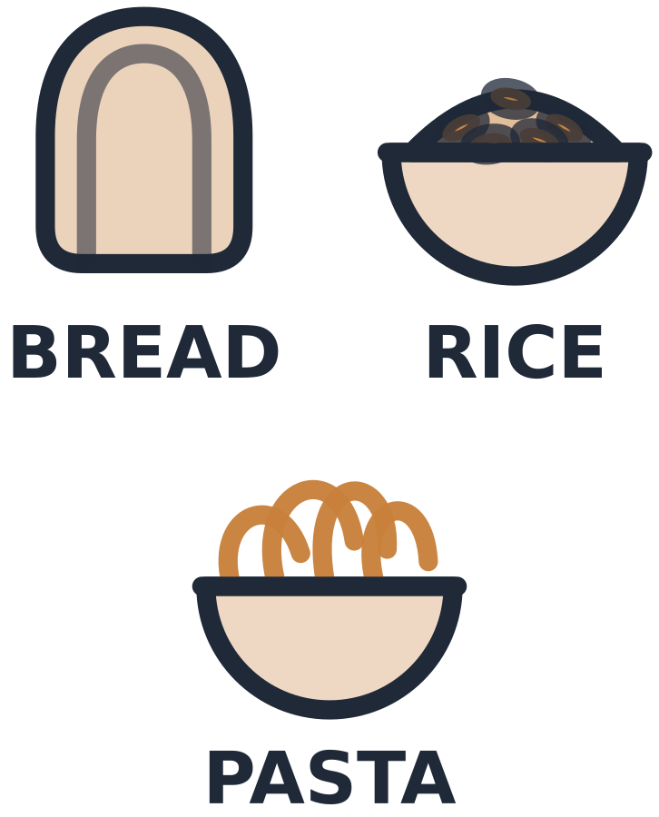
MADE BY MATT / BASE SCIENCE
Compare and revise model plates
A different food can fit the same group.
I can justify a swap and explain the model’s limits.
SCIENCE · BASE
01
Notes:
Workshop reference — 0 minutes within the source's 40-minute lesson.
Reference screen only; start the 32-minute workshop immediately. No additional starter or lesson time.

Slide 2
MADE BY MATT / BASE SCIENCE
Return to your labelled groups
Find this lesson’s group labels and cards.
Name or point to the five broad groups.
Choose: move, draw, label or direct.
SCIENCE · BASE
02
Notes:
Independent Work — retrieve — 4 minutes within the source's 40-minute lesson.
Four-minute source preparation. Use eight reference food cards and five broad group labels. Oils/spreads group remains in the reference although the eight-card set has no oil card. This is a simplified model, not actual meals.

Slide 3
MADE BY MATT / BASE SCIENCE
Case A: group the four foods
Rice
Chicken
Carrot
Milk
SCIENCE · BASE
03
Notes:
Independent Work — investigate — 5 minutes within the source's 40-minute lesson.
First five minutes of 20-minute investigation. Read case A as fictional food cards. Expected groups: starchy, protein, fruit/vegetables, dairy/alternatives. Ask pupil to place labels. Do not claim a complete balanced real meal from these four cards or infer portions.

Slide 4
MADE BY MATT / BASE SCIENCE
Case B: different cards
Bread
Beans
Apple
Fortified soya alternative
SCIENCE · BASE
04
Notes:
Independent Work — investigate — 5 minutes within the source's 40-minute lesson.
Next five minutes. Same broad group pattern as case A using different foods. Fortified soya is a labelled example, not every plant drink automatically nutritionally equivalent. Keep examples fictional and neutral.

Slide 5
MADE BY MATT / BASE SCIENCE
Compare the two models
WHAT CHANGED?
WHAT IS ALIKE?
Rice → bread
Chicken → beans
Carrot → apple
Milk → fortified soya
The specific foods differ.
Broad groups are similar.
Both models remain limited.
SCIENCE · BASE
05
Notes:
Independent Work — investigate — 5 minutes within the source's 40-minute lesson.
Next five minutes. These arrows indicate a card swap, not food-chain energy arrows. Adult can read full fortified-soya-alternative label. Same group pattern does not mean matching nutrients/portions. Ask learners to explain one correspondence.

Slide 6

MADE BY MATT / BASE SCIENCE
Make a protein-source swap
Start with the chicken card in case A.
Use beans to make a meat-free model.
Name the broad group that stays the same.
Could lentils be another option?
SCIENCE · BASE
06
Notes:
Independent Work — investigate — 5 minutes within the source's 40-minute lesson.
Final five minutes of source 20-minute phase. Beans/lentils are protein-source examples. Lentils can be written as an additional answer; main eight-card set stays intact. Multiple alternatives allowed; no personal belief/diet justification required.

Slide 7
MADE BY MATT / BASE SCIENCE
Pause and check what is missing
Check the five-group reference.
Does either model show every group?
Could a food appear at another time?
SCIENCE · BASE
07
Notes:
Independent Work — check — 2 minutes within the source's 40-minute lesson.
Two-minute source check. Eight-card examples omit oils/spreads. A simplified single model does not show the full day/week or all requirements. Do not mark pupil as unhealthy because a paper model is incomplete.

Slide 8
MADE BY MATT / BASE SCIENCE
Revise, explain and keep evidence
Keep your first and revised models together.
Give a reason for one swap.
Name one thing the model cannot tell us.
Save the record and put cards away.
SCIENCE · BASE
08
Notes:
Independent Work — improve — 6 minutes within the source's 40-minute lesson.
Final six-minute phase includes tidy. Explanation: beans replace chicken within broad protein group; whole diets and exact amounts not established. Pupil can point to matching group or dictate a reason. No real food, photos or public sharing needed.

Slide 9
MADE BY MATT / BASE SCIENCE
Your voice can change the lesson
What helped you join in?
What could make the next activity easier?
Point, sign, speak, write or pass privately.
Adult: agree one change and explain any limit.
SCIENCE · BASE
09
Notes:
Feedback Loop — 4 minutes within the source's 40-minute lesson.
Four minutes within the source lesson. Receive an actual observation or access request; do not force a peer audience. Name what can change now, make the change where possible and check whether it helped. The adult receives and names back the science shown as well as access feedback.

Slide 10
MADE BY MATT / BASE SCIENCE
What stays the same after a swap?
Supported: name a food in the protein group.
Independent: explain the chicken-to-beans swap.
Aspire: why can’t one plate show all needs?
SCIENCE · BASE
10
Notes:
Exit Ticket — 4 minutes within the source's 40-minute lesson.
Teacher answers only: chicken/beans/lentils/fish/eggs etc in protein group; swap preserves broad group but not exact nutrient equivalence; personal needs, full day/week intake and portions lie outside this simple model. Adult receives actual reasoning and chooses next step.

