Slide 1
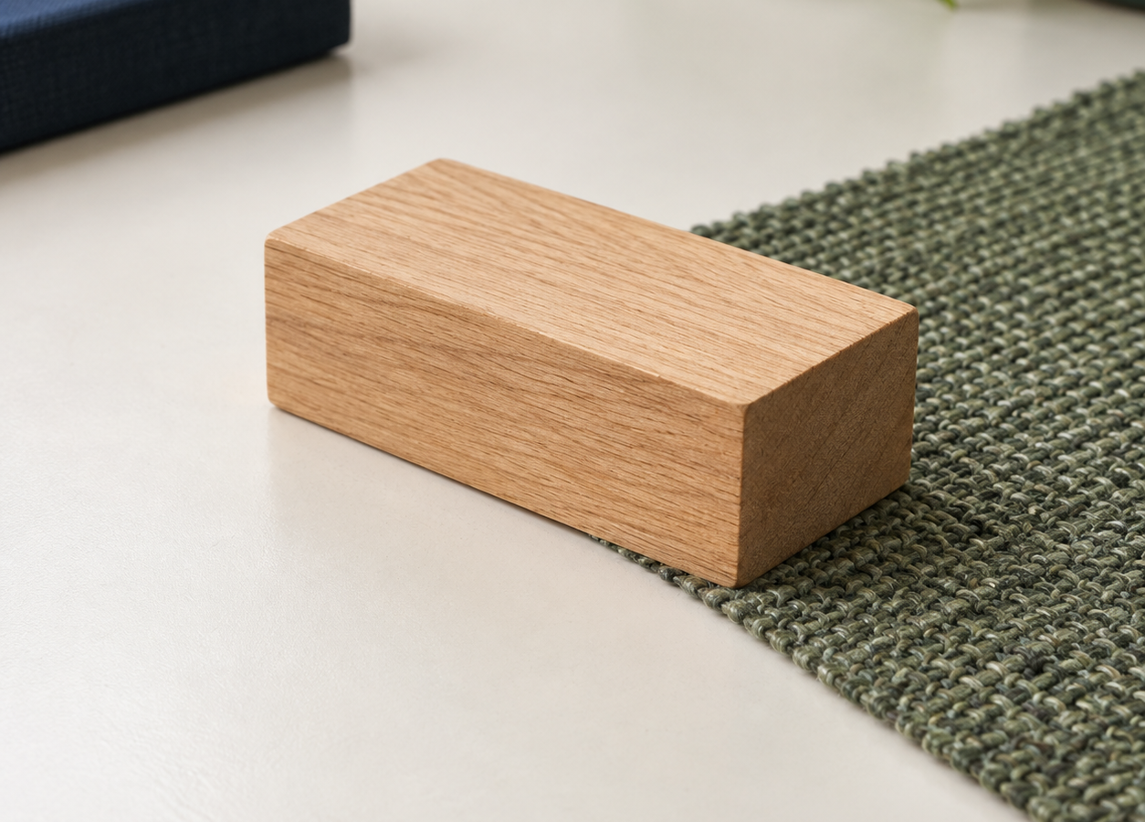
MADE BY MATT / TRACK SCIENCE
Friction: test the surfaces
One block. Three surfaces. Evidence.
Use repeated results to explain what happened in this setup.
SCIENCE · TRACK
01
Notes:
Independent Work — workshop reference — 0 minutes within the source's 40-minute lesson.
Reference screen only: no extra starter time. Lesson B begins with the source’s 32-minute Independent Work workshop. Retain the Lesson A prediction; use slide 2 immediately. Lesson B stays 32 + 4 + 4 minutes: workshop, Review the evidence, Exit Ticket.

Slide 2
MADE BY MATT / TRACK SCIENCE
Return to your prediction
01
Find your Lesson A prediction. Do not erase it.
02
Which surface do you think will stop the block sooner?
03
Choose a role: tester, observer, director or recorder.
SCIENCE · TRACK
02
Notes:
Independent Work — retrieve and prepare — 2 minutes within the source's 40-minute lesson.
First half of source four-minute preparation phase. Supported: point or direct an adult; standard: explain prediction; stretch: name a control or an uncertainty. Prediction can be wrong and still useful. Agree clear start/stop signals and sensory adjustments.

Slide 3
MADE BY MATT / TRACK SCIENCE
Set up a safe comparison
01
Adult checks the low ramp and padded stop.
02
Use the same block, release mark and ramp height.
03
Keep each surface level and the ramp join fixed.
04
Hands clear. Release gently; never add a push.
SCIENCE · TRACK
03
Notes:
Independent Work — retrieve and prepare — 2 minutes within the source's 40-minute lesson.
Completes source four-minute preparation. Equipment: adult-secured low ramp, one small sliding block, three level surface samples, ruler/tape, tray or padded stop. No oil, loose powders or pupils sliding on floors. Adult-operated apparatus or no-equipment data route are available.

Slide 4
MADE BY MATT / TRACK SCIENCE
Where will you measure from?
stopped block
Measure from the same ramp-foot zero to the same front edge of the stopped block.
fixed zero
same front edge each time
Record centimetres: cm.
SCIENCE · TRACK
04
Notes:
Independent Work — test and record — 2 minutes within the source's 40-minute lesson.
First two minutes of the source 20-minute test phase. Diagram is a measurement schematic, not measured data: arrow starts under fixed zero and ends under front/right edge of stopped block. Choose the front edge and use it every time. Check ruler zero rather than its physical end. Do not label a block that never reaches the run-out as a made-up distance: write 'did not slide' and describe what happened.

Slide 5
MADE BY MATT / TRACK SCIENCE
Surface 1: release, record, repeat
01
Name the surface in your results table.
02
Release from the mark without a push.
03
Measure the stopping distance in cm.
04
Reset everything and run Trial 2.
05
Keep both results, even if they differ.
SCIENCE · TRACK
05
Notes:
Independent Work — test and record — 6 minutes within the source's 40-minute lesson.
Six minutes within source 20-minute test phase. Adult/director checks start and zero. Record surface, Trial 1/cm, Trial 2/cm and what stayed the same. Supported pupils can point, dictate or enter selected values. If using source model data, identify card 42 and 44 cm as invented teaching data, not observed results.

Slide 6
MADE BY MATT / TRACK SCIENCE
Surface 2: change only the sample
01
Replace the level surface sample.
02
Keep the block, ramp, release and join the same.
03
Measure Trial 1 and Trial 2 from the same zero.
04
Write a note if the method changed.
SCIENCE · TRACK
06
Notes:
Independent Work — test and record — 6 minutes within the source's 40-minute lesson.
Next six minutes of the source 20-minute test. Check that sample thickness has not changed the ramp join; adult adjusts safely before release. Do not restart the test with a different block. For no-equipment route, source model fabric values are 25 and 27 cm, clearly labelled invented.

Slide 7
MADE BY MATT / TRACK SCIENCE
Surface 3: finish the comparison
01
Check the controls before the first release.
02
Record two trials if time and access allow.
03
Which results are close? Which need checking?
04
Record unfinished trials honestly.
SCIENCE · TRACK
07
Notes:
Independent Work — test and record — 6 minutes within the source's 40-minute lesson.
Final six minutes of source 20-minute test. No rush to operate unsafe kit. Adult-recorded data are acceptable but identify who operated and who interpreted. No-equipment model rubber-mat values: 15 and 18 cm. Their difference alone does not prove an error. Do not invent the second run if it was not performed.

Slide 8
MADE BY MATT / TRACK SCIENCE
No equipment? Use model data
INVENTED TEACHING DATA
DISCUSS THE EVIDENCE
Card: 42 cm, 44 cm
Fabric: 25 cm, 27 cm
Rubber mat: 15 cm, 18 cm
Which stopped the block sooner?
What had to stay the same?
What can these values not prove?
SCIENCE · TRACK
08
Notes:
Independent Work — alternative reference — 0 minutes within the source's 40-minute lesson.
Alternative reference within the same test time; not an additional activity. Exact model data provided in current source. Model answer: rubber mat has the shortest distances in both trials, supporting greater resistance to sliding in this stated setup if the controls were kept. Cannot claim a pupil experiment occurred or that rubber always has the greatest friction. For real experiments, keep actual results even if unlike these values.

Slide 9
MADE BY MATT / TRACK SCIENCE
Pause and check the method
01
Pause the equipment and compare your repeats.
02
Check one control: release, slope or measuring zero.
03
Mark an uncertain run. Keep the original value.
SCIENCE · TRACK
09
Notes:
Independent Work — evidence check — 2 minutes within the source's 40-minute lesson.
Source's planned two-minute check. Pens down if writing, but speech/signing allowed. A changed push, slope or zero weakens the comparison. Variation need not mean a mistake. Ask 'What did we notice about the method?' before proposing a repeat. No photography or public sharing required.

Slide 10
MADE BY MATT / TRACK SCIENCE
Repeat one doubtful run
01
Choose one specific method concern.
02
Correct that concern with the adult.
03
If time allows, repeat and label the new result.
04
Keep the first result and the reason for retrying.
SCIENCE · TRACK
10
Notes:
Independent Work — improve and conclude — 2 minutes within the source's 40-minute lesson.
First two minutes of source final six-minute phase. A valid reason is 'the block was pushed' or 'the sample moved'; not 'I wanted the result to match'. If no concern or safe time remains, compare controls and evidence instead. Do not erase or selectively keep data.

Slide 11
MADE BY MATT / TRACK SCIENCE
Use numbers in your conclusion
In our setup, ___ stopped the block
over a shorter distance: ___ cm and ___ cm.
This supports ___ because ___. A control or uncertainty to check is ___.
SCIENCE · TRACK
11
Notes:
Independent Work — improve and conclude — 3 minutes within the source's 40-minute lesson.
Three minutes within final six-minute phase. Accept pointing to the relevant pair and dictating conclusion. Model-data answer: rubber mat 15/18 cm shorter than card 42/44 cm and fabric 25/27 cm; evidence supports more resistance to sliding for this block and setup. Do not force real results into that order. Aspire: qualify conclusion and explain one measurement/control improvement.

Slide 12
MADE BY MATT / TRACK SCIENCE
Leave a clear record
01
Name and date your record; keep the prediction.
02
Label any model data or unfinished trials.
03
Return samples, block and measuring tools safely.
SCIENCE · TRACK
12
Notes:
Independent Work — improve and conclude — 1 minutes within the source's 40-minute lesson.
Final minute of source six-minute improvement/conclusion/tidy phase. Keep prediction, results, conclusion and control check together. Distinguish participation, observation and independent interpretation in teacher record. No photo/export requirement.

Slide 13
MADE BY MATT / TRACK SCIENCE
Review the evidence
Use your existing results or the clearly labelled model data. Point, speak, sign, draw or use your current work; no extra feedback form is needed.
Choose one conclusion. Show the adult which results support it. Name the surfaces and whether the evidence is measured or model data.
01
Consider the feedback. Does the conclusion fit both trials? Check one control or uncertainty; a surprising result is not automatically wrong.
02
Keep or improve your explanation and show why. The adult responds to your idea or question. Keep the original results; label any later retry separately.
03
You may ask for more thinking time, use a trusted adult or pass. Finish with the existing exit question; this review stays within its four minutes.
Need a different way to take part? (optional) While reviewing your evidence, point, say, sign or show the adult an idea, question or change that would help. You may pass or speak privately. The adult listens, explains what can change and checks whether it helped.
SCIENCE · TRACK
13
Notes:
Review the evidence — 4 minutes within the source’s 40-minute lesson. Exact four-minute stage between the 32-minute workshop and the 4-minute exit; no separate feedback form or standalone participation stage.
Revisit one conclusion against the existing results or clearly labelled model data. Hear, read or watch the pupil response; adapt the explanation or scaffold and explain any limit. Preserve original values and label retries. Passing is allowed. No automatic R.
Lesson B: review the evidence — After the 32-minute workshop, use four minutes to revisit one conclusion and its supporting results with the adult, then four minutes for the exit. Use the existing record or an equivalent response; do not require a separate loop sheet. Explain any limit on a requested change and check whether the response helped.
Listen and act — Space makes participation possible; Voice is the pupil's response in their own modality; Audience requires the adult to engage with it; Influence is the resulting adjustment to explanation, task, scaffold or subsequent teaching. One optional displayed prompt does not limit genuine feedback exchanges.
Use marking codes honestly — Use R only after a pupil response and genuine adult engagement. A click, download, opened explanation or completed exit does not automatically establish Audience, Influence, R or an assessment outcome. Record only the evidence and help actually provided; do not require a duplicate written record for every task. Use agreed policy codes appropriately. Extended writing or assessment may need one or two precise next steps and response time.
Policy and timing — Feedback & Marking Policy 2025/2026 (Pilot), Issue 1, May 2026; master order §25.3. Lesson A remains 40 minutes. Lesson B remains 32 + 4 + 4 minutes. No extra pupil form, signature, standalone participation stage or progression gate is required.

Slide 14
MADE BY MATT / TRACK SCIENCE
Explain one use of friction
01
Supported: name one place friction helps.
02
Independent: explain how a car’s brakes help it stop.
03
Aspire: explain a helpful and a harmful effect.
SCIENCE · TRACK
14
Notes:
Exit Ticket — 3 minutes within the source's 40-minute lesson.
First three minutes of four-minute source exit. Choose a response route appropriate to the learner; not three compulsory questions. Supported: brakes, shoes, tyres or handles. Independent: brake pads rub a disc/wheel; energy transfers to heat and wheel slows, with tyre-road grip also needed. Aspire: contrast intended functions, not a claim that friction always acts opposite overall movement.

Slide 15
MADE BY MATT / TRACK SCIENCE
Check and improve one detail
Brake friction transfers movement energy to heat.
It helps slow the wheel.
Rubbing in moving engine parts can cause unwanted heating and wear.
SCIENCE · TRACK
15
Notes:
Exit Ticket — 1 minutes within the source's 40-minute lesson.
Reveal after response, final exit minute. Accept equivalent scientifically sound answers. Record whether pupil named a surface pair, helpful/unhelpful effect and evidence from the comparison. Clarify that friction opposes relative sliding or attempted sliding at a contact; static grip can help a person walk forwards. Next lesson: Levers, pulleys and gears.

