Slide 1
GROW · HUMANITIES · Sum1·W1 · 0 MIN
My place, the UK and the wider world
Locate my place the UK and the wider world on maps.
• Locate Middlesbrough in north-east England.
• Locate the UK in Europe on a world map.
• Explain what changes when a map shows a wider area.
World of work
A town planner uses maps at different scales to connect a local site with a region. Choose the map view that would help plan a local visit.
Map: Natural Earth public-domain land. Simplified equirectangular view; country boundaries omitted.
1 / 9
Notes:
Locate one place you already know on a map.
Timing 0 minutes; one 40-minute session. Independent starts after 26 minutes.
Locate the school’s own locality with the group before the independent task. Middlesbrough is the worked Teesside example, not an assertion that every pupil lives there. Use the map marker, key and compass together. No home address is requested.
Europe is not the EU, and the UK is not a continent. This lesson locates geographical places; membership of a political organisation is a different question.
Space: allow time and a trusted adult. Voice: receive the stage-specific response in the pupil’s chosen mode. Audience: read it back exactly. Influence: Arrival: check the meanings of country and continent.
Natural Earth, 1:110m land
https://www.naturalearthdata.com/about/terms-of-use/
Public-domain coastline data; simplified equirectangular teaching maps generated from the supplied land geometry.
Ordnance Survey, Mapzone
https://www.ordnancesurvey.co.uk/mapzone/map-skills
Map-skills context; labels, prompts and worked examples authored for this lesson.

Slide 2
GROW · HUMANITIES · Sum1·W1 · 4 MIN
Arrival
Choose one route and answer four retrieval questions.
SUPPORTED
STANDARD
STRETCH
1. Does a map help show places or tell the time?
1. What does locate mean when reading a map?
1. Why could two maps of the same place look different?
2. Choose a country: England or Europe.
2. Is the UK a country or a continent?
2. Name the four countries of the UK.
3. Choose a continent: Europe or Middlesbrough.
3. What does north-east combine?
3. Correct: “Europe is another name for the UK.”
4. Which view could show a school gate: a local plan or a world map?
4. Why might a world map be unhelpful for finding a school entrance?
4. What happens to local detail when a larger area fits on the same page?
Choose one route. Point, speak, sign, draw, write or direct an adult.
Map: Natural Earth public-domain land. Simplified equirectangular view; country boundaries omitted.
2 / 9
Notes:
Choose one route and answer four retrieval questions.
Timing 4 minutes; one 40-minute session. Independent starts after 26 minutes.
Locate the school’s own locality with the group before the independent task. Middlesbrough is the worked Teesside example, not an assertion that every pupil lives there. Use the map marker, key and compass together. No home address is requested.
Europe is not the EU, and the UK is not a continent. This lesson locates geographical places; membership of a political organisation is a different question.
SUPPORTED
Does a map help show places or tell the time? Help: Think about finding a place. Answer: It helps show places.
Choose a country: England or Europe. Help: Europe is a continent. Answer: England.
Choose a continent: Europe or Middlesbrough. Help: Middlesbrough is a town. Answer: Europe.
Which view could show a school gate: a local plan or a world map? Help: Look for the view of a smaller area. Answer: A local plan.
STANDARD
What does locate mean when reading a map? Help: Think find and show. Answer: Find and show where a place is.
Is the UK a country or a continent? Help: Europe is the continent containing the UK. Answer: A country made up of England, Scotland, Wales and Northern Ireland.
What does north-east combine? Help: Use the two words in the direction. Answer: North and east.
Why might a world map be unhelpful for finding a school entrance? Help: Think about how much local detail fits. Answer: It covers a very large area so that local detail is too small.
STRETCH
Why could two maps of the same place look different? Help: Consider area shown, purpose and detail. Answer: Different scales, purposes or selected features.
Name the four countries of the UK. Help: England is one; Northern Ireland is another. Answer: England, Scotland, Wales and Northern Ireland.
Correct: “Europe is another name for the UK.” Help: Use country and continent. Answer: The UK is a country in Europe; Europe includes many countries.
What happens to local detail when a larger area fits on the same page? Help: Think of zooming out. Answer: Local detail becomes smaller and some is omitted.
Space: allow time and a trusted adult. Voice: receive the stage-specific response in the pupil’s chosen mode. Audience: read it back exactly. Influence: Starter: choose a map for a school entrance.
Natural Earth, 1:110m land
https://www.naturalearthdata.com/about/terms-of-use/
Public-domain coastline data; simplified equirectangular teaching maps generated from the supplied land geometry.
Ordnance Survey, Mapzone
https://www.ordnancesurvey.co.uk/mapzone/map-skills
Map-skills context; labels, prompts and worked examples authored for this lesson.

Slide 3
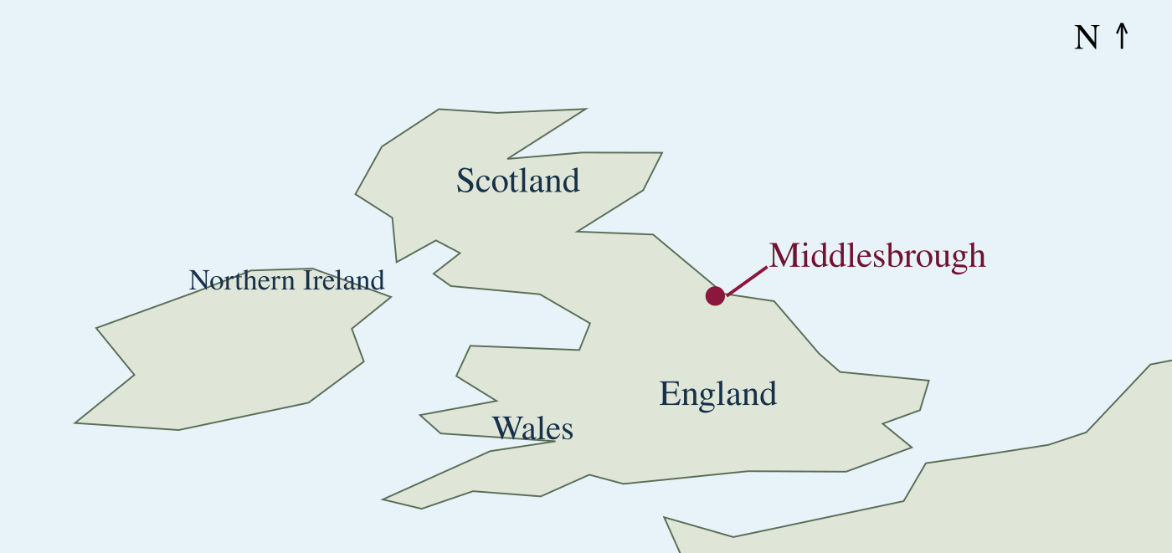
GROW · HUMANITIES · Sum1·W1 · 4 MIN
Starter
Choose the view that could show a school entrance.
Words before work
locate — find and show a place
scale — the relationship between map distance and real distance
locality — the area around a place
country — an area with its own government; the UK is a country made up of four countries
Map: Natural Earth public-domain land. Simplified equirectangular view; country boundaries omitted.
3 / 9
Notes:
Choose the view that could show a school entrance.
Timing 4 minutes; one 40-minute session. Independent starts after 26 minutes.
Locate the school’s own locality with the group before the independent task. Middlesbrough is the worked Teesside example, not an assertion that every pupil lives there. Use the map marker, key and compass together. No home address is requested.
Europe is not the EU, and the UK is not a continent. This lesson locates geographical places; membership of a political organisation is a different question.
Space: allow time and a trusted adult. Voice: receive the stage-specific response in the pupil’s chosen mode. Audience: read it back exactly. Influence: I Do: locate Middlesbrough, the UK and Europe.
Natural Earth, 1:110m land
https://www.naturalearthdata.com/about/terms-of-use/
Public-domain coastline data; simplified equirectangular teaching maps generated from the supplied land geometry.
Ordnance Survey, Mapzone
https://www.ordnancesurvey.co.uk/mapzone/map-skills
Map-skills context; labels, prompts and worked examples authored for this lesson.

Slide 4
GROW · HUMANITIES · Sum1·W1 · 5 MIN
I Do
Watch how I move from Middlesbrough to the UK and Europe.
I start with the local label: Middlesbrough. On the UK view its marker is in north-east England. I zoom out: the UK lies off the north-west coast of mainland Europe. Europe is a continent. England is one of the four countries of the UK; the UK is not a continent.
Map: Natural Earth public-domain land. Simplified equirectangular view; country boundaries omitted.
4 / 9
Notes:
Watch how I move from Middlesbrough to the UK and Europe.
Timing 5 minutes; one 40-minute session. Independent starts after 26 minutes.
Locate the school’s own locality with the group before the independent task. Middlesbrough is the worked Teesside example, not an assertion that every pupil lives there. Use the map marker, key and compass together. No home address is requested.
Europe is not the EU, and the UK is not a continent. This lesson locates geographical places; membership of a political organisation is a different question.
Natural Earth, 1:110m land
https://www.naturalearthdata.com/about/terms-of-use/
Public-domain coastline data; simplified equirectangular teaching maps generated from the supplied land geometry.
Ordnance Survey, Mapzone
https://www.ordnancesurvey.co.uk/mapzone/map-skills
Map-skills context; labels, prompts and worked examples authored for this lesson.

Slide 5
GROW · HUMANITIES · Sum1·W1 · 5 MIN
We Do
Locate Middlesbrough and the UK using the map views.
Where is Middlesbrough within England?
A. North-east
B. South-west
C. Outside England
Map: Natural Earth public-domain land. Simplified equirectangular view; country boundaries omitted.
5 / 9
Notes:
Locate Middlesbrough and the UK using the map views.
Timing 5 minutes; one 40-minute session. Independent starts after 26 minutes.
Locate the school’s own locality with the group before the independent task. Middlesbrough is the worked Teesside example, not an assertion that every pupil lives there. Use the map marker, key and compass together. No home address is requested.
Europe is not the EU, and the UK is not a continent. This lesson locates geographical places; membership of a political organisation is a different question.
Expected answer: The marker places Middlesbrough in north-east England.
Space: allow time and a trusted adult. Voice: receive the stage-specific response in the pupil’s chosen mode. Audience: read it back exactly. Influence: I Do 2: compare detail in two map views.
Natural Earth, 1:110m land
https://www.naturalearthdata.com/about/terms-of-use/
Public-domain coastline data; simplified equirectangular teaching maps generated from the supplied land geometry.
Ordnance Survey, Mapzone
https://www.ordnancesurvey.co.uk/mapzone/map-skills
Map-skills context; labels, prompts and worked examples authored for this lesson.

Slide 6
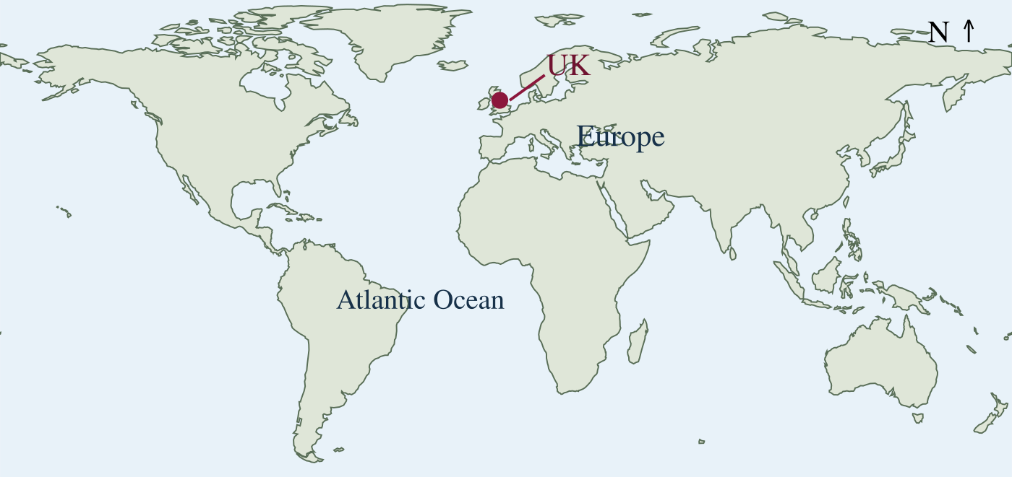
GROW · HUMANITIES · Sum1·W1 · 4 MIN
I Do 2
Watch how I explain the change from a local view to a world view.
A local plan can show school entrances and nearby streets. A world map shows countries, continents and oceans but cannot show our school entrance at this size. When I show a wider area on the same size page, local detail becomes smaller. I choose the view to suit the question.
Map: Natural Earth public-domain land. Simplified equirectangular view; country boundaries omitted.
6 / 9
Notes:
Watch how I explain the change from a local view to a world view.
Timing 4 minutes; one 40-minute session. Independent starts after 26 minutes.
Locate the school’s own locality with the group before the independent task. Middlesbrough is the worked Teesside example, not an assertion that every pupil lives there. Use the map marker, key and compass together. No home address is requested.
Europe is not the EU, and the UK is not a continent. This lesson locates geographical places; membership of a political organisation is a different question.
Natural Earth, 1:110m land
https://www.naturalearthdata.com/about/terms-of-use/
Public-domain coastline data; simplified equirectangular teaching maps generated from the supplied land geometry.
Ordnance Survey, Mapzone
https://www.ordnancesurvey.co.uk/mapzone/map-skills
Map-skills context; labels, prompts and worked examples authored for this lesson.

Slide 7
GROW · HUMANITIES · Sum1·W1 · 4 MIN
We Do 2
Repair the statement about a country and a continent.
Which correction is accurate?
A. The UK is a continent in Europe.
B. The UK is a country in the continent of Europe.
C. Europe is a town in England.
Map: Natural Earth public-domain land. Simplified equirectangular view; country boundaries omitted.
7 / 9
Notes:
Repair the statement about a country and a continent.
Timing 4 minutes; one 40-minute session. Independent starts after 26 minutes.
Locate the school’s own locality with the group before the independent task. Middlesbrough is the worked Teesside example, not an assertion that every pupil lives there. Use the map marker, key and compass together. No home address is requested.
Europe is not the EU, and the UK is not a continent. This lesson locates geographical places; membership of a political organisation is a different question.
Expected answer: The UK is a country in Europe. Europe is the continent; Middlesbrough is a town in England.
Space: allow time and a trusted adult. Voice: receive the stage-specific response in the pupil’s chosen mode. Audience: read it back exactly. Influence: Independent: locate places with the map key.
Natural Earth, 1:110m land
https://www.naturalearthdata.com/about/terms-of-use/
Public-domain coastline data; simplified equirectangular teaching maps generated from the supplied land geometry.
Ordnance Survey, Mapzone
https://www.ordnancesurvey.co.uk/mapzone/map-skills
Map-skills context; labels, prompts and worked examples authored for this lesson.

Slide 8
GROW · HUMANITIES · Sum1·W1 · 10 MIN
Independent
Locate your place, the UK and Europe and describe one change of scale.
SUPPORTED
STANDARD
STRETCH
Point to Middlesbrough on the UK map and to the UK on the world map. Identify Europe. Complete aloud: “My place is in ___. The UK is in ___.” Use the labels or ask for an exact scribe.
Locate Middlesbrough, the UK and Europe on the supplied maps. Draw a small location chain. Write or say two sentences: where your place is and what changes when you zoom out.
Locate your place within England, the UK and Europe. Explain why a local plan is more useful than a world map for finding a school entrance. Identify one limitation of these simplified maps.
Use the map or source, rehearse your explanation, then record your own response.
Map: Natural Earth public-domain land. Simplified equirectangular view; country boundaries omitted.
8 / 9
Notes:
Locate your place, the UK and Europe and describe one change of scale.
Timing 10 minutes; one 40-minute session. Independent starts after 26 minutes.
Locate the school’s own locality with the group before the independent task. Middlesbrough is the worked Teesside example, not an assertion that every pupil lives there. Use the map marker, key and compass together. No home address is requested.
Europe is not the EU, and the UK is not a continent. This lesson locates geographical places; membership of a political organisation is a different question.
Space: allow time and a trusted adult. Voice: receive the stage-specific response in the pupil’s chosen mode. Audience: read it back exactly. Influence: Exit: justify a map view for a local visit.
Natural Earth, 1:110m land
https://www.naturalearthdata.com/about/terms-of-use/
Public-domain coastline data; simplified equirectangular teaching maps generated from the supplied land geometry.
Ordnance Survey, Mapzone
https://www.ordnancesurvey.co.uk/mapzone/map-skills
Map-skills context; labels, prompts and worked examples authored for this lesson.

Slide 9
GROW · HUMANITIES · Sum1·W1 · 4 MIN
Exit
Explain which map view you would use for a local visit.
SUPPORTED
STANDARD
STRETCH
Choose the view for a school entrance and name the continent containing the UK.
Explain why a local plan is useful for a school visit but a world map is useful for locating the UK.
Correct a country/continent confusion and explain one limitation of a simplified map.
Show your response to the adult. Agree one next step for the next lesson.
Map: Natural Earth public-domain land. Simplified equirectangular view; country boundaries omitted.
9 / 9
Notes:
Explain which map view you would use for a local visit.
Timing 4 minutes; one 40-minute session. Independent starts after 26 minutes.
Locate the school’s own locality with the group before the independent task. Middlesbrough is the worked Teesside example, not an assertion that every pupil lives there. Use the map marker, key and compass together. No home address is requested.
Europe is not the EU, and the UK is not a continent. This lesson locates geographical places; membership of a political organisation is a different question.
supported: A local plan; Europe.
standard: Each shows the area and level of detail suited to the purpose.
stretch: The UK is a country in Europe; simplified maps omit detail and are not navigation instructions.
EFL: 30-second clip, photo, or one-line context note. Central tags only. Listen / look before tagging (Audience).
Space: allow time and a trusted adult. Voice: receive the stage-specific response in the pupil’s chosen mode. Audience: read it back exactly. Influence: Next lesson: use atlases, grid references and digital maps.
Natural Earth, 1:110m land
https://www.naturalearthdata.com/about/terms-of-use/
Public-domain coastline data; simplified equirectangular teaching maps generated from the supplied land geometry.
Ordnance Survey, Mapzone
https://www.ordnancesurvey.co.uk/mapzone/map-skills
Map-skills context; labels, prompts and worked examples authored for this lesson.

