Slide 1

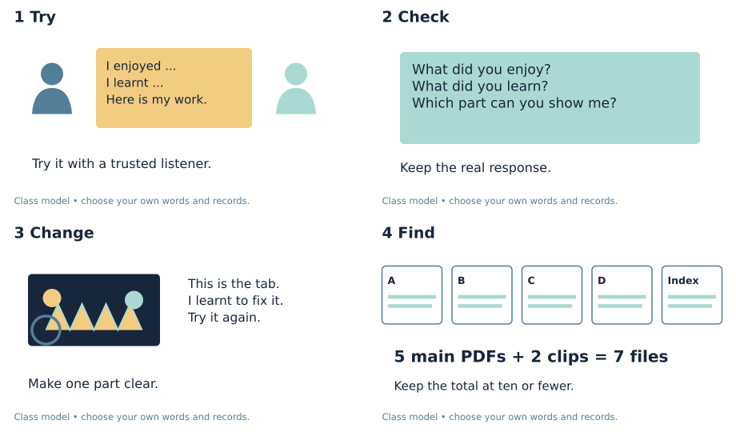
CREATIVE ARTS • BUILD / GROW • WEEK 7 LESSON 2
OPENING • PART D
Rehearse and check your portfolio
I can practise my share and check that my records can be found.
I can share what I enjoyed and learnt with a listener.
I can use a response to make my share clear.
I can find my work and check the file count.
Practise, use the response, then check the real records.
ART-BUILD-A2-W07-P2 • Public • 1/14
Original diagrams © Made by Matt 2026 • CC BY 4.0
Notes:
ART_BUILD_A2_W07_P2 • Public • Opening • 0 minutes (route detail slides use the same task time).
D page 2 records the actual rehearsal, listener response, pupil’s chosen adjustment or reasoned retained feature, and another try. Audit A–D separately against the existing requirements. Use Evidence_Index pages 1–2 for verified file/page locators, real time totals, file count and gaps. Count the index among the five core PDFs and all separate media within ten. The actual December event must later record enjoyment and achievement, date, audience and receipt at D page 3. Do not prefill a part outcome.
Use one route, with Independent as the GROW default. Offer Supported when useful and Aspire as optional stretch. All pupil text uses the BUILD band. The routes change support and depth, not the part requirements. For five learners, use a pair and a trio, with a separate piece and record for each learner. In the trio, rotate maker, observer and materials roles; every learner retains their own choices. Offer private responses, silent directing and a pause. Do not cold call or seek personal or family disclosure. Scribe exact words or confirmed choices, read them back and allow correction. Do not compose pupils’ plans or reviews. Mark I, S or C beside the task in staff records and note the actual prompt. Give one specific success and one useful next step. Use VF / WS / I / NS+ / // / ? / R / E as appropriate. Record R only after Voice, Audience, an NS+ prompt and the pupil’s response in their own colour; capture alone is not closure. Upload the selected individual evidence to the evidence app on the same day.
Evidence: D_Share.pdf • page 2; Evidence_Index.pdf • pages 1–2
Sources: CREATIVE_ARTS_A2_W06_BUNDLE.zip @ fd164cc6f64b784eb570bf3c0180aa6911ff7a0b10db87b03301f88201196f05; tools/artsaward/SPEC.json @ 72f1a9914f877b7aa14fd9ed91b6103799bf7b16; tools/artsaward/SLOTS.json @ 72f1a9914f877b7aa14fd9ed91b6103799bf7b16

Slide 2
CREATIVE ARTS • BUILD / GROW • WEEK 7 LESSON 2
ARRIVAL • PART D • 5 MIN
What we bring from last time
Find the choices you made for your share.
What did you enjoy, and why?
What did you learn or achieve?
What will you show to help your listener?
Practise, use the response, then check the real records.
In your book: Your own choices from last time.
ART-BUILD-A2-W07-P2 • Public • 2/14
Original diagrams © Made by Matt 2026 • CC BY 4.0
Notes:
ART_BUILD_A2_W07_P2 • Public • Arrival • 5 minutes (route detail slides use the same task time).
D page 1 or an actual learner-authored choice record.
Own enjoyment and reason. Read back any scribed words.
Own learnt skill or achievement, not a prescribed success statement.
A real piece, page, cue card or the pupil’s own recording. Do not require public performance.
D page 2 records the actual rehearsal, listener response, pupil’s chosen adjustment or reasoned retained feature, and another try. Audit A–D separately against the existing requirements. Use Evidence_Index pages 1–2 for verified file/page locators, real time totals, file count and gaps. Count the index among the five core PDFs and all separate media within ten. The actual December event must later record enjoyment and achievement, date, audience and receipt at D page 3. Do not prefill a part outcome.
Use one route, with Independent as the GROW default. Offer Supported when useful and Aspire as optional stretch. All pupil text uses the BUILD band. The routes change support and depth, not the part requirements. For five learners, use a pair and a trio, with a separate piece and record for each learner. In the trio, rotate maker, observer and materials roles; every learner retains their own choices. Offer private responses, silent directing and a pause. Do not cold call or seek personal or family disclosure. Scribe exact words or confirmed choices, read them back and allow correction. Do not compose pupils’ plans or reviews. Mark I, S or C beside the task in staff records and note the actual prompt. Give one specific success and one useful next step. Use VF / WS / I / NS+ / // / ? / R / E as appropriate. Record R only after Voice, Audience, an NS+ prompt and the pupil’s response in their own colour; capture alone is not closure. Upload the selected individual evidence to the evidence app on the same day.
Evidence: D_Share.pdf • page 2; Evidence_Index.pdf • pages 1–2
Sources: CREATIVE_ARTS_A2_W06_BUNDLE.zip @ fd164cc6f64b784eb570bf3c0180aa6911ff7a0b10db87b03301f88201196f05; tools/artsaward/SPEC.json @ 72f1a9914f877b7aa14fd9ed91b6103799bf7b16; tools/artsaward/SLOTS.json @ 72f1a9914f877b7aa14fd9ed91b6103799bf7b16

Slide 3
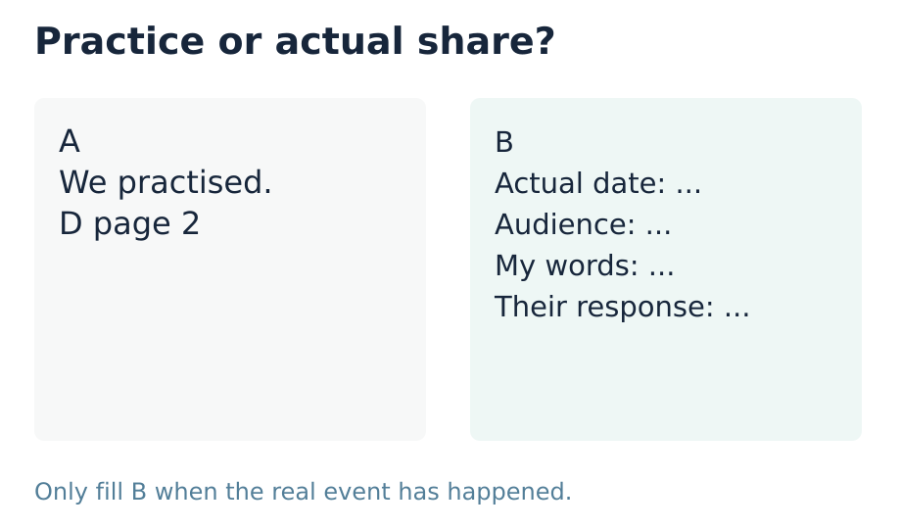
CREATIVE ARTS • BUILD / GROW • WEEK 7 LESSON 2
STARTER • PART D • 3 MIN
Look and choose
Which record shows a real share? A says “we practised”. B has a real date, audience and own words.
Practise, use the response, then check the real records.
In your book: A or B, with one reason.
ART-BUILD-A2-W07-P2 • Public • 3/14
Original diagrams © Made by Matt 2026 • CC BY 4.0
Notes:
ART_BUILD_A2_W07_P2 • Public • Starter • 3 minutes (route detail slides use the same task time).
B could support the actual share only if those details describe a real event. A is rehearsal. A label or tick alone is not evidence; check that enjoyment and achievement were actually communicated and received.
D page 2 records the actual rehearsal, listener response, pupil’s chosen adjustment or reasoned retained feature, and another try. Audit A–D separately against the existing requirements. Use Evidence_Index pages 1–2 for verified file/page locators, real time totals, file count and gaps. Count the index among the five core PDFs and all separate media within ten. The actual December event must later record enjoyment and achievement, date, audience and receipt at D page 3. Do not prefill a part outcome.
Use one route, with Independent as the GROW default. Offer Supported when useful and Aspire as optional stretch. All pupil text uses the BUILD band. The routes change support and depth, not the part requirements. For five learners, use a pair and a trio, with a separate piece and record for each learner. In the trio, rotate maker, observer and materials roles; every learner retains their own choices. Offer private responses, silent directing and a pause. Do not cold call or seek personal or family disclosure. Scribe exact words or confirmed choices, read them back and allow correction. Do not compose pupils’ plans or reviews. Mark I, S or C beside the task in staff records and note the actual prompt. Give one specific success and one useful next step. Use VF / WS / I / NS+ / // / ? / R / E as appropriate. Record R only after Voice, Audience, an NS+ prompt and the pupil’s response in their own colour; capture alone is not closure. Upload the selected individual evidence to the evidence app on the same day.
Evidence: D_Share.pdf • page 2; Evidence_Index.pdf • pages 1–2
Sources: CREATIVE_ARTS_A2_W06_BUNDLE.zip @ fd164cc6f64b784eb570bf3c0180aa6911ff7a0b10db87b03301f88201196f05; tools/artsaward/SPEC.json @ 72f1a9914f877b7aa14fd9ed91b6103799bf7b16; tools/artsaward/SLOTS.json @ 72f1a9914f877b7aa14fd9ed91b6103799bf7b16

Slide 4
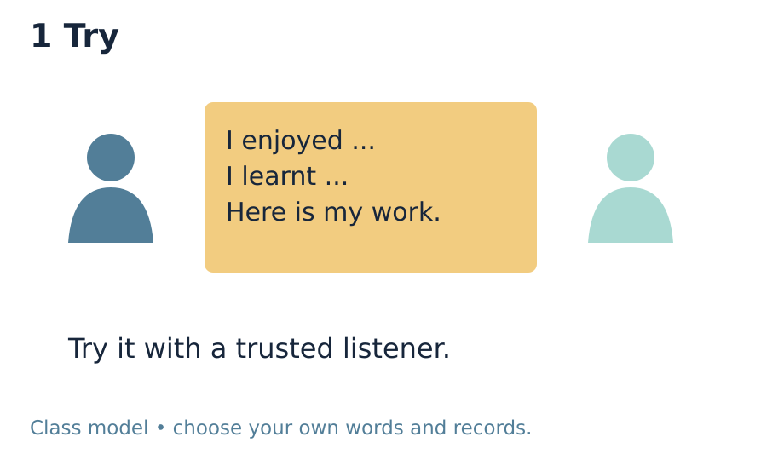
CREATIVE ARTS • BUILD / GROW • WEEK 7 LESSON 2
I DO • PART D • 2 MIN
Try and Check
Try your share with a listener you trust.
Ask what they learnt from your share.
Practise, use the response, then check the real records.
In your book: Your cue and your chosen listener.
ART-BUILD-A2-W07-P2 • Public • 4/14
Original diagrams © Made by Matt 2026 • CC BY 4.0
Notes:
ART_BUILD_A2_W07_P2 • Public • I do • 2 minutes (route detail slides use the same task time).
0–15 seconds Use the class cue card. Say: “I liked the new shades. I learnt to fix tabs.” Point to the matching work. Tell pupils this is a practice model. 15–30 seconds Ask the adult listener: “What did I enjoy and learn?” The listener says: “I heard the shades. Which bit is a tab?” This is a scripted model, not a pupil response. 30–45 seconds Point to the flat end of the strip. Say: “This is the tab I learnt to fix.” Try the short share again. Show how the audience response led to this change. 45–60 seconds Open a sample index and the named page. Count five main files plus two optional clips: seven. Say: “I check that the page and clip open. A missing record stays a gap.”
D page 2 records the actual rehearsal, listener response, pupil’s chosen adjustment or reasoned retained feature, and another try. Audit A–D separately against the existing requirements. Use Evidence_Index pages 1–2 for verified file/page locators, real time totals, file count and gaps. Count the index among the five core PDFs and all separate media within ten. The actual December event must later record enjoyment and achievement, date, audience and receipt at D page 3. Do not prefill a part outcome.
Use one route, with Independent as the GROW default. Offer Supported when useful and Aspire as optional stretch. All pupil text uses the BUILD band. The routes change support and depth, not the part requirements. For five learners, use a pair and a trio, with a separate piece and record for each learner. In the trio, rotate maker, observer and materials roles; every learner retains their own choices. Offer private responses, silent directing and a pause. Do not cold call or seek personal or family disclosure. Scribe exact words or confirmed choices, read them back and allow correction. Do not compose pupils’ plans or reviews. Mark I, S or C beside the task in staff records and note the actual prompt. Give one specific success and one useful next step. Use VF / WS / I / NS+ / // / ? / R / E as appropriate. Record R only after Voice, Audience, an NS+ prompt and the pupil’s response in their own colour; capture alone is not closure. Upload the selected individual evidence to the evidence app on the same day.
Evidence: D_Share.pdf • page 2; Evidence_Index.pdf • pages 1–2
Sources: CREATIVE_ARTS_A2_W06_BUNDLE.zip @ fd164cc6f64b784eb570bf3c0180aa6911ff7a0b10db87b03301f88201196f05; tools/artsaward/SPEC.json @ 72f1a9914f877b7aa14fd9ed91b6103799bf7b16; tools/artsaward/SLOTS.json @ 72f1a9914f877b7aa14fd9ed91b6103799bf7b16

Slide 5
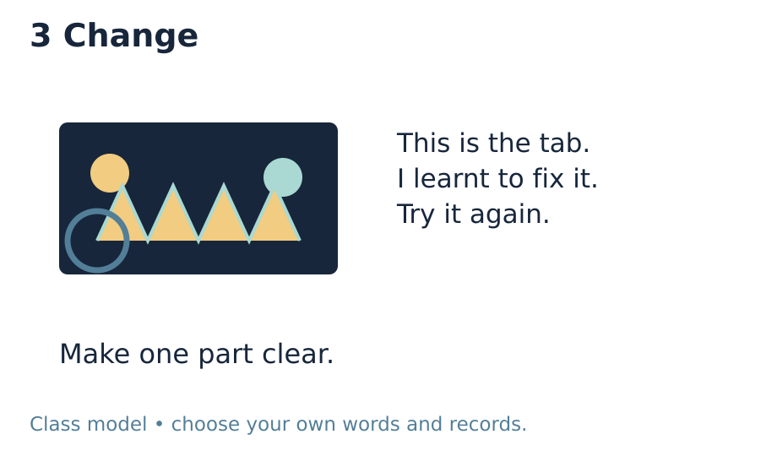
CREATIVE ARTS • BUILD / GROW • WEEK 7 LESSON 2
I DO • PART D • 2 MIN
Change and Find
Make one part clear. Try that part once more.
Check your files, pages and gaps with an adult.
Practise, use the response, then check the real records.
In your book: What the model listener asked.
ART-BUILD-A2-W07-P2 • Public • 5/14
Original diagrams © Made by Matt 2026 • CC BY 4.0
Notes:
ART_BUILD_A2_W07_P2 • Public • I do • 2 minutes (route detail slides use the same task time).
D page 2 records the actual rehearsal, listener response, pupil’s chosen adjustment or reasoned retained feature, and another try. Audit A–D separately against the existing requirements. Use Evidence_Index pages 1–2 for verified file/page locators, real time totals, file count and gaps. Count the index among the five core PDFs and all separate media within ten. The actual December event must later record enjoyment and achievement, date, audience and receipt at D page 3. Do not prefill a part outcome.
Use one route, with Independent as the GROW default. Offer Supported when useful and Aspire as optional stretch. All pupil text uses the BUILD band. The routes change support and depth, not the part requirements. For five learners, use a pair and a trio, with a separate piece and record for each learner. In the trio, rotate maker, observer and materials roles; every learner retains their own choices. Offer private responses, silent directing and a pause. Do not cold call or seek personal or family disclosure. Scribe exact words or confirmed choices, read them back and allow correction. Do not compose pupils’ plans or reviews. Mark I, S or C beside the task in staff records and note the actual prompt. Give one specific success and one useful next step. Use VF / WS / I / NS+ / // / ? / R / E as appropriate. Record R only after Voice, Audience, an NS+ prompt and the pupil’s response in their own colour; capture alone is not closure. Upload the selected individual evidence to the evidence app on the same day.
Evidence: D_Share.pdf • page 2; Evidence_Index.pdf • pages 1–2
Sources: CREATIVE_ARTS_A2_W06_BUNDLE.zip @ fd164cc6f64b784eb570bf3c0180aa6911ff7a0b10db87b03301f88201196f05; tools/artsaward/SPEC.json @ 72f1a9914f877b7aa14fd9ed91b6103799bf7b16; tools/artsaward/SLOTS.json @ 72f1a9914f877b7aa14fd9ed91b6103799bf7b16

Slide 6
CREATIVE ARTS • BUILD / GROW • WEEK 7 LESSON 2
I DO • PART D • 2 MIN
Words to use
rehearse — To try your share before the real event.
response — What someone says, signs or shows back to you.
index — A list that shows where to find each record.
file — A saved record with its own name.
Practise, use the response, then check the real records.
In your book: One word with a sketch or example.
ART-BUILD-A2-W07-P2 • Public • 6/14
Original diagrams © Made by Matt 2026 • CC BY 4.0
Notes:
ART_BUILD_A2_W07_P2 • Public • I do • 2 minutes (route detail slides use the same task time).
D page 2 records the actual rehearsal, listener response, pupil’s chosen adjustment or reasoned retained feature, and another try. Audit A–D separately against the existing requirements. Use Evidence_Index pages 1–2 for verified file/page locators, real time totals, file count and gaps. Count the index among the five core PDFs and all separate media within ten. The actual December event must later record enjoyment and achievement, date, audience and receipt at D page 3. Do not prefill a part outcome.
Use one route, with Independent as the GROW default. Offer Supported when useful and Aspire as optional stretch. All pupil text uses the BUILD band. The routes change support and depth, not the part requirements. For five learners, use a pair and a trio, with a separate piece and record for each learner. In the trio, rotate maker, observer and materials roles; every learner retains their own choices. Offer private responses, silent directing and a pause. Do not cold call or seek personal or family disclosure. Scribe exact words or confirmed choices, read them back and allow correction. Do not compose pupils’ plans or reviews. Mark I, S or C beside the task in staff records and note the actual prompt. Give one specific success and one useful next step. Use VF / WS / I / NS+ / // / ? / R / E as appropriate. Record R only after Voice, Audience, an NS+ prompt and the pupil’s response in their own colour; capture alone is not closure. Upload the selected individual evidence to the evidence app on the same day.
Evidence: D_Share.pdf • page 2; Evidence_Index.pdf • pages 1–2
Sources: CREATIVE_ARTS_A2_W06_BUNDLE.zip @ fd164cc6f64b784eb570bf3c0180aa6911ff7a0b10db87b03301f88201196f05; tools/artsaward/SPEC.json @ 72f1a9914f877b7aa14fd9ed91b6103799bf7b16; tools/artsaward/SLOTS.json @ 72f1a9914f877b7aa14fd9ed91b6103799bf7b16

Slide 7
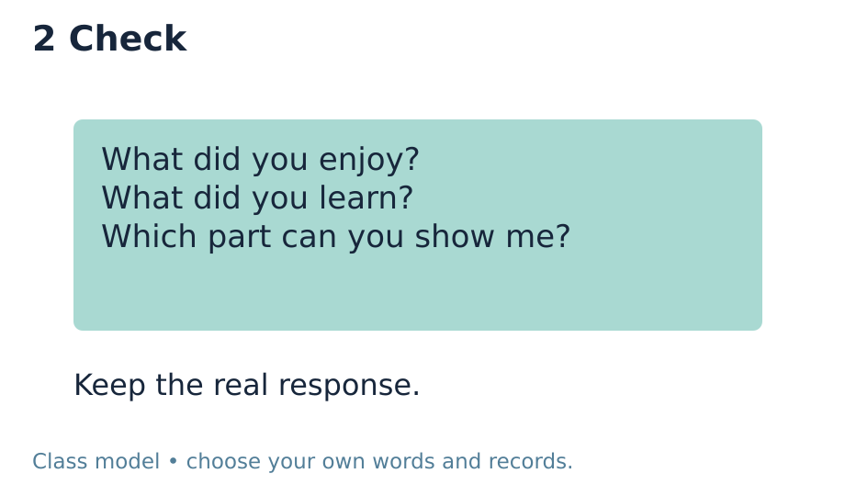
CREATIVE ARTS • BUILD / GROW • WEEK 7 LESSON 2
WE DO • PART D • 4 MIN
Try it together
We try the short share from the class model.
We ask what the listener understood.
Practise, use the response, then check the real records.
In your book: A real listener response.
ART-BUILD-A2-W07-P2 • Public • 7/14
Original diagrams © Made by Matt 2026 • CC BY 4.0
Notes:
ART_BUILD_A2_W07_P2 • Public • We do • 4 minutes (route detail slides use the same task time).
D page 2 records the actual rehearsal, listener response, pupil’s chosen adjustment or reasoned retained feature, and another try. Audit A–D separately against the existing requirements. Use Evidence_Index pages 1–2 for verified file/page locators, real time totals, file count and gaps. Count the index among the five core PDFs and all separate media within ten. The actual December event must later record enjoyment and achievement, date, audience and receipt at D page 3. Do not prefill a part outcome.
Use one route, with Independent as the GROW default. Offer Supported when useful and Aspire as optional stretch. All pupil text uses the BUILD band. The routes change support and depth, not the part requirements. For five learners, use a pair and a trio, with a separate piece and record for each learner. In the trio, rotate maker, observer and materials roles; every learner retains their own choices. Offer private responses, silent directing and a pause. Do not cold call or seek personal or family disclosure. Scribe exact words or confirmed choices, read them back and allow correction. Do not compose pupils’ plans or reviews. Mark I, S or C beside the task in staff records and note the actual prompt. Give one specific success and one useful next step. Use VF / WS / I / NS+ / // / ? / R / E as appropriate. Record R only after Voice, Audience, an NS+ prompt and the pupil’s response in their own colour; capture alone is not closure. Upload the selected individual evidence to the evidence app on the same day.
Evidence: D_Share.pdf • page 2; Evidence_Index.pdf • pages 1–2
Sources: CREATIVE_ARTS_A2_W06_BUNDLE.zip @ fd164cc6f64b784eb570bf3c0180aa6911ff7a0b10db87b03301f88201196f05; tools/artsaward/SPEC.json @ 72f1a9914f877b7aa14fd9ed91b6103799bf7b16; tools/artsaward/SLOTS.json @ 72f1a9914f877b7aa14fd9ed91b6103799bf7b16

Slide 8
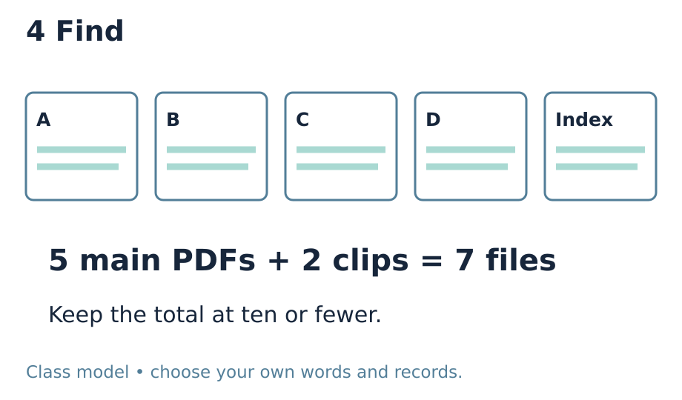
CREATIVE ARTS • BUILD / GROW • WEEK 7 LESSON 2
WE DO • PART D • 4 MIN
One check and one choice
We point to the tab to make the meaning clear.
We find the right page in the model index.
Practise, use the response, then check the real records.
In your book: A file name and page you opened.
ART-BUILD-A2-W07-P2 • Public • 8/14
Original diagrams © Made by Matt 2026 • CC BY 4.0
Notes:
ART_BUILD_A2_W07_P2 • Public • We do • 4 minutes (route detail slides use the same task time).
The listener’s question prompts a clearer point to the tab. The model index points to an actual opened page. Five main PDFs plus two separate clips total seven files. Do not count five files as proof all four parts are met.
D page 2 records the actual rehearsal, listener response, pupil’s chosen adjustment or reasoned retained feature, and another try. Audit A–D separately against the existing requirements. Use Evidence_Index pages 1–2 for verified file/page locators, real time totals, file count and gaps. Count the index among the five core PDFs and all separate media within ten. The actual December event must later record enjoyment and achievement, date, audience and receipt at D page 3. Do not prefill a part outcome.
Use one route, with Independent as the GROW default. Offer Supported when useful and Aspire as optional stretch. All pupil text uses the BUILD band. The routes change support and depth, not the part requirements. For five learners, use a pair and a trio, with a separate piece and record for each learner. In the trio, rotate maker, observer and materials roles; every learner retains their own choices. Offer private responses, silent directing and a pause. Do not cold call or seek personal or family disclosure. Scribe exact words or confirmed choices, read them back and allow correction. Do not compose pupils’ plans or reviews. Mark I, S or C beside the task in staff records and note the actual prompt. Give one specific success and one useful next step. Use VF / WS / I / NS+ / // / ? / R / E as appropriate. Record R only after Voice, Audience, an NS+ prompt and the pupil’s response in their own colour; capture alone is not closure. Upload the selected individual evidence to the evidence app on the same day.
Evidence: D_Share.pdf • page 2; Evidence_Index.pdf • pages 1–2
Sources: CREATIVE_ARTS_A2_W06_BUNDLE.zip @ fd164cc6f64b784eb570bf3c0180aa6911ff7a0b10db87b03301f88201196f05; tools/artsaward/SPEC.json @ 72f1a9914f877b7aa14fd9ed91b6103799bf7b16; tools/artsaward/SLOTS.json @ 72f1a9914f877b7aa14fd9ed91b6103799bf7b16

Slide 9
CREATIVE ARTS • BUILD / GROW • WEEK 7 LESSON 2
YOU DO • PART D • 15 MIN
Choose one route
Supported: use the steps with help.
Independent: make your own choices.
Aspire: add depth to your review or plan.
Use one route. Keep your own record.
Practise, use the response, then check the real records.
In your book: Your practice record and file check.
ART-BUILD-A2-W07-P2 • Public • 9/14
Original diagrams © Made by Matt 2026 • CC BY 4.0
Notes:
ART_BUILD_A2_W07_P2 • Public • You do • 15 minutes (route detail slides use the same task time).
D page 2 records the actual rehearsal, listener response, pupil’s chosen adjustment or reasoned retained feature, and another try. Audit A–D separately against the existing requirements. Use Evidence_Index pages 1–2 for verified file/page locators, real time totals, file count and gaps. Count the index among the five core PDFs and all separate media within ten. The actual December event must later record enjoyment and achievement, date, audience and receipt at D page 3. Do not prefill a part outcome.
Use one route, with Independent as the GROW default. Offer Supported when useful and Aspire as optional stretch. All pupil text uses the BUILD band. The routes change support and depth, not the part requirements. For five learners, use a pair and a trio, with a separate piece and record for each learner. In the trio, rotate maker, observer and materials roles; every learner retains their own choices. Offer private responses, silent directing and a pause. Do not cold call or seek personal or family disclosure. Scribe exact words or confirmed choices, read them back and allow correction. Do not compose pupils’ plans or reviews. Mark I, S or C beside the task in staff records and note the actual prompt. Give one specific success and one useful next step. Use VF / WS / I / NS+ / // / ? / R / E as appropriate. Record R only after Voice, Audience, an NS+ prompt and the pupil’s response in their own colour; capture alone is not closure. Upload the selected individual evidence to the evidence app on the same day.
Evidence: D_Share.pdf • page 2; Evidence_Index.pdf • pages 1–2
Sources: CREATIVE_ARTS_A2_W06_BUNDLE.zip @ fd164cc6f64b784eb570bf3c0180aa6911ff7a0b10db87b03301f88201196f05; tools/artsaward/SPEC.json @ 72f1a9914f877b7aa14fd9ed91b6103799bf7b16; tools/artsaward/SLOTS.json @ 72f1a9914f877b7aa14fd9ed91b6103799bf7b16

Slide 10
CREATIVE ARTS • BUILD / GROW • WEEK 7 LESSON 2
YOU DO • PART D
Supported
Use your own cue card with a trusted adult.
Show what you liked and what you learnt.
Ask what they saw or heard.
Try one part again with help if needed.
Find the right pages and count files with an adult.
Practise, use the response, then check the real records.
In your book: Your practice record and file check.
ART-BUILD-A2-W07-P2 • Public • 10/14
Original diagrams © Made by Matt 2026 • CC BY 4.0
Notes:
ART_BUILD_A2_W07_P2 • Public • You do • 0 minutes (route detail slides use the same task time).
D page 2 records the actual rehearsal, listener response, pupil’s chosen adjustment or reasoned retained feature, and another try. Audit A–D separately against the existing requirements. Use Evidence_Index pages 1–2 for verified file/page locators, real time totals, file count and gaps. Count the index among the five core PDFs and all separate media within ten. The actual December event must later record enjoyment and achievement, date, audience and receipt at D page 3. Do not prefill a part outcome.
Use one route, with Independent as the GROW default. Offer Supported when useful and Aspire as optional stretch. All pupil text uses the BUILD band. The routes change support and depth, not the part requirements. For five learners, use a pair and a trio, with a separate piece and record for each learner. In the trio, rotate maker, observer and materials roles; every learner retains their own choices. Offer private responses, silent directing and a pause. Do not cold call or seek personal or family disclosure. Scribe exact words or confirmed choices, read them back and allow correction. Do not compose pupils’ plans or reviews. Mark I, S or C beside the task in staff records and note the actual prompt. Give one specific success and one useful next step. Use VF / WS / I / NS+ / // / ? / R / E as appropriate. Record R only after Voice, Audience, an NS+ prompt and the pupil’s response in their own colour; capture alone is not closure. Upload the selected individual evidence to the evidence app on the same day.
Evidence: D_Share.pdf • page 2; Evidence_Index.pdf • pages 1–2
Sources: CREATIVE_ARTS_A2_W06_BUNDLE.zip @ fd164cc6f64b784eb570bf3c0180aa6911ff7a0b10db87b03301f88201196f05; tools/artsaward/SPEC.json @ 72f1a9914f877b7aa14fd9ed91b6103799bf7b16; tools/artsaward/SLOTS.json @ 72f1a9914f877b7aa14fd9ed91b6103799bf7b16

Slide 11
CREATIVE ARTS • BUILD / GROW • WEEK 7 LESSON 2
YOU DO • PART D
Independent
Rehearse your own share with a listener.
Ask what they understood about your choices.
Use their response to make one part clear.
Try that part again and keep a short record.
Open the files and pages in your index. Count them.
Practise, use the response, then check the real records.
In your book: Your practice record and file check.
ART-BUILD-A2-W07-P2 • Public • 11/14
Original diagrams © Made by Matt 2026 • CC BY 4.0
Notes:
ART_BUILD_A2_W07_P2 • Public • You do • 0 minutes (route detail slides use the same task time).
D page 2 records the actual rehearsal, listener response, pupil’s chosen adjustment or reasoned retained feature, and another try. Audit A–D separately against the existing requirements. Use Evidence_Index pages 1–2 for verified file/page locators, real time totals, file count and gaps. Count the index among the five core PDFs and all separate media within ten. The actual December event must later record enjoyment and achievement, date, audience and receipt at D page 3. Do not prefill a part outcome.
Use one route, with Independent as the GROW default. Offer Supported when useful and Aspire as optional stretch. All pupil text uses the BUILD band. The routes change support and depth, not the part requirements. For five learners, use a pair and a trio, with a separate piece and record for each learner. In the trio, rotate maker, observer and materials roles; every learner retains their own choices. Offer private responses, silent directing and a pause. Do not cold call or seek personal or family disclosure. Scribe exact words or confirmed choices, read them back and allow correction. Do not compose pupils’ plans or reviews. Mark I, S or C beside the task in staff records and note the actual prompt. Give one specific success and one useful next step. Use VF / WS / I / NS+ / // / ? / R / E as appropriate. Record R only after Voice, Audience, an NS+ prompt and the pupil’s response in their own colour; capture alone is not closure. Upload the selected individual evidence to the evidence app on the same day.
Evidence: D_Share.pdf • page 2; Evidence_Index.pdf • pages 1–2
Sources: CREATIVE_ARTS_A2_W06_BUNDLE.zip @ fd164cc6f64b784eb570bf3c0180aa6911ff7a0b10db87b03301f88201196f05; tools/artsaward/SPEC.json @ 72f1a9914f877b7aa14fd9ed91b6103799bf7b16; tools/artsaward/SLOTS.json @ 72f1a9914f877b7aa14fd9ed91b6103799bf7b16

Slide 12
CREATIVE ARTS • BUILD / GROW • WEEK 7 LESSON 2
YOU DO • PART D
Aspire
Explain two choices and what you learnt from them.
Ask which detail made your meaning clear.
Use the response to refine your own account.
Link your next aim to what you can show.
Check every page link and set a plan for each gap.
Practise, use the response, then check the real records.
In your book: Your practice record and file check.
ART-BUILD-A2-W07-P2 • Public • 12/14
Original diagrams © Made by Matt 2026 • CC BY 4.0
Notes:
ART_BUILD_A2_W07_P2 • Public • You do • 0 minutes (route detail slides use the same task time).
D page 2 records the actual rehearsal, listener response, pupil’s chosen adjustment or reasoned retained feature, and another try. Audit A–D separately against the existing requirements. Use Evidence_Index pages 1–2 for verified file/page locators, real time totals, file count and gaps. Count the index among the five core PDFs and all separate media within ten. The actual December event must later record enjoyment and achievement, date, audience and receipt at D page 3. Do not prefill a part outcome.
Use one route, with Independent as the GROW default. Offer Supported when useful and Aspire as optional stretch. All pupil text uses the BUILD band. The routes change support and depth, not the part requirements. For five learners, use a pair and a trio, with a separate piece and record for each learner. In the trio, rotate maker, observer and materials roles; every learner retains their own choices. Offer private responses, silent directing and a pause. Do not cold call or seek personal or family disclosure. Scribe exact words or confirmed choices, read them back and allow correction. Do not compose pupils’ plans or reviews. Mark I, S or C beside the task in staff records and note the actual prompt. Give one specific success and one useful next step. Use VF / WS / I / NS+ / // / ? / R / E as appropriate. Record R only after Voice, Audience, an NS+ prompt and the pupil’s response in their own colour; capture alone is not closure. Upload the selected individual evidence to the evidence app on the same day.
Evidence: D_Share.pdf • page 2; Evidence_Index.pdf • pages 1–2
Sources: CREATIVE_ARTS_A2_W06_BUNDLE.zip @ fd164cc6f64b784eb570bf3c0180aa6911ff7a0b10db87b03301f88201196f05; tools/artsaward/SPEC.json @ 72f1a9914f877b7aa14fd9ed91b6103799bf7b16; tools/artsaward/SLOTS.json @ 72f1a9914f877b7aa14fd9ed91b6103799bf7b16

Slide 13
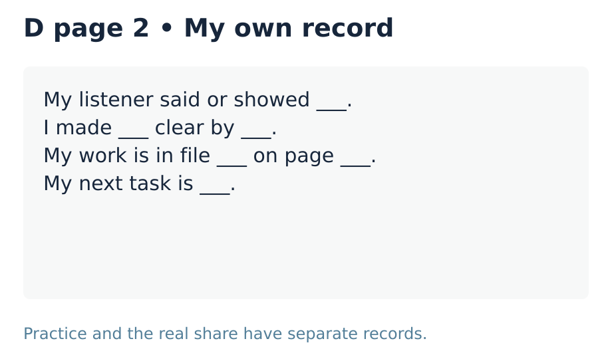
CREATIVE ARTS • BUILD / GROW • WEEK 7 LESSON 2
YOU DO • PART D
My evidence record
My listener said or showed ___.
I made ___ clear by ___.
When I tried again ___.
My next task is ___.
Keep practice at D page 2. Check the index on pages 1–2.
Practise, use the response, then check the real records.
In your book: Your practice at D page 2 and checked index.
ART-BUILD-A2-W07-P2 • Public • 13/14
Original diagrams © Made by Matt 2026 • CC BY 4.0
Notes:
ART_BUILD_A2_W07_P2 • Public • You do • 0 minutes (route detail slides use the same task time).
D page 2 records the actual rehearsal, listener response, pupil’s chosen adjustment or reasoned retained feature, and another try. Audit A–D separately against the existing requirements. Use Evidence_Index pages 1–2 for verified file/page locators, real time totals, file count and gaps. Count the index among the five core PDFs and all separate media within ten. The actual December event must later record enjoyment and achievement, date, audience and receipt at D page 3. Do not prefill a part outcome.
Use one route, with Independent as the GROW default. Offer Supported when useful and Aspire as optional stretch. All pupil text uses the BUILD band. The routes change support and depth, not the part requirements. For five learners, use a pair and a trio, with a separate piece and record for each learner. In the trio, rotate maker, observer and materials roles; every learner retains their own choices. Offer private responses, silent directing and a pause. Do not cold call or seek personal or family disclosure. Scribe exact words or confirmed choices, read them back and allow correction. Do not compose pupils’ plans or reviews. Mark I, S or C beside the task in staff records and note the actual prompt. Give one specific success and one useful next step. Use VF / WS / I / NS+ / // / ? / R / E as appropriate. Record R only after Voice, Audience, an NS+ prompt and the pupil’s response in their own colour; capture alone is not closure. Upload the selected individual evidence to the evidence app on the same day.
Evidence: D_Share.pdf • page 2; Evidence_Index.pdf • pages 1–2
Sources: CREATIVE_ARTS_A2_W06_BUNDLE.zip @ fd164cc6f64b784eb570bf3c0180aa6911ff7a0b10db87b03301f88201196f05; tools/artsaward/SPEC.json @ 72f1a9914f877b7aa14fd9ed91b6103799bf7b16; tools/artsaward/SLOTS.json @ 72f1a9914f877b7aa14fd9ed91b6103799bf7b16

Slide 14
CREATIVE ARTS • BUILD / GROW • WEEK 7 LESSON 2
EXIT • PART D • 3 MIN
What I learnt and what comes next
What did your listener understand?
What did you make clear when you tried again?
What is the file count, and what still needs to be done?
Practise, use the response, then check the real records.
In your book: One clear part and one task still to do.
ART-BUILD-A2-W07-P2 • Public • 14/14
Original diagrams © Made by Matt 2026 • CC BY 4.0
Notes:
ART_BUILD_A2_W07_P2 • Public • Exit • 3 minutes (route detail slides use the same task time).
A real listener response recorded at D page 2, in words, signs or confirmed choices.
A specific change or a reasoned decision to retain an already clear feature, followed by another try.
An actual file count no greater than ten for the submitted portfolio, verified locators and named gaps/actions. D page 3 remains pending unless the actual event has occurred.
D page 2 records the actual rehearsal, listener response, pupil’s chosen adjustment or reasoned retained feature, and another try. Audit A–D separately against the existing requirements. Use Evidence_Index pages 1–2 for verified file/page locators, real time totals, file count and gaps. Count the index among the five core PDFs and all separate media within ten. The actual December event must later record enjoyment and achievement, date, audience and receipt at D page 3. Do not prefill a part outcome.
Use one route, with Independent as the GROW default. Offer Supported when useful and Aspire as optional stretch. All pupil text uses the BUILD band. The routes change support and depth, not the part requirements. For five learners, use a pair and a trio, with a separate piece and record for each learner. In the trio, rotate maker, observer and materials roles; every learner retains their own choices. Offer private responses, silent directing and a pause. Do not cold call or seek personal or family disclosure. Scribe exact words or confirmed choices, read them back and allow correction. Do not compose pupils’ plans or reviews. Mark I, S or C beside the task in staff records and note the actual prompt. Give one specific success and one useful next step. Use VF / WS / I / NS+ / // / ? / R / E as appropriate. Record R only after Voice, Audience, an NS+ prompt and the pupil’s response in their own colour; capture alone is not closure. Upload the selected individual evidence to the evidence app on the same day.
Evidence: D_Share.pdf • page 2; Evidence_Index.pdf • pages 1–2
Sources: CREATIVE_ARTS_A2_W06_BUNDLE.zip @ fd164cc6f64b784eb570bf3c0180aa6911ff7a0b10db87b03301f88201196f05; tools/artsaward/SPEC.json @ 72f1a9914f877b7aa14fd9ed91b6103799bf7b16; tools/artsaward/SLOTS.json @ 72f1a9914f877b7aa14fd9ed91b6103799bf7b16

