Slide 1
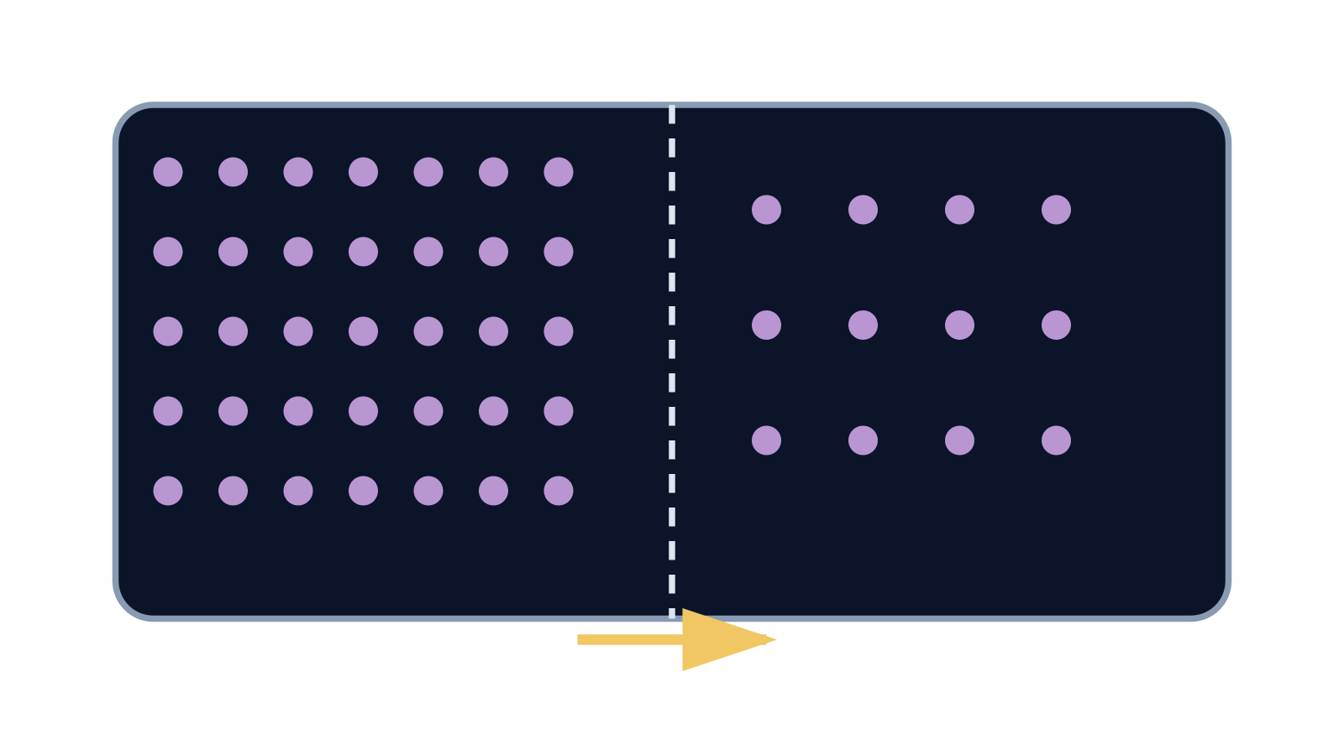
LAUNCH SCIENCE / W4L1
Arrival · 4 min
Arrival · Supported route
FOUR QUICK QUESTIONS / POINT, SAY, SIGN, DRAW OR WRITE / YOU MAY PASS
1
Someone opens a bottle of perfume at the front. Can people at the back smell it after a while? Yes / No.
2
Two glasses of squash: one strong, one weak. Which one has more squash particles in the same amount of water? Strong / Weak.
3
In a gas, are the particles close together or far apart? Close / Far apart.
4
When you breathe in, where does oxygen get into your blood? Lungs / Stomach.
Nothing here assumes you have met diffusion before. The questions use everyday ideas about smells, drinks and breathing; an adult can read them to you or write your words. Choose one route. Point, say, sign, draw, type or write. You may pass or say not sure. Use the screen or paper; you do not need to do both.
Arrival
Starter
I Do
We Do
I Do 2
We Do 2
Independent
Exit
Resources
Notes:
Stage: Arrival, 4 minutes shared across the three route slides; show the route you have chosen. Lesson 1 of Week 4, one 40-minute plan for every group. Use reveals within this slot; appendix slides are not added time.
Allow four minutes within the arrival stage. Read or scribe as needed. Start from what pupils show; a pass or a not-sure is information about the starting point, not a label. Accept spoken, signed, drawn, pointed, chosen or scribed answers as equal. Pupil worksheet page 3 carries all three routes; staff answers are in the teacher guide.
[Staff answers — Supported; do not display]
1. Yes. Accept pointing or nodding. The smell spreads through the air on its own.
2. Strong. More particles in the same volume means a higher concentration.
3. Far apart, and moving. Accept a gesture that shows spread-out particles.
4. Lungs. The air sacs in the lungs are where oxygen enters the blood.
Core explanation: Particles move randomly in both directions. Net movement is the difference between those two movements, not a rule obeyed by every particle.
Watch for: Passive means no energy supplied by respiration is needed. It does not mean particles have no kinetic energy.
Least help first: Ask the pupil to compare starting counts on both sides before discussing direction.
Support cue: Net movement = crossings one way minus crossings the other way. Start: “More particles move from ___ to ___ because…”
[Sources]
User-supplied LAUNCH W3–W7 pack: W4 Diffusion worksheet particle model and exam task; no W4 PPTX was supplied.
Made by Matt LAUNCH Science draft, lesson-content.json, W4L1; existing illustrative diagrams reused, active-transport direction corrected to lower → higher.
Pearson Edexcel GCSE Biology specification, sections 1.1–1.6 and 1.15–1.17: https://qualifications.pearson.com/content/dam/pdf/GCSE/Science/2016/Specification/gcse-biology-spec.pdf
Optional concept video: freesciencelessons, Diffusion, https://www.youtube.com/watch?v=O965gA4goVI (link located 5 September 2026).
[/Sources]
[Sources]
Source editable lesson: Original LAUNCH Science OneDrive pack, 5 September 2026, W4L1. Source teaching content preserved. Current HTML reference: https://madebymatt.uk/Lessons/Science_Teesside/Launch/. Native diagrams restate the source explanation and are not experimental measurements.
[/Sources]
Revision 15 September 2026: aligned with the canonical lesson (four-question arrival routes on slides 1–3, knowledge organiser on slides 5–6, stage minutes 4/1/4/4/3/5/15/4 as the lesson, one optional help prompt on slide 10, two-check exit routes on slide 12). Pupil worksheet pages 3–6 carry the arrival routes, organiser and exit routes; staff answers and the feedback card are in Teacher_Guide_And_Answers.

Slide 2
LAUNCH SCIENCE / W4L1
Arrival · 4 min
Arrival · Standard route
FOUR QUICK QUESTIONS / POINT, SAY, SIGN, DRAW OR WRITE / YOU MAY PASS
FOUR QUICK QUESTIONS / POINT, SAY, SIGN, DRAW OR WRITE / YOU MAY PASS
1
1
Someone opens a bottle of perfume at the front. Can people at the back smell it after a while? Yes / No.
A smell spreads across a still room. What is actually moving from the bottle to your nose?
2
2
Two glasses of squash: one strong, one weak. Which one has more squash particles in the same amount of water? Strong / Weak.
What does the word concentration mean when we talk about a solution or a gas?
3
3
In a gas, are the particles close together or far apart? Close / Far apart.
Particles move in solids, liquids and gases. In which state do they move most freely?
4
4
When you breathe in, where does oxygen get into your blood? Lungs / Stomach.
Name the gas that our blood collects in the lungs and the gas it gives up there.
Nothing here assumes you have met diffusion before. The questions use everyday ideas about smells, drinks and breathing; an adult can read them to you or write your words. Choose one route. Point, say, sign, draw, type or write. You may pass or say not sure. Use the screen or paper; you do not need to do both.
Nothing here assumes you have met diffusion before. The questions use everyday ideas about smells, drinks and breathing; an adult can read them to you or write your words. Choose one route. Point, say, sign, draw, type or write. You may pass or say not sure. Use the screen or paper; you do not need to do both.
Arrival
Starter
I Do
We Do
I Do 2
We Do 2
Independent
Exit
Resources
Notes:
Stage: Arrival, 4 minutes shared across the three route slides; show the route you have chosen. Lesson 1 of Week 4, one 40-minute plan for every group. Use reveals within this slot; appendix slides are not added time.
Allow four minutes within the arrival stage. Read or scribe as needed. Start from what pupils show; a pass or a not-sure is information about the starting point, not a label. Accept spoken, signed, drawn, pointed, chosen or scribed answers as equal. Pupil worksheet page 3 carries all three routes; staff answers are in the teacher guide.
[Staff answers — Standard; do not display]
1. Particles of the perfume, mixed into the air. Accept molecules.
2. How many particles of a substance there are in a given volume. Accept how much is dissolved in a certain amount.
3. Gases; the particles are far apart and move freely in all directions.
4. Oxygen is collected; carbon dioxide is given up.
Core explanation: Particles move randomly in both directions. Net movement is the difference between those two movements, not a rule obeyed by every particle.
Watch for: Passive means no energy supplied by respiration is needed. It does not mean particles have no kinetic energy.
Least help first: Ask the pupil to compare starting counts on both sides before discussing direction.
Support cue: Net movement = crossings one way minus crossings the other way. Start: “More particles move from ___ to ___ because…”
[Sources]
User-supplied LAUNCH W3–W7 pack: W4 Diffusion worksheet particle model and exam task; no W4 PPTX was supplied.
Made by Matt LAUNCH Science draft, lesson-content.json, W4L1; existing illustrative diagrams reused, active-transport direction corrected to lower → higher.
Pearson Edexcel GCSE Biology specification, sections 1.1–1.6 and 1.15–1.17: https://qualifications.pearson.com/content/dam/pdf/GCSE/Science/2016/Specification/gcse-biology-spec.pdf
Optional concept video: freesciencelessons, Diffusion, https://www.youtube.com/watch?v=O965gA4goVI (link located 5 September 2026).
[/Sources]
[Sources]
Source editable lesson: Original LAUNCH Science OneDrive pack, 5 September 2026, W4L1. Source teaching content preserved. Current HTML reference: https://madebymatt.uk/Lessons/Science_Teesside/Launch/. Native diagrams restate the source explanation and are not experimental measurements.
[/Sources]

Slide 3
LAUNCH SCIENCE / W4L1
Arrival · 4 min
Arrival · Stretch route
FOUR QUICK QUESTIONS / POINT, SAY, SIGN, DRAW OR WRITE / YOU MAY PASS
FOUR QUICK QUESTIONS / POINT, SAY, SIGN, DRAW OR WRITE / YOU MAY PASS
1
1
Someone opens a bottle of perfume at the front. Can people at the back smell it after a while? Yes / No.
A smell reaches the back of a still room. Explain what makes the particles spread when nothing is pushing them.
2
2
Two glasses of squash: one strong, one weak. Which one has more squash particles in the same amount of water? Strong / Weak.
Two areas have different concentrations of the same substance. What name do we give to that difference?
3
3
In a gas, are the particles close together or far apart? Close / Far apart.
Why do particles in a warm gas spread out faster than particles in a cold gas?
4
4
When you breathe in, where does oxygen get into your blood? Lungs / Stomach.
Oxygen passes from the air sacs of the lungs into the blood. Suggest why it goes that way and not the other.
Nothing here assumes you have met diffusion before. The questions use everyday ideas about smells, drinks and breathing; an adult can read them to you or write your words. Choose one route. Point, say, sign, draw, type or write. You may pass or say not sure. Use the screen or paper; you do not need to do both.
Nothing here assumes you have met diffusion before. The questions use everyday ideas about smells, drinks and breathing; an adult can read them to you or write your words. Choose one route. Point, say, sign, draw, type or write. You may pass or say not sure. Use the screen or paper; you do not need to do both.
Arrival
Starter
I Do
We Do
I Do 2
We Do 2
Independent
Exit
Resources
Notes:
Stage: Arrival, 4 minutes shared across the three route slides; show the route you have chosen. Lesson 1 of Week 4, one 40-minute plan for every group. Use reveals within this slot; appendix slides are not added time.
Allow four minutes within the arrival stage. Read or scribe as needed. Start from what pupils show; a pass or a not-sure is information about the starting point, not a label. Accept spoken, signed, drawn, pointed, chosen or scribed answers as equal. Pupil worksheet page 3 carries all three routes; staff answers are in the teacher guide.
[Staff answers — Stretch; do not display]
1. Particles move randomly all the time. Over time random motion carries more of them from where they are crowded to where they are few, so the smell spreads. Accept a first idea to refine later.
2. A concentration gradient. Accept the difference in concentration between two places.
3. Warm particles have more energy and move faster, so they spread out more quickly.
4. There is more oxygen in the air sac than in the blood arriving there, so the net movement is into the blood. Accept from high to low concentration.
Core explanation: Particles move randomly in both directions. Net movement is the difference between those two movements, not a rule obeyed by every particle.
Watch for: Passive means no energy supplied by respiration is needed. It does not mean particles have no kinetic energy.
Least help first: Ask the pupil to compare starting counts on both sides before discussing direction.
Support cue: Net movement = crossings one way minus crossings the other way. Start: “More particles move from ___ to ___ because…”
[Sources]
User-supplied LAUNCH W3–W7 pack: W4 Diffusion worksheet particle model and exam task; no W4 PPTX was supplied.
Made by Matt LAUNCH Science draft, lesson-content.json, W4L1; existing illustrative diagrams reused, active-transport direction corrected to lower → higher.
Pearson Edexcel GCSE Biology specification, sections 1.1–1.6 and 1.15–1.17: https://qualifications.pearson.com/content/dam/pdf/GCSE/Science/2016/Specification/gcse-biology-spec.pdf
Optional concept video: freesciencelessons, Diffusion, https://www.youtube.com/watch?v=O965gA4goVI (link located 5 September 2026).
[/Sources]
[Sources]
Source editable lesson: Original LAUNCH Science OneDrive pack, 5 September 2026, W4L1. Source teaching content preserved. Current HTML reference: https://madebymatt.uk/Lessons/Science_Teesside/Launch/. Native diagrams restate the source explanation and are not experimental measurements.
[/Sources]

Slide 4
LAUNCH SCIENCE / W4L1
Starter · 1 min
Make a prediction
Particles move randomly in both directions. Can there still be net movement from high to low concentration?
A No — random means no pattern
B Yes — more particles begin on the high side
C Only if every particle moves one way
Commit, then check
Arrival
Starter
I Do
We Do
I Do 2
We Do 2
Independent
Exit
Resources
Notes:
Stage: Starter, 1 minutes. Lesson 1 of Week 4, one 40-minute plan for every group. Use reveals within this slot; appendix slides are not added time.
Correct: Yes — more particles begin on the high side. Ask for the reason, then return to the original prediction.
Core explanation: Particles move randomly in both directions. Net movement is the difference between those two movements, not a rule obeyed by every particle.
Watch for: Passive means no energy supplied by respiration is needed. It does not mean particles have no kinetic energy.
Least help first: Ask the pupil to compare starting counts on both sides before discussing direction.
Support cue: Net movement = crossings one way minus crossings the other way. Start: “More particles move from ___ to ___ because…”
[Sources]
User-supplied LAUNCH W3–W7 pack: W4 Diffusion worksheet particle model and exam task; no W4 PPTX was supplied.
Made by Matt LAUNCH Science draft, lesson-content.json, W4L1; existing illustrative diagrams reused, active-transport direction corrected to lower → higher.
Pearson Edexcel GCSE Biology specification, sections 1.1–1.6 and 1.15–1.17: https://qualifications.pearson.com/content/dam/pdf/GCSE/Science/2016/Specification/gcse-biology-spec.pdf
Optional concept video: freesciencelessons, Diffusion, https://www.youtube.com/watch?v=O965gA4goVI (link located 5 September 2026).
[/Sources]
[Sources]
Source editable lesson: Original LAUNCH Science OneDrive pack, 5 September 2026, W4L1. Source teaching content preserved. Current HTML reference: https://madebymatt.uk/Lessons/Science_Teesside/Launch/. Native diagrams restate the source explanation and are not experimental measurements.
[/Sources]

Slide 5
LAUNCH SCIENCE / W4L1
Knowledge organiser
Diffusion knowledge organiser (1 of 2)
Objective: Explain diffusion and the factors that affect its rate.
KEY WORDS
SUCCESS CRITERIA
Diffusion (Tier 3) — The net movement of particles from a higher concentration to a lower concentration.
Concentration (Tier 2) — How many particles of a substance there are in a given volume.
Concentration gradient (Tier 3) — The difference in concentration between two places. Particles diffuse down it.
Net movement (Tier 3) — The overall movement once movement in both directions has been counted.
Passive (Tier 3) — Needing no energy from the cell; diffusion is passive.
Surface area (Tier 2) — The total area available for particles to cross.
Membrane (Tier 3) — A thin layer that particles must cross, such as a cell membrane.
Alveolus (Tier 3) — One of the tiny air sacs in the lungs where oxygen enters the blood. Plural: alveoli.
Rate (Tier 2) — How fast something happens; here, how quickly particles move across.
1. Define diffusion using net movement and concentration gradient.
2. Name three factors that change the rate of diffusion and say which way each one changes it.
3. Apply diffusion to a real example in the body and to the model shown, keeping the two apart.
Arrival
Starter
I Do
We Do
I Do 2
We Do 2
Independent
Exit
Resources
Notes:
Knowledge organiser — 0 minutes (reference). Lesson 1 of Week 4, one 40-minute plan for every group. Return to this slide at any point; it matches pupil worksheet pages 4–5 and the on-screen organiser. It is not an extra stage.
Core explanation: Particles move randomly in both directions. Net movement is the difference between those two movements, not a rule obeyed by every particle.
Watch for: Passive means no energy supplied by respiration is needed. It does not mean particles have no kinetic energy.
Least help first: Ask the pupil to compare starting counts on both sides before discussing direction.
Support cue: Net movement = crossings one way minus crossings the other way. Start: “More particles move from ___ to ___ because…”
[Sources]
User-supplied LAUNCH W3–W7 pack: W4 Diffusion worksheet particle model and exam task; no W4 PPTX was supplied.
Made by Matt LAUNCH Science draft, lesson-content.json, W4L1; existing illustrative diagrams reused, active-transport direction corrected to lower → higher.
Pearson Edexcel GCSE Biology specification, sections 1.1–1.6 and 1.15–1.17: https://qualifications.pearson.com/content/dam/pdf/GCSE/Science/2016/Specification/gcse-biology-spec.pdf
Optional concept video: freesciencelessons, Diffusion, https://www.youtube.com/watch?v=O965gA4goVI (link located 5 September 2026).
[/Sources]
[Sources]
Source editable lesson: Original LAUNCH Science OneDrive pack, 5 September 2026, W4L1. Source teaching content preserved. Current HTML reference: https://madebymatt.uk/Lessons/Science_Teesside/Launch/. Native diagrams restate the source explanation and are not experimental measurements.
[/Sources]

Slide 6
LAUNCH SCIENCE / W4L1
Knowledge organiser
Diffusion knowledge organiser (2 of 2)
KEY IDEAS
Particles move randomly all the time. Diffusion is the net result of that random movement, not a push.
Three factors raise the rate of diffusion: a steeper concentration gradient, a higher temperature and a larger surface area. A shorter distance to cross also raises it.
Diffusion needs no energy from the cell. Movement against a gradient using energy is active transport, a different process.
In the lungs, oxygen diffuses from the air in an alveolus into the blood; carbon dioxide diffuses the other way. The alveolus wall is one cell thick.
THE MODEL
A particle model of diffusion across a membrane. Particles are drawn far larger and fewer than the real thing, and the membrane is drawn as a line. This is an explanatory model, not a measurement of any real gas.
DIFFUSION OR NOT?
Diffusion: oxygen into the blood at the alveoli; carbon dioxide out of a respiring cell; a smell spreading across a room.
Not diffusion: glucose pumped into a root hair against its gradient (active transport); water across a partially permeable membrane (osmosis, a special case treated in the next lesson but one).
Arrival
Starter
I Do
We Do
I Do 2
We Do 2
Independent
Exit
Resources
Notes:
Knowledge organiser — 0 minutes (reference). Lesson 1 of Week 4, one 40-minute plan for every group. Return to this slide at any point; it matches pupil worksheet pages 4–5 and the on-screen organiser. It is not an extra stage.
Core explanation: Particles move randomly in both directions. Net movement is the difference between those two movements, not a rule obeyed by every particle.
Watch for: Passive means no energy supplied by respiration is needed. It does not mean particles have no kinetic energy.
Least help first: Ask the pupil to compare starting counts on both sides before discussing direction.
Support cue: Net movement = crossings one way minus crossings the other way. Start: “More particles move from ___ to ___ because…”
[Sources]
User-supplied LAUNCH W3–W7 pack: W4 Diffusion worksheet particle model and exam task; no W4 PPTX was supplied.
Made by Matt LAUNCH Science draft, lesson-content.json, W4L1; existing illustrative diagrams reused, active-transport direction corrected to lower → higher.
Pearson Edexcel GCSE Biology specification, sections 1.1–1.6 and 1.15–1.17: https://qualifications.pearson.com/content/dam/pdf/GCSE/Science/2016/Specification/gcse-biology-spec.pdf
Optional concept video: freesciencelessons, Diffusion, https://www.youtube.com/watch?v=O965gA4goVI (link located 5 September 2026).
[/Sources]
[Sources]
Source editable lesson: Original LAUNCH Science OneDrive pack, 5 September 2026, W4L1. Source teaching content preserved. Current HTML reference: https://madebymatt.uk/Lessons/Science_Teesside/Launch/. Native diagrams restate the source explanation and are not experimental measurements.
[/Sources]

Slide 7
LAUNCH SCIENCE / W4L1
I Do · 4 min
Watch the model
1
Individual particles move randomly in every direction.
Particles keep moving
2
More particles start in the high-concentration region, so more crossing events begin there.
Higher
Lower
3
Net movement is the overall difference between movements in opposite directions.
concentration
View labelled diagram
Optional video
Arrival
Starter
I Do
We Do
I Do 2
We Do 2
Independent
Exit
Resources
Notes:
Stage: I Do, 4 minutes. Lesson 1 of Week 4, one 40-minute plan for every group. Use reveals within this slot; appendix slides are not added time.
The chamber shows individual random paths and separate left-to-right and right-to-left crossing counts.
Model limit: The digital particles are a simplified two-dimensional sample and do not model every collision in a real material.
Video replaces up to 90 seconds of explanation; use the still diagram if unavailable.
Core explanation: Particles move randomly in both directions. Net movement is the difference between those two movements, not a rule obeyed by every particle.
Watch for: Passive means no energy supplied by respiration is needed. It does not mean particles have no kinetic energy.
Least help first: Ask the pupil to compare starting counts on both sides before discussing direction.
Support cue: Net movement = crossings one way minus crossings the other way. Start: “More particles move from ___ to ___ because…”
[Sources]
User-supplied LAUNCH W3–W7 pack: W4 Diffusion worksheet particle model and exam task; no W4 PPTX was supplied.
Made by Matt LAUNCH Science draft, lesson-content.json, W4L1; existing illustrative diagrams reused, active-transport direction corrected to lower → higher.
Pearson Edexcel GCSE Biology specification, sections 1.1–1.6 and 1.15–1.17: https://qualifications.pearson.com/content/dam/pdf/GCSE/Science/2016/Specification/gcse-biology-spec.pdf
Optional concept video: freesciencelessons, Diffusion, https://www.youtube.com/watch?v=O965gA4goVI (link located 5 September 2026).
[/Sources]
[Sources]
Source editable lesson: Original LAUNCH Science OneDrive pack, 5 September 2026, W4L1. Source teaching content preserved. Current HTML reference: https://madebymatt.uk/Lessons/Science_Teesside/Launch/. Native diagrams restate the source explanation and are not experimental measurements.
[/Sources]

Slide 8
LAUNCH SCIENCE / W4L1
We Do · 4 min
Choose and justify
Which statement is scientifically accurate during diffusion?
A All particles move from high to low
B Particles stop when concentrations match
C Particles move randomly, with net movement down the gradient
D Low-concentration particles pull high-concentration particles
Give the deciding clue before checking.
Check the reasoning
Arrival
Starter
I Do
We Do
I Do 2
We Do 2
Independent
Exit
Resources
Notes:
Stage: We Do, 4 minutes. Lesson 1 of Week 4, one 40-minute plan for every group. Use reveals within this slot; appendix slides are not added time.
A: All particles move from high to low — This removes random movement and creates a one-way misconception.
B: Particles stop when concentrations match — Particles continue moving at equilibrium; only the net change becomes zero.
C: Particles move randomly, with net movement down the gradient — Accurate. Use crossing counts to justify the net direction.
D: Low-concentration particles pull high-concentration particles — Diffusion does not require particles to pull or choose.
Core explanation: Particles move randomly in both directions. Net movement is the difference between those two movements, not a rule obeyed by every particle.
Watch for: Passive means no energy supplied by respiration is needed. It does not mean particles have no kinetic energy.
Least help first: Ask the pupil to compare starting counts on both sides before discussing direction.
Support cue: Net movement = crossings one way minus crossings the other way. Start: “More particles move from ___ to ___ because…”
[Sources]
User-supplied LAUNCH W3–W7 pack: W4 Diffusion worksheet particle model and exam task; no W4 PPTX was supplied.
Made by Matt LAUNCH Science draft, lesson-content.json, W4L1; existing illustrative diagrams reused, active-transport direction corrected to lower → higher.
Pearson Edexcel GCSE Biology specification, sections 1.1–1.6 and 1.15–1.17: https://qualifications.pearson.com/content/dam/pdf/GCSE/Science/2016/Specification/gcse-biology-spec.pdf
Optional concept video: freesciencelessons, Diffusion, https://www.youtube.com/watch?v=O965gA4goVI (link located 5 September 2026).
[/Sources]
[Sources]
Source editable lesson: Original LAUNCH Science OneDrive pack, 5 September 2026, W4L1. Source teaching content preserved. Current HTML reference: https://madebymatt.uk/Lessons/Science_Teesside/Launch/. Native diagrams restate the source explanation and are not experimental measurements.
[/Sources]

Slide 9
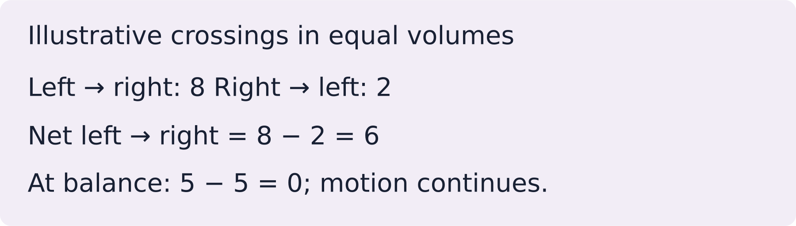
LAUNCH SCIENCE / W4L1
I Do 2 · 3 min
Connect the science
1
A steeper concentration difference usually increases the net rate.
2
Higher temperature increases particle kinetic energy and movement rate.
3
A longer diffusion distance reduces the rate of exchange.
Arrival
Starter
I Do
We Do
I Do 2
We Do 2
Independent
Exit
Resources
Notes:
Stage: I Do 2, 3 minutes. Lesson 1 of Week 4, one 40-minute plan for every group. Use reveals within this slot; appendix slides are not added time.
The digital particles are a simplified two-dimensional sample and do not model every collision in a real material.
Core explanation: Particles move randomly in both directions. Net movement is the difference between those two movements, not a rule obeyed by every particle.
Watch for: Passive means no energy supplied by respiration is needed. It does not mean particles have no kinetic energy.
Least help first: Ask the pupil to compare starting counts on both sides before discussing direction.
Support cue: Net movement = crossings one way minus crossings the other way. Start: “More particles move from ___ to ___ because…”
[Sources]
User-supplied LAUNCH W3–W7 pack: W4 Diffusion worksheet particle model and exam task; no W4 PPTX was supplied.
Made by Matt LAUNCH Science draft, lesson-content.json, W4L1; existing illustrative diagrams reused, active-transport direction corrected to lower → higher.
Pearson Edexcel GCSE Biology specification, sections 1.1–1.6 and 1.15–1.17: https://qualifications.pearson.com/content/dam/pdf/GCSE/Science/2016/Specification/gcse-biology-spec.pdf
Optional concept video: freesciencelessons, Diffusion, https://www.youtube.com/watch?v=O965gA4goVI (link located 5 September 2026).
[/Sources]
[Sources]
Source editable lesson: Original LAUNCH Science OneDrive pack, 5 September 2026, W4L1. Source teaching content preserved. Current HTML reference: https://madebymatt.uk/Lessons/Science_Teesside/Launch/. Native diagrams restate the source explanation and are not experimental measurements.
[/Sources]

Slide 10
LAUNCH SCIENCE / W4L1
We Do 2 · Task · 5 min
Count both directions
Equal volumes: 12 particles on the left, 3 on the right. Predict the initial net direction.
Interval | Left → right | Right → left
Early | 8 | 2
At balance | 5 | 5
Find the net crossing count for each interval. What keeps happening at balance?
Need a different way to take part? (optional) During the sort, point, say, sign or show the adult an idea, a question or a change that would help you take part. You may pass or speak privately. The adult listens, says what can change and checks whether it helped.
Reveal shared reasoning
Arrival
Starter
I Do
We Do
I Do 2
We Do 2
Independent
Exit
Resources
Notes:
Stage: We Do 2 · Task, 5 minutes. Lesson 1 of Week 4, one 40-minute plan for every group. Use reveals within this slot; appendix slides are not added time.
Early: 8 − 2 = 6 net left to right.
At balance: 5 − 5 = 0 net.
Particles still move randomly and cross both ways. These are illustrative model counts.
Run the printed activity or this board; one route is enough. The help line is the lesson’s one optional prompt: a pupil may point, say, sign or show an idea, question or change; the adult listens, explains what can change and checks whether it helped. Passing is allowed; no extra record.
Core explanation: Particles move randomly in both directions. Net movement is the difference between those two movements, not a rule obeyed by every particle.
Watch for: Passive means no energy supplied by respiration is needed. It does not mean particles have no kinetic energy.
Least help first: Ask the pupil to compare starting counts on both sides before discussing direction.
Support cue: Net movement = crossings one way minus crossings the other way. Start: “More particles move from ___ to ___ because…”
[Sources]
User-supplied LAUNCH W3–W7 pack: W4 Diffusion worksheet particle model and exam task; no W4 PPTX was supplied.
Made by Matt LAUNCH Science draft, lesson-content.json, W4L1; existing illustrative diagrams reused, active-transport direction corrected to lower → higher.
Pearson Edexcel GCSE Biology specification, sections 1.1–1.6 and 1.15–1.17: https://qualifications.pearson.com/content/dam/pdf/GCSE/Science/2016/Specification/gcse-biology-spec.pdf
Optional concept video: freesciencelessons, Diffusion, https://www.youtube.com/watch?v=O965gA4goVI (link located 5 September 2026).
[/Sources]
[Sources]
Source editable lesson: Original LAUNCH Science OneDrive pack, 5 September 2026, W4L1. Source teaching content preserved. Current HTML reference: https://madebymatt.uk/Lessons/Science_Teesside/Launch/. Native diagrams restate the source explanation and are not experimental measurements.
[/Sources]

Slide 11
LAUNCH SCIENCE / W4L1
Independent Task · 15 min
Your independent evidence
Equal-volume chambers have the same temperature and diffusion distance. A starts with 80 particles left, 20 right; B has 60 left, 40 right. Which has faster initial net diffusion? Explain using random motion and the gradient.
Optional support
Net movement = crossings one way minus crossings the other way. Start: “More particles move from ___ to ___ because…”
Make one precise correction to the same work after feedback.
Open worksheet pages
Model after first attempt
Arrival
Starter
I Do
We Do
I Do 2
We Do 2
Independent
Exit
Resources
Notes:
Stage: Independent Task, 15 minutes. Lesson 1 of Week 4, one 40-minute plan for every group. Use reveals within this slot; appendix slides are not added time.
Model answer: Chamber A has the faster initial net diffusion because its concentration difference is larger. Particles move randomly in both directions, but more particles begin on the left in A, so more left-to-right crossings occur at first. This produces a greater net movement down the concentration gradient.
Select only questions that fit the ten-minute slot. W7L3: Q2, Q3 and Q5 total 11 marks. The full paper needs a separate 25-minute slot.
Core explanation: Particles move randomly in both directions. Net movement is the difference between those two movements, not a rule obeyed by every particle.
Watch for: Passive means no energy supplied by respiration is needed. It does not mean particles have no kinetic energy.
Least help first: Ask the pupil to compare starting counts on both sides before discussing direction.
Support cue: Net movement = crossings one way minus crossings the other way. Start: “More particles move from ___ to ___ because…”
[Sources]
User-supplied LAUNCH W3–W7 pack: W4 Diffusion worksheet particle model and exam task; no W4 PPTX was supplied.
Made by Matt LAUNCH Science draft, lesson-content.json, W4L1; existing illustrative diagrams reused, active-transport direction corrected to lower → higher.
Pearson Edexcel GCSE Biology specification, sections 1.1–1.6 and 1.15–1.17: https://qualifications.pearson.com/content/dam/pdf/GCSE/Science/2016/Specification/gcse-biology-spec.pdf
Optional concept video: freesciencelessons, Diffusion, https://www.youtube.com/watch?v=O965gA4goVI (link located 5 September 2026).
[/Sources]
[Sources]
Source editable lesson: Original LAUNCH Science OneDrive pack, 5 September 2026, W4L1. Source teaching content preserved. Current HTML reference: https://madebymatt.uk/Lessons/Science_Teesside/Launch/. Native diagrams restate the source explanation and are not experimental measurements.
[/Sources]

Slide 12
LAUNCH SCIENCE / W4L1
Exit · 4 min
Before you go · two small checks
CHOOSE ONE ROUTE, ONCE / SUPPORTED · STANDARD · STRETCH / YOU MAY PASS
SUP 1
Diffusion is the net movement of particles from a higher concentration to a ____ concentration. lower / higher
SUP 2
A steeper concentration gradient makes diffusion happen ____. faster / slower
STA 1
Complete the definition: diffusion is the ____ movement of particles from a higher to a lower ____.
STA 2
Name two factors that increase the rate of diffusion.
STR 1
Explain why a thinner membrane increases the rate of diffusion. Use the word distance.
STR 2
Explain why warming a gas increases the rate of diffusion. Use the words energy and particles.
Two small checks to finish. Point, say, sign, draw, type or use paper. An adult can scribe your words. You may pass; complete one route, once. Next lesson: Diffusion in the Lungs: Testing Breath.
Arrival
Starter
I Do
We Do
I Do 2
We Do 2
Independent
Exit
Resources
Notes:
Stage: Exit, 4 minutes. Lesson 1 of Week 4, one 40-minute plan for every group. Use reveals within this slot; appendix slides are not added time.
Use the last four minutes for one exit route. Read the response in light of the help used; accept spoken, signed, drawn, pointed, chosen, typed or scribed answers. A response is not automatically marked; an adult reads or hears it. The next lesson is named on the slide by name only. Pupil worksheet page 6 carries the three exit routes.
[Staff explanations — do not display]
Supported 1. Lower. Particles spread from where they are crowded to where they are few.
Supported 2. Faster. A bigger difference in concentration means a faster net movement.
Standard 1. Net; concentration. Accept net movement of particles down a concentration gradient.
Standard 2. Any two of: a steeper concentration gradient, a higher temperature, a larger surface area, a shorter distance to cross.
Stretch 1. A thinner membrane means a shorter distance for particles to cross, so each particle crosses in less time and the rate is higher.
Stretch 2. Warmer particles have more energy and move faster, so more of them cross in a given time and the rate rises.
Next lesson: Diffusion in the Lungs: Testing Breath.
Receive the request, record the agreed next action and check it next lesson. Keep responses private when requested.
Core explanation: Particles move randomly in both directions. Net movement is the difference between those two movements, not a rule obeyed by every particle.
Watch for: Passive means no energy supplied by respiration is needed. It does not mean particles have no kinetic energy.
Least help first: Ask the pupil to compare starting counts on both sides before discussing direction.
Support cue: Net movement = crossings one way minus crossings the other way. Start: “More particles move from ___ to ___ because…”
[Sources]
User-supplied LAUNCH W3–W7 pack: W4 Diffusion worksheet particle model and exam task; no W4 PPTX was supplied.
Made by Matt LAUNCH Science draft, lesson-content.json, W4L1; existing illustrative diagrams reused, active-transport direction corrected to lower → higher.
Pearson Edexcel GCSE Biology specification, sections 1.1–1.6 and 1.15–1.17: https://qualifications.pearson.com/content/dam/pdf/GCSE/Science/2016/Specification/gcse-biology-spec.pdf
Optional concept video: freesciencelessons, Diffusion, https://www.youtube.com/watch?v=O965gA4goVI (link located 5 September 2026).
[/Sources]
[Sources]
Source editable lesson: Original LAUNCH Science OneDrive pack, 5 September 2026, W4L1. Source teaching content preserved. Current HTML reference: https://madebymatt.uk/Lessons/Science_Teesside/Launch/. Native diagrams restate the source explanation and are not experimental measurements.
[/Sources]

Slide 13
LAUNCH SCIENCE / W4L1
Resources
Prediction check
Yes — more particles begin on the high side
Return to Starter
Arrival
Starter
I Do
We Do
I Do 2
We Do 2
Independent
Exit
Resources
Notes:
Read only after an attempt; retain the pupil’s first view. The arrival answers are in the notes of slides 1–3 and in the teacher guide.
Core explanation: Particles move randomly in both directions. Net movement is the difference between those two movements, not a rule obeyed by every particle.
Watch for: Passive means no energy supplied by respiration is needed. It does not mean particles have no kinetic energy.
Least help first: Ask the pupil to compare starting counts on both sides before discussing direction.
Support cue: Net movement = crossings one way minus crossings the other way. Start: “More particles move from ___ to ___ because…”
[Sources]
User-supplied LAUNCH W3–W7 pack: W4 Diffusion worksheet particle model and exam task; no W4 PPTX was supplied.
Made by Matt LAUNCH Science draft, lesson-content.json, W4L1; existing illustrative diagrams reused, active-transport direction corrected to lower → higher.
Pearson Edexcel GCSE Biology specification, sections 1.1–1.6 and 1.15–1.17: https://qualifications.pearson.com/content/dam/pdf/GCSE/Science/2016/Specification/gcse-biology-spec.pdf
Optional concept video: freesciencelessons, Diffusion, https://www.youtube.com/watch?v=O965gA4goVI (link located 5 September 2026).
[/Sources]
[Sources]
Source editable lesson: Original LAUNCH Science OneDrive pack, 5 September 2026, W4L1. Source teaching content preserved. Current HTML reference: https://madebymatt.uk/Lessons/Science_Teesside/Launch/. Native diagrams restate the source explanation and are not experimental measurements.
[/Sources]

Slide 14
LAUNCH SCIENCE / W4L1
Resources
Check the deciding clue
Particles move randomly, with net movement down the gradient
Accurate. Use crossing counts to justify the net direction.
Compare your reason. Correct one step if needed.
Return to We Do
Arrival
Starter
I Do
We Do
I Do 2
We Do 2
Independent
Exit
Resources
Notes:
This removes random movement and creates a one-way misconception.
Particles continue moving at equilibrium; only the net change becomes zero.
Accurate. Use crossing counts to justify the net direction.
Diffusion does not require particles to pull or choose.
Core explanation: Particles move randomly in both directions. Net movement is the difference between those two movements, not a rule obeyed by every particle.
Watch for: Passive means no energy supplied by respiration is needed. It does not mean particles have no kinetic energy.
Least help first: Ask the pupil to compare starting counts on both sides before discussing direction.
Support cue: Net movement = crossings one way minus crossings the other way. Start: “More particles move from ___ to ___ because…”
[Sources]
User-supplied LAUNCH W3–W7 pack: W4 Diffusion worksheet particle model and exam task; no W4 PPTX was supplied.
Made by Matt LAUNCH Science draft, lesson-content.json, W4L1; existing illustrative diagrams reused, active-transport direction corrected to lower → higher.
Pearson Edexcel GCSE Biology specification, sections 1.1–1.6 and 1.15–1.17: https://qualifications.pearson.com/content/dam/pdf/GCSE/Science/2016/Specification/gcse-biology-spec.pdf
Optional concept video: freesciencelessons, Diffusion, https://www.youtube.com/watch?v=O965gA4goVI (link located 5 September 2026).
[/Sources]
[Sources]
Source editable lesson: Original LAUNCH Science OneDrive pack, 5 September 2026, W4L1. Source teaching content preserved. Current HTML reference: https://madebymatt.uk/Lessons/Science_Teesside/Launch/. Native diagrams restate the source explanation and are not experimental measurements.
[/Sources]

Slide 15
LAUNCH SCIENCE / W4L1
Resources
Our shared reasoning
Early: 8 − 2 = 6 net left to right.
At balance: 5 − 5 = 0 net.
Particles still move randomly and cross both ways. These are illustrative model counts.
Return to shared task
Arrival
Starter
I Do
We Do
I Do 2
We Do 2
Independent
Exit
Resources
Notes:
Pupils should justify, compare and revise rather than copy a complete answer before trying.
Core explanation: Particles move randomly in both directions. Net movement is the difference between those two movements, not a rule obeyed by every particle.
Watch for: Passive means no energy supplied by respiration is needed. It does not mean particles have no kinetic energy.
Least help first: Ask the pupil to compare starting counts on both sides before discussing direction.
Support cue: Net movement = crossings one way minus crossings the other way. Start: “More particles move from ___ to ___ because…”
[Sources]
User-supplied LAUNCH W3–W7 pack: W4 Diffusion worksheet particle model and exam task; no W4 PPTX was supplied.
Made by Matt LAUNCH Science draft, lesson-content.json, W4L1; existing illustrative diagrams reused, active-transport direction corrected to lower → higher.
Pearson Edexcel GCSE Biology specification, sections 1.1–1.6 and 1.15–1.17: https://qualifications.pearson.com/content/dam/pdf/GCSE/Science/2016/Specification/gcse-biology-spec.pdf
Optional concept video: freesciencelessons, Diffusion, https://www.youtube.com/watch?v=O965gA4goVI (link located 5 September 2026).
[/Sources]
[Sources]
Source editable lesson: Original LAUNCH Science OneDrive pack, 5 September 2026, W4L1. Source teaching content preserved. Current HTML reference: https://madebymatt.uk/Lessons/Science_Teesside/Launch/. Native diagrams restate the source explanation and are not experimental measurements.
[/Sources]

Slide 16
LAUNCH SCIENCE / W4L1
Resources
Compare after your first attempt
Chamber A has the faster initial net diffusion because its concentration difference is larger. Particles move randomly in both directions, but more particles begin on the left in A, so more left-to-right crossings occur at first. This produces a greater net movement down the concentration gradient.
Use the model to improve your explanation in your own words.
Return to independent task
Arrival
Starter
I Do
We Do
I Do 2
We Do 2
Independent
Exit
Resources
Notes:
Staff guide includes question-by-question answers. Do not distribute this presentation as a secure assessment paper.
Core explanation: Particles move randomly in both directions. Net movement is the difference between those two movements, not a rule obeyed by every particle.
Watch for: Passive means no energy supplied by respiration is needed. It does not mean particles have no kinetic energy.
Least help first: Ask the pupil to compare starting counts on both sides before discussing direction.
Support cue: Net movement = crossings one way minus crossings the other way. Start: “More particles move from ___ to ___ because…”
[Sources]
User-supplied LAUNCH W3–W7 pack: W4 Diffusion worksheet particle model and exam task; no W4 PPTX was supplied.
Made by Matt LAUNCH Science draft, lesson-content.json, W4L1; existing illustrative diagrams reused, active-transport direction corrected to lower → higher.
Pearson Edexcel GCSE Biology specification, sections 1.1–1.6 and 1.15–1.17: https://qualifications.pearson.com/content/dam/pdf/GCSE/Science/2016/Specification/gcse-biology-spec.pdf
Optional concept video: freesciencelessons, Diffusion, https://www.youtube.com/watch?v=O965gA4goVI (link located 5 September 2026).
[/Sources]
[Sources]
Source editable lesson: Original LAUNCH Science OneDrive pack, 5 September 2026, W4L1. Source teaching content preserved. Current HTML reference: https://madebymatt.uk/Lessons/Science_Teesside/Launch/. Native diagrams restate the source explanation and are not experimental measurements.
[/Sources]

Slide 17
LAUNCH SCIENCE / W4L1
Resources
Your lesson resources
Worksheet pages are stored inside this PowerPoint.
Worksheet · page 1
Worksheet · page 2
Standard PDF
Supported PDF
Depth PDF
Editable Word worksheet
Open online lesson / model
Named files are in this week’s folder. Online lesson and video need internet.
Optional concept video
Arrival
Starter
I Do
We Do
I Do 2
We Do 2
Independent
Exit
Resources
Notes:
File buttons use relative links for downloaded/synced folders. OneDrive preview may not resolve relative links. Use the embedded pages or open the named file in the week folder.
Core explanation: Particles move randomly in both directions. Net movement is the difference between those two movements, not a rule obeyed by every particle.
Watch for: Passive means no energy supplied by respiration is needed. It does not mean particles have no kinetic energy.
Least help first: Ask the pupil to compare starting counts on both sides before discussing direction.
Support cue: Net movement = crossings one way minus crossings the other way. Start: “More particles move from ___ to ___ because…”
[Sources]
User-supplied LAUNCH W3–W7 pack: W4 Diffusion worksheet particle model and exam task; no W4 PPTX was supplied.
Made by Matt LAUNCH Science draft, lesson-content.json, W4L1; existing illustrative diagrams reused, active-transport direction corrected to lower → higher.
Pearson Edexcel GCSE Biology specification, sections 1.1–1.6 and 1.15–1.17: https://qualifications.pearson.com/content/dam/pdf/GCSE/Science/2016/Specification/gcse-biology-spec.pdf
Optional concept video: freesciencelessons, Diffusion, https://www.youtube.com/watch?v=O965gA4goVI (link located 5 September 2026).
[/Sources]
[Sources]
Source editable lesson: Original LAUNCH Science OneDrive pack, 5 September 2026, W4L1. Source teaching content preserved. Current HTML reference: https://madebymatt.uk/Lessons/Science_Teesside/Launch/. Native diagrams restate the source explanation and are not experimental measurements.
[/Sources]

Slide 18
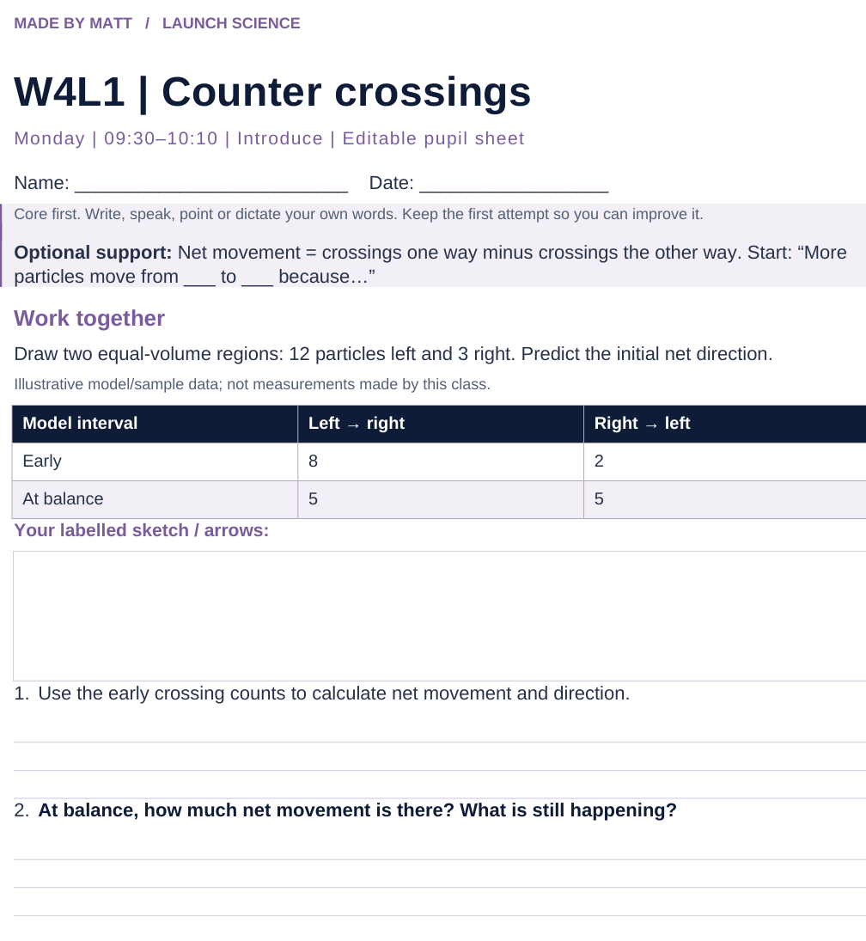
LAUNCH SCIENCE / W4L1
Resources
Worksheet · page 1
Use your printed copy.
Keep the first attempt.
Return to task
Arrival
Starter
I Do
We Do
I Do 2
We Do 2
Independent
Exit
Resources
Notes:
Embedded worksheet reference; print the separate PDF at A4 for writable space.
Core explanation: Particles move randomly in both directions. Net movement is the difference between those two movements, not a rule obeyed by every particle.
Watch for: Passive means no energy supplied by respiration is needed. It does not mean particles have no kinetic energy.
Least help first: Ask the pupil to compare starting counts on both sides before discussing direction.
Support cue: Net movement = crossings one way minus crossings the other way. Start: “More particles move from ___ to ___ because…”
[Sources]
User-supplied LAUNCH W3–W7 pack: W4 Diffusion worksheet particle model and exam task; no W4 PPTX was supplied.
Made by Matt LAUNCH Science draft, lesson-content.json, W4L1; existing illustrative diagrams reused, active-transport direction corrected to lower → higher.
Pearson Edexcel GCSE Biology specification, sections 1.1–1.6 and 1.15–1.17: https://qualifications.pearson.com/content/dam/pdf/GCSE/Science/2016/Specification/gcse-biology-spec.pdf
Optional concept video: freesciencelessons, Diffusion, https://www.youtube.com/watch?v=O965gA4goVI (link located 5 September 2026).
[/Sources]
[Sources]
Source editable lesson: Original LAUNCH Science OneDrive pack, 5 September 2026, W4L1. Source teaching content preserved. Current HTML reference: https://madebymatt.uk/Lessons/Science_Teesside/Launch/. Native diagrams restate the source explanation and are not experimental measurements.
[/Sources]

Slide 19
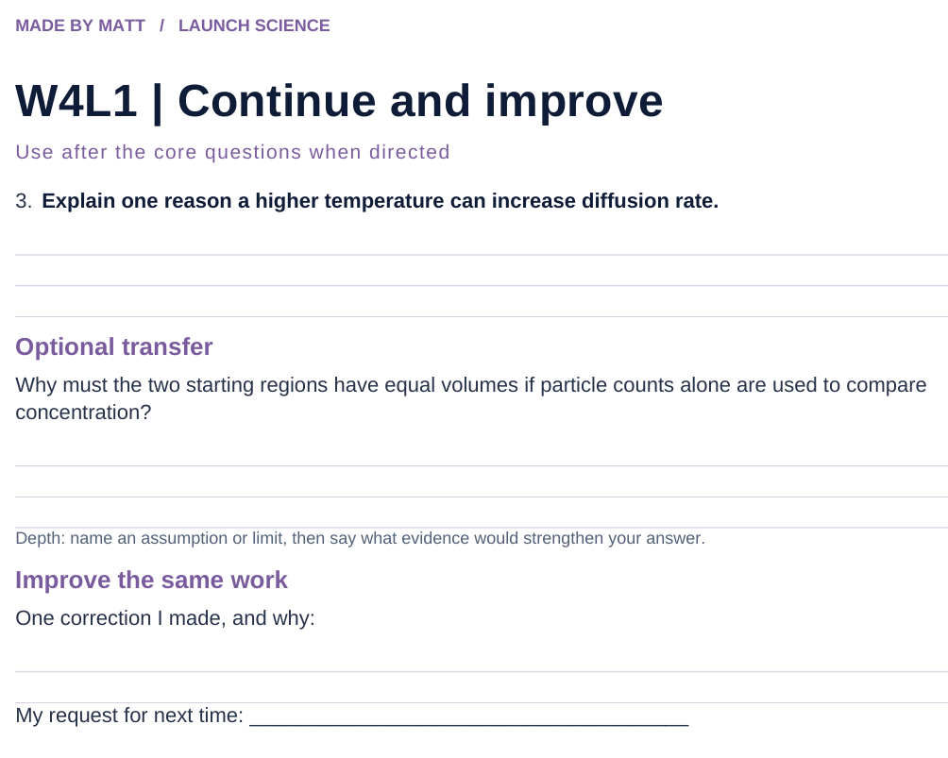
LAUNCH SCIENCE / W4L1
Resources
Worksheet · page 2
Continuation is optional.
Improve the same work.
Return to task
Arrival
Starter
I Do
We Do
I Do 2
We Do 2
Independent
Exit
Resources
Notes:
Embedded worksheet reference; print the separate PDF at A4 for writable space.
Core explanation: Particles move randomly in both directions. Net movement is the difference between those two movements, not a rule obeyed by every particle.
Watch for: Passive means no energy supplied by respiration is needed. It does not mean particles have no kinetic energy.
Least help first: Ask the pupil to compare starting counts on both sides before discussing direction.
Support cue: Net movement = crossings one way minus crossings the other way. Start: “More particles move from ___ to ___ because…”
[Sources]
User-supplied LAUNCH W3–W7 pack: W4 Diffusion worksheet particle model and exam task; no W4 PPTX was supplied.
Made by Matt LAUNCH Science draft, lesson-content.json, W4L1; existing illustrative diagrams reused, active-transport direction corrected to lower → higher.
Pearson Edexcel GCSE Biology specification, sections 1.1–1.6 and 1.15–1.17: https://qualifications.pearson.com/content/dam/pdf/GCSE/Science/2016/Specification/gcse-biology-spec.pdf
Optional concept video: freesciencelessons, Diffusion, https://www.youtube.com/watch?v=O965gA4goVI (link located 5 September 2026).
[/Sources]
[Sources]
Source editable lesson: Original LAUNCH Science OneDrive pack, 5 September 2026, W4L1. Source teaching content preserved. Current HTML reference: https://madebymatt.uk/Lessons/Science_Teesside/Launch/. Native diagrams restate the source explanation and are not experimental measurements.
[/Sources]

Slide 20
LAUNCH SCIENCE / W4L1
Resources
Watch, pause and explain
Diffusion
What keeps happening when there is no net movement?
Play freesciencelessons video
No connection? Use the still model and explain the same question.
Arrival
Starter
I Do
We Do
I Do 2
We Do 2
Independent
Exit
Resources
Notes:
Use at most 90 seconds within I Do. Pause on the first relevant example; ask for a reason. This is an optional concept clip, not evidence of practical completion.
Core explanation: Particles move randomly in both directions. Net movement is the difference between those two movements, not a rule obeyed by every particle.
Watch for: Passive means no energy supplied by respiration is needed. It does not mean particles have no kinetic energy.
Least help first: Ask the pupil to compare starting counts on both sides before discussing direction.
Support cue: Net movement = crossings one way minus crossings the other way. Start: “More particles move from ___ to ___ because…”
[Sources]
User-supplied LAUNCH W3–W7 pack: W4 Diffusion worksheet particle model and exam task; no W4 PPTX was supplied.
Made by Matt LAUNCH Science draft, lesson-content.json, W4L1; existing illustrative diagrams reused, active-transport direction corrected to lower → higher.
Pearson Edexcel GCSE Biology specification, sections 1.1–1.6 and 1.15–1.17: https://qualifications.pearson.com/content/dam/pdf/GCSE/Science/2016/Specification/gcse-biology-spec.pdf
Optional concept video: freesciencelessons, Diffusion, https://www.youtube.com/watch?v=O965gA4goVI (link located 5 September 2026).
[/Sources]
[Sources]
Source editable lesson: Original LAUNCH Science OneDrive pack, 5 September 2026, W4L1. Source teaching content preserved. Current HTML reference: https://madebymatt.uk/Lessons/Science_Teesside/Launch/. Native diagrams restate the source explanation and are not experimental measurements.
[/Sources]

Slide 21
LAUNCH SCIENCE / W4L1
Resources
Look closely at the model
● HIGH CONCENTRATION
○ LOW CONCENTRATION
NET MOVEMENT
↑ STEEPER GRADIENT
↑ HIGHER TEMPERATURE
↑ MORE SURFACE AREA
A model illustration: use the stated data for calculations.
Return to I Do
Arrival
Starter
I Do
We Do
I Do 2
We Do 2
Independent
Exit
Resources
Notes:
Source image: https://madebymatt.uk/Lessons/Science_Teesside/Launch/SCI_L_W4_L1_Diffusion.html; existing vector illustration embedded for offline use.
Core explanation: Particles move randomly in both directions. Net movement is the difference between those two movements, not a rule obeyed by every particle.
Watch for: Passive means no energy supplied by respiration is needed. It does not mean particles have no kinetic energy.
Least help first: Ask the pupil to compare starting counts on both sides before discussing direction.
Support cue: Net movement = crossings one way minus crossings the other way. Start: “More particles move from ___ to ___ because…”
[Sources]
User-supplied LAUNCH W3–W7 pack: W4 Diffusion worksheet particle model and exam task; no W4 PPTX was supplied.
Made by Matt LAUNCH Science draft, lesson-content.json, W4L1; existing illustrative diagrams reused, active-transport direction corrected to lower → higher.
Pearson Edexcel GCSE Biology specification, sections 1.1–1.6 and 1.15–1.17: https://qualifications.pearson.com/content/dam/pdf/GCSE/Science/2016/Specification/gcse-biology-spec.pdf
Optional concept video: freesciencelessons, Diffusion, https://www.youtube.com/watch?v=O965gA4goVI (link located 5 September 2026).
[/Sources]
[Sources]
Diagram labels and particle counts retained from the original editable LAUNCH Science pack, slide17. Recreated as editable shapes to separate labels from triangle edges and boundary lines.
[/Sources]
[Sources]
Source editable lesson: Original LAUNCH Science OneDrive pack, 5 September 2026, W4L1. Source teaching content preserved. Current HTML reference: https://madebymatt.uk/Lessons/Science_Teesside/Launch/. Native diagrams restate the source explanation and are not experimental measurements.
[/Sources]

