Slide 1

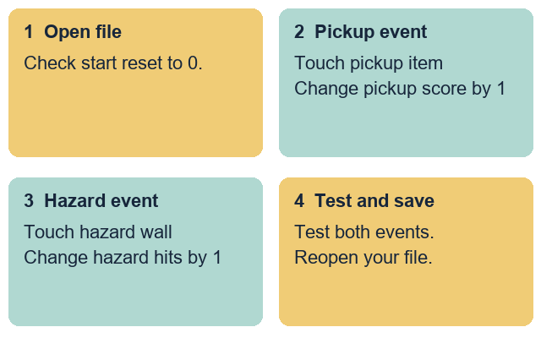
GROW ICT • YEAR A • AUTUMN 2 · WEEK 2
OPENING
Update scores from two game events
I can add one point when the player touches a pickup.
I can add one hit when the player touches a hazard.
I can choose change blocks instead of set blocks.
I can save and test my maze project.
Fictional teaching model
ICT-GROW-A2-W02 • Year A • 1/14
Made by Matt
Notes:
ICT_GROW_A2_W02; Year A; week commencing 9 November 2026.
Introduce Week 2 of the GROW ICT Autumn 2 maze sequence for the unit award. All variable names and event rules come from fictional project cards A and B. Keep personal names, places and external account details out of the task.
Term theme: Identity & Belonging. Careers: Game testers check that each player action updates the right counter on screen.
Source: OWNER_APPROVED_ICT_OUTLINE.txt, issue 1. Continuation of Autumn 1 GROW Computing two-level maze sequence for the unit award.

Slide 2
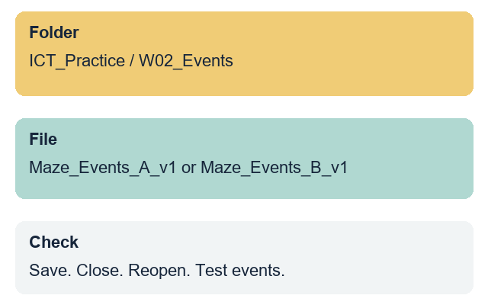
GROW ICT • YEAR A • AUTUMN 2 · WEEK 2
ARRIVAL • 3 MIN
Our variable skills from last week
Where did you save your Week 1 maze file?
Which two score variables did you create?
How do both variables reset to zero on start?
Open your Week 1 file or the clean starter file.
Fictional teaching model
Your response: Show or explain how your start script resets both scores.
ICT-GROW-A2-W02 • Year A • 2/14
Made by Matt
Notes:
ICT_GROW_A2_W02; Year A; week commencing 9 November 2026.
Retrieve the Week 1 file and check that both score variables reset to 0 on start. If a pupil's Week 1 file is absent, open the prepared Week 2 starter maze file with both variables and start resets ready.
Term theme: Identity & Belonging. Careers: Game testers check that each player action updates the right counter on screen.
Source: OWNER_APPROVED_ICT_OUTLINE.txt, issue 1. Continuation of Autumn 1 GROW Computing two-level maze sequence for the unit award.

Slide 3
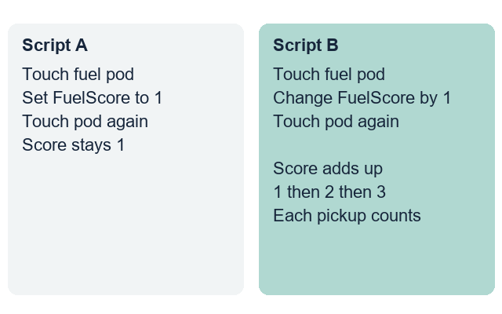
GROW ICT • YEAR A • AUTUMN 2 · WEEK 2
STARTER • 4 MIN
Why is Score A stuck at 1?
Look at Script A and Script B. Which script adds points each time you touch a pickup?
Fictional teaching model
Your response: Choose a script and explain why the score goes up.
ICT-GROW-A2-W02 • Year A • 3/14
Made by Matt
Notes:
ICT_GROW_A2_W02; Year A; week commencing 9 November 2026.
Compare a pickup script that uses set FuelScore to 1 with one that uses change FuelScore by 1. Explain that set fixes the value at 1 every time, while change adds 1 to the current total.
Term theme: Identity & Belonging. Careers: Game testers check that each player action updates the right counter on screen.
Source: OWNER_APPROVED_ICT_OUTLINE.txt, issue 1. Continuation of Autumn 1 GROW Computing two-level maze sequence for the unit award.
Term theme: Identity & Belonging. Careers: Office support staff use headings and clear paragraphs so readers can find the right information.
Source: OWNER_APPROVED_ICT_OUTLINE.txt, issue 1. Context: LAUNCH KS4 - 2026-27-2.xlsx, LAUNCH - Autumn C19 and E19; Theme & Text Map B5. Accepted predecessor: LAUNCH_ICT_A2_W01_BUNDLE.zip, School/ICT_LAUNCH_A2_W01_Slides.pptx.

Slide 4
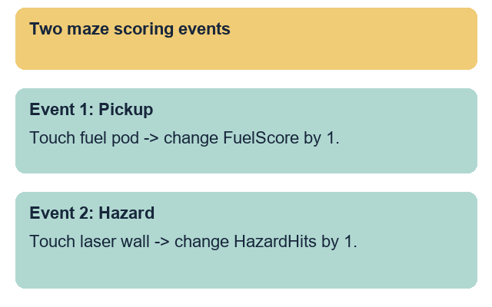
GROW ICT • YEAR A • AUTUMN 2 · WEEK 2
MODEL • 3 MIN
Update the pickup variable on contact
Check when the player touches the pickup sprite.
Change the pickup variable by 1 inside that check.
Fictional teaching model
Your response: Point to the block that adds one pickup point.
ICT-GROW-A2-W02 • Year A • 4/14
Made by Matt
Notes:
ICT_GROW_A2_W02; Year A; week commencing 9 November 2026.
Model adding a touching check for the pickup item in Card A. Place change FuelScore by 1 inside the touching check and make sure the variable drop-down selects FuelScore, not HazardHits.
Term theme: Identity & Belonging. Careers: Game testers check that each player action updates the right counter on screen.
Source: OWNER_APPROVED_ICT_OUTLINE.txt, issue 1. Continuation of Autumn 1 GROW Computing two-level maze sequence for the unit award.

Slide 5
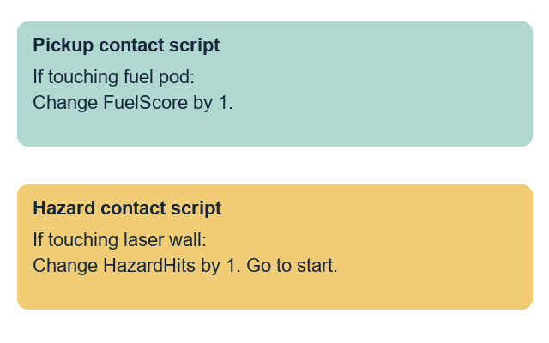
GROW ICT • YEAR A • AUTUMN 2 · WEEK 2
MODEL • 3 MIN
Update the hazard variable on contact
Check when the player touches a hazard wall.
Change the hazard variable by 1 and return to start.
Fictional teaching model
Your response: Point to the block that records a hazard hit.
ICT-GROW-A2-W02 • Year A • 5/14
Made by Matt
Notes:
ICT_GROW_A2_W02; Year A; week commencing 9 November 2026.
Model the second event rule for Card A: when touching the hazard wall, change HazardHits by 1 and move the player back to the start pad so the hit is counted clearly.
Term theme: Identity & Belonging. Careers: Game testers check that each player action updates the right counter on screen.
Source: OWNER_APPROVED_ICT_OUTLINE.txt, issue 1. Continuation of Autumn 1 GROW Computing two-level maze sequence for the unit award.

Slide 6
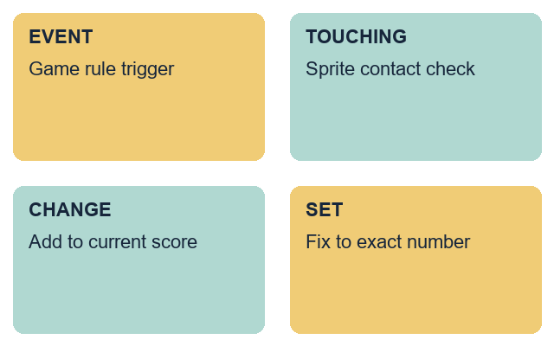
GROW ICT • YEAR A • AUTUMN 2 · WEEK 2
WORDS • 2 MIN
Words for scoring events
event: a trigger that runs a rule in the game
touching: a check for contact between two sprites
change: add to or take away from a variable value
set: fix a variable to one exact value
Fictional teaching model
Your response: Use one word to explain how a score goes up.
ICT-GROW-A2-W02 • Year A • 6/14
Made by Matt
Notes:
ICT_GROW_A2_W02; Year A; week commencing 9 November 2026.
Teach the four words using the two event scripts on screen. Highlight the difference between set on start and change on contact.
Term theme: Identity & Belonging. Careers: Game testers check that each player action updates the right counter on screen.
Source: OWNER_APPROVED_ICT_OUTLINE.txt, issue 1. Continuation of Autumn 1 GROW Computing two-level maze sequence for the unit award.

Slide 7
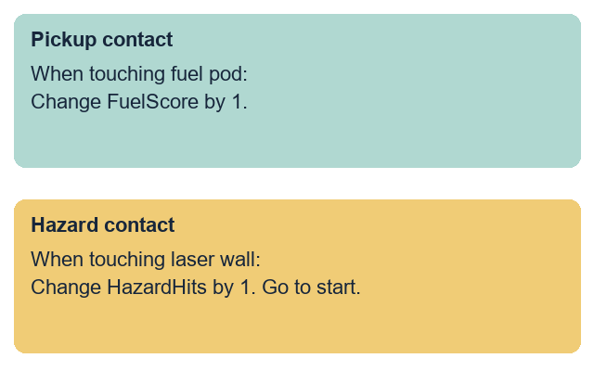
GROW ICT • YEAR A • AUTUMN 2 · WEEK 2
TOGETHER • 5 MIN
Match each event to its score block
Touch fuel pod: change FuelScore by 1.
Touch hazard wall: change HazardHits by 1.
Fictional teaching model
Your response: Match each maze contact to the right variable block.
ICT-GROW-A2-W02 • Year A • 7/14
Made by Matt
Notes:
ICT_GROW_A2_W02; Year A; week commencing 9 November 2026.
Use Space maze card A. Match pickup contact to change FuelScore by 1 and hazard contact to change HazardHits by 1. Check that set-to-zero stays on the start event only.
Term theme: Identity & Belonging. Careers: Game testers check that each player action updates the right counter on screen.
Source: OWNER_APPROVED_ICT_OUTLINE.txt, issue 1. Continuation of Autumn 1 GROW Computing two-level maze sequence for the unit award.
Term theme: Identity & Belonging. Careers: Office support staff use headings and clear paragraphs so readers can find the right information.
Source: OWNER_APPROVED_ICT_OUTLINE.txt, issue 1. Context: LAUNCH KS4 - 2026-27-2.xlsx, LAUNCH - Autumn C19 and E19; Theme & Text Map B5. Accepted predecessor: LAUNCH_ICT_A2_W01_BUNDLE.zip, School/ICT_LAUNCH_A2_W01_Slides.pptx.

Slide 8
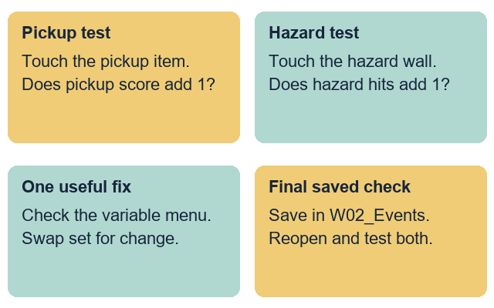
GROW ICT • YEAR A • AUTUMN 2 · WEEK 2
CHECK • 3 MIN
A partner tests both game events
Touch the pickup and watch the pickup readout.
Touch the hazard and watch the hazard readout.
Fictional teaching model
Your response: Give one fix if the wrong variable changes.
ICT-GROW-A2-W02 • Year A • 8/14
Made by Matt
Notes:
ICT_GROW_A2_W02; Year A; week commencing 9 November 2026.
Model testing both events in turn: touch the pickup, check that FuelScore increases by 1, then touch the hazard wall and check that HazardHits increases by 1. Press start to verify both still reset to 0.
Term theme: Identity & Belonging. Careers: Game testers check that each player action updates the right counter on screen.
Source: OWNER_APPROVED_ICT_OUTLINE.txt, issue 1. Continuation of Autumn 1 GROW Computing two-level maze sequence for the unit award.
Term theme: Identity & Belonging. Careers: Office support staff use headings and clear paragraphs so readers can find the right information.
Source: OWNER_APPROVED_ICT_OUTLINE.txt, issue 1. Context: LAUNCH KS4 - 2026-27-2.xlsx, LAUNCH - Autumn C19 and E19; Theme & Text Map B5. Accepted predecessor: LAUNCH_ICT_A2_W01_BUNDLE.zip, School/ICT_LAUNCH_A2_W01_Slides.pptx.

Slide 9
GROW ICT • YEAR A • AUTUMN 2 · WEEK 2
YOUR TASK • 12 MIN
Update scores from two events in your maze
Supported: use the two-event scoring frame.
Independent: build and test both event score rules.
Aspire: add a finish bonus event and save v2.
Each person saves and checks their own project file.
Fictional teaching model
Your response: Choose a route and build your two scoring events.
ICT-GROW-A2-W02 • Year A • 9/14
Made by Matt
Notes:
ICT_GROW_A2_W02; Year A; week commencing 9 November 2026.
Slides 10-13 share this 12-minute task time. Each pupil updates their own maze file in ICT_Practice/W02_Events. A shared device uses six-minute turns: Card A then Card B, swapping builder and tester roles.
Term theme: Identity & Belonging. Careers: Game testers check that each player action updates the right counter on screen.
Source: OWNER_APPROVED_ICT_OUTLINE.txt, issue 1. Continuation of Autumn 1 GROW Computing two-level maze sequence for the unit award.

Slide 10
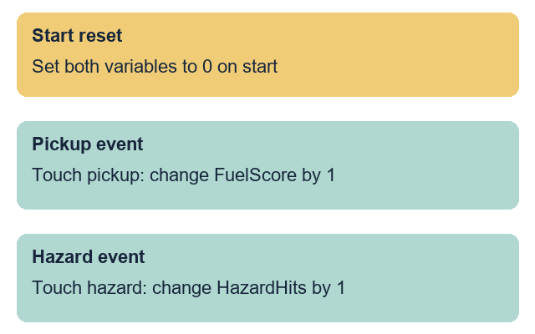
GROW ICT • YEAR A • AUTUMN 2 · WEEK 2
ROUTE
Supported
Open your maze file for card A or card B.
Add change pickup score by 1 to the pickup check.
Add change hazard hits by 1 to the hazard check.
Test both events with your partner.
Save, reopen and test the events again.
Fictional teaching model
Your response: Show each score changing when you touch each item.
ICT-GROW-A2-W02 • Year A • 10/14
Made by Matt
Notes:
ICT_GROW_A2_W02; Year A; week commencing 9 November 2026.
Use the Supported planning frame. Point to the two touching checks and let the pupil choose the variable name and change value. Record any prompts or exact scribing used.
Term theme: Identity & Belonging. Careers: Game testers check that each player action updates the right counter on screen.
Source: OWNER_APPROVED_ICT_OUTLINE.txt, issue 1. Continuation of Autumn 1 GROW Computing two-level maze sequence for the unit award.

Slide 11
GROW ICT • YEAR A • AUTUMN 2 · WEEK 2
ROUTE
Independent
Open your maze file for card A or card B.
Build the pickup contact rule to add 1 to the pickup score.
Build the hazard contact rule to add 1 to hazard hits.
Test pickup contact, hazard contact and start reset.
Save your file in W02_Events, then reopen it.
Fictional teaching model
Your response: Ask your partner to test both scoring events.
ICT-GROW-A2-W02 • Year A • 11/14
Made by Matt
Notes:
ICT_GROW_A2_W02; Year A; week commencing 9 November 2026.
The pupil builds both event rules using their project card and saves as Maze_Events_A_v1 or Maze_Events_B_v1 in ICT_Practice/W02_Events.
Term theme: Identity & Belonging. Careers: Game testers check that each player action updates the right counter on screen.
Source: OWNER_APPROVED_ICT_OUTLINE.txt, issue 1. Continuation of Autumn 1 GROW Computing two-level maze sequence for the unit award.

Slide 12
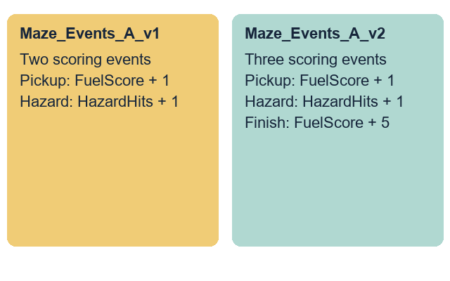
GROW ICT • YEAR A • AUTUMN 2 · WEEK 2
ROUTE
Aspire
Complete the Independent task first.
Add the finish gate bonus rule from your project card.
Change the pickup score by 5 when touching the finish.
Ask a partner to test all three scoring events.
Save a new v2 file and explain your change.
Fictional teaching model
Your response: Show how the finish gate adds a bonus to your score.
ICT-GROW-A2-W02 • Year A • 12/14
Made by Matt
Notes:
ICT_GROW_A2_W02; Year A; week commencing 9 November 2026.
Use the card's stretch rule to add a +5 finish bonus when touching the finish target. Save as Maze_Events_A_v2 or Maze_Events_B_v2 while keeping v1.
Term theme: Identity & Belonging. Careers: Game testers check that each player action updates the right counter on screen.
Source: OWNER_APPROVED_ICT_OUTLINE.txt, issue 1. Continuation of Autumn 1 GROW Computing two-level maze sequence for the unit award.

Slide 13
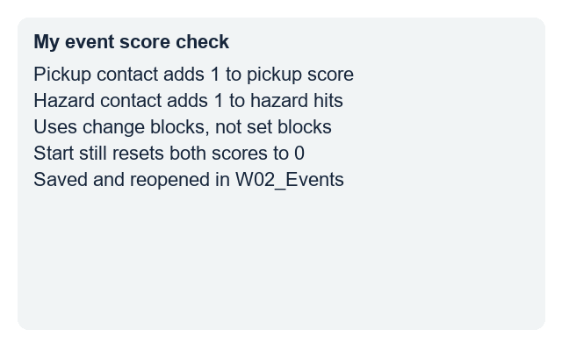
GROW ICT • YEAR A • AUTUMN 2 · WEEK 2
EVIDENCE
My evidence record
My file name is ...
My pickup event changes ... by ...
My hazard event changes ... by ...
I fixed or improved ... because ...
I reopened the saved file and tested both events.
Fictional teaching model
Your response: Record your two event rules and the help used.
ICT-GROW-A2-W02 • Year A • 13/14
Made by Matt
Notes:
ICT_GROW_A2_W02; Year A; week commencing 9 November 2026.
Observe the pickup score rule, the hazard hit rule, the distinction between change and set, and the reopened file check. Record actual support. Do not prefill pupil codes or tick boxes.
Term theme: Identity & Belonging. Careers: Game testers check that each player action updates the right counter on screen.
Source: OWNER_APPROVED_ICT_OUTLINE.txt, issue 1. Continuation of Autumn 1 GROW Computing two-level maze sequence for the unit award.

Slide 14
GROW ICT • YEAR A • AUTUMN 2 · WEEK 2
EXIT • 5 MIN
How do events update our scores?
Show your pickup event and your hazard event.
Explain why we use change by 1 instead of set to 1.
Open your saved file and test both events.
Fictional teaching model
Your response: Show your two event rules and give one reason.
ICT-GROW-A2-W02 • Year A • 14/14
Made by Matt
Notes:
ICT_GROW_A2_W02; Year A; week commencing 9 November 2026.
Three minutes for individual checks, two for feedback and close. Check the saved file in W02_Events. Week 3 stops a pickup counting more than once. Week 7 is the assessing lesson; this week is formative.
Term theme: Identity & Belonging. Careers: Game testers check that each player action updates the right counter on screen.
Source: OWNER_APPROVED_ICT_OUTLINE.txt, issue 1. Continuation of Autumn 1 GROW Computing two-level maze sequence for the unit award.

