Slide 1

Look closely at rocks
I am learning to look at rocks and sort them.
I can look and feel.
I can sort two rocks.
I can tell my sort rule.
SCI-BUILD-A2-W02 • BUILD Science
1
Made by Matt · madebymatt.uk · © Matt Roper · CC BY-NC-SA 4.0: free for classroom use, share and adapt with credit, no resale · v9 · 25 Sep 2026
Notes:
Lesson code: SCI-BUILD-A2-W02
SoW objective: Compare and group rocks by their appearance and simple properties.
Reading band: BUILD below age 8
Staff focus: {'i_do': 'Watch my first step. What do you see?', 'we_do': 'What step is missing? Show it with the kit.', 'independent': 'What can you do first on your own?'}
Prompt ladder: ['Wait and count to 5.', 'Point to the object or model.', 'Ask: What will you check next?', 'Model one step and give the next turn back.', 'Finish one example together, then let the pupil try.']
Sources:
https://www.gov.uk/government/publications/national-curriculum-in-england-science-programmes-of-study/national-curriculum-in-england-science-programmes-of-study
https://www.gov.uk/government/publications/national-curriculum-in-england-science-programmes-of-study/national-curriculum-in-england-science-programmes-of-study ; https://www.bgs.ac.uk/discovering-geology/maps-and-resources/grain-size-charts/
BUILD scheme of work, Autumn 2 week 1
BUILD scheme of work, Autumn 1 week 7
BUILD scheme of work, Autumn 1 week 4
Local school risk assessment and CLEAPSS guidance; staff confirm exact kit

Slide 2
Arrival
Look at two safe rocks. Point to one you know.
SCI-BUILD-A2-W02 • BUILD Science
2
Made by Matt · madebymatt.uk · © Matt Roper · CC BY-NC-SA 4.0: free for classroom use, share and adapt with credit, no resale · v9 · 25 Sep 2026
Notes:
Offer a safe kit choice and short first–then cue.

Slide 3
Starter
Think back. Say, sign or point.
What are three ways to use less waste?
How do animals get food?
Which part helps you move with bones?
SCI-BUILD-A2-W02 • BUILD Science
3
Made by Matt · madebymatt.uk · © Matt Roper · CC BY-NC-SA 4.0: free for classroom use, share and adapt with credit, no resale · v9 · 25 Sep 2026
Notes:
Ask three low-stakes prior questions; answers in note.
What are three ways to use less waste? → Use less, use again, recycle.
How do animals get food? → From what they eat.
Which part helps you move with bones? → Muscles.

Slide 4
Model
Watch one rock sort.
This rock feels rough. I put it with the rough rocks.
SCI-BUILD-A2-W02 • BUILD Science
4
Made by Matt · madebymatt.uk · © Matt Roper · CC BY-NC-SA 4.0: free for classroom use, share and adapt with credit, no resale · v9 · 25 Sep 2026
Notes:
Pre-teach words; show the full model; ask the show-me check.

Slide 5
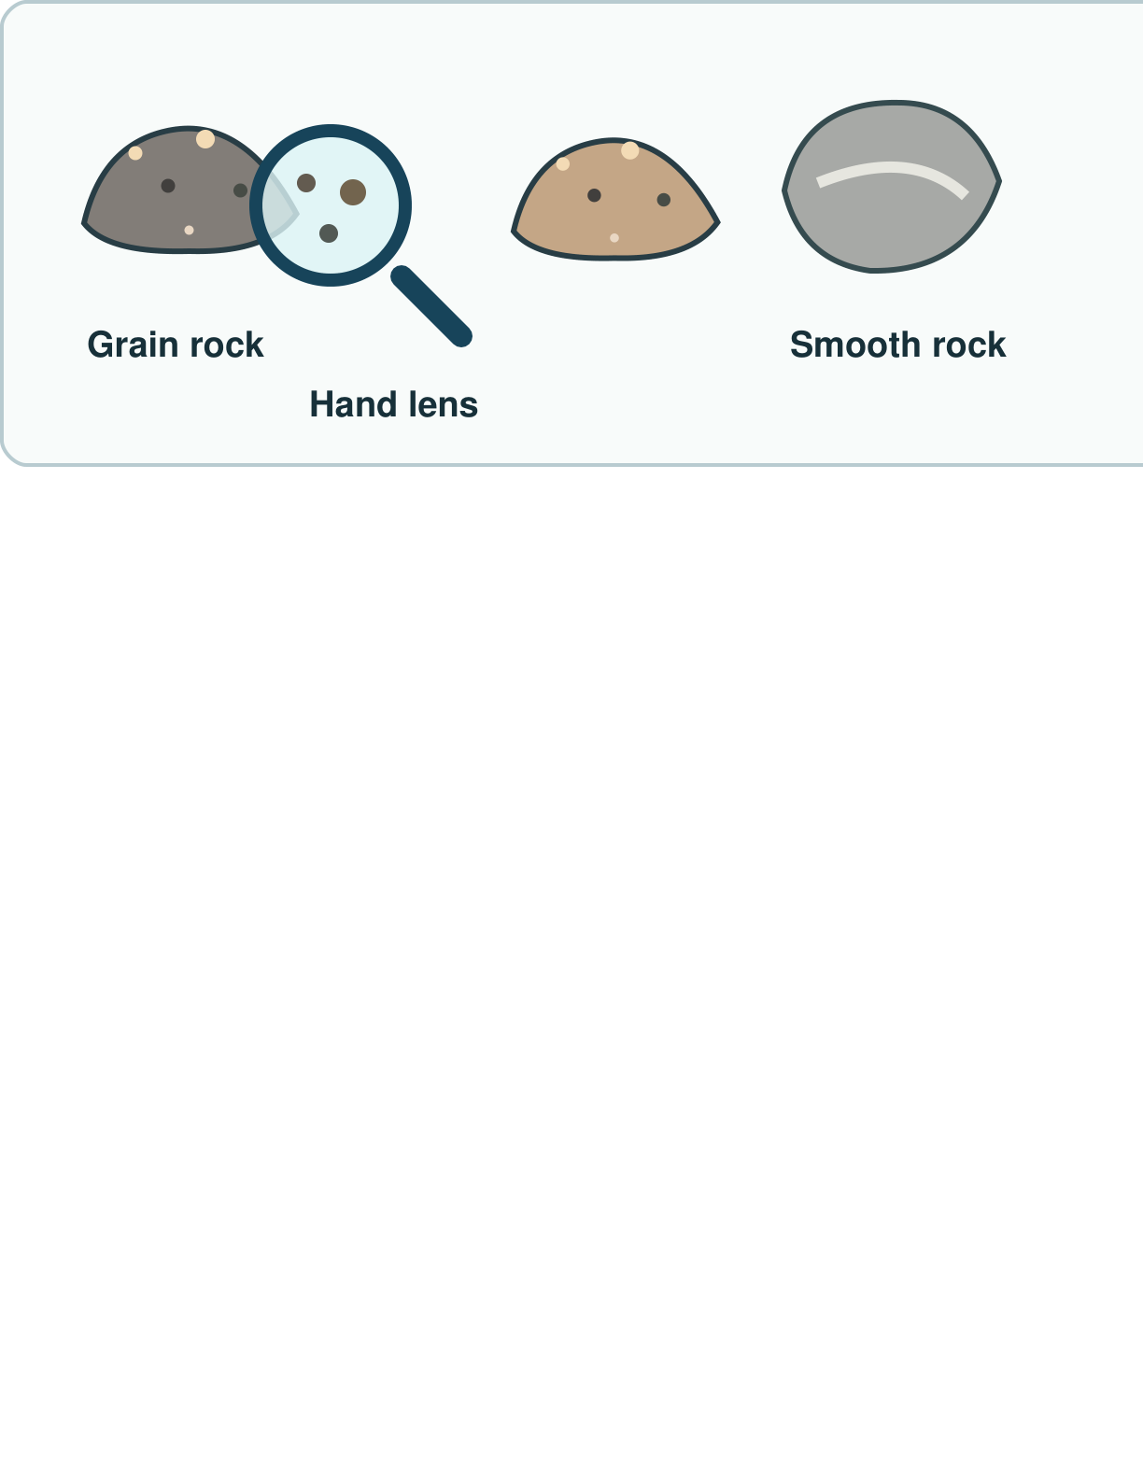
Picture model
SCI-BUILD-A2-W02 • BUILD Science
5
Made by Matt · madebymatt.uk · © Matt Roper · CC BY-NC-SA 4.0: free for classroom use, share and adapt with credit, no resale · v9 · 25 Sep 2026
Notes:
Look at grains with a hand lens. Compare with a smoother sample. Simplified; not to scale.

Slide 6
Show me
Point to the sample that feels rough.
SCI-BUILD-A2-W02 • BUILD Science
6
Made by Matt · madebymatt.uk · © Matt Roper · CC BY-NC-SA 4.0: free for classroom use, share and adapt with credit, no resale · v9 · 25 Sep 2026
Notes:
The sample with the rough surface; depend on the real kit.

Slide 7
Our turn
Feel two rocks. Sort safe samples.
This rock feels smooth. I put it with the ____ rocks.
SCI-BUILD-A2-W02 • BUILD Science
7
Made by Matt · madebymatt.uk · © Matt Roper · CC BY-NC-SA 4.0: free for classroom use, share and adapt with credit, no resale · v9 · 25 Sep 2026
Notes:
Hand over the missing step; offer F or H route. Reset once.
Missing step: Name the group from an observed property.

Slide 8
Talk, then sort
Smooth
Rough
Practice clue: smooth face
Practice clue: bumpy face
Practice clue: jagged edge
SCI-BUILD-A2-W02 • BUILD Science
8
Made by Matt · madebymatt.uk · © Matt Roper · CC BY-NC-SA 4.0: free for classroom use, share and adapt with credit, no resale · v9 · 25 Sep 2026
Notes:
Practice clue: smooth face → Smooth
Practice clue: bumpy face → Rough
Practice clue: jagged edge → Rough

Slide 9
Check
Two rocks look alike. How can you sort them?
A. Check one thing you can see or feel
B. Guess from the name
C. Call them the same
D. Use only a photo of colour
SCI-BUILD-A2-W02 • BUILD Science
9
Made by Matt · madebymatt.uk · © Matt Roper · CC BY-NC-SA 4.0: free for classroom use, share and adapt with credit, no resale · v9 · 25 Sep 2026
Notes:
Take all pupil responses at once; use decision rule and parallel hinge.
A. Check one thing you can see or feel | Correct | Uses an observed property.
B. Guess from the name | Not correct | Uses a label instead of checking.
C. Call them the same | Not correct | Misses a possible difference.
D. Use only a photo of colour | Not correct | Assumes one cue tells all properties.
About 3 in 4 or more right → move on; otherwise re-model This rock feels rough. I put it with the rough rocks. Ask the parallel hinge. No scores or answers saved.

Slide 10
Independent · F
Sort a safe rock. Show your rule.
Look at two rocks. Point to one change.
This one feels ____.
SCI-BUILD-A2-W02 • BUILD Science
10
Made by Matt · madebymatt.uk · © Matt Roper · CC BY-NC-SA 4.0: free for classroom use, share and adapt with credit, no resale · v9 · 25 Sep 2026
Notes:
Choose one adult for supported pupils, one for group; swap across the week.

Slide 11
Independent · M
Sort a safe rock. Show your rule.
Sort two rocks by one thing you can check.
I put these in one group as they are ____.
SCI-BUILD-A2-W02 • BUILD Science
11
Made by Matt · madebymatt.uk · © Matt Roper · CC BY-NC-SA 4.0: free for classroom use, share and adapt with credit, no resale · v9 · 25 Sep 2026
Notes:
Choose one adult for supported pupils, one for group; swap across the week.

Slide 12
Independent · H
Sort a safe rock. Show your rule.
Sort the same rocks in two ways. Tell why.
I can sort them by ____ and by ____.
SCI-BUILD-A2-W02 • BUILD Science
12
Made by Matt · madebymatt.uk · © Matt Roper · CC BY-NC-SA 4.0: free for classroom use, share and adapt with credit, no resale · v9 · 25 Sep 2026
Notes:
Choose one adult for supported pupils, one for group; swap across the week.

Slide 13
Go deeper
Could one rock fit two groups? Show both rules.
Swap the rule. Which rocks move group, and why?
SCI-BUILD-A2-W02 • BUILD Science
13
Made by Matt · madebymatt.uk · © Matt Roper · CC BY-NC-SA 4.0: free for classroom use, share and adapt with credit, no resale · v9 · 25 Sep 2026

Slide 14
Review
Show one sort. Hear one next step.
SCI-BUILD-A2-W02 • BUILD Science
14
Made by Matt · madebymatt.uk · © Matt Roper · CC BY-NC-SA 4.0: free for classroom use, share and adapt with credit, no resale · v9 · 25 Sep 2026
Notes:
Give VF and one NS(+); invite one self-edit. Reset once.

Slide 15
Exit
Show your rule to an adult.
Read it back: I am learning to look at rocks and sort them.
My feedback was… I showed…
Next I need to… try one small fix.
How I know: I can look and feel. I can sort two rocks. I can tell my sort rule.
Tell your teacher. They will pick our next start.
Take one quiet minute before the next lesson.
SCI-BUILD-A2-W02 • BUILD Science
15
Made by Matt · madebymatt.uk · © Matt Roper · CC BY-NC-SA 4.0: free for classroom use, share and adapt with credit, no resale · v9 · 25 Sep 2026
Notes:
Hear feedback and next step, choose next start, then one-minute reset.

Slide 16
Word help · rock
a solid thing from the ground
I hold a safe rock.
SCI-BUILD-A2-W02 • BUILD Science
16
Made by Matt · madebymatt.uk · © Matt Roper · CC BY-NC-SA 4.0: free for classroom use, share and adapt with credit, no resale · v9 · 25 Sep 2026

Slide 17
Word help · grain
a small bit in a rock
I see tiny grains.
SCI-BUILD-A2-W02 • BUILD Science
17
Made by Matt · madebymatt.uk · © Matt Roper · CC BY-NC-SA 4.0: free for classroom use, share and adapt with credit, no resale · v9 · 25 Sep 2026

Slide 18
Word help · property
a thing you can check
This rock feels rough.
SCI-BUILD-A2-W02 • BUILD Science
18
Made by Matt · madebymatt.uk · © Matt Roper · CC BY-NC-SA 4.0: free for classroom use, share and adapt with credit, no resale · v9 · 25 Sep 2026

Slide 19
Word help · group
things put together by a rule
These rocks are smooth.
SCI-BUILD-A2-W02 • BUILD Science
19
Made by Matt · madebymatt.uk · © Matt Roper · CC BY-NC-SA 4.0: free for classroom use, share and adapt with credit, no resale · v9 · 25 Sep 2026

