Slide 1

Test rock hardness and water
I am learning to test a rock in two ways.
I can show a safe mark test.
I can watch where drops go.
I can tell what I saw.
SCI-BUILD-A2-W03 • BUILD Science
1
Made by Matt · madebymatt.uk · © Matt Roper · CC BY-NC-SA 4.0: free for classroom use, share and adapt with credit, no resale · v9 · 25 Sep 2026
Notes:
Lesson code: SCI-BUILD-A2-W03
SoW objective: Test rocks for hardness and whether they let water through.
Reading band: BUILD below age 8
Staff focus: {'i_do': 'Watch my first step. What do you see?', 'we_do': 'What step is missing? Show it with the kit.', 'independent': 'What can you do first on your own?'}
Prompt ladder: ['Wait and count to 5.', 'Point to the object or model.', 'Ask: What will you check next?', 'Model one step and give the next turn back.', 'Finish one example together, then let the pupil try.']
Sources:
https://www.bgs.ac.uk/?wpdmdl=102317 ; https://www.usgs.gov/water-science-school/science/aquifers-and-groundwater
https://www.usgs.gov/water-science-school/science/aquifers-and-groundwater
Authored classroom apparatus; inspect actual route during lesson
https://www.gov.uk/government/publications/national-curriculum-in-england-science-programmes-of-study/national-curriculum-in-england-science-programmes-of-study
BUILD scheme of work, Autumn 2 week 2
BUILD scheme of work, Autumn 2 week 1
BUILD scheme of work, Autumn 1 week 1
Local school risk assessment and CLEAPSS guidance; staff confirm exact kit

Slide 2
Arrival
Point to a safe rock.
SCI-BUILD-A2-W03 • BUILD Science
2
Made by Matt · madebymatt.uk · © Matt Roper · CC BY-NC-SA 4.0: free for classroom use, share and adapt with credit, no resale · v9 · 25 Sep 2026
Notes:
Offer a safe kit choice and short first–then cue.

Slide 3
Starter
Think back. Say, sign or point.
How can we sort two rocks?
What can we do with a clean tub?
Name one body part that helps protect organs.
SCI-BUILD-A2-W03 • BUILD Science
3
Made by Matt · madebymatt.uk · © Matt Roper · CC BY-NC-SA 4.0: free for classroom use, share and adapt with credit, no resale · v9 · 25 Sep 2026
Notes:
Ask three low-stakes prior questions; answers in note.
How can we sort two rocks? → Check a property you can see or feel.
What can we do with a clean tub? → Use it again if safe.
Name one body part that helps protect organs. → A skeleton or bones.

Slide 4
Model
Watch two safe tests.
Adult uses one blunt tool. A gets a mark. Three drops stay on top.
SCI-BUILD-A2-W03 • BUILD Science
4
Made by Matt · madebymatt.uk · © Matt Roper · CC BY-NC-SA 4.0: free for classroom use, share and adapt with credit, no resale · v9 · 25 Sep 2026
Notes:
Pre-teach words; show the full model; ask the show-me check.

Slide 5
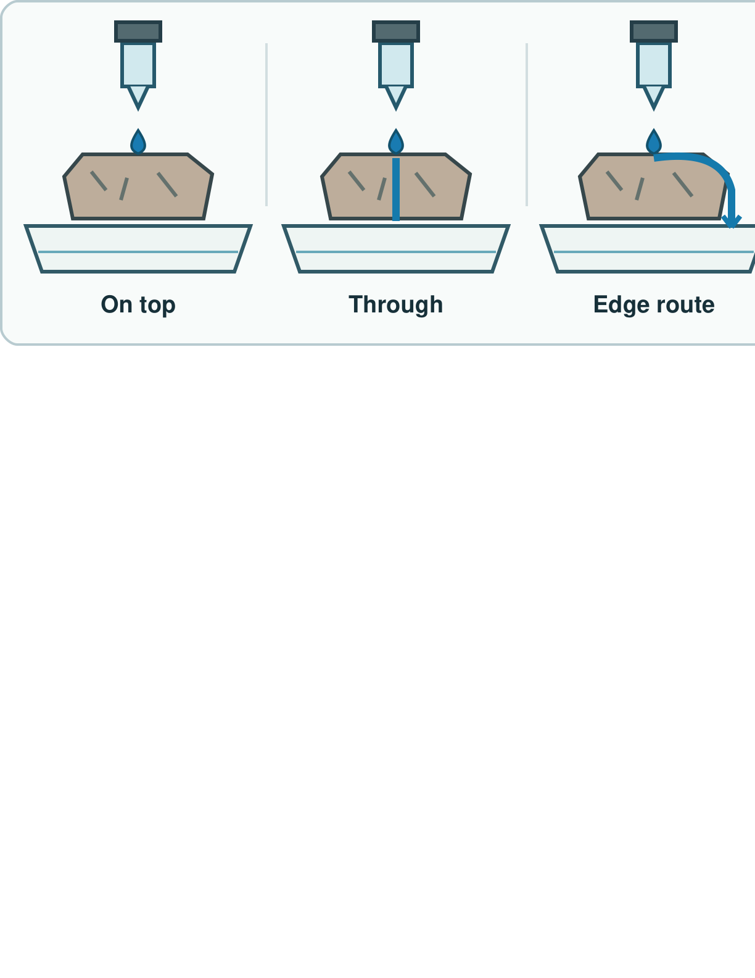
Picture model
SCI-BUILD-A2-W03 • BUILD Science
5
Made by Matt · madebymatt.uk · © Matt Roper · CC BY-NC-SA 4.0: free for classroom use, share and adapt with credit, no resale · v9 · 25 Sep 2026
Notes:
Check the path: on top, through the rock or round its edge. The pictures are models, not test results. Simplified; not to scale.

Slide 6
Show me
Is a wet top proof that water went right through?
SCI-BUILD-A2-W03 • BUILD Science
6
Made by Matt · madebymatt.uk · © Matt Roper · CC BY-NC-SA 4.0: free for classroom use, share and adapt with credit, no resale · v9 · 25 Sep 2026
Notes:
No. Look beneath the rock or in the tray to check whether any water passed through.

Slide 7
Our turn
Test two safe rocks.
Mark B. Add three drops. The drops ____.
SCI-BUILD-A2-W03 • BUILD Science
7
Made by Matt · madebymatt.uk · © Matt Roper · CC BY-NC-SA 4.0: free for classroom use, share and adapt with credit, no resale · v9 · 25 Sep 2026
Notes:
Hand over the missing step; offer F or H route. Reset once.
Missing step: State the observed result at rock B, rather than guess it.

Slide 8
Talk, then sort
Mark test
Water test
Use an adult-held blunt tool
Add three drops
Look in the tray below
SCI-BUILD-A2-W03 • BUILD Science
8
Made by Matt · madebymatt.uk · © Matt Roper · CC BY-NC-SA 4.0: free for classroom use, share and adapt with credit, no resale · v9 · 25 Sep 2026
Notes:
Use an adult-held blunt tool → Mark test
Add three drops → Water test
Look in the tray below → Water test

Slide 9
Check
The tray under a new rock C is wet before the water test. What should the class do first?
A. Call C porous from the wet tray.
B. Call C hard from the wet tray.
C. Skip the test and guess from colour.
D. Dry the tray, then repeat the test.
SCI-BUILD-A2-W03 • BUILD Science
9
Made by Matt · madebymatt.uk · © Matt Roper · CC BY-NC-SA 4.0: free for classroom use, share and adapt with credit, no resale · v9 · 25 Sep 2026
Notes:
Take all pupil responses at once; use decision rule and parallel hinge.
A. Call C porous from the wet tray. | Not correct | Uses water present before the test as a result.
B. Call C hard from the wet tray. | Not correct | Confuses a water clue with hardness.
C. Skip the test and guess from colour. | Not correct | Uses appearance instead of the planned check.
D. Dry the tray, then repeat the test. | Correct | Removes the old water before observing a new result.
About 3 in 4 or more right → move on; otherwise re-model Adult uses one blunt tool. A gets a mark. Three drops stay on top. Ask the parallel hinge. No scores or answers saved.

Slide 10
Independent · F
Show each test. Record what you saw.
Point to a mark and a wet rock.
I can see ____ on the rock.
SCI-BUILD-A2-W03 • BUILD Science
10
Made by Matt · madebymatt.uk · © Matt Roper · CC BY-NC-SA 4.0: free for classroom use, share and adapt with credit, no resale · v9 · 25 Sep 2026
Notes:
Choose one adult for supported pupils, one for group; swap across the week.

Slide 11
Independent · M
Show each test. Record what you saw.
Show both tests. Tell what you saw.
The drops ____ on sample ____.
SCI-BUILD-A2-W03 • BUILD Science
11
Made by Matt · madebymatt.uk · © Matt Roper · CC BY-NC-SA 4.0: free for classroom use, share and adapt with credit, no resale · v9 · 25 Sep 2026
Notes:
Choose one adult for supported pupils, one for group; swap across the week.

Slide 12
Independent · H
Show each test. Record what you saw.
Why use the same tool and drops?
This is fair as I kept ____ the same.
SCI-BUILD-A2-W03 • BUILD Science
12
Made by Matt · madebymatt.uk · © Matt Roper · CC BY-NC-SA 4.0: free for classroom use, share and adapt with credit, no resale · v9 · 25 Sep 2026
Notes:
Choose one adult for supported pupils, one for group; swap across the week.

Slide 13
Go deeper
Could a hard rock also let water through? Use each test result.
A drop slides off. How will you fix the test?
SCI-BUILD-A2-W03 • BUILD Science
13
Made by Matt · madebymatt.uk · © Matt Roper · CC BY-NC-SA 4.0: free for classroom use, share and adapt with credit, no resale · v9 · 25 Sep 2026

Slide 14
Review
Check one result. Hear a next step.
SCI-BUILD-A2-W03 • BUILD Science
14
Made by Matt · madebymatt.uk · © Matt Roper · CC BY-NC-SA 4.0: free for classroom use, share and adapt with credit, no resale · v9 · 25 Sep 2026
Notes:
Give VF and one NS(+); invite one self-edit. Reset once.

Slide 15
Exit
Tell an adult what you saw.
Read it back: I am learning to test a rock in two ways.
My feedback was… I showed…
Next I need to… try one small fix.
How I know: I can show a safe mark test. I can watch where drops go. I can tell what I saw.
Tell your teacher. They will pick our next start.
Take one quiet minute before the next lesson.
SCI-BUILD-A2-W03 • BUILD Science
15
Made by Matt · madebymatt.uk · © Matt Roper · CC BY-NC-SA 4.0: free for classroom use, share and adapt with credit, no resale · v9 · 25 Sep 2026
Notes:
Hear feedback and next step, choose next start, then one-minute reset.

Slide 16
Word help · hardness
how hard a thing is to mark
The tool marks this rock.
SCI-BUILD-A2-W03 • BUILD Science
16
Made by Matt · madebymatt.uk · © Matt Roper · CC BY-NC-SA 4.0: free for classroom use, share and adapt with credit, no resale · v9 · 25 Sep 2026

Slide 17
Word help · absorb
take in a liquid
Water soaks in.
SCI-BUILD-A2-W03 • BUILD Science
17
Made by Matt · madebymatt.uk · © Matt Roper · CC BY-NC-SA 4.0: free for classroom use, share and adapt with credit, no resale · v9 · 25 Sep 2026

Slide 18
Word help · water
a liquid used in our test
I add three drops.
SCI-BUILD-A2-W03 • BUILD Science
18
Made by Matt · madebymatt.uk · © Matt Roper · CC BY-NC-SA 4.0: free for classroom use, share and adapt with credit, no resale · v9 · 25 Sep 2026

Slide 19
Word help · test
a check to find out
I test two rocks.
SCI-BUILD-A2-W03 • BUILD Science
19
Made by Matt · madebymatt.uk · © Matt Roper · CC BY-NC-SA 4.0: free for classroom use, share and adapt with credit, no resale · v9 · 25 Sep 2026

