Slide 1

Choose a rock for a job
I am learning to match a rock to a job.
I can name one rock use.
I can check one rock feature.
I can say why the feature helps.
SCI-BUILD-A2-W04 • BUILD Science
1
Made by Matt · madebymatt.uk · © Matt Roper · CC BY-NC-SA 4.0: free for classroom use, share and adapt with credit, no resale · v9 · 25 Sep 2026
Notes:
Lesson code: SCI-BUILD-A2-W04
SoW objective: Identify everyday uses of different rocks (links D&T / Construction).
Reading band: BUILD below age 8
Staff focus: {'i_do': 'Watch my first step. What do you see?', 'we_do': 'What step is missing? Show it with the kit.', 'independent': 'What can you do first on your own?'}
Prompt ladder: ['Wait and count to 5.', 'Point to the object or model.', 'Ask: What will you check next?', 'Model one step and give the next turn back.', 'Finish one example together, then let the pupil try.']
Sources:
https://www.gov.uk/government/publications/national-curriculum-in-england-science-programmes-of-study/national-curriculum-in-england-science-programmes-of-study
https://historicengland.org.uk/advice/technical-advice/buildings/building-materials-for-historic-buildings/stone-slate-roofing
https://www.gov.uk/government/publications/national-curriculum-in-england-science-programmes-of-study/national-curriculum-in-england-science-programmes-of-study ; https://www.bgs.ac.uk/?wpdmdl=102317
https://webapps.bgs.ac.uk/bgsrcs/rcs_details.cfm?code=SLTE
BUILD scheme of work, Autumn 2 week 3
BUILD scheme of work, Autumn 2 week 2
BUILD scheme of work, Autumn 1 week 4
Local school risk assessment and exact prepared kit; staff confirm

Slide 2
Arrival
Look at a safe sample or roof card.
SCI-BUILD-A2-W04 • BUILD Science
2
Made by Matt · madebymatt.uk · © Matt Roper · CC BY-NC-SA 4.0: free for classroom use, share and adapt with credit, no resale · v9 · 25 Sep 2026
Notes:
Offer a safe kit choice and short first–then cue.

Slide 3
Starter
Think back. Say, sign or point.
What two checks did we use on rocks?
Name one way to sort rocks.
What helps bones move?
SCI-BUILD-A2-W04 • BUILD Science
3
Made by Matt · madebymatt.uk · © Matt Roper · CC BY-NC-SA 4.0: free for classroom use, share and adapt with credit, no resale · v9 · 25 Sep 2026
Notes:
Ask three low-stakes prior questions; answers in note.
What two checks did we use on rocks? → Mark and water-through tests.
Name one way to sort rocks. → By what they look or feel like.
What helps bones move? → Muscles.

Slide 4
Model
Watch one match: feature to job.
This slate sample is thin. Slate can make a roof tile. I match it to a roof.
SCI-BUILD-A2-W04 • BUILD Science
4
Made by Matt · madebymatt.uk · © Matt Roper · CC BY-NC-SA 4.0: free for classroom use, share and adapt with credit, no resale · v9 · 25 Sep 2026
Notes:
Pre-teach words; show the full model; ask the show-me check.

Slide 5
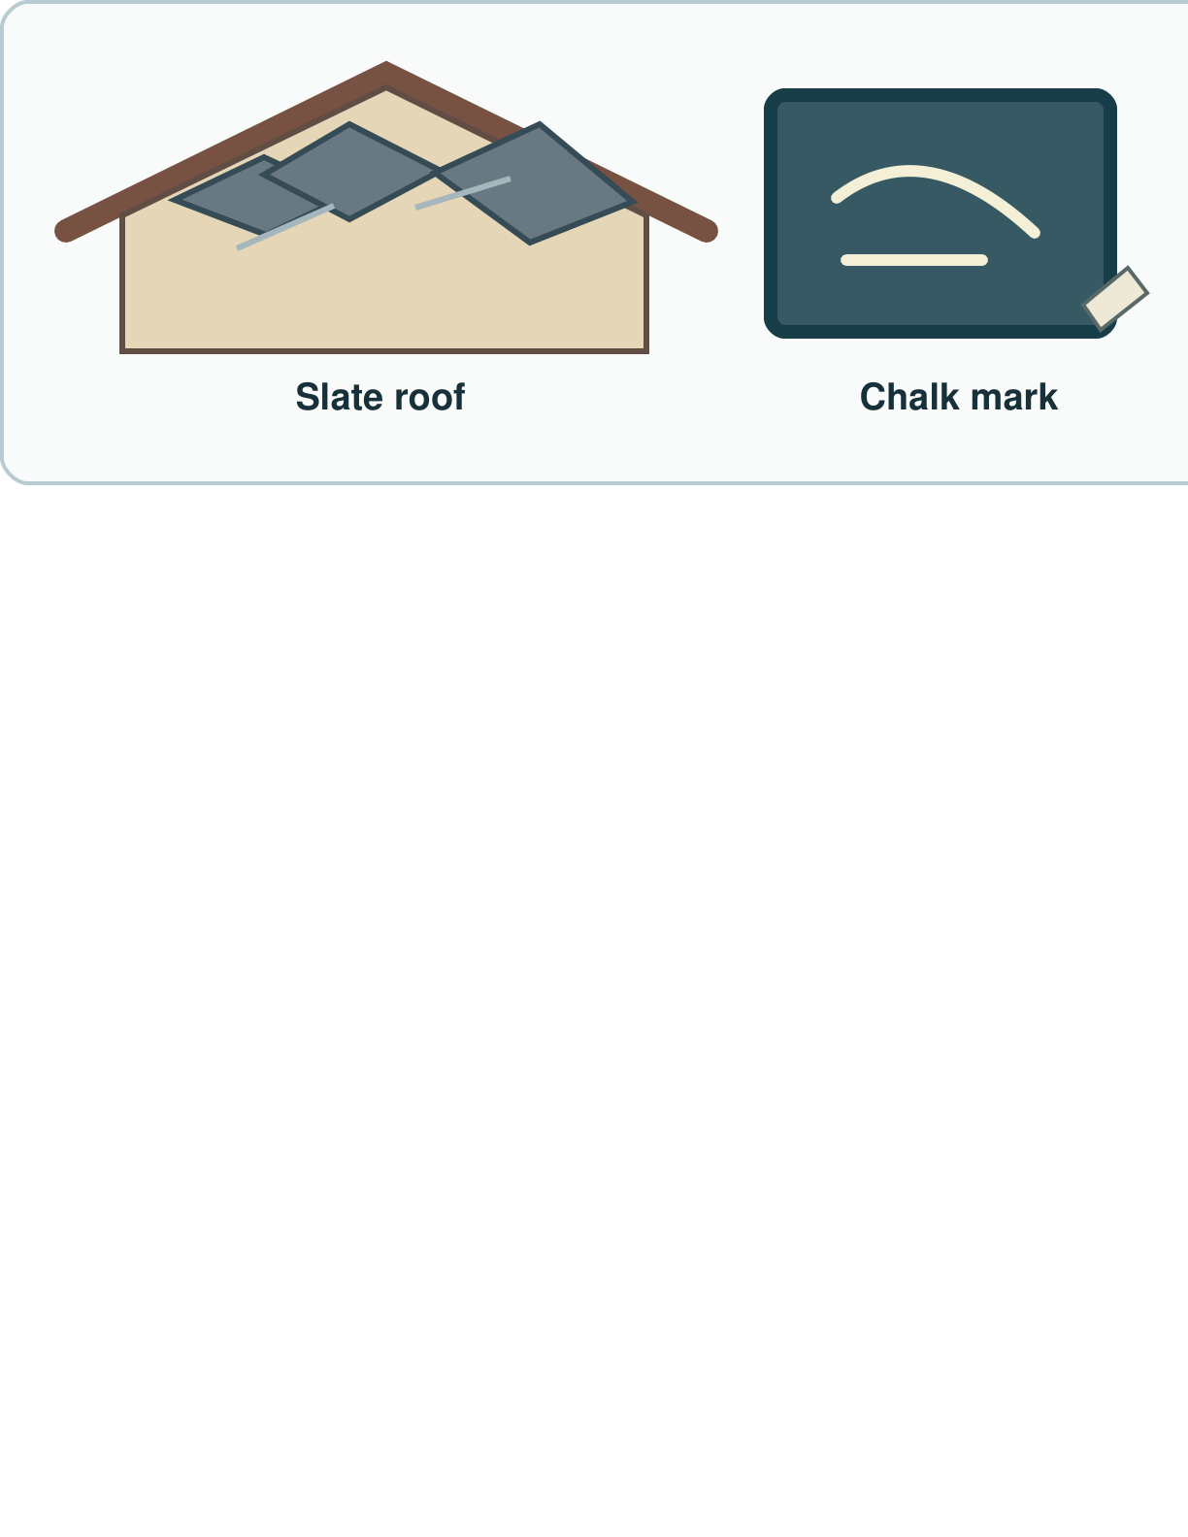
Picture model
SCI-BUILD-A2-W04 • BUILD Science
5
Made by Matt · madebymatt.uk · © Matt Roper · CC BY-NC-SA 4.0: free for classroom use, share and adapt with credit, no resale · v9 · 25 Sep 2026
Notes:
A slate tile can cover a roof; a suitable chalk piece can mark a board. Check actual samples. Simplified; not to scale.

Slide 6
Show me
What feature of the slate helped our roof example?
SCI-BUILD-A2-W04 • BUILD Science
6
Made by Matt · madebymatt.uk · © Matt Roper · CC BY-NC-SA 4.0: free for classroom use, share and adapt with credit, no resale · v9 · 25 Sep 2026
Notes:
It is thin and can be made into a roofing slate.

Slide 7
Our turn
Match each sample to a possible job.
This sample leaves a mark on the small board. I match it to ____.
SCI-BUILD-A2-W04 • BUILD Science
7
Made by Matt · madebymatt.uk · © Matt Roper · CC BY-NC-SA 4.0: free for classroom use, share and adapt with credit, no resale · v9 · 25 Sep 2026
Notes:
Hand over the missing step; offer F or H route. Reset once.
Missing step: Name the job based on the observed mark.

Slide 8
Talk, then sort
Roof
Marking
Path
Thin slate tile
Safe sample that leaves a mark
Small firm stone pieces
SCI-BUILD-A2-W04 • BUILD Science
8
Made by Matt · madebymatt.uk · © Matt Roper · CC BY-NC-SA 4.0: free for classroom use, share and adapt with credit, no resale · v9 · 25 Sep 2026
Notes:
Thin slate tile → Roof
Safe sample that leaves a mark → Marking
Small firm stone pieces → Path

Slide 9
Check
A new sample stays firm in a safe pressure test. Which possible job fits that clue?
A. A writing stick if it leaves a mark.
B. A path stone if it stays firm.
C. A sponge if it soaks up water.
D. A window if it lets through light.
SCI-BUILD-A2-W04 • BUILD Science
9
Made by Matt · madebymatt.uk · © Matt Roper · CC BY-NC-SA 4.0: free for classroom use, share and adapt with credit, no resale · v9 · 25 Sep 2026
Notes:
Take all pupil responses at once; use decision rule and parallel hinge.
A. A writing stick if it leaves a mark. | Not correct | A mark was not observed in this test.
B. A path stone if it stays firm. | Correct | Uses the observed firmness for a possible job, subject to more checks.
C. A sponge if it soaks up water. | Not correct | Water uptake was not observed in this test.
D. A window if it lets through light. | Not correct | Light transmission was not observed in this test.
About 3 in 4 or more right → move on; otherwise re-model This slate sample is thin. Slate can make a roof tile. I match it to a roof. Ask the parallel hinge. No scores or answers saved.

Slide 10
Independent · F
Choose a sample and show its use.
Match one sample to one job.
I match ____ with ____.
SCI-BUILD-A2-W04 • BUILD Science
10
Made by Matt · madebymatt.uk · © Matt Roper · CC BY-NC-SA 4.0: free for classroom use, share and adapt with credit, no resale · v9 · 25 Sep 2026
Notes:
Choose one adult for supported pupils, one for group; swap across the week.

Slide 11
Independent · M
Choose a sample and show its use.
Choose a rock and say what feature helps.
This ____ can do the job as it is ____.
SCI-BUILD-A2-W04 • BUILD Science
11
Made by Matt · madebymatt.uk · © Matt Roper · CC BY-NC-SA 4.0: free for classroom use, share and adapt with credit, no resale · v9 · 25 Sep 2026
Notes:
Choose one adult for supported pupils, one for group; swap across the week.

Slide 12
Independent · H
Choose a sample and show its use.
Why could a soft rock fail on a busy path?
For a ____, I choose ____ as ____.
SCI-BUILD-A2-W04 • BUILD Science
12
Made by Matt · madebymatt.uk · © Matt Roper · CC BY-NC-SA 4.0: free for classroom use, share and adapt with credit, no resale · v9 · 25 Sep 2026
Notes:
Choose one adult for supported pupils, one for group; swap across the week.

Slide 13
Go deeper
Can one rock suit two jobs? Show the need for each job.
Choose a sample for a roof and a mark. Test each reason.
SCI-BUILD-A2-W04 • BUILD Science
13
Made by Matt · madebymatt.uk · © Matt Roper · CC BY-NC-SA 4.0: free for classroom use, share and adapt with credit, no resale · v9 · 25 Sep 2026

Slide 14
Review
Check your reason. Hear one next step.
SCI-BUILD-A2-W04 • BUILD Science
14
Made by Matt · madebymatt.uk · © Matt Roper · CC BY-NC-SA 4.0: free for classroom use, share and adapt with credit, no resale · v9 · 25 Sep 2026
Notes:
Give VF and one NS(+); invite one self-edit. Reset once.

Slide 15
Exit
Tell an adult why your match fits.
Read it back: I am learning to match a rock to a job.
My feedback was… I showed…
Next I need to… try one small fix.
How I know: I can name one rock use. I can check one rock feature. I can say why the feature helps.
Tell your teacher. They will pick our next start.
Take one quiet minute before the next lesson.
SCI-BUILD-A2-W04 • BUILD Science
15
Made by Matt · madebymatt.uk · © Matt Roper · CC BY-NC-SA 4.0: free for classroom use, share and adapt with credit, no resale · v9 · 25 Sep 2026
Notes:
Hear feedback and next step, choose next start, then one-minute reset.

Slide 16
Word help · rock
a solid thing from the ground
This is a safe rock sample.
SCI-BUILD-A2-W04 • BUILD Science
16
Made by Matt · madebymatt.uk · © Matt Roper · CC BY-NC-SA 4.0: free for classroom use, share and adapt with credit, no resale · v9 · 25 Sep 2026

Slide 17
Word help · hard
not easy to mark or change
This hard rock takes little mark.
SCI-BUILD-A2-W04 • BUILD Science
17
Made by Matt · madebymatt.uk · © Matt Roper · CC BY-NC-SA 4.0: free for classroom use, share and adapt with credit, no resale · v9 · 25 Sep 2026

Slide 18
Word help · slate
a rock that can split into thin sheets
A slate tile can cover a roof.
SCI-BUILD-A2-W04 • BUILD Science
18
Made by Matt · madebymatt.uk · © Matt Roper · CC BY-NC-SA 4.0: free for classroom use, share and adapt with credit, no resale · v9 · 25 Sep 2026

Slide 19
Word help · property
a thing you can check
This slate is thin.
SCI-BUILD-A2-W04 • BUILD Science
19
Made by Matt · madebymatt.uk · © Matt Roper · CC BY-NC-SA 4.0: free for classroom use, share and adapt with credit, no resale · v9 · 25 Sep 2026

