Slide 1

Keep a rock test fair
I am learning to keep a rock test the same each time.
I can name what we change.
I can name what stays the same.
I can record what I see.
SCI-BUILD-A2-W06 • BUILD Science
1
Made by Matt · madebymatt.uk · © Matt Roper · CC BY-NC-SA 4.0: free for classroom use, share and adapt with credit, no resale · v9 · 25 Sep 2026
Notes:
Lesson code: SCI-BUILD-A2-W06
SoW objective: Plan and carry out a simple fair test on rocks.
Reading band: BUILD below age 8
Staff focus: {'i_do': 'Watch my first step. What do you see?', 'we_do': 'What step is missing? Show it with the kit.', 'independent': 'What can you do first on your own?'}
Prompt ladder: ['Wait and count to 5.', 'Point to the object or model.', 'Ask: What will you check next?', 'Model one step and give the next turn back.', 'Finish one example together, then let the pupil try.']
Sources:
https://www.gov.uk/government/publications/national-curriculum-in-england-science-programmes-of-study/national-curriculum-in-england-science-programmes-of-study
https://www.usgs.gov/water-science-school/science/aquifers-and-groundwater
BUILD scheme of work, Autumn 2 week 5
BUILD scheme of work, Autumn 2 week 4
BUILD scheme of work, Autumn 1 week 6
Local school risk assessment and CLEAPSS guidance; staff confirm exact kit

Slide 2
Arrival
See two rocks and a dropper.
SCI-BUILD-A2-W06 • BUILD Science
2
Made by Matt · madebymatt.uk · © Matt Roper · CC BY-NC-SA 4.0: free for classroom use, share and adapt with credit, no resale · v9 · 25 Sep 2026
Notes:
Offer a safe kit choice and short first–then cue.

Slide 3
Starter
Think back. Say, sign or point.
Name one raw and one made item.
Why can slate suit a roof?
How can food help a body?
SCI-BUILD-A2-W06 • BUILD Science
3
Made by Matt · madebymatt.uk · © Matt Roper · CC BY-NC-SA 4.0: free for classroom use, share and adapt with credit, no resale · v9 · 25 Sep 2026
Notes:
Ask three low-stakes prior questions; answers in note.
Name one raw and one made item. → Raw rock and finished brick.
Why can slate suit a roof? → A suitable slate can form thin roof pieces.
How can food help a body? → It gives nutrition.

Slide 4
Model
Watch a fair water check.
A gets three drops. I wait one count. B gets the same.
SCI-BUILD-A2-W06 • BUILD Science
4
Made by Matt · madebymatt.uk · © Matt Roper · CC BY-NC-SA 4.0: free for classroom use, share and adapt with credit, no resale · v9 · 25 Sep 2026
Notes:
Pre-teach words; show the full model; ask the show-me check.

Slide 5
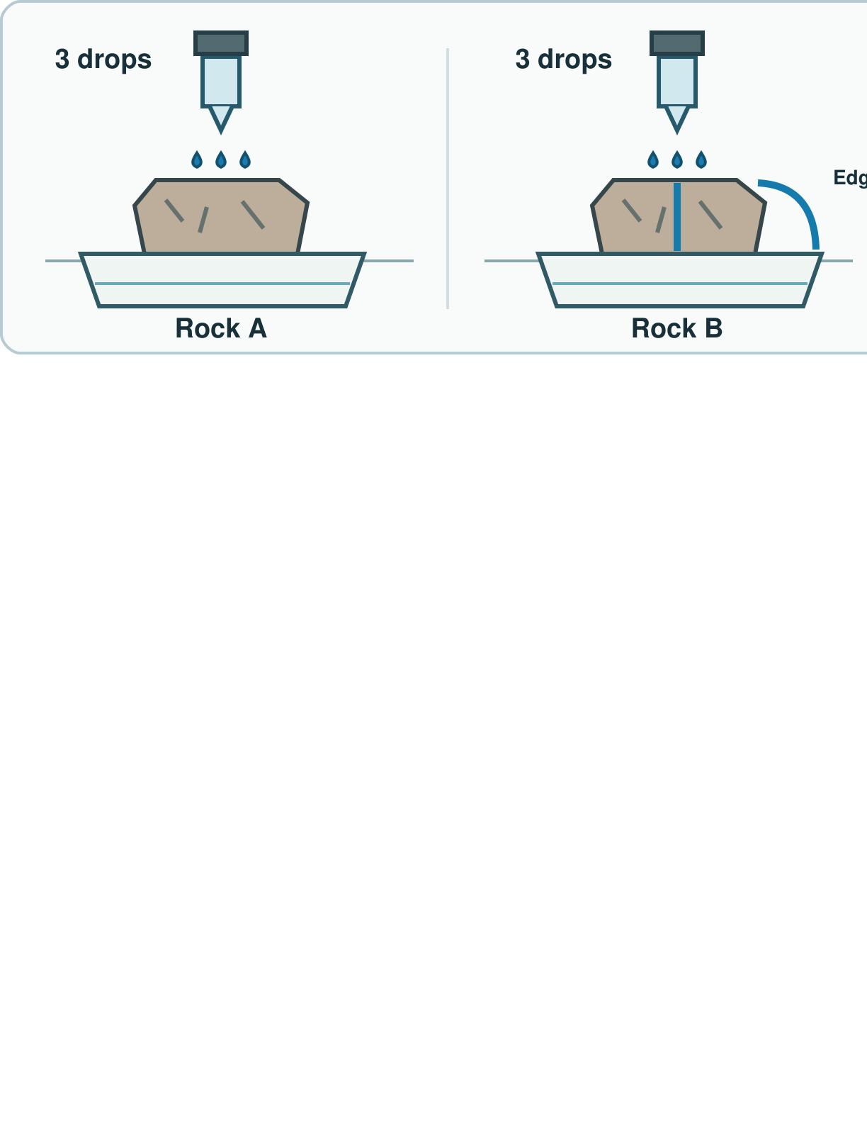
Picture model
SCI-BUILD-A2-W06 • BUILD Science
5
Made by Matt · madebymatt.uk · © Matt Roper · CC BY-NC-SA 4.0: free for classroom use, share and adapt with credit, no resale · v9 · 25 Sep 2026
Notes:
Fair check: same drops and wait; inspect top, through and edge routes. No result is assumed. Simplified; not to scale.

Slide 6
Show me
Do three drops on A and ten on B keep the water amount the same?
SCI-BUILD-A2-W06 • BUILD Science
6
Made by Matt · madebymatt.uk · © Matt Roper · CC BY-NC-SA 4.0: free for classroom use, share and adapt with credit, no resale · v9 · 25 Sep 2026
Notes:
No. Use the same amount for both.

Slide 7
Our turn
Plan and run the same steps.
A gets three drops. B gets ____ drops. I wait the same time.
SCI-BUILD-A2-W06 • BUILD Science
7
Made by Matt · madebymatt.uk · © Matt Roper · CC BY-NC-SA 4.0: free for classroom use, share and adapt with credit, no resale · v9 · 25 Sep 2026
Notes:
Hand over the missing step; offer F or H route. Reset once.
Missing step: Fill three as the water amount for rock B.

Slide 8
Talk, then sort
Keep the same
Change
Use three drops each time
Wait for the same count
Test a second rock
Use the same tray each time
SCI-BUILD-A2-W06 • BUILD Science
8
Made by Matt · madebymatt.uk · © Matt Roper · CC BY-NC-SA 4.0: free for classroom use, share and adapt with credit, no resale · v9 · 25 Sep 2026
Notes:
Use three drops each time → Keep the same
Wait for the same count → Keep the same
Test a second rock → Change
Use the same tray each time → Keep the same

Slide 9
Check
New samples C and D get four and nine drops. Is the water amount controlled?
A. No. Give each four drops.
B. Yes. Both got some water.
C. No. Use the same rock.
D. Yes. D could be bigger.
SCI-BUILD-A2-W06 • BUILD Science
9
Made by Matt · madebymatt.uk · © Matt Roper · CC BY-NC-SA 4.0: free for classroom use, share and adapt with credit, no resale · v9 · 25 Sep 2026
Notes:
Take all pupil responses at once; use decision rule and parallel hinge.
A. No. Give each four drops. | Correct | Keeps the water amount equal across samples.
B. Yes. Both got some water. | Not correct | Ignores the different amounts.
C. No. Use the same rock. | Not correct | Removes the changed sample from the comparison.
D. Yes. D could be bigger. | Not correct | Adds an unsupported reason for unequal amounts.
About 3 in 4 or more right → move on; otherwise re-model A gets three drops. I wait one count. B gets the same. Ask the parallel hinge. No scores or answers saved.

Slide 10
Independent · F
Test two rocks. Record what you see.
Point to what stays the same.
I keep ____ the same.
SCI-BUILD-A2-W06 • BUILD Science
10
Made by Matt · madebymatt.uk · © Matt Roper · CC BY-NC-SA 4.0: free for classroom use, share and adapt with credit, no resale · v9 · 25 Sep 2026
Notes:
Choose one adult for supported pupils, one for group; swap across the week.

Slide 11
Independent · M
Test two rocks. Record what you see.
Plan one fair water check.
I change ____ and keep ____ the same.
SCI-BUILD-A2-W06 • BUILD Science
11
Made by Matt · madebymatt.uk · © Matt Roper · CC BY-NC-SA 4.0: free for classroom use, share and adapt with credit, no resale · v9 · 25 Sep 2026
Notes:
Choose one adult for supported pupils, one for group; swap across the week.

Slide 12
Independent · H
Test two rocks. Record what you see.
One rock is much larger. How could you compare?
The check may fail if ____; I will ____.
SCI-BUILD-A2-W06 • BUILD Science
12
Made by Matt · madebymatt.uk · © Matt Roper · CC BY-NC-SA 4.0: free for classroom use, share and adapt with credit, no resale · v9 · 25 Sep 2026
Notes:
Choose one adult for supported pupils, one for group; swap across the week.

Slide 13
Go deeper
Drops run off an edge. Did water pass through? Fix it.
Find two unfair steps. Fix them.
SCI-BUILD-A2-W06 • BUILD Science
13
Made by Matt · madebymatt.uk · © Matt Roper · CC BY-NC-SA 4.0: free for classroom use, share and adapt with credit, no resale · v9 · 25 Sep 2026

Slide 14
Review
Check two rows. Hear a next step.
SCI-BUILD-A2-W06 • BUILD Science
14
Made by Matt · madebymatt.uk · © Matt Roper · CC BY-NC-SA 4.0: free for classroom use, share and adapt with credit, no resale · v9 · 25 Sep 2026
Notes:
Give VF and one NS(+); invite one self-edit. Reset once.

Slide 15
Exit
Say what stayed the same.
Read it back: I am learning to keep a rock test the same each time.
My feedback was… I showed…
Next I need to… try one small fix.
How I know: I can name what we change. I can name what stays the same. I can record what I see.
Tell your teacher. They will pick our next start.
Take one quiet minute before the next lesson.
SCI-BUILD-A2-W06 • BUILD Science
15
Made by Matt · madebymatt.uk · © Matt Roper · CC BY-NC-SA 4.0: free for classroom use, share and adapt with credit, no resale · v9 · 25 Sep 2026
Notes:
Hear feedback and next step, choose next start, then one-minute reset.

Slide 16
Word help · fair test
a check with one planned change
I use three drops each time.
SCI-BUILD-A2-W06 • BUILD Science
16
Made by Matt · madebymatt.uk · © Matt Roper · CC BY-NC-SA 4.0: free for classroom use, share and adapt with credit, no resale · v9 · 25 Sep 2026

Slide 17
Word help · same
not changed in each try
I use the same water.
SCI-BUILD-A2-W06 • BUILD Science
17
Made by Matt · madebymatt.uk · © Matt Roper · CC BY-NC-SA 4.0: free for classroom use, share and adapt with credit, no resale · v9 · 25 Sep 2026

Slide 18
Word help · change
make one thing different
I change the rock.
SCI-BUILD-A2-W06 • BUILD Science
18
Made by Matt · madebymatt.uk · © Matt Roper · CC BY-NC-SA 4.0: free for classroom use, share and adapt with credit, no resale · v9 · 25 Sep 2026

Slide 19
Word help · result
what the check showed
A drop stayed on top.
SCI-BUILD-A2-W06 • BUILD Science
19
Made by Matt · madebymatt.uk · © Matt Roper · CC BY-NC-SA 4.0: free for classroom use, share and adapt with credit, no resale · v9 · 25 Sep 2026

