Slide 1

The shapes of Sun, Earth and Moon
show how a ball models the Sun, Earth and Moon.
I can choose a ball to model a round body.
I can turn it to show more than one side.
I can name one limit of a model.
SCI-GROW-A2-W02 • GROW Science
1
Made by Matt · madebymatt.uk · © Matt Roper · CC BY-NC-SA 4.0: free for classroom use, share and adapt with credit, no resale · v9 · 25 Sep 2026
Notes:
Lesson code: SCI-GROW-A2-W02
SoW objective: Describe the Sun, Earth and Moon as approximately spherical bodies.
Reading band: GROW 8–11
Staff focus: {'i_do': 'Watch the ball, then point to the side you can see.', 'we_do': 'What is done? What does turning show next?', 'independent': 'Show your model choice. What can you explain yourself?'}
Prompt ladder: ['Wait and count to 5.', 'Point to the lesson’s diagram, kit or source.', 'Ask: What is done, and what is the next step?', 'Model one step, then return the next step to the pupil.', 'Finish one example together, then fade the help.']
Sources:
NASA Science, Sketch the Shape of the Sun, https://science.nasa.gov/solar-system/skywatching/sketch-the-shape-of-the-sun-for-science-during-the-solar-eclipse/
NASA Science, What is a Planet?, https://science.nasa.gov/solar-system/planets/what-is-a-planet/; NASA Science, Facts About Earth, https://science.nasa.gov/earth/facts/
NASA Science, Top Moon Questions, https://science.nasa.gov/moon/top-moon-questions/
NASA eClips Glossary, model/simulation, https://science.nasa.gov/eclips/resources/glossary/; NASA Science, What is a Planet?, https://science.nasa.gov/solar-system/planets/what-is-a-planet/
NASA eClips Glossary, model/simulation, https://science.nasa.gov/eclips/resources/glossary/
NASA Science, eclipse geometry, https://science.nasa.gov/eclipses/geometry/
the GROW scheme of work
NASA Science, What is a Planet?, https://science.nasa.gov/solar-system/planets/what-is-a-planet/; NASA Science, Earth Facts, https://science.nasa.gov/earth/facts/; NASA eClips Glossary, model/simulation, https://science.nasa.gov/eclips/resources/glossary/
Local school risk assessment and CLEAPSS guidance; staff confirm exact kit

Slide 2
Arrival
Sort a coin, paper circle and ball: flat or solid?
SCI-GROW-A2-W02 • GROW Science
2
Made by Matt · madebymatt.uk · © Matt Roper · CC BY-NC-SA 4.0: free for classroom use, share and adapt with credit, no resale · v9 · 25 Sep 2026
Notes:
Offer a predictable seat or standing spot and the first visual cue. No public test.

Slide 3
Starter
Think back. Say, point or write one answer for each question.
What makes day turn to night at one place?
What goes around the Sun?
Name one force you have explored.
SCI-GROW-A2-W02 • GROW Science
3
Made by Matt · madebymatt.uk · © Matt Roper · CC BY-NC-SA 4.0: free for classroom use, share and adapt with credit, no resale · v9 · 25 Sep 2026
Notes:
Ask three low-stakes retrieval questions; prior coverage must be checked.
What makes day turn to night at one place? → Earth turns on its axis.
What goes around the Sun? → Earth and other planets.
Name one force you have explored. → Gravity, air resistance or friction.

Slide 4
Model
Watch me turn a ball. I can see another curved side. A paper circle is flat. A ball helps show the shape of the Sun, Earth and Moon, but its size is not exact.
Ball → turn it → see another curved side → useful for an approximately spherical body; ball sizes and gaps are not to scale.
SCI-GROW-A2-W02 • GROW Science
4
Made by Matt · madebymatt.uk · © Matt Roper · CC BY-NC-SA 4.0: free for classroom use, share and adapt with credit, no resale · v9 · 25 Sep 2026
Notes:
Model the full reasoning step, pre-teach four words and ask the show-me question.

Slide 5
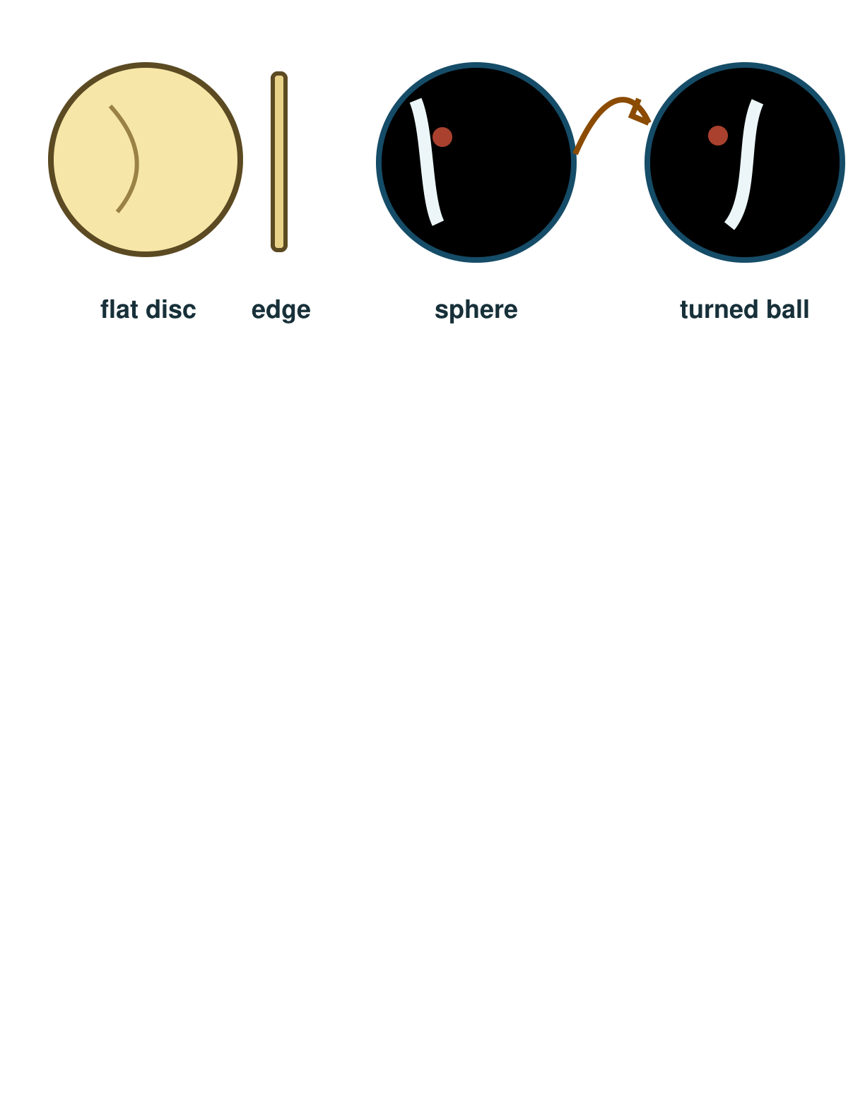
Picture model
SCI-GROW-A2-W02 • GROW Science
5
Made by Matt · madebymatt.uk · © Matt Roper · CC BY-NC-SA 4.0: free for classroom use, share and adapt with credit, no resale · v9 · 25 Sep 2026
Notes:
The disc is flat. A ball has a curved surface even when turned. Simplified shape model; not to scale.

Slide 6
Show me
Point: which object can I turn to see another curved side?
SCI-GROW-A2-W02 • GROW Science
6
Made by Matt · madebymatt.uk · © Matt Roper · CC BY-NC-SA 4.0: free for classroom use, share and adapt with credit, no resale · v9 · 25 Sep 2026
Notes:
The ball.

Slide 7
Our turn
Use a ball and a paper circle. The model and first label are ready. Turn the ball and complete the missing label: new side or the same flat face?
Ball → turn it → see ____ → useful because ____.
SCI-GROW-A2-W02 • GROW Science
7
Made by Matt · madebymatt.uk · © Matt Roper · CC BY-NC-SA 4.0: free for classroom use, share and adapt with credit, no resale · v9 · 25 Sep 2026
Notes:
Show the part-done example, then allow paired talk before an answer. One-minute reset inside this stage.
Missing step: Name the new curved side and explain why it helps.

Slide 8
Talk, then sort
flat
solid
Paper circle
Coin face
Ball
SCI-GROW-A2-W02 • GROW Science
8
Made by Matt · madebymatt.uk · © Matt Roper · CC BY-NC-SA 4.0: free for classroom use, share and adapt with credit, no resale · v9 · 25 Sep 2026
Notes:
Paper circle → flat
Coin face → flat
Ball → solid

Slide 9
Check
A class models the Moon’s whole shape. Which object is the closest simple shape?
A. A thin flat disc.
B. A long straight stick.
C. A round solid ball.
D. A flat square sheet.
SCI-GROW-A2-W02 • GROW Science
9
Made by Matt · madebymatt.uk · © Matt Roper · CC BY-NC-SA 4.0: free for classroom use, share and adapt with credit, no resale · v9 · 25 Sep 2026
Notes:
All pupils answer the four-option hinge; use the decision rule, not a score.
A. A thin flat disc. | Not correct | Uses a flat circle for a three-dimensional Moon.
B. A long straight stick. | Not correct | Mistakes a long one-dimensional shape for a round body.
C. A round solid ball. | Correct | Uses the new case accurately.
D. A flat square sheet. | Not correct | Chooses a flat square because the diagram is on paper.
About 3 in 4 or more right → move on. Otherwise re-model with the named I-do example, then ask the parallel hinge.

Slide 10
Independent · F
Turn a shape model. Explain one way it helps and one limit. You can show, say or draw.
Choose a ball rather than a flat circle.
I choose the ___ to show shape.
SCI-GROW-A2-W02 • GROW Science
10
Made by Matt · madebymatt.uk · © Matt Roper · CC BY-NC-SA 4.0: free for classroom use, share and adapt with credit, no resale · v9 · 25 Sep 2026
Notes:
One adult supports agreed pupils, the other holds the group; swap across the week. One-minute reset inside this stage.

Slide 11
Independent · M
Turn a shape model. Explain one way it helps and one limit. You can show, say or draw.
Turn the ball and explain what new view it gives.
When I turn it, I see ___ because ___.
SCI-GROW-A2-W02 • GROW Science
11
Made by Matt · madebymatt.uk · © Matt Roper · CC BY-NC-SA 4.0: free for classroom use, share and adapt with credit, no resale · v9 · 25 Sep 2026
Notes:
One adult supports agreed pupils, the other holds the group; swap across the week. One-minute reset inside this stage.

Slide 12
Independent · H
Turn a shape model. Explain one way it helps and one limit. You can show, say or draw.
Explain what a ball model reveals and how its scale may mislead.
The model helps because ___; its limit is ___.
SCI-GROW-A2-W02 • GROW Science
12
Made by Matt · madebymatt.uk · © Matt Roper · CC BY-NC-SA 4.0: free for classroom use, share and adapt with credit, no resale · v9 · 25 Sep 2026
Notes:
One adult supports agreed pupils, the other holds the group; swap across the week. One-minute reset inside this stage.

Slide 13
Go deeper
Compare a ball and a photo. What can each show, and what does each hide?
A photo shows Earth as a circle. Choose another observation or model to test its full shape. Explain why one photo is not enough.
SCI-GROW-A2-W02 • GROW Science
13
Made by Matt · madebymatt.uk · © Matt Roper · CC BY-NC-SA 4.0: free for classroom use, share and adapt with credit, no resale · v9 · 25 Sep 2026

Slide 14
Review
Hear a comment on your model. Change one label or spoken reason and say what changed.
SCI-GROW-A2-W02 • GROW Science
14
Made by Matt · madebymatt.uk · © Matt Roper · CC BY-NC-SA 4.0: free for classroom use, share and adapt with credit, no resale · v9 · 25 Sep 2026
Notes:
Give a specific verbal comment (VF) and invite one self-edit (//) or read-back (?).

Slide 15
Exit
Show which shape model helps. Say one way it helps and one thing it cannot show exactly.
? Read it back: show how a ball models the Sun, Earth and Moon.
My feedback was… say what changed. Next I need to… name a fix.
How I know: I can choose a ball to model a round body. I can turn it to show more than one side. I can name one limit of a model.
The adult hears you and chooses our next example. Take one quiet minute.
SCI-GROW-A2-W02 • GROW Science
15
Made by Matt · madebymatt.uk · © Matt Roper · CC BY-NC-SA 4.0: free for classroom use, share and adapt with credit, no resale · v9 · 25 Sep 2026
Notes:
Hear the answer and name how it changes the next example or support. One-minute reset and handoff.

Slide 16
Word help · spherical
shaped roughly like a ball
Earth is approximately spherical.
SCI-GROW-A2-W02 • GROW Science
16
Made by Matt · madebymatt.uk · © Matt Roper · CC BY-NC-SA 4.0: free for classroom use, share and adapt with credit, no resale · v9 · 25 Sep 2026

Slide 17
Word help · curve
a line or surface that bends
The ball has a curved surface.
SCI-GROW-A2-W02 • GROW Science
17
Made by Matt · madebymatt.uk · © Matt Roper · CC BY-NC-SA 4.0: free for classroom use, share and adapt with credit, no resale · v9 · 25 Sep 2026

Slide 18
Word help · shadow
a dark area where an object blocks light
The ball makes a shadow on the card.
SCI-GROW-A2-W02 • GROW Science
18
Made by Matt · madebymatt.uk · © Matt Roper · CC BY-NC-SA 4.0: free for classroom use, share and adapt with credit, no resale · v9 · 25 Sep 2026

Slide 19
Word help · model
a simple way to show an object or idea
A ball is a model of Earth’s shape.
SCI-GROW-A2-W02 • GROW Science
19
Made by Matt · madebymatt.uk · © Matt Roper · CC BY-NC-SA 4.0: free for classroom use, share and adapt with credit, no resale · v9 · 25 Sep 2026

