Slide 1

Researching the Solar System
check a source and share a fact about the Solar System.
I can find a fact on a class source card.
I can name the card that supports my fact.
I can fix a claim that the card does not support.
SCI-GROW-A2-W03 • GROW Science
1
Made by Matt · madebymatt.uk · © Matt Roper · CC BY-NC-SA 4.0: free for classroom use, share and adapt with credit, no resale · v9 · 25 Sep 2026
Notes:
Lesson code: SCI-GROW-A2-W03
SoW objective: Research and present findings about the Solar System (ICT).
Reading band: GROW 8–11
Staff focus: {'i_do': 'Listen to my claim, then watch me point to card B.', 'we_do': 'Which part is done? Where is the card label still missing?', 'independent': 'Which card gives your fact? Show that part without my help.'}
Prompt ladder: ['Wait and count to 5.', 'Point to the lesson’s diagram, kit or source.', 'Ask: What is done, and what is the next step?', 'Model one step, then return the next step to the pupil.', 'Finish one example together, then fade the help.']
Sources:
NASA Science, Sun Facts, https://science.nasa.gov/sun/facts/
NASA Science, What is a Planet?, https://science.nasa.gov/solar-system/planets/what-is-a-planet/
NASA Science, What is a Planet?, https://science.nasa.gov/solar-system/planets/what-is-a-planet/; NASA Science, Facts About Earth, https://science.nasa.gov/earth/facts/
NASA Science, What is a Planet?, https://science.nasa.gov/solar-system/planets/what-is-a-planet/; NASA Science, Moon Facts, https://science.nasa.gov/moon/facts/
NASA Science, Solar System Facts, https://science.nasa.gov/solar-system/solar-system-facts/
NASA Science, Solar System Facts, https://science.nasa.gov/solar-system/solar-system-facts/; NASA Science, What is a Planet?, https://science.nasa.gov/solar-system/planets/what-is-a-planet/
the GROW scheme of work
NASA Science, Solar System Facts, https://science.nasa.gov/solar-system/solar-system-facts/; NASA Science, Moon Facts, https://science.nasa.gov/moon/facts/
Local school risk assessment and exact prepared kit; staff confirm

Slide 2
Arrival
Choose the body that makes its own light: Sun, Earth or Moon.
SCI-GROW-A2-W03 • GROW Science
2
Made by Matt · madebymatt.uk · © Matt Roper · CC BY-NC-SA 4.0: free for classroom use, share and adapt with credit, no resale · v9 · 25 Sep 2026
Notes:
Offer a predictable seat or standing spot and the first visual cue. No public test.

Slide 3
Starter
Think back. Say, point or write one answer for each question.
What shape is the Moon roughly?
Why do we get day and night?
What goes round Earth?
SCI-GROW-A2-W03 • GROW Science
3
Made by Matt · madebymatt.uk · © Matt Roper · CC BY-NC-SA 4.0: free for classroom use, share and adapt with credit, no resale · v9 · 25 Sep 2026
Notes:
Ask three low-stakes retrieval questions; prior coverage must be checked.
What shape is the Moon roughly? → Approximately spherical, like a ball.
Why do we get day and night? → Earth turns on its axis.
What goes round Earth? → The Moon.

Slide 4
Model
I read card B: Earth goes round the Sun. I point to card B as my source. A claim without a matching source is a guess.
Claim: Earth goes round the Sun → card B says the same → cite card B.
SCI-GROW-A2-W03 • GROW Science
4
Made by Matt · madebymatt.uk · © Matt Roper · CC BY-NC-SA 4.0: free for classroom use, share and adapt with credit, no resale · v9 · 25 Sep 2026
Notes:
Model the full reasoning step, pre-teach four words and ask the show-me question.

Slide 5
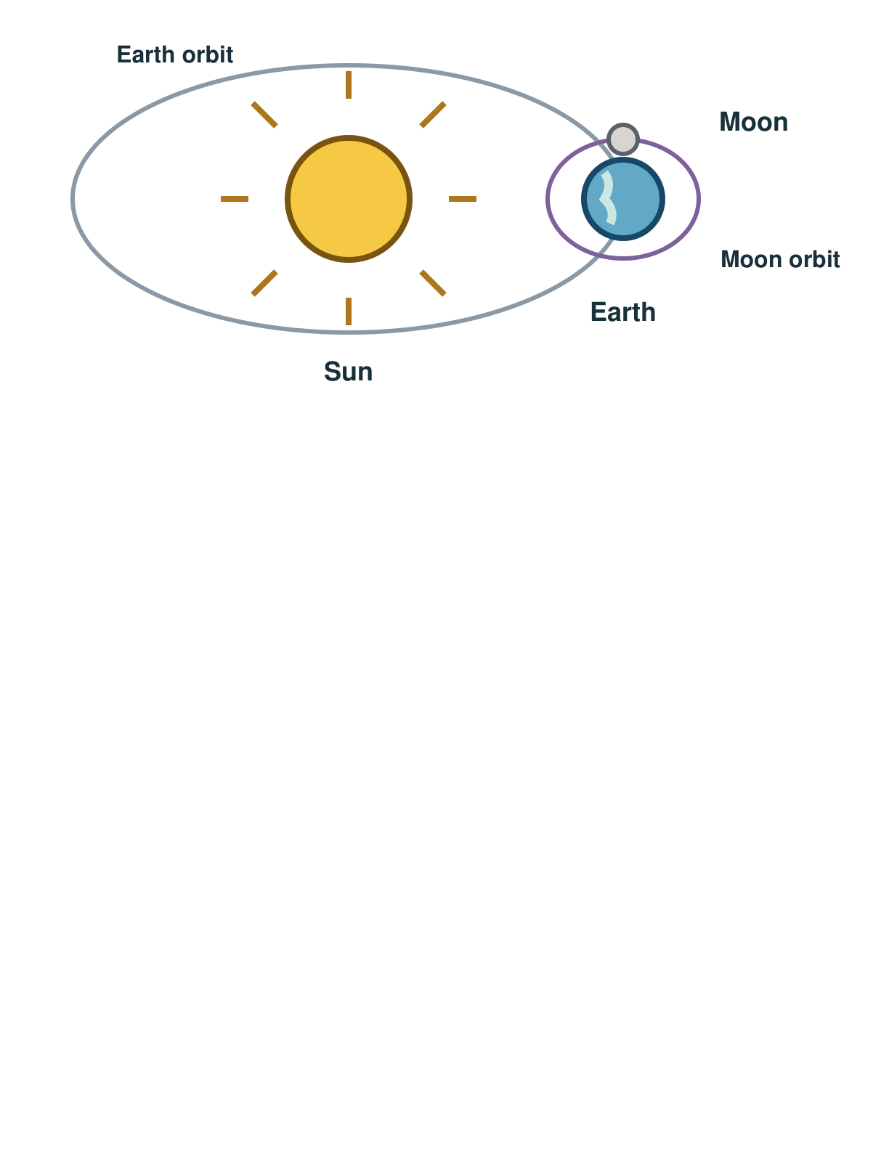
Picture model
SCI-GROW-A2-W03 • GROW Science
5
Made by Matt · madebymatt.uk · © Matt Roper · CC BY-NC-SA 4.0: free for classroom use, share and adapt with credit, no resale · v9 · 25 Sep 2026
Notes:
Earth orbits the Sun. The Moon orbits Earth. Paths and sizes are simplified; not to scale.

Slide 6
Show me
Card B says Earth goes round the Sun. Which card should I name with that claim?
SCI-GROW-A2-W03 • GROW Science
6
Made by Matt · madebymatt.uk · © Matt Roper · CC BY-NC-SA 4.0: free for classroom use, share and adapt with credit, no resale · v9 · 25 Sep 2026
Notes:
Card B.

Slide 7
Our turn
Card A is matched to Sun is a star. Card B has a fact but no label. Find the missing source label for Earth goes round the Sun.
Claim: The Moon goes round Earth → card C says the same → cite card ____.
SCI-GROW-A2-W03 • GROW Science
7
Made by Matt · madebymatt.uk · © Matt Roper · CC BY-NC-SA 4.0: free for classroom use, share and adapt with credit, no resale · v9 · 25 Sep 2026
Notes:
Show the part-done example, then allow paired talk before an answer. One-minute reset inside this stage.
Missing step: Choose and name the source card for the Moon claim.

Slide 8
Talk, then sort
Card A
Card B
Card C
Sun is a star
Earth orbits the Sun
Moon orbits Earth
SCI-GROW-A2-W03 • GROW Science
8
Made by Matt · madebymatt.uk · © Matt Roper · CC BY-NC-SA 4.0: free for classroom use, share and adapt with credit, no resale · v9 · 25 Sep 2026
Notes:
Sun is a star → Card A
Earth orbits the Sun → Card B
Moon orbits Earth → Card C

Slide 9
Check
Which claim is backed by our class cards?
A. Earth makes its own light.
B. The Sun is a star.
C. The Moon is a planet.
D. Card C says Earth goes round the Sun.
SCI-GROW-A2-W03 • GROW Science
9
Made by Matt · madebymatt.uk · © Matt Roper · CC BY-NC-SA 4.0: free for classroom use, share and adapt with credit, no resale · v9 · 25 Sep 2026
Notes:
All pupils answer the four-option hinge; use the decision rule, not a score.
A. Earth makes its own light. | Not correct | Confuses a planet with a star.
B. The Sun is a star. | Correct | Correct use of card A.
C. The Moon is a planet. | Not correct | Confuses a natural satellite with a planet.
D. Card C says Earth goes round the Sun. | Not correct | Chooses the wrong source label even for a true fact.
About 3 in 4 or more right → move on. Otherwise re-model with the named I-do example, then ask the parallel hinge.

Slide 10
Independent · F
Share two facts about the Solar System. Name the class card that supports each fact. Correct one claim if its card does not match.
Point to one fact and its source card.
Card ___ says ___.
SCI-GROW-A2-W03 • GROW Science
10
Made by Matt · madebymatt.uk · © Matt Roper · CC BY-NC-SA 4.0: free for classroom use, share and adapt with credit, no resale · v9 · 25 Sep 2026
Notes:
One adult supports agreed pupils, the other holds the group; swap across the week. One-minute reset inside this stage.

Slide 11
Independent · M
Share two facts about the Solar System. Name the class card that supports each fact. Correct one claim if its card does not match.
Share two facts and name each matching card.
My fact is ___; card ___ supports it.
SCI-GROW-A2-W03 • GROW Science
11
Made by Matt · madebymatt.uk · © Matt Roper · CC BY-NC-SA 4.0: free for classroom use, share and adapt with credit, no resale · v9 · 25 Sep 2026
Notes:
One adult supports agreed pupils, the other holds the group; swap across the week. One-minute reset inside this stage.

Slide 12
Independent · H
Share two facts about the Solar System. Name the class card that supports each fact. Correct one claim if its card does not match.
Use two cards to explain Earth’s place, then repair a false label.
Card ___ supports ___, but it cannot show ___ because ___.
SCI-GROW-A2-W03 • GROW Science
12
Made by Matt · madebymatt.uk · © Matt Roper · CC BY-NC-SA 4.0: free for classroom use, share and adapt with credit, no resale · v9 · 25 Sep 2026
Notes:
One adult supports agreed pupils, the other holds the group; swap across the week. One-minute reset inside this stage.

Slide 13
Go deeper
A poster calls the Moon a planet. Use two class cards to repair the label and name both sources.
Two cards disagree about the Moon. Choose the supported claim, then name a reliable source for a further check.
SCI-GROW-A2-W03 • GROW Science
13
Made by Matt · madebymatt.uk · © Matt Roper · CC BY-NC-SA 4.0: free for classroom use, share and adapt with credit, no resale · v9 · 25 Sep 2026

Slide 14
Review
Hear which card backs your fact. Change a source label or fact if needed, then say what changed.
SCI-GROW-A2-W03 • GROW Science
14
Made by Matt · madebymatt.uk · © Matt Roper · CC BY-NC-SA 4.0: free for classroom use, share and adapt with credit, no resale · v9 · 25 Sep 2026
Notes:
Give a specific verbal comment (VF) and invite one self-edit (//) or read-back (?).

Slide 15
Exit
Say one checked fact and point to the matching class card. Say which source label you fixed.
? Read it back: check a source and share a fact about the Solar System.
My feedback was… say what changed. Next I need to… name a fix.
How I know: I can find a fact on a class source card. I can name the card that supports my fact. I can fix a claim that the card does not support.
The adult hears you and chooses our next example. Take one quiet minute.
SCI-GROW-A2-W03 • GROW Science
15
Made by Matt · madebymatt.uk · © Matt Roper · CC BY-NC-SA 4.0: free for classroom use, share and adapt with credit, no resale · v9 · 25 Sep 2026
Notes:
Hear the answer and name how it changes the next example or support. One-minute reset and handoff.

Slide 16
Word help · Solar System
the Sun and the objects that move around it
Earth is part of our Solar System.
SCI-GROW-A2-W03 • GROW Science
16
Made by Matt · madebymatt.uk · © Matt Roper · CC BY-NC-SA 4.0: free for classroom use, share and adapt with credit, no resale · v9 · 25 Sep 2026

Slide 17
Word help · planet
a large, nearly round body that moves around a star
Earth is a planet that moves around the Sun.
SCI-GROW-A2-W03 • GROW Science
17
Made by Matt · madebymatt.uk · © Matt Roper · CC BY-NC-SA 4.0: free for classroom use, share and adapt with credit, no resale · v9 · 25 Sep 2026

Slide 18
Word help · star
a hot body in space that makes its own light
The Sun is a star.
SCI-GROW-A2-W03 • GROW Science
18
Made by Matt · madebymatt.uk · © Matt Roper · CC BY-NC-SA 4.0: free for classroom use, share and adapt with credit, no resale · v9 · 25 Sep 2026

Slide 19
Word help · source
where a fact or idea comes from
Card B is my source for Earth’s orbit.
SCI-GROW-A2-W03 • GROW Science
19
Made by Matt · madebymatt.uk · © Matt Roper · CC BY-NC-SA 4.0: free for classroom use, share and adapt with credit, no resale · v9 · 25 Sep 2026

