Slide 1

Forces, space and climate questions
choose a model that fits a science question and use a matching clue.
I can match a question to a model.
I can give a claim with a matching clue.
I can say one thing the model cannot show.
SCI-GROW-A2-W05 • GROW Science
1
Made by Matt · madebymatt.uk · © Matt Roper · CC BY-NC-SA 4.0: free for classroom use, share and adapt with credit, no resale · v9 · 25 Sep 2026
Notes:
Lesson code: SCI-GROW-A2-W05
SoW objective: Consolidate forces, space and climate; answer scientific questions.
Reading band: GROW 8–11
Staff focus: {'i_do': 'Listen: first I read the question, then choose the matching kit.', 'we_do': 'Which model is already chosen? What observation is missing?', 'independent': 'Show me your claim; which clue did you find on your own?'}
Prompt ladder: ['Wait and count to 5.', 'Point to the lesson’s diagram, kit or source.', 'Ask: What is done, and what is the next step?', 'Model one step, then return the next step to the pupil.', 'Finish one example together, then fade the help.']
Sources:
AQA GCSE Combined Science 8464, Physics 6.5.1.2, https://www.aqa.org.uk/subjects/science/gcse/science-8464/specification/physics-subject-content
AQA GCSE Combined Science 8464, Physics 6.5.1.2, https://www.aqa.org.uk/subjects/science/gcse/science-8464/specification/physics-subject-content; AQA GCSE Combined Science 8464, Working Scientifically WS 2.2, 2.6, 3.5, 3.7, https://www.aqa.org.uk/subjects/science/gcse/science-8464/specification/working-scientifically
NASA Science, Heliophysics Big Idea 1.1, https://science.nasa.gov/learn/heat/big-ideas/big-idea-1-1/
NASA Science, Causes of Climate Change, https://science.nasa.gov/climate-change/causes/
NASA eClips Glossary, model/simulation, https://science.nasa.gov/eclips/resources/glossary/
AQA GCSE Combined Science 8464, Working Scientifically WS 2.2, 2.6, 3.5, 3.7, https://www.aqa.org.uk/subjects/science/gcse/science-8464/specification/working-scientifically
the GROW scheme of work
AQA GCSE Combined Science 8464, Physics 6.5.1.2, https://www.aqa.org.uk/subjects/science/gcse/science-8464/specification/physics-subject-content; NASA Science, Facts About Earth, https://science.nasa.gov/earth/facts/; Met Office, Climate Glossary, https://weather.metoffice.gov.uk/climate-change/climate-glossary
Local school risk assessment and CLEAPSS guidance; staff confirm exact kit

Slide 2
Arrival
Match each question to a kit card: toy and surface, globe and torch, or warming chain.
SCI-GROW-A2-W05 • GROW Science
2
Made by Matt · madebymatt.uk · © Matt Roper · CC BY-NC-SA 4.0: free for classroom use, share and adapt with credit, no resale · v9 · 25 Sep 2026
Notes:
Offer a predictable seat or standing spot and the first visual cue. No public test.

Slide 3
Starter
Think back. Say, point or write one answer for each question.
Give one link in the warming chain.
Name one fact our Solar System cards support.
How can friction affect a moving toy?
SCI-GROW-A2-W05 • GROW Science
3
Made by Matt · madebymatt.uk · © Matt Roper · CC BY-NC-SA 4.0: free for classroom use, share and adapt with credit, no resale · v9 · 25 Sep 2026
Notes:
Ask three low-stakes retrieval questions; prior coverage must be checked.
Give one link in the warming chain. → Burning fossil fuel adds carbon dioxide; extra greenhouse gas slows heat loss.
Name one fact our Solar System cards support. → The Sun is a star; Earth orbits it; or the Moon orbits Earth.
How can friction affect a moving toy? → It can slow it down.

Slide 4
Model
I choose a toy for a motion question. The toy went less far on rough paper in this run. I must repeat before I claim why.
Toy motion question → choose toy and surface → measure distance → test friction as one cause.
SCI-GROW-A2-W05 • GROW Science
4
Made by Matt · madebymatt.uk · © Matt Roper · CC BY-NC-SA 4.0: free for classroom use, share and adapt with credit, no resale · v9 · 25 Sep 2026
Notes:
Model the full reasoning step, pre-teach four words and ask the show-me question.

Slide 5
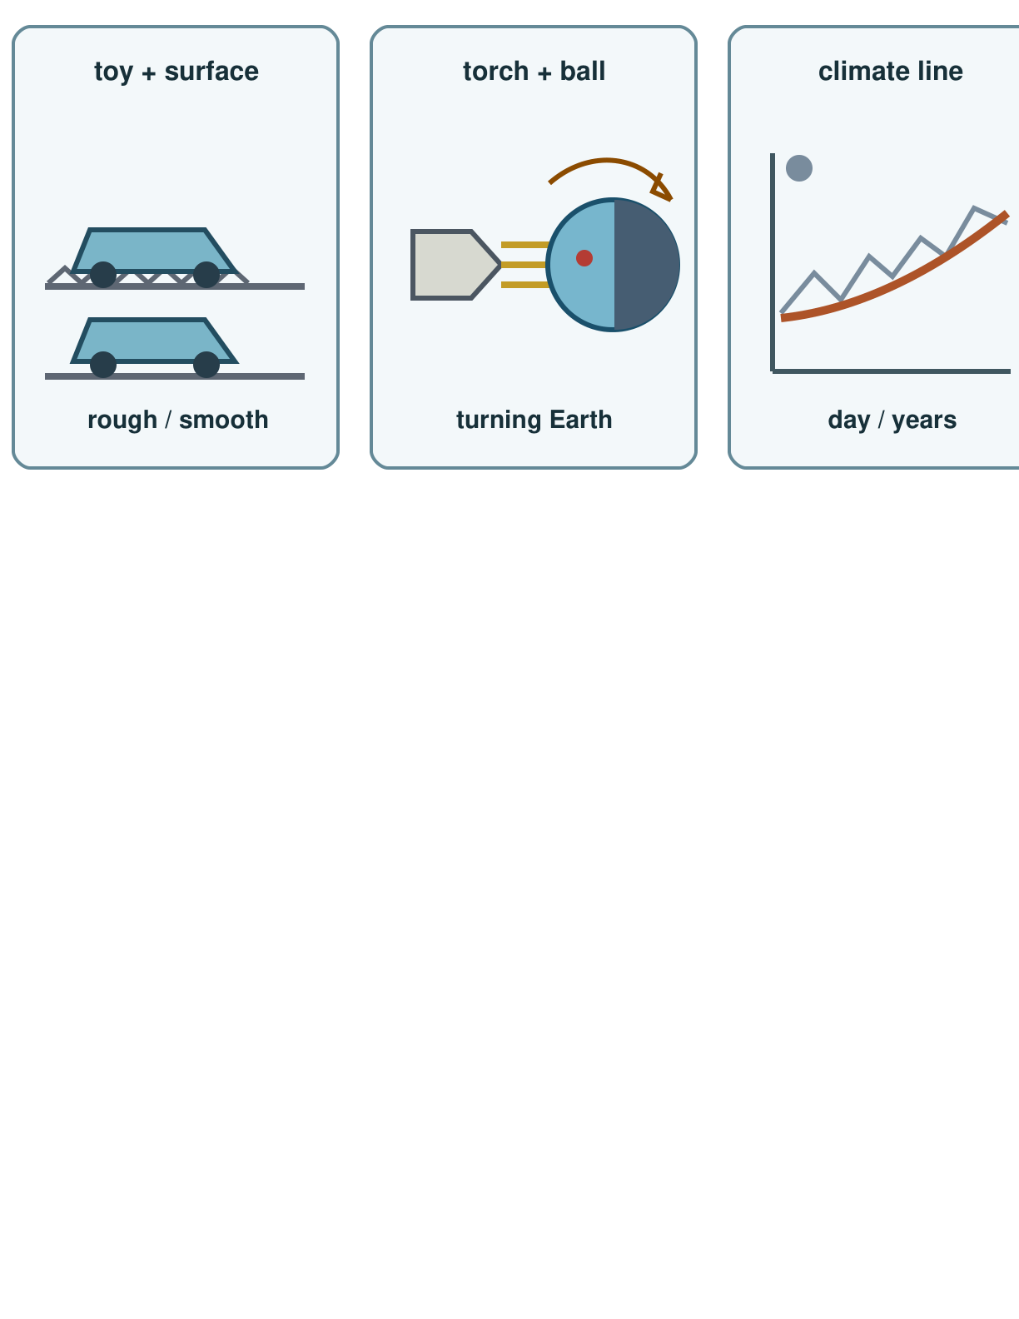
Picture model
SCI-GROW-A2-W05 • GROW Science
5
Made by Matt · madebymatt.uk · © Matt Roper · CC BY-NC-SA 4.0: free for classroom use, share and adapt with credit, no resale · v9 · 25 Sep 2026
Notes:
Choose a model: toy and surface, torch and ball, or long climate record. Sketches are simplified; the climate line is not data.

Slide 6
Show me
If my question is about day and night, should I point to the toy or torch-and-ball?
SCI-GROW-A2-W05 • GROW Science
6
Made by Matt · madebymatt.uk · © Matt Roper · CC BY-NC-SA 4.0: free for classroom use, share and adapt with credit, no resale · v9 · 25 Sep 2026
Notes:
Torch and ball.

Slide 7
Our turn
Torch and ball are chosen for day and night. Add the missing clue. Say why it fits.
Day and night question → choose torch and ball → observe ____ → explain Earth’s turn.
SCI-GROW-A2-W05 • GROW Science
7
Made by Matt · madebymatt.uk · © Matt Roper · CC BY-NC-SA 4.0: free for classroom use, share and adapt with credit, no resale · v9 · 25 Sep 2026
Notes:
Show the part-done example, then allow paired talk before an answer. One-minute reset inside this stage.
Missing step: Name the observation of the marked place moving away from the light.

Slide 8
Talk, then sort
toy and surface
torch and ball
warming cards
Why did the toy slow?
Why is a place in night?
Why is climate warming?
SCI-GROW-A2-W05 • GROW Science
8
Made by Matt · madebymatt.uk · © Matt Roper · CC BY-NC-SA 4.0: free for classroom use, share and adapt with credit, no resale · v9 · 25 Sep 2026
Notes:
Why did the toy slow? → toy and surface
Why is a place in night? → torch and ball
Why is climate warming? → warming cards

Slide 9
Check
A model trolley stops sooner on a mat than on a smooth board. Which idea is relevant to test?
A. The length of Earth’s orbit.
B. Friction at the trolley surface.
C. The amount of daylight outside.
D. The climate of the whole Earth.
SCI-GROW-A2-W05 • GROW Science
9
Made by Matt · madebymatt.uk · © Matt Roper · CC BY-NC-SA 4.0: free for classroom use, share and adapt with credit, no resale · v9 · 25 Sep 2026
Notes:
All pupils answer the four-option hinge; use the decision rule, not a score.
A. The length of Earth’s orbit. | Not correct | Transfers a space model to a surface-and-motion question.
B. Friction at the trolley surface. | Correct | Uses the new case accurately.
C. The amount of daylight outside. | Not correct | Uses daylight rather than the changed surface to explain the trolley run.
D. The climate of the whole Earth. | Not correct | Uses a whole-Earth climate pattern for a local trolley test.
About 3 in 4 or more right → move on. Otherwise re-model with the named I-do example, then ask the parallel hinge.

Slide 10
Independent · F
Choose two stations. Give a claim and matching clue for each. Name one limit.
Match a question to a model.
For ___, I choose the ___ model.
SCI-GROW-A2-W05 • GROW Science
10
Made by Matt · madebymatt.uk · © Matt Roper · CC BY-NC-SA 4.0: free for classroom use, share and adapt with credit, no resale · v9 · 25 Sep 2026
Notes:
One adult supports agreed pupils, the other holds the group; swap across the week. One-minute reset inside this stage.

Slide 11
Independent · M
Choose two stations. Give a claim and matching clue for each. Name one limit.
Give an answer and a matching clue.
My claim is ___; the clue is ___.
SCI-GROW-A2-W05 • GROW Science
11
Made by Matt · madebymatt.uk · © Matt Roper · CC BY-NC-SA 4.0: free for classroom use, share and adapt with credit, no resale · v9 · 25 Sep 2026
Notes:
One adult supports agreed pupils, the other holds the group; swap across the week. One-minute reset inside this stage.

Slide 12
Independent · H
Choose two stations. Give a claim and matching clue for each. Name one limit.
Compare two models, clues and limits.
The ___ model fits because ___, but it cannot show ___.
SCI-GROW-A2-W05 • GROW Science
12
Made by Matt · madebymatt.uk · © Matt Roper · CC BY-NC-SA 4.0: free for classroom use, share and adapt with credit, no resale · v9 · 25 Sep 2026
Notes:
One adult supports agreed pupils, the other holds the group; swap across the week. One-minute reset inside this stage.

Slide 13
Go deeper
Compare two models: what can each show and miss?
Two toy runs differ on one surface. Can friction alone explain this? Choose one control that would help.
SCI-GROW-A2-W05 • GROW Science
13
Made by Matt · madebymatt.uk · © Matt Roper · CC BY-NC-SA 4.0: free for classroom use, share and adapt with credit, no resale · v9 · 25 Sep 2026

Slide 14
Review
Does your clue fit? Fix one clue or add a limit.
SCI-GROW-A2-W05 • GROW Science
14
Made by Matt · madebymatt.uk · © Matt Roper · CC BY-NC-SA 4.0: free for classroom use, share and adapt with credit, no resale · v9 · 25 Sep 2026
Notes:
Give a specific verbal comment (VF) and invite one self-edit (//) or read-back (?).

Slide 15
Exit
Name a model, claim and clue. Say what changed after feedback.
? Read it back: choose a model that fits a science question and use a matching clue.
My feedback was… say what changed. Next I need to… name a fix.
How I know: I can match a question to a model. I can give a claim with a matching clue. I can say one thing the model cannot show.
The adult hears you and chooses our next example. Take one quiet minute.
SCI-GROW-A2-W05 • GROW Science
15
Made by Matt · madebymatt.uk · © Matt Roper · CC BY-NC-SA 4.0: free for classroom use, share and adapt with credit, no resale · v9 · 25 Sep 2026
Notes:
Hear the answer and name how it changes the next example or support. One-minute reset and handoff.

Slide 16
Word help · force
a push or pull on an object
Friction is a force that can slow a toy.
SCI-GROW-A2-W05 • GROW Science
16
Made by Matt · madebymatt.uk · © Matt Roper · CC BY-NC-SA 4.0: free for classroom use, share and adapt with credit, no resale · v9 · 25 Sep 2026

Slide 17
Word help · rotation
a turn around an axis
Earth’s rotation brings day and night.
SCI-GROW-A2-W05 • GROW Science
17
Made by Matt · madebymatt.uk · © Matt Roper · CC BY-NC-SA 4.0: free for classroom use, share and adapt with credit, no resale · v9 · 25 Sep 2026

Slide 18
Word help · evidence
an observation or result that supports a claim
The shorter run is evidence for my answer.
SCI-GROW-A2-W05 • GROW Science
18
Made by Matt · madebymatt.uk · © Matt Roper · CC BY-NC-SA 4.0: free for classroom use, share and adapt with credit, no resale · v9 · 25 Sep 2026

Slide 19
Word help · climate
weather patterns over many years
A hot day alone does not show a climate trend.
SCI-GROW-A2-W05 • GROW Science
19
Made by Matt · madebymatt.uk · © Matt Roper · CC BY-NC-SA 4.0: free for classroom use, share and adapt with credit, no resale · v9 · 25 Sep 2026

