Slide 1

Investigating a science question
plan a fair investigation, record a result and explain a limit.
I can name what I change and what I keep the same.
I can record what happened in a small test.
I can explain one way to make the test more dependable.
SCI-GROW-A2-W06 • GROW Science
1
Made by Matt · madebymatt.uk · © Matt Roper · CC BY-NC-SA 4.0: free for classroom use, share and adapt with credit, no resale · v9 · 25 Sep 2026
Notes:
Lesson code: SCI-GROW-A2-W06
SoW objective: Consolidate and revisit key ideas through investigation.
Reading band: GROW 8–11
Staff focus: {'i_do': 'Watch: one thing changes; I keep the other parts the same.', 'we_do': 'Which control is already on the plan? What is still missing?', 'independent': 'Point to your result. What did you measure without my help?'}
Prompt ladder: ['Wait and count to 5.', 'Point to the lesson’s diagram, kit or source.', 'Ask: What is done, and what is the next step?', 'Model one step, then return the next step to the pupil.', 'Finish one example together, then fade the help.']
Sources:
AQA GCSE Combined Science 8464, Working Scientifically WS 2.2, 2.6, 3.5, 3.7, https://www.aqa.org.uk/subjects/science/gcse/science-8464/specification/working-scientifically
AQA GCSE Combined Science 8464, Working Scientifically WS 2.2, 2.6, 3.5, 3.7, https://www.aqa.org.uk/subjects/science/gcse/science-8464/specification/working-scientifically; AQA GCSE Combined Science 8464, Physics 6.5.1.2, https://www.aqa.org.uk/subjects/science/gcse/science-8464/specification/physics-subject-content
AQA GCSE Combined Science 8464, Physics 6.5.1.2, https://www.aqa.org.uk/subjects/science/gcse/science-8464/specification/physics-subject-content
the GROW scheme of work
Local school risk assessment and CLEAPSS guidance; staff confirm exact kit

Slide 2
Arrival
Choose the question card: does surface change how far this toy goes? Point to what we will change.
SCI-GROW-A2-W06 • GROW Science
2
Made by Matt · madebymatt.uk · © Matt Roper · CC BY-NC-SA 4.0: free for classroom use, share and adapt with credit, no resale · v9 · 25 Sep 2026
Notes:
Offer a predictable seat or standing spot and the first visual cue. No public test.

Slide 3
Starter
Think back. Say, point or write one answer for each question.
What should match a science claim?
Name an effect of added greenhouse gases.
What do we keep the same in a fair test?
SCI-GROW-A2-W06 • GROW Science
3
Made by Matt · madebymatt.uk · © Matt Roper · CC BY-NC-SA 4.0: free for classroom use, share and adapt with credit, no resale · v9 · 25 Sep 2026
Notes:
Ask three low-stakes retrieval questions; prior coverage must be checked.
What should match a science claim? → An observation or result from a suitable model.
Name an effect of added greenhouse gases. → They slow heat loss and add to warming.
What do we keep the same in a fair test? → Key conditions apart from the one factor we change.

Slide 4
Model
I mark a start line. I keep the toy and launch the same. I change the surface, measure distance and repeat. Runs may still vary.
Change rough/smooth surface → keep toy, start and launch the same → measure distance → repeat.
SCI-GROW-A2-W06 • GROW Science
4
Made by Matt · madebymatt.uk · © Matt Roper · CC BY-NC-SA 4.0: free for classroom use, share and adapt with credit, no resale · v9 · 25 Sep 2026
Notes:
Model the full reasoning step, pre-teach four words and ask the show-me question.

Slide 5
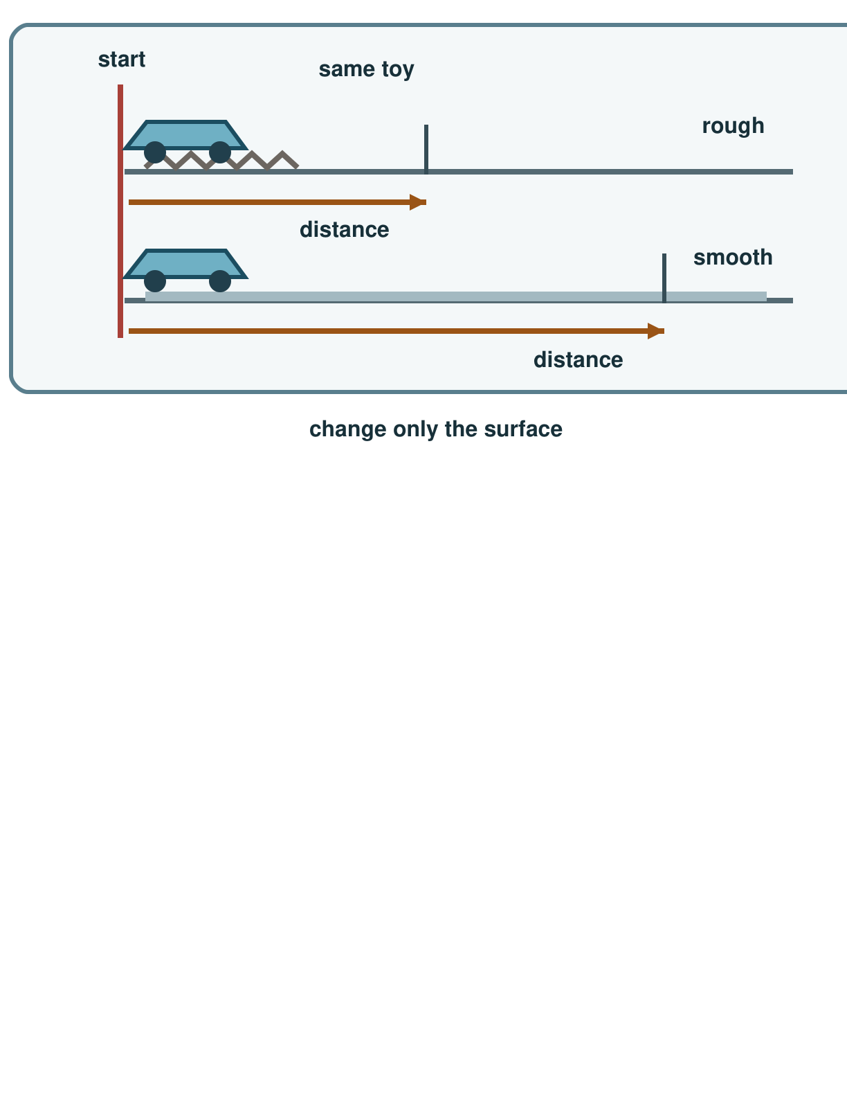
Picture model
SCI-GROW-A2-W06 • GROW Science
5
Made by Matt · madebymatt.uk · © Matt Roper · CC BY-NC-SA 4.0: free for classroom use, share and adapt with credit, no resale · v9 · 25 Sep 2026
Notes:
Use the same toy and start line. Change only the surface; measure distance. End marks are examples, not results.

Slide 6
Show me
If I change the surface, should I also change the toy?
SCI-GROW-A2-W06 • GROW Science
6
Made by Matt · madebymatt.uk · © Matt Roper · CC BY-NC-SA 4.0: free for classroom use, share and adapt with credit, no resale · v9 · 25 Sep 2026
Notes:
No. Keep the toy the same.

Slide 7
Our turn
The plan has a fixed toy and start line. Add the missing launch control. Name the surface to change.
Change ____ → keep toy and ____ the same → measure distance.
SCI-GROW-A2-W06 • GROW Science
7
Made by Matt · madebymatt.uk · © Matt Roper · CC BY-NC-SA 4.0: free for classroom use, share and adapt with credit, no resale · v9 · 25 Sep 2026
Notes:
Show the part-done example, then allow paired talk before an answer. One-minute reset inside this stage.
Missing step: Name surface as the changed factor and a consistent launch as a control.

Slide 8
Talk, then sort
change
keep same
measure
Surface type
Toy
Start line
Travel distance
SCI-GROW-A2-W06 • GROW Science
8
Made by Matt · madebymatt.uk · © Matt Roper · CC BY-NC-SA 4.0: free for classroom use, share and adapt with credit, no resale · v9 · 25 Sep 2026
Notes:
Surface type → change
Toy → keep same
Start line → keep same
Travel distance → measure

Slide 9
Check
A team compares carpet and vinyl using one trolley. Which plan lets them test the surface fairly?
A. Same push; change start and surface.
B. Same start; change trolley and surface.
C. Same surface; change trolley and push.
D. Same start and push; change surface.
SCI-GROW-A2-W06 • GROW Science
9
Made by Matt · madebymatt.uk · © Matt Roper · CC BY-NC-SA 4.0: free for classroom use, share and adapt with credit, no resale · v9 · 25 Sep 2026
Notes:
All pupils answer the four-option hinge; use the decision rule, not a score.
A. Same push; change start and surface. | Not correct | Changes the start as well as the surface, so the comparison is confounded.
B. Same start; change trolley and surface. | Not correct | Changes the trolley as well as the surface, so the comparison is confounded.
C. Same surface; change trolley and push. | Not correct | Keeps the surface and changes both the trolley and push; it cannot test surface effect.
D. Same start and push; change surface. | Correct | Uses the new case accurately.
About 3 in 4 or more right → move on. Otherwise re-model with the named I-do example, then ask the parallel hinge.

Slide 10
Independent · F
Test two runs per surface or observe. Record distance. Name what changed, stayed the same and could limit the test.
Point to the factor that changes.
I change the ___; I keep ___ the same.
SCI-GROW-A2-W06 • GROW Science
10
Made by Matt · madebymatt.uk · © Matt Roper · CC BY-NC-SA 4.0: free for classroom use, share and adapt with credit, no resale · v9 · 25 Sep 2026
Notes:
One adult supports agreed pupils, the other holds the group; swap across the week. One-minute reset inside this stage.

Slide 11
Independent · M
Test two runs per surface or observe. Record distance. Name what changed, stayed the same and could limit the test.
Name two controls and record a result.
I changed ___ and kept ___ the same. My result was ___.
SCI-GROW-A2-W06 • GROW Science
11
Made by Matt · madebymatt.uk · © Matt Roper · CC BY-NC-SA 4.0: free for classroom use, share and adapt with credit, no resale · v9 · 25 Sep 2026
Notes:
One adult supports agreed pupils, the other holds the group; swap across the week. One-minute reset inside this stage.

Slide 12
Independent · H
Test two runs per surface or observe. Record distance. Name what changed, stayed the same and could limit the test.
Explain why repeat runs help and identify a method limit.
My result suggests ___, but I would repeat ___ because ___.
SCI-GROW-A2-W06 • GROW Science
12
Made by Matt · madebymatt.uk · © Matt Roper · CC BY-NC-SA 4.0: free for classroom use, share and adapt with credit, no resale · v9 · 25 Sep 2026
Notes:
One adult supports agreed pupils, the other holds the group; swap across the week. One-minute reset inside this stage.

Slide 13
Go deeper
Two runs differ. Name a reason and fix a method step.
Two repeats differ. Name a safe conclusion, then improve the method for the next test.
SCI-GROW-A2-W06 • GROW Science
13
Made by Matt · madebymatt.uk · © Matt Roper · CC BY-NC-SA 4.0: free for classroom use, share and adapt with credit, no resale · v9 · 25 Sep 2026

Slide 14
Review
Check the controls and result with a partner. Fix one label before you conclude.
SCI-GROW-A2-W06 • GROW Science
14
Made by Matt · madebymatt.uk · © Matt Roper · CC BY-NC-SA 4.0: free for classroom use, share and adapt with credit, no resale · v9 · 25 Sep 2026
Notes:
Give a specific verbal comment (VF) and invite one self-edit (//) or read-back (?).

Slide 15
Exit
Name the change, one control, one result and a next step.
? Read it back: plan a fair investigation, record a result and explain a limit.
My feedback was… say what changed. Next I need to… name a fix.
How I know: I can name what I change and what I keep the same. I can record what happened in a small test. I can explain one way to make the test more dependable.
The adult hears you and chooses our next example. Take one quiet minute.
SCI-GROW-A2-W06 • GROW Science
15
Made by Matt · madebymatt.uk · © Matt Roper · CC BY-NC-SA 4.0: free for classroom use, share and adapt with credit, no resale · v9 · 25 Sep 2026
Notes:
Hear the answer and name how it changes the next example or support. One-minute reset and handoff.

Slide 16
Word help · variable
a factor that can change in a test
The surface is our changed variable.
SCI-GROW-A2-W06 • GROW Science
16
Made by Matt · madebymatt.uk · © Matt Roper · CC BY-NC-SA 4.0: free for classroom use, share and adapt with credit, no resale · v9 · 25 Sep 2026

Slide 17
Word help · fair test
a test that changes one key factor and keeps other key factors the same
We use the same toy in both runs for a fair test.
SCI-GROW-A2-W06 • GROW Science
17
Made by Matt · madebymatt.uk · © Matt Roper · CC BY-NC-SA 4.0: free for classroom use, share and adapt with credit, no resale · v9 · 25 Sep 2026

Slide 18
Word help · result
what you observe or measure in a test
Our result is the distance the toy travelled.
SCI-GROW-A2-W06 • GROW Science
18
Made by Matt · madebymatt.uk · © Matt Roper · CC BY-NC-SA 4.0: free for classroom use, share and adapt with credit, no resale · v9 · 25 Sep 2026

Slide 19
Word help · repeat
do the test again under the same conditions
We repeat each run to check our result.
SCI-GROW-A2-W06 • GROW Science
19
Made by Matt · madebymatt.uk · © Matt Roper · CC BY-NC-SA 4.0: free for classroom use, share and adapt with credit, no resale · v9 · 25 Sep 2026

