Slide 1

Autumn science review and evidence
use a model and a matching clue to show what you know in science.
I can choose a model that fits my question.
I can give a clue that supports my answer.
I can name one next step after feedback.
SCI-GROW-A2-W07 • GROW Science
1
Made by Matt · madebymatt.uk · © Matt Roper · CC BY-NC-SA 4.0: free for classroom use, share and adapt with credit, no resale · v9 · 25 Sep 2026
Notes:
Lesson code: SCI-GROW-A2-W07
SoW objective: Review and evidence autumn science (Entry Level Science / UAS).
Reading band: GROW 8–11
Staff focus: {'i_do': 'Watch me select one model for this question.', 'we_do': 'What is supplied? Which observed clue is missing?', 'independent': 'Choose your own question. Which clue can you show without my prompt?'}
Prompt ladder: ['Wait and count to 5.', 'Point to the lesson’s diagram, kit or source.', 'Ask: What is done, and what is the next step?', 'Model one step, then return the next step to the pupil.', 'Finish one example together, then fade the help.']
Sources:
AQA GCSE Combined Science 8464, Physics 6.5.1.2, https://www.aqa.org.uk/subjects/science/gcse/science-8464/specification/physics-subject-content
NASA Science, Heliophysics Big Idea 1.1, https://science.nasa.gov/learn/heat/big-ideas/big-idea-1-1/
Met Office, Climate Glossary, https://weather.metoffice.gov.uk/climate-change/climate-glossary
AQA GCSE Combined Science 8464, Working Scientifically WS 2.2, 2.6, 3.5, 3.7, https://www.aqa.org.uk/subjects/science/gcse/science-8464/specification/working-scientifically; NASA eClips Glossary, model/simulation, https://science.nasa.gov/eclips/resources/glossary/; AQA GCSE Combined Science 8464, Working Scientifically WS 1.2 and 1.3 (models and limitations), https://www.aqa.org.uk/subjects/science/gcse/science-8464/specification/working-scientifically
staff to confirm against the actual qualification route and pupil access arrangements
the GROW scheme of work
AQA GCSE Combined Science 8464, Physics 6.5.1.2, https://www.aqa.org.uk/subjects/science/gcse/science-8464/specification/physics-subject-content; NASA Science, Facts About Earth, https://science.nasa.gov/earth/facts/; Met Office, Climate Glossary, https://weather.metoffice.gov.uk/climate-change/climate-glossary
Local school risk assessment and exact prepared kit; staff confirm

Slide 2
Arrival
Choose a model used this term. Point to one question it could help answer.
SCI-GROW-A2-W07 • GROW Science
2
Made by Matt · madebymatt.uk · © Matt Roper · CC BY-NC-SA 4.0: free for classroom use, share and adapt with credit, no resale · v9 · 25 Sep 2026
Notes:
Offer a predictable seat or standing spot and the first visual cue. No public test.

Slide 3
Starter
Think back. Say, point or write one answer for each question.
What changed in last week’s fair test?
What model can help with a toy motion question?
Name one force you learned in Autumn 1.
SCI-GROW-A2-W07 • GROW Science
3
Made by Matt · madebymatt.uk · © Matt Roper · CC BY-NC-SA 4.0: free for classroom use, share and adapt with credit, no resale · v9 · 25 Sep 2026
Notes:
Ask three low-stakes retrieval questions; prior coverage must be checked.
What changed in last week’s fair test? → The surface; the toy, start and launch were controls.
What model can help with a toy motion question? → Toy and surface.
Name one force you learned in Autumn 1. → Gravity, air resistance or friction.

Slide 4
Model
I choose a question, then a matching model and clue. For day and night, the torch lights one side of a turning ball. I explain the place turning into shade. This is practice, not help during formal evidence.
Question: why does a place get night? → choose torch and turning ball → marked place turns away from light → explain Earth’s rotation.
SCI-GROW-A2-W07 • GROW Science
4
Made by Matt · madebymatt.uk · © Matt Roper · CC BY-NC-SA 4.0: free for classroom use, share and adapt with credit, no resale · v9 · 25 Sep 2026
Notes:
Model the full reasoning step, pre-teach four words and ask the show-me question.

Slide 5
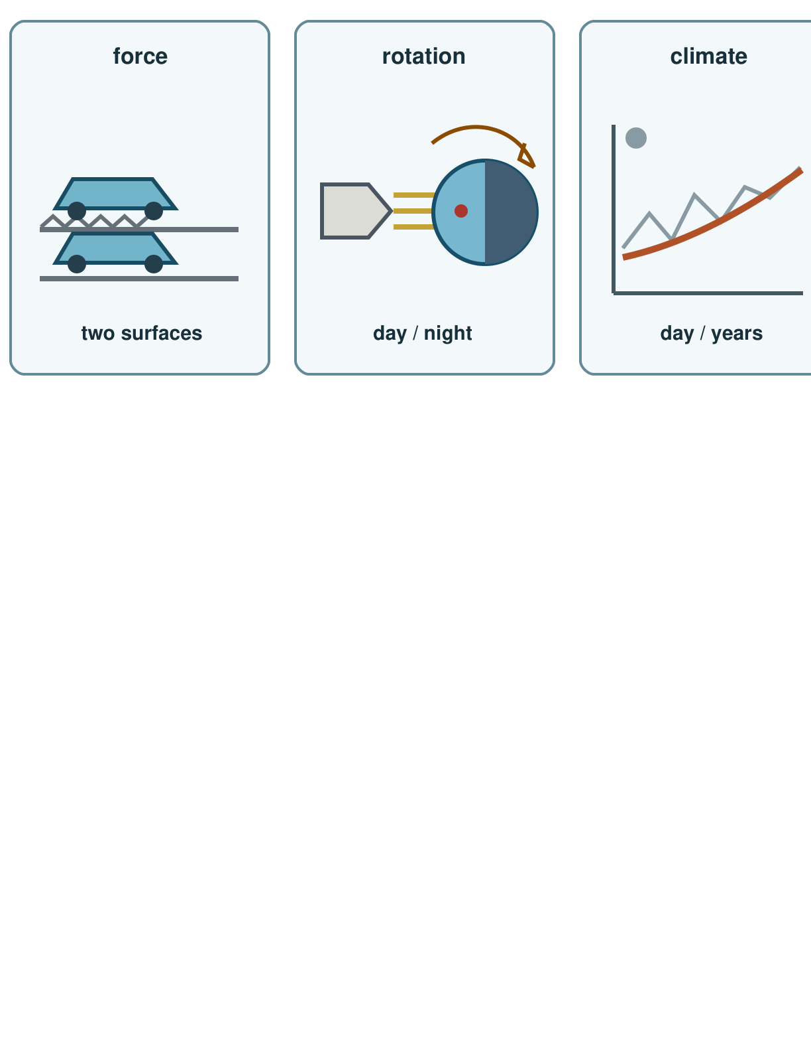
Picture model
SCI-GROW-A2-W07 • GROW Science
5
Made by Matt · madebymatt.uk · © Matt Roper · CC BY-NC-SA 4.0: free for classroom use, share and adapt with credit, no resale · v9 · 25 Sep 2026
Notes:
Three ideas: toy on two surfaces, day and night, and a long climate pattern. Sketches are simplified; the line is not data.

Slide 6
Show me
Show me the model you would use for day and night.
SCI-GROW-A2-W07 • GROW Science
6
Made by Matt · madebymatt.uk · © Matt Roper · CC BY-NC-SA 4.0: free for classroom use, share and adapt with credit, no resale · v9 · 25 Sep 2026
Notes:
Torch and turning ball.

Slide 7
Our turn
In practice, the question and torch-and-ball model are supplied. Complete the missing clue: what happens to the marked place as the ball turns?
Question: what slowed the toy? → choose toy and surface → observe ____ → explain a possible force; check with repeat runs.
SCI-GROW-A2-W07 • GROW Science
7
Made by Matt · madebymatt.uk · © Matt Roper · CC BY-NC-SA 4.0: free for classroom use, share and adapt with credit, no resale · v9 · 25 Sep 2026
Notes:
Show the part-done example, then allow paired talk before an answer. One-minute reset inside this stage.
Missing step: Identify an observed travel-distance clue for the toy claim, not a space fact.

Slide 8
Talk, then sort
toy and surface
torch and ball
long-term cards
Question about friction
Question about day and night
Question about climate
SCI-GROW-A2-W07 • GROW Science
8
Made by Matt · madebymatt.uk · © Matt Roper · CC BY-NC-SA 4.0: free for classroom use, share and adapt with credit, no resale · v9 · 25 Sep 2026
Notes:
Question about friction → toy and surface
Question about day and night → torch and ball
Question about climate → long-term cards

Slide 9
Check
A new question asks why a model sled stops sooner on a mat. Which kit can help test it?
A. Sled and two marked surfaces.
B. A torch and turning globe.
C. Two ice cubes on dark card.
D. A weather report from today.
SCI-GROW-A2-W07 • GROW Science
9
Made by Matt · madebymatt.uk · © Matt Roper · CC BY-NC-SA 4.0: free for classroom use, share and adapt with credit, no resale · v9 · 25 Sep 2026
Notes:
All pupils answer the four-option hinge; use the decision rule, not a score.
A. Sled and two marked surfaces. | Correct | Uses the new case accurately.
B. A torch and turning globe. | Not correct | Uses a rotation model to answer a friction question.
C. Two ice cubes on dark card. | Not correct | Uses melting ice rather than a moving sled to test the surface effect.
D. A weather report from today. | Not correct | Uses a single weather report instead of a surface-and-motion test.
About 3 in 4 or more right → move on. Otherwise re-model with the named I-do example, then ask the parallel hinge.

Slide 10
Independent · F
Choose two science questions from forces, space or climate. Show an answer with a model and a matching clue. Use only your agreed support if this is formal evidence.
Match one question to its model.
For ___, I choose ___.
SCI-GROW-A2-W07 • GROW Science
10
Made by Matt · madebymatt.uk · © Matt Roper · CC BY-NC-SA 4.0: free for classroom use, share and adapt with credit, no resale · v9 · 25 Sep 2026
Notes:
One adult supports agreed pupils, the other holds the group; swap across the week. One-minute reset inside this stage.

Slide 11
Independent · M
Choose two science questions from forces, space or climate. Show an answer with a model and a matching clue. Use only your agreed support if this is formal evidence.
Use a model and matching clue to explain a science idea.
My answer is ___; I saw ___ in the model.
SCI-GROW-A2-W07 • GROW Science
11
Made by Matt · madebymatt.uk · © Matt Roper · CC BY-NC-SA 4.0: free for classroom use, share and adapt with credit, no resale · v9 · 25 Sep 2026
Notes:
One adult supports agreed pupils, the other holds the group; swap across the week. One-minute reset inside this stage.

Slide 12
Independent · H
Choose two science questions from forces, space or climate. Show an answer with a model and a matching clue. Use only your agreed support if this is formal evidence.
State one limit of a model and suggest a further check.
The model suggests ___, but I would check ___ because ___.
SCI-GROW-A2-W07 • GROW Science
12
Made by Matt · madebymatt.uk · © Matt Roper · CC BY-NC-SA 4.0: free for classroom use, share and adapt with credit, no resale · v9 · 25 Sep 2026
Notes:
One adult supports agreed pupils, the other holds the group; swap across the week. One-minute reset inside this stage.

Slide 13
Go deeper
For one claim, give two checks and one model limit. Say which extra observation you would seek.
Compare two model limits. Choose a claim neither can settle alone and name a new observation that would help.
SCI-GROW-A2-W07 • GROW Science
13
Made by Matt · madebymatt.uk · © Matt Roper · CC BY-NC-SA 4.0: free for classroom use, share and adapt with credit, no resale · v9 · 25 Sep 2026

Slide 14
Review
In practice, hear one comment on claim and clue. Self-edit one mismatch. If this is formal evidence, receive and act on feedback after collection under the agreed conditions.
SCI-GROW-A2-W07 • GROW Science
14
Made by Matt · madebymatt.uk · © Matt Roper · CC BY-NC-SA 4.0: free for classroom use, share and adapt with credit, no resale · v9 · 25 Sep 2026
Notes:
Give a specific verbal comment (VF) and invite one self-edit (//) or read-back (?).

Slide 15
Exit
Tell the adult what you learned, which clue you used, your feedback and one next step. They use your answer to plan the next model or support.
? Read it back: use a model and a matching clue to show what you know in science.
My feedback was… say what changed. Next I need to… name a fix.
How I know: I can choose a model that fits my question. I can give a clue that supports my answer. I can name one next step after feedback.
The adult hears you and chooses our next example. Take one quiet minute.
SCI-GROW-A2-W07 • GROW Science
15
Made by Matt · madebymatt.uk · © Matt Roper · CC BY-NC-SA 4.0: free for classroom use, share and adapt with credit, no resale · v9 · 25 Sep 2026
Notes:
Hear the answer and name how it changes the next example or support. One-minute reset and handoff.

Slide 16
Word help · evidence
a result or observation that supports a claim
A measured distance is evidence about a toy run.
SCI-GROW-A2-W07 • GROW Science
16
Made by Matt · madebymatt.uk · © Matt Roper · CC BY-NC-SA 4.0: free for classroom use, share and adapt with credit, no resale · v9 · 25 Sep 2026

Slide 17
Word help · force
a push or pull on an object
Friction is a contact force.
SCI-GROW-A2-W07 • GROW Science
17
Made by Matt · madebymatt.uk · © Matt Roper · CC BY-NC-SA 4.0: free for classroom use, share and adapt with credit, no resale · v9 · 25 Sep 2026

Slide 18
Word help · rotation
a turn around an axis
Earth’s rotation makes day and night.
SCI-GROW-A2-W07 • GROW Science
18
Made by Matt · madebymatt.uk · © Matt Roper · CC BY-NC-SA 4.0: free for classroom use, share and adapt with credit, no resale · v9 · 25 Sep 2026

Slide 19
Word help · climate
weather patterns over many years
Climate is not the weather on one day.
SCI-GROW-A2-W07 • GROW Science
19
Made by Matt · madebymatt.uk · © Matt Roper · CC BY-NC-SA 4.0: free for classroom use, share and adapt with credit, no resale · v9 · 25 Sep 2026

