Slide 1

Mitosis and the cell cycle
I am learning to order the cell cycle and explain why a cell makes two matching cells.
I can order interphase, four mitosis phases and cytokinesis.
I can show that the two new body cells have matching chromosome sets.
I can explain how mitosis helps growth or repair.
SCI-LAUNCH-A2-W01 • LAUNCH Science
1
Made by Matt · madebymatt.uk · © Matt Roper · CC BY-NC-SA 4.0: free for classroom use, share and adapt with credit, no resale · v9 · 25 Sep 2026
Notes:
Lesson code: SCI-LAUNCH-A2-W01
SoW objective: Describe mitosis & the cell cycle (animation).
Reading band: LAUNCH 11+
Staff focus: {'i_do': '“Watch the DNA copy. Point to where the two matching sets go.”', 'we_do': '“You have the first and last steps. What might happen between them?”', 'independent': '“Show me the last step you know. What does the model tell you next?”'}
Prompt ladder: ['Wait: count to five and watch for an independent move.', 'Point or gesture to the last complete card or model step.', 'Verbal cue: “What happened to the copied chromosomes?”', 'Model one move with one colour; pupil repeats with the other colour.', 'Finish one step together; then ask the pupil to try a fresh step alone.']
Sources:
Pearson Edexcel GCSE Biology 1BI0 / Combined Science 1SC0, Biology Topic 1, points 1.1 and 1.15; https://qualifications.pearson.com/content/dam/pdf/GCSE/Science/2016/Specification/gcse-biology-spec.pdf; https://qualifications.pearson.com/content/dam/pdf/GCSE/Science/2016/Specification/gcse-combinedscience-spec.pdf; Pearson Edexcel GCSE Biology 1BI0 points 1.1 and 2.3, https://qualifications.pearson.com/content/dam/pdf/GCSE/Science/2016/Specification/gcse-biology-spec.pdf
Pearson Edexcel GCSE Biology 1BI0 / Combined Science 1SC0, Biology Topic 1, points 1.1 and 1.15; https://qualifications.pearson.com/content/dam/pdf/GCSE/Science/2016/Specification/gcse-biology-spec.pdf; https://qualifications.pearson.com/content/dam/pdf/GCSE/Science/2016/Specification/gcse-combinedscience-spec.pdf; Pearson Edexcel GCSE Biology 5BI2F examiner report, Q5(a)(i), https://qualifications.pearson.com/content/dam/pdf/GCSE/Science/2011/Exam%20materials/Examiner-report-Unit-2F-June-2014.pdf
Pearson Edexcel GCSE Biology 1BI0 point 1.15, https://qualifications.pearson.com/content/dam/pdf/GCSE/Science/2016/Specification/gcse-biology-spec.pdf; AQA GCSE Biology 8461, Transport in cells 4.1.3.2, https://www.aqa.org.uk/subjects/biology/gcse/biology-8461/specification/subject-content/cell-biology
Pearson Edexcel GCSE Biology 1BI0, Topic 2, points 2.1–2.3, https://qualifications.pearson.com/content/dam/pdf/GCSE/Science/2016/Specification/gcse-biology-spec.pdf; Pearson Edexcel GCSE Combined Science 1SC0, Biology Topic 2, points 2.1–2.3, https://qualifications.pearson.com/content/dam/pdf/GCSE/Science/2016/Specification/gcse-combinedscience-spec.pdf
Pearson Edexcel 1BI0 / 1SC0 Biology 3.4–3.5, 3.13; Pearson Edexcel GCSE Biology 1BI0, Topic 2, points 2.1–2.3, https://qualifications.pearson.com/content/dam/pdf/GCSE/Science/2016/Specification/gcse-biology-spec.pdf; Pearson Edexcel GCSE Combined Science 1SC0, Biology Topic 2, points 2.1–2.3, https://qualifications.pearson.com/content/dam/pdf/GCSE/Science/2016/Specification/gcse-combinedscience-spec.pdf
Pearson Edexcel 1BI0 Paper 1 mark scheme, Q9(a)(i), https://qualifications.pearson.com/content/dam/pdf/GCSE/Science/2016/Exam-materials/1bi0-1h-rms-20240822.pdf; Pearson Edexcel GCSE Biology 1BI0, Topic 2, points 2.1–2.3, https://qualifications.pearson.com/content/dam/pdf/GCSE/Science/2016/Specification/gcse-biology-spec.pdf; Pearson Edexcel GCSE Combined Science 1SC0, Biology Topic 2, points 2.1–2.3, https://qualifications.pearson.com/content/dam/pdf/GCSE/Science/2016/Specification/gcse-combinedscience-spec.pdf
Pearson Edexcel GCSE Biology 1BI0, Topic 2 points 2.1 and 2.3, https://qualifications.pearson.com/content/dam/pdf/GCSE/Science/2016/Specification/gcse-biology-spec.pdf
Pearson Edexcel 1BI0 / 1SC0 Biology 2.3 and 3.3; Pearson Edexcel GCSE Biology 1BI0, Topic 2, points 2.1–2.3, https://qualifications.pearson.com/content/dam/pdf/GCSE/Science/2016/Specification/gcse-biology-spec.pdf; Pearson Edexcel GCSE Combined Science 1SC0, Biology Topic 2, points 2.1–2.3, https://qualifications.pearson.com/content/dam/pdf/GCSE/Science/2016/Specification/gcse-combinedscience-spec.pdf
Pearson Edexcel GCSE Biology 1BI0 and Combined Science 1SC0, specification, Biology Topics 2–3; https://qualifications.pearson.com/content/dam/pdf/GCSE/Science/2016/Specification/gcse-biology-spec.pdf; https://qualifications.pearson.com/content/dam/pdf/GCSE/Science/2016/Specification/gcse-combinedscience-spec.pdf
Local school risk assessment and exact prepared kit; staff confirm

Slide 2
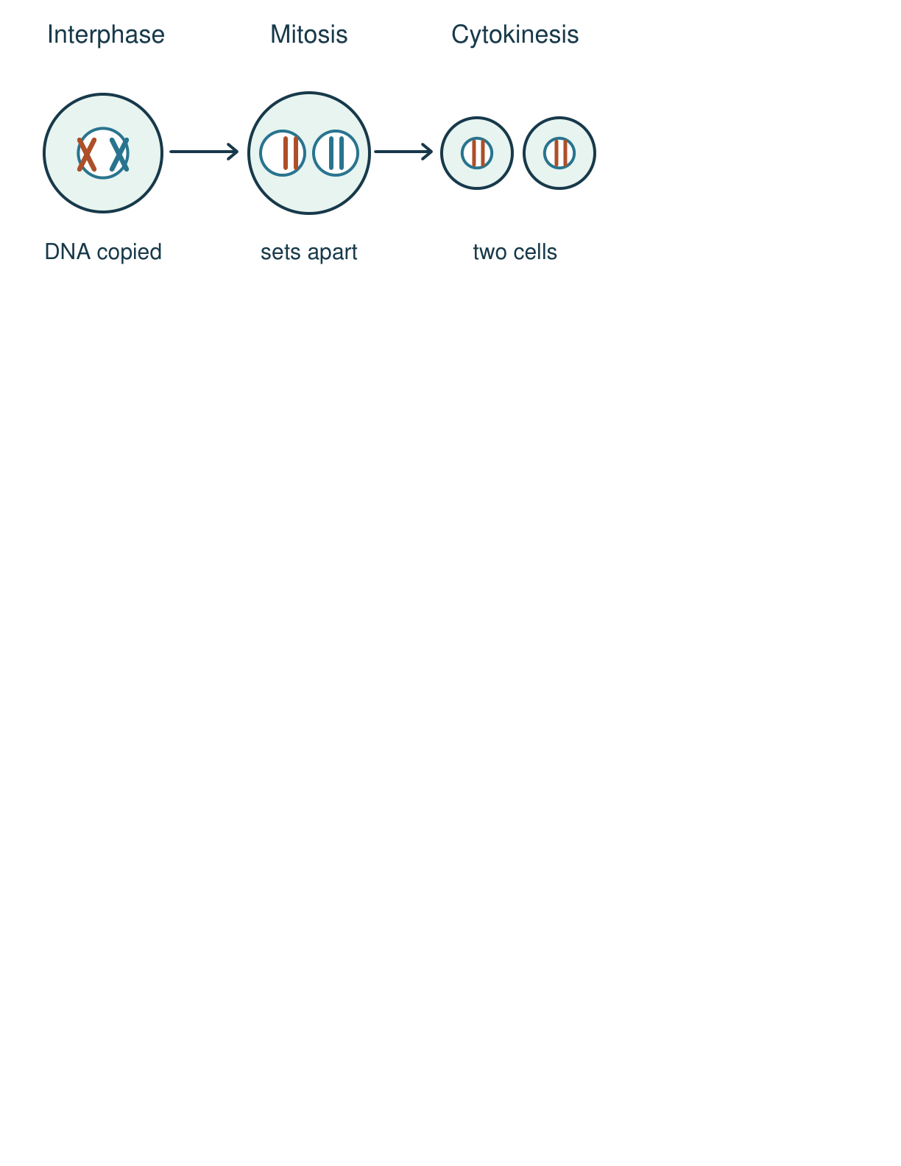
Arrival
Point to the first and last picture in the cell strip. What changed?
SCI-LAUNCH-A2-W01 • LAUNCH Science
2
Made by Matt · madebymatt.uk · © Matt Roper · CC BY-NC-SA 4.0: free for classroom use, share and adapt with credit, no resale · v9 · 25 Sep 2026
Notes:
Offer the same strip as large print or tactile paper shapes; accept pointing before speaking.

Slide 3
Starter
Recall three things from earlier lessons. Show one answer at a time.
Which process uses energy to move a substance from low to high concentration?
In osmosis, which substance moves through a partially permeable membrane?
In a eukaryotic animal cell, which structure holds the chromosomes?
SCI-LAUNCH-A2-W01 • LAUNCH Science
3
Made by Matt · madebymatt.uk · © Matt Roper · CC BY-NC-SA 4.0: free for classroom use, share and adapt with credit, no resale · v9 · 25 Sep 2026
Notes:
Ask the three retrieval questions in order, reveal answers after all pupils respond, then point to the three success criteria.
Which process uses energy to move a substance from low to high concentration? → Active transport.
In osmosis, which substance moves through a partially permeable membrane? → Water.
In a eukaryotic animal cell, which structure holds the chromosomes? → The nucleus.

Slide 4
Model
Watch the full model: copy the DNA, separate the matching chromosomes, then split the cell.
Interphase: copy DNA. Mitosis: prophase (condense), metaphase (line up), anaphase (the two copies of each chromosome are pulled to opposite ends), telophase (two nuclei). Cytokinesis: split the cell.
SCI-LAUNCH-A2-W01 • LAUNCH Science
4
Made by Matt · madebymatt.uk · © Matt Roper · CC BY-NC-SA 4.0: free for classroom use, share and adapt with credit, no resale · v9 · 25 Sep 2026
Notes:
Show the paper-strip model; pause for the show-me check before the next stage.

Slide 5
Picture model
SCI-LAUNCH-A2-W01 • LAUNCH Science
5
Made by Matt · madebymatt.uk · © Matt Roper · CC BY-NC-SA 4.0: free for classroom use, share and adapt with credit, no resale · v9 · 25 Sep 2026
Notes:
Body-cell division: copied chromosomes separate, then one cell splits into two. Simplified; not to scale.

Slide 6
Show me
Show me: is DNA copied before, during or after mitosis?
SCI-LAUNCH-A2-W01 • LAUNCH Science
6
Made by Matt · madebymatt.uk · © Matt Roper · CC BY-NC-SA 4.0: free for classroom use, share and adapt with credit, no resale · v9 · 25 Sep 2026
Notes:
Before mitosis, in interphase.

Slide 7
Our turn
Complete the missing step in the part-done model. Then place the paper strips in both new cells.
Interphase: copy DNA. Mitosis: prophase (condense), metaphase (line up), ________, telophase (two nuclei). Cytokinesis: split the cell.
SCI-LAUNCH-A2-W01 • LAUNCH Science
7
Made by Matt · madebymatt.uk · © Matt Roper · CC BY-NC-SA 4.0: free for classroom use, share and adapt with credit, no resale · v9 · 25 Sep 2026
Notes:
Run paired talk before the card or select task; offer the support route without giving the missing step.
Missing step: Anaphase: the two copies of each chromosome are pulled to opposite ends.

Slide 8
Talk, then sort
Interphase
Mitosis
Cytokinesis
First
Then
Last
SCI-LAUNCH-A2-W01 • LAUNCH Science
8
Made by Matt · madebymatt.uk · © Matt Roper · CC BY-NC-SA 4.0: free for classroom use, share and adapt with credit, no resale · v9 · 25 Sep 2026
Notes:
First → See the lesson teacher note.
Then → See the lesson teacher note.
Last → See the lesson teacher note.

Slide 9
Check
A new body-cell model starts with six chromosomes. After DNA copying, mitosis and cell division, what should each daughter cell contain?
A. A. Half the original set, with just three chromosomes each.
B. B. Double the original set, with twelve chromosomes in each.
C. C. The same six-chromosome set as the original body cell.
D. D. No chromosomes, because the copies remain in one cell.
SCI-LAUNCH-A2-W01 • LAUNCH Science
9
Made by Matt · madebymatt.uk · © Matt Roper · CC BY-NC-SA 4.0: free for classroom use, share and adapt with credit, no resale · v9 · 25 Sep 2026
Notes:
Use simultaneous whiteboards, point or symbol cards. Apply the decision rule and parallel hinge in the note.
A. A. Half the original set, with just three chromosomes each. | Not correct | Confuses body-cell mitosis with chromosome halving in meiosis.
B. B. Double the original set, with twelve chromosomes in each. | Not correct | Counts the copied chromosomes before separation as the number retained by each daughter cell.
C. C. The same six-chromosome set as the original body cell. | Correct | Uses the new case accurately.
D. D. No chromosomes, because the copies remain in one cell. | Not correct | Assumes copied chromosomes stay in the parent cell instead of separating into two cells.
About 3 in 4 or more right → move on; otherwise re-model copying and splitting with two blue and two orange paper strips, then ask the parallel hinge. No automatic grade or saved response.

Slide 10
Independent · F
Use the model to explain how cell division helps replace damaged body cells.
Order the three cards and show the same chromosome colours in each new cell.
First …; then …; last …
SCI-LAUNCH-A2-W01 • LAUNCH Science
10
Made by Matt · madebymatt.uk · © Matt Roper · CC BY-NC-SA 4.0: free for classroom use, share and adapt with credit, no resale · v9 · 25 Sep 2026
Notes:
One adult supports pupils; the other holds the group, swapping roles across the week. Record actual independence and prompt level.

Slide 11
Independent · M
Use the model to explain how cell division helps replace damaged body cells.
Explain why each new cell has a matching chromosome set.
Each new cell matches because …
SCI-LAUNCH-A2-W01 • LAUNCH Science
11
Made by Matt · madebymatt.uk · © Matt Roper · CC BY-NC-SA 4.0: free for classroom use, share and adapt with credit, no resale · v9 · 25 Sep 2026
Notes:
One adult supports pupils; the other holds the group, swapping roles across the week. Record actual independence and prompt level.

Slide 12
Independent · H
Use the model to explain how cell division helps replace damaged body cells.
Predict what would happen to the sets if copied chromosomes did not separate evenly.
If the copies did not separate evenly, then … because …
SCI-LAUNCH-A2-W01 • LAUNCH Science
12
Made by Matt · madebymatt.uk · © Matt Roper · CC BY-NC-SA 4.0: free for classroom use, share and adapt with credit, no resale · v9 · 25 Sep 2026
Notes:
One adult supports pupils; the other holds the group, swapping roles across the week. Record actual independence and prompt level.

Slide 13
Go deeper
How do copy, separate and split work together when new cells are needed for repair?
Fault finder: compare two faulty models. One skips DNA copying; the other puts both copies of one chromosome in one nucleus. Find each first error and propose a repair.
SCI-LAUNCH-A2-W01 • LAUNCH Science
13
Made by Matt · madebymatt.uk · © Matt Roper · CC BY-NC-SA 4.0: free for classroom use, share and adapt with credit, no resale · v9 · 25 Sep 2026

Slide 14
Review
Tell your partner what you changed after feedback. Mark a real self-edit // and read it back when asked ?.
SCI-LAUNCH-A2-W01 • LAUNCH Science
14
Made by Matt · madebymatt.uk · © Matt Roper · CC BY-NC-SA 4.0: free for classroom use, share and adapt with credit, no resale · v9 · 25 Sep 2026
Notes:
Give one specific piece of VF, allow a true self-edit and record only feedback that occurred.

Slide 15
Exit
Show how you know: order the three stages and explain why the new cells match.
Check today’s success:
I can order interphase, four mitosis phases and cytokinesis.
I can show that the two new body cells have matching chromosome sets.
I can explain how mitosis helps growth or repair.
My feedback was … Name the feedback you heard at Review.
Next I need to … Check both matching chromosome sets and the final cell split.
How I know: My model shows two matching cells, and I can explain the order.
Your teacher hears your answer and uses it to choose the next example or prompt.
SCI-LAUNCH-A2-W01 • LAUNCH Science
15
Made by Matt · madebymatt.uk · © Matt Roper · CC BY-NC-SA 4.0: free for classroom use, share and adapt with credit, no resale · v9 · 25 Sep 2026
Notes:
Hear every response through speech, sign, point, drawing or writing; use it to change the next example or prompt.

Slide 16
Word help · cell cycle
the series of steps in which a cell grows and divides
The cell cycle includes interphase, mitosis and cytokinesis.
SCI-LAUNCH-A2-W01 • LAUNCH Science
16
Made by Matt · madebymatt.uk · © Matt Roper · CC BY-NC-SA 4.0: free for classroom use, share and adapt with credit, no resale · v9 · 25 Sep 2026

Slide 17
Word help · interphase
the stage in which the cell grows and copies its DNA
The cell copies its DNA in interphase.
SCI-LAUNCH-A2-W01 • LAUNCH Science
17
Made by Matt · madebymatt.uk · © Matt Roper · CC BY-NC-SA 4.0: free for classroom use, share and adapt with credit, no resale · v9 · 25 Sep 2026

Slide 18
Word help · mitosis
the stage in which copied chromosomes separate into two nuclei
Mitosis separates the chromosome sets.
SCI-LAUNCH-A2-W01 • LAUNCH Science
18
Made by Matt · madebymatt.uk · © Matt Roper · CC BY-NC-SA 4.0: free for classroom use, share and adapt with credit, no resale · v9 · 25 Sep 2026

Slide 19
Word help · chromosome
a structure of DNA that carries genes
Each new nucleus receives a matching set of chromosomes.
SCI-LAUNCH-A2-W01 • LAUNCH Science
19
Made by Matt · madebymatt.uk · © Matt Roper · CC BY-NC-SA 4.0: free for classroom use, share and adapt with credit, no resale · v9 · 25 Sep 2026

Slide 20
Word help · cytokinesis
the division of the cell after the nuclei form
Cytokinesis splits one cell into two.
SCI-LAUNCH-A2-W01 • LAUNCH Science
20
Made by Matt · madebymatt.uk · © Matt Roper · CC BY-NC-SA 4.0: free for classroom use, share and adapt with credit, no resale · v9 · 25 Sep 2026

Slide 21
Word help · prophase
the mitosis phase when chromosomes condense
In prophase, chromosomes become easier to see.
SCI-LAUNCH-A2-W01 • LAUNCH Science
21
Made by Matt · madebymatt.uk · © Matt Roper · CC BY-NC-SA 4.0: free for classroom use, share and adapt with credit, no resale · v9 · 25 Sep 2026

Slide 22
Word help · metaphase
the mitosis phase when chromosomes line up in the middle
In metaphase, chromosomes form a line.
SCI-LAUNCH-A2-W01 • LAUNCH Science
22
Made by Matt · madebymatt.uk · © Matt Roper · CC BY-NC-SA 4.0: free for classroom use, share and adapt with credit, no resale · v9 · 25 Sep 2026

Slide 23
Word help · anaphase
the mitosis phase when the two copies of each chromosome are pulled to opposite ends
In anaphase, the two copies of each chromosome are pulled to opposite ends.
SCI-LAUNCH-A2-W01 • LAUNCH Science
23
Made by Matt · madebymatt.uk · © Matt Roper · CC BY-NC-SA 4.0: free for classroom use, share and adapt with credit, no resale · v9 · 25 Sep 2026

Slide 24
Word help · telophase
the mitosis phase when two new nuclei form
In telophase, each set gains a nucleus.
SCI-LAUNCH-A2-W01 • LAUNCH Science
24
Made by Matt · madebymatt.uk · © Matt Roper · CC BY-NC-SA 4.0: free for classroom use, share and adapt with credit, no resale · v9 · 25 Sep 2026

