Slide 1

Growth and stem cells
I am learning to explain how cells divide and then take on different jobs for growth and repair.
I can distinguish making more cells from cells taking on a specialised job.
I can compare animal growth with plant growth.
I can identify a role for an animal stem cell or a plant meristem.
SCI-LAUNCH-A2-W02 • LAUNCH Science
1
Made by Matt · madebymatt.uk · © Matt Roper · CC BY-NC-SA 4.0: free for classroom use, share and adapt with credit, no resale · v9 · 25 Sep 2026
Notes:
Lesson code: SCI-LAUNCH-A2-W02
SoW objective: Explain growth & stem cells.
Reading band: LAUNCH 11+
Staff focus: {'i_do': '“Watch the model. Point to what makes more cells, then what gives one cell a job.”', 'we_do': '“One step is blank. Which part of the shoot becomes longer?”', 'independent': '“Which branch is your comparison about? Show the last step you know.”'}
Prompt ladder: ['Wait five seconds; watch for an unaided card choice.', 'Point to the last completed branch or visual cue.', 'Ask “Which step makes more cells, and which gives a job?”', 'Model only the placement of the mitosis card; pupil places the next card.', 'Finish one branch together; pupil tries the other branch independently.']
Sources:
Pearson Edexcel GCSE Biology 1BI0 / Combined Science 1SC0, Biology specification, 2.2; https://qualifications.pearson.com/content/dam/pdf/GCSE/Science/2016/Specification/gcse-biology-spec.pdf; https://qualifications.pearson.com/content/dam/pdf/GCSE/Science/2016/Specification/gcse-combinedscience-spec.pdf
Pearson Edexcel GCSE Biology 1BI0 / Combined Science 1SC0, Biology specification, 2.5; https://qualifications.pearson.com/content/dam/pdf/GCSE/Science/2016/Specification/gcse-biology-spec.pdf; https://qualifications.pearson.com/content/dam/pdf/GCSE/Science/2016/Specification/gcse-combinedscience-spec.pdf
Pearson Edexcel GCSE Biology 1BI0 / Combined Science 1SC0, Biology specification, 2.6; https://qualifications.pearson.com/content/dam/pdf/GCSE/Science/2016/Specification/gcse-biology-spec.pdf; https://qualifications.pearson.com/content/dam/pdf/GCSE/Science/2016/Specification/gcse-combinedscience-spec.pdf
Pearson Edexcel GCSE Biology 1BI0 / Combined Science 1SC0, Biology specification, 2.8; https://qualifications.pearson.com/content/dam/pdf/GCSE/Science/2016/Specification/gcse-biology-spec.pdf; https://qualifications.pearson.com/content/dam/pdf/GCSE/Science/2016/Specification/gcse-combinedscience-spec.pdf
National Human Genome Research Institute, Epigenomics Fact Sheet; https://www.genome.gov/about-genomics/fact-sheets/Epigenomics-Fact-Sheet
Pearson Edexcel GCSE Biology 1BI0 and Combined Science 1SC0, specification, Biology Topics 2–3; https://qualifications.pearson.com/content/dam/pdf/GCSE/Science/2016/Specification/gcse-biology-spec.pdf; https://qualifications.pearson.com/content/dam/pdf/GCSE/Science/2016/Specification/gcse-combinedscience-spec.pdf; NHS Blood and Transplant, stem cell–derived red blood cells, https://www.nhsbt.nhs.uk/how-we-help/advanced-therapies/
lesson content–source checks ruling; static SVG geometry and mechanism check; browser confirmation remains NOT RUN
Local school risk assessment and exact prepared kit; staff confirm

Slide 2
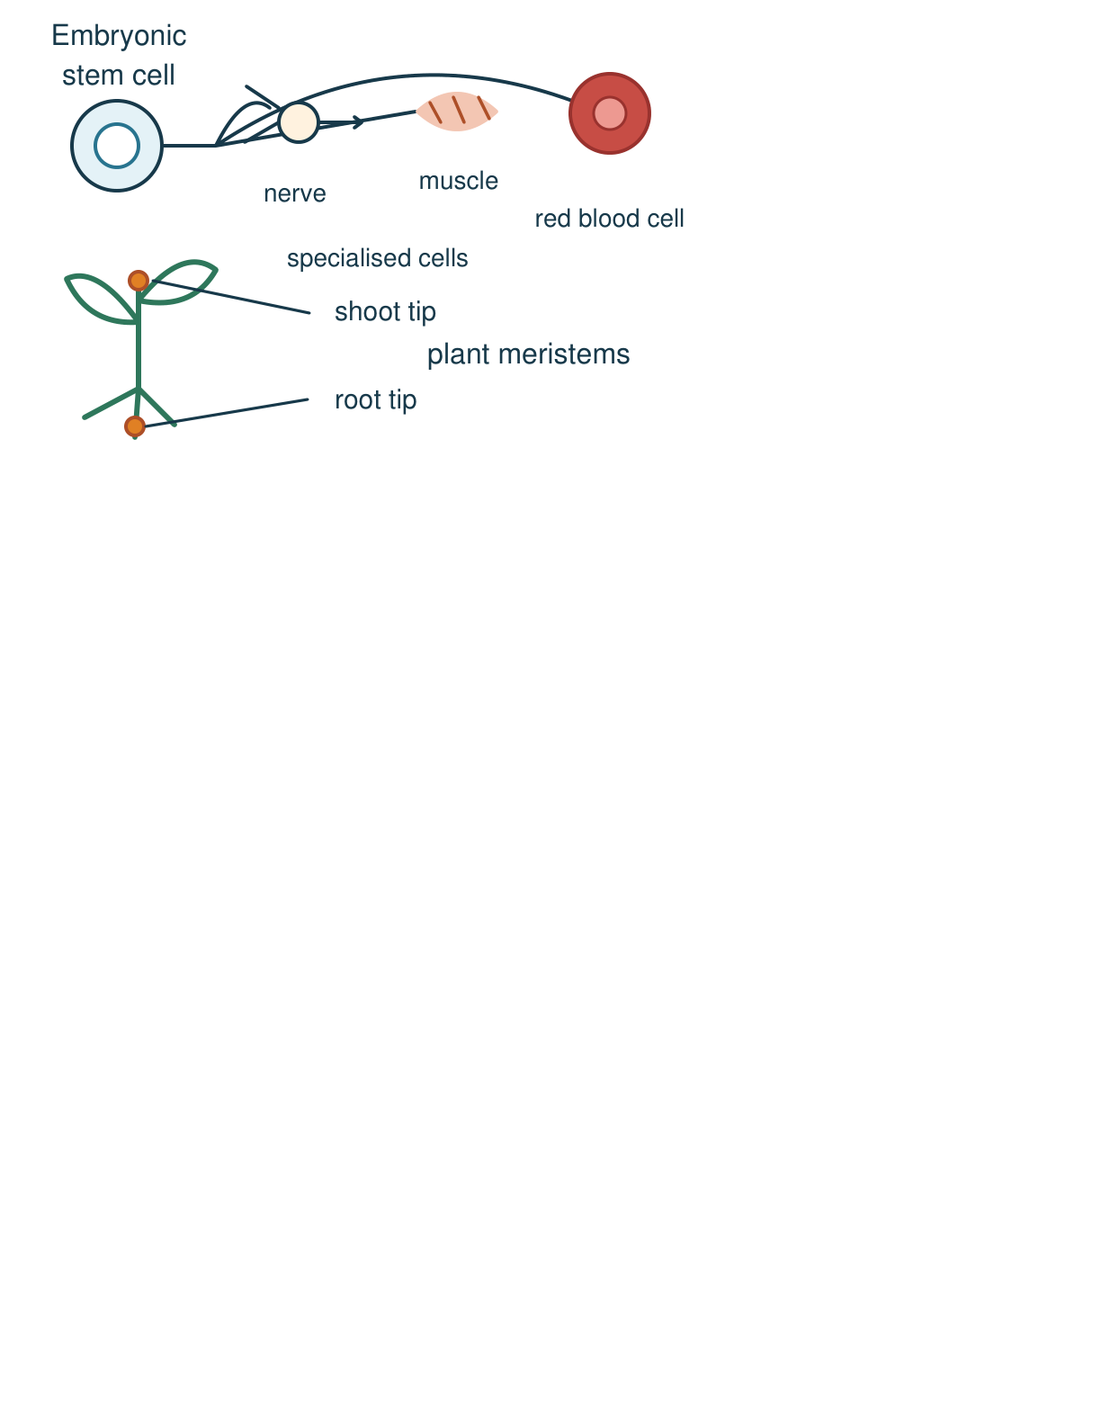
Arrival
Look at this week’s seedling and skin-repair model. Point to one detail you notice.
SCI-LAUNCH-A2-W02 • LAUNCH Science
2
Made by Matt · madebymatt.uk · © Matt Roper · CC BY-NC-SA 4.0: free for classroom use, share and adapt with credit, no resale · v9 · 25 Sep 2026
Notes:
Offer a private, predictable start. Do not require previous knowledge.

Slide 3
Starter
Recall three ideas from earlier lessons. Show one answer at a time.
What two matching products follow body-cell mitosis and cell splitting?
Which process moves particles from low to high concentration using energy?
In which part of a eukaryotic animal cell are chromosomes found?
SCI-LAUNCH-A2-W02 • LAUNCH Science
3
Made by Matt · madebymatt.uk · © Matt Roper · CC BY-NC-SA 4.0: free for classroom use, share and adapt with credit, no resale · v9 · 25 Sep 2026
Notes:
All pupils respond; reveal the answers only after attempts. Revisit success criteria.
What two matching products follow body-cell mitosis and cell splitting? → Two daughter body cells with the same chromosome set.
Which process moves particles from low to high concentration using energy? → Active transport.
In which part of a eukaryotic animal cell are chromosomes found? → The nucleus.

Slide 4
Model
Watch the full model. Point to the step that answers today’s question.
In skin, mitosis adds cells; some stem-cell descendants differentiate for a tissue job. At a shoot tip, meristem cells divide, then elongate and differentiate.
SCI-LAUNCH-A2-W02 • LAUNCH Science
4
Made by Matt · madebymatt.uk · © Matt Roper · CC BY-NC-SA 4.0: free for classroom use, share and adapt with credit, no resale · v9 · 25 Sep 2026
Notes:
Model one complete example; check every pupil’s response to the show-me question.

Slide 5
Picture model
SCI-LAUNCH-A2-W02 • LAUNCH Science
5
Made by Matt · madebymatt.uk · © Matt Roper · CC BY-NC-SA 4.0: free for classroom use, share and adapt with credit, no resale · v9 · 25 Sep 2026
Notes:
An embryonic stem cell can give rise to different specialised cells; meristems at growing plant tips produce new cells. Simplified; not to scale.

Slide 6
Show me
Show me: does making more cells on its own mean those cells now have a specialised job?
SCI-LAUNCH-A2-W02 • LAUNCH Science
6
Made by Matt · madebymatt.uk · © Matt Roper · CC BY-NC-SA 4.0: free for classroom use, share and adapt with credit, no resale · v9 · 25 Sep 2026
Notes:
No; cell differentiation gives specialised roles.

Slide 7
Our turn
Complete the missing step in the part-done model. Speak, then match the cards.
Skin: mitosis adds cells → differentiation gives a job. Shoot: meristem adds cells → ________ lengthens cells → differentiation.
SCI-LAUNCH-A2-W02 • LAUNCH Science
7
Made by Matt · madebymatt.uk · © Matt Roper · CC BY-NC-SA 4.0: free for classroom use, share and adapt with credit, no resale · v9 · 25 Sep 2026
Notes:
Wait five seconds, gesture, then cue if needed. Support the route without supplying the missing answer.
Missing step: Elongation increases the length of plant cells during growth.

Slide 8
Talk, then sort
differentiation
division
elongation
Makes more cells
Plant cells become longer
Cell gains a tissue job
SCI-LAUNCH-A2-W02 • LAUNCH Science
8
Made by Matt · madebymatt.uk · © Matt Roper · CC BY-NC-SA 4.0: free for classroom use, share and adapt with credit, no resale · v9 · 25 Sep 2026
Notes:
Makes more cells → division
Plant cells become longer → elongation
Cell gains a tissue job → differentiation

Slide 9
Check
A gut-lining cell and a nerve cell share inherited DNA but have different structures. Which explanation fits this new pair?
A. A. They differentiated into specialised cells with different jobs.
B. B. One cell must have lost every inherited gene.
C. C. Both cells must perform exactly the same job.
D. D. Neither cell can have developed through cell division.
SCI-LAUNCH-A2-W02 • LAUNCH Science
9
Made by Matt · madebymatt.uk · © Matt Roper · CC BY-NC-SA 4.0: free for classroom use, share and adapt with credit, no resale · v9 · 25 Sep 2026
Notes:
Collect simultaneous responses, apply the decision rule and parallel hinge in the staff note.
A. A. They differentiated into specialised cells with different jobs. | Correct | Uses the new case accurately.
B. B. One cell must have lost every inherited gene. | Not correct | Assumes specialisation requires losing all inherited genes.
C. C. Both cells must perform exactly the same job. | Not correct | Confuses shared DNA with identical cell functions.
D. D. Neither cell can have developed through cell division. | Not correct | Assumes differentiated cells could not have arisen after cell division.
About 3 in 4 or more correct: proceed; otherwise re-model a dividing stem cell and one specialised skin-cell branch with two paper cards, then ask the parallel hinge. No auto-grade.

Slide 10
Independent · F
A skin model shows division. What gives a new cell its job?
Place divide, elongate and differentiate cards on the skin/shoot branches; omit elongate on the skin branch.
In the shoot, first cells …; then they …
SCI-LAUNCH-A2-W02 • LAUNCH Science
10
Made by Matt · madebymatt.uk · © Matt Roper · CC BY-NC-SA 4.0: free for classroom use, share and adapt with credit, no resale · v9 · 25 Sep 2026
Notes:
At lesson start choose one adult with supported pupils and one holding the group; swap during the week. Record independence and prompt level.

Slide 11
Independent · M
A skin model shows division. What gives a new cell its job?
Explain why mitosis alone does not give a new cell its specialised tissue job.
More cells are made by …, but a job develops when …
SCI-LAUNCH-A2-W02 • LAUNCH Science
11
Made by Matt · madebymatt.uk · © Matt Roper · CC BY-NC-SA 4.0: free for classroom use, share and adapt with credit, no resale · v9 · 25 Sep 2026
Notes:
At lesson start choose one adult with supported pupils and one holding the group; swap during the week. Record independence and prompt level.

Slide 12
Independent · H
A skin model shows division. What gives a new cell its job?
Compare growth in animal tissue with a plant shoot, including an appropriate stem-cell region and what each process adds.
Both organisms …; however, the plant also … because …
SCI-LAUNCH-A2-W02 • LAUNCH Science
12
Made by Matt · madebymatt.uk · © Matt Roper · CC BY-NC-SA 4.0: free for classroom use, share and adapt with credit, no resale · v9 · 25 Sep 2026
Notes:
At lesson start choose one adult with supported pupils and one holding the group; swap during the week. Record independence and prompt level.

Slide 13
Go deeper
A tissue gains more cells but no new cell types. What does the model explain, and what is missing?
Correct a diagram labelling new skin cells “stem cell”; justify two changes.
SCI-LAUNCH-A2-W02 • LAUNCH Science
13
Made by Matt · madebymatt.uk · © Matt Roper · CC BY-NC-SA 4.0: free for classroom use, share and adapt with credit, no resale · v9 · 25 Sep 2026

Slide 14
Review
Tell a partner what you changed after feedback. Mark a real edit // and read it back when asked ?.
SCI-LAUNCH-A2-W02 • LAUNCH Science
14
Made by Matt · madebymatt.uk · © Matt Roper · CC BY-NC-SA 4.0: free for classroom use, share and adapt with credit, no resale · v9 · 25 Sep 2026
Notes:
Give a precise VF or NS(+) only when it actually happens. Invite a true self-edit and read-back.

Slide 15
Exit
Show what you know with a model and explain one reason.
Check today’s success:
I can distinguish making more cells from cells taking on a specialised job.
I can compare animal growth with plant growth.
I can identify a role for an animal stem cell or a plant meristem.
What am I learning? I am learning to explain how cells divide and then take on different jobs for growth and repair.
My feedback was … Name what you heard at Review.
Next I need to … Add the step showing how one newly made cell takes on a specialised role.
How I know: I can show division and differentiation and compare the animal and plant growth routes.
Your teacher hears your answer and uses it to choose our next model, prompt or example.
SCI-LAUNCH-A2-W02 • LAUNCH Science
15
Made by Matt · madebymatt.uk · © Matt Roper · CC BY-NC-SA 4.0: free for classroom use, share and adapt with credit, no resale · v9 · 25 Sep 2026
Notes:
Hear the answer privately in a valid mode and use it to change the next example or prompt.

Slide 16
Word help · differentiation
a cell becoming specialised for a particular job
A developing skin cell differentiates to do a job in skin.
SCI-LAUNCH-A2-W02 • LAUNCH Science
16
Made by Matt · madebymatt.uk · © Matt Roper · CC BY-NC-SA 4.0: free for classroom use, share and adapt with credit, no resale · v9 · 25 Sep 2026

Slide 17
Word help · stem cell
a cell that can divide and form specialised cell types
Some adult stem cells make replacement blood cells.
SCI-LAUNCH-A2-W02 • LAUNCH Science
17
Made by Matt · madebymatt.uk · © Matt Roper · CC BY-NC-SA 4.0: free for classroom use, share and adapt with credit, no resale · v9 · 25 Sep 2026

Slide 18
Word help · meristem
a plant region whose cells divide to make new cells
A root tip contains a meristem.
SCI-LAUNCH-A2-W02 • LAUNCH Science
18
Made by Matt · madebymatt.uk · © Matt Roper · CC BY-NC-SA 4.0: free for classroom use, share and adapt with credit, no resale · v9 · 25 Sep 2026

Slide 19
Word help · growth
an increase in size, including by making more cells
A shoot grows as its cells divide and elongate.
SCI-LAUNCH-A2-W02 • LAUNCH Science
19
Made by Matt · madebymatt.uk · © Matt Roper · CC BY-NC-SA 4.0: free for classroom use, share and adapt with credit, no resale · v9 · 25 Sep 2026

