Slide 1

DNA, genes and chromosomes
I am learning to show how a gene is part of DNA and how DNA is packed into chromosomes.
I can label DNA, a gene and a chromosome in a simple model.
I can explain that a gene is a section of DNA with a protein instruction.
I can distinguish one chromosome from the genome.
SCI-LAUNCH-A2-W04 • LAUNCH Science
1
Made by Matt · madebymatt.uk · © Matt Roper · CC BY-NC-SA 4.0: free for classroom use, share and adapt with credit, no resale · v9 · 25 Sep 2026
Notes:
Lesson code: SCI-LAUNCH-A2-W04
SoW objective: Describe DNA, genes & chromosomes.
Reading band: LAUNCH 11+
Staff focus: {'i_do': '“Point to the short marked section, then trace the whole DNA string.”', 'we_do': '“Where is the missing label on this model? What size is it?”', 'independent': '“Show the incorrect label first. What does the short section stand for?”'}
Prompt ladder: ['Wait five seconds for an independent label.', 'Point to the marked part of the string.', 'Ask “Is this marker the entire string or part of it?”', 'Model the DNA label on one string; pupil labels the coloured part.', 'Complete one label together, then pupil corrects a fresh diagram alone.']
Sources:
Pearson Edexcel GCSE Biology 1BI0 / Combined Science 1SC0, Biology specification, 3.5; https://qualifications.pearson.com/content/dam/pdf/GCSE/Science/2016/Specification/gcse-biology-spec.pdf; https://qualifications.pearson.com/content/dam/pdf/GCSE/Science/2016/Specification/gcse-combinedscience-spec.pdf
Pearson Edexcel GCSE Biology 1BI0 / Combined Science 1SC0, Biology specification, 3.4; https://qualifications.pearson.com/content/dam/pdf/GCSE/Science/2016/Specification/gcse-biology-spec.pdf; https://qualifications.pearson.com/content/dam/pdf/GCSE/Science/2016/Specification/gcse-combinedscience-spec.pdf
Pearson Edexcel GCSE Biology 1BI0 / Combined Science 1SC0, Biology specification, 3.13; https://qualifications.pearson.com/content/dam/pdf/GCSE/Science/2016/Specification/gcse-biology-spec.pdf; https://qualifications.pearson.com/content/dam/pdf/GCSE/Science/2016/Specification/gcse-combinedscience-spec.pdf
Wellcome Connecting Science, Introduction to Genomics; https://www.yourgenome.org/explore-genomics/introduction-to-genomics/
Constructed physical and SVG classroom model, labelled simplified/not to scale.
Wellcome Connecting Science, DNA in the cell, https://www.yourgenome.org/explore-genomics/in-the-cell/; NHGRI, Chromosomes Fact Sheet, https://www.genome.gov/about-genomics/fact-sheets/Chromosomes-Fact-Sheet
Local school risk assessment and exact prepared kit; staff confirm

Slide 2
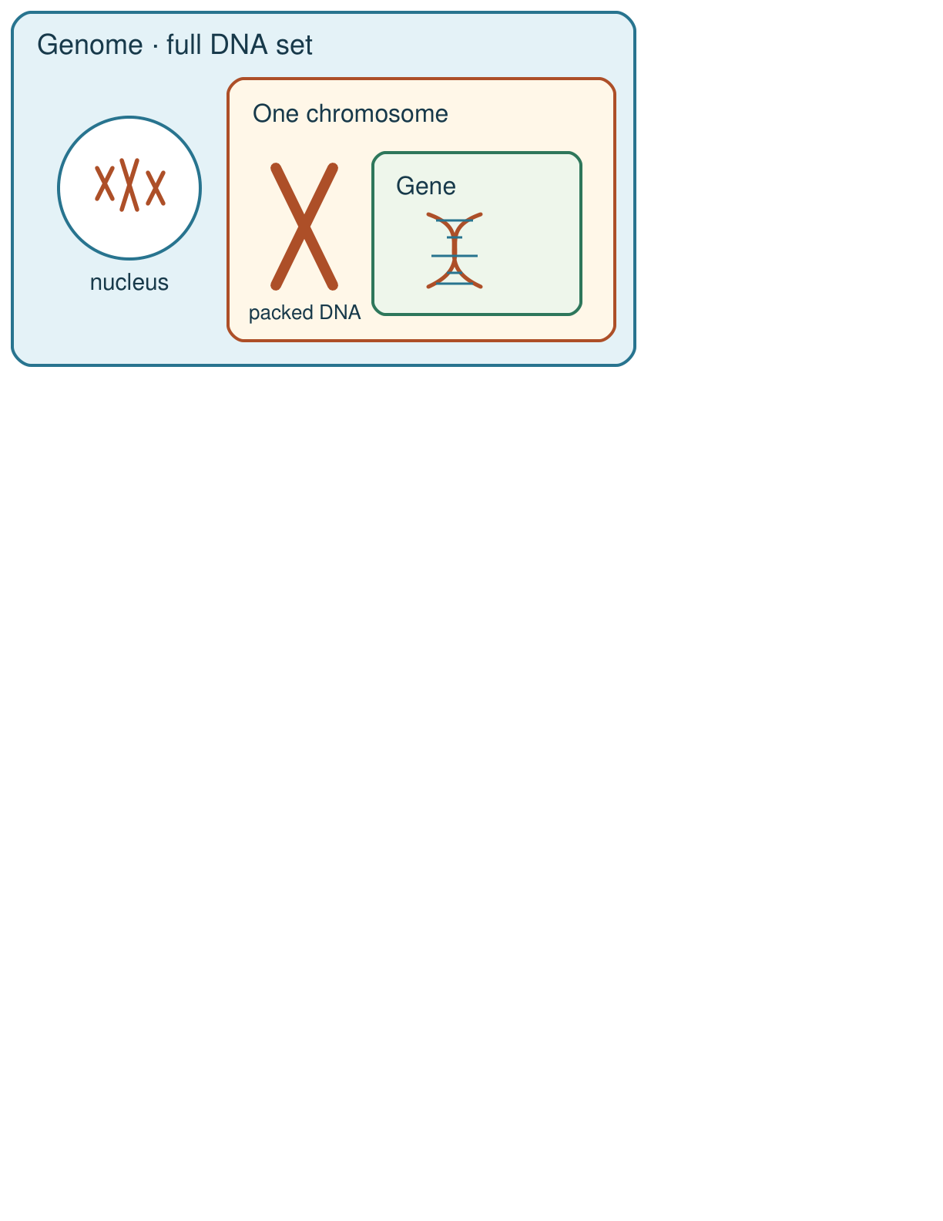
Arrival
Look at this week’s string-and-clip DNA model. Point to one detail you notice.
SCI-LAUNCH-A2-W04 • LAUNCH Science
2
Made by Matt · madebymatt.uk · © Matt Roper · CC BY-NC-SA 4.0: free for classroom use, share and adapt with credit, no resale · v9 · 25 Sep 2026
Notes:
Offer a private, predictable start. Do not require previous knowledge.

Slide 3
Starter
Recall three ideas from earlier lessons. Show one answer at a time.
What is one reason a claim of a new stem-cell treatment needs evidence?
Which structure carries the matching chromosome sets after mitosis?
Where are chromosomes found in a eukaryotic animal cell?
SCI-LAUNCH-A2-W04 • LAUNCH Science
3
Made by Matt · madebymatt.uk · © Matt Roper · CC BY-NC-SA 4.0: free for classroom use, share and adapt with credit, no resale · v9 · 25 Sep 2026
Notes:
All pupils respond; reveal the answers only after attempts. Revisit success criteria.
What is one reason a claim of a new stem-cell treatment needs evidence? → To check whether it benefits people and what risks it has.
Which structure carries the matching chromosome sets after mitosis? → Each new daughter-cell nucleus.
Where are chromosomes found in a eukaryotic animal cell? → In the nucleus.

Slide 4
Model
Watch the full model. Point to the step that answers today’s question.
Mark a short section of a DNA cord as a gene. Coil the cord as one chromosome; place it inside a border for the genome. Name the section, molecule, package and complete DNA set.
SCI-LAUNCH-A2-W04 • LAUNCH Science
4
Made by Matt · madebymatt.uk · © Matt Roper · CC BY-NC-SA 4.0: free for classroom use, share and adapt with credit, no resale · v9 · 25 Sep 2026
Notes:
Model one complete example; check every pupil’s response to the show-me question.

Slide 5
Picture model
SCI-LAUNCH-A2-W04 • LAUNCH Science
5
Made by Matt · madebymatt.uk · © Matt Roper · CC BY-NC-SA 4.0: free for classroom use, share and adapt with credit, no resale · v9 · 25 Sep 2026
Notes:
The genome is the full DNA set; a chromosome carries part of it; a gene is a section of DNA on a chromosome. Nested view; not to scale.

Slide 6
Show me
Show me: is a gene a section of DNA, or is all DNA inside one gene?
SCI-LAUNCH-A2-W04 • LAUNCH Science
6
Made by Matt · madebymatt.uk · © Matt Roper · CC BY-NC-SA 4.0: free for classroom use, share and adapt with credit, no resale · v9 · 25 Sep 2026
Notes:
A gene is a section of DNA.

Slide 7
Our turn
Complete the missing step in the part-done model. Speak, then match the cards.
DNA cord → a short marked ________ codes for a protein → chromosome package → the genome contains all DNA.
SCI-LAUNCH-A2-W04 • LAUNCH Science
7
Made by Matt · madebymatt.uk · © Matt Roper · CC BY-NC-SA 4.0: free for classroom use, share and adapt with credit, no resale · v9 · 25 Sep 2026
Notes:
Wait five seconds, gesture, then cue if needed. Support the route without supplying the missing answer.
Missing step: Label the short marked DNA section “gene” and explain it codes for a specific protein.

Slide 8
Talk, then sort
DNA
chromosome
gene
genome
short coloured DNA section
whole genetic molecule
long DNA package
all of the organism’s DNA
SCI-LAUNCH-A2-W04 • LAUNCH Science
8
Made by Matt · madebymatt.uk · © Matt Roper · CC BY-NC-SA 4.0: free for classroom use, share and adapt with credit, no resale · v9 · 25 Sep 2026
Notes:
short coloured DNA section → gene
whole genetic molecule → DNA
long DNA package → chromosome
all of the organism’s DNA → genome

Slide 9
Check
A new diagram marks a short DNA region carrying instructions for one protein. Which label belongs to that region?
A. A. A genome containing the whole cell.
B. B. A gene within the DNA molecule.
C. C. A complete cell containing no DNA.
D. D. A chromosome containing the whole genome.
SCI-LAUNCH-A2-W04 • LAUNCH Science
9
Made by Matt · madebymatt.uk · © Matt Roper · CC BY-NC-SA 4.0: free for classroom use, share and adapt with credit, no resale · v9 · 25 Sep 2026
Notes:
Collect simultaneous responses, apply the decision rule and parallel hinge in the staff note.
A. A. A genome containing the whole cell. | Not correct | Treats a short DNA region as the whole genome.
B. B. A gene within the DNA molecule. | Correct | Uses the new case accurately.
C. C. A complete cell containing no DNA. | Not correct | Labels a DNA segment as an entire cell and overlooks its DNA.
D. D. A chromosome containing the whole genome. | Not correct | Uses chromosome for the marked gene and confuses one chromosome with the whole genome.
About 3 in 4 or more correct: proceed; otherwise re-model a coloured section on one long string and ask the parallel hinge. No auto-grade.

Slide 10
Independent · F
Two diagrams label a gene differently. Choose the accurate model and explain one reason.
Label a gene, DNA, chromosome and genome on the model.
This short marked section is a …; the long package is a …
SCI-LAUNCH-A2-W04 • LAUNCH Science
10
Made by Matt · madebymatt.uk · © Matt Roper · CC BY-NC-SA 4.0: free for classroom use, share and adapt with credit, no resale · v9 · 25 Sep 2026
Notes:
At lesson start choose one adult with supported pupils and one holding the group; swap during the week. Record independence and prompt level.

Slide 11
Independent · M
Two diagrams label a gene differently. Choose the accurate model and explain one reason.
Explain why a gene is a DNA section, not another material.
A gene is part of … and codes for …
SCI-LAUNCH-A2-W04 • LAUNCH Science
11
Made by Matt · madebymatt.uk · © Matt Roper · CC BY-NC-SA 4.0: free for classroom use, share and adapt with credit, no resale · v9 · 25 Sep 2026
Notes:
At lesson start choose one adult with supported pupils and one holding the group; swap during the week. Record independence and prompt level.

Slide 12
Independent · H
Two diagrams label a gene differently. Choose the accurate model and explain one reason.
Correct a faulty gene label and explain the protein instruction.
The faulty label is …; it should be … because …
SCI-LAUNCH-A2-W04 • LAUNCH Science
12
Made by Matt · madebymatt.uk · © Matt Roper · CC BY-NC-SA 4.0: free for classroom use, share and adapt with credit, no resale · v9 · 25 Sep 2026
Notes:
At lesson start choose one adult with supported pupils and one holding the group; swap during the week. Record independence and prompt level.

Slide 13
Go deeper
What distinctions disappear if the whole genome is called one gene?
Repair two faulty diagrams: DNA inside a gene, and one chromosome as the entire genome. Justify both.
SCI-LAUNCH-A2-W04 • LAUNCH Science
13
Made by Matt · madebymatt.uk · © Matt Roper · CC BY-NC-SA 4.0: free for classroom use, share and adapt with credit, no resale · v9 · 25 Sep 2026

Slide 14
Review
Tell a partner what you changed after feedback. Mark a real edit // and read it back when asked ?.
SCI-LAUNCH-A2-W04 • LAUNCH Science
14
Made by Matt · madebymatt.uk · © Matt Roper · CC BY-NC-SA 4.0: free for classroom use, share and adapt with credit, no resale · v9 · 25 Sep 2026
Notes:
Give a precise VF or NS(+) only when it actually happens. Invite a true self-edit and read-back.

Slide 15
Exit
Show what you know with a model and explain one reason.
Check today’s success:
I can label DNA, a gene and a chromosome in a simple model.
I can explain that a gene is a section of DNA with a protein instruction.
I can distinguish one chromosome from the genome.
What am I learning? I am learning to show how a gene is part of DNA and how DNA is packed into chromosomes.
My feedback was … Name what you heard at Review.
Next I need to … Use “section of DNA” and “codes for a protein” precisely in one sentence.
How I know: I can show a gene within DNA, DNA packaged in a chromosome, and the genome as all DNA.
Your teacher hears your answer and uses it to choose our next model, prompt or example.
SCI-LAUNCH-A2-W04 • LAUNCH Science
15
Made by Matt · madebymatt.uk · © Matt Roper · CC BY-NC-SA 4.0: free for classroom use, share and adapt with credit, no resale · v9 · 25 Sep 2026
Notes:
Hear the answer privately in a valid mode and use it to change the next example or prompt.

Slide 16
Word help · DNA
the molecule that stores genetic instructions
DNA contains the instructions for making proteins.
SCI-LAUNCH-A2-W04 • LAUNCH Science
16
Made by Matt · madebymatt.uk · © Matt Roper · CC BY-NC-SA 4.0: free for classroom use, share and adapt with credit, no resale · v9 · 25 Sep 2026

Slide 17
Word help · gene
a section of DNA that codes for a specific protein
The coloured section of the model stands for one gene.
SCI-LAUNCH-A2-W04 • LAUNCH Science
17
Made by Matt · madebymatt.uk · © Matt Roper · CC BY-NC-SA 4.0: free for classroom use, share and adapt with credit, no resale · v9 · 25 Sep 2026

Slide 18
Word help · chromosome
a long DNA molecule packaged with proteins in a cell
A chromosome contains many DNA sections, including genes.
SCI-LAUNCH-A2-W04 • LAUNCH Science
18
Made by Matt · madebymatt.uk · © Matt Roper · CC BY-NC-SA 4.0: free for classroom use, share and adapt with credit, no resale · v9 · 25 Sep 2026

Slide 19
Word help · genome
the entire DNA of an organism
The genome includes all of the organism’s chromosomes and other DNA.
SCI-LAUNCH-A2-W04 • LAUNCH Science
19
Made by Matt · madebymatt.uk · © Matt Roper · CC BY-NC-SA 4.0: free for classroom use, share and adapt with credit, no resale · v9 · 25 Sep 2026

