Slide 1

A simple genetic cross
I am learning to calculate genetic probability with a Punnett square and evaluate its limits.
I can pair one allele from each parent.
I can find the aa chance in four squares.
I can evaluate why probability does not guarantee an exact count.
SCI-LAUNCH-A2-W05 • LAUNCH Science
1
Made by Matt · madebymatt.uk · © Matt Roper · CC BY-NC-SA 4.0: free for classroom use, share and adapt with credit, no resale · v9 · 25 Sep 2026
Notes:
Lesson code: SCI-LAUNCH-A2-W05
SoW objective: Complete a genetic cross (digital Punnett square).
Reading band: LAUNCH 11+
Staff focus: {'i_do': '“Watch one letter from each parent enter one square.”', 'we_do': '“Which edge has not supplied a letter yet?”', 'independent': '“Point to one finished square. How will you use that step next?”'}
Prompt ladder: ['Wait five seconds for an independent tile move.', 'Point to the unfinished square and the two edges.', 'Ask “Which one allele can this parent pass on?”', 'Model one edge-to-square move; pupil repeats with another square.', 'Complete one square together, then pupil tries a fresh one alone.']
Sources:
Pearson Edexcel GCSE Biology 1BI0 Foundation, Biology Topics 2–3, https://qualifications.pearson.com/content/dam/pdf/GCSE/Science/2016/Specification/gcse-biology-spec.pdf; Pearson Edexcel GCSE Combined Science 1SC0 Foundation, Biology Topics 2–3, https://qualifications.pearson.com/content/dam/pdf/GCSE/Science/2016/Specification/gcse-combinedscience-spec.pdf
Authored fictional classroom model; not a species claim.
Pearson Edexcel GCSE Biology 1BI0 and Combined Science 1SC0, specification, Biology Topics 2–3; https://qualifications.pearson.com/content/dam/pdf/GCSE/Science/2016/Specification/gcse-biology-spec.pdf; https://qualifications.pearson.com/content/dam/pdf/GCSE/Science/2016/Specification/gcse-combinedscience-spec.pdf
lesson content–source checks ruling; static SVG geometry and mechanism check; browser confirmation remains NOT RUN
Local school risk assessment and exact prepared kit; staff confirm

Slide 2
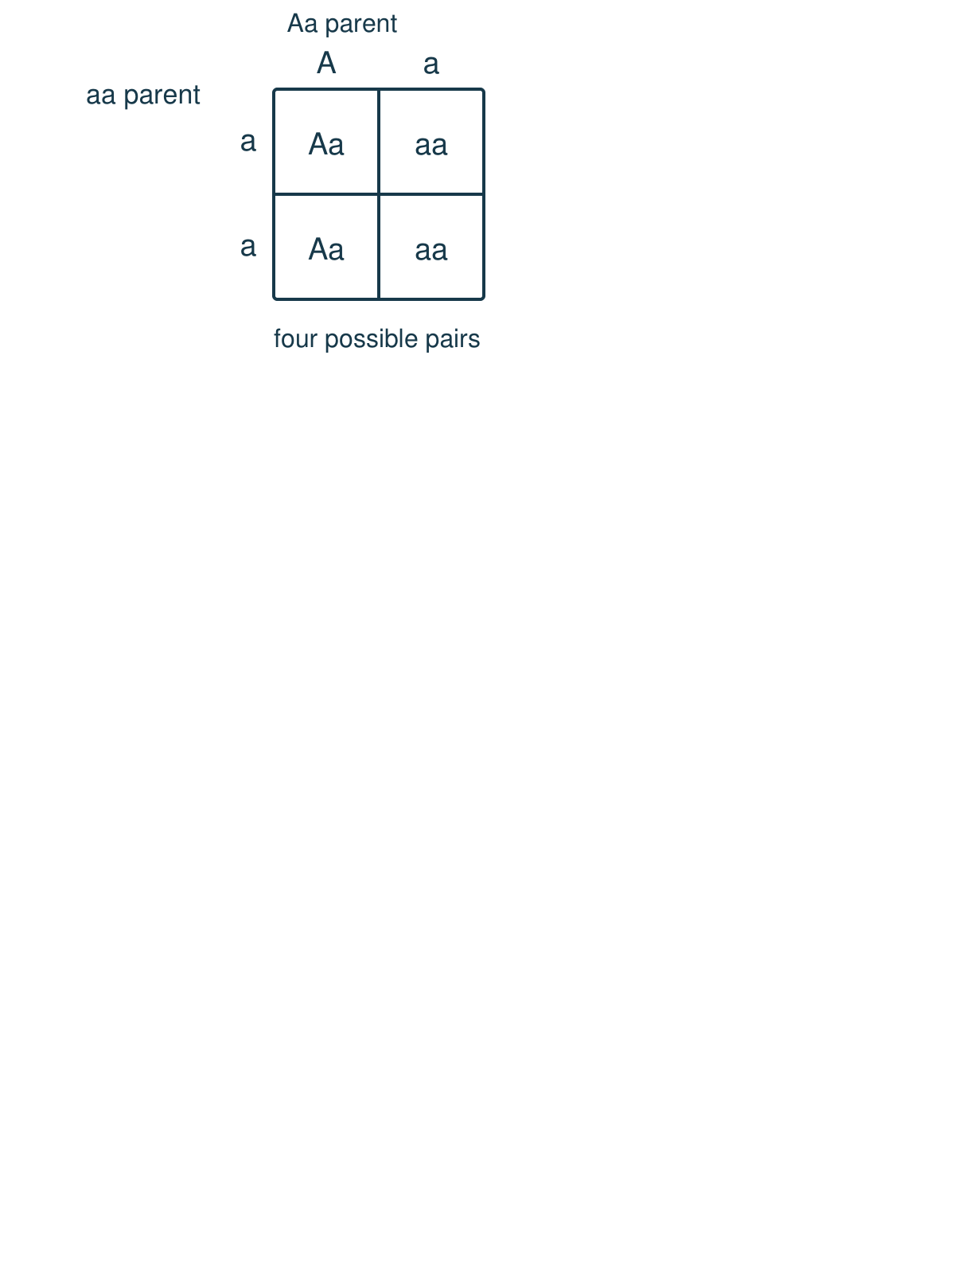
Arrival
Look at this week’s letter tiles A and a. Point to one detail you notice.
SCI-LAUNCH-A2-W05 • LAUNCH Science
2
Made by Matt · madebymatt.uk · © Matt Roper · CC BY-NC-SA 4.0: free for classroom use, share and adapt with credit, no resale · v9 · 25 Sep 2026
Notes:
Offer a private, predictable start. Do not require previous knowledge.

Slide 3
Starter
Recall three ideas from earlier lessons. Show one answer at a time.
What is a gene?
What do stem cells do in growth?
Where are chromosomes found in an animal cell?
SCI-LAUNCH-A2-W05 • LAUNCH Science
3
Made by Matt · madebymatt.uk · © Matt Roper · CC BY-NC-SA 4.0: free for classroom use, share and adapt with credit, no resale · v9 · 25 Sep 2026
Notes:
All pupils respond; reveal the answers only after attempts. Revisit success criteria.
What is a gene? → A section of DNA that codes for a protein.
What do stem cells do in growth? → They divide and some become specialised.
Where are chromosomes found in an animal cell? → In the nucleus.

Slide 4
Model
Watch the full model. Point to the step that answers today’s question.
Place A/a atop the grid for one parent; place a/a at its side for the other. Pair one allele from each edge: Aa, aa, Aa, aa. Two of four boxes are aa: a 1 in 2 chance per offspring, not an exact family count.
SCI-LAUNCH-A2-W05 • LAUNCH Science
4
Made by Matt · madebymatt.uk · © Matt Roper · CC BY-NC-SA 4.0: free for classroom use, share and adapt with credit, no resale · v9 · 25 Sep 2026
Notes:
Model one complete example; check every pupil’s response to the show-me question.

Slide 5
Picture model
SCI-LAUNCH-A2-W05 • LAUNCH Science
5
Made by Matt · madebymatt.uk · © Matt Roper · CC BY-NC-SA 4.0: free for classroom use, share and adapt with credit, no resale · v9 · 25 Sep 2026
Notes:
Invented A/a flower model: Aa × aa gives two Aa and two aa possibilities. Each square is a possibility, not a family count. Simplified.

Slide 6
Show me
Show me: which allele can the aa parent pass on?
SCI-LAUNCH-A2-W05 • LAUNCH Science
6
Made by Matt · madebymatt.uk · © Matt Roper · CC BY-NC-SA 4.0: free for classroom use, share and adapt with credit, no resale · v9 · 25 Sep 2026
Notes:
Only a.

Slide 7
Our turn
Complete the missing step in the part-done model. Speak, then match the cards.
Aa × aa: top A, a; side a, a. First row Aa, aa; second row ___, ___. Chance of aa: ___ out of 4.
SCI-LAUNCH-A2-W05 • LAUNCH Science
7
Made by Matt · madebymatt.uk · © Matt Roper · CC BY-NC-SA 4.0: free for classroom use, share and adapt with credit, no resale · v9 · 25 Sep 2026
Notes:
Wait five seconds, gesture, then cue if needed. Support the route without supplying the missing answer.
Missing step: Combine one top allele and one side allele in each second-row square; count two aa squares.

Slide 8
Talk, then sort
Aa
aa
Top A with side a
Top a with first side a
Top A with second side a
Top a with second side a
SCI-LAUNCH-A2-W05 • LAUNCH Science
8
Made by Matt · madebymatt.uk · © Matt Roper · CC BY-NC-SA 4.0: free for classroom use, share and adapt with credit, no resale · v9 · 25 Sep 2026
Notes:
Top A with side a → Aa
Top a with first side a → aa
Top A with second side a → Aa
Top a with second side a → aa

Slide 9
Check
New cross: Aa × Aa. What is the chance of aa for each offspring?
A. A. 1 in 4 for each offspring.
B. B. 1 in 2 for each offspring.
C. C. 3 in 4 for each offspring.
D. D. Certain for every single offspring.
SCI-LAUNCH-A2-W05 • LAUNCH Science
9
Made by Matt · madebymatt.uk · © Matt Roper · CC BY-NC-SA 4.0: free for classroom use, share and adapt with credit, no resale · v9 · 25 Sep 2026
Notes:
Collect simultaneous responses, apply the decision rule and parallel hinge in the staff note.
A. A. 1 in 4 for each offspring. | Correct | Uses the new case accurately.
B. B. 1 in 2 for each offspring. | Not correct | Counts the two heterozygous squares rather than the one aa square.
C. C. 3 in 4 for each offspring. | Not correct | Counts all outcomes except aa rather than the recessive genotype.
D. D. Certain for every single offspring. | Not correct | Treats one possible aa square as a guaranteed outcome.
About 3 in 4 or more right → move on. Otherwise re-model the Aa × aa top and side headings with two colours, pair one allele in each square, then ask the parallel hinge. No automatic mark or saved response.

Slide 10
Independent · F
Calculate the aa probability for Aa × aa. Evaluate an exact-count claim about real offspring.
Complete Aa × aa with allele tiles.
Top ___ and side ___ make ___.
SCI-LAUNCH-A2-W05 • LAUNCH Science
10
Made by Matt · madebymatt.uk · © Matt Roper · CC BY-NC-SA 4.0: free for classroom use, share and adapt with credit, no resale · v9 · 25 Sep 2026
Notes:
At lesson start choose one adult with supported pupils and one holding the group; swap during the week. Record independence and prompt level.

Slide 11
Independent · M
Calculate the aa probability for Aa × aa. Evaluate an exact-count claim about real offspring.
Calculate and justify the aa probability from the grid.
I count ___ aa squares out of four, so …
SCI-LAUNCH-A2-W05 • LAUNCH Science
11
Made by Matt · madebymatt.uk · © Matt Roper · CC BY-NC-SA 4.0: free for classroom use, share and adapt with credit, no resale · v9 · 25 Sep 2026
Notes:
At lesson start choose one adult with supported pupils and one holding the group; swap during the week. Record independence and prompt level.

Slide 12
Independent · H
Calculate the aa probability for Aa × aa. Evaluate an exact-count claim about real offspring.
Evaluate an exact-count claim about four real offspring.
The grid shows a chance, not a promise, because …
SCI-LAUNCH-A2-W05 • LAUNCH Science
12
Made by Matt · madebymatt.uk · © Matt Roper · CC BY-NC-SA 4.0: free for classroom use, share and adapt with credit, no resale · v9 · 25 Sep 2026
Notes:
At lesson start choose one adult with supported pupils and one holding the group; swap during the week. Record independence and prompt level.

Slide 13
Go deeper
Compare aa chances for Aa × Aa and Aa × aa with a second grid.
Correct a faulty grid that gives an Aa parent two A headings; explain its wrong probability.
SCI-LAUNCH-A2-W05 • LAUNCH Science
13
Made by Matt · madebymatt.uk · © Matt Roper · CC BY-NC-SA 4.0: free for classroom use, share and adapt with credit, no resale · v9 · 25 Sep 2026

Slide 14
Review
Tell a partner what you changed after feedback. Mark a real edit // and read it back when asked ?.
SCI-LAUNCH-A2-W05 • LAUNCH Science
14
Made by Matt · madebymatt.uk · © Matt Roper · CC BY-NC-SA 4.0: free for classroom use, share and adapt with credit, no resale · v9 · 25 Sep 2026
Notes:
Give a precise VF or NS(+) only when it actually happens. Invite a true self-edit and read-back.

Slide 15
Exit
Show what you know with a model and explain one reason.
Check today’s success:
I can pair one allele from each parent.
I can find the aa chance in four squares.
I can evaluate why probability does not guarantee an exact count.
What am I learning? I am learning to calculate genetic probability with a Punnett square and evaluate its limits.
My feedback was … Name what you heard at Review.
Next I need to … Check the top and side alleles before giving a chance.
How I know: I can fill Aa × aa and explain that two of four model squares are aa, with no promise about real offspring.
Your teacher hears your answer and uses it to choose our next model, prompt or example.
SCI-LAUNCH-A2-W05 • LAUNCH Science
15
Made by Matt · madebymatt.uk · © Matt Roper · CC BY-NC-SA 4.0: free for classroom use, share and adapt with credit, no resale · v9 · 25 Sep 2026
Notes:
Hear the answer privately in a valid mode and use it to change the next example or prompt.

Slide 16
Word help · allele
a version of a gene
A and a represent two alleles in our invented model.
SCI-LAUNCH-A2-W05 • LAUNCH Science
16
Made by Matt · madebymatt.uk · © Matt Roper · CC BY-NC-SA 4.0: free for classroom use, share and adapt with credit, no resale · v9 · 25 Sep 2026

Slide 17
Word help · genotype
the pair of alleles shown by letters
Aa is one possible genotype in this model.
SCI-LAUNCH-A2-W05 • LAUNCH Science
17
Made by Matt · madebymatt.uk · © Matt Roper · CC BY-NC-SA 4.0: free for classroom use, share and adapt with credit, no resale · v9 · 25 Sep 2026

Slide 18
Word help · dominant
an allele shown by one copy in this simple model
A is dominant in our invented flower model.
SCI-LAUNCH-A2-W05 • LAUNCH Science
18
Made by Matt · madebymatt.uk · © Matt Roper · CC BY-NC-SA 4.0: free for classroom use, share and adapt with credit, no resale · v9 · 25 Sep 2026

Slide 19
Word help · recessive
an allele shown when two copies are present in this model
aa shows the recessive version in our model.
SCI-LAUNCH-A2-W05 • LAUNCH Science
19
Made by Matt · madebymatt.uk · © Matt Roper · CC BY-NC-SA 4.0: free for classroom use, share and adapt with credit, no resale · v9 · 25 Sep 2026

Slide 20
Word help · Punnett square
a grid that shows possible allele pairs
The Punnett square for Aa × aa has four cells.
SCI-LAUNCH-A2-W05 • LAUNCH Science
20
Made by Matt · madebymatt.uk · © Matt Roper · CC BY-NC-SA 4.0: free for classroom use, share and adapt with credit, no resale · v9 · 25 Sep 2026

