Slide 1
LAUNCH Vocational Spring 1 Week 3
Gardening tool safety
Using gardening tools safely.
Gardening and enterprise
Resilience & Change
Monday 18 January 2027, P1
1

Slide 2
LAUNCH Vocational Spring 1 Week 3
Our checked work area
An adult checks the tools and clear working space.
Wear suitable footwear. Cover cuts and use agreed gloves.
Stop, park the tool and tell an adult if something is wrong.
Keep a clear gap. A safe pause is always allowed.
Monday 18 January 2027, P1
2

Slide 3
LAUNCH Vocational Spring 1 Week 3
Tools and their jobs
Tool | Job
Hand trowel | Lift small amounts of growing medium.
Hand fork | Loosen soil in an empty practice area.
Secateurs | Cut small stems. Adult controls blades.
Watering can | Give controlled water after a moisture check.
Gloves | Protect skin. Keep hands clear of blades.
Monday 18 January 2027, P1
3

Slide 4
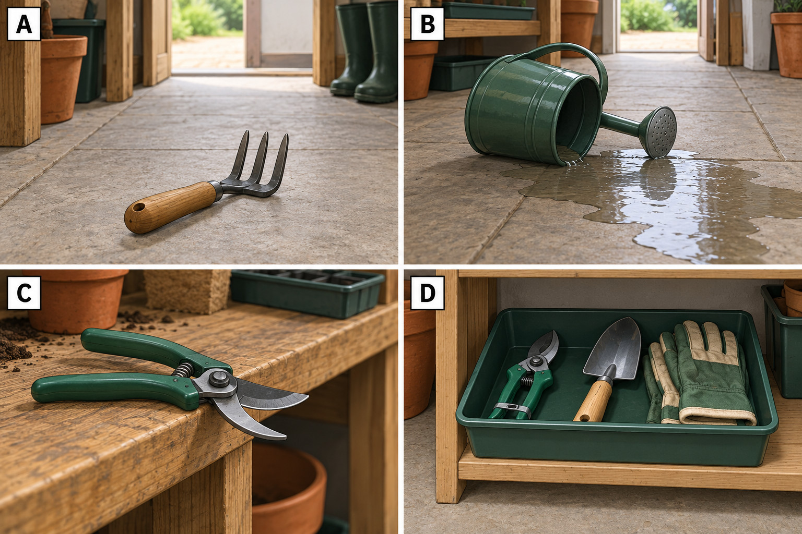
LAUNCH Vocational Spring 1 Week 3
Hazards in the picture
A, B, C or D?
Name the hazard.
Give a safer action.
Invented illustration.
Monday 18 January 2027, P1
4

Slide 5
LAUNCH Vocational Spring 1 Week 3
Our safe handling check
The next person needs the secateurs.
A Pass them with the blades open.
B Keep them closed and locked, then place them down.
Which action keeps hands clear of sharp blades?
Monday 18 January 2027, P1
5

Slide 6
LAUNCH Vocational Spring 1 Week 3
Supervised handling practice
Step | My practice
1 | Choose a checked tool and name its job.
2 | Walk with one tool low and away from others.
3 | Use it only as the adult has shown.
4 | Clean, dry, store and wash hands.
The adult ticks the skill actually observed.
Monday 18 January 2027, P1
6

Slide 7
LAUNCH Vocational Spring 1 Week 3
My one-line evidence
I used ____ safely by ____.
Tell an adult or use your book.
Give the safe action you actually showed.
Monday 18 January 2027, P1
7

Slide 8
LAUNCH Vocational Spring 1 Week 3
Clear up and exit
Park tools. Clean blunt tools as the adult shows.
The adult checks storage. Wash hands with soap and water.
Name one safe action from your practice.
Next lesson: a short safe-use task and self-check.
Monday 18 January 2027, P1
8

