Slide 1
BUILD RSHE
1 / 12
Who can help with change
Year A · Wednesday 3 February 2027 · P1 · 40 minutes
Use the story. Pick a helper and a kind of help.
Theme: Resilience & Change
You can pass, point or ask for help.
RSHE-BUILD-S1-W05
Public edition
Lesson resource · CC BY-NC-SA 4.0: free for classroom use, share and adapt with credit, no resale
Notes:
Opening only. Three to four learners, one forty-minute formative lesson. The objective is identification of a helper and suitable help, not independent speech. No real change or worry is requested.
Source: owner brief, BUILD Weekly Spring row68; accepted Week4 format. No external text or campaign resource reproduced. Lesson resource · CC BY-NC-SA 4.0: free for classroom use, share and adapt with credit, no resale

Slide 2
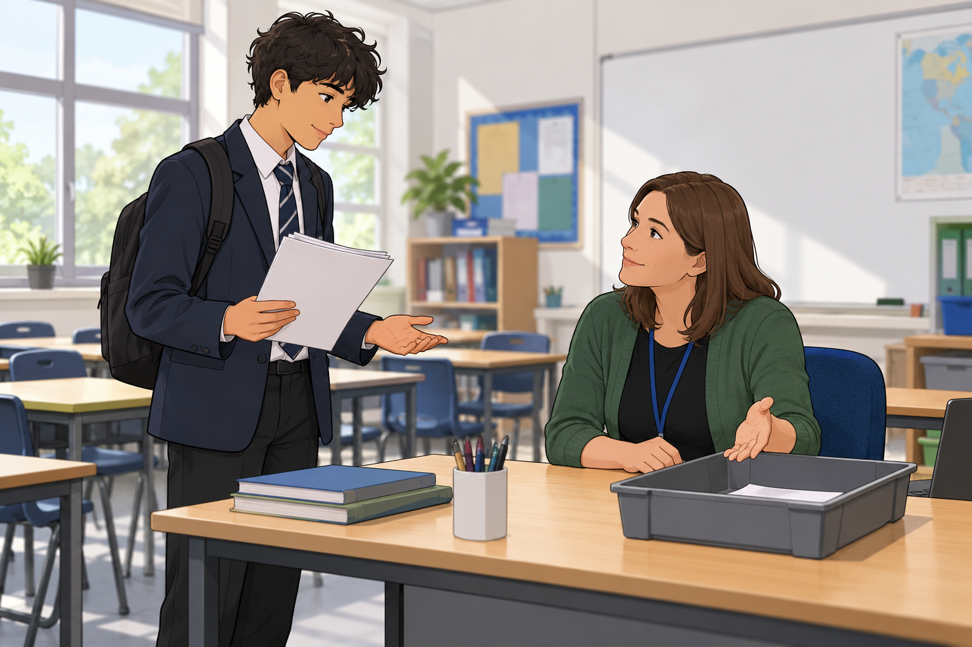
CHUNK 1
2 / 12 · 0–3 min
A new class routine
A pupil has a new start to class.
They are not sure what comes next.
Who could help the pupil?
Words: pupil, new, step, help
Start: The pupil could ask ... .
Model: The pupil could ask a teacher.
RSHE-BUILD-S1-W05
Public edition
Lesson resource · CC BY-NC-SA 4.0: free for classroom use, share and adapt with credit, no resale
Notes:
A pupil has a new start to class. First they put their book on the table. Then they look at the first task. They are not sure what comes next. Read the mild invented story only. Illustration reused from the accepted prior lesson is a generic fictional school-help example, not a record of this pupil or situation. No personal change question or emotion-reading test.
Source: owner brief, BUILD Weekly Spring row68; accepted Week4 format. No external text or campaign resource reproduced. Lesson resource · CC BY-NC-SA 4.0: free for classroom use, share and adapt with credit, no resale

Slide 3
CHUNK 1
3 / 12 · 3–7 min
Circle of support
Identify who helps me through change.
At home
Parent or carer
At school
Teacher
Teaching assistant
In the community
Club leader
Story pupil
Words: adult, role, show, step
Start: They could help by ... .
Model: A teaching assistant could show the next step.
RSHE-BUILD-S1-W05
Public edition
Lesson resource · CC BY-NC-SA 4.0: free for classroom use, share and adapt with credit, no resale
Notes:
A circle of support is a group of people who can help. Use adults you know and trust. The same kind of help can come from more than one person. These are examples. A role does not mean you must trust that person. Use adults the pupil knows and trusts, including a familiar community role where appropriate. Do not instruct pupils to approach an unfamiliar adult alone. Use agreed home/school routes for help. A role title is a possible starting point, not a guarantee of safe support. No pupil has to endorse any adult or fill all three areas. If an adult is busy or the first response does not help, support asking another trusted adult. All three settings are examples, not a checklist a learner must fill. Read community as people in a local group, such as a familiar club leader; no place or organisation is named.
Source: owner brief, BUILD Weekly Spring row68; accepted Week4 format. No external text or campaign resource reproduced. Lesson resource · CC BY-NC-SA 4.0: free for classroom use, share and adapt with credit, no resale

Slide 4
CHUNK 1
4 / 12 · 7–11 min
A helper and a kind of help
The pupil puts their book on the table.
Then they look at the first task.
A teaching assistant could show the next step.
Who could help? How could they help?
Words: adult, role, show, step
Start: They could help by ... .
Model: A teaching assistant could show the next step.
RSHE-BUILD-S1-W05
Public edition
Lesson resource · CC BY-NC-SA 4.0: free for classroom use, share and adapt with credit, no resale
Notes:
First show the helper and kind of help. Then leave the helper choice to the pupil while the bank, starter and visible model remain. Next ask the pupil to choose how that adult could help. Privately check one role/how match by point, words or usual aid. Model is a possible answer, not the only safe fit. 11–12 reset is included in forty minutes.
Source: owner brief, BUILD Weekly Spring row68; accepted Week4 format. No external text or campaign resource reproduced. Lesson resource · CC BY-NC-SA 4.0: free for classroom use, share and adapt with credit, no resale

Slide 5
CHUNK 2
5 / 12 · 12–17 min
Kinds of help
Match a role to a kind of help.
Role cards
Help cards
A. Parent or carer
1. Show the steps for a new club task.
B. Teacher
2. Help get kit ready at home.
C. Teaching assistant
3. Try the first class step with the pupil.
D. Club leader
4. Show the new class steps.
Words: home, school, club, help
Start: This role could ... .
Model: A parent or carer could help get kit ready.
RSHE-BUILD-S1-W05
Public edition
Lesson resource · CC BY-NC-SA 4.0: free for classroom use, share and adapt with credit, no resale
Notes:
Match each role card to a kind of help. Use the made-up examples. More than one safe match may fit. Say, point or use your usual aid. Sort on the table or note the match in your book. These are sample fits, not fixed job limits. Accept any safe match with a sensible context or explanation. For the school story a teacher or teaching assistant is a clear fit. A parent/carer may help get kit ready; a familiar club leader is a separate community example, not required in the classroom story. Physical role/help cards are on Support Cards p2. Learners can sort a reduced pair set or note choices in books; no write-on worksheet or extra writing requirement. All four model fits are in staff answers.
Source: owner brief, BUILD Weekly Spring row68; accepted Week4 format. No external text or campaign resource reproduced. Lesson resource · CC BY-NC-SA 4.0: free for classroom use, share and adapt with credit, no resale

Slide 6
CHUNK 2
6 / 12 · 17–20 min
Help that fits the change
The pupil needs the new class steps. Which help fits?
A. Ask a teacher to show the steps.
B. Ask for help with a different task only.
Words: role, help, next, adult
Start: The pupil could choose ... .
Model: The pupil could choose a teacher to show the steps.
RSHE-BUILD-S1-W05
Public edition
Lesson resource · CC BY-NC-SA 4.0: free for classroom use, share and adapt with credit, no resale
Notes:
Main answer A. Check privately using the invented scene. Accept usual pointing/words/aid and other sensible safe role/help combinations. If A or a suitable alternative with a clear fit, proceed. If B, unclear or no response, re-model role plus relevant help, reduce to two choices and use parallel check. A pass is not evidence of misunderstanding. Parallel: The pupil needs to try the first class step. Which help fits? A. Keep the steps hidden. B. Ask a teaching assistant to try the first step with them. Answer B. All check questions private and fictional.
Source: owner brief, BUILD Weekly Spring row68; accepted Week4 format. No external text or campaign resource reproduced. Lesson resource · CC BY-NC-SA 4.0: free for classroom use, share and adapt with credit, no resale

Slide 7
CHUNK 2
7 / 12 · 20–24 min
Who could help and how
Pick a safe helper role for the story.
Choose a kind of help that fits.
In your book: point, draw or note your choice.
Use the bank, starter and model.
Words: teacher, helper, show, try
Start: They could ask ... to ... .
Model: They could ask a teaching assistant to show the next step.
RSHE-BUILD-S1-W05
Public edition
Lesson resource · CC BY-NC-SA 4.0: free for classroom use, share and adapt with credit, no resale
Notes:
Supported: two choices; Independent: role plus relevant help after general cue with normal aids; Aspire: alternative safe helper/help. Normal word bank, sentence starter, visible model, role/help cards and usual aids stay on all routes. Independent means the learner chooses a suitable helper role and kind of help for the invented change after a general task cue, without adult next-step content prompts. A faithful scribe/voicing of the learner's exact choice is access, not an adult-generated answer. Record mode and prompts precisely. The objective is identification, not independent spoken performance or real-life help-seeking. 24–25 reset is included.
Source: owner brief, BUILD Weekly Spring row68; accepted Week4 format. No external text or campaign resource reproduced. Lesson resource · CC BY-NC-SA 4.0: free for classroom use, share and adapt with credit, no resale

Slide 8
CHUNK 3
8 / 12 · 25–33 min
The story choice
Show who could help the story pupil.
Show how they could help with the new step.
More than one safe match may fit.
You can watch a model or pass.
Words: role, help, blank, private
Start: In the story, ... could help by ... .
Model: In the story, a teacher could help by showing the steps.
RSHE-BUILD-S1-W05
Public edition
Lesson resource · CC BY-NC-SA 4.0: free for classroom use, share and adapt with credit, no resale
Notes:
All class prompts, sorting and explanation use made-up examples and the invented class-routine scene. No learner has to describe a real change, relationship or worry. Choose a helper role and match a kind of help by speaking, pointing, usual communication aid, drawing or faithful scribe/readback. A pass/observer option is valid; record learning not observed rather than failure. Do not use or collect the private card as evidence. Use Evidence Sheet for anonymous/session learning notes: helper role and relevant kind of help chosen for the invented change; an alternative safe helper if offered; usual mode, access and adult content prompts; one NS and learner response. Do not record personal roles from My circle, names, relationships or worries. Observed with content prompts, observed without next-step content prompts and learning not observed remain distinct. Identification can be shown by selecting or pointing; no independent speech or real-life help-seeking claim. Up to four private two-minute checks. Others can revisit the neutral story/sort. Record unobserved choices honestly, not as failure.
Source: owner brief, BUILD Weekly Spring row68; accepted Week4 format. No external text or campaign resource reproduced. Lesson resource · CC BY-NC-SA 4.0: free for classroom use, share and adapt with credit, no resale

Slide 9
CHUNK 3
9 / 12 · 33–36 min
My circle card
Fill this card in private. Use roles, not names.
At home. At school. In the community.
You may leave any space blank.
Not sure who could help? Ask for help in private.
Words: role, help, blank, private
Start: In the story, ... could help by ... .
Model: In the story, a teacher could help by showing the steps.
RSHE-BUILD-S1-W05
Public edition
Lesson resource · CC BY-NC-SA 4.0: free for classroom use, share and adapt with credit, no resale
Notes:
Private personal card is the optional exception to fictional class prompts. It stays with the pupil. Completion or number of roles is never assessed. If a pupil cannot identify a trusted adult or support in any area, support them privately and do not press them. Offer a familiar school role and help make contact through the school route; accept any blank space, a blank card or pass. Any disclosure goes to the safeguarding lead through school procedure. Listen calmly, reassure, do not probe or promise secrecy. Follow urgent school procedures where needed. Do not write disclosure details in this pack, the private card, a book task or shared learning evidence. Do not read private cards aloud, collect or photograph them for assessment. Staff may support completion only with pupil agreement; the pupil keeps the card. Use adults the pupil knows and trusts, including a familiar community role where appropriate. Do not instruct pupils to approach an unfamiliar adult alone. Use agreed home/school routes for help. A role title is a possible starting point, not a guarantee of safe support. No pupil has to endorse any adult or fill all three areas. If an adult is busy or the first response does not help, support asking another trusted adult.
Source: owner brief, BUILD Weekly Spring row68; accepted Week4 format. No external text or campaign resource reproduced. Lesson resource · CC BY-NC-SA 4.0: free for classroom use, share and adapt with credit, no resale

Slide 10
CHUNK 3
10 / 12 · 36–38 min
One next step
What other help could fit the story?
Use one next step from the adult.
Show your own reply in your usual way.
Keep the support card if it helps.
Words: busy, next, help, adult
Start: Another helper could be ... .
Model: Another helper could be a teaching assistant.
RSHE-BUILD-S1-W05
Public edition
Lesson resource · CC BY-NC-SA 4.0: free for classroom use, share and adapt with credit, no resale
Notes:
Set one concrete NS from actual helper/how choice. Learner responds in the same colour, on the same page or usual mode. Voice and Audience plus NS and actual reply required for R. VF verbal feedback; WS worked with support; I independent; NS next step in green; // self-edit; ? read this back to me; E actual evidence banked; R responded. R only when Voice and Audience are present, one NS is set and the pupil responds in the same colour, on the same page or usual mode. Offer to the Communication portfolio; staff confirm mapping. Private card is never a required evidence item.
Source: owner brief, BUILD Weekly Spring row68; accepted Week4 format. No external text or campaign resource reproduced. Lesson resource · CC BY-NC-SA 4.0: free for classroom use, share and adapt with credit, no resale

Slide 11
CHUNK 3
11 / 12 · 38–40 min
A safe way to get help
If one adult is busy, try another trusted adult.
For real help, ask a trusted adult in private.
A role is a type, such as a teacher.
You can pass in class and still get help.
Words: busy, next, help, adult
Start: Another helper could be ... .
Model: Another helper could be a teaching assistant.
RSHE-BUILD-S1-W05
Public edition
Lesson resource · CC BY-NC-SA 4.0: free for classroom use, share and adapt with credit, no resale
Notes:
Private exit: choose one other safe role/how match for the invented pupil, or point to it. Do not ask for the learner’s own circle. This helps me find safe help when I learn a new task or do a job. Use adults the pupil knows and trusts, including a familiar community role where appropriate. Do not instruct pupils to approach an unfamiliar adult alone. Use agreed home/school routes for help. A role title is a possible starting point, not a guarantee of safe support. No pupil has to endorse any adult or fill all three areas. If an adult is busy or the first response does not help, support asking another trusted adult. If a pupil cannot identify a trusted adult or support in any area, support them privately and do not press them. Offer a familiar school role and help make contact through the school route; accept any blank space, a blank card or pass. Any disclosure goes to the safeguarding lead through school procedure. Listen calmly, reassure, do not probe or promise secrecy. Follow urgent school procedures where needed. Do not write disclosure details in this pack, the private card, a book task or shared learning evidence. Do not read private cards aloud, collect or photograph them for assessment. Staff may support completion only with pupil agreement; the pupil keeps the card.
Source: owner brief, BUILD Weekly Spring row68; accepted Week4 format. No external text or campaign resource reproduced. Lesson resource · CC BY-NC-SA 4.0: free for classroom use, share and adapt with credit, no resale

Slide 12
STAFF ONLY
12 / 12
Staff reference
BUILD Weekly Spring row 68: owner-supplied outcome.
Wednesday 3 February 2027. P1. Year A.
Chunks: 12, 13 and 15 minutes. Resets included.
Private My circle cards stay with pupils. Any blank is valid.
Any disclosure goes to the safeguarding lead.
RSHE-BUILD-S1-W05
Public edition
Lesson resource · CC BY-NC-SA 4.0: free for classroom use, share and adapt with credit, no resale
Notes:
Outcome and row reference supplied verbatim in the owner's Week 5 brief. Accepted Week 4 supplies format only. The underlying workbook was not reopened in this return; no independent cell check or source hash is claimed. If a pupil cannot identify a trusted adult or support in any area, support them privately and do not press them. Offer a familiar school role and help make contact through the school route; accept any blank space, a blank card or pass. Any disclosure goes to the safeguarding lead through school procedure. Listen calmly, reassure, do not probe or promise secrecy. Follow urgent school procedures where needed. Do not write disclosure details in this pack, the private card, a book task or shared learning evidence. Do not read private cards aloud, collect or photograph them for assessment. Staff may support completion only with pupil agreement; the pupil keeps the card. All class prompts, sorting and explanation use made-up examples and the invented class-routine scene. No learner has to describe a real change, relationship or worry. Choose a helper role and match a kind of help by speaking, pointing, usual communication aid, drawing or faithful scribe/readback. A pass/observer option is valid; record learning not observed rather than failure. Do not use or collect the private card as evidence. Week5 only authored. Week6 assessing with six-outcome grid is queued after Downloaded; not included.
Source: owner brief, BUILD Weekly Spring row68; accepted Week4 format. No external text or campaign resource reproduced. Lesson resource · CC BY-NC-SA 4.0: free for classroom use, share and adapt with credit, no resale

