Slide 1
GROW / HUMANITIES
OVERVIEW
Teesside: Connected World
I can describe and explain different global connections, using map and source evidence with a limitation.
Open the original interactive lesson
40 MINUTES
1 / 18
Notes:
Companion for GROW_HUM_W10_Teesside_Connected_World_OUTSTANDING_V3_1.html. Overview: 0 minutes TOTAL across all slides in this stage.
Check source pack, print route, prior report-back and access before pupils arrive.
Prepare accessible versions without lowering the disciplinary goal.
Full source-stage teaching text:
Global connection mapper · NC KS2/3 Geography/History enquiry
Learning objective: I can describe and explain different global connections, using map and source evidence with a limitation.
Success criteria
I distinguish goods, people, communication and cultural connections.
I link at least one mapped route to an authorised source.
I avoid turning a category or route into a claim about every person.
⌖
Global connection mapper
precision · connection · respectful enquiry
Source gate: genuine source = creator/date/origin/reference/rights/use/limit. Adapted and constructed material is labelled. Personal/family disclosure is optional.
HTML controls remain in the original HTML file. PowerPoint contains editable teaching text and static source visuals; use the paper response route for sorting and investigation.
[Sources]
Uploaded lesson: GROW_HUM_W10_Teesside_Connected_World_OUTSTANDING_V3_1.html
https://www.middlesbrough.gov.uk/open-data-and-foi/local-statistics-and-data/local-population-diversity/
https://www.ons.gov.uk/visualisations/censusareachanges/E06000002
https://www.pdports.co.uk/locations/teesport/
[/Sources]

Slide 2
GROW / HUMANITIES
ARRIVAL
Teacher reports which W9 map-support improvement was adopted, declined or adapted, with the reason.
Standard
Describe Teesside’s position using one location and one direction statement.
ARRIVAL · 3 min across this stage
2 / 18
Notes:
Companion for GROW_HUM_W10_Teesside_Connected_World_OUTSTANDING_V3_1.html. Arrival: 3 minutes TOTAL across all slides in this stage.
Give the previous bounded-choice report-back first; then use quiet retrieval.
If secure, fade one content prompt. If access blocks response, change the route rather than the goal.
Full source-stage teaching text:
▲ Standard
Describe Teesside’s position using one location and one direction statement.
HTML controls remain in the original HTML file. PowerPoint contains editable teaching text and static source visuals; use the paper response route for sorting and investigation.
[Sources]
Uploaded lesson: GROW_HUM_W10_Teesside_Connected_World_OUTSTANDING_V3_1.html
https://www.middlesbrough.gov.uk/open-data-and-foi/local-statistics-and-data/local-population-diversity/
https://www.ons.gov.uk/visualisations/censusareachanges/E06000002
https://www.pdports.co.uk/locations/teesport/
[/Sources]

Slide 3
GROW / HUMANITIES
STARTER
How can maps and sources show connections without reducing a community to one route or statistic?
Enquiry
CONNECTION IS MORE THAN ONE LINE
One line shows one kind of link. A place has many.
GOODS, PEOPLE, IDEAS AND MESSAGES MOVE DIFFERENTLY
Ships carry goods . Planes carry people . Cables carry messages . Food, music and festivals carry culture .
A ROUTE IS EVIDENCE OF LINK, NOT OF EVERYONE
STARTER · 3 min across this stage
3 / 18
Notes:
Companion for GROW_HUM_W10_Teesside_Connected_World_OUTSTANDING_V3_1.html. Starter: 3 minutes TOTAL across all slides in this stage.
Receive a doubt/reason first. No public confidence vote.
Ask which map/source clue prompted the response.
Full source-stage teaching text:
Enquiry
CONNECTION IS MORE THAN ONE LINE
One line shows one kind of link. A place has many.
GOODS, PEOPLE, IDEAS AND MESSAGES MOVE DIFFERENTLY
Ships carry goods . Planes carry people . Cables carry messages . Food, music and festivals carry culture .
A ROUTE IS EVIDENCE OF LINK, NOT OF EVERYONE
A people route says some people moved. It cannot say why, or what every person thinks.
SOURCE + MAP + LIMIT
Every mapped route needs a source, and every claim needs its limit.
HTML controls remain in the original HTML file. PowerPoint contains editable teaching text and static source visuals; use the paper response route for sorting and investigation.
[Sources]
Uploaded lesson: GROW_HUM_W10_Teesside_Connected_World_OUTSTANDING_V3_1.html
https://www.middlesbrough.gov.uk/open-data-and-foi/local-statistics-and-data/local-population-diversity/
https://www.ons.gov.uk/visualisations/censusareachanges/E06000002
https://www.pdports.co.uk/locations/teesport/
[/Sources]

Slide 4
GROW / HUMANITIES
STARTER
How can maps and sources show connections without reducing a community to one route or statistic?
A people route says some people moved. It cannot say why, or what every person thinks.
SOURCE + MAP + LIMIT
Every mapped route needs a source, and every claim needs its limit.
STARTER · 3 min across this stage
4 / 18
Notes:
Companion for GROW_HUM_W10_Teesside_Connected_World_OUTSTANDING_V3_1.html. Starter: 3 minutes TOTAL across all slides in this stage.
Receive a doubt/reason first. No public confidence vote.
Ask which map/source clue prompted the response.
Full source-stage teaching text:
Enquiry
CONNECTION IS MORE THAN ONE LINE
One line shows one kind of link. A place has many.
GOODS, PEOPLE, IDEAS AND MESSAGES MOVE DIFFERENTLY
Ships carry goods . Planes carry people . Cables carry messages . Food, music and festivals carry culture .
A ROUTE IS EVIDENCE OF LINK, NOT OF EVERYONE
A people route says some people moved. It cannot say why, or what every person thinks.
SOURCE + MAP + LIMIT
Every mapped route needs a source, and every claim needs its limit.
HTML controls remain in the original HTML file. PowerPoint contains editable teaching text and static source visuals; use the paper response route for sorting and investigation.
[Sources]
Uploaded lesson: GROW_HUM_W10_Teesside_Connected_World_OUTSTANDING_V3_1.html
https://www.middlesbrough.gov.uk/open-data-and-foi/local-statistics-and-data/local-population-diversity/
https://www.ons.gov.uk/visualisations/censusareachanges/E06000002
https://www.pdports.co.uk/locations/teesport/
[/Sources]

Slide 5
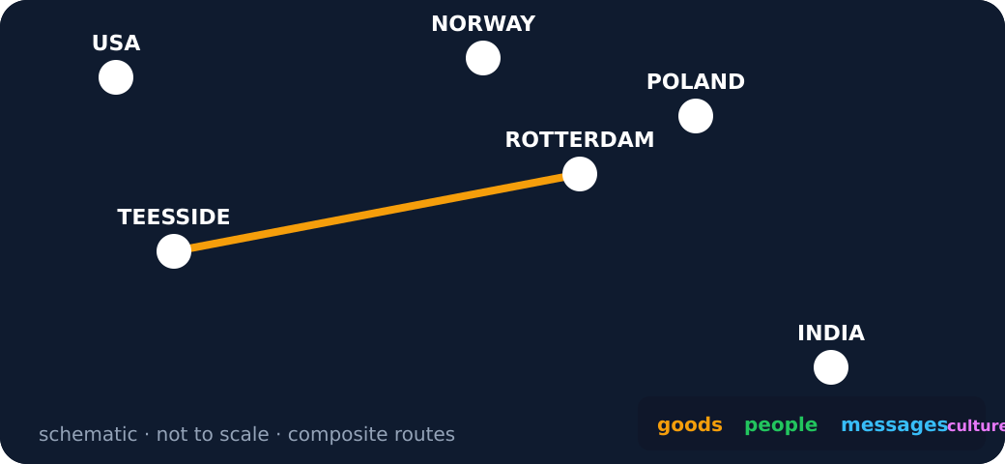
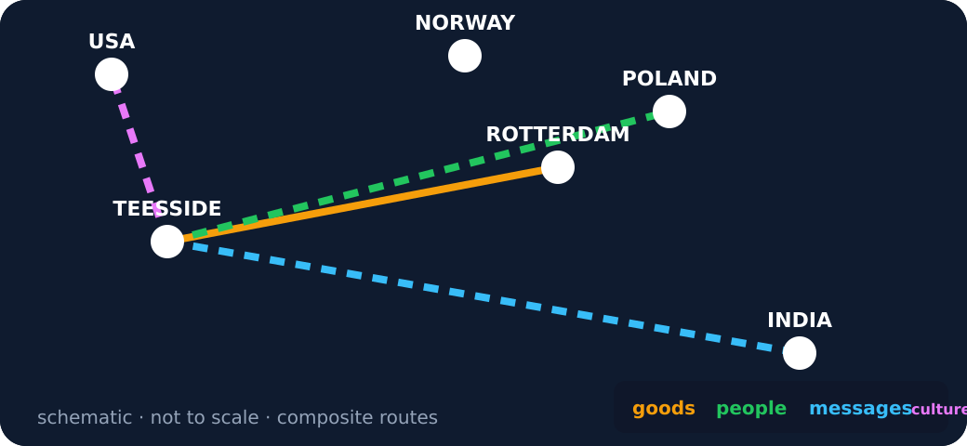
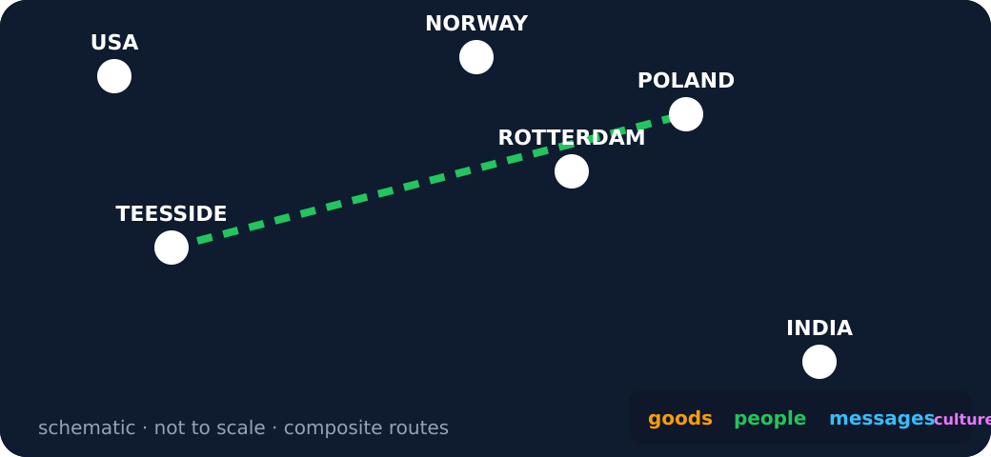
GROW / HUMANITIES
STARTER
How can maps and sources show connections without reducing a community to one route or statistic?
Schematic network with one goods route from Teesside to Rotterdam
Four route types from Teesside
A single people route
STARTER · 3 min across this stage
5 / 18
Notes:
Companion for GROW_HUM_W10_Teesside_Connected_World_OUTSTANDING_V3_1.html. Starter: 3 minutes TOTAL across all slides in this stage.
Receive a doubt/reason first. No public confidence vote.
Ask which map/source clue prompted the response.
Full source-stage teaching text:
Enquiry
CONNECTION IS MORE THAN ONE LINE
One line shows one kind of link. A place has many.
GOODS, PEOPLE, IDEAS AND MESSAGES MOVE DIFFERENTLY
Ships carry goods . Planes carry people . Cables carry messages . Food, music and festivals carry culture .
A ROUTE IS EVIDENCE OF LINK, NOT OF EVERYONE
A people route says some people moved. It cannot say why, or what every person thinks.
SOURCE + MAP + LIMIT
Every mapped route needs a source, and every claim needs its limit.
HTML controls remain in the original HTML file. PowerPoint contains editable teaching text and static source visuals; use the paper response route for sorting and investigation.
[Sources]
Uploaded lesson: GROW_HUM_W10_Teesside_Connected_World_OUTSTANDING_V3_1.html
https://www.middlesbrough.gov.uk/open-data-and-foi/local-statistics-and-data/local-population-diversity/
https://www.ons.gov.uk/visualisations/censusareachanges/E06000002
https://www.pdports.co.uk/locations/teesport/
[/Sources]

Slide 6
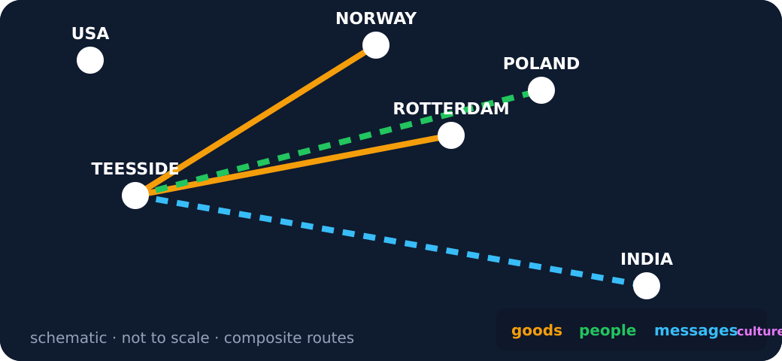
GROW / HUMANITIES
STARTER
How can maps and sources show connections without reducing a community to one route or statistic?
Several routes with a limit note
STARTER · 3 min across this stage
6 / 18
Notes:
Companion for GROW_HUM_W10_Teesside_Connected_World_OUTSTANDING_V3_1.html. Starter: 3 minutes TOTAL across all slides in this stage.
Receive a doubt/reason first. No public confidence vote.
Ask which map/source clue prompted the response.
Full source-stage teaching text:
Enquiry
CONNECTION IS MORE THAN ONE LINE
One line shows one kind of link. A place has many.
GOODS, PEOPLE, IDEAS AND MESSAGES MOVE DIFFERENTLY
Ships carry goods . Planes carry people . Cables carry messages . Food, music and festivals carry culture .
A ROUTE IS EVIDENCE OF LINK, NOT OF EVERYONE
A people route says some people moved. It cannot say why, or what every person thinks.
SOURCE + MAP + LIMIT
Every mapped route needs a source, and every claim needs its limit.
HTML controls remain in the original HTML file. PowerPoint contains editable teaching text and static source visuals; use the paper response route for sorting and investigation.
[Sources]
Uploaded lesson: GROW_HUM_W10_Teesside_Connected_World_OUTSTANDING_V3_1.html
https://www.middlesbrough.gov.uk/open-data-and-foi/local-statistics-and-data/local-population-diversity/
https://www.ons.gov.uk/visualisations/censusareachanges/E06000002
https://www.pdports.co.uk/locations/teesport/
[/Sources]

Slide 7
GROW / HUMANITIES
I DO
Model defensible map-and-source reasoning
Watch the decision, evidence and limitation—not just the finished sentence.
1. Locate Teesside and one connected place; name the connection type before explaining it.
2. Use the source precisely: PD Ports describes trade links; Census data describes population categories.
3. Do not use port evidence to claim why a person moved, or census evidence to assume belief or identity.
Connection sorter · what kind of link is this?
I DO · 4 min across this stage
7 / 18
Notes:
Companion for GROW_HUM_W10_Teesside_Connected_World_OUTSTANDING_V3_1.html. I do: 4 minutes TOTAL across all slides in this stage.
Reveal one controlled decision at a time and name the evidence boundary.
Model process, not a pupil answer. Keep authentic and constructed sources distinct.
Full source-stage teaching text:
Watch the decision, evidence and limitation—not just the finished sentence.
1. Locate Teesside and one connected place; name the connection type before explaining it.
2. Use the source precisely: PD Ports describes trade links; Census data describes population categories.
3. Do not use port evidence to claim why a person moved, or census evidence to assume belief or identity.
Connection sorter · what kind of link is this?
Composite cards: each is a typical, labelled example, not a claim about a named person. Match each to its route type.
Steel and chemicals leave Teesport by ship for Rotterdam
A family moves to Middlesbrough for work in a food factory
A video call from Redcar to a cousin in Mumbai
A Polish bakery opens on Linthorpe Road
Wind-turbine parts arrive on the Tees from Norway
A school in Stockton emails its partner school in Kraków
goods
people
messages
culture
Press a card, then its type.
Is this claim too big?
Overgeneralised claim to test: “Everyone in Teesside is connected to Poland.” A route line is evidence that SOME connection exists — never proof about every person.
HTML controls remain in the original HTML file. PowerPoint contains editable teaching text and static source visuals; use the paper response route for sorting and investigation.
[Sources]
Uploaded lesson: GROW_HUM_W10_Teesside_Connected_World_OUTSTANDING_V3_1.html
https://www.middlesbrough.gov.uk/open-data-and-foi/local-statistics-and-data/local-population-diversity/
https://www.ons.gov.uk/visualisations/censusareachanges/E06000002
https://www.pdports.co.uk/locations/teesport/
[/Sources]

Slide 8
GROW / HUMANITIES
I DO
Model defensible map-and-source reasoning
Composite cards: each is a typical, labelled example, not a claim about a named person. Match each to its route type.
I DO · 4 min across this stage
8 / 18
Notes:
Companion for GROW_HUM_W10_Teesside_Connected_World_OUTSTANDING_V3_1.html. I do: 4 minutes TOTAL across all slides in this stage.
Reveal one controlled decision at a time and name the evidence boundary.
Model process, not a pupil answer. Keep authentic and constructed sources distinct.
Full source-stage teaching text:
Watch the decision, evidence and limitation—not just the finished sentence.
1. Locate Teesside and one connected place; name the connection type before explaining it.
2. Use the source precisely: PD Ports describes trade links; Census data describes population categories.
3. Do not use port evidence to claim why a person moved, or census evidence to assume belief or identity.
Connection sorter · what kind of link is this?
Composite cards: each is a typical, labelled example, not a claim about a named person. Match each to its route type.
Steel and chemicals leave Teesport by ship for Rotterdam
A family moves to Middlesbrough for work in a food factory
A video call from Redcar to a cousin in Mumbai
A Polish bakery opens on Linthorpe Road
Wind-turbine parts arrive on the Tees from Norway
A school in Stockton emails its partner school in Kraków
goods
people
messages
culture
Press a card, then its type.
Is this claim too big?
Overgeneralised claim to test: “Everyone in Teesside is connected to Poland.” A route line is evidence that SOME connection exists — never proof about every person.
HTML controls remain in the original HTML file. PowerPoint contains editable teaching text and static source visuals; use the paper response route for sorting and investigation.
[Sources]
Uploaded lesson: GROW_HUM_W10_Teesside_Connected_World_OUTSTANDING_V3_1.html
https://www.middlesbrough.gov.uk/open-data-and-foi/local-statistics-and-data/local-population-diversity/
https://www.ons.gov.uk/visualisations/censusareachanges/E06000002
https://www.pdports.co.uk/locations/teesport/
[/Sources]

Slide 9
GROW / HUMANITIES
I DO
Model defensible map-and-source reasoning
A. Steel and chemicals leave Teesport by ship for Rotterdam
B. A family moves to Middlesbrough for work in a food factory
C. A video call from Redcar to a cousin in Mumbai
D. A Polish bakery opens on Linthorpe Road
E. Wind-turbine parts arrive on the Tees from Norway
F. A school in Stockton emails its partner school in Kraków
G. goods
H. people
I DO · 4 min across this stage
9 / 18
Notes:
Companion for GROW_HUM_W10_Teesside_Connected_World_OUTSTANDING_V3_1.html. I do: 4 minutes TOTAL across all slides in this stage.
Reveal one controlled decision at a time and name the evidence boundary.
Model process, not a pupil answer. Keep authentic and constructed sources distinct.
Full source-stage teaching text:
Watch the decision, evidence and limitation—not just the finished sentence.
1. Locate Teesside and one connected place; name the connection type before explaining it.
2. Use the source precisely: PD Ports describes trade links; Census data describes population categories.
3. Do not use port evidence to claim why a person moved, or census evidence to assume belief or identity.
Connection sorter · what kind of link is this?
Composite cards: each is a typical, labelled example, not a claim about a named person. Match each to its route type.
Steel and chemicals leave Teesport by ship for Rotterdam
A family moves to Middlesbrough for work in a food factory
A video call from Redcar to a cousin in Mumbai
A Polish bakery opens on Linthorpe Road
Wind-turbine parts arrive on the Tees from Norway
A school in Stockton emails its partner school in Kraków
goods
people
messages
culture
Press a card, then its type.
Is this claim too big?
Overgeneralised claim to test: “Everyone in Teesside is connected to Poland.” A route line is evidence that SOME connection exists — never proof about every person.
HTML controls remain in the original HTML file. PowerPoint contains editable teaching text and static source visuals; use the paper response route for sorting and investigation.
[Sources]
Uploaded lesson: GROW_HUM_W10_Teesside_Connected_World_OUTSTANDING_V3_1.html
https://www.middlesbrough.gov.uk/open-data-and-foi/local-statistics-and-data/local-population-diversity/
https://www.ons.gov.uk/visualisations/censusareachanges/E06000002
https://www.pdports.co.uk/locations/teesport/
[/Sources]

Slide 10
GROW / HUMANITIES
I DO
Model defensible map-and-source reasoning
I. messages
J. culture
Choose a card, then its type.
A. Is this claim too big?
Overgeneralised claim to test: “Everyone in Teesside is connected to Poland.” A route line is evidence that SOME connection exists — never proof about every person.
I DO · 4 min across this stage
10 / 18
Notes:
Companion for GROW_HUM_W10_Teesside_Connected_World_OUTSTANDING_V3_1.html. I do: 4 minutes TOTAL across all slides in this stage.
Reveal one controlled decision at a time and name the evidence boundary.
Model process, not a pupil answer. Keep authentic and constructed sources distinct.
Full source-stage teaching text:
Watch the decision, evidence and limitation—not just the finished sentence.
1. Locate Teesside and one connected place; name the connection type before explaining it.
2. Use the source precisely: PD Ports describes trade links; Census data describes population categories.
3. Do not use port evidence to claim why a person moved, or census evidence to assume belief or identity.
Connection sorter · what kind of link is this?
Composite cards: each is a typical, labelled example, not a claim about a named person. Match each to its route type.
Steel and chemicals leave Teesport by ship for Rotterdam
A family moves to Middlesbrough for work in a food factory
A video call from Redcar to a cousin in Mumbai
A Polish bakery opens on Linthorpe Road
Wind-turbine parts arrive on the Tees from Norway
A school in Stockton emails its partner school in Kraków
goods
people
messages
culture
Press a card, then its type.
Is this claim too big?
Overgeneralised claim to test: “Everyone in Teesside is connected to Poland.” A route line is evidence that SOME connection exists — never proof about every person.
HTML controls remain in the original HTML file. PowerPoint contains editable teaching text and static source visuals; use the paper response route for sorting and investigation.
[Sources]
Uploaded lesson: GROW_HUM_W10_Teesside_Connected_World_OUTSTANDING_V3_1.html
https://www.middlesbrough.gov.uk/open-data-and-foi/local-statistics-and-data/local-population-diversity/
https://www.ons.gov.uk/visualisations/censusareachanges/E06000002
https://www.pdports.co.uk/locations/teesport/
[/Sources]

Slide 11
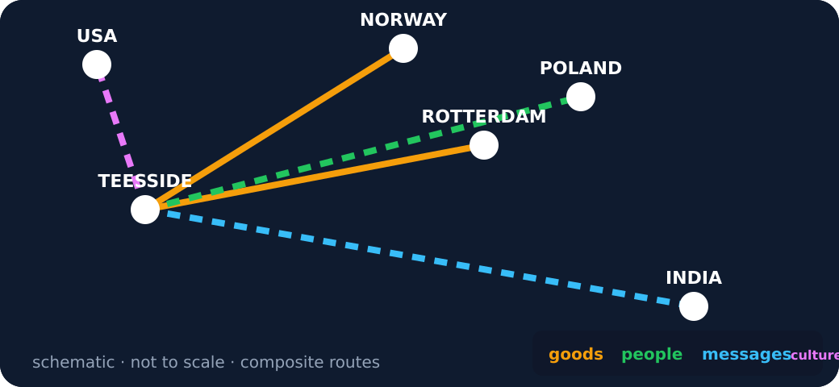
GROW / HUMANITIES
I DO
Model defensible map-and-source reasoning
Schematic network with all four route types
I DO · 4 min across this stage
11 / 18
Notes:
Companion for GROW_HUM_W10_Teesside_Connected_World_OUTSTANDING_V3_1.html. I do: 4 minutes TOTAL across all slides in this stage.
Reveal one controlled decision at a time and name the evidence boundary.
Model process, not a pupil answer. Keep authentic and constructed sources distinct.
Full source-stage teaching text:
Watch the decision, evidence and limitation—not just the finished sentence.
1. Locate Teesside and one connected place; name the connection type before explaining it.
2. Use the source precisely: PD Ports describes trade links; Census data describes population categories.
3. Do not use port evidence to claim why a person moved, or census evidence to assume belief or identity.
Connection sorter · what kind of link is this?
Composite cards: each is a typical, labelled example, not a claim about a named person. Match each to its route type.
Steel and chemicals leave Teesport by ship for Rotterdam
A family moves to Middlesbrough for work in a food factory
A video call from Redcar to a cousin in Mumbai
A Polish bakery opens on Linthorpe Road
Wind-turbine parts arrive on the Tees from Norway
A school in Stockton emails its partner school in Kraków
goods
people
messages
culture
Press a card, then its type.
Is this claim too big?
Overgeneralised claim to test: “Everyone in Teesside is connected to Poland.” A route line is evidence that SOME connection exists — never proof about every person.
HTML controls remain in the original HTML file. PowerPoint contains editable teaching text and static source visuals; use the paper response route for sorting and investigation.
[Sources]
Uploaded lesson: GROW_HUM_W10_Teesside_Connected_World_OUTSTANDING_V3_1.html
https://www.middlesbrough.gov.uk/open-data-and-foi/local-statistics-and-data/local-population-diversity/
https://www.ons.gov.uk/visualisations/censusareachanges/E06000002
https://www.pdports.co.uk/locations/teesport/
[/Sources]

Slide 12
GROW / HUMANITIES
WE DO
Commit before reveal
A port website shows a sea route from Teesport to the Netherlands. What is the strongest claim that evidence supports?
A. Teesport has a trade/transport connection with a Dutch market or hub.
B. Everyone in Teesside regularly travels to the Netherlands.
C. The route explains every cultural connection in Middlesbrough.
WE DO · 3 min across this stage
12 / 18
Notes:
Companion for GROW_HUM_W10_Teesside_Connected_World_OUTSTANDING_V3_1.html. We do: 3 minutes TOTAL across all slides in this stage.
Every learner commits privately before feedback; re-attempt is available unless assessment has begun.
Secure → ask for reason/limit. Not yet → return to the exact clue and allow one re-attempt.
Ask every learner to commit privately before feedback. Use the pupil cards, table or evidence sheet; pointing, saying, signing and directing a partner are valid routes.
Full source-stage teaching text:
A port website shows a sea route from Teesport to the Netherlands. What is the strongest claim that evidence supports?
Teesport has a trade/transport connection with a Dutch market or hub.
Everyone in Teesside regularly travels to the Netherlands.
The route explains every cultural connection in Middlesbrough.
HTML controls remain in the original HTML file. PowerPoint contains editable teaching text and static source visuals; use the paper response route for sorting and investigation.
[Sources]
Uploaded lesson: GROW_HUM_W10_Teesside_Connected_World_OUTSTANDING_V3_1.html
https://www.middlesbrough.gov.uk/open-data-and-foi/local-statistics-and-data/local-population-diversity/
https://www.ons.gov.uk/visualisations/censusareachanges/E06000002
https://www.pdports.co.uk/locations/teesport/
[/Sources]

Slide 13
GROW / HUMANITIES
I DO 2
Add precision without overclaiming
Compare, qualify, protect variation.
1. Connection chain: located places → route or medium → movement/exchange → local effect → source limitation.
2. The 2021 Census is a population snapshot; country of birth does not reveal an individual’s identity, faith or reason for moving.
3. A responsible explanation uses plural language: ‘some’, ‘one source shows’, ‘may connect’, ‘does not prove’.
I DO 2 · 3 min across this stage
13 / 18
Notes:
Companion for GROW_HUM_W10_Teesside_Connected_World_OUTSTANDING_V3_1.html. I do 2: 3 minutes TOTAL across all slides in this stage.
Raise challenge through perspective, scale, limitation or counterexample—not more writing.
Name the source creator and what the representation leaves out.
Full source-stage teaching text:
Compare, qualify, protect variation.
1. Connection chain: located places → route or medium → movement/exchange → local effect → source limitation.
2. The 2021 Census is a population snapshot; country of birth does not reveal an individual’s identity, faith or reason for moving.
3. A responsible explanation uses plural language: ‘some’, ‘one source shows’, ‘may connect’, ‘does not prove’.
HTML controls remain in the original HTML file. PowerPoint contains editable teaching text and static source visuals; use the paper response route for sorting and investigation.
[Sources]
Uploaded lesson: GROW_HUM_W10_Teesside_Connected_World_OUTSTANDING_V3_1.html
https://www.middlesbrough.gov.uk/open-data-and-foi/local-statistics-and-data/local-population-diversity/
https://www.ons.gov.uk/visualisations/censusareachanges/E06000002
https://www.pdports.co.uk/locations/teesport/
[/Sources]

Slide 14
GROW / HUMANITIES
WE DO 2
Rehearse the disciplinary move
Teesside connection switchboard
Evidence mix: operator source, official statistics and a clearly fictional composite message. Do not merge their claims.
TEES EUROPE COMPOSITE YOUTH HUB
A. Goods / trade
B. People / population
C. Messages / culture
Switch on one connection. Name the source type and its limit.
WE DO 2 · 4 min across this stage
14 / 18
Notes:
Companion for GROW_HUM_W10_Teesside_Connected_World_OUTSTANDING_V3_1.html. We do 2: 4 minutes TOTAL across all slides in this stage.
Let the learner manipulate, locate, compare or confirm. The lab is rehearsal only.
Ask what becomes visible and what remains hidden; adapt the next approved source or question.
Ask every learner to commit privately before feedback. Use the pupil cards, table or evidence sheet; pointing, saying, signing and directing a partner are valid routes.
Full source-stage teaching text:
Teesside connection switchboard
Evidence mix: operator source, official statistics and a clearly fictional composite message. Do not merge their claims.
TEES EUROPE COMPOSITE YOUTH HUB
Goods / trade
People / population
Messages / culture
Switch on one connection. Name the source type and its limit.
HTML controls remain in the original HTML file. PowerPoint contains editable teaching text and static source visuals; use the paper response route for sorting and investigation.
[Sources]
Uploaded lesson: GROW_HUM_W10_Teesside_Connected_World_OUTSTANDING_V3_1.html
https://www.middlesbrough.gov.uk/open-data-and-foi/local-statistics-and-data/local-population-diversity/
https://www.ons.gov.uk/visualisations/censusareachanges/E06000002
https://www.pdports.co.uk/locations/teesport/
[/Sources]

Slide 15
GROW / HUMANITIES
INDEPENDENT
Independent Humanities mission
Build a Teesside connection profile using at least two connection types. Add locations, a route/medium, evidence, one possible local effect and a limitation. Use fictional/composite people unless an individual independently opts into a personal route.
EVIDENCE READY
Materials Printed route, named source cards and approved atlas/map as specified.
Access / care Enlarge, chunk, colour-adjust, read exactly or use agreed response mode. No personal disclosure required.
INDEPENDENT · 16 min across this stage
15 / 18
Notes:
Companion for GROW_HUM_W10_Teesside_Connected_World_OUTSTANDING_V3_1.html. Independent: 16 minutes TOTAL across all slides in this stage.
Protect authorship. Exact scribing only if authorised; do not improve reasoning while scribing.
Feedback produces one edit/re-attempt/next scaffold, not a second evidence task.
Full source-stage teaching text:
Build a Teesside connection profile using at least two connection types. Add locations, a route/medium, evidence, one possible local effect and a limitation. Use fictional/composite people unless an individual independently opts into a personal route.
EVIDENCE READY
Materials Printed route, named source cards and approved atlas/map as specified.
Access / care Enlarge, chunk, colour-adjust, read exactly or use agreed response mode. No personal disclosure required.
Evidence target Decision → map/source action or product → learner explanation; highest prompt recorded.
◆ Supported
Complete two safe connection chains from the approved cards and add one ‘does not prove’ statement.
____ connects Teesside to ____ through ____. Source ____ shows ____. It does not prove ____.
▲ Standard
Explain two different connection types with a mapped route, source reference, local effect and limitation.
Place → connection type → route/medium → evidence → possible effect → limitation.
Stretch
Compare operator, census and community perspectives; judge which claim is best supported and what evidence is missing.
Perspective/scale comparison → strongest claim → counterexample or missing voice → qualified judgement.
HTML controls remain in the original HTML file. PowerPoint contains editable teaching text and static source visuals; use the paper response route for sorting and investigation.
[Sources]
Uploaded lesson: GROW_HUM_W10_Teesside_Connected_World_OUTSTANDING_V3_1.html
https://www.middlesbrough.gov.uk/open-data-and-foi/local-statistics-and-data/local-population-diversity/
https://www.ons.gov.uk/visualisations/censusareachanges/E06000002
https://www.pdports.co.uk/locations/teesport/
[/Sources]

Slide 16
GROW / HUMANITIES
INDEPENDENT
Independent Humanities mission
Evidence target Decision → map/source action or product → learner explanation; highest prompt recorded.
Supported
Complete two safe connection chains from the approved cards and add one ‘does not prove’ statement.
____ connects Teesside to ____ through ____. Source ____ shows ____. It does not prove ____.
Standard
INDEPENDENT · 16 min across this stage
16 / 18
Notes:
Companion for GROW_HUM_W10_Teesside_Connected_World_OUTSTANDING_V3_1.html. Independent: 16 minutes TOTAL across all slides in this stage.
Protect authorship. Exact scribing only if authorised; do not improve reasoning while scribing.
Feedback produces one edit/re-attempt/next scaffold, not a second evidence task.
Full source-stage teaching text:
Build a Teesside connection profile using at least two connection types. Add locations, a route/medium, evidence, one possible local effect and a limitation. Use fictional/composite people unless an individual independently opts into a personal route.
EVIDENCE READY
Materials Printed route, named source cards and approved atlas/map as specified.
Access / care Enlarge, chunk, colour-adjust, read exactly or use agreed response mode. No personal disclosure required.
Evidence target Decision → map/source action or product → learner explanation; highest prompt recorded.
◆ Supported
Complete two safe connection chains from the approved cards and add one ‘does not prove’ statement.
____ connects Teesside to ____ through ____. Source ____ shows ____. It does not prove ____.
▲ Standard
Explain two different connection types with a mapped route, source reference, local effect and limitation.
Place → connection type → route/medium → evidence → possible effect → limitation.
Stretch
Compare operator, census and community perspectives; judge which claim is best supported and what evidence is missing.
Perspective/scale comparison → strongest claim → counterexample or missing voice → qualified judgement.
HTML controls remain in the original HTML file. PowerPoint contains editable teaching text and static source visuals; use the paper response route for sorting and investigation.
[Sources]
Uploaded lesson: GROW_HUM_W10_Teesside_Connected_World_OUTSTANDING_V3_1.html
https://www.middlesbrough.gov.uk/open-data-and-foi/local-statistics-and-data/local-population-diversity/
https://www.ons.gov.uk/visualisations/censusareachanges/E06000002
https://www.pdports.co.uk/locations/teesport/
[/Sources]

Slide 17
GROW / HUMANITIES
INDEPENDENT
Independent Humanities mission
Explain two different connection types with a mapped route, source reference, local effect and limitation.
Place → connection type → route/medium → evidence → possible effect → limitation.
Stretch
Compare operator, census and community perspectives; judge which claim is best supported and what evidence is missing.
Perspective/scale comparison → strongest claim → counterexample or missing voice → qualified judgement.
INDEPENDENT · 16 min across this stage
17 / 18
Notes:
Companion for GROW_HUM_W10_Teesside_Connected_World_OUTSTANDING_V3_1.html. Independent: 16 minutes TOTAL across all slides in this stage.
Protect authorship. Exact scribing only if authorised; do not improve reasoning while scribing.
Feedback produces one edit/re-attempt/next scaffold, not a second evidence task.
Full source-stage teaching text:
Build a Teesside connection profile using at least two connection types. Add locations, a route/medium, evidence, one possible local effect and a limitation. Use fictional/composite people unless an individual independently opts into a personal route.
EVIDENCE READY
Materials Printed route, named source cards and approved atlas/map as specified.
Access / care Enlarge, chunk, colour-adjust, read exactly or use agreed response mode. No personal disclosure required.
Evidence target Decision → map/source action or product → learner explanation; highest prompt recorded.
◆ Supported
Complete two safe connection chains from the approved cards and add one ‘does not prove’ statement.
____ connects Teesside to ____ through ____. Source ____ shows ____. It does not prove ____.
▲ Standard
Explain two different connection types with a mapped route, source reference, local effect and limitation.
Place → connection type → route/medium → evidence → possible effect → limitation.
Stretch
Compare operator, census and community perspectives; judge which claim is best supported and what evidence is missing.
Perspective/scale comparison → strongest claim → counterexample or missing voice → qualified judgement.
HTML controls remain in the original HTML file. PowerPoint contains editable teaching text and static source visuals; use the paper response route for sorting and investigation.
[Sources]
Uploaded lesson: GROW_HUM_W10_Teesside_Connected_World_OUTSTANDING_V3_1.html
https://www.middlesbrough.gov.uk/open-data-and-foi/local-statistics-and-data/local-population-diversity/
https://www.ons.gov.uk/visualisations/censusareachanges/E06000002
https://www.pdports.co.uk/locations/teesport/
[/Sources]

Slide 18
GROW / HUMANITIES
EXIT
Close one loop—do not create a second task
Standard
Explain one connection chain and qualify the claim.
Named audience receipt
“I heard your claim/decision as ____. Your evidence was ____. Your uncertainty/limit was ____.”
Influence: Pupils select one of three already-approved festival case-source sets for first investigation in W11. Teacher checks provenance and reports the selection/boundary at W11.
EXIT · 4 min across this stage
18 / 18
Notes:
Companion for GROW_HUM_W10_Teesside_Connected_World_OUTSTANDING_V3_1.html. Exit: 4 minutes TOTAL across all slides in this stage.
Receive actual reasoning. Restate claim/evidence/uncertainty before praise or correction.
Record one response branch and one next move; explain any accuracy, provenance or assessment boundary.
Full source-stage teaching text:
▲ Standard
Explain one connection chain and qualify the claim.
Named audience receipt
“I heard your claim/decision as ____. Your evidence was ____. Your uncertainty/limit was ____.”
Influence: Pupils select one of three already-approved festival case-source sets for first investigation in W11. Teacher checks provenance and reports the selection/boundary at W11.
HTML controls remain in the original HTML file. PowerPoint contains editable teaching text and static source visuals; use the paper response route for sorting and investigation.
[Sources]
Uploaded lesson: GROW_HUM_W10_Teesside_Connected_World_OUTSTANDING_V3_1.html
https://www.middlesbrough.gov.uk/open-data-and-foi/local-statistics-and-data/local-population-diversity/
https://www.ons.gov.uk/visualisations/censusareachanges/E06000002
https://www.pdports.co.uk/locations/teesport/
[/Sources]

