Slide 1
GROW / HUMANITIES
OVERVIEW
Light Across the Map
I can map festival examples, extract meaning/practice from faith-community sources and explain variation.
Open the original interactive lesson
40 MINUTES
1 / 17
Notes:
Companion for GROW_HUM_W11_Light_Across_the_Map_OUTSTANDING_V3_1.html. Overview: 0 minutes TOTAL across all slides in this stage.
Check source pack, print route, prior report-back and access before pupils arrive.
Prepare accessible versions without lowering the disciplinary goal.
Full source-stage teaching text:
Festival geography enquiry · NC KS2/3 Geography/History enquiry
Learning objective: I can map festival examples, extract meaning/practice from faith-community sources and explain variation.
Success criteria
I locate example places and distinguish origin/association from present-day global reach.
I identify source-backed meaning and practice without treating one account as universal.
I use respectful plural language and state a source or map limitation.
⌖
Festival geography enquiry
precision · connection · respectful enquiry
Source gate: genuine source = creator/date/origin/reference/rights/use/limit. Adapted and constructed material is labelled. Personal/family disclosure is optional.
HTML controls remain in the original HTML file. PowerPoint contains editable teaching text and static source visuals; use the paper response route for sorting and investigation.
[Sources]
Uploaded lesson: GROW_HUM_W11_Light_Across_the_Map_OUTSTANDING_V3_1.html
https://jewishmuseum.org.uk/learning/inclusive-judaism/imagelibrary/hanukah-candle-lightning-at-milton-keynes-and-district-reform-synagogue/
https://londonmandir.baps.org/2023/11/diwali-hindu-new-year-annakut-celebrations-2023/
https://www.churchofengland.org/prayer-and-worship/worship-texts-and-resources/common-worship/churchs-year/times-and-seasons-0
https://www.oikoumene.org/news/christmas-messages-across-the-world-bring-light-and-hope
https://www.reformjudaism.org.uk/jewish-holidays-chanukah/
https://www.worldjewishcongress.org/en/news/jews-around-the-world-celebrate-hanukkah
[/Sources]

Slide 2
GROW / HUMANITIES
ARRIVAL
Teacher reports which approved case-source set pupils selected in W10 and any provenance boundary.
Standard
Explain why ‘celebrated in India’ is different from ‘only celebrated in India’.
ARRIVAL · 3 min across this stage
2 / 17
Notes:
Companion for GROW_HUM_W11_Light_Across_the_Map_OUTSTANDING_V3_1.html. Arrival: 3 minutes TOTAL across all slides in this stage.
Give the previous bounded-choice report-back first; then use quiet retrieval.
If secure, fade one content prompt. If access blocks response, change the route rather than the goal.
Full source-stage teaching text:
▲ Standard
Explain why ‘celebrated in India’ is different from ‘only celebrated in India’.
HTML controls remain in the original HTML file. PowerPoint contains editable teaching text and static source visuals; use the paper response route for sorting and investigation.
[Sources]
Uploaded lesson: GROW_HUM_W11_Light_Across_the_Map_OUTSTANDING_V3_1.html
https://jewishmuseum.org.uk/learning/inclusive-judaism/imagelibrary/hanukah-candle-lightning-at-milton-keynes-and-district-reform-synagogue/
https://londonmandir.baps.org/2023/11/diwali-hindu-new-year-annakut-celebrations-2023/
https://www.churchofengland.org/prayer-and-worship/worship-texts-and-resources/common-worship/churchs-year/times-and-seasons-0
https://www.oikoumene.org/news/christmas-messages-across-the-world-bring-light-and-hope
https://www.reformjudaism.org.uk/jewish-holidays-chanukah/
https://www.worldjewishcongress.org/en/news/jews-around-the-world-celebrate-hanukkah
[/Sources]

Slide 3
GROW / HUMANITIES
STARTER
How do place, movement and community shape where a festival is celebrated—without making faith equal nationality?
Enquiry
MAP EXAMPLES · NOT FAITH BORDERS
A pin marks one documented example. It never means “this faith lives here”.
ASK WHO CREATED EACH ACCOUNT
Every account has a maker. Name them before you quote them.
MEANING AND PRACTICE VARY
A shared lens is not a shared meaning.
USE “SOME”, “THIS SOURCE” AND “ONE EXAMPLE”
STARTER · 3 min across this stage
3 / 17
Notes:
Companion for GROW_HUM_W11_Light_Across_the_Map_OUTSTANDING_V3_1.html. Starter: 3 minutes TOTAL across all slides in this stage.
Receive a doubt/reason first. No public confidence vote.
Ask which map/source clue prompted the response.
Full source-stage teaching text:
Enquiry
MAP EXAMPLES · NOT FAITH BORDERS
A pin marks one documented example. It never means “this faith lives here”.
ASK WHO CREATED EACH ACCOUNT
Every account has a maker. Name them before you quote them.
MEANING AND PRACTICE VARY
A shared lens is not a shared meaning.
USE “SOME”, “THIS SOURCE” AND “ONE EXAMPLE”
Qualified claims are accurate claims.
HTML controls remain in the original HTML file. PowerPoint contains editable teaching text and static source visuals; use the paper response route for sorting and investigation.
[Sources]
Uploaded lesson: GROW_HUM_W11_Light_Across_the_Map_OUTSTANDING_V3_1.html
https://jewishmuseum.org.uk/learning/inclusive-judaism/imagelibrary/hanukah-candle-lightning-at-milton-keynes-and-district-reform-synagogue/
https://londonmandir.baps.org/2023/11/diwali-hindu-new-year-annakut-celebrations-2023/
https://www.churchofengland.org/prayer-and-worship/worship-texts-and-resources/common-worship/churchs-year/times-and-seasons-0
https://www.oikoumene.org/news/christmas-messages-across-the-world-bring-light-and-hope
https://www.reformjudaism.org.uk/jewish-holidays-chanukah/
https://www.worldjewishcongress.org/en/news/jews-around-the-world-celebrate-hanukkah
[/Sources]

Slide 4
GROW / HUMANITIES
STARTER
How do place, movement and community shape where a festival is celebrated—without making faith equal nationality?
Qualified claims are accurate claims.
STARTER · 3 min across this stage
4 / 17
Notes:
Companion for GROW_HUM_W11_Light_Across_the_Map_OUTSTANDING_V3_1.html. Starter: 3 minutes TOTAL across all slides in this stage.
Receive a doubt/reason first. No public confidence vote.
Ask which map/source clue prompted the response.
Full source-stage teaching text:
Enquiry
MAP EXAMPLES · NOT FAITH BORDERS
A pin marks one documented example. It never means “this faith lives here”.
ASK WHO CREATED EACH ACCOUNT
Every account has a maker. Name them before you quote them.
MEANING AND PRACTICE VARY
A shared lens is not a shared meaning.
USE “SOME”, “THIS SOURCE” AND “ONE EXAMPLE”
Qualified claims are accurate claims.
HTML controls remain in the original HTML file. PowerPoint contains editable teaching text and static source visuals; use the paper response route for sorting and investigation.
[Sources]
Uploaded lesson: GROW_HUM_W11_Light_Across_the_Map_OUTSTANDING_V3_1.html
https://jewishmuseum.org.uk/learning/inclusive-judaism/imagelibrary/hanukah-candle-lightning-at-milton-keynes-and-district-reform-synagogue/
https://londonmandir.baps.org/2023/11/diwali-hindu-new-year-annakut-celebrations-2023/
https://www.churchofengland.org/prayer-and-worship/worship-texts-and-resources/common-worship/churchs-year/times-and-seasons-0
https://www.oikoumene.org/news/christmas-messages-across-the-world-bring-light-and-hope
https://www.reformjudaism.org.uk/jewish-holidays-chanukah/
https://www.worldjewishcongress.org/en/news/jews-around-the-world-celebrate-hanukkah
[/Sources]

Slide 5
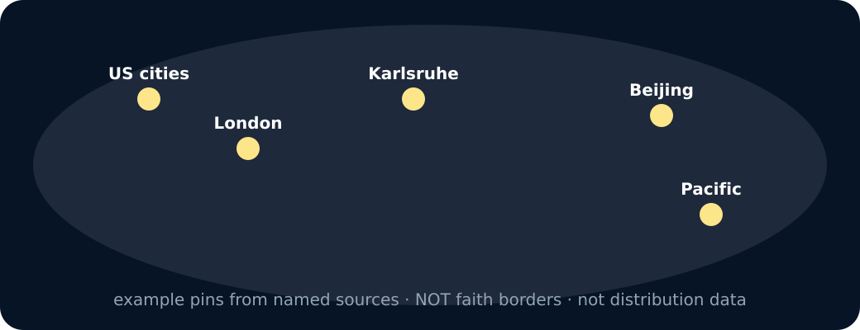
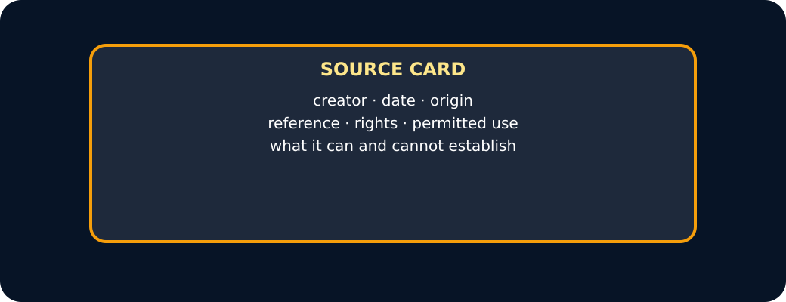
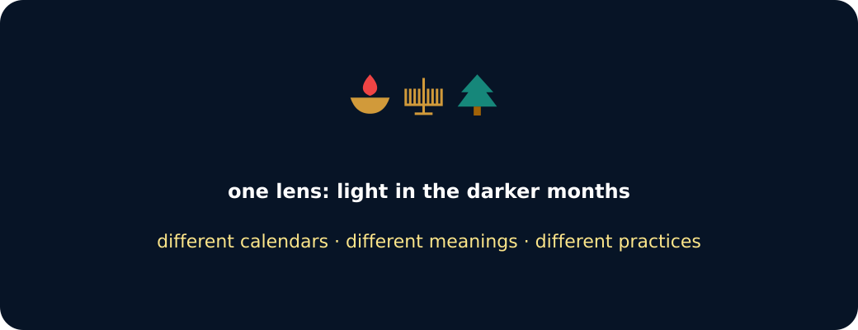
GROW / HUMANITIES
STARTER
How do place, movement and community shape where a festival is celebrated—without making faith equal nationality?
Schematic world with example pins
Source card
Three light symbols
STARTER · 3 min across this stage
5 / 17
Notes:
Companion for GROW_HUM_W11_Light_Across_the_Map_OUTSTANDING_V3_1.html. Starter: 3 minutes TOTAL across all slides in this stage.
Receive a doubt/reason first. No public confidence vote.
Ask which map/source clue prompted the response.
Full source-stage teaching text:
Enquiry
MAP EXAMPLES · NOT FAITH BORDERS
A pin marks one documented example. It never means “this faith lives here”.
ASK WHO CREATED EACH ACCOUNT
Every account has a maker. Name them before you quote them.
MEANING AND PRACTICE VARY
A shared lens is not a shared meaning.
USE “SOME”, “THIS SOURCE” AND “ONE EXAMPLE”
Qualified claims are accurate claims.
HTML controls remain in the original HTML file. PowerPoint contains editable teaching text and static source visuals; use the paper response route for sorting and investigation.
[Sources]
Uploaded lesson: GROW_HUM_W11_Light_Across_the_Map_OUTSTANDING_V3_1.html
https://jewishmuseum.org.uk/learning/inclusive-judaism/imagelibrary/hanukah-candle-lightning-at-milton-keynes-and-district-reform-synagogue/
https://londonmandir.baps.org/2023/11/diwali-hindu-new-year-annakut-celebrations-2023/
https://www.churchofengland.org/prayer-and-worship/worship-texts-and-resources/common-worship/churchs-year/times-and-seasons-0
https://www.oikoumene.org/news/christmas-messages-across-the-world-bring-light-and-hope
https://www.reformjudaism.org.uk/jewish-holidays-chanukah/
https://www.worldjewishcongress.org/en/news/jews-around-the-world-celebrate-hanukkah
[/Sources]

Slide 6
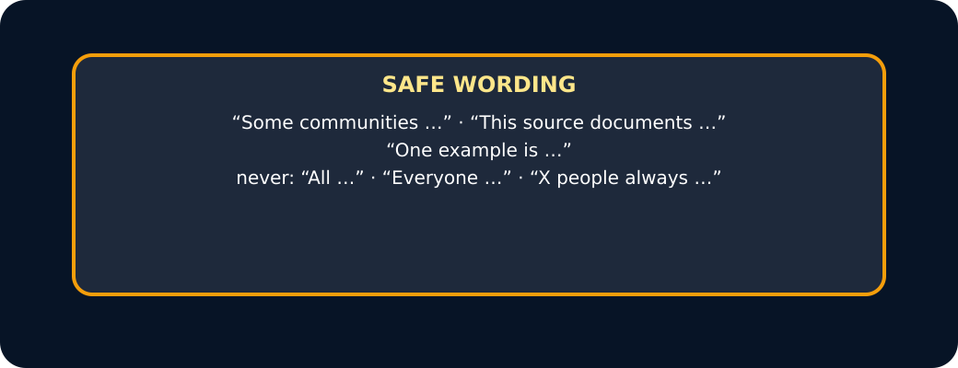
GROW / HUMANITIES
STARTER
How do place, movement and community shape where a festival is celebrated—without making faith equal nationality?
Safe wording card
STARTER · 3 min across this stage
6 / 17
Notes:
Companion for GROW_HUM_W11_Light_Across_the_Map_OUTSTANDING_V3_1.html. Starter: 3 minutes TOTAL across all slides in this stage.
Receive a doubt/reason first. No public confidence vote.
Ask which map/source clue prompted the response.
Full source-stage teaching text:
Enquiry
MAP EXAMPLES · NOT FAITH BORDERS
A pin marks one documented example. It never means “this faith lives here”.
ASK WHO CREATED EACH ACCOUNT
Every account has a maker. Name them before you quote them.
MEANING AND PRACTICE VARY
A shared lens is not a shared meaning.
USE “SOME”, “THIS SOURCE” AND “ONE EXAMPLE”
Qualified claims are accurate claims.
HTML controls remain in the original HTML file. PowerPoint contains editable teaching text and static source visuals; use the paper response route for sorting and investigation.
[Sources]
Uploaded lesson: GROW_HUM_W11_Light_Across_the_Map_OUTSTANDING_V3_1.html
https://jewishmuseum.org.uk/learning/inclusive-judaism/imagelibrary/hanukah-candle-lightning-at-milton-keynes-and-district-reform-synagogue/
https://londonmandir.baps.org/2023/11/diwali-hindu-new-year-annakut-celebrations-2023/
https://www.churchofengland.org/prayer-and-worship/worship-texts-and-resources/common-worship/churchs-year/times-and-seasons-0
https://www.oikoumene.org/news/christmas-messages-across-the-world-bring-light-and-hope
https://www.reformjudaism.org.uk/jewish-holidays-chanukah/
https://www.worldjewishcongress.org/en/news/jews-around-the-world-celebrate-hanukkah
[/Sources]

Slide 7
GROW / HUMANITIES
I DO
Model defensible map-and-source reasoning
Watch the decision, evidence and limitation—not just the finished sentence.
1. Plot an example location, then label it ‘one documented celebration’, not ‘the home of all believers’.
2. Separate evidence fields: calendar/date, meaning, practice, community/place and source perspective.
3. Diwali, Chanukah and Christmas each include light in different ways; similarity in symbol does not make meanings identical.
Claim checker · safe, or too big?
I DO · 4 min across this stage
7 / 17
Notes:
Companion for GROW_HUM_W11_Light_Across_the_Map_OUTSTANDING_V3_1.html. I do: 4 minutes TOTAL across all slides in this stage.
Reveal one controlled decision at a time and name the evidence boundary.
Model process, not a pupil answer. Keep authentic and constructed sources distinct.
Full source-stage teaching text:
Watch the decision, evidence and limitation—not just the finished sentence.
1. Plot an example location, then label it ‘one documented celebration’, not ‘the home of all believers’.
2. Separate evidence fields: calendar/date, meaning, practice, community/place and source perspective.
3. Diwali, Chanukah and Christmas each include light in different ways; similarity in symbol does not make meanings identical.
Claim checker · safe, or too big?
Press a sentence. Is it qualified with “some”, “this source” or “one example” — or does it claim everyone?
This source documents one London event where lamps were lit.
All Hindus celebrate Diwali in the same way.
Some communities in more than one country mark a festival of light.
Everyone in that country is religious.
Jewish people always light candles in December.
One example in this pack is a Reform community in Milton Keynes.
safe wording
too big
Press a sentence.
Repair rule: add the source, shrink the group (some / one / this), and keep the calendar and meaning to what the source actually says.
HTML controls remain in the original HTML file. PowerPoint contains editable teaching text and static source visuals; use the paper response route for sorting and investigation.
[Sources]
Uploaded lesson: GROW_HUM_W11_Light_Across_the_Map_OUTSTANDING_V3_1.html
https://jewishmuseum.org.uk/learning/inclusive-judaism/imagelibrary/hanukah-candle-lightning-at-milton-keynes-and-district-reform-synagogue/
https://londonmandir.baps.org/2023/11/diwali-hindu-new-year-annakut-celebrations-2023/
https://www.churchofengland.org/prayer-and-worship/worship-texts-and-resources/common-worship/churchs-year/times-and-seasons-0
https://www.oikoumene.org/news/christmas-messages-across-the-world-bring-light-and-hope
https://www.reformjudaism.org.uk/jewish-holidays-chanukah/
https://www.worldjewishcongress.org/en/news/jews-around-the-world-celebrate-hanukkah
[/Sources]

Slide 8
GROW / HUMANITIES
I DO
Model defensible map-and-source reasoning
Choose a sentence. Is it qualified with “some”, “this source” or “one example” — or does it claim everyone?
A. This source documents one London event where lamps were lit.
B. All Hindus celebrate Diwali in the same way.
C. Some communities in more than one country mark a festival of light.
D. Everyone in that country is religious.
E. Jewish people always light candles in December.
F. One example in this pack is a Reform community in Milton Keynes.
I DO · 4 min across this stage
8 / 17
Notes:
Companion for GROW_HUM_W11_Light_Across_the_Map_OUTSTANDING_V3_1.html. I do: 4 minutes TOTAL across all slides in this stage.
Reveal one controlled decision at a time and name the evidence boundary.
Model process, not a pupil answer. Keep authentic and constructed sources distinct.
Full source-stage teaching text:
Watch the decision, evidence and limitation—not just the finished sentence.
1. Plot an example location, then label it ‘one documented celebration’, not ‘the home of all believers’.
2. Separate evidence fields: calendar/date, meaning, practice, community/place and source perspective.
3. Diwali, Chanukah and Christmas each include light in different ways; similarity in symbol does not make meanings identical.
Claim checker · safe, or too big?
Press a sentence. Is it qualified with “some”, “this source” or “one example” — or does it claim everyone?
This source documents one London event where lamps were lit.
All Hindus celebrate Diwali in the same way.
Some communities in more than one country mark a festival of light.
Everyone in that country is religious.
Jewish people always light candles in December.
One example in this pack is a Reform community in Milton Keynes.
safe wording
too big
Press a sentence.
Repair rule: add the source, shrink the group (some / one / this), and keep the calendar and meaning to what the source actually says.
HTML controls remain in the original HTML file. PowerPoint contains editable teaching text and static source visuals; use the paper response route for sorting and investigation.
[Sources]
Uploaded lesson: GROW_HUM_W11_Light_Across_the_Map_OUTSTANDING_V3_1.html
https://jewishmuseum.org.uk/learning/inclusive-judaism/imagelibrary/hanukah-candle-lightning-at-milton-keynes-and-district-reform-synagogue/
https://londonmandir.baps.org/2023/11/diwali-hindu-new-year-annakut-celebrations-2023/
https://www.churchofengland.org/prayer-and-worship/worship-texts-and-resources/common-worship/churchs-year/times-and-seasons-0
https://www.oikoumene.org/news/christmas-messages-across-the-world-bring-light-and-hope
https://www.reformjudaism.org.uk/jewish-holidays-chanukah/
https://www.worldjewishcongress.org/en/news/jews-around-the-world-celebrate-hanukkah
[/Sources]

Slide 9
GROW / HUMANITIES
I DO
Model defensible map-and-source reasoning
G. safe wording
H. too big
Choose a sentence.
Repair rule: add the source, shrink the group (some / one / this), and keep the calendar and meaning to what the source actually says.
I DO · 4 min across this stage
9 / 17
Notes:
Companion for GROW_HUM_W11_Light_Across_the_Map_OUTSTANDING_V3_1.html. I do: 4 minutes TOTAL across all slides in this stage.
Reveal one controlled decision at a time and name the evidence boundary.
Model process, not a pupil answer. Keep authentic and constructed sources distinct.
Full source-stage teaching text:
Watch the decision, evidence and limitation—not just the finished sentence.
1. Plot an example location, then label it ‘one documented celebration’, not ‘the home of all believers’.
2. Separate evidence fields: calendar/date, meaning, practice, community/place and source perspective.
3. Diwali, Chanukah and Christmas each include light in different ways; similarity in symbol does not make meanings identical.
Claim checker · safe, or too big?
Press a sentence. Is it qualified with “some”, “this source” or “one example” — or does it claim everyone?
This source documents one London event where lamps were lit.
All Hindus celebrate Diwali in the same way.
Some communities in more than one country mark a festival of light.
Everyone in that country is religious.
Jewish people always light candles in December.
One example in this pack is a Reform community in Milton Keynes.
safe wording
too big
Press a sentence.
Repair rule: add the source, shrink the group (some / one / this), and keep the calendar and meaning to what the source actually says.
HTML controls remain in the original HTML file. PowerPoint contains editable teaching text and static source visuals; use the paper response route for sorting and investigation.
[Sources]
Uploaded lesson: GROW_HUM_W11_Light_Across_the_Map_OUTSTANDING_V3_1.html
https://jewishmuseum.org.uk/learning/inclusive-judaism/imagelibrary/hanukah-candle-lightning-at-milton-keynes-and-district-reform-synagogue/
https://londonmandir.baps.org/2023/11/diwali-hindu-new-year-annakut-celebrations-2023/
https://www.churchofengland.org/prayer-and-worship/worship-texts-and-resources/common-worship/churchs-year/times-and-seasons-0
https://www.oikoumene.org/news/christmas-messages-across-the-world-bring-light-and-hope
https://www.reformjudaism.org.uk/jewish-holidays-chanukah/
https://www.worldjewishcongress.org/en/news/jews-around-the-world-celebrate-hanukkah
[/Sources]

Slide 10
GROW / HUMANITIES
WE DO
Commit before reveal
A BAPS page describes diyas, rangoli, worship and gathering. Which conclusion is defensible?
A. This BAPS source gives examples from one Hindu tradition; practices and meanings can vary.
B. Every Hindu person celebrates Diwali in exactly this way.
C. Diwali is only celebrated inside India.
WE DO · 3 min across this stage
10 / 17
Notes:
Companion for GROW_HUM_W11_Light_Across_the_Map_OUTSTANDING_V3_1.html. We do: 3 minutes TOTAL across all slides in this stage.
Every learner commits privately before feedback; re-attempt is available unless assessment has begun.
Secure → ask for reason/limit. Not yet → return to the exact clue and allow one re-attempt.
Ask every learner to commit privately before feedback. Use the pupil cards, table or evidence sheet; pointing, saying, signing and directing a partner are valid routes.
Full source-stage teaching text:
A BAPS page describes diyas, rangoli, worship and gathering. Which conclusion is defensible?
This BAPS source gives examples from one Hindu tradition; practices and meanings can vary.
Every Hindu person celebrates Diwali in exactly this way.
Diwali is only celebrated inside India.
HTML controls remain in the original HTML file. PowerPoint contains editable teaching text and static source visuals; use the paper response route for sorting and investigation.
[Sources]
Uploaded lesson: GROW_HUM_W11_Light_Across_the_Map_OUTSTANDING_V3_1.html
https://jewishmuseum.org.uk/learning/inclusive-judaism/imagelibrary/hanukah-candle-lightning-at-milton-keynes-and-district-reform-synagogue/
https://londonmandir.baps.org/2023/11/diwali-hindu-new-year-annakut-celebrations-2023/
https://www.churchofengland.org/prayer-and-worship/worship-texts-and-resources/common-worship/churchs-year/times-and-seasons-0
https://www.oikoumene.org/news/christmas-messages-across-the-world-bring-light-and-hope
https://www.reformjudaism.org.uk/jewish-holidays-chanukah/
https://www.worldjewishcongress.org/en/news/jews-around-the-world-celebrate-hanukkah
[/Sources]

Slide 11
GROW / HUMANITIES
I DO 2
Add precision without overclaiming
Compare, qualify, protect variation.
1. Diwali source: one Hindu organisational account; light, knowledge, worship, food and gathering are examples, not a universal checklist.
2. Named Reform/Jewish sources: MRJ explains eight days, rededication and visible-window/public lighting; JML locates one Milton Keynes community candle-lighting; WJC documents Beijing and US examples.
3. Christmas sources: Anglican/ecumenical accounts centre the Incarnation, with light and hope expressed differently across world churches.
I DO 2 · 3 min across this stage
11 / 17
Notes:
Companion for GROW_HUM_W11_Light_Across_the_Map_OUTSTANDING_V3_1.html. I do 2: 3 minutes TOTAL across all slides in this stage.
Raise challenge through perspective, scale, limitation or counterexample—not more writing.
Name the source creator and what the representation leaves out.
Full source-stage teaching text:
Compare, qualify, protect variation.
1. Diwali source: one Hindu organisational account; light, knowledge, worship, food and gathering are examples, not a universal checklist.
2. Named Reform/Jewish sources: MRJ explains eight days, rededication and visible-window/public lighting; JML locates one Milton Keynes community candle-lighting; WJC documents Beijing and US examples.
3. Christmas sources: Anglican/ecumenical accounts centre the Incarnation, with light and hope expressed differently across world churches.
HTML controls remain in the original HTML file. PowerPoint contains editable teaching text and static source visuals; use the paper response route for sorting and investigation.
[Sources]
Uploaded lesson: GROW_HUM_W11_Light_Across_the_Map_OUTSTANDING_V3_1.html
https://jewishmuseum.org.uk/learning/inclusive-judaism/imagelibrary/hanukah-candle-lightning-at-milton-keynes-and-district-reform-synagogue/
https://londonmandir.baps.org/2023/11/diwali-hindu-new-year-annakut-celebrations-2023/
https://www.churchofengland.org/prayer-and-worship/worship-texts-and-resources/common-worship/churchs-year/times-and-seasons-0
https://www.oikoumene.org/news/christmas-messages-across-the-world-bring-light-and-hope
https://www.reformjudaism.org.uk/jewish-holidays-chanukah/
https://www.worldjewishcongress.org/en/news/jews-around-the-world-celebrate-hanukkah
[/Sources]

Slide 12
GROW / HUMANITIES
WE DO 2
Rehearse the disciplinary move
Festival example map
Example pins, not faith borders: the schematic shows selected documented/global examples. It is not distribution data.
London · BAPS-LDN Beijing · WJC US cities · WJC Karlsruhe · WCC Pacific · WCC
A. Diwali
B. Chanukah
C. Christmas
WE DO 2 · 4 min across this stage
12 / 17
Notes:
Companion for GROW_HUM_W11_Light_Across_the_Map_OUTSTANDING_V3_1.html. We do 2: 4 minutes TOTAL across all slides in this stage.
Let the learner manipulate, locate, compare or confirm. The lab is rehearsal only.
Ask what becomes visible and what remains hidden; adapt the next approved source or question.
Ask every learner to commit privately before feedback. Use the pupil cards, table or evidence sheet; pointing, saying, signing and directing a partner are valid routes.
Full source-stage teaching text:
Festival example map
Example pins, not faith borders: the schematic shows selected documented/global examples. It is not distribution data.
London · BAPS-LDN Beijing · WJC US cities · WJC Karlsruhe · WCC Pacific · WCC
Diwali
Chanukah
Christmas
Choose one named perspective. Locate examples, extract meaning/practice, then qualify.
HTML controls remain in the original HTML file. PowerPoint contains editable teaching text and static source visuals; use the paper response route for sorting and investigation.
[Sources]
Uploaded lesson: GROW_HUM_W11_Light_Across_the_Map_OUTSTANDING_V3_1.html
https://jewishmuseum.org.uk/learning/inclusive-judaism/imagelibrary/hanukah-candle-lightning-at-milton-keynes-and-district-reform-synagogue/
https://londonmandir.baps.org/2023/11/diwali-hindu-new-year-annakut-celebrations-2023/
https://www.churchofengland.org/prayer-and-worship/worship-texts-and-resources/common-worship/churchs-year/times-and-seasons-0
https://www.oikoumene.org/news/christmas-messages-across-the-world-bring-light-and-hope
https://www.reformjudaism.org.uk/jewish-holidays-chanukah/
https://www.worldjewishcongress.org/en/news/jews-around-the-world-celebrate-hanukkah
[/Sources]

Slide 13
GROW / HUMANITIES
WE DO 2
Rehearse the disciplinary move
Choose one named perspective. Locate examples, extract meaning/practice, then qualify.
WE DO 2 · 4 min across this stage
13 / 17
Notes:
Companion for GROW_HUM_W11_Light_Across_the_Map_OUTSTANDING_V3_1.html. We do 2: 4 minutes TOTAL across all slides in this stage.
Let the learner manipulate, locate, compare or confirm. The lab is rehearsal only.
Ask what becomes visible and what remains hidden; adapt the next approved source or question.
Ask every learner to commit privately before feedback. Use the pupil cards, table or evidence sheet; pointing, saying, signing and directing a partner are valid routes.
Full source-stage teaching text:
Festival example map
Example pins, not faith borders: the schematic shows selected documented/global examples. It is not distribution data.
London · BAPS-LDN Beijing · WJC US cities · WJC Karlsruhe · WCC Pacific · WCC
Diwali
Chanukah
Christmas
Choose one named perspective. Locate examples, extract meaning/practice, then qualify.
HTML controls remain in the original HTML file. PowerPoint contains editable teaching text and static source visuals; use the paper response route for sorting and investigation.
[Sources]
Uploaded lesson: GROW_HUM_W11_Light_Across_the_Map_OUTSTANDING_V3_1.html
https://jewishmuseum.org.uk/learning/inclusive-judaism/imagelibrary/hanukah-candle-lightning-at-milton-keynes-and-district-reform-synagogue/
https://londonmandir.baps.org/2023/11/diwali-hindu-new-year-annakut-celebrations-2023/
https://www.churchofengland.org/prayer-and-worship/worship-texts-and-resources/common-worship/churchs-year/times-and-seasons-0
https://www.oikoumene.org/news/christmas-messages-across-the-world-bring-light-and-hope
https://www.reformjudaism.org.uk/jewish-holidays-chanukah/
https://www.worldjewishcongress.org/en/news/jews-around-the-world-celebrate-hanukkah
[/Sources]

Slide 14
GROW / HUMANITIES
INDEPENDENT
Independent Humanities mission
Create a three-case festival geography board. For each case: plot one example location or global-reach statement, record meaning/practice from the named source, and add a variation/limitation label. No personal faith disclosure is required.
EVIDENCE READY
Materials Printed route, named source cards and approved atlas/map as specified.
Access / care Enlarge, chunk, colour-adjust, read exactly or use agreed response mode. No personal disclosure required.
INDEPENDENT · 16 min across this stage
14 / 17
Notes:
Companion for GROW_HUM_W11_Light_Across_the_Map_OUTSTANDING_V3_1.html. Independent: 16 minutes TOTAL across all slides in this stage.
Protect authorship. Exact scribing only if authorised; do not improve reasoning while scribing.
Feedback produces one edit/re-attempt/next scaffold, not a second evidence task.
Full source-stage teaching text:
Create a three-case festival geography board. For each case: plot one example location or global-reach statement, record meaning/practice from the named source, and add a variation/limitation label. No personal faith disclosure is required.
EVIDENCE READY
Materials Printed route, named source cards and approved atlas/map as specified.
Access / care Enlarge, chunk, colour-adjust, read exactly or use agreed response mode. No personal disclosure required.
Evidence target Decision → map/source action or product → learner explanation; highest prompt recorded.
◆ Supported
Complete two case cards using provided phrases; plot two examples; add ‘This source cannot represent ___.’
Source ____ shows that some ____ communities ____. One example place is ____. This does not mean ____.
▲ Standard
Complete three sourced case cards with location/reach, meaning, practice and one respectful qualification each.
Example location/reach → creator → meaning → practice → variation/limitation.
Stretch
Compare how source perspective and map scale alter the story; repair one misleading ‘faith = country’ claim.
Map selection + source perspective → misleading inference → evidence-led repair.
HTML controls remain in the original HTML file. PowerPoint contains editable teaching text and static source visuals; use the paper response route for sorting and investigation.
[Sources]
Uploaded lesson: GROW_HUM_W11_Light_Across_the_Map_OUTSTANDING_V3_1.html
https://jewishmuseum.org.uk/learning/inclusive-judaism/imagelibrary/hanukah-candle-lightning-at-milton-keynes-and-district-reform-synagogue/
https://londonmandir.baps.org/2023/11/diwali-hindu-new-year-annakut-celebrations-2023/
https://www.churchofengland.org/prayer-and-worship/worship-texts-and-resources/common-worship/churchs-year/times-and-seasons-0
https://www.oikoumene.org/news/christmas-messages-across-the-world-bring-light-and-hope
https://www.reformjudaism.org.uk/jewish-holidays-chanukah/
https://www.worldjewishcongress.org/en/news/jews-around-the-world-celebrate-hanukkah
[/Sources]

Slide 15
GROW / HUMANITIES
INDEPENDENT
Independent Humanities mission
Evidence target Decision → map/source action or product → learner explanation; highest prompt recorded.
Supported
Complete two case cards using provided phrases; plot two examples; add ‘This source cannot represent ___.’
Source ____ shows that some ____ communities ____. One example place is ____. This does not mean ____.
Standard
INDEPENDENT · 16 min across this stage
15 / 17
Notes:
Companion for GROW_HUM_W11_Light_Across_the_Map_OUTSTANDING_V3_1.html. Independent: 16 minutes TOTAL across all slides in this stage.
Protect authorship. Exact scribing only if authorised; do not improve reasoning while scribing.
Feedback produces one edit/re-attempt/next scaffold, not a second evidence task.
Full source-stage teaching text:
Create a three-case festival geography board. For each case: plot one example location or global-reach statement, record meaning/practice from the named source, and add a variation/limitation label. No personal faith disclosure is required.
EVIDENCE READY
Materials Printed route, named source cards and approved atlas/map as specified.
Access / care Enlarge, chunk, colour-adjust, read exactly or use agreed response mode. No personal disclosure required.
Evidence target Decision → map/source action or product → learner explanation; highest prompt recorded.
◆ Supported
Complete two case cards using provided phrases; plot two examples; add ‘This source cannot represent ___.’
Source ____ shows that some ____ communities ____. One example place is ____. This does not mean ____.
▲ Standard
Complete three sourced case cards with location/reach, meaning, practice and one respectful qualification each.
Example location/reach → creator → meaning → practice → variation/limitation.
Stretch
Compare how source perspective and map scale alter the story; repair one misleading ‘faith = country’ claim.
Map selection + source perspective → misleading inference → evidence-led repair.
HTML controls remain in the original HTML file. PowerPoint contains editable teaching text and static source visuals; use the paper response route for sorting and investigation.
[Sources]
Uploaded lesson: GROW_HUM_W11_Light_Across_the_Map_OUTSTANDING_V3_1.html
https://jewishmuseum.org.uk/learning/inclusive-judaism/imagelibrary/hanukah-candle-lightning-at-milton-keynes-and-district-reform-synagogue/
https://londonmandir.baps.org/2023/11/diwali-hindu-new-year-annakut-celebrations-2023/
https://www.churchofengland.org/prayer-and-worship/worship-texts-and-resources/common-worship/churchs-year/times-and-seasons-0
https://www.oikoumene.org/news/christmas-messages-across-the-world-bring-light-and-hope
https://www.reformjudaism.org.uk/jewish-holidays-chanukah/
https://www.worldjewishcongress.org/en/news/jews-around-the-world-celebrate-hanukkah
[/Sources]

Slide 16
GROW / HUMANITIES
INDEPENDENT
Independent Humanities mission
Complete three sourced case cards with location/reach, meaning, practice and one respectful qualification each.
Example location/reach → creator → meaning → practice → variation/limitation.
Stretch
Compare how source perspective and map scale alter the story; repair one misleading ‘faith = country’ claim.
Map selection + source perspective → misleading inference → evidence-led repair.
INDEPENDENT · 16 min across this stage
16 / 17
Notes:
Companion for GROW_HUM_W11_Light_Across_the_Map_OUTSTANDING_V3_1.html. Independent: 16 minutes TOTAL across all slides in this stage.
Protect authorship. Exact scribing only if authorised; do not improve reasoning while scribing.
Feedback produces one edit/re-attempt/next scaffold, not a second evidence task.
Full source-stage teaching text:
Create a three-case festival geography board. For each case: plot one example location or global-reach statement, record meaning/practice from the named source, and add a variation/limitation label. No personal faith disclosure is required.
EVIDENCE READY
Materials Printed route, named source cards and approved atlas/map as specified.
Access / care Enlarge, chunk, colour-adjust, read exactly or use agreed response mode. No personal disclosure required.
Evidence target Decision → map/source action or product → learner explanation; highest prompt recorded.
◆ Supported
Complete two case cards using provided phrases; plot two examples; add ‘This source cannot represent ___.’
Source ____ shows that some ____ communities ____. One example place is ____. This does not mean ____.
▲ Standard
Complete three sourced case cards with location/reach, meaning, practice and one respectful qualification each.
Example location/reach → creator → meaning → practice → variation/limitation.
Stretch
Compare how source perspective and map scale alter the story; repair one misleading ‘faith = country’ claim.
Map selection + source perspective → misleading inference → evidence-led repair.
HTML controls remain in the original HTML file. PowerPoint contains editable teaching text and static source visuals; use the paper response route for sorting and investigation.
[Sources]
Uploaded lesson: GROW_HUM_W11_Light_Across_the_Map_OUTSTANDING_V3_1.html
https://jewishmuseum.org.uk/learning/inclusive-judaism/imagelibrary/hanukah-candle-lightning-at-milton-keynes-and-district-reform-synagogue/
https://londonmandir.baps.org/2023/11/diwali-hindu-new-year-annakut-celebrations-2023/
https://www.churchofengland.org/prayer-and-worship/worship-texts-and-resources/common-worship/churchs-year/times-and-seasons-0
https://www.oikoumene.org/news/christmas-messages-across-the-world-bring-light-and-hope
https://www.reformjudaism.org.uk/jewish-holidays-chanukah/
https://www.worldjewishcongress.org/en/news/jews-around-the-world-celebrate-hanukkah
[/Sources]

Slide 17
GROW / HUMANITIES
EXIT
Close one loop—do not create a second task
Standard
Explain one global-reach claim with a respectful qualification.
Named audience receipt
“I heard your claim/decision as ____. Your evidence was ____. Your uncertainty/limit was ____.”
Influence: Pupils choose an approved pair and one comparison lens for W12: meaning, practice, calendar or public/private place. Teacher reports the viable choice at W12.
EXIT · 4 min across this stage
17 / 17
Notes:
Companion for GROW_HUM_W11_Light_Across_the_Map_OUTSTANDING_V3_1.html. Exit: 4 minutes TOTAL across all slides in this stage.
Receive actual reasoning. Restate claim/evidence/uncertainty before praise or correction.
Record one response branch and one next move; explain any accuracy, provenance or assessment boundary.
Full source-stage teaching text:
▲ Standard
Explain one global-reach claim with a respectful qualification.
Named audience receipt
“I heard your claim/decision as ____. Your evidence was ____. Your uncertainty/limit was ____.”
Influence: Pupils choose an approved pair and one comparison lens for W12: meaning, practice, calendar or public/private place. Teacher reports the viable choice at W12.
HTML controls remain in the original HTML file. PowerPoint contains editable teaching text and static source visuals; use the paper response route for sorting and investigation.
[Sources]
Uploaded lesson: GROW_HUM_W11_Light_Across_the_Map_OUTSTANDING_V3_1.html
https://jewishmuseum.org.uk/learning/inclusive-judaism/imagelibrary/hanukah-candle-lightning-at-milton-keynes-and-district-reform-synagogue/
https://londonmandir.baps.org/2023/11/diwali-hindu-new-year-annakut-celebrations-2023/
https://www.churchofengland.org/prayer-and-worship/worship-texts-and-resources/common-worship/churchs-year/times-and-seasons-0
https://www.oikoumene.org/news/christmas-messages-across-the-world-bring-light-and-hope
https://www.reformjudaism.org.uk/jewish-holidays-chanukah/
https://www.worldjewishcongress.org/en/news/jews-around-the-world-celebrate-hanukkah
[/Sources]

