Slide 1
GROW / HUMANITIES
OVERVIEW
Compare With Care
I can compare two named source accounts using a shared lens, evidence, difference and qualification.
Open the original interactive lesson
40 MINUTES
1 / 18
Notes:
Companion for GROW_HUM_W12_Compare_With_Care_OUTSTANDING_V3_1.html. Overview: 0 minutes TOTAL across all slides in this stage.
Check source pack, print route, prior report-back and access before pupils arrive.
Prepare accessible versions without lowering the disciplinary goal.
Full source-stage teaching text:
Evidence-led community comparison · NC KS2/3 Geography/History enquiry
Learning objective: I can compare two named source accounts using a shared lens, evidence, difference and qualification.
Success criteria
I compare the same feature on both sides rather than listing unrelated facts.
I support one similarity and one difference with named-source evidence.
I recognise variation and avoid ranking, stereotypes or universal claims.
⌖
Evidence-led community comparison
precision · connection · respectful enquiry
Source gate: genuine source = creator/date/origin/reference/rights/use/limit. Adapted and constructed material is labelled. Personal/family disclosure is optional.
HTML controls remain in the original HTML file. PowerPoint contains editable teaching text and static source visuals; use the paper response route for sorting and investigation.
[Sources]
Uploaded lesson: GROW_HUM_W12_Compare_With_Care_OUTSTANDING_V3_1.html
https://jewishmuseum.org.uk/learning/inclusive-judaism/imagelibrary/hanukah-candle-lightning-at-milton-keynes-and-district-reform-synagogue/
https://londonmandir.baps.org/2023/11/diwali-hindu-new-year-annakut-celebrations-2023/
https://www.churchofengland.org/prayer-and-worship/worship-texts-and-resources/common-worship/churchs-year/times-and-seasons-0
https://www.oikoumene.org/news/christmas-messages-across-the-world-bring-light-and-hope
https://www.reformjudaism.org.uk/jewish-holidays-chanukah/
[/Sources]

Slide 2
GROW / HUMANITIES
ARRIVAL
Teacher reports the approved source pair/lens selected after W11 and explains any boundary.
Standard
Explain why ‘both use light’ is a starting point, not a complete comparison.
ARRIVAL · 3 min across this stage
2 / 18
Notes:
Companion for GROW_HUM_W12_Compare_With_Care_OUTSTANDING_V3_1.html. Arrival: 3 minutes TOTAL across all slides in this stage.
Give the previous bounded-choice report-back first; then use quiet retrieval.
If secure, fade one content prompt. If access blocks response, change the route rather than the goal.
Full source-stage teaching text:
▲ Standard
Explain why ‘both use light’ is a starting point, not a complete comparison.
HTML controls remain in the original HTML file. PowerPoint contains editable teaching text and static source visuals; use the paper response route for sorting and investigation.
[Sources]
Uploaded lesson: GROW_HUM_W12_Compare_With_Care_OUTSTANDING_V3_1.html
https://jewishmuseum.org.uk/learning/inclusive-judaism/imagelibrary/hanukah-candle-lightning-at-milton-keynes-and-district-reform-synagogue/
https://londonmandir.baps.org/2023/11/diwali-hindu-new-year-annakut-celebrations-2023/
https://www.churchofengland.org/prayer-and-worship/worship-texts-and-resources/common-worship/churchs-year/times-and-seasons-0
https://www.oikoumene.org/news/christmas-messages-across-the-world-bring-light-and-hope
https://www.reformjudaism.org.uk/jewish-holidays-chanukah/
[/Sources]

Slide 3
GROW / HUMANITIES
STARTER
How can we compare celebrations accurately while protecting difference within each community?
Enquiry
COMPARE THE SAME LENS
Compare like with like: the same lens on both.
EVIDENCE BOTH SIDES
A quote from each, with its maker.
SIMILAR SYMBOL ≠ SAME MEANING
Do not let a shared image smuggle in a shared meaning.
QUALIFY: SOURCE, PLACE, TRADITION, VARIATION
STARTER · 3 min across this stage
3 / 18
Notes:
Companion for GROW_HUM_W12_Compare_With_Care_OUTSTANDING_V3_1.html. Starter: 3 minutes TOTAL across all slides in this stage.
Receive a doubt/reason first. No public confidence vote.
Ask which map/source clue prompted the response.
Full source-stage teaching text:
Enquiry
COMPARE THE SAME LENS
Compare like with like: the same lens on both.
EVIDENCE BOTH SIDES
A quote from each, with its maker.
SIMILAR SYMBOL ≠ SAME MEANING
Do not let a shared image smuggle in a shared meaning.
QUALIFY: SOURCE, PLACE, TRADITION, VARIATION
Four qualifiers make a comparison honest.
HTML controls remain in the original HTML file. PowerPoint contains editable teaching text and static source visuals; use the paper response route for sorting and investigation.
[Sources]
Uploaded lesson: GROW_HUM_W12_Compare_With_Care_OUTSTANDING_V3_1.html
https://jewishmuseum.org.uk/learning/inclusive-judaism/imagelibrary/hanukah-candle-lightning-at-milton-keynes-and-district-reform-synagogue/
https://londonmandir.baps.org/2023/11/diwali-hindu-new-year-annakut-celebrations-2023/
https://www.churchofengland.org/prayer-and-worship/worship-texts-and-resources/common-worship/churchs-year/times-and-seasons-0
https://www.oikoumene.org/news/christmas-messages-across-the-world-bring-light-and-hope
https://www.reformjudaism.org.uk/jewish-holidays-chanukah/
[/Sources]

Slide 4
GROW / HUMANITIES
STARTER
How can we compare celebrations accurately while protecting difference within each community?
Four qualifiers make a comparison honest.
STARTER · 3 min across this stage
4 / 18
Notes:
Companion for GROW_HUM_W12_Compare_With_Care_OUTSTANDING_V3_1.html. Starter: 3 minutes TOTAL across all slides in this stage.
Receive a doubt/reason first. No public confidence vote.
Ask which map/source clue prompted the response.
Full source-stage teaching text:
Enquiry
COMPARE THE SAME LENS
Compare like with like: the same lens on both.
EVIDENCE BOTH SIDES
A quote from each, with its maker.
SIMILAR SYMBOL ≠ SAME MEANING
Do not let a shared image smuggle in a shared meaning.
QUALIFY: SOURCE, PLACE, TRADITION, VARIATION
Four qualifiers make a comparison honest.
HTML controls remain in the original HTML file. PowerPoint contains editable teaching text and static source visuals; use the paper response route for sorting and investigation.
[Sources]
Uploaded lesson: GROW_HUM_W12_Compare_With_Care_OUTSTANDING_V3_1.html
https://jewishmuseum.org.uk/learning/inclusive-judaism/imagelibrary/hanukah-candle-lightning-at-milton-keynes-and-district-reform-synagogue/
https://londonmandir.baps.org/2023/11/diwali-hindu-new-year-annakut-celebrations-2023/
https://www.churchofengland.org/prayer-and-worship/worship-texts-and-resources/common-worship/churchs-year/times-and-seasons-0
https://www.oikoumene.org/news/christmas-messages-across-the-world-bring-light-and-hope
https://www.reformjudaism.org.uk/jewish-holidays-chanukah/
[/Sources]

Slide 5
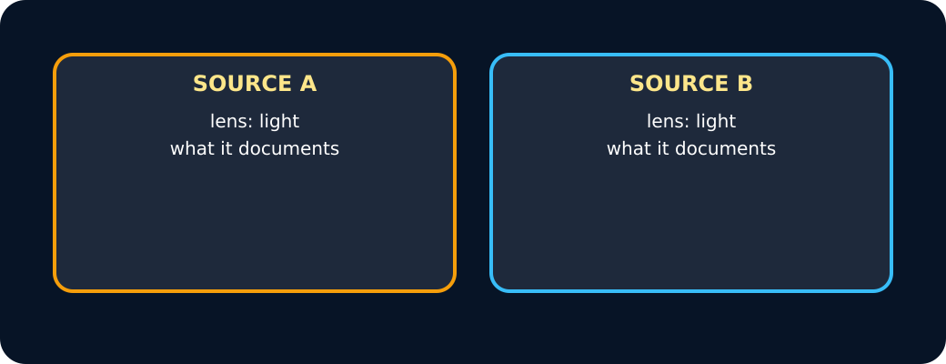
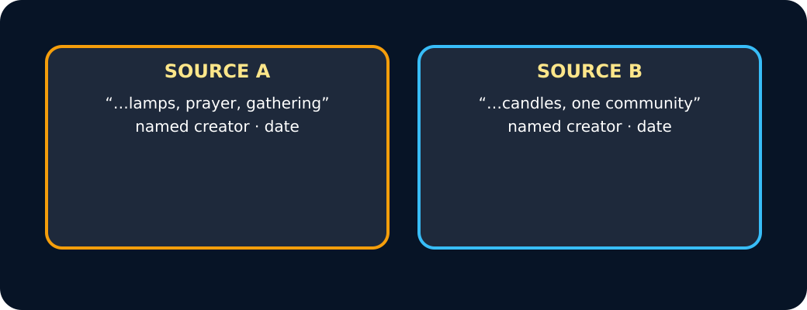
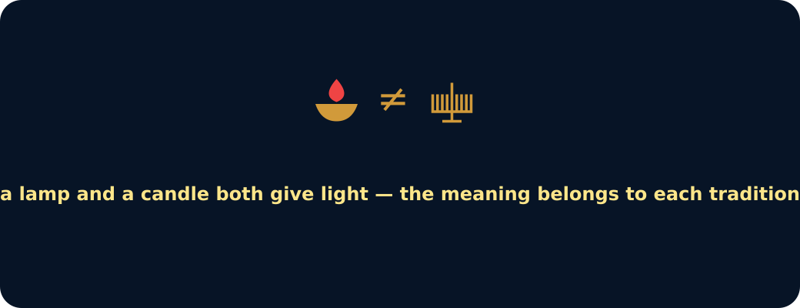
GROW / HUMANITIES
STARTER
How can we compare celebrations accurately while protecting difference within each community?
Two sources, one lens
Evidence from both
Similar symbol not same meaning
STARTER · 3 min across this stage
5 / 18
Notes:
Companion for GROW_HUM_W12_Compare_With_Care_OUTSTANDING_V3_1.html. Starter: 3 minutes TOTAL across all slides in this stage.
Receive a doubt/reason first. No public confidence vote.
Ask which map/source clue prompted the response.
Full source-stage teaching text:
Enquiry
COMPARE THE SAME LENS
Compare like with like: the same lens on both.
EVIDENCE BOTH SIDES
A quote from each, with its maker.
SIMILAR SYMBOL ≠ SAME MEANING
Do not let a shared image smuggle in a shared meaning.
QUALIFY: SOURCE, PLACE, TRADITION, VARIATION
Four qualifiers make a comparison honest.
HTML controls remain in the original HTML file. PowerPoint contains editable teaching text and static source visuals; use the paper response route for sorting and investigation.
[Sources]
Uploaded lesson: GROW_HUM_W12_Compare_With_Care_OUTSTANDING_V3_1.html
https://jewishmuseum.org.uk/learning/inclusive-judaism/imagelibrary/hanukah-candle-lightning-at-milton-keynes-and-district-reform-synagogue/
https://londonmandir.baps.org/2023/11/diwali-hindu-new-year-annakut-celebrations-2023/
https://www.churchofengland.org/prayer-and-worship/worship-texts-and-resources/common-worship/churchs-year/times-and-seasons-0
https://www.oikoumene.org/news/christmas-messages-across-the-world-bring-light-and-hope
https://www.reformjudaism.org.uk/jewish-holidays-chanukah/
[/Sources]

Slide 6
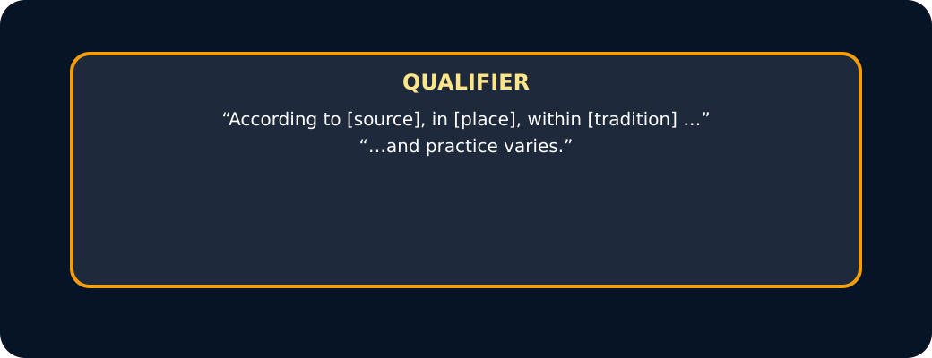
GROW / HUMANITIES
STARTER
How can we compare celebrations accurately while protecting difference within each community?
Qualifier
STARTER · 3 min across this stage
6 / 18
Notes:
Companion for GROW_HUM_W12_Compare_With_Care_OUTSTANDING_V3_1.html. Starter: 3 minutes TOTAL across all slides in this stage.
Receive a doubt/reason first. No public confidence vote.
Ask which map/source clue prompted the response.
Full source-stage teaching text:
Enquiry
COMPARE THE SAME LENS
Compare like with like: the same lens on both.
EVIDENCE BOTH SIDES
A quote from each, with its maker.
SIMILAR SYMBOL ≠ SAME MEANING
Do not let a shared image smuggle in a shared meaning.
QUALIFY: SOURCE, PLACE, TRADITION, VARIATION
Four qualifiers make a comparison honest.
HTML controls remain in the original HTML file. PowerPoint contains editable teaching text and static source visuals; use the paper response route for sorting and investigation.
[Sources]
Uploaded lesson: GROW_HUM_W12_Compare_With_Care_OUTSTANDING_V3_1.html
https://jewishmuseum.org.uk/learning/inclusive-judaism/imagelibrary/hanukah-candle-lightning-at-milton-keynes-and-district-reform-synagogue/
https://londonmandir.baps.org/2023/11/diwali-hindu-new-year-annakut-celebrations-2023/
https://www.churchofengland.org/prayer-and-worship/worship-texts-and-resources/common-worship/churchs-year/times-and-seasons-0
https://www.oikoumene.org/news/christmas-messages-across-the-world-bring-light-and-hope
https://www.reformjudaism.org.uk/jewish-holidays-chanukah/
[/Sources]

Slide 7
GROW / HUMANITIES
I DO
Model defensible map-and-source reasoning
Watch the decision, evidence and limitation—not just the finished sentence.
1. Frame: ‘Both source accounts mention light, but they connect it to different histories, beliefs and practices.’
2. Evidence both sides using creator codes, not unattributed festival facts.
3. Qualify scope: BAPS and Reform Judaism are named perspectives, not every Hindu or Jewish account.
Same-lens checker
I DO · 4 min across this stage
7 / 18
Notes:
Companion for GROW_HUM_W12_Compare_With_Care_OUTSTANDING_V3_1.html. I do: 4 minutes TOTAL across all slides in this stage.
Reveal one controlled decision at a time and name the evidence boundary.
Model process, not a pupil answer. Keep authentic and constructed sources distinct.
Full source-stage teaching text:
Watch the decision, evidence and limitation—not just the finished sentence.
1. Frame: ‘Both source accounts mention light, but they connect it to different histories, beliefs and practices.’
2. Evidence both sides using creator codes, not unattributed festival facts.
3. Qualify scope: BAPS and Reform Judaism are named perspectives, not every Hindu or Jewish account.
Same-lens checker
A fair comparison looks at the SAME thing in both sources. Press each pair: same lens, or mismatched?
A: how light is used · B: how light is used
A: how light is used · B: how many people attended
A: what the gathering is for · B: what the gathering is for
A: the food served · B: the date it falls
A: where the event took place · B: where the event took place
same lens
mismatched
Press a pair.
Add the four qualifiers
HTML controls remain in the original HTML file. PowerPoint contains editable teaching text and static source visuals; use the paper response route for sorting and investigation.
[Sources]
Uploaded lesson: GROW_HUM_W12_Compare_With_Care_OUTSTANDING_V3_1.html
https://jewishmuseum.org.uk/learning/inclusive-judaism/imagelibrary/hanukah-candle-lightning-at-milton-keynes-and-district-reform-synagogue/
https://londonmandir.baps.org/2023/11/diwali-hindu-new-year-annakut-celebrations-2023/
https://www.churchofengland.org/prayer-and-worship/worship-texts-and-resources/common-worship/churchs-year/times-and-seasons-0
https://www.oikoumene.org/news/christmas-messages-across-the-world-bring-light-and-hope
https://www.reformjudaism.org.uk/jewish-holidays-chanukah/
[/Sources]

Slide 8
GROW / HUMANITIES
I DO
Model defensible map-and-source reasoning
A fair comparison looks at the SAME thing in both sources. Choose each pair: same lens, or mismatched?
A. A: how light is used · B: how light is used
B. A: how light is used · B: how many people attended
C. A: what the gathering is for · B: what the gathering is for
D. A: the food served · B: the date it falls
E. A: where the event took place · B: where the event took place
F. same lens
I DO · 4 min across this stage
8 / 18
Notes:
Companion for GROW_HUM_W12_Compare_With_Care_OUTSTANDING_V3_1.html. I do: 4 minutes TOTAL across all slides in this stage.
Reveal one controlled decision at a time and name the evidence boundary.
Model process, not a pupil answer. Keep authentic and constructed sources distinct.
Full source-stage teaching text:
Watch the decision, evidence and limitation—not just the finished sentence.
1. Frame: ‘Both source accounts mention light, but they connect it to different histories, beliefs and practices.’
2. Evidence both sides using creator codes, not unattributed festival facts.
3. Qualify scope: BAPS and Reform Judaism are named perspectives, not every Hindu or Jewish account.
Same-lens checker
A fair comparison looks at the SAME thing in both sources. Press each pair: same lens, or mismatched?
A: how light is used · B: how light is used
A: how light is used · B: how many people attended
A: what the gathering is for · B: what the gathering is for
A: the food served · B: the date it falls
A: where the event took place · B: where the event took place
same lens
mismatched
Press a pair.
Add the four qualifiers
HTML controls remain in the original HTML file. PowerPoint contains editable teaching text and static source visuals; use the paper response route for sorting and investigation.
[Sources]
Uploaded lesson: GROW_HUM_W12_Compare_With_Care_OUTSTANDING_V3_1.html
https://jewishmuseum.org.uk/learning/inclusive-judaism/imagelibrary/hanukah-candle-lightning-at-milton-keynes-and-district-reform-synagogue/
https://londonmandir.baps.org/2023/11/diwali-hindu-new-year-annakut-celebrations-2023/
https://www.churchofengland.org/prayer-and-worship/worship-texts-and-resources/common-worship/churchs-year/times-and-seasons-0
https://www.oikoumene.org/news/christmas-messages-across-the-world-bring-light-and-hope
https://www.reformjudaism.org.uk/jewish-holidays-chanukah/
[/Sources]

Slide 9
GROW / HUMANITIES
I DO
Model defensible map-and-source reasoning
G. mismatched
Choose a pair.
A. Add the four qualifiers
I DO · 4 min across this stage
9 / 18
Notes:
Companion for GROW_HUM_W12_Compare_With_Care_OUTSTANDING_V3_1.html. I do: 4 minutes TOTAL across all slides in this stage.
Reveal one controlled decision at a time and name the evidence boundary.
Model process, not a pupil answer. Keep authentic and constructed sources distinct.
Full source-stage teaching text:
Watch the decision, evidence and limitation—not just the finished sentence.
1. Frame: ‘Both source accounts mention light, but they connect it to different histories, beliefs and practices.’
2. Evidence both sides using creator codes, not unattributed festival facts.
3. Qualify scope: BAPS and Reform Judaism are named perspectives, not every Hindu or Jewish account.
Same-lens checker
A fair comparison looks at the SAME thing in both sources. Press each pair: same lens, or mismatched?
A: how light is used · B: how light is used
A: how light is used · B: how many people attended
A: what the gathering is for · B: what the gathering is for
A: the food served · B: the date it falls
A: where the event took place · B: where the event took place
same lens
mismatched
Press a pair.
Add the four qualifiers
HTML controls remain in the original HTML file. PowerPoint contains editable teaching text and static source visuals; use the paper response route for sorting and investigation.
[Sources]
Uploaded lesson: GROW_HUM_W12_Compare_With_Care_OUTSTANDING_V3_1.html
https://jewishmuseum.org.uk/learning/inclusive-judaism/imagelibrary/hanukah-candle-lightning-at-milton-keynes-and-district-reform-synagogue/
https://londonmandir.baps.org/2023/11/diwali-hindu-new-year-annakut-celebrations-2023/
https://www.churchofengland.org/prayer-and-worship/worship-texts-and-resources/common-worship/churchs-year/times-and-seasons-0
https://www.oikoumene.org/news/christmas-messages-across-the-world-bring-light-and-hope
https://www.reformjudaism.org.uk/jewish-holidays-chanukah/
[/Sources]

Slide 10
GROW / HUMANITIES
WE DO
Commit before reveal
Which sentence makes the most careful comparison?
A. Both named sources include light, but they explain different meanings and neither represents every community.
B. Diwali and Chanukah are basically the same festival because both use lights.
C. All Hindus and all Jewish people celebrate in opposite ways.
WE DO · 3 min across this stage
10 / 18
Notes:
Companion for GROW_HUM_W12_Compare_With_Care_OUTSTANDING_V3_1.html. We do: 3 minutes TOTAL across all slides in this stage.
Every learner commits privately before feedback; re-attempt is available unless assessment has begun.
Secure → ask for reason/limit. Not yet → return to the exact clue and allow one re-attempt.
Ask every learner to commit privately before feedback. Use the pupil cards, table or evidence sheet; pointing, saying, signing and directing a partner are valid routes.
Full source-stage teaching text:
Which sentence makes the most careful comparison?
Both named sources include light, but they explain different meanings and neither represents every community.
Diwali and Chanukah are basically the same festival because both use lights.
All Hindus and all Jewish people celebrate in opposite ways.
HTML controls remain in the original HTML file. PowerPoint contains editable teaching text and static source visuals; use the paper response route for sorting and investigation.
[Sources]
Uploaded lesson: GROW_HUM_W12_Compare_With_Care_OUTSTANDING_V3_1.html
https://jewishmuseum.org.uk/learning/inclusive-judaism/imagelibrary/hanukah-candle-lightning-at-milton-keynes-and-district-reform-synagogue/
https://londonmandir.baps.org/2023/11/diwali-hindu-new-year-annakut-celebrations-2023/
https://www.churchofengland.org/prayer-and-worship/worship-texts-and-resources/common-worship/churchs-year/times-and-seasons-0
https://www.oikoumene.org/news/christmas-messages-across-the-world-bring-light-and-hope
https://www.reformjudaism.org.uk/jewish-holidays-chanukah/
[/Sources]

Slide 11
GROW / HUMANITIES
I DO 2
Add precision without overclaiming
Compare, qualify, protect variation.
1. A valid difference is evidence-led: calendar, historical/religious meaning, practice, setting or source emphasis.
2. Avoid ranking (‘better’, ‘more important’) unless the enquiry and evidence genuinely justify a criterion—which this enquiry does not.
3. A comparison grid helps thinking but can flatten lived variation; say what the frame leaves out.
I DO 2 · 3 min across this stage
11 / 18
Notes:
Companion for GROW_HUM_W12_Compare_With_Care_OUTSTANDING_V3_1.html. I do 2: 3 minutes TOTAL across all slides in this stage.
Raise challenge through perspective, scale, limitation or counterexample—not more writing.
Name the source creator and what the representation leaves out.
Full source-stage teaching text:
Compare, qualify, protect variation.
1. A valid difference is evidence-led: calendar, historical/religious meaning, practice, setting or source emphasis.
2. Avoid ranking (‘better’, ‘more important’) unless the enquiry and evidence genuinely justify a criterion—which this enquiry does not.
3. A comparison grid helps thinking but can flatten lived variation; say what the frame leaves out.
HTML controls remain in the original HTML file. PowerPoint contains editable teaching text and static source visuals; use the paper response route for sorting and investigation.
[Sources]
Uploaded lesson: GROW_HUM_W12_Compare_With_Care_OUTSTANDING_V3_1.html
https://jewishmuseum.org.uk/learning/inclusive-judaism/imagelibrary/hanukah-candle-lightning-at-milton-keynes-and-district-reform-synagogue/
https://londonmandir.baps.org/2023/11/diwali-hindu-new-year-annakut-celebrations-2023/
https://www.churchofengland.org/prayer-and-worship/worship-texts-and-resources/common-worship/churchs-year/times-and-seasons-0
https://www.oikoumene.org/news/christmas-messages-across-the-world-bring-light-and-hope
https://www.reformjudaism.org.uk/jewish-holidays-chanukah/
[/Sources]

Slide 12
GROW / HUMANITIES
WE DO 2
Rehearse the disciplinary move
Compare-with-care lab
A. Diwali + Chanukah
B. Chanukah + Christmas
C. Diwali + Christmas
WE DO 2 · 4 min across this stage
12 / 18
Notes:
Companion for GROW_HUM_W12_Compare_With_Care_OUTSTANDING_V3_1.html. We do 2: 4 minutes TOTAL across all slides in this stage.
Let the learner manipulate, locate, compare or confirm. The lab is rehearsal only.
Ask what becomes visible and what remains hidden; adapt the next approved source or question.
Ask every learner to commit privately before feedback. Use the pupil cards, table or evidence sheet; pointing, saying, signing and directing a partner are valid routes.
Full source-stage teaching text:
Compare-with-care lab
Diwali + Chanukah
Chanukah + Christmas
Diwali + Christmas
Choose the approved pair. Compare the same lens and protect variation.
HTML controls remain in the original HTML file. PowerPoint contains editable teaching text and static source visuals; use the paper response route for sorting and investigation.
[Sources]
Uploaded lesson: GROW_HUM_W12_Compare_With_Care_OUTSTANDING_V3_1.html
https://jewishmuseum.org.uk/learning/inclusive-judaism/imagelibrary/hanukah-candle-lightning-at-milton-keynes-and-district-reform-synagogue/
https://londonmandir.baps.org/2023/11/diwali-hindu-new-year-annakut-celebrations-2023/
https://www.churchofengland.org/prayer-and-worship/worship-texts-and-resources/common-worship/churchs-year/times-and-seasons-0
https://www.oikoumene.org/news/christmas-messages-across-the-world-bring-light-and-hope
https://www.reformjudaism.org.uk/jewish-holidays-chanukah/
[/Sources]

Slide 13
GROW / HUMANITIES
WE DO 2
Rehearse the disciplinary move
Same lens
Source A
Source B
Qualification
Meaning / practice / calendar / place
Name creator + evidence
Name creator + evidence
Some / this source / varies / cannot show
WE DO 2 · 4 min across this stage
13 / 18
Notes:
Companion for GROW_HUM_W12_Compare_With_Care_OUTSTANDING_V3_1.html. We do 2: 4 minutes TOTAL across all slides in this stage.
Let the learner manipulate, locate, compare or confirm. The lab is rehearsal only.
Ask what becomes visible and what remains hidden; adapt the next approved source or question.
Ask every learner to commit privately before feedback. Use the pupil cards, table or evidence sheet; pointing, saying, signing and directing a partner are valid routes.
Full source-stage teaching text:
Compare-with-care lab
Diwali + Chanukah
Chanukah + Christmas
Diwali + Christmas
Choose the approved pair. Compare the same lens and protect variation.
HTML controls remain in the original HTML file. PowerPoint contains editable teaching text and static source visuals; use the paper response route for sorting and investigation.
[Sources]
Uploaded lesson: GROW_HUM_W12_Compare_With_Care_OUTSTANDING_V3_1.html
https://jewishmuseum.org.uk/learning/inclusive-judaism/imagelibrary/hanukah-candle-lightning-at-milton-keynes-and-district-reform-synagogue/
https://londonmandir.baps.org/2023/11/diwali-hindu-new-year-annakut-celebrations-2023/
https://www.churchofengland.org/prayer-and-worship/worship-texts-and-resources/common-worship/churchs-year/times-and-seasons-0
https://www.oikoumene.org/news/christmas-messages-across-the-world-bring-light-and-hope
https://www.reformjudaism.org.uk/jewish-holidays-chanukah/
[/Sources]

Slide 14
GROW / HUMANITIES
WE DO 2
Rehearse the disciplinary move
Choose the approved pair. Compare the same lens and protect variation.
WE DO 2 · 4 min across this stage
14 / 18
Notes:
Companion for GROW_HUM_W12_Compare_With_Care_OUTSTANDING_V3_1.html. We do 2: 4 minutes TOTAL across all slides in this stage.
Let the learner manipulate, locate, compare or confirm. The lab is rehearsal only.
Ask what becomes visible and what remains hidden; adapt the next approved source or question.
Ask every learner to commit privately before feedback. Use the pupil cards, table or evidence sheet; pointing, saying, signing and directing a partner are valid routes.
Full source-stage teaching text:
Compare-with-care lab
Diwali + Chanukah
Chanukah + Christmas
Diwali + Christmas
Choose the approved pair. Compare the same lens and protect variation.
HTML controls remain in the original HTML file. PowerPoint contains editable teaching text and static source visuals; use the paper response route for sorting and investigation.
[Sources]
Uploaded lesson: GROW_HUM_W12_Compare_With_Care_OUTSTANDING_V3_1.html
https://jewishmuseum.org.uk/learning/inclusive-judaism/imagelibrary/hanukah-candle-lightning-at-milton-keynes-and-district-reform-synagogue/
https://londonmandir.baps.org/2023/11/diwali-hindu-new-year-annakut-celebrations-2023/
https://www.churchofengland.org/prayer-and-worship/worship-texts-and-resources/common-worship/churchs-year/times-and-seasons-0
https://www.oikoumene.org/news/christmas-messages-across-the-world-bring-light-and-hope
https://www.reformjudaism.org.uk/jewish-holidays-chanukah/
[/Sources]

Slide 15
GROW / HUMANITIES
INDEPENDENT
Independent Humanities mission
Compare two approved source accounts through one shared lens. Produce a similarity, difference, evidence on both sides, belonging connection and one scope limitation. A third-person or source-based route is the default.
EVIDENCE READY
Materials Printed route, named source cards and approved atlas/map as specified.
Access / care Enlarge, chunk, colour-adjust, read exactly or use agreed response mode. No personal disclosure required.
INDEPENDENT · 16 min across this stage
15 / 18
Notes:
Companion for GROW_HUM_W12_Compare_With_Care_OUTSTANDING_V3_1.html. Independent: 16 minutes TOTAL across all slides in this stage.
Protect authorship. Exact scribing only if authorised; do not improve reasoning while scribing.
Feedback produces one edit/re-attempt/next scaffold, not a second evidence task.
Full source-stage teaching text:
Compare two approved source accounts through one shared lens. Produce a similarity, difference, evidence on both sides, belonging connection and one scope limitation. A third-person or source-based route is the default.
EVIDENCE READY
Materials Printed route, named source cards and approved atlas/map as specified.
Access / care Enlarge, chunk, colour-adjust, read exactly or use agreed response mode. No personal disclosure required.
Evidence target Decision → map/source action or product → learner explanation; highest prompt recorded.
◆ Supported
Complete a two-column evidence grid and use the frame ‘Both sources ____. However, source A ____ while source B ____. This may connect people by ____. The sources cannot show ____.’
Both ____ and ____. However, ____ while ____. Source ____ says ____. This matters for belonging because ____. It cannot show ____.
▲ Standard
Write or record one linked comparison using both sources, a belonging explanation and a within-community qualification.
Shared lens → A evidence → B evidence → similarity/difference → belonging → qualification.
Stretch
Evaluate how creator/perspective or a changed lens would alter the comparison; select the most defensible claim.
Perspective/lens change → what becomes visible/hidden → best-supported comparison.
HTML controls remain in the original HTML file. PowerPoint contains editable teaching text and static source visuals; use the paper response route for sorting and investigation.
[Sources]
Uploaded lesson: GROW_HUM_W12_Compare_With_Care_OUTSTANDING_V3_1.html
https://jewishmuseum.org.uk/learning/inclusive-judaism/imagelibrary/hanukah-candle-lightning-at-milton-keynes-and-district-reform-synagogue/
https://londonmandir.baps.org/2023/11/diwali-hindu-new-year-annakut-celebrations-2023/
https://www.churchofengland.org/prayer-and-worship/worship-texts-and-resources/common-worship/churchs-year/times-and-seasons-0
https://www.oikoumene.org/news/christmas-messages-across-the-world-bring-light-and-hope
https://www.reformjudaism.org.uk/jewish-holidays-chanukah/
[/Sources]

Slide 16
GROW / HUMANITIES
INDEPENDENT
Independent Humanities mission
Evidence target Decision → map/source action or product → learner explanation; highest prompt recorded.
Supported
Complete a two-column evidence grid and use the frame ‘Both sources ____. However, source A ____ while source B ____. This may connect people by ____. The sources cannot show ____.’
Both ____ and ____. However, ____ while ____. Source ____ says ____. This matters for belonging because ____. It cannot show ____.
Standard
INDEPENDENT · 16 min across this stage
16 / 18
Notes:
Companion for GROW_HUM_W12_Compare_With_Care_OUTSTANDING_V3_1.html. Independent: 16 minutes TOTAL across all slides in this stage.
Protect authorship. Exact scribing only if authorised; do not improve reasoning while scribing.
Feedback produces one edit/re-attempt/next scaffold, not a second evidence task.
Full source-stage teaching text:
Compare two approved source accounts through one shared lens. Produce a similarity, difference, evidence on both sides, belonging connection and one scope limitation. A third-person or source-based route is the default.
EVIDENCE READY
Materials Printed route, named source cards and approved atlas/map as specified.
Access / care Enlarge, chunk, colour-adjust, read exactly or use agreed response mode. No personal disclosure required.
Evidence target Decision → map/source action or product → learner explanation; highest prompt recorded.
◆ Supported
Complete a two-column evidence grid and use the frame ‘Both sources ____. However, source A ____ while source B ____. This may connect people by ____. The sources cannot show ____.’
Both ____ and ____. However, ____ while ____. Source ____ says ____. This matters for belonging because ____. It cannot show ____.
▲ Standard
Write or record one linked comparison using both sources, a belonging explanation and a within-community qualification.
Shared lens → A evidence → B evidence → similarity/difference → belonging → qualification.
Stretch
Evaluate how creator/perspective or a changed lens would alter the comparison; select the most defensible claim.
Perspective/lens change → what becomes visible/hidden → best-supported comparison.
HTML controls remain in the original HTML file. PowerPoint contains editable teaching text and static source visuals; use the paper response route for sorting and investigation.
[Sources]
Uploaded lesson: GROW_HUM_W12_Compare_With_Care_OUTSTANDING_V3_1.html
https://jewishmuseum.org.uk/learning/inclusive-judaism/imagelibrary/hanukah-candle-lightning-at-milton-keynes-and-district-reform-synagogue/
https://londonmandir.baps.org/2023/11/diwali-hindu-new-year-annakut-celebrations-2023/
https://www.churchofengland.org/prayer-and-worship/worship-texts-and-resources/common-worship/churchs-year/times-and-seasons-0
https://www.oikoumene.org/news/christmas-messages-across-the-world-bring-light-and-hope
https://www.reformjudaism.org.uk/jewish-holidays-chanukah/
[/Sources]

Slide 17
GROW / HUMANITIES
INDEPENDENT
Independent Humanities mission
Write or record one linked comparison using both sources, a belonging explanation and a within-community qualification.
Shared lens → A evidence → B evidence → similarity/difference → belonging → qualification.
Stretch
Evaluate how creator/perspective or a changed lens would alter the comparison; select the most defensible claim.
Perspective/lens change → what becomes visible/hidden → best-supported comparison.
INDEPENDENT · 16 min across this stage
17 / 18
Notes:
Companion for GROW_HUM_W12_Compare_With_Care_OUTSTANDING_V3_1.html. Independent: 16 minutes TOTAL across all slides in this stage.
Protect authorship. Exact scribing only if authorised; do not improve reasoning while scribing.
Feedback produces one edit/re-attempt/next scaffold, not a second evidence task.
Full source-stage teaching text:
Compare two approved source accounts through one shared lens. Produce a similarity, difference, evidence on both sides, belonging connection and one scope limitation. A third-person or source-based route is the default.
EVIDENCE READY
Materials Printed route, named source cards and approved atlas/map as specified.
Access / care Enlarge, chunk, colour-adjust, read exactly or use agreed response mode. No personal disclosure required.
Evidence target Decision → map/source action or product → learner explanation; highest prompt recorded.
◆ Supported
Complete a two-column evidence grid and use the frame ‘Both sources ____. However, source A ____ while source B ____. This may connect people by ____. The sources cannot show ____.’
Both ____ and ____. However, ____ while ____. Source ____ says ____. This matters for belonging because ____. It cannot show ____.
▲ Standard
Write or record one linked comparison using both sources, a belonging explanation and a within-community qualification.
Shared lens → A evidence → B evidence → similarity/difference → belonging → qualification.
Stretch
Evaluate how creator/perspective or a changed lens would alter the comparison; select the most defensible claim.
Perspective/lens change → what becomes visible/hidden → best-supported comparison.
HTML controls remain in the original HTML file. PowerPoint contains editable teaching text and static source visuals; use the paper response route for sorting and investigation.
[Sources]
Uploaded lesson: GROW_HUM_W12_Compare_With_Care_OUTSTANDING_V3_1.html
https://jewishmuseum.org.uk/learning/inclusive-judaism/imagelibrary/hanukah-candle-lightning-at-milton-keynes-and-district-reform-synagogue/
https://londonmandir.baps.org/2023/11/diwali-hindu-new-year-annakut-celebrations-2023/
https://www.churchofengland.org/prayer-and-worship/worship-texts-and-resources/common-worship/churchs-year/times-and-seasons-0
https://www.oikoumene.org/news/christmas-messages-across-the-world-bring-light-and-hope
https://www.reformjudaism.org.uk/jewish-holidays-chanukah/
[/Sources]

Slide 18
GROW / HUMANITIES
EXIT
Close one loop—do not create a second task
Standard
Give the full comparison plus a scope limit.
Named audience receipt
“I heard your claim/decision as ____. Your evidence was ____. Your uncertainty/limit was ____.”
Influence: Pupils choose one viable presentation mode for W13—live, audio with consent, slides or poster—and one audience access need. Adult owner confirms arrangements at W13.
EXIT · 4 min across this stage
18 / 18
Notes:
Companion for GROW_HUM_W12_Compare_With_Care_OUTSTANDING_V3_1.html. Exit: 4 minutes TOTAL across all slides in this stage.
Receive actual reasoning. Restate claim/evidence/uncertainty before praise or correction.
Record one response branch and one next move; explain any accuracy, provenance or assessment boundary.
Full source-stage teaching text:
▲ Standard
Give the full comparison plus a scope limit.
Named audience receipt
“I heard your claim/decision as ____. Your evidence was ____. Your uncertainty/limit was ____.”
Influence: Pupils choose one viable presentation mode for W13—live, audio with consent, slides or poster—and one audience access need. Adult owner confirms arrangements at W13.
HTML controls remain in the original HTML file. PowerPoint contains editable teaching text and static source visuals; use the paper response route for sorting and investigation.
[Sources]
Uploaded lesson: GROW_HUM_W12_Compare_With_Care_OUTSTANDING_V3_1.html
https://jewishmuseum.org.uk/learning/inclusive-judaism/imagelibrary/hanukah-candle-lightning-at-milton-keynes-and-district-reform-synagogue/
https://londonmandir.baps.org/2023/11/diwali-hindu-new-year-annakut-celebrations-2023/
https://www.churchofengland.org/prayer-and-worship/worship-texts-and-resources/common-worship/churchs-year/times-and-seasons-0
https://www.oikoumene.org/news/christmas-messages-across-the-world-bring-light-and-hope
https://www.reformjudaism.org.uk/jewish-holidays-chanukah/
[/Sources]

