Slide 1
GROW / HUMANITIES
OVERVIEW
Pinpoint the Place
I can use an atlas index and grid references to locate and describe a place, then state one representation limit.
Open the original interactive lesson
40 MINUTES
1 / 20
Notes:
Companion for GROW_HUM_W9_Pinpoint_the_Place_OUTSTANDING_V3_1.html. Overview: 0 minutes TOTAL across all slides in this stage.
Check source pack, print route, prior report-back and access before pupils arrive.
Prepare accessible versions without lowering the disciplinary goal.
Full source-stage teaching text:
Atlas & grid-reference studio · NC KS2/3 Geography/History enquiry
Learning objective: I can use an atlas index and grid references to locate and describe a place, then state one representation limit.
Success criteria
I use eastings before northings and check the atlas key/index.
I give an accurate four-figure reference and describe relative location.
I explain what the grid or map still cannot show.
⌖
Atlas & grid-reference studio
precision · connection · respectful enquiry
Source gate: genuine source = creator/date/origin/reference/rights/use/limit. Adapted and constructed material is labelled. Personal/family disclosure is optional.
HTML controls remain in the original HTML file. PowerPoint contains editable teaching text and static source visuals; use the paper response route for sorting and investigation.
[Sources]
Uploaded lesson: GROW_HUM_W9_Pinpoint_the_Place_OUTSTANDING_V3_1.html
https://getoutside.ordnancesurvey.co.uk/guides/beginners-guide-to-grid-references/
[/Sources]

Slide 2
GROW / HUMANITIES
ARRIVAL
Named adult reports what happened to the Week 8 resource/curriculum recommendation before new choice begins.
Standard
Explain one thing a map showed in Week 8 and one thing it could not explain.
ARRIVAL · 3 min across this stage
2 / 20
Notes:
Companion for GROW_HUM_W9_Pinpoint_the_Place_OUTSTANDING_V3_1.html. Arrival: 3 minutes TOTAL across all slides in this stage.
Give the previous bounded-choice report-back first; then use quiet retrieval.
If secure, fade one content prompt. If access blocks response, change the route rather than the goal.
Full source-stage teaching text:
▲ Standard
Explain one thing a map showed in Week 8 and one thing it could not explain.
HTML controls remain in the original HTML file. PowerPoint contains editable teaching text and static source visuals; use the paper response route for sorting and investigation.
[Sources]
Uploaded lesson: GROW_HUM_W9_Pinpoint_the_Place_OUTSTANDING_V3_1.html
https://getoutside.ordnancesurvey.co.uk/guides/beginners-guide-to-grid-references/
[/Sources]

Slide 3
GROW / HUMANITIES
STARTER
How can a grid reference make a location precise without pretending a map shows everything?
Enquiry
INDEX FINDS THE SQUARE
The atlas index gives a page and a reference: 33 44 .
EASTINGS FIRST — ALONG THE CORRIDOR
Read the blue numbers along the bottom first: 33 .
NORTHINGS SECOND — UP THE STAIRS
Then the red numbers up the side: 44 . Along, then up.
PRECISE IS NOT COMPLETE
STARTER · 3 min across this stage
3 / 20
Notes:
Companion for GROW_HUM_W9_Pinpoint_the_Place_OUTSTANDING_V3_1.html. Starter: 3 minutes TOTAL across all slides in this stage.
Receive a doubt/reason first. No public confidence vote.
Ask which map/source clue prompted the response.
Full source-stage teaching text:
Enquiry
INDEX FINDS THE SQUARE
The atlas index gives a page and a reference: 33 44 .
EASTINGS FIRST — ALONG THE CORRIDOR
Read the blue numbers along the bottom first: 33 .
NORTHINGS SECOND — UP THE STAIRS
Then the red numbers up the side: 44 . Along, then up.
PRECISE IS NOT COMPLETE
A four-figure reference finds a 1 km square. It does not show what the place is like.
HTML controls remain in the original HTML file. PowerPoint contains editable teaching text and static source visuals; use the paper response route for sorting and investigation.
[Sources]
Uploaded lesson: GROW_HUM_W9_Pinpoint_the_Place_OUTSTANDING_V3_1.html
https://getoutside.ordnancesurvey.co.uk/guides/beginners-guide-to-grid-references/
[/Sources]

Slide 4
GROW / HUMANITIES
STARTER
How can a grid reference make a location precise without pretending a map shows everything?
A four-figure reference finds a 1 km square. It does not show what the place is like.
STARTER · 3 min across this stage
4 / 20
Notes:
Companion for GROW_HUM_W9_Pinpoint_the_Place_OUTSTANDING_V3_1.html. Starter: 3 minutes TOTAL across all slides in this stage.
Receive a doubt/reason first. No public confidence vote.
Ask which map/source clue prompted the response.
Full source-stage teaching text:
Enquiry
INDEX FINDS THE SQUARE
The atlas index gives a page and a reference: 33 44 .
EASTINGS FIRST — ALONG THE CORRIDOR
Read the blue numbers along the bottom first: 33 .
NORTHINGS SECOND — UP THE STAIRS
Then the red numbers up the side: 44 . Along, then up.
PRECISE IS NOT COMPLETE
A four-figure reference finds a 1 km square. It does not show what the place is like.
HTML controls remain in the original HTML file. PowerPoint contains editable teaching text and static source visuals; use the paper response route for sorting and investigation.
[Sources]
Uploaded lesson: GROW_HUM_W9_Pinpoint_the_Place_OUTSTANDING_V3_1.html
https://getoutside.ordnancesurvey.co.uk/guides/beginners-guide-to-grid-references/
[/Sources]

Slide 5
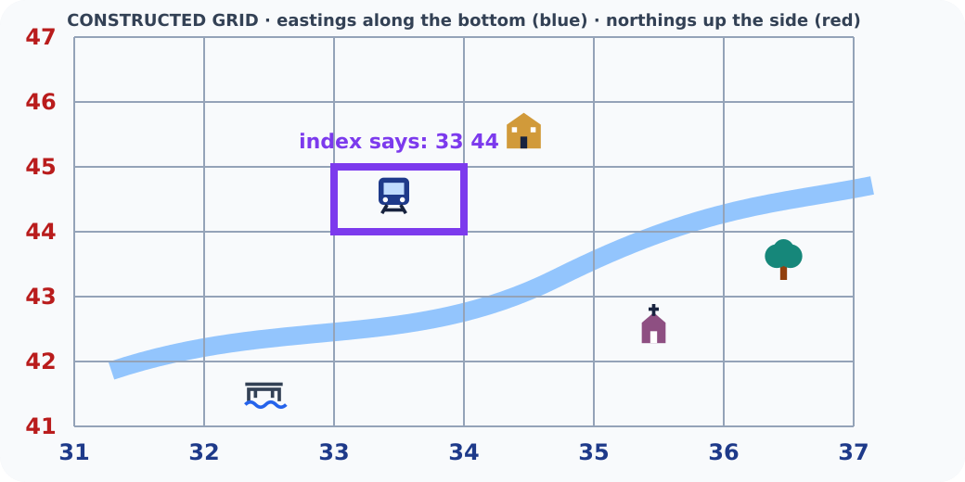
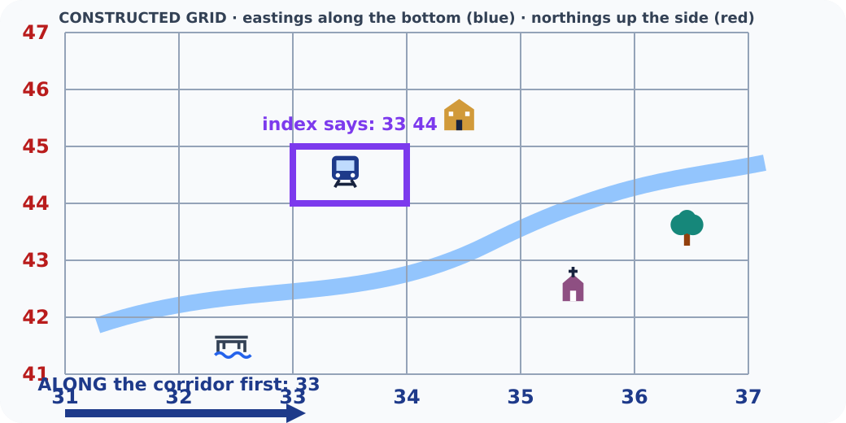
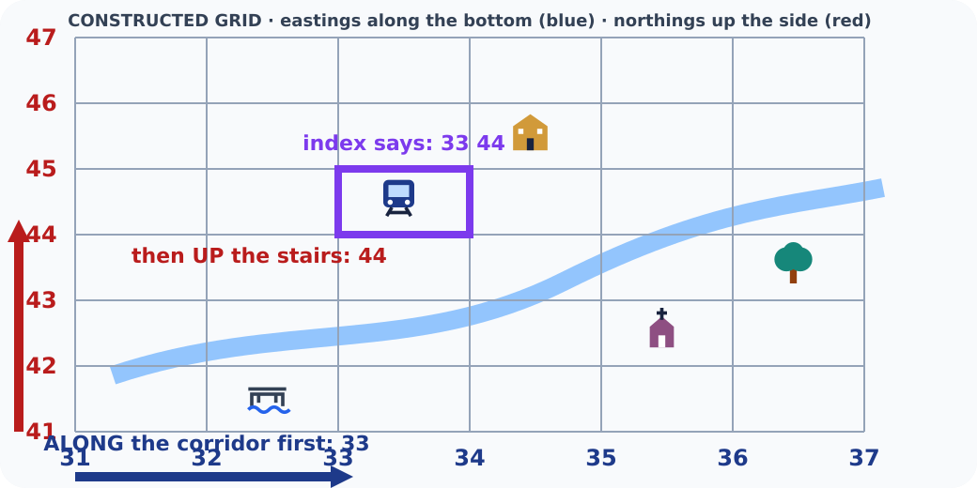
GROW / HUMANITIES
STARTER
How can a grid reference make a location precise without pretending a map shows everything?
Grid map with the target square highlighted
Arrow along the bottom to easting 33
Arrow up the side to northing 44
STARTER · 3 min across this stage
5 / 20
Notes:
Companion for GROW_HUM_W9_Pinpoint_the_Place_OUTSTANDING_V3_1.html. Starter: 3 minutes TOTAL across all slides in this stage.
Receive a doubt/reason first. No public confidence vote.
Ask which map/source clue prompted the response.
Full source-stage teaching text:
Enquiry
INDEX FINDS THE SQUARE
The atlas index gives a page and a reference: 33 44 .
EASTINGS FIRST — ALONG THE CORRIDOR
Read the blue numbers along the bottom first: 33 .
NORTHINGS SECOND — UP THE STAIRS
Then the red numbers up the side: 44 . Along, then up.
PRECISE IS NOT COMPLETE
A four-figure reference finds a 1 km square. It does not show what the place is like.
HTML controls remain in the original HTML file. PowerPoint contains editable teaching text and static source visuals; use the paper response route for sorting and investigation.
[Sources]
Uploaded lesson: GROW_HUM_W9_Pinpoint_the_Place_OUTSTANDING_V3_1.html
https://getoutside.ordnancesurvey.co.uk/guides/beginners-guide-to-grid-references/
[/Sources]

Slide 6
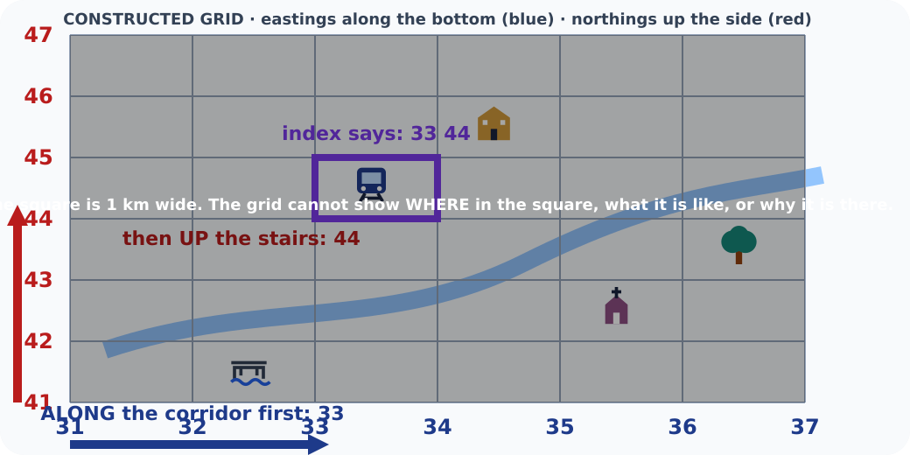
GROW / HUMANITIES
STARTER
How can a grid reference make a location precise without pretending a map shows everything?
Grid map dimmed with a note on its limits
STARTER · 3 min across this stage
6 / 20
Notes:
Companion for GROW_HUM_W9_Pinpoint_the_Place_OUTSTANDING_V3_1.html. Starter: 3 minutes TOTAL across all slides in this stage.
Receive a doubt/reason first. No public confidence vote.
Ask which map/source clue prompted the response.
Full source-stage teaching text:
Enquiry
INDEX FINDS THE SQUARE
The atlas index gives a page and a reference: 33 44 .
EASTINGS FIRST — ALONG THE CORRIDOR
Read the blue numbers along the bottom first: 33 .
NORTHINGS SECOND — UP THE STAIRS
Then the red numbers up the side: 44 . Along, then up.
PRECISE IS NOT COMPLETE
A four-figure reference finds a 1 km square. It does not show what the place is like.
HTML controls remain in the original HTML file. PowerPoint contains editable teaching text and static source visuals; use the paper response route for sorting and investigation.
[Sources]
Uploaded lesson: GROW_HUM_W9_Pinpoint_the_Place_OUTSTANDING_V3_1.html
https://getoutside.ordnancesurvey.co.uk/guides/beginners-guide-to-grid-references/
[/Sources]

Slide 7
GROW / HUMANITIES
I DO
Model defensible map-and-source reasoning
Watch the decision, evidence and limitation—not just the finished sentence.
1. Use the atlas index to find a page or grid square; use the key to identify the symbol.
2. Read the numbered vertical line on the left of the square first: the easting.
3. Read the numbered horizontal line below the square second: the northing.
⌖ Grid trainer · find it, then reference it
Constructed model: not an OS map. It rehearses easting-first, northing-second.
I DO · 4 min across this stage
7 / 20
Notes:
Companion for GROW_HUM_W9_Pinpoint_the_Place_OUTSTANDING_V3_1.html. I do: 4 minutes TOTAL across all slides in this stage.
Reveal one controlled decision at a time and name the evidence boundary.
Model process, not a pupil answer. Keep authentic and constructed sources distinct.
Full source-stage teaching text:
Watch the decision, evidence and limitation—not just the finished sentence.
1. Use the atlas index to find a page or grid square; use the key to identify the symbol.
2. Read the numbered vertical line on the left of the square first: the easting.
3. Read the numbered horizontal line below the square second: the northing.
⌖ Grid trainer · find it, then reference it
Constructed model: not an OS map. It rehearses easting-first, northing-second.
1 · Press a symbol. 2 · Press its easting (blue). 3 · Press its northing (red).
Easting (along):
31
32
33
34
35
36
Northing (up):
41
42
43
44
45
46
Press a symbol on the map.
What can this reference NOT show?
HTML controls remain in the original HTML file. PowerPoint contains editable teaching text and static source visuals; use the paper response route for sorting and investigation.
[Sources]
Uploaded lesson: GROW_HUM_W9_Pinpoint_the_Place_OUTSTANDING_V3_1.html
https://getoutside.ordnancesurvey.co.uk/guides/beginners-guide-to-grid-references/
[/Sources]

Slide 8
GROW / HUMANITIES
I DO
Model defensible map-and-source reasoning
1 · Choose a symbol. 2 · Choose its easting (blue). 3 · Choose its northing (red).
Easting (along):
I DO · 4 min across this stage
8 / 20
Notes:
Companion for GROW_HUM_W9_Pinpoint_the_Place_OUTSTANDING_V3_1.html. I do: 4 minutes TOTAL across all slides in this stage.
Reveal one controlled decision at a time and name the evidence boundary.
Model process, not a pupil answer. Keep authentic and constructed sources distinct.
Full source-stage teaching text:
Watch the decision, evidence and limitation—not just the finished sentence.
1. Use the atlas index to find a page or grid square; use the key to identify the symbol.
2. Read the numbered vertical line on the left of the square first: the easting.
3. Read the numbered horizontal line below the square second: the northing.
⌖ Grid trainer · find it, then reference it
Constructed model: not an OS map. It rehearses easting-first, northing-second.
1 · Press a symbol. 2 · Press its easting (blue). 3 · Press its northing (red).
Easting (along):
31
32
33
34
35
36
Northing (up):
41
42
43
44
45
46
Press a symbol on the map.
What can this reference NOT show?
HTML controls remain in the original HTML file. PowerPoint contains editable teaching text and static source visuals; use the paper response route for sorting and investigation.
[Sources]
Uploaded lesson: GROW_HUM_W9_Pinpoint_the_Place_OUTSTANDING_V3_1.html
https://getoutside.ordnancesurvey.co.uk/guides/beginners-guide-to-grid-references/
[/Sources]

Slide 9
GROW / HUMANITIES
I DO
Model defensible map-and-source reasoning
A. 31
B. 32
C. 33
D. 34
E. 35
F. 36
Northing (up):
I DO · 4 min across this stage
9 / 20
Notes:
Companion for GROW_HUM_W9_Pinpoint_the_Place_OUTSTANDING_V3_1.html. I do: 4 minutes TOTAL across all slides in this stage.
Reveal one controlled decision at a time and name the evidence boundary.
Model process, not a pupil answer. Keep authentic and constructed sources distinct.
Full source-stage teaching text:
Watch the decision, evidence and limitation—not just the finished sentence.
1. Use the atlas index to find a page or grid square; use the key to identify the symbol.
2. Read the numbered vertical line on the left of the square first: the easting.
3. Read the numbered horizontal line below the square second: the northing.
⌖ Grid trainer · find it, then reference it
Constructed model: not an OS map. It rehearses easting-first, northing-second.
1 · Press a symbol. 2 · Press its easting (blue). 3 · Press its northing (red).
Easting (along):
31
32
33
34
35
36
Northing (up):
41
42
43
44
45
46
Press a symbol on the map.
What can this reference NOT show?
HTML controls remain in the original HTML file. PowerPoint contains editable teaching text and static source visuals; use the paper response route for sorting and investigation.
[Sources]
Uploaded lesson: GROW_HUM_W9_Pinpoint_the_Place_OUTSTANDING_V3_1.html
https://getoutside.ordnancesurvey.co.uk/guides/beginners-guide-to-grid-references/
[/Sources]

Slide 10
GROW / HUMANITIES
I DO
Model defensible map-and-source reasoning
A. 41
B. 42
C. 43
D. 44
E. 45
F. 46
Choose a symbol on the map.
A. What can this reference NOT show?
I DO · 4 min across this stage
10 / 20
Notes:
Companion for GROW_HUM_W9_Pinpoint_the_Place_OUTSTANDING_V3_1.html. I do: 4 minutes TOTAL across all slides in this stage.
Reveal one controlled decision at a time and name the evidence boundary.
Model process, not a pupil answer. Keep authentic and constructed sources distinct.
Full source-stage teaching text:
Watch the decision, evidence and limitation—not just the finished sentence.
1. Use the atlas index to find a page or grid square; use the key to identify the symbol.
2. Read the numbered vertical line on the left of the square first: the easting.
3. Read the numbered horizontal line below the square second: the northing.
⌖ Grid trainer · find it, then reference it
Constructed model: not an OS map. It rehearses easting-first, northing-second.
1 · Press a symbol. 2 · Press its easting (blue). 3 · Press its northing (red).
Easting (along):
31
32
33
34
35
36
Northing (up):
41
42
43
44
45
46
Press a symbol on the map.
What can this reference NOT show?
HTML controls remain in the original HTML file. PowerPoint contains editable teaching text and static source visuals; use the paper response route for sorting and investigation.
[Sources]
Uploaded lesson: GROW_HUM_W9_Pinpoint_the_Place_OUTSTANDING_V3_1.html
https://getoutside.ordnancesurvey.co.uk/guides/beginners-guide-to-grid-references/
[/Sources]

Slide 11
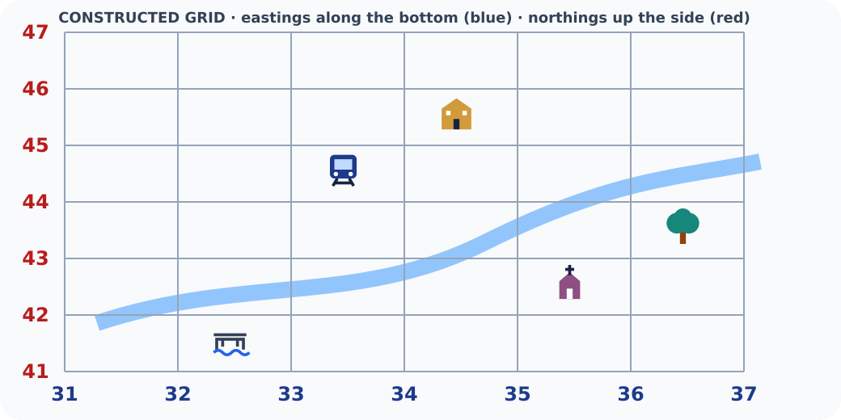
GROW / HUMANITIES
I DO
Model defensible map-and-source reasoning
Tappable six by six grid map with symbols
I DO · 4 min across this stage
11 / 20
Notes:
Companion for GROW_HUM_W9_Pinpoint_the_Place_OUTSTANDING_V3_1.html. I do: 4 minutes TOTAL across all slides in this stage.
Reveal one controlled decision at a time and name the evidence boundary.
Model process, not a pupil answer. Keep authentic and constructed sources distinct.
Full source-stage teaching text:
Watch the decision, evidence and limitation—not just the finished sentence.
1. Use the atlas index to find a page or grid square; use the key to identify the symbol.
2. Read the numbered vertical line on the left of the square first: the easting.
3. Read the numbered horizontal line below the square second: the northing.
⌖ Grid trainer · find it, then reference it
Constructed model: not an OS map. It rehearses easting-first, northing-second.
1 · Press a symbol. 2 · Press its easting (blue). 3 · Press its northing (red).
Easting (along):
31
32
33
34
35
36
Northing (up):
41
42
43
44
45
46
Press a symbol on the map.
What can this reference NOT show?
HTML controls remain in the original HTML file. PowerPoint contains editable teaching text and static source visuals; use the paper response route for sorting and investigation.
[Sources]
Uploaded lesson: GROW_HUM_W9_Pinpoint_the_Place_OUTSTANDING_V3_1.html
https://getoutside.ordnancesurvey.co.uk/guides/beginners-guide-to-grid-references/
[/Sources]

Slide 12
GROW / HUMANITIES
WE DO
Commit before reveal
A bridge lies in the square east of line 31 and north of line 44. Which four-figure reference identifies the square?
A. 3144
B. 4431
C. 3245
WE DO · 3 min across this stage
12 / 20
Notes:
Companion for GROW_HUM_W9_Pinpoint_the_Place_OUTSTANDING_V3_1.html. We do: 3 minutes TOTAL across all slides in this stage.
Every learner commits privately before feedback; re-attempt is available unless assessment has begun.
Secure → ask for reason/limit. Not yet → return to the exact clue and allow one re-attempt.
Ask every learner to commit privately before feedback. Use the pupil cards, table or evidence sheet; pointing, saying, signing and directing a partner are valid routes.
Full source-stage teaching text:
A bridge lies in the square east of line 31 and north of line 44. Which four-figure reference identifies the square?
3144
4431
3245
HTML controls remain in the original HTML file. PowerPoint contains editable teaching text and static source visuals; use the paper response route for sorting and investigation.
[Sources]
Uploaded lesson: GROW_HUM_W9_Pinpoint_the_Place_OUTSTANDING_V3_1.html
https://getoutside.ordnancesurvey.co.uk/guides/beginners-guide-to-grid-references/
[/Sources]

Slide 13
GROW / HUMANITIES
I DO 2
Add precision without overclaiming
Compare, qualify, protect variation.
1. A four-figure reference identifies a 1 km square on an OS grid; greater precision needs more digits.
2. Relative location adds meaning: north-east of, beside, across the river from, about two squares away.
3. A grid can locate a symbol but cannot by itself explain experience, importance, movement or belonging.
I DO 2 · 3 min across this stage
13 / 20
Notes:
Companion for GROW_HUM_W9_Pinpoint_the_Place_OUTSTANDING_V3_1.html. I do 2: 3 minutes TOTAL across all slides in this stage.
Raise challenge through perspective, scale, limitation or counterexample—not more writing.
Name the source creator and what the representation leaves out.
Full source-stage teaching text:
Compare, qualify, protect variation.
1. A four-figure reference identifies a 1 km square on an OS grid; greater precision needs more digits.
2. Relative location adds meaning: north-east of, beside, across the river from, about two squares away.
3. A grid can locate a symbol but cannot by itself explain experience, importance, movement or belonging.
HTML controls remain in the original HTML file. PowerPoint contains editable teaching text and static source visuals; use the paper response route for sorting and investigation.
[Sources]
Uploaded lesson: GROW_HUM_W9_Pinpoint_the_Place_OUTSTANDING_V3_1.html
https://getoutside.ordnancesurvey.co.uk/guides/beginners-guide-to-grid-references/
[/Sources]

Slide 14
GROW / HUMANITIES
WE DO 2
Rehearse the disciplinary move
River Tees grid lab
Constructed model: this is not an OS or navigation map. It rehearses easting-first, northing-second.
31
32
33
34
35
WE DO 2 · 4 min across this stage
14 / 20
Notes:
Companion for GROW_HUM_W9_Pinpoint_the_Place_OUTSTANDING_V3_1.html. We do 2: 4 minutes TOTAL across all slides in this stage.
Let the learner manipulate, locate, compare or confirm. The lab is rehearsal only.
Ask what becomes visible and what remains hidden; adapt the next approved source or question.
Ask every learner to commit privately before feedback. Use the pupil cards, table or evidence sheet; pointing, saying, signing and directing a partner are valid routes.
Full source-stage teaching text:
River Tees grid lab
Constructed model: this is not an OS or navigation map. It rehearses easting-first, northing-second.
31
32
33
34
35
36
41
42
43
44
45
46
Bridge
▣ Market
◆ Library
Locate bridge
Locate market
Locate library
Choose a symbol. Read along first, then up.
HTML controls remain in the original HTML file. PowerPoint contains editable teaching text and static source visuals; use the paper response route for sorting and investigation.
[Sources]
Uploaded lesson: GROW_HUM_W9_Pinpoint_the_Place_OUTSTANDING_V3_1.html
https://getoutside.ordnancesurvey.co.uk/guides/beginners-guide-to-grid-references/
[/Sources]

Slide 15
GROW / HUMANITIES
WE DO 2
Rehearse the disciplinary move
36
41
42
43
44
45
46
Bridge
WE DO 2 · 4 min across this stage
15 / 20
Notes:
Companion for GROW_HUM_W9_Pinpoint_the_Place_OUTSTANDING_V3_1.html. We do 2: 4 minutes TOTAL across all slides in this stage.
Let the learner manipulate, locate, compare or confirm. The lab is rehearsal only.
Ask what becomes visible and what remains hidden; adapt the next approved source or question.
Ask every learner to commit privately before feedback. Use the pupil cards, table or evidence sheet; pointing, saying, signing and directing a partner are valid routes.
Full source-stage teaching text:
River Tees grid lab
Constructed model: this is not an OS or navigation map. It rehearses easting-first, northing-second.
31
32
33
34
35
36
41
42
43
44
45
46
Bridge
▣ Market
◆ Library
Locate bridge
Locate market
Locate library
Choose a symbol. Read along first, then up.
HTML controls remain in the original HTML file. PowerPoint contains editable teaching text and static source visuals; use the paper response route for sorting and investigation.
[Sources]
Uploaded lesson: GROW_HUM_W9_Pinpoint_the_Place_OUTSTANDING_V3_1.html
https://getoutside.ordnancesurvey.co.uk/guides/beginners-guide-to-grid-references/
[/Sources]

Slide 16
GROW / HUMANITIES
WE DO 2
Rehearse the disciplinary move
▣ Market
Library
A. Locate bridge
B. Locate market
C. Locate library
Choose a symbol. Read along first, then up.
WE DO 2 · 4 min across this stage
16 / 20
Notes:
Companion for GROW_HUM_W9_Pinpoint_the_Place_OUTSTANDING_V3_1.html. We do 2: 4 minutes TOTAL across all slides in this stage.
Let the learner manipulate, locate, compare or confirm. The lab is rehearsal only.
Ask what becomes visible and what remains hidden; adapt the next approved source or question.
Ask every learner to commit privately before feedback. Use the pupil cards, table or evidence sheet; pointing, saying, signing and directing a partner are valid routes.
Full source-stage teaching text:
River Tees grid lab
Constructed model: this is not an OS or navigation map. It rehearses easting-first, northing-second.
31
32
33
34
35
36
41
42
43
44
45
46
Bridge
▣ Market
◆ Library
Locate bridge
Locate market
Locate library
Choose a symbol. Read along first, then up.
HTML controls remain in the original HTML file. PowerPoint contains editable teaching text and static source visuals; use the paper response route for sorting and investigation.
[Sources]
Uploaded lesson: GROW_HUM_W9_Pinpoint_the_Place_OUTSTANDING_V3_1.html
https://getoutside.ordnancesurvey.co.uk/guides/beginners-guide-to-grid-references/
[/Sources]

Slide 17
GROW / HUMANITIES
INDEPENDENT
Independent Humanities mission
Use the printed River Tees rehearsal grid and one teacher-approved atlas/map. Record locations with grid evidence, write a relative-location sentence, then identify one limitation of the representation.
EVIDENCE READY
Materials Printed route, named source cards and approved atlas/map as specified.
Access / care Enlarge, chunk, colour-adjust, read exactly or use agreed response mode. No personal disclosure required.
INDEPENDENT · 16 min across this stage
17 / 20
Notes:
Companion for GROW_HUM_W9_Pinpoint_the_Place_OUTSTANDING_V3_1.html. Independent: 16 minutes TOTAL across all slides in this stage.
Protect authorship. Exact scribing only if authorised; do not improve reasoning while scribing.
Feedback produces one edit/re-attempt/next scaffold, not a second evidence task.
Full source-stage teaching text:
Use the printed River Tees rehearsal grid and one teacher-approved atlas/map. Record locations with grid evidence, write a relative-location sentence, then identify one limitation of the representation.
EVIDENCE READY
Materials Printed route, named source cards and approved atlas/map as specified.
Access / care Enlarge, chunk, colour-adjust, read exactly or use agreed response mode. No personal disclosure required.
Evidence target Decision → map/source action or product → learner explanation; highest prompt recorded.
◆ Supported
Find two symbols; record two four-figure references; complete ‘___ is ___ of ___. The map cannot show ___.’
Along first: ____. Up second: ____. Grid reference: ____. It is ____ of ____. The map cannot show ____.
▲ Standard
Use index/key plus three four-figure references; describe a route or relative location; explain one map limitation.
Index/key → easting → northing → direction/distance → representation limit.
Stretch
Use the symbol’s position within its square to explain what a six-figure reference would add; do not invent one from this schematic. Then judge whether extra precision changes the conclusion.
Four figures locate a square. Six figures would narrow the point by ____. More precise location does / does not strengthen the wider claim because ____.
HTML controls remain in the original HTML file. PowerPoint contains editable teaching text and static source visuals; use the paper response route for sorting and investigation.
[Sources]
Uploaded lesson: GROW_HUM_W9_Pinpoint_the_Place_OUTSTANDING_V3_1.html
https://getoutside.ordnancesurvey.co.uk/guides/beginners-guide-to-grid-references/
[/Sources]

Slide 18
GROW / HUMANITIES
INDEPENDENT
Independent Humanities mission
Evidence target Decision → map/source action or product → learner explanation; highest prompt recorded.
Supported
Find two symbols; record two four-figure references; complete ‘___ is ___ of ___. The map cannot show ___.’
Along first: ____. Up second: ____. Grid reference: ____. It is ____ of ____. The map cannot show ____.
Standard
INDEPENDENT · 16 min across this stage
18 / 20
Notes:
Companion for GROW_HUM_W9_Pinpoint_the_Place_OUTSTANDING_V3_1.html. Independent: 16 minutes TOTAL across all slides in this stage.
Protect authorship. Exact scribing only if authorised; do not improve reasoning while scribing.
Feedback produces one edit/re-attempt/next scaffold, not a second evidence task.
Full source-stage teaching text:
Use the printed River Tees rehearsal grid and one teacher-approved atlas/map. Record locations with grid evidence, write a relative-location sentence, then identify one limitation of the representation.
EVIDENCE READY
Materials Printed route, named source cards and approved atlas/map as specified.
Access / care Enlarge, chunk, colour-adjust, read exactly or use agreed response mode. No personal disclosure required.
Evidence target Decision → map/source action or product → learner explanation; highest prompt recorded.
◆ Supported
Find two symbols; record two four-figure references; complete ‘___ is ___ of ___. The map cannot show ___.’
Along first: ____. Up second: ____. Grid reference: ____. It is ____ of ____. The map cannot show ____.
▲ Standard
Use index/key plus three four-figure references; describe a route or relative location; explain one map limitation.
Index/key → easting → northing → direction/distance → representation limit.
Stretch
Use the symbol’s position within its square to explain what a six-figure reference would add; do not invent one from this schematic. Then judge whether extra precision changes the conclusion.
Four figures locate a square. Six figures would narrow the point by ____. More precise location does / does not strengthen the wider claim because ____.
HTML controls remain in the original HTML file. PowerPoint contains editable teaching text and static source visuals; use the paper response route for sorting and investigation.
[Sources]
Uploaded lesson: GROW_HUM_W9_Pinpoint_the_Place_OUTSTANDING_V3_1.html
https://getoutside.ordnancesurvey.co.uk/guides/beginners-guide-to-grid-references/
[/Sources]

Slide 19
GROW / HUMANITIES
INDEPENDENT
Independent Humanities mission
Use index/key plus three four-figure references; describe a route or relative location; explain one map limitation.
Index/key → easting → northing → direction/distance → representation limit.
Stretch
Use the symbol’s position within its square to explain what a six-figure reference would add; do not invent one from this schematic. Then judge whether extra precision changes the conclusion.
Four figures locate a square. Six figures would narrow the point by ____. More precise location does / does not strengthen the wider claim because ____.
INDEPENDENT · 16 min across this stage
19 / 20
Notes:
Companion for GROW_HUM_W9_Pinpoint_the_Place_OUTSTANDING_V3_1.html. Independent: 16 minutes TOTAL across all slides in this stage.
Protect authorship. Exact scribing only if authorised; do not improve reasoning while scribing.
Feedback produces one edit/re-attempt/next scaffold, not a second evidence task.
Full source-stage teaching text:
Use the printed River Tees rehearsal grid and one teacher-approved atlas/map. Record locations with grid evidence, write a relative-location sentence, then identify one limitation of the representation.
EVIDENCE READY
Materials Printed route, named source cards and approved atlas/map as specified.
Access / care Enlarge, chunk, colour-adjust, read exactly or use agreed response mode. No personal disclosure required.
Evidence target Decision → map/source action or product → learner explanation; highest prompt recorded.
◆ Supported
Find two symbols; record two four-figure references; complete ‘___ is ___ of ___. The map cannot show ___.’
Along first: ____. Up second: ____. Grid reference: ____. It is ____ of ____. The map cannot show ____.
▲ Standard
Use index/key plus three four-figure references; describe a route or relative location; explain one map limitation.
Index/key → easting → northing → direction/distance → representation limit.
Stretch
Use the symbol’s position within its square to explain what a six-figure reference would add; do not invent one from this schematic. Then judge whether extra precision changes the conclusion.
Four figures locate a square. Six figures would narrow the point by ____. More precise location does / does not strengthen the wider claim because ____.
HTML controls remain in the original HTML file. PowerPoint contains editable teaching text and static source visuals; use the paper response route for sorting and investigation.
[Sources]
Uploaded lesson: GROW_HUM_W9_Pinpoint_the_Place_OUTSTANDING_V3_1.html
https://getoutside.ordnancesurvey.co.uk/guides/beginners-guide-to-grid-references/
[/Sources]

Slide 20
GROW / HUMANITIES
EXIT
Close one loop—do not create a second task
Standard
Give one location statement plus one map limitation.
Named audience receipt
“I heard your claim/decision as ____. Your evidence was ____. Your uncertainty/limit was ____.”
Influence: Pupils choose one approved map-support improvement for Week 10: larger coordinates, colour-safe symbols or a direction compass. Teacher owns feasibility and reports back at W10.
EXIT · 4 min across this stage
20 / 20
Notes:
Companion for GROW_HUM_W9_Pinpoint_the_Place_OUTSTANDING_V3_1.html. Exit: 4 minutes TOTAL across all slides in this stage.
Receive actual reasoning. Restate claim/evidence/uncertainty before praise or correction.
Record one response branch and one next move; explain any accuracy, provenance or assessment boundary.
Full source-stage teaching text:
▲ Standard
Give one location statement plus one map limitation.
Named audience receipt
“I heard your claim/decision as ____. Your evidence was ____. Your uncertainty/limit was ____.”
Influence: Pupils choose one approved map-support improvement for Week 10: larger coordinates, colour-safe symbols or a direction compass. Teacher owns feasibility and reports back at W10.
HTML controls remain in the original HTML file. PowerPoint contains editable teaching text and static source visuals; use the paper response route for sorting and investigation.
[Sources]
Uploaded lesson: GROW_HUM_W9_Pinpoint_the_Place_OUTSTANDING_V3_1.html
https://getoutside.ordnancesurvey.co.uk/guides/beginners-guide-to-grid-references/
[/Sources]

