Slide 1
LAUNCH / HUMANITIES
OVERVIEW
Settlement & Urbanisation · Why Here?
I can explain settlement growth through a connected causal chain, weigh a counter-factor and reach a qualified judgement.
Open the original interactive lesson
40 MINUTES
1 / 18
Notes:
Companion for LAUNCH_HUM_W10_Settlement_And_Urbanisation.html. Overview: 0 minutes TOTAL across all slides in this stage.
Check the approved source/data pack, access route and lesson boundary before pupils arrive.
Stable Space first. Replace inaccessible format before reducing geographical demand.
Full source-stage teaching text:
Place, Settlement & Urbanisation · Identity & Belonging · Autumn 2
Learning objective: I can explain settlement growth through a connected causal chain, weigh a counter-factor and reach a qualified judgement.
GIS → URBANISATION → FIELDWORK → DATA → COMPARE → VERDICT
KS3 National Curriculum Geography + KS4 GCSE/UAS bridge. Developmental language is not a GCSE grade. Exact UAS unit, version and outcomes remain centre-controlled.
HTML controls remain in the original HTML file. PowerPoint contains editable teaching text and static source visuals; use the paper response route for sorting and investigation.
[Sources]
Uploaded lesson: LAUNCH_HUM_W10_Settlement_And_Urbanisation.html
[/Sources]

Slide 2
LAUNCH / HUMANITIES
ARRIVAL
Arrival · retrieve and reconnect
Standard
Retrieve the W9 pattern and offer one possible explanation labelled as a hypothesis.
ARRIVAL · 3 min across this stage
2 / 18
Notes:
Companion for LAUNCH_HUM_W10_Settlement_And_Urbanisation.html. Arrival: 3 minutes TOTAL across all slides in this stage.
Give quiet retrieval time and the smallest useful cue.
Secure → step back. Access block → change format, not the geographical demand.
Full source-stage teaching text:
▲ Standard
Retrieve the W9 pattern and offer one possible explanation labelled as a hypothesis.
HTML controls remain in the original HTML file. PowerPoint contains editable teaching text and static source visuals; use the paper response route for sorting and investigation.
[Sources]
Uploaded lesson: LAUNCH_HUM_W10_Settlement_And_Urbanisation.html
[/Sources]

Slide 3
LAUNCH / HUMANITIES
STARTER
Starter · enquiry / tension
Enquiry
Why do settlements grow, and who experiences the effects differently?
QUESTION / HYPOTHESIS
From 25 people to 91,000 in a century. Why here, and why then?
MAP / DATA / METHOD
A causal chain joins events with so . Each link needs evidence.
PATTERN + ANOMALY
Counter-factor: Stockton had the river first. Why did it not grow as fast?
STARTER · 3 min across this stage
3 / 18
Notes:
Companion for LAUNCH_HUM_W10_Settlement_And_Urbanisation.html. Starter: 3 minutes TOTAL across all slides in this stage.
Elicit a provisional geographical judgement before explanation.
Do not use a public vote to validate reasoning.
Full source-stage teaching text:
Enquiry
Why do settlements grow, and who experiences the effects differently?
QUESTION / HYPOTHESIS
From 25 people to 91,000 in a century. Why here, and why then?
MAP / DATA / METHOD
A causal chain joins events with so . Each link needs evidence.
PATTERN + ANOMALY
Counter-factor: Stockton had the river first. Why did it not grow as fast?
JUDGEMENT + LIMIT
Weigh the factors. Then say which mattered most — and what the evidence cannot settle.
HTML controls remain in the original HTML file. PowerPoint contains editable teaching text and static source visuals; use the paper response route for sorting and investigation.
[Sources]
Uploaded lesson: LAUNCH_HUM_W10_Settlement_And_Urbanisation.html
[/Sources]

Slide 4
LAUNCH / HUMANITIES
STARTER
Starter · enquiry / tension
JUDGEMENT + LIMIT
Weigh the factors. Then say which mattered most — and what the evidence cannot settle.
STARTER · 3 min across this stage
4 / 18
Notes:
Companion for LAUNCH_HUM_W10_Settlement_And_Urbanisation.html. Starter: 3 minutes TOTAL across all slides in this stage.
Elicit a provisional geographical judgement before explanation.
Do not use a public vote to validate reasoning.
Full source-stage teaching text:
Enquiry
Why do settlements grow, and who experiences the effects differently?
QUESTION / HYPOTHESIS
From 25 people to 91,000 in a century. Why here, and why then?
MAP / DATA / METHOD
A causal chain joins events with so . Each link needs evidence.
PATTERN + ANOMALY
Counter-factor: Stockton had the river first. Why did it not grow as fast?
JUDGEMENT + LIMIT
Weigh the factors. Then say which mattered most — and what the evidence cannot settle.
HTML controls remain in the original HTML file. PowerPoint contains editable teaching text and static source visuals; use the paper response route for sorting and investigation.
[Sources]
Uploaded lesson: LAUNCH_HUM_W10_Settlement_And_Urbanisation.html
[/Sources]

Slide 5
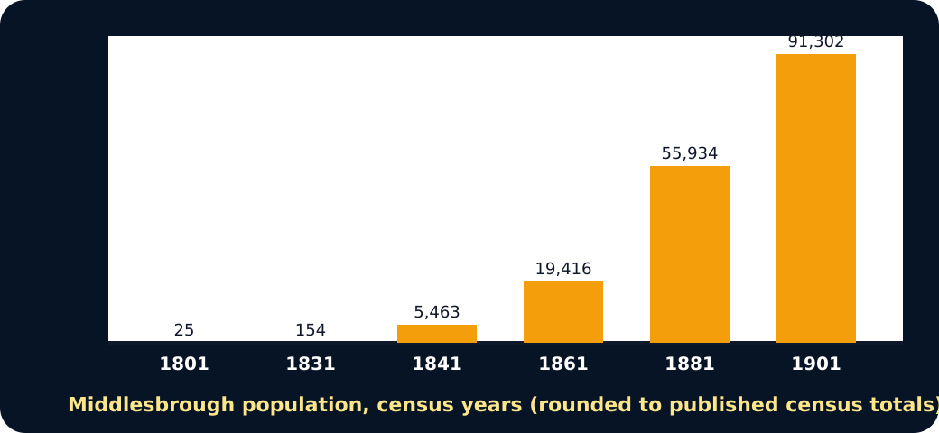
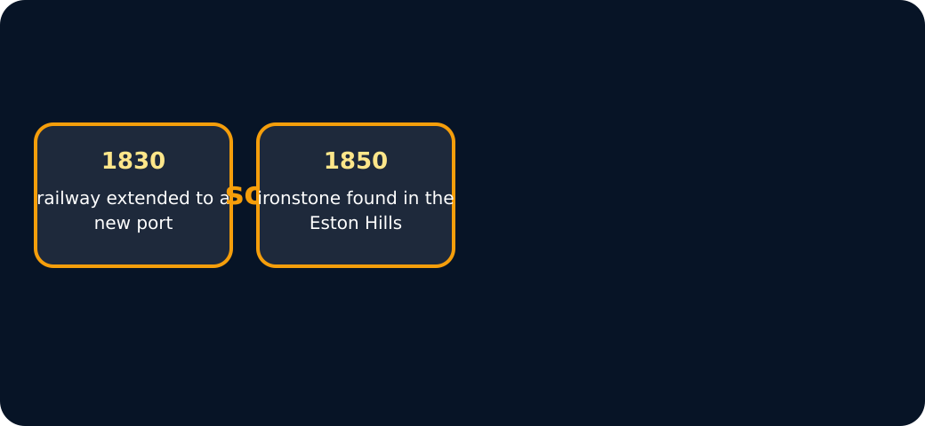
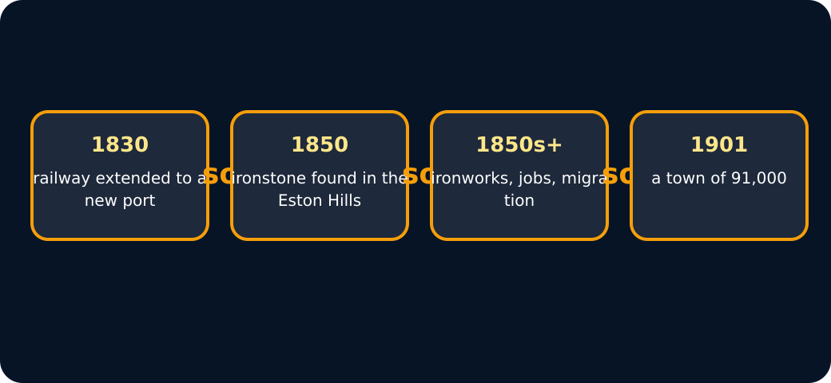
LAUNCH / HUMANITIES
STARTER
Starter · enquiry / tension
Bar chart of Middlesbrough population growth 1801 to 1901
Causal chain: railway then ironstone
Full causal chain to 1901
STARTER · 3 min across this stage
5 / 18
Notes:
Companion for LAUNCH_HUM_W10_Settlement_And_Urbanisation.html. Starter: 3 minutes TOTAL across all slides in this stage.
Elicit a provisional geographical judgement before explanation.
Do not use a public vote to validate reasoning.
Full source-stage teaching text:
Enquiry
Why do settlements grow, and who experiences the effects differently?
QUESTION / HYPOTHESIS
From 25 people to 91,000 in a century. Why here, and why then?
MAP / DATA / METHOD
A causal chain joins events with so . Each link needs evidence.
PATTERN + ANOMALY
Counter-factor: Stockton had the river first. Why did it not grow as fast?
JUDGEMENT + LIMIT
Weigh the factors. Then say which mattered most — and what the evidence cannot settle.
HTML controls remain in the original HTML file. PowerPoint contains editable teaching text and static source visuals; use the paper response route for sorting and investigation.
[Sources]
Uploaded lesson: LAUNCH_HUM_W10_Settlement_And_Urbanisation.html
[/Sources]

Slide 6
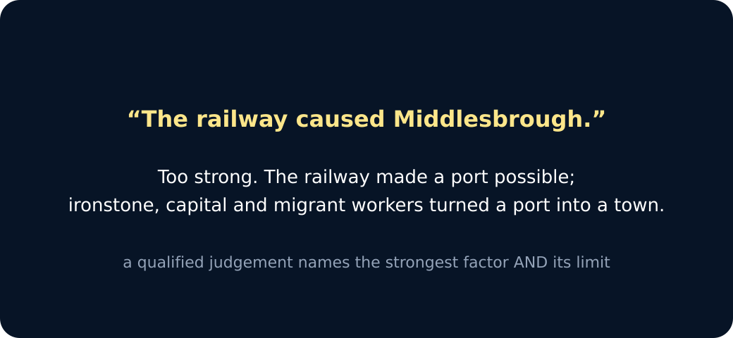
LAUNCH / HUMANITIES
STARTER
Starter · enquiry / tension
A qualified judgement
STARTER · 3 min across this stage
6 / 18
Notes:
Companion for LAUNCH_HUM_W10_Settlement_And_Urbanisation.html. Starter: 3 minutes TOTAL across all slides in this stage.
Elicit a provisional geographical judgement before explanation.
Do not use a public vote to validate reasoning.
Full source-stage teaching text:
Enquiry
Why do settlements grow, and who experiences the effects differently?
QUESTION / HYPOTHESIS
From 25 people to 91,000 in a century. Why here, and why then?
MAP / DATA / METHOD
A causal chain joins events with so . Each link needs evidence.
PATTERN + ANOMALY
Counter-factor: Stockton had the river first. Why did it not grow as fast?
JUDGEMENT + LIMIT
Weigh the factors. Then say which mattered most — and what the evidence cannot settle.
HTML controls remain in the original HTML file. PowerPoint contains editable teaching text and static source visuals; use the paper response route for sorting and investigation.
[Sources]
Uploaded lesson: LAUNCH_HUM_W10_Settlement_And_Urbanisation.html
[/Sources]

Slide 7
LAUNCH / HUMANITIES
I DO
I Do · model geographical reasoning
Model one reasoning step at a time.
Settlement growth is change in one settlement; urbanisation is a rising share of people living in urban areas.
Build Driver → Process → Spatial change → Impact, rather than listing disconnected causes.
Use jobs, transport, housing, services and migration as interacting factors, not a single automatic cause.
Causal chain builder · choose the links in order, then weigh them
I DO · 4 min across this stage
7 / 18
Notes:
Companion for LAUNCH_HUM_W10_Settlement_And_Urbanisation.html. I do: 4 minutes TOTAL across all slides in this stage.
Model one evidence-to-judgement step at a time.
Ask the learner to name the evidence used in each step.
Full source-stage teaching text:
Model one reasoning step at a time.
Settlement growth is change in one settlement; urbanisation is a rising share of people living in urban areas.
Build Driver → Process → Spatial change → Impact, rather than listing disconnected causes.
Use jobs, transport, housing, services and migration as interacting factors, not a single automatic cause.
Causal chain builder · press the links in order, then weigh them
Dates: railway extension 1830 · ironstone found in the Eston Hills 1850 · census totals 1841 5,463 → 1861 19,416 → 1901 91,302. Check against the source pack before quoting.
Ironworks open; workers arrive from Wales, Ireland, Scotland and the countryside
1830: the railway is extended to a new coal port on the Tees
1901: population passes 90,000
1850: ironstone is found in the Eston Hills, close to the port
Chain: —
Weigh a counter-factor
Stockton had the river first — so the river alone cannot explain it
The coal port was slow at first — so the railway alone cannot explain it
The town needed people to choose to move — so growth also depended on migrants
Each counter-factor limits one claim. Press to see which.
Judgement: the railway caused the town
Judgement: ironstone was decisive, but only because the railway and port already existed
Which judgement is qualified?
HTML controls remain in the original HTML file. PowerPoint contains editable teaching text and static source visuals; use the paper response route for sorting and investigation.
[Sources]
Uploaded lesson: LAUNCH_HUM_W10_Settlement_And_Urbanisation.html
[/Sources]

Slide 8
LAUNCH / HUMANITIES
I DO
I Do · model geographical reasoning
Dates: railway extension 1830 · ironstone found in the Eston Hills 1850 · census totals 1841 5,463 → 1861 19,416 → 1901 91,302. Check against the source pack before quoting.
A. Ironworks open; workers arrive from Wales, Ireland, Scotland and the countryside
B. 1830: the railway is extended to a new coal port on the Tees
C. 1901: population passes 90,000
D. 1850: ironstone is found in the Eston Hills, close to the port
I DO · 4 min across this stage
8 / 18
Notes:
Companion for LAUNCH_HUM_W10_Settlement_And_Urbanisation.html. I do: 4 minutes TOTAL across all slides in this stage.
Model one evidence-to-judgement step at a time.
Ask the learner to name the evidence used in each step.
Full source-stage teaching text:
Model one reasoning step at a time.
Settlement growth is change in one settlement; urbanisation is a rising share of people living in urban areas.
Build Driver → Process → Spatial change → Impact, rather than listing disconnected causes.
Use jobs, transport, housing, services and migration as interacting factors, not a single automatic cause.
Causal chain builder · press the links in order, then weigh them
Dates: railway extension 1830 · ironstone found in the Eston Hills 1850 · census totals 1841 5,463 → 1861 19,416 → 1901 91,302. Check against the source pack before quoting.
Ironworks open; workers arrive from Wales, Ireland, Scotland and the countryside
1830: the railway is extended to a new coal port on the Tees
1901: population passes 90,000
1850: ironstone is found in the Eston Hills, close to the port
Chain: —
Weigh a counter-factor
Stockton had the river first — so the river alone cannot explain it
The coal port was slow at first — so the railway alone cannot explain it
The town needed people to choose to move — so growth also depended on migrants
Each counter-factor limits one claim. Press to see which.
Judgement: the railway caused the town
Judgement: ironstone was decisive, but only because the railway and port already existed
Which judgement is qualified?
HTML controls remain in the original HTML file. PowerPoint contains editable teaching text and static source visuals; use the paper response route for sorting and investigation.
[Sources]
Uploaded lesson: LAUNCH_HUM_W10_Settlement_And_Urbanisation.html
[/Sources]

Slide 9
LAUNCH / HUMANITIES
I DO
I Do · model geographical reasoning
Chain: —
Weigh a counter-factor
A. Stockton had the river first — so the river alone cannot explain it
B. The coal port was slow at first — so the railway alone cannot explain it
C. The town needed people to choose to move — so growth also depended on migrants
Each counter-factor limits one claim. Choose to see which.
I DO · 4 min across this stage
9 / 18
Notes:
Companion for LAUNCH_HUM_W10_Settlement_And_Urbanisation.html. I do: 4 minutes TOTAL across all slides in this stage.
Model one evidence-to-judgement step at a time.
Ask the learner to name the evidence used in each step.
Full source-stage teaching text:
Model one reasoning step at a time.
Settlement growth is change in one settlement; urbanisation is a rising share of people living in urban areas.
Build Driver → Process → Spatial change → Impact, rather than listing disconnected causes.
Use jobs, transport, housing, services and migration as interacting factors, not a single automatic cause.
Causal chain builder · press the links in order, then weigh them
Dates: railway extension 1830 · ironstone found in the Eston Hills 1850 · census totals 1841 5,463 → 1861 19,416 → 1901 91,302. Check against the source pack before quoting.
Ironworks open; workers arrive from Wales, Ireland, Scotland and the countryside
1830: the railway is extended to a new coal port on the Tees
1901: population passes 90,000
1850: ironstone is found in the Eston Hills, close to the port
Chain: —
Weigh a counter-factor
Stockton had the river first — so the river alone cannot explain it
The coal port was slow at first — so the railway alone cannot explain it
The town needed people to choose to move — so growth also depended on migrants
Each counter-factor limits one claim. Press to see which.
Judgement: the railway caused the town
Judgement: ironstone was decisive, but only because the railway and port already existed
Which judgement is qualified?
HTML controls remain in the original HTML file. PowerPoint contains editable teaching text and static source visuals; use the paper response route for sorting and investigation.
[Sources]
Uploaded lesson: LAUNCH_HUM_W10_Settlement_And_Urbanisation.html
[/Sources]

Slide 10
LAUNCH / HUMANITIES
I DO
I Do · model geographical reasoning
A. Judgement: the railway caused the town
B. Judgement: ironstone was decisive, but only because the railway and port already existed
Which judgement is qualified?
I DO · 4 min across this stage
10 / 18
Notes:
Companion for LAUNCH_HUM_W10_Settlement_And_Urbanisation.html. I do: 4 minutes TOTAL across all slides in this stage.
Model one evidence-to-judgement step at a time.
Ask the learner to name the evidence used in each step.
Full source-stage teaching text:
Model one reasoning step at a time.
Settlement growth is change in one settlement; urbanisation is a rising share of people living in urban areas.
Build Driver → Process → Spatial change → Impact, rather than listing disconnected causes.
Use jobs, transport, housing, services and migration as interacting factors, not a single automatic cause.
Causal chain builder · press the links in order, then weigh them
Dates: railway extension 1830 · ironstone found in the Eston Hills 1850 · census totals 1841 5,463 → 1861 19,416 → 1901 91,302. Check against the source pack before quoting.
Ironworks open; workers arrive from Wales, Ireland, Scotland and the countryside
1830: the railway is extended to a new coal port on the Tees
1901: population passes 90,000
1850: ironstone is found in the Eston Hills, close to the port
Chain: —
Weigh a counter-factor
Stockton had the river first — so the river alone cannot explain it
The coal port was slow at first — so the railway alone cannot explain it
The town needed people to choose to move — so growth also depended on migrants
Each counter-factor limits one claim. Press to see which.
Judgement: the railway caused the town
Judgement: ironstone was decisive, but only because the railway and port already existed
Which judgement is qualified?
HTML controls remain in the original HTML file. PowerPoint contains editable teaching text and static source visuals; use the paper response route for sorting and investigation.
[Sources]
Uploaded lesson: LAUNCH_HUM_W10_Settlement_And_Urbanisation.html
[/Sources]

Slide 11
LAUNCH / HUMANITIES
WE DO
We Do · hinge judgement
Commit before reveal: Which evidence most directly demonstrates urbanisation?
A. One town’s population rises.
B. New homes are built beside a road.
C. The fictional region’s urban population share rises from 54% to 67%.
WE DO · 3 min across this stage
11 / 18
Notes:
Companion for LAUNCH_HUM_W10_Settlement_And_Urbanisation.html. We do: 3 minutes TOTAL across all slides in this stage.
Require a reason before giving feedback.
Secure → transfer or counter-evidence. Not yet → return to the key evidence and retry.
Ask every learner to commit privately before feedback. Use the pupil cards, table or evidence sheet; pointing, saying, signing and directing a partner are valid routes.
Full source-stage teaching text:
Commit before reveal: Which evidence most directly demonstrates urbanisation?
One town’s population rises.
New homes are built beside a road.
The fictional region’s urban population share rises from 54% to 67%.
HTML controls remain in the original HTML file. PowerPoint contains editable teaching text and static source visuals; use the paper response route for sorting and investigation.
[Sources]
Uploaded lesson: LAUNCH_HUM_W10_Settlement_And_Urbanisation.html
[/Sources]

Slide 12
LAUNCH / HUMANITIES
I DO 2
I Do 2 · counter / qualification
Strengthen—not lengthen—the reasoning.
Consequences are uneven: identify who gains, who bears a cost and at what scale.
Rank the strongest factor, then test it with a counter-factor or counterfactual.
Urban growth is not automatically positive or negative; a judgement must expose the trade-off.
I DO 2 · 3 min across this stage
12 / 18
Notes:
Companion for LAUNCH_HUM_W10_Settlement_And_Urbanisation.html. I do 2: 3 minutes TOTAL across all slides in this stage.
Raise challenge with counter-evidence, scale, alternative method or validity.
No volume-only stretch; keep access supports available.
Full source-stage teaching text:
Strengthen—not lengthen—the reasoning.
Consequences are uneven: identify who gains, who bears a cost and at what scale.
Rank the strongest factor, then test it with a counter-factor or counterfactual.
Urban growth is not automatically positive or negative; a judgement must expose the trade-off.
HTML controls remain in the original HTML file. PowerPoint contains editable teaching text and static source visuals; use the paper response route for sorting and investigation.
[Sources]
Uploaded lesson: LAUNCH_HUM_W10_Settlement_And_Urbanisation.html
[/Sources]

Slide 13
LAUNCH / HUMANITIES
WE DO 2
We Do 2 · interactive reasoning lab
Urban Futures Board
CONSTRUCTED CLASSROOM RESOURCE: This fictional composite is inspired by the broad Teesside setting. It is not official data, is not to scale and must not be used for navigation, safety or real-world planning.
Spend up to three planning tokens. Gauges are bounded 0–10 classroom indices, not official forecasts. There is no perfect score: defend the trade-off with evidence.
WE DO 2 · 4 min across this stage
13 / 18
Notes:
Companion for LAUNCH_HUM_W10_Settlement_And_Urbanisation.html. We do 2: 4 minutes TOTAL across all slides in this stage.
The learner makes the geographical choice; the interface is rehearsal only.
Use the response to adjust the independent question or scaffold.
Ask every learner to commit privately before feedback. Use the pupil cards, table or evidence sheet; pointing, saying, signing and directing a partner are valid routes.
Full source-stage teaching text:
Rehearsal only: the panel exposes reasoning. Clicks and screen states are not assessment or portfolio evidence.
Urban Futures Board
CONSTRUCTED CLASSROOM RESOURCE: This fictional composite is inspired by the broad Teesside setting. It is not official data, is not to scale and must not be used for navigation, safety or real-world planning.
Spend up to three planning tokens. Gauges are bounded 0–10 classroom indices, not official forecasts. There is no perfect score: defend the trade-off with evidence.
Brownfield homes
↗ Edge expansion
Bus investment
Riverside green
↺ Reset
● ● ●
Choose a policy. Then explain one gain, one cost and who experiences each.
HTML controls remain in the original HTML file. PowerPoint contains editable teaching text and static source visuals; use the paper response route for sorting and investigation.
[Sources]
Uploaded lesson: LAUNCH_HUM_W10_Settlement_And_Urbanisation.html
[/Sources]

Slide 14
LAUNCH / HUMANITIES
WE DO 2
We Do 2 · interactive reasoning lab
A. Brownfield homes
B. ↗ Edge expansion
C. Bus investment
D. Riverside green
E. ↺ Reset
● ● ●
Choose a policy. Then explain one gain, one cost and who experiences each.
WE DO 2 · 4 min across this stage
14 / 18
Notes:
Companion for LAUNCH_HUM_W10_Settlement_And_Urbanisation.html. We do 2: 4 minutes TOTAL across all slides in this stage.
The learner makes the geographical choice; the interface is rehearsal only.
Use the response to adjust the independent question or scaffold.
Ask every learner to commit privately before feedback. Use the pupil cards, table or evidence sheet; pointing, saying, signing and directing a partner are valid routes.
Full source-stage teaching text:
Rehearsal only: the panel exposes reasoning. Clicks and screen states are not assessment or portfolio evidence.
Urban Futures Board
CONSTRUCTED CLASSROOM RESOURCE: This fictional composite is inspired by the broad Teesside setting. It is not official data, is not to scale and must not be used for navigation, safety or real-world planning.
Spend up to three planning tokens. Gauges are bounded 0–10 classroom indices, not official forecasts. There is no perfect score: defend the trade-off with evidence.
Brownfield homes
↗ Edge expansion
Bus investment
Riverside green
↺ Reset
● ● ●
Choose a policy. Then explain one gain, one cost and who experiences each.
HTML controls remain in the original HTML file. PowerPoint contains editable teaching text and static source visuals; use the paper response route for sorting and investigation.
[Sources]
Uploaded lesson: LAUNCH_HUM_W10_Settlement_And_Urbanisation.html
[/Sources]

Slide 15
LAUNCH / HUMANITIES
INDEPENDENT
Independent · sustained evidence
Independent mission
I can explain settlement growth through a connected causal chain, weigh a counter-factor and reach a qualified judgement.
16 minutes. Approved access can change format, reading load or response mode; it cannot supply the geographical judgement.
Supported
Arrange the causal cards, add one time-series figure and explain one chain with because → therefore → however.
INDEPENDENT · 16 min across this stage
15 / 18
Notes:
Companion for LAUNCH_HUM_W10_Settlement_And_Urbanisation.html. Independent: 16 minutes TOTAL across all slides in this stage.
Protect learner ownership; fade content prompts while access remains.
Feedback should produce a substantive edit or re-attempt.
Full source-stage teaching text:
Independent mission
I can explain settlement growth through a connected causal chain, weigh a counter-factor and reach a qualified judgement.
16 minutes. Approved access can change format, reading load or response mode; it cannot supply the geographical judgement.
◆ Supported
Arrange the causal cards, add one time-series figure and explain one chain with because → therefore → however.
Supported access: causal-chain tiles and stakeholder icons; learner supplies the link.
Access stays; content prompts fade as independence grows.
▲ Standard
Use two quantified changes in a connected causal chain, then weigh a counter-factor or stakeholder trade-off.
Standard scaffold: driver → process → evidence → impact → however.
Access stays; content prompts fade as independence grows.
Stretch
Make a planning decision using two time-series figures, defend it from two stakeholder viewpoints and weigh a counter-policy.
Stretch scaffold: ranked factor → counter-factor/counterfactual → qualified verdict.
Access stays; content prompts fade as independence grows.
HTML controls remain in the original HTML file. PowerPoint contains editable teaching text and static source visuals; use the paper response route for sorting and investigation.
[Sources]
Uploaded lesson: LAUNCH_HUM_W10_Settlement_And_Urbanisation.html
[/Sources]

Slide 16
LAUNCH / HUMANITIES
INDEPENDENT
Independent · sustained evidence
Supported access: causal-chain tiles and stakeholder icons; learner supplies the link.
Standard
Use two quantified changes in a connected causal chain, then weigh a counter-factor or stakeholder trade-off.
Standard scaffold: driver → process → evidence → impact → however.
Stretch
INDEPENDENT · 16 min across this stage
16 / 18
Notes:
Companion for LAUNCH_HUM_W10_Settlement_And_Urbanisation.html. Independent: 16 minutes TOTAL across all slides in this stage.
Protect learner ownership; fade content prompts while access remains.
Feedback should produce a substantive edit or re-attempt.
Full source-stage teaching text:
Independent mission
I can explain settlement growth through a connected causal chain, weigh a counter-factor and reach a qualified judgement.
16 minutes. Approved access can change format, reading load or response mode; it cannot supply the geographical judgement.
◆ Supported
Arrange the causal cards, add one time-series figure and explain one chain with because → therefore → however.
Supported access: causal-chain tiles and stakeholder icons; learner supplies the link.
Access stays; content prompts fade as independence grows.
▲ Standard
Use two quantified changes in a connected causal chain, then weigh a counter-factor or stakeholder trade-off.
Standard scaffold: driver → process → evidence → impact → however.
Access stays; content prompts fade as independence grows.
Stretch
Make a planning decision using two time-series figures, defend it from two stakeholder viewpoints and weigh a counter-policy.
Stretch scaffold: ranked factor → counter-factor/counterfactual → qualified verdict.
Access stays; content prompts fade as independence grows.
HTML controls remain in the original HTML file. PowerPoint contains editable teaching text and static source visuals; use the paper response route for sorting and investigation.
[Sources]
Uploaded lesson: LAUNCH_HUM_W10_Settlement_And_Urbanisation.html
[/Sources]

Slide 17
LAUNCH / HUMANITIES
INDEPENDENT
Independent · sustained evidence
Make a planning decision using two time-series figures, defend it from two stakeholder viewpoints and weigh a counter-policy.
Stretch scaffold: ranked factor → counter-factor/counterfactual → qualified verdict.
INDEPENDENT · 16 min across this stage
17 / 18
Notes:
Companion for LAUNCH_HUM_W10_Settlement_And_Urbanisation.html. Independent: 16 minutes TOTAL across all slides in this stage.
Protect learner ownership; fade content prompts while access remains.
Feedback should produce a substantive edit or re-attempt.
Full source-stage teaching text:
Independent mission
I can explain settlement growth through a connected causal chain, weigh a counter-factor and reach a qualified judgement.
16 minutes. Approved access can change format, reading load or response mode; it cannot supply the geographical judgement.
◆ Supported
Arrange the causal cards, add one time-series figure and explain one chain with because → therefore → however.
Supported access: causal-chain tiles and stakeholder icons; learner supplies the link.
Access stays; content prompts fade as independence grows.
▲ Standard
Use two quantified changes in a connected causal chain, then weigh a counter-factor or stakeholder trade-off.
Standard scaffold: driver → process → evidence → impact → however.
Access stays; content prompts fade as independence grows.
Stretch
Make a planning decision using two time-series figures, defend it from two stakeholder viewpoints and weigh a counter-policy.
Stretch scaffold: ranked factor → counter-factor/counterfactual → qualified verdict.
Access stays; content prompts fade as independence grows.
HTML controls remain in the original HTML file. PowerPoint contains editable teaching text and static source visuals; use the paper response route for sorting and investigation.
[Sources]
Uploaded lesson: LAUNCH_HUM_W10_Settlement_And_Urbanisation.html
[/Sources]

Slide 18
LAUNCH / HUMANITIES
EXIT
Exit · evidence → response → Influence
VOICE: Complete: Urbanisation is more than population growth because… Then state the strongest evidence limit.
EXIT · 4 min across this stage
18 / 18
Notes:
Companion for LAUNCH_HUM_W10_Settlement_And_Urbanisation.html. Exit: 4 minutes TOTAL across all slides in this stage.
Receive the actual response; record product, route and highest content prompt.
Change the next source, question, scaffold or method and explain what changed.
Full source-stage teaching text:
LAUNCH Humanities close
VOICE: Complete: Urbanisation is more than population growth because… Then state the strongest evidence limit.
AUDIENCE: a named adult genuinely engages with the response before recording.
INFLUENCE: The selected consequence becomes W11’s fieldwork variable or desk-based enquiry.
HTML controls remain in the original HTML file. PowerPoint contains editable teaching text and static source visuals; use the paper response route for sorting and investigation.
[Sources]
Uploaded lesson: LAUNCH_HUM_W10_Settlement_And_Urbanisation.html
[/Sources]

