Slide 1
LAUNCH / HUMANITIES
OVERVIEW
Local Fieldwork · Test the Claim
I can design and use a repeatable sampling method, identify bias and apply ethical and safety controls.
Open the original interactive lesson
40 MINUTES
1 / 18
Notes:
Companion for LAUNCH_HUM_W11_Local_Fieldwork_Collect_Data.html. Overview: 0 minutes TOTAL across all slides in this stage.
Check the approved source/data pack, access route and lesson boundary before pupils arrive.
Stable Space first. Replace inaccessible format before reducing geographical demand.
Full source-stage teaching text:
Place, Settlement & Urbanisation · Identity & Belonging · Autumn 2
Learning objective: I can design and use a repeatable sampling method, identify bias and apply ethical and safety controls.
GIS → URBANISATION → FIELDWORK → DATA → COMPARE → VERDICT
KS3 National Curriculum Geography + KS4 GCSE/UAS bridge. Developmental language is not a GCSE grade. Exact UAS unit, version and outcomes remain centre-controlled.
HTML controls remain in the original HTML file. PowerPoint contains editable teaching text and static source visuals; use the paper response route for sorting and investigation.
[Sources]
Uploaded lesson: LAUNCH_HUM_W11_Local_Fieldwork_Collect_Data.html
[/Sources]

Slide 2
LAUNCH / HUMANITIES
ARRIVAL
Arrival · retrieve and reconnect
Standard
Turn a W10 claim into a measurable question with one variable.
ARRIVAL · 3 min across this stage
2 / 18
Notes:
Companion for LAUNCH_HUM_W11_Local_Fieldwork_Collect_Data.html. Arrival: 3 minutes TOTAL across all slides in this stage.
Give quiet retrieval time and the smallest useful cue.
Secure → step back. Access block → change format, not the geographical demand.
Full source-stage teaching text:
▲ Standard
Turn a W10 claim into a measurable question with one variable.
HTML controls remain in the original HTML file. PowerPoint contains editable teaching text and static source visuals; use the paper response route for sorting and investigation.
[Sources]
Uploaded lesson: LAUNCH_HUM_W11_Local_Fieldwork_Collect_Data.html
[/Sources]

Slide 3
LAUNCH / HUMANITIES
STARTER
Starter · enquiry / tension
Enquiry
How can we collect safe, fair and repeatable local fieldwork evidence?
QUESTION / HYPOTHESIS
Write the question so a sample can answer it.
MAP / DATA / METHOD
Systematic: every 60 m. Repeatable by someone else.
PATTERN + ANOMALY
STARTER · 3 min across this stage
3 / 18
Notes:
Companion for LAUNCH_HUM_W11_Local_Fieldwork_Collect_Data.html. Starter: 3 minutes TOTAL across all slides in this stage.
Elicit a provisional geographical judgement before explanation.
Do not use a public vote to validate reasoning.
Full source-stage teaching text:
Enquiry
How can we collect safe, fair and repeatable local fieldwork evidence?
QUESTION / HYPOTHESIS
Write the question so a sample can answer it.
MAP / DATA / METHOD
Systematic: every 60 m. Repeatable by someone else.
PATTERN + ANOMALY
Convenience: all eight points by the school gate. Bias — the sample cannot represent the street.
JUDGEMENT + LIMIT
Controls are part of the method, not an afterthought.
HTML controls remain in the original HTML file. PowerPoint contains editable teaching text and static source visuals; use the paper response route for sorting and investigation.
[Sources]
Uploaded lesson: LAUNCH_HUM_W11_Local_Fieldwork_Collect_Data.html
[/Sources]

Slide 4
LAUNCH / HUMANITIES
STARTER
Starter · enquiry / tension
Convenience: all eight points by the school gate. Bias — the sample cannot represent the street.
JUDGEMENT + LIMIT
Controls are part of the method, not an afterthought.
STARTER · 3 min across this stage
4 / 18
Notes:
Companion for LAUNCH_HUM_W11_Local_Fieldwork_Collect_Data.html. Starter: 3 minutes TOTAL across all slides in this stage.
Elicit a provisional geographical judgement before explanation.
Do not use a public vote to validate reasoning.
Full source-stage teaching text:
Enquiry
How can we collect safe, fair and repeatable local fieldwork evidence?
QUESTION / HYPOTHESIS
Write the question so a sample can answer it.
MAP / DATA / METHOD
Systematic: every 60 m. Repeatable by someone else.
PATTERN + ANOMALY
Convenience: all eight points by the school gate. Bias — the sample cannot represent the street.
JUDGEMENT + LIMIT
Controls are part of the method, not an afterthought.
HTML controls remain in the original HTML file. PowerPoint contains editable teaching text and static source visuals; use the paper response route for sorting and investigation.
[Sources]
Uploaded lesson: LAUNCH_HUM_W11_Local_Fieldwork_Collect_Data.html
[/Sources]

Slide 5
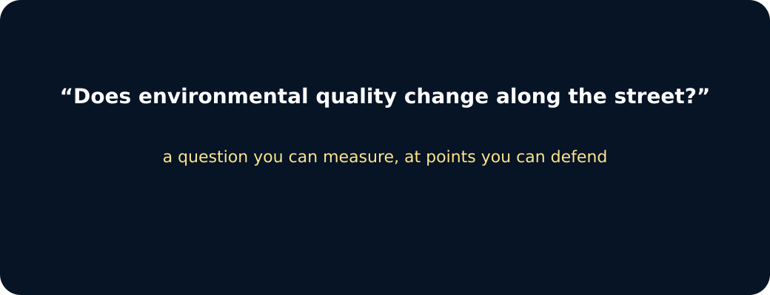
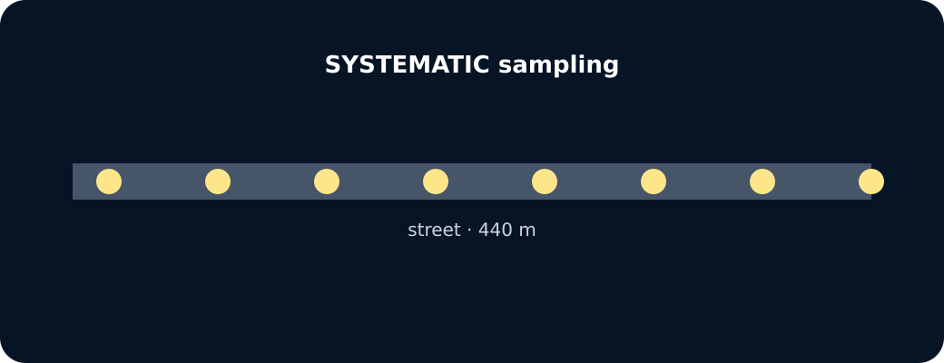
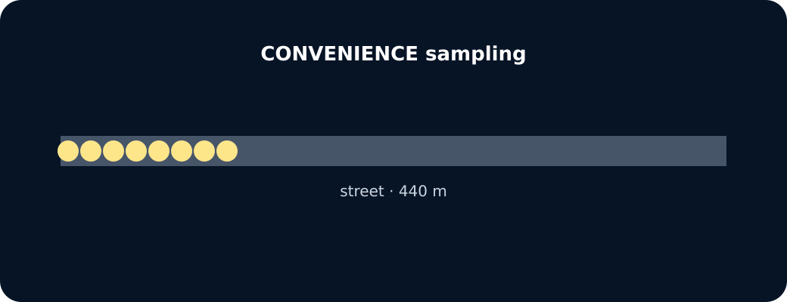
LAUNCH / HUMANITIES
STARTER
Starter · enquiry / tension
Question
Systematic transect
Convenience sampling
STARTER · 3 min across this stage
5 / 18
Notes:
Companion for LAUNCH_HUM_W11_Local_Fieldwork_Collect_Data.html. Starter: 3 minutes TOTAL across all slides in this stage.
Elicit a provisional geographical judgement before explanation.
Do not use a public vote to validate reasoning.
Full source-stage teaching text:
Enquiry
How can we collect safe, fair and repeatable local fieldwork evidence?
QUESTION / HYPOTHESIS
Write the question so a sample can answer it.
MAP / DATA / METHOD
Systematic: every 60 m. Repeatable by someone else.
PATTERN + ANOMALY
Convenience: all eight points by the school gate. Bias — the sample cannot represent the street.
JUDGEMENT + LIMIT
Controls are part of the method, not an afterthought.
HTML controls remain in the original HTML file. PowerPoint contains editable teaching text and static source visuals; use the paper response route for sorting and investigation.
[Sources]
Uploaded lesson: LAUNCH_HUM_W11_Local_Fieldwork_Collect_Data.html
[/Sources]

Slide 6
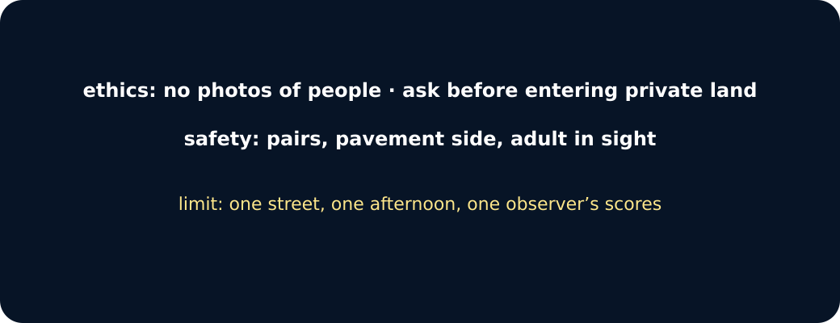
LAUNCH / HUMANITIES
STARTER
Starter · enquiry / tension
Ethics, safety, limit
STARTER · 3 min across this stage
6 / 18
Notes:
Companion for LAUNCH_HUM_W11_Local_Fieldwork_Collect_Data.html. Starter: 3 minutes TOTAL across all slides in this stage.
Elicit a provisional geographical judgement before explanation.
Do not use a public vote to validate reasoning.
Full source-stage teaching text:
Enquiry
How can we collect safe, fair and repeatable local fieldwork evidence?
QUESTION / HYPOTHESIS
Write the question so a sample can answer it.
MAP / DATA / METHOD
Systematic: every 60 m. Repeatable by someone else.
PATTERN + ANOMALY
Convenience: all eight points by the school gate. Bias — the sample cannot represent the street.
JUDGEMENT + LIMIT
Controls are part of the method, not an afterthought.
HTML controls remain in the original HTML file. PowerPoint contains editable teaching text and static source visuals; use the paper response route for sorting and investigation.
[Sources]
Uploaded lesson: LAUNCH_HUM_W11_Local_Fieldwork_Collect_Data.html
[/Sources]

Slide 7
LAUNCH / HUMANITIES
I DO
I Do · model geographical reasoning
Model one reasoning step at a time.
Write the enquiry first, then define each variable using observable criteria.
Choose systematic, random or stratified sampling because it answers the question—not because it is easiest.
Keep interval, duration and criteria constant; repeat observations before judging reliability.
I DO · 4 min across this stage
7 / 18
Notes:
Companion for LAUNCH_HUM_W11_Local_Fieldwork_Collect_Data.html. I do: 4 minutes TOTAL across all slides in this stage.
Model one evidence-to-judgement step at a time.
Ask the learner to name the evidence used in each step.
Full source-stage teaching text:
Model one reasoning step at a time.
Write the enquiry first, then define each variable using observable criteria.
Choose systematic, random or stratified sampling because it answers the question—not because it is easiest.
Keep interval, duration and criteria constant; repeat observations before judging reliability.
Sampling designer · pick a method, spot the bias
systematic
random
convenience
Systematic: equal spacing along the whole street. Repeatable, covers the range. Bias risk: a regular pattern in the street could line up with your interval.
Which control fixes which problem?
Two people score each site independently
Sample at the same time of day
Only sample where it is easy to stand
Controls, or a new bias?
HTML controls remain in the original HTML file. PowerPoint contains editable teaching text and static source visuals; use the paper response route for sorting and investigation.
[Sources]
Uploaded lesson: LAUNCH_HUM_W11_Local_Fieldwork_Collect_Data.html
[/Sources]

Slide 8
LAUNCH / HUMANITIES
I DO
I Do · model geographical reasoning
Sampling designer · pick a method, spot the bias
A. systematic
B. random
C. convenience
Systematic: equal spacing along the whole street. Repeatable, covers the range. Bias risk: a regular pattern in the street could line up with your interval.
I DO · 4 min across this stage
8 / 18
Notes:
Companion for LAUNCH_HUM_W11_Local_Fieldwork_Collect_Data.html. I do: 4 minutes TOTAL across all slides in this stage.
Model one evidence-to-judgement step at a time.
Ask the learner to name the evidence used in each step.
Full source-stage teaching text:
Model one reasoning step at a time.
Write the enquiry first, then define each variable using observable criteria.
Choose systematic, random or stratified sampling because it answers the question—not because it is easiest.
Keep interval, duration and criteria constant; repeat observations before judging reliability.
Sampling designer · pick a method, spot the bias
systematic
random
convenience
Systematic: equal spacing along the whole street. Repeatable, covers the range. Bias risk: a regular pattern in the street could line up with your interval.
Which control fixes which problem?
Two people score each site independently
Sample at the same time of day
Only sample where it is easy to stand
Controls, or a new bias?
HTML controls remain in the original HTML file. PowerPoint contains editable teaching text and static source visuals; use the paper response route for sorting and investigation.
[Sources]
Uploaded lesson: LAUNCH_HUM_W11_Local_Fieldwork_Collect_Data.html
[/Sources]

Slide 9
LAUNCH / HUMANITIES
I DO
I Do · model geographical reasoning
Which control fixes which problem?
A. Two people score each site independently
B. Sample at the same time of day
C. Only sample where it is easy to stand
I DO · 4 min across this stage
9 / 18
Notes:
Companion for LAUNCH_HUM_W11_Local_Fieldwork_Collect_Data.html. I do: 4 minutes TOTAL across all slides in this stage.
Model one evidence-to-judgement step at a time.
Ask the learner to name the evidence used in each step.
Full source-stage teaching text:
Model one reasoning step at a time.
Write the enquiry first, then define each variable using observable criteria.
Choose systematic, random or stratified sampling because it answers the question—not because it is easiest.
Keep interval, duration and criteria constant; repeat observations before judging reliability.
Sampling designer · pick a method, spot the bias
systematic
random
convenience
Systematic: equal spacing along the whole street. Repeatable, covers the range. Bias risk: a regular pattern in the street could line up with your interval.
Which control fixes which problem?
Two people score each site independently
Sample at the same time of day
Only sample where it is easy to stand
Controls, or a new bias?
HTML controls remain in the original HTML file. PowerPoint contains editable teaching text and static source visuals; use the paper response route for sorting and investigation.
[Sources]
Uploaded lesson: LAUNCH_HUM_W11_Local_Fieldwork_Collect_Data.html
[/Sources]

Slide 10
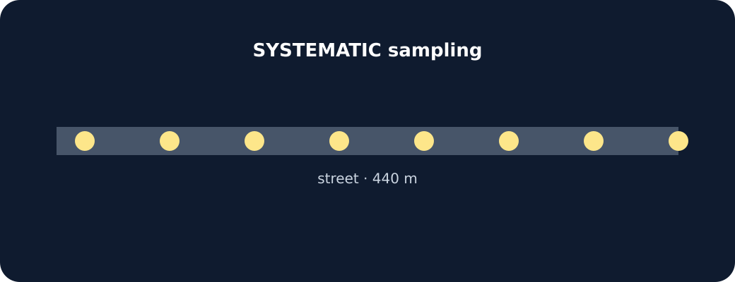
LAUNCH / HUMANITIES
I DO
I Do · model geographical reasoning
Sampling points along a street
I DO · 4 min across this stage
10 / 18
Notes:
Companion for LAUNCH_HUM_W11_Local_Fieldwork_Collect_Data.html. I do: 4 minutes TOTAL across all slides in this stage.
Model one evidence-to-judgement step at a time.
Ask the learner to name the evidence used in each step.
Full source-stage teaching text:
Model one reasoning step at a time.
Write the enquiry first, then define each variable using observable criteria.
Choose systematic, random or stratified sampling because it answers the question—not because it is easiest.
Keep interval, duration and criteria constant; repeat observations before judging reliability.
Sampling designer · pick a method, spot the bias
systematic
random
convenience
Systematic: equal spacing along the whole street. Repeatable, covers the range. Bias risk: a regular pattern in the street could line up with your interval.
Which control fixes which problem?
Two people score each site independently
Sample at the same time of day
Only sample where it is easy to stand
Controls, or a new bias?
HTML controls remain in the original HTML file. PowerPoint contains editable teaching text and static source visuals; use the paper response route for sorting and investigation.
[Sources]
Uploaded lesson: LAUNCH_HUM_W11_Local_Fieldwork_Collect_Data.html
[/Sources]

Slide 11
LAUNCH / HUMANITIES
WE DO
We Do · hinge judgement
Commit before reveal: Recording data every 120 m along the same transect is which sampling method?
A. Systematic sampling
B. Random sampling
C. Opportunity sampling
WE DO · 3 min across this stage
11 / 18
Notes:
Companion for LAUNCH_HUM_W11_Local_Fieldwork_Collect_Data.html. We do: 3 minutes TOTAL across all slides in this stage.
Require a reason before giving feedback.
Secure → transfer or counter-evidence. Not yet → return to the key evidence and retry.
Ask every learner to commit privately before feedback. Use the pupil cards, table or evidence sheet; pointing, saying, signing and directing a partner are valid routes.
Full source-stage teaching text:
Commit before reveal: Recording data every 120 m along the same transect is which sampling method?
Systematic sampling
Random sampling
Opportunity sampling
HTML controls remain in the original HTML file. PowerPoint contains editable teaching text and static source visuals; use the paper response route for sorting and investigation.
[Sources]
Uploaded lesson: LAUNCH_HUM_W11_Local_Fieldwork_Collect_Data.html
[/Sources]

Slide 12
LAUNCH / HUMANITIES
I DO 2
I Do 2 · counter / qualification
Strengthen—not lengthen—the reasoning.
Where authorised, the intended core is teacher-approved local/on-site micro-fieldwork under the centre risk assessment; the desk-based equivalent has equal curriculum status.
Do not collect names, faces, number plates, home locations, interviews or personal travel routes.
Record deviations and missing observations honestly; never invent a result to complete the table.
I DO 2 · 3 min across this stage
12 / 18
Notes:
Companion for LAUNCH_HUM_W11_Local_Fieldwork_Collect_Data.html. I do 2: 3 minutes TOTAL across all slides in this stage.
Raise challenge with counter-evidence, scale, alternative method or validity.
No volume-only stretch; keep access supports available.
Full source-stage teaching text:
Strengthen—not lengthen—the reasoning.
Where authorised, the intended core is teacher-approved local/on-site micro-fieldwork under the centre risk assessment; the desk-based equivalent has equal curriculum status.
Do not collect names, faces, number plates, home locations, interviews or personal travel routes.
Record deviations and missing observations honestly; never invent a result to complete the table.
HTML controls remain in the original HTML file. PowerPoint contains editable teaching text and static source visuals; use the paper response route for sorting and investigation.
[Sources]
Uploaded lesson: LAUNCH_HUM_W11_Local_Fieldwork_Collect_Data.html
[/Sources]

Slide 13
LAUNCH / HUMANITIES
WE DO 2
We Do 2 · interactive reasoning lab
Virtual Transect · equal-status fallback / method rehearsal
CONSTRUCTED CLASSROOM RESOURCE: This fictional composite is inspired by the broad Teesside setting. It is not official data, is not to scale and must not be used for navigation, safety or real-world planning.
Default enquiry: How do environmental quality and pedestrian activity vary with distance from the fictional Transit Gate?
WE DO 2 · 4 min across this stage
13 / 18
Notes:
Companion for LAUNCH_HUM_W11_Local_Fieldwork_Collect_Data.html. We do 2: 4 minutes TOTAL across all slides in this stage.
The learner makes the geographical choice; the interface is rehearsal only.
Use the response to adjust the independent question or scaffold.
Ask every learner to commit privately before feedback. Use the pupil cards, table or evidence sheet; pointing, saying, signing and directing a partner are valid routes.
Full source-stage teaching text:
Rehearsal only: the panel exposes reasoning. Clicks and screen states are not assessment or portfolio evidence.
Virtual Transect · equal-status fallback / method rehearsal
CONSTRUCTED CLASSROOM RESOURCE: This fictional composite is inspired by the broad Teesside setting. It is not official data, is not to scale and must not be used for navigation, safety or real-world planning.
Default enquiry: How do environmental quality and pedestrian activity vary with distance from the fictional Transit Gate?
Where local collection is authorised, use the approved on-site plan. This equal-status fallback rehearses or replaces collection when safety, access, absence or conditions require it. Use the fixed −2 to +2 litter, traffic, vegetation and upkeep descriptors in the complete resource pack.
↺ Clear sample
Select sites. Then judge whether your sampling pattern is systematic, selective or incomplete.
HTML controls remain in the original HTML file. PowerPoint contains editable teaching text and static source visuals; use the paper response route for sorting and investigation.
[Sources]
Uploaded lesson: LAUNCH_HUM_W11_Local_Fieldwork_Collect_Data.html
[/Sources]

Slide 14
LAUNCH / HUMANITIES
WE DO 2
We Do 2 · interactive reasoning lab
Where local collection is authorised, use the approved on-site plan. This equal-status fallback rehearses or replaces collection when safety, access, absence or conditions require it. Use the fixed −2 to +2 litter, traffic, vegetation and upkeep descriptors in the complete resource pack.
A. ↺ Clear sample
Select sites. Then judge whether your sampling pattern is systematic, selective or incomplete.
WE DO 2 · 4 min across this stage
14 / 18
Notes:
Companion for LAUNCH_HUM_W11_Local_Fieldwork_Collect_Data.html. We do 2: 4 minutes TOTAL across all slides in this stage.
The learner makes the geographical choice; the interface is rehearsal only.
Use the response to adjust the independent question or scaffold.
Ask every learner to commit privately before feedback. Use the pupil cards, table or evidence sheet; pointing, saying, signing and directing a partner are valid routes.
Full source-stage teaching text:
Rehearsal only: the panel exposes reasoning. Clicks and screen states are not assessment or portfolio evidence.
Virtual Transect · equal-status fallback / method rehearsal
CONSTRUCTED CLASSROOM RESOURCE: This fictional composite is inspired by the broad Teesside setting. It is not official data, is not to scale and must not be used for navigation, safety or real-world planning.
Default enquiry: How do environmental quality and pedestrian activity vary with distance from the fictional Transit Gate?
Where local collection is authorised, use the approved on-site plan. This equal-status fallback rehearses or replaces collection when safety, access, absence or conditions require it. Use the fixed −2 to +2 litter, traffic, vegetation and upkeep descriptors in the complete resource pack.
↺ Clear sample
Select sites. Then judge whether your sampling pattern is systematic, selective or incomplete.
HTML controls remain in the original HTML file. PowerPoint contains editable teaching text and static source visuals; use the paper response route for sorting and investigation.
[Sources]
Uploaded lesson: LAUNCH_HUM_W11_Local_Fieldwork_Collect_Data.html
[/Sources]

Slide 15
LAUNCH / HUMANITIES
INDEPENDENT
Independent · sustained evidence
Independent mission
I can design and use a repeatable sampling method, identify bias and apply ethical and safety controls.
16 minutes. Approved access can change format, reading load or response mode; it cannot supply the geographical judgement.
Supported
Complete the method builder, then collect or legitimately use at least four labelled observations and retain one safety, ethics or bias control.
INDEPENDENT · 16 min across this stage
15 / 18
Notes:
Companion for LAUNCH_HUM_W11_Local_Fieldwork_Collect_Data.html. Independent: 16 minutes TOTAL across all slides in this stage.
Protect learner ownership; fade content prompts while access remains.
Feedback should produce a substantive edit or re-attempt.
Full source-stage teaching text:
Independent mission
I can design and use a repeatable sampling method, identify bias and apply ethical and safety controls.
16 minutes. Approved access can change format, reading load or response mode; it cannot supply the geographical judgement.
◆ Supported
Complete the method builder, then collect or legitimately use at least four labelled observations and retain one safety, ethics or bias control.
Supported access: method headings, fixed descriptors and desk-based virtual transect.
Access stays; content prompts fade as independence grows.
▲ Standard
Write a replicable method, collect or legitimately use at least four labelled observations and evaluate two bias/safety controls.
Standard scaffold: question → variables → sample → repeat → record → evaluate.
Access stays; content prompts fade as independence grows.
Stretch
Apply the justified sampling method to at least four labelled observations, retain one safety/ethics control, then evaluate reliability and validity separately.
Stretch scaffold: compare sampling methods and expose bias, reliability and validity limits.
Access stays; content prompts fade as independence grows.
HTML controls remain in the original HTML file. PowerPoint contains editable teaching text and static source visuals; use the paper response route for sorting and investigation.
[Sources]
Uploaded lesson: LAUNCH_HUM_W11_Local_Fieldwork_Collect_Data.html
[/Sources]

Slide 16
LAUNCH / HUMANITIES
INDEPENDENT
Independent · sustained evidence
Supported access: method headings, fixed descriptors and desk-based virtual transect.
Standard
Write a replicable method, collect or legitimately use at least four labelled observations and evaluate two bias/safety controls.
Standard scaffold: question → variables → sample → repeat → record → evaluate.
Stretch
INDEPENDENT · 16 min across this stage
16 / 18
Notes:
Companion for LAUNCH_HUM_W11_Local_Fieldwork_Collect_Data.html. Independent: 16 minutes TOTAL across all slides in this stage.
Protect learner ownership; fade content prompts while access remains.
Feedback should produce a substantive edit or re-attempt.
Full source-stage teaching text:
Independent mission
I can design and use a repeatable sampling method, identify bias and apply ethical and safety controls.
16 minutes. Approved access can change format, reading load or response mode; it cannot supply the geographical judgement.
◆ Supported
Complete the method builder, then collect or legitimately use at least four labelled observations and retain one safety, ethics or bias control.
Supported access: method headings, fixed descriptors and desk-based virtual transect.
Access stays; content prompts fade as independence grows.
▲ Standard
Write a replicable method, collect or legitimately use at least four labelled observations and evaluate two bias/safety controls.
Standard scaffold: question → variables → sample → repeat → record → evaluate.
Access stays; content prompts fade as independence grows.
Stretch
Apply the justified sampling method to at least four labelled observations, retain one safety/ethics control, then evaluate reliability and validity separately.
Stretch scaffold: compare sampling methods and expose bias, reliability and validity limits.
Access stays; content prompts fade as independence grows.
HTML controls remain in the original HTML file. PowerPoint contains editable teaching text and static source visuals; use the paper response route for sorting and investigation.
[Sources]
Uploaded lesson: LAUNCH_HUM_W11_Local_Fieldwork_Collect_Data.html
[/Sources]

Slide 17
LAUNCH / HUMANITIES
INDEPENDENT
Independent · sustained evidence
Apply the justified sampling method to at least four labelled observations, retain one safety/ethics control, then evaluate reliability and validity separately.
Stretch scaffold: compare sampling methods and expose bias, reliability and validity limits.
INDEPENDENT · 16 min across this stage
17 / 18
Notes:
Companion for LAUNCH_HUM_W11_Local_Fieldwork_Collect_Data.html. Independent: 16 minutes TOTAL across all slides in this stage.
Protect learner ownership; fade content prompts while access remains.
Feedback should produce a substantive edit or re-attempt.
Full source-stage teaching text:
Independent mission
I can design and use a repeatable sampling method, identify bias and apply ethical and safety controls.
16 minutes. Approved access can change format, reading load or response mode; it cannot supply the geographical judgement.
◆ Supported
Complete the method builder, then collect or legitimately use at least four labelled observations and retain one safety, ethics or bias control.
Supported access: method headings, fixed descriptors and desk-based virtual transect.
Access stays; content prompts fade as independence grows.
▲ Standard
Write a replicable method, collect or legitimately use at least four labelled observations and evaluate two bias/safety controls.
Standard scaffold: question → variables → sample → repeat → record → evaluate.
Access stays; content prompts fade as independence grows.
Stretch
Apply the justified sampling method to at least four labelled observations, retain one safety/ethics control, then evaluate reliability and validity separately.
Stretch scaffold: compare sampling methods and expose bias, reliability and validity limits.
Access stays; content prompts fade as independence grows.
HTML controls remain in the original HTML file. PowerPoint contains editable teaching text and static source visuals; use the paper response route for sorting and investigation.
[Sources]
Uploaded lesson: LAUNCH_HUM_W11_Local_Fieldwork_Collect_Data.html
[/Sources]

Slide 18
LAUNCH / HUMANITIES
EXIT
Exit · evidence → response → Influence
VOICE: State the sampling method, one control that made it fair and one remaining limitation.
EXIT · 4 min across this stage
18 / 18
Notes:
Companion for LAUNCH_HUM_W11_Local_Fieldwork_Collect_Data.html. Exit: 4 minutes TOTAL across all slides in this stage.
Receive the actual response; record product, route and highest content prompt.
Change the next source, question, scaffold or method and explain what changed.
Full source-stage teaching text:
LAUNCH Humanities close
VOICE: State the sampling method, one control that made it fair and one remaining limitation.
AUDIENCE: a named adult genuinely engages with the response before recording.
INFLUENCE: The class agrees which raw observations are legitimate enough to enter W12; missing values stay missing.
HTML controls remain in the original HTML file. PowerPoint contains editable teaching text and static source visuals; use the paper response route for sorting and investigation.
[Sources]
Uploaded lesson: LAUNCH_HUM_W11_Local_Fieldwork_Collect_Data.html
[/Sources]

