Slide 1
LAUNCH / HUMANITIES
OVERVIEW
Fieldwork Data Lab · Pattern & Anomaly
I can check and present fieldwork data in a suitable graph, then interpret pattern, anomaly and reliability.
Open the original interactive lesson
40 MINUTES
1 / 19
Notes:
Companion for LAUNCH_HUM_W12_Fieldwork_Data_Graphs.html. Overview: 0 minutes TOTAL across all slides in this stage.
Check the approved source/data pack, access route and lesson boundary before pupils arrive.
Stable Space first. Replace inaccessible format before reducing geographical demand.
Full source-stage teaching text:
Place, Settlement & Urbanisation · Identity & Belonging · Autumn 2
Learning objective: I can check and present fieldwork data in a suitable graph, then interpret pattern, anomaly and reliability.
GIS → URBANISATION → FIELDWORK → DATA → COMPARE → VERDICT
KS3 National Curriculum Geography + KS4 GCSE/UAS bridge. Developmental language is not a GCSE grade. Exact UAS unit, version and outcomes remain centre-controlled.
HTML controls remain in the original HTML file. PowerPoint contains editable teaching text and static source visuals; use the paper response route for sorting and investigation.
[Sources]
Uploaded lesson: LAUNCH_HUM_W12_Fieldwork_Data_Graphs.html
[/Sources]

Slide 2
LAUNCH / HUMANITIES
ARRIVAL
Arrival · retrieve and reconnect
Standard
Retrieve one W11 pattern and identify one missing or unreliable value.
ARRIVAL · 3 min across this stage
2 / 19
Notes:
Companion for LAUNCH_HUM_W12_Fieldwork_Data_Graphs.html. Arrival: 3 minutes TOTAL across all slides in this stage.
Give quiet retrieval time and the smallest useful cue.
Secure → step back. Access block → change format, not the geographical demand.
Full source-stage teaching text:
▲ Standard
Retrieve one W11 pattern and identify one missing or unreliable value.
HTML controls remain in the original HTML file. PowerPoint contains editable teaching text and static source visuals; use the paper response route for sorting and investigation.
[Sources]
Uploaded lesson: LAUNCH_HUM_W12_Fieldwork_Data_Graphs.html
[/Sources]

Slide 3
LAUNCH / HUMANITIES
STARTER
Starter · enquiry / tension
Enquiry
Which representation makes the fieldwork pattern clearest without distorting it?
QUESTION / HYPOTHESIS
A hypothesis is a claim the data can contradict.
MAP / DATA / METHOD
Right graph for the data: category per site → bar chart.
PATTERN + ANOMALY
STARTER · 3 min across this stage
3 / 19
Notes:
Companion for LAUNCH_HUM_W12_Fieldwork_Data_Graphs.html. Starter: 3 minutes TOTAL across all slides in this stage.
Elicit a provisional geographical judgement before explanation.
Do not use a public vote to validate reasoning.
Full source-stage teaching text:
Enquiry
Which representation makes the fieldwork pattern clearest without distorting it?
QUESTION / HYPOTHESIS
A hypothesis is a claim the data can contradict.
MAP / DATA / METHOD
Right graph for the data: category per site → bar chart.
PATTERN + ANOMALY
Pattern: falling. Anomaly: site 5. Do not delete it — explain or re-sample it.
JUDGEMENT + LIMIT
Pattern, anomaly, reliability — all three in the write-up.
HTML controls remain in the original HTML file. PowerPoint contains editable teaching text and static source visuals; use the paper response route for sorting and investigation.
[Sources]
Uploaded lesson: LAUNCH_HUM_W12_Fieldwork_Data_Graphs.html
[/Sources]

Slide 4
LAUNCH / HUMANITIES
STARTER
Starter · enquiry / tension
Pattern: falling. Anomaly: site 5. Do not delete it — explain or re-sample it.
JUDGEMENT + LIMIT
Pattern, anomaly, reliability — all three in the write-up.
STARTER · 3 min across this stage
4 / 19
Notes:
Companion for LAUNCH_HUM_W12_Fieldwork_Data_Graphs.html. Starter: 3 minutes TOTAL across all slides in this stage.
Elicit a provisional geographical judgement before explanation.
Do not use a public vote to validate reasoning.
Full source-stage teaching text:
Enquiry
Which representation makes the fieldwork pattern clearest without distorting it?
QUESTION / HYPOTHESIS
A hypothesis is a claim the data can contradict.
MAP / DATA / METHOD
Right graph for the data: category per site → bar chart.
PATTERN + ANOMALY
Pattern: falling. Anomaly: site 5. Do not delete it — explain or re-sample it.
JUDGEMENT + LIMIT
Pattern, anomaly, reliability — all three in the write-up.
HTML controls remain in the original HTML file. PowerPoint contains editable teaching text and static source visuals; use the paper response route for sorting and investigation.
[Sources]
Uploaded lesson: LAUNCH_HUM_W12_Fieldwork_Data_Graphs.html
[/Sources]

Slide 5
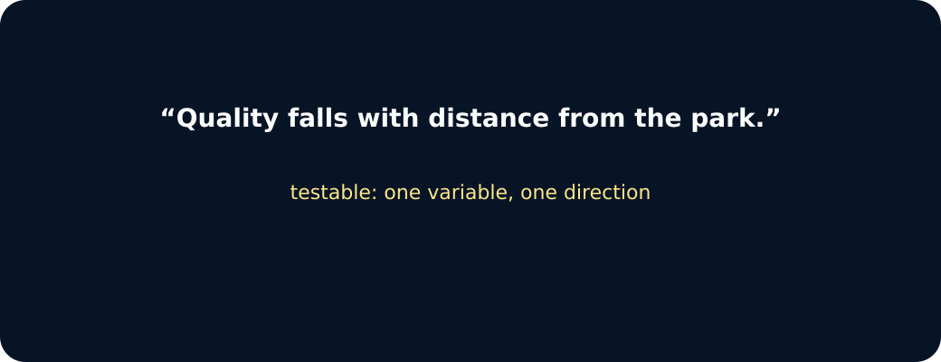
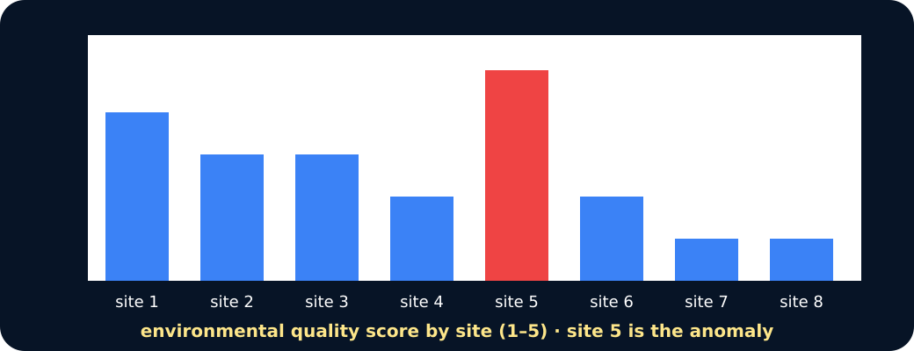

LAUNCH / HUMANITIES
STARTER
Starter · enquiry / tension
Hypothesis
Bar chart of site scores
Anomaly circled
STARTER · 3 min across this stage
5 / 19
Notes:
Companion for LAUNCH_HUM_W12_Fieldwork_Data_Graphs.html. Starter: 3 minutes TOTAL across all slides in this stage.
Elicit a provisional geographical judgement before explanation.
Do not use a public vote to validate reasoning.
Full source-stage teaching text:
Enquiry
Which representation makes the fieldwork pattern clearest without distorting it?
QUESTION / HYPOTHESIS
A hypothesis is a claim the data can contradict.
MAP / DATA / METHOD
Right graph for the data: category per site → bar chart.
PATTERN + ANOMALY
Pattern: falling. Anomaly: site 5. Do not delete it — explain or re-sample it.
JUDGEMENT + LIMIT
Pattern, anomaly, reliability — all three in the write-up.
HTML controls remain in the original HTML file. PowerPoint contains editable teaching text and static source visuals; use the paper response route for sorting and investigation.
[Sources]
Uploaded lesson: LAUNCH_HUM_W12_Fieldwork_Data_Graphs.html
[/Sources]

Slide 6
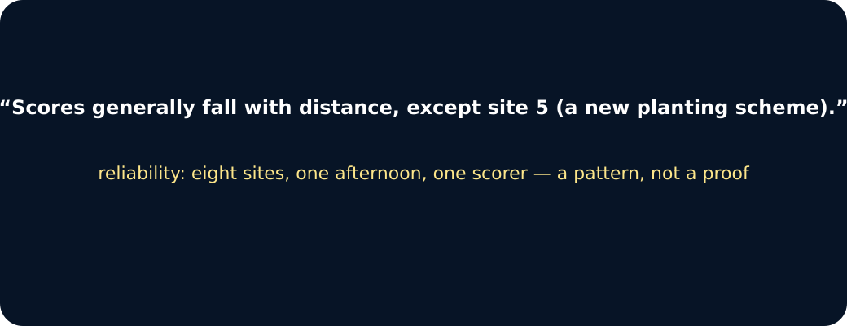
LAUNCH / HUMANITIES
STARTER
Starter · enquiry / tension
Judgement
STARTER · 3 min across this stage
6 / 19
Notes:
Companion for LAUNCH_HUM_W12_Fieldwork_Data_Graphs.html. Starter: 3 minutes TOTAL across all slides in this stage.
Elicit a provisional geographical judgement before explanation.
Do not use a public vote to validate reasoning.
Full source-stage teaching text:
Enquiry
Which representation makes the fieldwork pattern clearest without distorting it?
QUESTION / HYPOTHESIS
A hypothesis is a claim the data can contradict.
MAP / DATA / METHOD
Right graph for the data: category per site → bar chart.
PATTERN + ANOMALY
Pattern: falling. Anomaly: site 5. Do not delete it — explain or re-sample it.
JUDGEMENT + LIMIT
Pattern, anomaly, reliability — all three in the write-up.
HTML controls remain in the original HTML file. PowerPoint contains editable teaching text and static source visuals; use the paper response route for sorting and investigation.
[Sources]
Uploaded lesson: LAUNCH_HUM_W12_Fieldwork_Data_Graphs.html
[/Sources]

Slide 7
LAUNCH / HUMANITIES
I DO
I Do · model geographical reasoning
Model one reasoning step at a time.
Clean before graphing: preserve raw data, label units, retain blanks and flag impossible values.
Choose a bar chart for categories, a line graph for ordered change and a scatter graph for relationships between numerical variables.
Use a clear title, labelled axes, equal scale and visible constructed/source note.
Graph doctor · right graph, right verdict
I DO · 4 min across this stage
7 / 19
Notes:
Companion for LAUNCH_HUM_W12_Fieldwork_Data_Graphs.html. I do: 4 minutes TOTAL across all slides in this stage.
Model one evidence-to-judgement step at a time.
Ask the learner to name the evidence used in each step.
Full source-stage teaching text:
Model one reasoning step at a time.
Clean before graphing: preserve raw data, label units, retain blanks and flag impossible values.
Choose a bar chart for categories, a line graph for ordered change and a scatter graph for relationships between numerical variables.
Use a clear title, labelled axes, equal scale and visible constructed/source note.
Graph doctor · right graph, right verdict
Data: a quality score (1–5) at eight named sites. Best graph?
bar chart
pie chart
line graph
Which graph fits categories with a score each?
Site 5 scored 5 when the pattern predicts 2. What now?
delete it
keep it, flag it, explain or re-sample
Anomalies are evidence too.
HTML controls remain in the original HTML file. PowerPoint contains editable teaching text and static source visuals; use the paper response route for sorting and investigation.
[Sources]
Uploaded lesson: LAUNCH_HUM_W12_Fieldwork_Data_Graphs.html
[/Sources]

Slide 8
LAUNCH / HUMANITIES
I DO
I Do · model geographical reasoning
Data: a quality score (1–5) at eight named sites. Best graph?
A. bar chart
B. pie chart
C. line graph
Which graph fits categories with a score each?
Site 5 scored 5 when the pattern predicts 2. What now?
A. delete it
B. keep it, flag it, explain or re-sample
I DO · 4 min across this stage
8 / 19
Notes:
Companion for LAUNCH_HUM_W12_Fieldwork_Data_Graphs.html. I do: 4 minutes TOTAL across all slides in this stage.
Model one evidence-to-judgement step at a time.
Ask the learner to name the evidence used in each step.
Full source-stage teaching text:
Model one reasoning step at a time.
Clean before graphing: preserve raw data, label units, retain blanks and flag impossible values.
Choose a bar chart for categories, a line graph for ordered change and a scatter graph for relationships between numerical variables.
Use a clear title, labelled axes, equal scale and visible constructed/source note.
Graph doctor · right graph, right verdict
Data: a quality score (1–5) at eight named sites. Best graph?
bar chart
pie chart
line graph
Which graph fits categories with a score each?
Site 5 scored 5 when the pattern predicts 2. What now?
delete it
keep it, flag it, explain or re-sample
Anomalies are evidence too.
HTML controls remain in the original HTML file. PowerPoint contains editable teaching text and static source visuals; use the paper response route for sorting and investigation.
[Sources]
Uploaded lesson: LAUNCH_HUM_W12_Fieldwork_Data_Graphs.html
[/Sources]

Slide 9
LAUNCH / HUMANITIES
I DO
I Do · model geographical reasoning
Anomalies are evidence too.
I DO · 4 min across this stage
9 / 19
Notes:
Companion for LAUNCH_HUM_W12_Fieldwork_Data_Graphs.html. I do: 4 minutes TOTAL across all slides in this stage.
Model one evidence-to-judgement step at a time.
Ask the learner to name the evidence used in each step.
Full source-stage teaching text:
Model one reasoning step at a time.
Clean before graphing: preserve raw data, label units, retain blanks and flag impossible values.
Choose a bar chart for categories, a line graph for ordered change and a scatter graph for relationships between numerical variables.
Use a clear title, labelled axes, equal scale and visible constructed/source note.
Graph doctor · right graph, right verdict
Data: a quality score (1–5) at eight named sites. Best graph?
bar chart
pie chart
line graph
Which graph fits categories with a score each?
Site 5 scored 5 when the pattern predicts 2. What now?
delete it
keep it, flag it, explain or re-sample
Anomalies are evidence too.
HTML controls remain in the original HTML file. PowerPoint contains editable teaching text and static source visuals; use the paper response route for sorting and investigation.
[Sources]
Uploaded lesson: LAUNCH_HUM_W12_Fieldwork_Data_Graphs.html
[/Sources]

Slide 10
LAUNCH / HUMANITIES
WE DO
We Do · hinge judgement
Commit before reveal: Which graph best tests the relationship between distance and environmental-quality score?
A. Pie chart
B. Scatter graph
C. Pictogram
WE DO · 3 min across this stage
10 / 19
Notes:
Companion for LAUNCH_HUM_W12_Fieldwork_Data_Graphs.html. We do: 3 minutes TOTAL across all slides in this stage.
Require a reason before giving feedback.
Secure → transfer or counter-evidence. Not yet → return to the key evidence and retry.
Ask every learner to commit privately before feedback. Use the pupil cards, table or evidence sheet; pointing, saying, signing and directing a partner are valid routes.
Full source-stage teaching text:
Commit before reveal: Which graph best tests the relationship between distance and environmental-quality score?
Pie chart
Scatter graph
Pictogram
HTML controls remain in the original HTML file. PowerPoint contains editable teaching text and static source visuals; use the paper response route for sorting and investigation.
[Sources]
Uploaded lesson: LAUNCH_HUM_W12_Fieldwork_Data_Graphs.html
[/Sources]

Slide 11
LAUNCH / HUMANITIES
I DO 2
I Do 2 · counter / qualification
Strengthen—not lengthen—the reasoning.
Describe a pattern with specific figures, then identify an anomaly before explaining.
Calculate and check summary values; do not let a formula hide a data-entry mistake.
Correlation is association, not proof that one variable caused the other.
I DO 2 · 3 min across this stage
11 / 19
Notes:
Companion for LAUNCH_HUM_W12_Fieldwork_Data_Graphs.html. I do 2: 3 minutes TOTAL across all slides in this stage.
Raise challenge with counter-evidence, scale, alternative method or validity.
No volume-only stretch; keep access supports available.
Full source-stage teaching text:
Strengthen—not lengthen—the reasoning.
Describe a pattern with specific figures, then identify an anomaly before explaining.
Calculate and check summary values; do not let a formula hide a data-entry mistake.
Correlation is association, not proof that one variable caused the other.
HTML controls remain in the original HTML file. PowerPoint contains editable teaching text and static source visuals; use the paper response route for sorting and investigation.
[Sources]
Uploaded lesson: LAUNCH_HUM_W12_Fieldwork_Data_Graphs.html
[/Sources]

Slide 12
LAUNCH / HUMANITIES
WE DO 2
We Do 2 · interactive reasoning lab
Data Bench · Graph Doctor
CONSTRUCTED CLASSROOM RESOURCE: This fictional composite is inspired by the broad Teesside setting. It is not official data, is not to scale and must not be used for navigation, safety or real-world planning.
Mini spreadsheet · calculate/check means
WE DO 2 · 4 min across this stage
12 / 19
Notes:
Companion for LAUNCH_HUM_W12_Fieldwork_Data_Graphs.html. We do 2: 4 minutes TOTAL across all slides in this stage.
The learner makes the geographical choice; the interface is rehearsal only.
Use the response to adjust the independent question or scaffold.
Ask every learner to commit privately before feedback. Use the pupil cards, table or evidence sheet; pointing, saying, signing and directing a partner are valid routes.
Full source-stage teaching text:
Rehearsal only: the panel exposes reasoning. Clicks and screen states are not assessment or portfolio evidence.
Data Bench · Graph Doctor
CONSTRUCTED CLASSROOM RESOURCE: This fictional composite is inspired by the broad Teesside setting. It is not official data, is not to scale and must not be used for navigation, safety or real-world planning.
Mini spreadsheet · calculate/check means
Footfall scatter
EQS scatter
Green scatter
Noise scatter
Calculate/check first. Then inspect a scatter view, quote two values and retain anomaly and limitation.
Accessible data table
HTML controls remain in the original HTML file. PowerPoint contains editable teaching text and static source visuals; use the paper response route for sorting and investigation.
[Sources]
Uploaded lesson: LAUNCH_HUM_W12_Fieldwork_Data_Graphs.html
[/Sources]

Slide 13
LAUNCH / HUMANITIES
WE DO 2
We Do 2 · interactive reasoning lab
Site
Counts
Your mean
Transit Gate
58, 63, 61
Market Link
49, 46, 50
Riverside Walk
26, 29, 27
WE DO 2 · 4 min across this stage
13 / 19
Notes:
Companion for LAUNCH_HUM_W12_Fieldwork_Data_Graphs.html. We do 2: 4 minutes TOTAL across all slides in this stage.
The learner makes the geographical choice; the interface is rehearsal only.
Use the response to adjust the independent question or scaffold.
Ask every learner to commit privately before feedback. Use the pupil cards, table or evidence sheet; pointing, saying, signing and directing a partner are valid routes.
Full source-stage teaching text:
Rehearsal only: the panel exposes reasoning. Clicks and screen states are not assessment or portfolio evidence.
Data Bench · Graph Doctor
CONSTRUCTED CLASSROOM RESOURCE: This fictional composite is inspired by the broad Teesside setting. It is not official data, is not to scale and must not be used for navigation, safety or real-world planning.
Mini spreadsheet · calculate/check means
Footfall scatter
EQS scatter
Green scatter
Noise scatter
Calculate/check first. Then inspect a scatter view, quote two values and retain anomaly and limitation.
Accessible data table
HTML controls remain in the original HTML file. PowerPoint contains editable teaching text and static source visuals; use the paper response route for sorting and investigation.
[Sources]
Uploaded lesson: LAUNCH_HUM_W12_Fieldwork_Data_Graphs.html
[/Sources]

Slide 14
LAUNCH / HUMANITIES
WE DO 2
We Do 2 · interactive reasoning lab
A. Footfall scatter
B. EQS scatter
C. Green scatter
D. Noise scatter
Calculate/check first. Then inspect a scatter view, quote two values and retain anomaly and limitation.
Accessible data table
WE DO 2 · 4 min across this stage
14 / 19
Notes:
Companion for LAUNCH_HUM_W12_Fieldwork_Data_Graphs.html. We do 2: 4 minutes TOTAL across all slides in this stage.
The learner makes the geographical choice; the interface is rehearsal only.
Use the response to adjust the independent question or scaffold.
Ask every learner to commit privately before feedback. Use the pupil cards, table or evidence sheet; pointing, saying, signing and directing a partner are valid routes.
Full source-stage teaching text:
Rehearsal only: the panel exposes reasoning. Clicks and screen states are not assessment or portfolio evidence.
Data Bench · Graph Doctor
CONSTRUCTED CLASSROOM RESOURCE: This fictional composite is inspired by the broad Teesside setting. It is not official data, is not to scale and must not be used for navigation, safety or real-world planning.
Mini spreadsheet · calculate/check means
Footfall scatter
EQS scatter
Green scatter
Noise scatter
Calculate/check first. Then inspect a scatter view, quote two values and retain anomaly and limitation.
Accessible data table
HTML controls remain in the original HTML file. PowerPoint contains editable teaching text and static source visuals; use the paper response route for sorting and investigation.
[Sources]
Uploaded lesson: LAUNCH_HUM_W12_Fieldwork_Data_Graphs.html
[/Sources]

Slide 15

LAUNCH / HUMANITIES
WE DO 2
We Do 2 · interactive reasoning lab
Constructed fieldwork scatter graph
WE DO 2 · 4 min across this stage
15 / 19
Notes:
Companion for LAUNCH_HUM_W12_Fieldwork_Data_Graphs.html. We do 2: 4 minutes TOTAL across all slides in this stage.
The learner makes the geographical choice; the interface is rehearsal only.
Use the response to adjust the independent question or scaffold.
Ask every learner to commit privately before feedback. Use the pupil cards, table or evidence sheet; pointing, saying, signing and directing a partner are valid routes.
Full source-stage teaching text:
Rehearsal only: the panel exposes reasoning. Clicks and screen states are not assessment or portfolio evidence.
Data Bench · Graph Doctor
CONSTRUCTED CLASSROOM RESOURCE: This fictional composite is inspired by the broad Teesside setting. It is not official data, is not to scale and must not be used for navigation, safety or real-world planning.
Mini spreadsheet · calculate/check means
Footfall scatter
EQS scatter
Green scatter
Noise scatter
Calculate/check first. Then inspect a scatter view, quote two values and retain anomaly and limitation.
Accessible data table
HTML controls remain in the original HTML file. PowerPoint contains editable teaching text and static source visuals; use the paper response route for sorting and investigation.
[Sources]
Uploaded lesson: LAUNCH_HUM_W12_Fieldwork_Data_Graphs.html
[/Sources]

Slide 16
LAUNCH / HUMANITIES
INDEPENDENT
Independent · sustained evidence
Independent mission
I can check and present fieldwork data in a suitable graph, then interpret pattern, anomaly and reliability.
16 minutes. Approved access can change format, reading load or response mode; it cannot supply the geographical judgement.
Supported
Use the raw repeat counts to check three means, complete graph title/axis/unit prompts, then state a pattern, anomaly and reliability limit.
INDEPENDENT · 16 min across this stage
16 / 19
Notes:
Companion for LAUNCH_HUM_W12_Fieldwork_Data_Graphs.html. Independent: 16 minutes TOTAL across all slides in this stage.
Protect learner ownership; fade content prompts while access remains.
Feedback should produce a substantive edit or re-attempt.
Full source-stage teaching text:
Independent mission
I can check and present fieldwork data in a suitable graph, then interpret pattern, anomaly and reliability.
16 minutes. Approved access can change format, reading load or response mode; it cannot supply the geographical judgement.
◆ Supported
Use the raw repeat counts to check three means, complete graph title/axis/unit prompts, then state a pattern, anomaly and reliability limit.
Supported access: prepared table, formula cue and labelled axis frame; interpretation remains learner-owned.
Access stays; content prompts fade as independence grows.
▲ Standard
Create a suitable graph and write two quantified pattern statements, one anomaly and one reliability or causation limit.
Standard scaffold: clean → calculate → choose → label → check → interpret.
Access stays; content prompts fade as independence grows.
Stretch
Compare two graph choices, evaluate reliability and explain why the evidence cannot establish cause.
Stretch scaffold: test alternative graph, anomaly and correlation/causation limit.
Access stays; content prompts fade as independence grows.
HTML controls remain in the original HTML file. PowerPoint contains editable teaching text and static source visuals; use the paper response route for sorting and investigation.
[Sources]
Uploaded lesson: LAUNCH_HUM_W12_Fieldwork_Data_Graphs.html
[/Sources]

Slide 17
LAUNCH / HUMANITIES
INDEPENDENT
Independent · sustained evidence
Supported access: prepared table, formula cue and labelled axis frame; interpretation remains learner-owned.
Standard
Create a suitable graph and write two quantified pattern statements, one anomaly and one reliability or causation limit.
Standard scaffold: clean → calculate → choose → label → check → interpret.
Stretch
INDEPENDENT · 16 min across this stage
17 / 19
Notes:
Companion for LAUNCH_HUM_W12_Fieldwork_Data_Graphs.html. Independent: 16 minutes TOTAL across all slides in this stage.
Protect learner ownership; fade content prompts while access remains.
Feedback should produce a substantive edit or re-attempt.
Full source-stage teaching text:
Independent mission
I can check and present fieldwork data in a suitable graph, then interpret pattern, anomaly and reliability.
16 minutes. Approved access can change format, reading load or response mode; it cannot supply the geographical judgement.
◆ Supported
Use the raw repeat counts to check three means, complete graph title/axis/unit prompts, then state a pattern, anomaly and reliability limit.
Supported access: prepared table, formula cue and labelled axis frame; interpretation remains learner-owned.
Access stays; content prompts fade as independence grows.
▲ Standard
Create a suitable graph and write two quantified pattern statements, one anomaly and one reliability or causation limit.
Standard scaffold: clean → calculate → choose → label → check → interpret.
Access stays; content prompts fade as independence grows.
Stretch
Compare two graph choices, evaluate reliability and explain why the evidence cannot establish cause.
Stretch scaffold: test alternative graph, anomaly and correlation/causation limit.
Access stays; content prompts fade as independence grows.
HTML controls remain in the original HTML file. PowerPoint contains editable teaching text and static source visuals; use the paper response route for sorting and investigation.
[Sources]
Uploaded lesson: LAUNCH_HUM_W12_Fieldwork_Data_Graphs.html
[/Sources]

Slide 18
LAUNCH / HUMANITIES
INDEPENDENT
Independent · sustained evidence
Compare two graph choices, evaluate reliability and explain why the evidence cannot establish cause.
Stretch scaffold: test alternative graph, anomaly and correlation/causation limit.
INDEPENDENT · 16 min across this stage
18 / 19
Notes:
Companion for LAUNCH_HUM_W12_Fieldwork_Data_Graphs.html. Independent: 16 minutes TOTAL across all slides in this stage.
Protect learner ownership; fade content prompts while access remains.
Feedback should produce a substantive edit or re-attempt.
Full source-stage teaching text:
Independent mission
I can check and present fieldwork data in a suitable graph, then interpret pattern, anomaly and reliability.
16 minutes. Approved access can change format, reading load or response mode; it cannot supply the geographical judgement.
◆ Supported
Use the raw repeat counts to check three means, complete graph title/axis/unit prompts, then state a pattern, anomaly and reliability limit.
Supported access: prepared table, formula cue and labelled axis frame; interpretation remains learner-owned.
Access stays; content prompts fade as independence grows.
▲ Standard
Create a suitable graph and write two quantified pattern statements, one anomaly and one reliability or causation limit.
Standard scaffold: clean → calculate → choose → label → check → interpret.
Access stays; content prompts fade as independence grows.
Stretch
Compare two graph choices, evaluate reliability and explain why the evidence cannot establish cause.
Stretch scaffold: test alternative graph, anomaly and correlation/causation limit.
Access stays; content prompts fade as independence grows.
HTML controls remain in the original HTML file. PowerPoint contains editable teaching text and static source visuals; use the paper response route for sorting and investigation.
[Sources]
Uploaded lesson: LAUNCH_HUM_W12_Fieldwork_Data_Graphs.html
[/Sources]

Slide 19
LAUNCH / HUMANITIES
EXIT
Exit · evidence → response → Influence
VOICE: Give one quantified pattern, one anomaly and one reason the graph cannot prove cause.
EXIT · 4 min across this stage
19 / 19
Notes:
Companion for LAUNCH_HUM_W12_Fieldwork_Data_Graphs.html. Exit: 4 minutes TOTAL across all slides in this stage.
Receive the actual response; record product, route and highest content prompt.
Change the next source, question, scaffold or method and explain what changed.
Full source-stage teaching text:
LAUNCH Humanities close
VOICE: Give one quantified pattern, one anomaly and one reason the graph cannot prove cause.
AUDIENCE: a named adult genuinely engages with the response before recording.
INFLUENCE: The strongest local measure and its uncertainty become W13’s matched comparison rule.
HTML controls remain in the original HTML file. PowerPoint contains editable teaching text and static source visuals; use the paper response route for sorting and investigation.
[Sources]
Uploaded lesson: LAUNCH_HUM_W12_Fieldwork_Data_Graphs.html
[/Sources]

