Slide 1
LAUNCH / HUMANITIES
OVERVIEW
Contrasting Places · Same Measure, Different Meaning
I can compare two places using matched evidence and scale, explain similarities and differences, and qualify the comparison.
Open the original interactive lesson
40 MINUTES
1 / 18
Notes:
Companion for LAUNCH_HUM_W13_Contrasting_Places.html. Overview: 0 minutes TOTAL across all slides in this stage.
Check the approved source/data pack, access route and lesson boundary before pupils arrive.
Stable Space first. Replace inaccessible format before reducing geographical demand.
Full source-stage teaching text:
Place, Settlement & Urbanisation · Identity & Belonging · Autumn 2
Learning objective: I can compare two places using matched evidence and scale, explain similarities and differences, and qualify the comparison.
⇄
GIS → URBANISATION → FIELDWORK → DATA → COMPARE → VERDICT
KS3 National Curriculum Geography + KS4 GCSE/UAS bridge. Developmental language is not a GCSE grade. Exact UAS unit, version and outcomes remain centre-controlled.
HTML controls remain in the original HTML file. PowerPoint contains editable teaching text and static source visuals; use the paper response route for sorting and investigation.
[Sources]
Uploaded lesson: LAUNCH_HUM_W13_Contrasting_Places.html
[/Sources]

Slide 2
LAUNCH / HUMANITIES
ARRIVAL
Arrival · retrieve and reconnect
Standard
State a W12 pattern, then name the year/method needed for a fair comparison.
ARRIVAL · 3 min across this stage
2 / 18
Notes:
Companion for LAUNCH_HUM_W13_Contrasting_Places.html. Arrival: 3 minutes TOTAL across all slides in this stage.
Give quiet retrieval time and the smallest useful cue.
Secure → step back. Access block → change format, not the geographical demand.
Full source-stage teaching text:
▲ Standard
State a W12 pattern, then name the year/method needed for a fair comparison.
HTML controls remain in the original HTML file. PowerPoint contains editable teaching text and static source visuals; use the paper response route for sorting and investigation.
[Sources]
Uploaded lesson: LAUNCH_HUM_W13_Contrasting_Places.html
[/Sources]

Slide 3
LAUNCH / HUMANITIES
STARTER
Starter · enquiry / tension
Enquiry
How far are two contrasting places different—and what evidence might challenge that claim?
QUESTION / HYPOTHESIS
“How do two places compare, and why?”
MAP / DATA / METHOD
Matched evidence: the same measures at the same scale.
PATTERN + ANOMALY
STARTER · 3 min across this stage
3 / 18
Notes:
Companion for LAUNCH_HUM_W13_Contrasting_Places.html. Starter: 3 minutes TOTAL across all slides in this stage.
Elicit a provisional geographical judgement before explanation.
Do not use a public vote to validate reasoning.
Full source-stage teaching text:
Enquiry
How far are two contrasting places different—and what evidence might challenge that claim?
QUESTION / HYPOTHESIS
“How do two places compare, and why?”
MAP / DATA / METHOD
Matched evidence: the same measures at the same scale.
PATTERN + ANOMALY
Similarity, difference, and the thing that does not fit.
JUDGEMENT + LIMIT
A comparison is only as fair as its match.
HTML controls remain in the original HTML file. PowerPoint contains editable teaching text and static source visuals; use the paper response route for sorting and investigation.
[Sources]
Uploaded lesson: LAUNCH_HUM_W13_Contrasting_Places.html
[/Sources]

Slide 4
LAUNCH / HUMANITIES
STARTER
Starter · enquiry / tension
Similarity, difference, and the thing that does not fit.
JUDGEMENT + LIMIT
A comparison is only as fair as its match.
STARTER · 3 min across this stage
4 / 18
Notes:
Companion for LAUNCH_HUM_W13_Contrasting_Places.html. Starter: 3 minutes TOTAL across all slides in this stage.
Elicit a provisional geographical judgement before explanation.
Do not use a public vote to validate reasoning.
Full source-stage teaching text:
Enquiry
How far are two contrasting places different—and what evidence might challenge that claim?
QUESTION / HYPOTHESIS
“How do two places compare, and why?”
MAP / DATA / METHOD
Matched evidence: the same measures at the same scale.
PATTERN + ANOMALY
Similarity, difference, and the thing that does not fit.
JUDGEMENT + LIMIT
A comparison is only as fair as its match.
HTML controls remain in the original HTML file. PowerPoint contains editable teaching text and static source visuals; use the paper response route for sorting and investigation.
[Sources]
Uploaded lesson: LAUNCH_HUM_W13_Contrasting_Places.html
[/Sources]

Slide 5
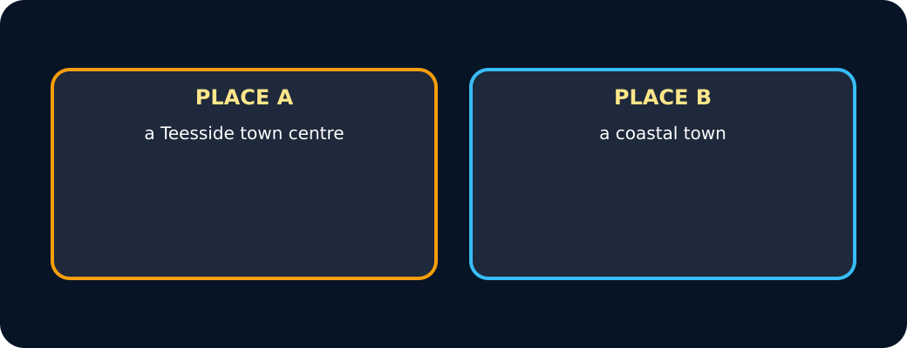
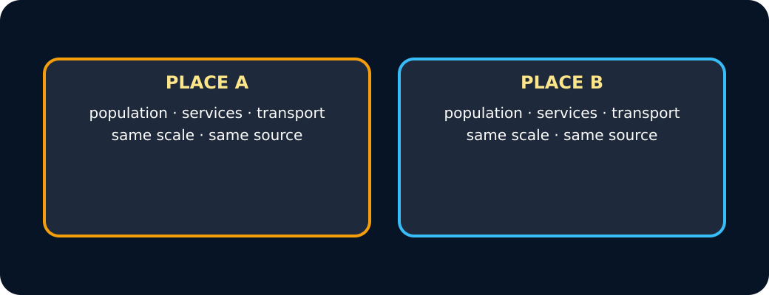
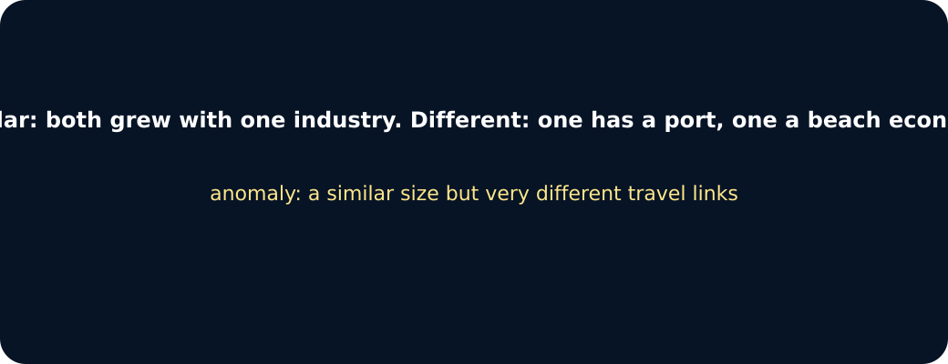
LAUNCH / HUMANITIES
STARTER
Starter · enquiry / tension
Two places
Matched evidence
Pattern
STARTER · 3 min across this stage
5 / 18
Notes:
Companion for LAUNCH_HUM_W13_Contrasting_Places.html. Starter: 3 minutes TOTAL across all slides in this stage.
Elicit a provisional geographical judgement before explanation.
Do not use a public vote to validate reasoning.
Full source-stage teaching text:
Enquiry
How far are two contrasting places different—and what evidence might challenge that claim?
QUESTION / HYPOTHESIS
“How do two places compare, and why?”
MAP / DATA / METHOD
Matched evidence: the same measures at the same scale.
PATTERN + ANOMALY
Similarity, difference, and the thing that does not fit.
JUDGEMENT + LIMIT
A comparison is only as fair as its match.
HTML controls remain in the original HTML file. PowerPoint contains editable teaching text and static source visuals; use the paper response route for sorting and investigation.
[Sources]
Uploaded lesson: LAUNCH_HUM_W13_Contrasting_Places.html
[/Sources]

Slide 6
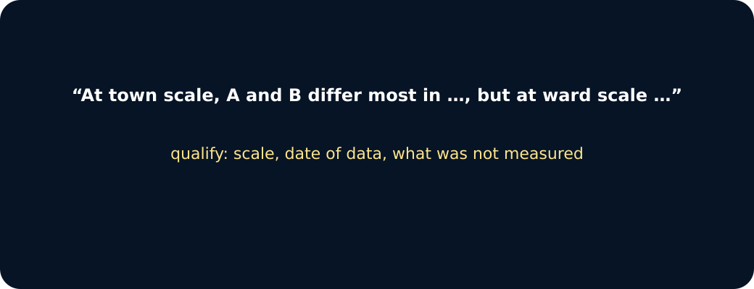
LAUNCH / HUMANITIES
STARTER
Starter · enquiry / tension
Judgement
STARTER · 3 min across this stage
6 / 18
Notes:
Companion for LAUNCH_HUM_W13_Contrasting_Places.html. Starter: 3 minutes TOTAL across all slides in this stage.
Elicit a provisional geographical judgement before explanation.
Do not use a public vote to validate reasoning.
Full source-stage teaching text:
Enquiry
How far are two contrasting places different—and what evidence might challenge that claim?
QUESTION / HYPOTHESIS
“How do two places compare, and why?”
MAP / DATA / METHOD
Matched evidence: the same measures at the same scale.
PATTERN + ANOMALY
Similarity, difference, and the thing that does not fit.
JUDGEMENT + LIMIT
A comparison is only as fair as its match.
HTML controls remain in the original HTML file. PowerPoint contains editable teaching text and static source visuals; use the paper response route for sorting and investigation.
[Sources]
Uploaded lesson: LAUNCH_HUM_W13_Contrasting_Places.html
[/Sources]

Slide 7
LAUNCH / HUMANITIES
I DO
I Do · model geographical reasoning
Model one reasoning step at a time.
Match indicator, unit, date, method and spatial scale before comparing values.
Description identifies similarity/difference; explanation links it cautiously to context.
Contrasting does not mean opposite, and a place should not be reduced to one indicator.
Matched or mismatched?
I DO · 4 min across this stage
7 / 18
Notes:
Companion for LAUNCH_HUM_W13_Contrasting_Places.html. I do: 4 minutes TOTAL across all slides in this stage.
Model one evidence-to-judgement step at a time.
Ask the learner to name the evidence used in each step.
Full source-stage teaching text:
Model one reasoning step at a time.
Match indicator, unit, date, method and spatial scale before comparing values.
Description identifies similarity/difference; explanation links it cautiously to context.
Contrasting does not mean opposite, and a place should not be reduced to one indicator.
Matched or mismatched?
Press each comparison. Is the evidence matched (same measure, scale and source) or not?
A: 2021 census population · B: 2021 census population
A: 2021 census population · B: a 1991 estimate
A: bus routes per hour (timetable) · B: bus routes per hour (timetable)
A: whole town area · B: one street survey
A: “feels busy” · B: footfall count
A: shops per 1,000 people · B: shops per 1,000 people
matched
mismatched
Press a comparison.
HTML controls remain in the original HTML file. PowerPoint contains editable teaching text and static source visuals; use the paper response route for sorting and investigation.
[Sources]
Uploaded lesson: LAUNCH_HUM_W13_Contrasting_Places.html
[/Sources]

Slide 8
LAUNCH / HUMANITIES
I DO
I Do · model geographical reasoning
Choose each comparison. Is the evidence matched (same measure, scale and source) or not?
A. A: 2021 census population · B: 2021 census population
B. A: 2021 census population · B: a 1991 estimate
C. A: bus routes per hour (timetable) · B: bus routes per hour (timetable)
D. A: whole town area · B: one street survey
E. A: “feels busy” · B: footfall count
F. A: shops per 1,000 people · B: shops per 1,000 people
I DO · 4 min across this stage
8 / 18
Notes:
Companion for LAUNCH_HUM_W13_Contrasting_Places.html. I do: 4 minutes TOTAL across all slides in this stage.
Model one evidence-to-judgement step at a time.
Ask the learner to name the evidence used in each step.
Full source-stage teaching text:
Model one reasoning step at a time.
Match indicator, unit, date, method and spatial scale before comparing values.
Description identifies similarity/difference; explanation links it cautiously to context.
Contrasting does not mean opposite, and a place should not be reduced to one indicator.
Matched or mismatched?
Press each comparison. Is the evidence matched (same measure, scale and source) or not?
A: 2021 census population · B: 2021 census population
A: 2021 census population · B: a 1991 estimate
A: bus routes per hour (timetable) · B: bus routes per hour (timetable)
A: whole town area · B: one street survey
A: “feels busy” · B: footfall count
A: shops per 1,000 people · B: shops per 1,000 people
matched
mismatched
Press a comparison.
HTML controls remain in the original HTML file. PowerPoint contains editable teaching text and static source visuals; use the paper response route for sorting and investigation.
[Sources]
Uploaded lesson: LAUNCH_HUM_W13_Contrasting_Places.html
[/Sources]

Slide 9
LAUNCH / HUMANITIES
I DO
I Do · model geographical reasoning
G. matched
H. mismatched
Choose a comparison.
I DO · 4 min across this stage
9 / 18
Notes:
Companion for LAUNCH_HUM_W13_Contrasting_Places.html. I do: 4 minutes TOTAL across all slides in this stage.
Model one evidence-to-judgement step at a time.
Ask the learner to name the evidence used in each step.
Full source-stage teaching text:
Model one reasoning step at a time.
Match indicator, unit, date, method and spatial scale before comparing values.
Description identifies similarity/difference; explanation links it cautiously to context.
Contrasting does not mean opposite, and a place should not be reduced to one indicator.
Matched or mismatched?
Press each comparison. Is the evidence matched (same measure, scale and source) or not?
A: 2021 census population · B: 2021 census population
A: 2021 census population · B: a 1991 estimate
A: bus routes per hour (timetable) · B: bus routes per hour (timetable)
A: whole town area · B: one street survey
A: “feels busy” · B: footfall count
A: shops per 1,000 people · B: shops per 1,000 people
matched
mismatched
Press a comparison.
HTML controls remain in the original HTML file. PowerPoint contains editable teaching text and static source visuals; use the paper response route for sorting and investigation.
[Sources]
Uploaded lesson: LAUNCH_HUM_W13_Contrasting_Places.html
[/Sources]

Slide 10
LAUNCH / HUMANITIES
WE DO
We Do · hinge judgement
Commit before reveal: Which is the strongest geographical comparison?
A. Riverside East has 48 scheduled departures compared with Dalehaven’s 8, using the same constructed 2025 measure.
B. Dalehaven looks nicer.
C. One place has more buses and the other has more land-based jobs.
WE DO · 3 min across this stage
10 / 18
Notes:
Companion for LAUNCH_HUM_W13_Contrasting_Places.html. We do: 3 minutes TOTAL across all slides in this stage.
Require a reason before giving feedback.
Secure → transfer or counter-evidence. Not yet → return to the key evidence and retry.
Ask every learner to commit privately before feedback. Use the pupil cards, table or evidence sheet; pointing, saying, signing and directing a partner are valid routes.
Full source-stage teaching text:
Commit before reveal: Which is the strongest geographical comparison?
Riverside East has 48 scheduled departures compared with Dalehaven’s 8, using the same constructed 2025 measure.
Dalehaven looks nicer.
One place has more buses and the other has more land-based jobs.
HTML controls remain in the original HTML file. PowerPoint contains editable teaching text and static source visuals; use the paper response route for sorting and investigation.
[Sources]
Uploaded lesson: LAUNCH_HUM_W13_Contrasting_Places.html
[/Sources]

Slide 11
LAUNCH / HUMANITIES
I DO 2
I Do 2 · counter / qualification
Strengthen—not lengthen—the reasoning.
Use Both… whereas… because… however… to sustain comparison rather than write two separate descriptions.
Explain an apparent difference using context, then test it with a counter-example.
State missing evidence and avoid unsupported better/worse, deprived/pleasant or urban/rural stereotypes.
I DO 2 · 3 min across this stage
11 / 18
Notes:
Companion for LAUNCH_HUM_W13_Contrasting_Places.html. I do 2: 3 minutes TOTAL across all slides in this stage.
Raise challenge with counter-evidence, scale, alternative method or validity.
No volume-only stretch; keep access supports available.
Full source-stage teaching text:
Strengthen—not lengthen—the reasoning.
Use Both… whereas… because… however… to sustain comparison rather than write two separate descriptions.
Explain an apparent difference using context, then test it with a counter-example.
State missing evidence and avoid unsupported better/worse, deprived/pleasant or urban/rural stereotypes.
HTML controls remain in the original HTML file. PowerPoint contains editable teaching text and static source visuals; use the paper response route for sorting and investigation.
[Sources]
Uploaded lesson: LAUNCH_HUM_W13_Contrasting_Places.html
[/Sources]

Slide 12
LAUNCH / HUMANITIES
WE DO 2
We Do 2 · interactive reasoning lab
Matched Place Lens
CONSTRUCTED CLASSROOM RESOURCE: This fictional composite is inspired by the broad Teesside setting. It is not official data, is not to scale and must not be used for navigation, safety or real-world planning.
WE DO 2 · 4 min across this stage
12 / 18
Notes:
Companion for LAUNCH_HUM_W13_Contrasting_Places.html. We do 2: 4 minutes TOTAL across all slides in this stage.
The learner makes the geographical choice; the interface is rehearsal only.
Use the response to adjust the independent question or scaffold.
Ask every learner to commit privately before feedback. Use the pupil cards, table or evidence sheet; pointing, saying, signing and directing a partner are valid routes.
Full source-stage teaching text:
Rehearsal only: the panel exposes reasoning. Clicks and screen states are not assessment or portfolio evidence.
Matched Place Lens
CONSTRUCTED CLASSROOM RESOURCE: This fictional composite is inspired by the broad Teesside setting. It is not official data, is not to scale and must not be used for navigation, safety or real-world planning.
Density
Green land
Bus access
Services
Service jobs
Riverside East
Dalehaven
Matched 2025 indicator ready. Describe, explain cautiously and state what else is needed.
HTML controls remain in the original HTML file. PowerPoint contains editable teaching text and static source visuals; use the paper response route for sorting and investigation.
[Sources]
Uploaded lesson: LAUNCH_HUM_W13_Contrasting_Places.html
[/Sources]

Slide 13
LAUNCH / HUMANITIES
WE DO 2
We Do 2 · interactive reasoning lab
A. Density
B. Green land
C. Bus access
D. Services
E. Service jobs
Riverside East
Dalehaven
WE DO 2 · 4 min across this stage
13 / 18
Notes:
Companion for LAUNCH_HUM_W13_Contrasting_Places.html. We do 2: 4 minutes TOTAL across all slides in this stage.
The learner makes the geographical choice; the interface is rehearsal only.
Use the response to adjust the independent question or scaffold.
Ask every learner to commit privately before feedback. Use the pupil cards, table or evidence sheet; pointing, saying, signing and directing a partner are valid routes.
Full source-stage teaching text:
Rehearsal only: the panel exposes reasoning. Clicks and screen states are not assessment or portfolio evidence.
Matched Place Lens
CONSTRUCTED CLASSROOM RESOURCE: This fictional composite is inspired by the broad Teesside setting. It is not official data, is not to scale and must not be used for navigation, safety or real-world planning.
Density
Green land
Bus access
Services
Service jobs
Riverside East
Dalehaven
Matched 2025 indicator ready. Describe, explain cautiously and state what else is needed.
HTML controls remain in the original HTML file. PowerPoint contains editable teaching text and static source visuals; use the paper response route for sorting and investigation.
[Sources]
Uploaded lesson: LAUNCH_HUM_W13_Contrasting_Places.html
[/Sources]

Slide 14
LAUNCH / HUMANITIES
WE DO 2
We Do 2 · interactive reasoning lab
Matched 2025 indicator ready. Describe, explain cautiously and state what else is needed.
WE DO 2 · 4 min across this stage
14 / 18
Notes:
Companion for LAUNCH_HUM_W13_Contrasting_Places.html. We do 2: 4 minutes TOTAL across all slides in this stage.
The learner makes the geographical choice; the interface is rehearsal only.
Use the response to adjust the independent question or scaffold.
Ask every learner to commit privately before feedback. Use the pupil cards, table or evidence sheet; pointing, saying, signing and directing a partner are valid routes.
Full source-stage teaching text:
Rehearsal only: the panel exposes reasoning. Clicks and screen states are not assessment or portfolio evidence.
Matched Place Lens
CONSTRUCTED CLASSROOM RESOURCE: This fictional composite is inspired by the broad Teesside setting. It is not official data, is not to scale and must not be used for navigation, safety or real-world planning.
Density
Green land
Bus access
Services
Service jobs
Riverside East
Dalehaven
Matched 2025 indicator ready. Describe, explain cautiously and state what else is needed.
HTML controls remain in the original HTML file. PowerPoint contains editable teaching text and static source visuals; use the paper response route for sorting and investigation.
[Sources]
Uploaded lesson: LAUNCH_HUM_W13_Contrasting_Places.html
[/Sources]

Slide 15
LAUNCH / HUMANITIES
INDEPENDENT
Independent · sustained evidence
Independent mission
I can compare two places using matched evidence and scale, explain similarities and differences, and qualify the comparison.
16 minutes. Approved access can change format, reading load or response mode; it cannot supply the geographical judgement.
Supported
Using the centre-approved real-place pack or the constructed equal fallback, match four indicators and complete Both… whereas… because… however… frames.
INDEPENDENT · 16 min across this stage
15 / 18
Notes:
Companion for LAUNCH_HUM_W13_Contrasting_Places.html. Independent: 16 minutes TOTAL across all slides in this stage.
Protect learner ownership; fade content prompts while access remains.
Feedback should produce a substantive edit or re-attempt.
Full source-stage teaching text:
Independent mission
I can compare two places using matched evidence and scale, explain similarities and differences, and qualify the comparison.
16 minutes. Approved access can change format, reading load or response mode; it cannot supply the geographical judgement.
◆ Supported
Using the centre-approved real-place pack or the constructed equal fallback, match four indicators and complete Both… whereas… because… however… frames.
Supported access: paired values appear together; learner selects evidence and supplies comparison.
Access stays; content prompts fade as independence grows.
▲ Standard
Using the approved real-place pack or fallback, write a sustained comparison with three paired statistics, context and one limitation.
Standard scaffold: similarity → difference → evidence → explanation → however.
Access stays; content prompts fade as independence grows.
Stretch
Using the approved real-place pack or fallback, judge whether accessibility is the most important contrast with counter-evidence and a scale/method caveat.
Stretch scaffold: weigh importance, counter-example, representation and missing data.
Access stays; content prompts fade as independence grows.
HTML controls remain in the original HTML file. PowerPoint contains editable teaching text and static source visuals; use the paper response route for sorting and investigation.
[Sources]
Uploaded lesson: LAUNCH_HUM_W13_Contrasting_Places.html
[/Sources]

Slide 16
LAUNCH / HUMANITIES
INDEPENDENT
Independent · sustained evidence
Supported access: paired values appear together; learner selects evidence and supplies comparison.
Standard
Using the approved real-place pack or fallback, write a sustained comparison with three paired statistics, context and one limitation.
Standard scaffold: similarity → difference → evidence → explanation → however.
Stretch
INDEPENDENT · 16 min across this stage
16 / 18
Notes:
Companion for LAUNCH_HUM_W13_Contrasting_Places.html. Independent: 16 minutes TOTAL across all slides in this stage.
Protect learner ownership; fade content prompts while access remains.
Feedback should produce a substantive edit or re-attempt.
Full source-stage teaching text:
Independent mission
I can compare two places using matched evidence and scale, explain similarities and differences, and qualify the comparison.
16 minutes. Approved access can change format, reading load or response mode; it cannot supply the geographical judgement.
◆ Supported
Using the centre-approved real-place pack or the constructed equal fallback, match four indicators and complete Both… whereas… because… however… frames.
Supported access: paired values appear together; learner selects evidence and supplies comparison.
Access stays; content prompts fade as independence grows.
▲ Standard
Using the approved real-place pack or fallback, write a sustained comparison with three paired statistics, context and one limitation.
Standard scaffold: similarity → difference → evidence → explanation → however.
Access stays; content prompts fade as independence grows.
Stretch
Using the approved real-place pack or fallback, judge whether accessibility is the most important contrast with counter-evidence and a scale/method caveat.
Stretch scaffold: weigh importance, counter-example, representation and missing data.
Access stays; content prompts fade as independence grows.
HTML controls remain in the original HTML file. PowerPoint contains editable teaching text and static source visuals; use the paper response route for sorting and investigation.
[Sources]
Uploaded lesson: LAUNCH_HUM_W13_Contrasting_Places.html
[/Sources]

Slide 17
LAUNCH / HUMANITIES
INDEPENDENT
Independent · sustained evidence
Using the approved real-place pack or fallback, judge whether accessibility is the most important contrast with counter-evidence and a scale/method caveat.
Stretch scaffold: weigh importance, counter-example, representation and missing data.
INDEPENDENT · 16 min across this stage
17 / 18
Notes:
Companion for LAUNCH_HUM_W13_Contrasting_Places.html. Independent: 16 minutes TOTAL across all slides in this stage.
Protect learner ownership; fade content prompts while access remains.
Feedback should produce a substantive edit or re-attempt.
Full source-stage teaching text:
Independent mission
I can compare two places using matched evidence and scale, explain similarities and differences, and qualify the comparison.
16 minutes. Approved access can change format, reading load or response mode; it cannot supply the geographical judgement.
◆ Supported
Using the centre-approved real-place pack or the constructed equal fallback, match four indicators and complete Both… whereas… because… however… frames.
Supported access: paired values appear together; learner selects evidence and supplies comparison.
Access stays; content prompts fade as independence grows.
▲ Standard
Using the approved real-place pack or fallback, write a sustained comparison with three paired statistics, context and one limitation.
Standard scaffold: similarity → difference → evidence → explanation → however.
Access stays; content prompts fade as independence grows.
Stretch
Using the approved real-place pack or fallback, judge whether accessibility is the most important contrast with counter-evidence and a scale/method caveat.
Stretch scaffold: weigh importance, counter-example, representation and missing data.
Access stays; content prompts fade as independence grows.
HTML controls remain in the original HTML file. PowerPoint contains editable teaching text and static source visuals; use the paper response route for sorting and investigation.
[Sources]
Uploaded lesson: LAUNCH_HUM_W13_Contrasting_Places.html
[/Sources]

Slide 18
LAUNCH / HUMANITIES
EXIT
Exit · evidence → response → Influence
VOICE: State the strongest matched contrast, one similarity and one missing indicator that could change the judgement.
EXIT · 4 min across this stage
18 / 18
Notes:
Companion for LAUNCH_HUM_W13_Contrasting_Places.html. Exit: 4 minutes TOTAL across all slides in this stage.
Receive the actual response; record product, route and highest content prompt.
Change the next source, question, scaffold or method and explain what changed.
Full source-stage teaching text:
LAUNCH Humanities close
VOICE: State the strongest matched contrast, one similarity and one missing indicator that could change the judgement.
AUDIENCE: a named adult genuinely engages with the response before recording.
INFLUENCE: The best-supported comparison and limitation enter W14’s frozen evidence pack.
HTML controls remain in the original HTML file. PowerPoint contains editable teaching text and static source visuals; use the paper response route for sorting and investigation.
[Sources]
Uploaded lesson: LAUNCH_HUM_W13_Contrasting_Places.html
[/Sources]

