Slide 1
LAUNCH / HUMANITIES
OVERVIEW
GIS Layers · Reading Place
I can select and combine GIS layers at two scales to produce and qualify an evidence-based place description.
Open the original interactive lesson
40 MINUTES
1 / 18
Notes:
Companion for LAUNCH_HUM_W9_GIS_Layers_Reading_Place.html. Overview: 0 minutes TOTAL across all slides in this stage.
Check the approved source/data pack, access route and lesson boundary before pupils arrive.
Stable Space first. Replace inaccessible format before reducing geographical demand.
Full source-stage teaching text:
Place, Settlement & Urbanisation · Identity & Belonging · Autumn 2
Learning objective: I can select and combine GIS layers at two scales to produce and qualify an evidence-based place description.
GIS → URBANISATION → FIELDWORK → DATA → COMPARE → VERDICT
KS3 National Curriculum Geography + KS4 GCSE/UAS bridge. Developmental language is not a GCSE grade. Exact UAS unit, version and outcomes remain centre-controlled.
HTML controls remain in the original HTML file. PowerPoint contains editable teaching text and static source visuals; use the paper response route for sorting and investigation.
[Sources]
Uploaded lesson: LAUNCH_HUM_W9_GIS_Layers_Reading_Place.html
[/Sources]

Slide 2
LAUNCH / HUMANITIES
ARRIVAL
Arrival · retrieve and reconnect
Standard
Confirm the W8 report-back status, retrieve the map judgement and add one evidence limit.
ARRIVAL · 3 min across this stage
2 / 18
Notes:
Companion for LAUNCH_HUM_W9_GIS_Layers_Reading_Place.html. Arrival: 3 minutes TOTAL across all slides in this stage.
Give quiet retrieval time and the smallest useful cue.
Secure → step back. Access block → change format, not the geographical demand.
Full source-stage teaching text:
▲ Standard
Confirm the W8 report-back status, retrieve the map judgement and add one evidence limit.
HTML controls remain in the original HTML file. PowerPoint contains editable teaching text and static source visuals; use the paper response route for sorting and investigation.
[Sources]
Uploaded lesson: LAUNCH_HUM_W9_GIS_Layers_Reading_Place.html
[/Sources]

Slide 3
LAUNCH / HUMANITIES
STARTER
Starter · enquiry / tension
Enquiry
What can GIS reveal about a place—and what does it hide?
QUESTION / HYPOTHESIS
Start with a question you can test: where do people live, and why there?
MAP / DATA / METHOD
Layers are evidence. Housing clusters near transport — a pattern .
PATTERN + ANOMALY
STARTER · 3 min across this stage
3 / 18
Notes:
Companion for LAUNCH_HUM_W9_GIS_Layers_Reading_Place.html. Starter: 3 minutes TOTAL across all slides in this stage.
Elicit a provisional geographical judgement before explanation.
Do not use a public vote to validate reasoning.
Full source-stage teaching text:
Enquiry
What can GIS reveal about a place—and what does it hide?
QUESTION / HYPOTHESIS
Start with a question you can test: where do people live, and why there?
MAP / DATA / METHOD
Layers are evidence. Housing clusters near transport — a pattern .
PATTERN + ANOMALY
Anomaly: some housing sits inside the flood zone. The pattern is not the whole story.
JUDGEMENT + LIMIT
A judgement with a limit: the layers show where , not why or who . Change scale and the picture changes.
HTML controls remain in the original HTML file. PowerPoint contains editable teaching text and static source visuals; use the paper response route for sorting and investigation.
[Sources]
Uploaded lesson: LAUNCH_HUM_W9_GIS_Layers_Reading_Place.html
[/Sources]

Slide 4
LAUNCH / HUMANITIES
STARTER
Starter · enquiry / tension
Anomaly: some housing sits inside the flood zone. The pattern is not the whole story.
JUDGEMENT + LIMIT
A judgement with a limit: the layers show where , not why or who . Change scale and the picture changes.
STARTER · 3 min across this stage
4 / 18
Notes:
Companion for LAUNCH_HUM_W9_GIS_Layers_Reading_Place.html. Starter: 3 minutes TOTAL across all slides in this stage.
Elicit a provisional geographical judgement before explanation.
Do not use a public vote to validate reasoning.
Full source-stage teaching text:
Enquiry
What can GIS reveal about a place—and what does it hide?
QUESTION / HYPOTHESIS
Start with a question you can test: where do people live, and why there?
MAP / DATA / METHOD
Layers are evidence. Housing clusters near transport — a pattern .
PATTERN + ANOMALY
Anomaly: some housing sits inside the flood zone. The pattern is not the whole story.
JUDGEMENT + LIMIT
A judgement with a limit: the layers show where , not why or who . Change scale and the picture changes.
HTML controls remain in the original HTML file. PowerPoint contains editable teaching text and static source visuals; use the paper response route for sorting and investigation.
[Sources]
Uploaded lesson: LAUNCH_HUM_W9_GIS_Layers_Reading_Place.html
[/Sources]

Slide 5
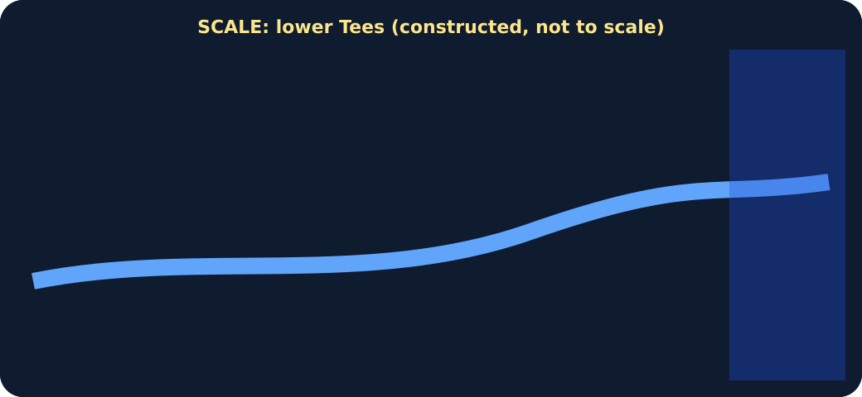
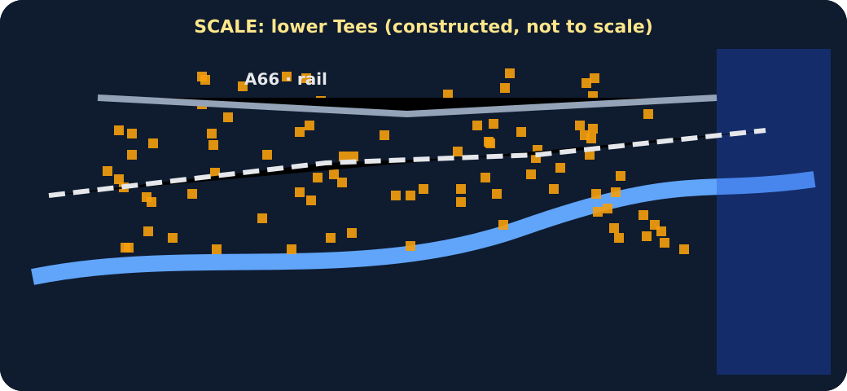
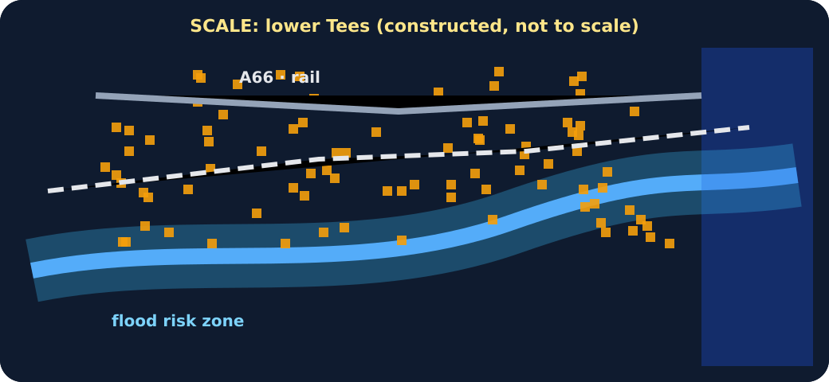
LAUNCH / HUMANITIES
STARTER
Starter · enquiry / tension
Base layer: river and sea only
Housing and transport layers added
Flood-risk layer added
STARTER · 3 min across this stage
5 / 18
Notes:
Companion for LAUNCH_HUM_W9_GIS_Layers_Reading_Place.html. Starter: 3 minutes TOTAL across all slides in this stage.
Elicit a provisional geographical judgement before explanation.
Do not use a public vote to validate reasoning.
Full source-stage teaching text:
Enquiry
What can GIS reveal about a place—and what does it hide?
QUESTION / HYPOTHESIS
Start with a question you can test: where do people live, and why there?
MAP / DATA / METHOD
Layers are evidence. Housing clusters near transport — a pattern .
PATTERN + ANOMALY
Anomaly: some housing sits inside the flood zone. The pattern is not the whole story.
JUDGEMENT + LIMIT
A judgement with a limit: the layers show where , not why or who . Change scale and the picture changes.
HTML controls remain in the original HTML file. PowerPoint contains editable teaching text and static source visuals; use the paper response route for sorting and investigation.
[Sources]
Uploaded lesson: LAUNCH_HUM_W9_GIS_Layers_Reading_Place.html
[/Sources]

Slide 6
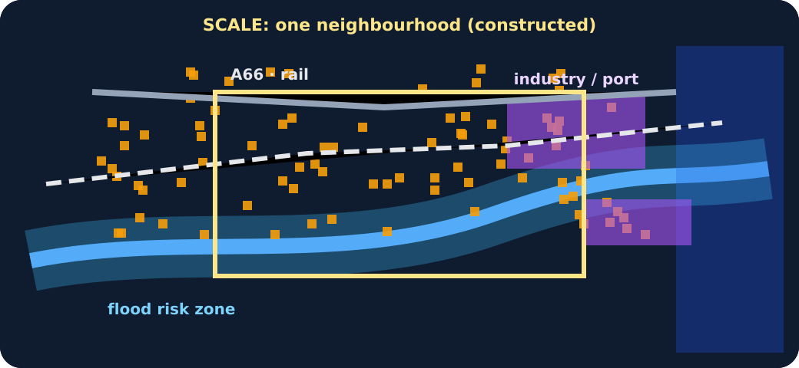
LAUNCH / HUMANITIES
STARTER
Starter · enquiry / tension
All layers with a zoom box
STARTER · 3 min across this stage
6 / 18
Notes:
Companion for LAUNCH_HUM_W9_GIS_Layers_Reading_Place.html. Starter: 3 minutes TOTAL across all slides in this stage.
Elicit a provisional geographical judgement before explanation.
Do not use a public vote to validate reasoning.
Full source-stage teaching text:
Enquiry
What can GIS reveal about a place—and what does it hide?
QUESTION / HYPOTHESIS
Start with a question you can test: where do people live, and why there?
MAP / DATA / METHOD
Layers are evidence. Housing clusters near transport — a pattern .
PATTERN + ANOMALY
Anomaly: some housing sits inside the flood zone. The pattern is not the whole story.
JUDGEMENT + LIMIT
A judgement with a limit: the layers show where , not why or who . Change scale and the picture changes.
HTML controls remain in the original HTML file. PowerPoint contains editable teaching text and static source visuals; use the paper response route for sorting and investigation.
[Sources]
Uploaded lesson: LAUNCH_HUM_W9_GIS_Layers_Reading_Place.html
[/Sources]

Slide 7
LAUNCH / HUMANITIES
I DO
I Do · model geographical reasoning
Model one reasoning step at a time.
Read title, key, date, scale and source before describing any pattern.
Locate precisely, then describe distribution as clustered, linear, dispersed or concentrated.
Combine two layers to suggest a possible relationship; keep explanation separate from description.
GIS layer stack · switch layers on and off
I DO · 4 min across this stage
7 / 18
Notes:
Companion for LAUNCH_HUM_W9_GIS_Layers_Reading_Place.html. I do: 4 minutes TOTAL across all slides in this stage.
Model one evidence-to-judgement step at a time.
Ask the learner to name the evidence used in each step.
Full source-stage teaching text:
Model one reasoning step at a time.
Read title, key, date, scale and source before describing any pattern.
Locate precisely, then describe distribution as clustered, linear, dispersed or concentrated.
Combine two layers to suggest a possible relationship; keep explanation separate from description.
GIS layer stack · switch layers on and off
Constructed model: a schematic, not real GIS data. It rehearses selecting and combining layers at two scales.
river + sea
housing
roads + rail
industry / port
flood risk
zoom to one neighbourhood
Base layer only. Add housing and roads. What pattern appears?
Claim A: people live near transport because it is convenient
Claim B: the housing layer shows a cluster near transport; the reason needs other evidence
Which claim does the layer stack actually support?
HTML controls remain in the original HTML file. PowerPoint contains editable teaching text and static source visuals; use the paper response route for sorting and investigation.
[Sources]
Uploaded lesson: LAUNCH_HUM_W9_GIS_Layers_Reading_Place.html
[/Sources]

Slide 8
LAUNCH / HUMANITIES
I DO
I Do · model geographical reasoning
Constructed model: a schematic, not real GIS data. It rehearses selecting and combining layers at two scales.
A. river + sea
B. housing
C. roads + rail
D. industry / port
E. flood risk
F. zoom to one neighbourhood
I DO · 4 min across this stage
8 / 18
Notes:
Companion for LAUNCH_HUM_W9_GIS_Layers_Reading_Place.html. I do: 4 minutes TOTAL across all slides in this stage.
Model one evidence-to-judgement step at a time.
Ask the learner to name the evidence used in each step.
Full source-stage teaching text:
Model one reasoning step at a time.
Read title, key, date, scale and source before describing any pattern.
Locate precisely, then describe distribution as clustered, linear, dispersed or concentrated.
Combine two layers to suggest a possible relationship; keep explanation separate from description.
GIS layer stack · switch layers on and off
Constructed model: a schematic, not real GIS data. It rehearses selecting and combining layers at two scales.
river + sea
housing
roads + rail
industry / port
flood risk
zoom to one neighbourhood
Base layer only. Add housing and roads. What pattern appears?
Claim A: people live near transport because it is convenient
Claim B: the housing layer shows a cluster near transport; the reason needs other evidence
Which claim does the layer stack actually support?
HTML controls remain in the original HTML file. PowerPoint contains editable teaching text and static source visuals; use the paper response route for sorting and investigation.
[Sources]
Uploaded lesson: LAUNCH_HUM_W9_GIS_Layers_Reading_Place.html
[/Sources]

Slide 9
LAUNCH / HUMANITIES
I DO
I Do · model geographical reasoning
Base layer only. Add housing and roads. What pattern appears?
A. Claim A: people live near transport because it is convenient
B. Claim B: the housing layer shows a cluster near transport; the reason needs other evidence
Which claim does the layer stack actually support?
I DO · 4 min across this stage
9 / 18
Notes:
Companion for LAUNCH_HUM_W9_GIS_Layers_Reading_Place.html. I do: 4 minutes TOTAL across all slides in this stage.
Model one evidence-to-judgement step at a time.
Ask the learner to name the evidence used in each step.
Full source-stage teaching text:
Model one reasoning step at a time.
Read title, key, date, scale and source before describing any pattern.
Locate precisely, then describe distribution as clustered, linear, dispersed or concentrated.
Combine two layers to suggest a possible relationship; keep explanation separate from description.
GIS layer stack · switch layers on and off
Constructed model: a schematic, not real GIS data. It rehearses selecting and combining layers at two scales.
river + sea
housing
roads + rail
industry / port
flood risk
zoom to one neighbourhood
Base layer only. Add housing and roads. What pattern appears?
Claim A: people live near transport because it is convenient
Claim B: the housing layer shows a cluster near transport; the reason needs other evidence
Which claim does the layer stack actually support?
HTML controls remain in the original HTML file. PowerPoint contains editable teaching text and static source visuals; use the paper response route for sorting and investigation.
[Sources]
Uploaded lesson: LAUNCH_HUM_W9_GIS_Layers_Reading_Place.html
[/Sources]

Slide 10

LAUNCH / HUMANITIES
I DO
I Do · model geographical reasoning
Layered schematic GIS map
I DO · 4 min across this stage
10 / 18
Notes:
Companion for LAUNCH_HUM_W9_GIS_Layers_Reading_Place.html. I do: 4 minutes TOTAL across all slides in this stage.
Model one evidence-to-judgement step at a time.
Ask the learner to name the evidence used in each step.
Full source-stage teaching text:
Model one reasoning step at a time.
Read title, key, date, scale and source before describing any pattern.
Locate precisely, then describe distribution as clustered, linear, dispersed or concentrated.
Combine two layers to suggest a possible relationship; keep explanation separate from description.
GIS layer stack · switch layers on and off
Constructed model: a schematic, not real GIS data. It rehearses selecting and combining layers at two scales.
river + sea
housing
roads + rail
industry / port
flood risk
zoom to one neighbourhood
Base layer only. Add housing and roads. What pattern appears?
Claim A: people live near transport because it is convenient
Claim B: the housing layer shows a cluster near transport; the reason needs other evidence
Which claim does the layer stack actually support?
HTML controls remain in the original HTML file. PowerPoint contains editable teaching text and static source visuals; use the paper response route for sorting and investigation.
[Sources]
Uploaded lesson: LAUNCH_HUM_W9_GIS_Layers_Reading_Place.html
[/Sources]

Slide 11
LAUNCH / HUMANITIES
WE DO
We Do · hinge judgement
Commit before reveal: Which sentence best describes the situation of a place?
A. The site occupies mostly flat land.
B. It lies east of the centre and is linked to it by a bridge and rail corridor.
C. Retail is the dominant land use.
WE DO · 3 min across this stage
11 / 18
Notes:
Companion for LAUNCH_HUM_W9_GIS_Layers_Reading_Place.html. We do: 3 minutes TOTAL across all slides in this stage.
Require a reason before giving feedback.
Secure → transfer or counter-evidence. Not yet → return to the key evidence and retry.
Ask every learner to commit privately before feedback. Use the pupil cards, table or evidence sheet; pointing, saying, signing and directing a partner are valid routes.
Full source-stage teaching text:
Commit before reveal: Which sentence best describes the situation of a place?
The site occupies mostly flat land.
It lies east of the centre and is linked to it by a bridge and rail corridor.
Retail is the dominant land use.
HTML controls remain in the original HTML file. PowerPoint contains editable teaching text and static source visuals; use the paper response route for sorting and investigation.
[Sources]
Uploaded lesson: LAUNCH_HUM_W9_GIS_Layers_Reading_Place.html
[/Sources]

Slide 12
LAUNCH / HUMANITIES
I DO 2
I Do 2 · counter / qualification
Strengthen—not lengthen—the reasoning.
Use Locate → Layer → Link → Limit to control the description.
A mapped relationship is a hypothesis, not proof of cause.
State which missing layer, date or scale would most improve the judgement.
I DO 2 · 3 min across this stage
12 / 18
Notes:
Companion for LAUNCH_HUM_W9_GIS_Layers_Reading_Place.html. I do 2: 3 minutes TOTAL across all slides in this stage.
Raise challenge with counter-evidence, scale, alternative method or validity.
No volume-only stretch; keep access supports available.
Full source-stage teaching text:
Strengthen—not lengthen—the reasoning.
Use Locate → Layer → Link → Limit to control the description.
A mapped relationship is a hypothesis, not proof of cause.
State which missing layer, date or scale would most improve the judgement.
HTML controls remain in the original HTML file. PowerPoint contains editable teaching text and static source visuals; use the paper response route for sorting and investigation.
[Sources]
Uploaded lesson: LAUNCH_HUM_W9_GIS_Layers_Reading_Place.html
[/Sources]

Slide 13
LAUNCH / HUMANITIES
WE DO 2
We Do 2 · interactive reasoning lab
Layer Lens · Teesbridge Quarter
CONSTRUCTED CLASSROOM RESOURCE: This fictional composite is inspired by the broad Teesside setting. It is not official data, is not to scale and must not be used for navigation, safety or real-world planning.
≈ river ═ transport ▦ land use ● services environment
Select more than one thematic layer to combine evidence. Base resets the view.
WE DO 2 · 4 min across this stage
13 / 18
Notes:
Companion for LAUNCH_HUM_W9_GIS_Layers_Reading_Place.html. We do 2: 4 minutes TOTAL across all slides in this stage.
The learner makes the geographical choice; the interface is rehearsal only.
Use the response to adjust the independent question or scaffold.
Ask every learner to commit privately before feedback. Use the pupil cards, table or evidence sheet; pointing, saying, signing and directing a partner are valid routes.
Full source-stage teaching text:
Rehearsal only: the panel exposes reasoning. Clicks and screen states are not assessment or portfolio evidence.
Layer Lens · Teesbridge Quarter
CONSTRUCTED CLASSROOM RESOURCE: This fictional composite is inspired by the broad Teesside setting. It is not official data, is not to scale and must not be used for navigation, safety or real-world planning.
≈ river ═ transport ▦ land use ● services environment
Select more than one thematic layer to combine evidence. Base resets the view.
Base / reset
Transport
Land use
Services
Environment
Base layer ready. Combine two layers, describe a pattern, then name a limit.
HTML controls remain in the original HTML file. PowerPoint contains editable teaching text and static source visuals; use the paper response route for sorting and investigation.
[Sources]
Uploaded lesson: LAUNCH_HUM_W9_GIS_Layers_Reading_Place.html
[/Sources]

Slide 14
LAUNCH / HUMANITIES
WE DO 2
We Do 2 · interactive reasoning lab
A. Base / reset
B. Transport
C. Land use
D. Services
E. Environment
Base layer ready. Combine two layers, describe a pattern, then name a limit.
WE DO 2 · 4 min across this stage
14 / 18
Notes:
Companion for LAUNCH_HUM_W9_GIS_Layers_Reading_Place.html. We do 2: 4 minutes TOTAL across all slides in this stage.
The learner makes the geographical choice; the interface is rehearsal only.
Use the response to adjust the independent question or scaffold.
Ask every learner to commit privately before feedback. Use the pupil cards, table or evidence sheet; pointing, saying, signing and directing a partner are valid routes.
Full source-stage teaching text:
Rehearsal only: the panel exposes reasoning. Clicks and screen states are not assessment or portfolio evidence.
Layer Lens · Teesbridge Quarter
CONSTRUCTED CLASSROOM RESOURCE: This fictional composite is inspired by the broad Teesside setting. It is not official data, is not to scale and must not be used for navigation, safety or real-world planning.
≈ river ═ transport ▦ land use ● services environment
Select more than one thematic layer to combine evidence. Base resets the view.
Base / reset
Transport
Land use
Services
Environment
Base layer ready. Combine two layers, describe a pattern, then name a limit.
HTML controls remain in the original HTML file. PowerPoint contains editable teaching text and static source visuals; use the paper response route for sorting and investigation.
[Sources]
Uploaded lesson: LAUNCH_HUM_W9_GIS_Layers_Reading_Place.html
[/Sources]

Slide 15
LAUNCH / HUMANITIES
INDEPENDENT
Independent · sustained evidence
Independent mission
I can select and combine GIS layers at two scales to produce and qualify an evidence-based place description.
16 minutes. Approved access can change format, reading load or response mode; it cannot supply the geographical judgement.
Supported
Sort six prepared statements into site or situation, complete a four-sentence description using two layers, then add one sentence from the wider corridor view.
INDEPENDENT · 16 min across this stage
15 / 18
Notes:
Companion for LAUNCH_HUM_W9_GIS_Layers_Reading_Place.html. Independent: 16 minutes TOTAL across all slides in this stage.
Protect learner ownership; fade content prompts while access remains.
Feedback should produce a substantive edit or re-attempt.
Full source-stage teaching text:
Independent mission
I can select and combine GIS layers at two scales to produce and qualify an evidence-based place description.
16 minutes. Approved access can change format, reading load or response mode; it cannot supply the geographical judgement.
◆ Supported
Sort six prepared statements into site or situation, complete a four-sentence description using two layers, then add one sentence from the wider corridor view.
Supported access: layer key, site/situation sorter and Locate → Layer → Link → Limit headings.
Access stays; content prompts fade as independence grows.
▲ Standard
Write a place evidence brief with location, two patterns, a layer relationship, one limitation and one claim that survives, changes or becomes less certain at the wider scale.
Standard scaffold: claim → mapped detail → comparison → limitation.
Access stays; content prompts fade as independence grows.
Stretch
Judge which two layers are most useful for locating a fictional clinic; reject one layer and explain uncertainty.
Stretch scaffold: weigh layer usefulness across two scales and reject a plausible alternative.
Access stays; content prompts fade as independence grows.
HTML controls remain in the original HTML file. PowerPoint contains editable teaching text and static source visuals; use the paper response route for sorting and investigation.
[Sources]
Uploaded lesson: LAUNCH_HUM_W9_GIS_Layers_Reading_Place.html
[/Sources]

Slide 16
LAUNCH / HUMANITIES
INDEPENDENT
Independent · sustained evidence
Supported access: layer key, site/situation sorter and Locate → Layer → Link → Limit headings.
Standard
Write a place evidence brief with location, two patterns, a layer relationship, one limitation and one claim that survives, changes or becomes less certain at the wider scale.
Standard scaffold: claim → mapped detail → comparison → limitation.
Stretch
INDEPENDENT · 16 min across this stage
16 / 18
Notes:
Companion for LAUNCH_HUM_W9_GIS_Layers_Reading_Place.html. Independent: 16 minutes TOTAL across all slides in this stage.
Protect learner ownership; fade content prompts while access remains.
Feedback should produce a substantive edit or re-attempt.
Full source-stage teaching text:
Independent mission
I can select and combine GIS layers at two scales to produce and qualify an evidence-based place description.
16 minutes. Approved access can change format, reading load or response mode; it cannot supply the geographical judgement.
◆ Supported
Sort six prepared statements into site or situation, complete a four-sentence description using two layers, then add one sentence from the wider corridor view.
Supported access: layer key, site/situation sorter and Locate → Layer → Link → Limit headings.
Access stays; content prompts fade as independence grows.
▲ Standard
Write a place evidence brief with location, two patterns, a layer relationship, one limitation and one claim that survives, changes or becomes less certain at the wider scale.
Standard scaffold: claim → mapped detail → comparison → limitation.
Access stays; content prompts fade as independence grows.
Stretch
Judge which two layers are most useful for locating a fictional clinic; reject one layer and explain uncertainty.
Stretch scaffold: weigh layer usefulness across two scales and reject a plausible alternative.
Access stays; content prompts fade as independence grows.
HTML controls remain in the original HTML file. PowerPoint contains editable teaching text and static source visuals; use the paper response route for sorting and investigation.
[Sources]
Uploaded lesson: LAUNCH_HUM_W9_GIS_Layers_Reading_Place.html
[/Sources]

Slide 17
LAUNCH / HUMANITIES
INDEPENDENT
Independent · sustained evidence
Judge which two layers are most useful for locating a fictional clinic; reject one layer and explain uncertainty.
Stretch scaffold: weigh layer usefulness across two scales and reject a plausible alternative.
INDEPENDENT · 16 min across this stage
17 / 18
Notes:
Companion for LAUNCH_HUM_W9_GIS_Layers_Reading_Place.html. Independent: 16 minutes TOTAL across all slides in this stage.
Protect learner ownership; fade content prompts while access remains.
Feedback should produce a substantive edit or re-attempt.
Full source-stage teaching text:
Independent mission
I can select and combine GIS layers at two scales to produce and qualify an evidence-based place description.
16 minutes. Approved access can change format, reading load or response mode; it cannot supply the geographical judgement.
◆ Supported
Sort six prepared statements into site or situation, complete a four-sentence description using two layers, then add one sentence from the wider corridor view.
Supported access: layer key, site/situation sorter and Locate → Layer → Link → Limit headings.
Access stays; content prompts fade as independence grows.
▲ Standard
Write a place evidence brief with location, two patterns, a layer relationship, one limitation and one claim that survives, changes or becomes less certain at the wider scale.
Standard scaffold: claim → mapped detail → comparison → limitation.
Access stays; content prompts fade as independence grows.
Stretch
Judge which two layers are most useful for locating a fictional clinic; reject one layer and explain uncertainty.
Stretch scaffold: weigh layer usefulness across two scales and reject a plausible alternative.
Access stays; content prompts fade as independence grows.
HTML controls remain in the original HTML file. PowerPoint contains editable teaching text and static source visuals; use the paper response route for sorting and investigation.
[Sources]
Uploaded lesson: LAUNCH_HUM_W9_GIS_Layers_Reading_Place.html
[/Sources]

Slide 18
LAUNCH / HUMANITIES
EXIT
Exit · evidence → response → Influence
VOICE: Name the strongest layer for the enquiry, one pattern it reveals and one thing it cannot prove.
EXIT · 4 min across this stage
18 / 18
Notes:
Companion for LAUNCH_HUM_W9_GIS_Layers_Reading_Place.html. Exit: 4 minutes TOTAL across all slides in this stage.
Receive the actual response; record product, route and highest content prompt.
Change the next source, question, scaffold or method and explain what changed.
Full source-stage teaching text:
LAUNCH Humanities close
VOICE: Name the strongest layer for the enquiry, one pattern it reveals and one thing it cannot prove.
AUDIENCE: a named adult genuinely engages with the response before recording.
INFLUENCE: The chosen pattern becomes W10’s urbanisation question; the missing layer becomes the next evidence request.
HTML controls remain in the original HTML file. PowerPoint contains editable teaching text and static source visuals; use the paper response route for sorting and investigation.
[Sources]
Uploaded lesson: LAUNCH_HUM_W9_GIS_Layers_Reading_Place.html
[/Sources]

