Slide 1
BUILD / SCIENCE
OVERVIEW
Sugar Evidence: Read the Label
I can compare sugar values using the same label basis and order four supplied food labels from least to most sugar.
FIND
number + unit
CHECK
fair comparison
ORDER
use evidence
Open the original interactive lesson
40 MINUTES
1 / 18
Notes:
Companion for SCI_B_W8A_Sugar_Labels_Explore.html. Overview: 0 minutes TOTAL across all slides in this stage.
Read setup, safety and sensory notes before pupils enter.
Set predictable Space and keep the learning goal visible.
Model limit: The simplified cards show sugar values only. They do not show portion eaten, frequency, other nutrients, allergies, medical needs or a whole dietary pattern.
Full source-stage teaching text:
BUILD · Science · Week 8A · Explore
Learning objective: I can compare sugar values using the same label basis and order four supplied food labels from least to most sugar.
Success criteria
I can find the sugar line and read three things: the number, the unit (g) and the basis (per 100 g).
I can compare values only when the unit and basis match.
I can order four labels and explain that sugar is one part of nutrition evidence.
HTML controls remain in the original HTML file. PowerPoint contains editable teaching text and static source visuals; use the paper response route for sorting and investigation.
[Sources]
Uploaded lesson: SCI_B_W8A_Sugar_Labels_Explore.html
[/Sources]

Slide 2
BUILD / SCIENCE
OVERVIEW
What success looks like
• I can find the sugar number, unit and label basis.
• I can compare values only when the unit and basis match.
• I can order four labels and explain that sugar is one part of nutrition evidence.
40 MINUTES
2 / 18
Notes:
Companion for SCI_B_W8A_Sugar_Labels_Explore.html. Overview: 0 minutes TOTAL across all slides in this stage.
Read setup, safety and sensory notes before pupils enter.
Set predictable Space and keep the learning goal visible.
Model limit: The simplified cards show sugar values only. They do not show portion eaten, frequency, other nutrients, allergies, medical needs or a whole dietary pattern.
Full source-stage teaching text:
BUILD · Science · Week 8A · Explore
Learning objective: I can compare sugar values using the same label basis and order four supplied food labels from least to most sugar.
Success criteria
I can find the sugar line and read three things: the number, the unit (g) and the basis (per 100 g).
I can compare values only when the unit and basis match.
I can order four labels and explain that sugar is one part of nutrition evidence.
HTML controls remain in the original HTML file. PowerPoint contains editable teaching text and static source visuals; use the paper response route for sorting and investigation.
[Sources]
Uploaded lesson: SCI_B_W8A_Sugar_Labels_Explore.html
[/Sources]

Slide 3
BUILD / SCIENCE
ARRIVAL
Retrieve and reconnect
• Explain what the arrow means in plant → caterpillar → bird.
• Name two different jobs supported by nutrients.
• State why a balanced pattern includes a range of food groups.
• Lead-in: read the number, unit and basis from one supplied sugar line.
ARRIVAL · 4 min across this stage
3 / 18
Notes:
Companion for SCI_B_W8A_Sugar_Labels_Explore.html. Arrival: 4 minutes TOTAL across all slides in this stage.
Wait, regulate and retrieve through the lightest workable route.
If recall is inaccessible, point to one retrieval sentence; do not teach today’s answer.
Model limit: The simplified cards show sugar values only. They do not show portion eaten, frequency, other nutrients, allergies, medical needs or a whole dietary pattern.
Full source-stage teaching text:
Retrieve only what has already been taught
W7B: a food-chain arrow shows the direction of food and energy transfer.
W6: foods can be grouped, and balance means a varied pattern rather than one perfect food.
W5: food supports jobs such as energy, growth and repair.
Lead-in: a nutrition label gives numbers that can be compared carefully.
New to this class, absent, or not sure? Everything needed is in the retrieval box above. Read it, point to it or ask a familiar adult to read it exactly.
▲ Standard
Explain what the arrow means in plant → caterpillar → bird.
Name two different jobs supported by nutrients.
State why a balanced pattern includes a range of food groups.
Lead-in: read the number, unit and basis from one supplied sugar line.
Read-aloud route: a familiar adult may read the task exactly while the text remains visible. No device voice or media permission is required.
HTML controls remain in the original HTML file. PowerPoint contains editable teaching text and static source visuals; use the paper response route for sorting and investigation.
[Sources]
Uploaded lesson: SCI_B_W8A_Sugar_Labels_Explore.html
[/Sources]

Slide 4
BUILD / SCIENCE
STARTER
Label A says 6 g sugar per 100 g. Label B says 9 g sugar per 100 g. Which first claim can the evidence support?
Think first. Point, say, sign or write your choice. Give one reason.
A. Label A has less sugar per 100 g than Label B.
B. Label A is the healthiest food in every way.
C. The values cannot be compared because every number on a label means something different.
STARTER · 4 min across this stage
4 / 18
Notes:
Companion for SCI_B_W8A_Sugar_Labels_Explore.html. Starter: 4 minutes TOTAL across all slides in this stage.
Protect curiosity: receive every first idea without judgement.
Ask ‘What makes you think that?’ and preserve the prediction for later evidence.
Model limit: The simplified cards show sugar values only. They do not show portion eaten, frequency, other nutrients, allergies, medical needs or a whole dietary pattern.
Full source-stage teaching text:
LOCAL VISUAL HOOK · FRAME 1
LABEL A · find the sugar line
Look at the yellow line. It says of which sugars 6 g . The panel says per 100 g .
LOCAL VISUAL HOOK · FRAME 2
LABEL B · find the sugar line
Same line, different food: 9 g per 100 g.
LOCAL VISUAL HOOK · FRAME 3
QUESTION · what can these numbers show?
They can show which has less sugar per 100 g . They cannot say which food is healthiest.
Commit one first idea. Predictions are held, not marked. Pointing, selecting, saying or signing all count.
Label A has less sugar per 100 g than Label B.
Label A is the healthiest food in every way.
The values cannot be compared because every number on a label means something different.
HTML controls remain in the original HTML file. PowerPoint contains editable teaching text and static source visuals; use the paper response route for sorting and investigation.
[Sources]
Uploaded lesson: SCI_B_W8A_Sugar_Labels_Explore.html
[/Sources]

Slide 5
BUILD / SCIENCE
STARTER
Look closely · what is the evidence?
LABEL A · sugars 6 g per 100 g
LABEL B · sugars 9 g per 100 g
QUESTION · what can the same-basis numbers show, and what can they not show?
STARTER · 4 min across this stage
5 / 18
Notes:
Companion for SCI_B_W8A_Sugar_Labels_Explore.html. Starter: 4 minutes TOTAL across all slides in this stage.
Protect curiosity: receive every first idea without judgement.
Ask ‘What makes you think that?’ and preserve the prediction for later evidence.
Model limit: The simplified cards show sugar values only. They do not show portion eaten, frequency, other nutrients, allergies, medical needs or a whole dietary pattern.
Full source-stage teaching text:
LOCAL VISUAL HOOK · FRAME 1
LABEL A · find the sugar line
Look at the yellow line. It says of which sugars 6 g . The panel says per 100 g .
LOCAL VISUAL HOOK · FRAME 2
LABEL B · find the sugar line
Same line, different food: 9 g per 100 g.
LOCAL VISUAL HOOK · FRAME 3
QUESTION · what can these numbers show?
They can show which has less sugar per 100 g . They cannot say which food is healthiest.
Commit one first idea. Predictions are held, not marked. Pointing, selecting, saying or signing all count.
Label A has less sugar per 100 g than Label B.
Label A is the healthiest food in every way.
The values cannot be compared because every number on a label means something different.
HTML controls remain in the original HTML file. PowerPoint contains editable teaching text and static source visuals; use the paper response route for sorting and investigation.
[Sources]
Uploaded lesson: SCI_B_W8A_Sugar_Labels_Explore.html
[/Sources]

Slide 6
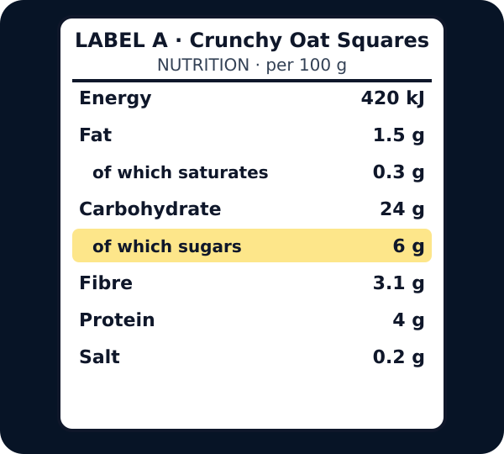
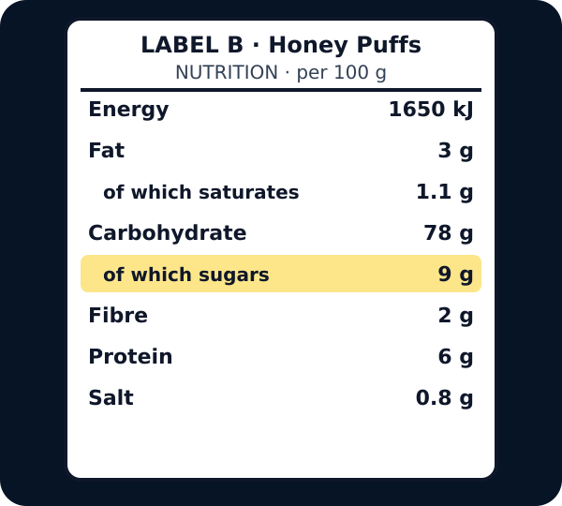
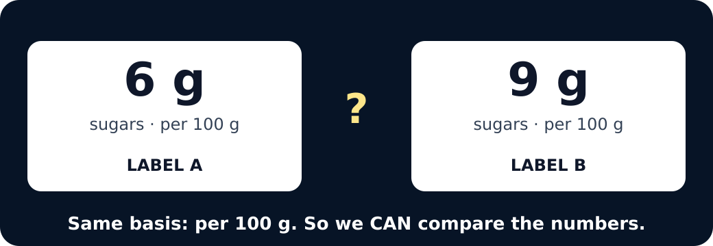
BUILD / SCIENCE
STARTER
Look closely · what is the evidence?
Nutrition label A with the of-which-sugars line highlighted: 6 g per 100 g
Nutrition label B with the of-which-sugars line highlighted: 9 g per 100 g
Six grams beside nine grams, both per 100 g, with a question mark
STARTER · 4 min across this stage
6 / 18
Notes:
Companion for SCI_B_W8A_Sugar_Labels_Explore.html. Starter: 4 minutes TOTAL across all slides in this stage.
Protect curiosity: receive every first idea without judgement.
Ask ‘What makes you think that?’ and preserve the prediction for later evidence.
Model limit: The simplified cards show sugar values only. They do not show portion eaten, frequency, other nutrients, allergies, medical needs or a whole dietary pattern.
Full source-stage teaching text:
LOCAL VISUAL HOOK · FRAME 1
LABEL A · find the sugar line
Look at the yellow line. It says of which sugars 6 g . The panel says per 100 g .
LOCAL VISUAL HOOK · FRAME 2
LABEL B · find the sugar line
Same line, different food: 9 g per 100 g.
LOCAL VISUAL HOOK · FRAME 3
QUESTION · what can these numbers show?
They can show which has less sugar per 100 g . They cannot say which food is healthiest.
Commit one first idea. Predictions are held, not marked. Pointing, selecting, saying or signing all count.
Label A has less sugar per 100 g than Label B.
Label A is the healthiest food in every way.
The values cannot be compared because every number on a label means something different.
HTML controls remain in the original HTML file. PowerPoint contains editable teaching text and static source visuals; use the paper response route for sorting and investigation.
[Sources]
Uploaded lesson: SCI_B_W8A_Sugar_Labels_Explore.html
[/Sources]

Slide 7
BUILD / SCIENCE
I DO
Words we will use
• nutrition label — food information panel
• per 100 g — in the same 100 g amount
• evidence — the number we read
I DO · 5 min across this stage
7 / 18
Notes:
Companion for SCI_B_W8A_Sugar_Labels_Explore.html. I do: 5 minutes TOTAL across all slides in this stage.
Let the teacher/model carry the explanation; pupils watch, point or track.
Use a visual cue only if access is the barrier, then fade it.
Model limit: The simplified cards show sugar values only. They do not show portion eaten, frequency, other nutrients, allergies, medical needs or a whole dietary pattern.
Full source-stage teaching text:
NUTRITION LABEL food information panel a standard panel giving amounts of energy and nutrients in a stated quantity of food
PER 100 G in the same 100 g amount a common basis that lets equal masses of foods be compared
EVIDENCE the number we read information used to support or challenge a claim
WHAT THIS MODEL HELPS US SEE
The matched label cards remove serving-size differences so pupils can see a fair numerical comparison.
WHAT THIS MODEL DOES NOT SHOW
The simplified cards show sugar values only. They do not show portion eaten, frequency, other nutrients, allergies, medical needs or a whole dietary pattern.
Step 1
Find the nutrition panel, then find ‘Carbohydrate — of which sugars’ on the supplied simplified card.
Step 2
Read all three parts aloud: the number, the unit g and the basis per 100 g.
Step 3
Copy only the sugar value into the matching row of the results table; do not copy the total carbohydrate number by mistake.
Find the sugar line · picture first
Press the line that says of which sugars . Then read the three parts: the number, the unit, the basis.
Label 1
Label 2
Press a line on the label.
Watch for the trap: Carbohydrate is the big number. Of which sugars is the smaller number under it. Only the sugars line counts today.
Fair or not fair? · press one
A fair comparison needs the same basis : per 100 g with per 100 g.
4 g per 100 g vs 11 g per 100 g
FAIR
NOT FAIR
4 g per 100 g vs 3 g per serving
FAIR
NOT FAIR
23 g per 100 g vs 9 g per 100 g
FAIR
NOT FAIR
6 g per 30 g serving vs 6 g per 100 g
FAIR
NOT FAIR
Not fair means the basis is different, so the numbers cannot be lined up. Convert first or leave it out.
HTML controls remain in the original HTML file. PowerPoint contains editable teaching text and static source visuals; use the paper response route for sorting and investigation.
[Sources]
Uploaded lesson: SCI_B_W8A_Sugar_Labels_Explore.html
[/Sources]

Slide 8
BUILD / SCIENCE
I DO
Watch the model
• Find the nutrition panel, then find ‘Carbohydrate — of which sugars’ on the supplied simplified card.
• Read all three parts aloud: the number, the unit g and the basis per 100 g.
• Copy only the sugar value into the matching row of the results table; do not copy the total carbohydrate number by mistake.
I DO · 5 min across this stage
8 / 18
Notes:
Companion for SCI_B_W8A_Sugar_Labels_Explore.html. I do: 5 minutes TOTAL across all slides in this stage.
Let the teacher/model carry the explanation; pupils watch, point or track.
Use a visual cue only if access is the barrier, then fade it.
Model limit: The simplified cards show sugar values only. They do not show portion eaten, frequency, other nutrients, allergies, medical needs or a whole dietary pattern.
Full source-stage teaching text:
NUTRITION LABEL food information panel a standard panel giving amounts of energy and nutrients in a stated quantity of food
PER 100 G in the same 100 g amount a common basis that lets equal masses of foods be compared
EVIDENCE the number we read information used to support or challenge a claim
WHAT THIS MODEL HELPS US SEE
The matched label cards remove serving-size differences so pupils can see a fair numerical comparison.
WHAT THIS MODEL DOES NOT SHOW
The simplified cards show sugar values only. They do not show portion eaten, frequency, other nutrients, allergies, medical needs or a whole dietary pattern.
Step 1
Find the nutrition panel, then find ‘Carbohydrate — of which sugars’ on the supplied simplified card.
Step 2
Read all three parts aloud: the number, the unit g and the basis per 100 g.
Step 3
Copy only the sugar value into the matching row of the results table; do not copy the total carbohydrate number by mistake.
Find the sugar line · picture first
Press the line that says of which sugars . Then read the three parts: the number, the unit, the basis.
Label 1
Label 2
Press a line on the label.
Watch for the trap: Carbohydrate is the big number. Of which sugars is the smaller number under it. Only the sugars line counts today.
Fair or not fair? · press one
A fair comparison needs the same basis : per 100 g with per 100 g.
4 g per 100 g vs 11 g per 100 g
FAIR
NOT FAIR
4 g per 100 g vs 3 g per serving
FAIR
NOT FAIR
23 g per 100 g vs 9 g per 100 g
FAIR
NOT FAIR
6 g per 30 g serving vs 6 g per 100 g
FAIR
NOT FAIR
Not fair means the basis is different, so the numbers cannot be lined up. Convert first or leave it out.
HTML controls remain in the original HTML file. PowerPoint contains editable teaching text and static source visuals; use the paper response route for sorting and investigation.
[Sources]
Uploaded lesson: SCI_B_W8A_Sugar_Labels_Explore.html
[/Sources]

Slide 9
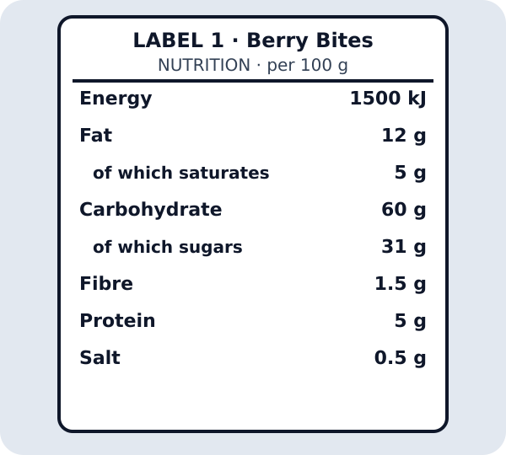
BUILD / SCIENCE
I DO
Watch the model
Tappable nutrition label 1
I DO · 5 min across this stage
9 / 18
Notes:
Companion for SCI_B_W8A_Sugar_Labels_Explore.html. I do: 5 minutes TOTAL across all slides in this stage.
Let the teacher/model carry the explanation; pupils watch, point or track.
Use a visual cue only if access is the barrier, then fade it.
Model limit: The simplified cards show sugar values only. They do not show portion eaten, frequency, other nutrients, allergies, medical needs or a whole dietary pattern.
Full source-stage teaching text:
NUTRITION LABEL food information panel a standard panel giving amounts of energy and nutrients in a stated quantity of food
PER 100 G in the same 100 g amount a common basis that lets equal masses of foods be compared
EVIDENCE the number we read information used to support or challenge a claim
WHAT THIS MODEL HELPS US SEE
The matched label cards remove serving-size differences so pupils can see a fair numerical comparison.
WHAT THIS MODEL DOES NOT SHOW
The simplified cards show sugar values only. They do not show portion eaten, frequency, other nutrients, allergies, medical needs or a whole dietary pattern.
Step 1
Find the nutrition panel, then find ‘Carbohydrate — of which sugars’ on the supplied simplified card.
Step 2
Read all three parts aloud: the number, the unit g and the basis per 100 g.
Step 3
Copy only the sugar value into the matching row of the results table; do not copy the total carbohydrate number by mistake.
Find the sugar line · picture first
Press the line that says of which sugars . Then read the three parts: the number, the unit, the basis.
Label 1
Label 2
Press a line on the label.
Watch for the trap: Carbohydrate is the big number. Of which sugars is the smaller number under it. Only the sugars line counts today.
Fair or not fair? · press one
A fair comparison needs the same basis : per 100 g with per 100 g.
4 g per 100 g vs 11 g per 100 g
FAIR
NOT FAIR
4 g per 100 g vs 3 g per serving
FAIR
NOT FAIR
23 g per 100 g vs 9 g per 100 g
FAIR
NOT FAIR
6 g per 30 g serving vs 6 g per 100 g
FAIR
NOT FAIR
Not fair means the basis is different, so the numbers cannot be lined up. Convert first or leave it out.
HTML controls remain in the original HTML file. PowerPoint contains editable teaching text and static source visuals; use the paper response route for sorting and investigation.
[Sources]
Uploaded lesson: SCI_B_W8A_Sugar_Labels_Explore.html
[/Sources]

Slide 10
BUILD / SCIENCE
WE DO
Which comparison is fair using the supplied cards?
A. Compare 4 g per 100 g with 11 g per 100 g.
B. Compare 4 g per 100 g with 3 g per serving without converting.
C. Choose the packet with the picture we like best.
Commit to an answer. Show the evidence you used. Listen, then revise if needed.
WE DO · 5 min across this stage
10 / 18
Notes:
Companion for SCI_B_W8A_Sugar_Labels_Explore.html. We do: 5 minutes TOTAL across all slides in this stage.
Scan every response mode. Do not infer understanding from handwriting or confidence.
Secure: transfer. Mixed: contrast. Misconception: counterexample then a fresh question.
Ask every learner to commit privately before feedback. Use the pupil cards, table or evidence sheet; pointing, saying, signing and directing a partner are valid routes.
Model limit: The simplified cards show sugar values only. They do not show portion eaten, frequency, other nutrients, allergies, medical needs or a whole dietary pattern.
Full source-stage teaching text:
Everyone commits before explanation.
Use a button, point, say/sign or let an adult operate the chosen button. A retry is information, not a penalty.
Audience move:
Compare 4 g per 100 g with 11 g per 100 g.
Compare 4 g per 100 g with 3 g per serving without converting.
Choose the packet with the picture we like best.
HTML controls remain in the original HTML file. PowerPoint contains editable teaching text and static source visuals; use the paper response route for sorting and investigation.
[Sources]
Uploaded lesson: SCI_B_W8A_Sugar_Labels_Explore.html
[/Sources]

Slide 11
BUILD / SCIENCE
I DO 2
Build the explanation
• Place the four same-basis values on a number line from the smallest number to the largest.
• Say the bounded conclusion: ‘Label A has less sugar per 100 g than Label D.’ Keep ‘per 100 g’ in the sentence.
• Name the limit: sugar is one part of a nutrition label. It cannot by itself prove which whole food, meal or diet is healthiest.
I DO 2 · 4 min across this stage
11 / 18
Notes:
Companion for SCI_B_W8A_Sugar_Labels_Explore.html. I do 2: 4 minutes TOTAL across all slides in this stage.
Model one complete evidence-to-explanation sentence, then pause.
Keep the science words; change density, modality or adult role before changing the goal.
Model limit: The simplified cards show sugar values only. They do not show portion eaten, frequency, other nutrients, allergies, medical needs or a whole dietary pattern.
Full source-stage teaching text:
Connection: the model is useful when its visible pattern is translated into a scientific explanation.
Connection 1
Place the four same-basis values on a number line from the smallest number to the largest.
Connection 2
Say the bounded conclusion: ‘Label A has less sugar per 100 g than Label D.’ Keep ‘per 100 g’ in the sentence.
Connection 3
Name the limit: sugar is one part of a nutrition label. It cannot by itself prove which whole food, meal or diet is healthiest.
MODEL STRENGTH
The matched label cards remove serving-size differences so pupils can see a fair numerical comparison.
MODEL LIMIT
The simplified cards show sugar values only. They do not show portion eaten, frequency, other nutrients, allergies, medical needs or a whole dietary pattern.
HTML controls remain in the original HTML file. PowerPoint contains editable teaching text and static source visuals; use the paper response route for sorting and investigation.
[Sources]
Uploaded lesson: SCI_B_W8A_Sugar_Labels_Explore.html
[/Sources]

Slide 12
BUILD / SCIENCE
I DO 2
Find and repair the misconception
Label glitch: the food with the least sugar per 100 g is automatically the healthiest food for every person.
A. Keep it: one sugar number answers every health question.
B. Repair it: sugar is one measure; the label order supports only a same-basis sugar comparison.
C. Repair it: ignore the numbers and choose by packet picture.
I DO 2 · 4 min across this stage
12 / 18
Notes:
Companion for SCI_B_W8A_Sugar_Labels_Explore.html. I do 2: 4 minutes TOTAL across all slides in this stage.
Model one complete evidence-to-explanation sentence, then pause.
Keep the science words; change density, modality or adult role before changing the goal.
Model limit: The simplified cards show sugar values only. They do not show portion eaten, frequency, other nutrients, allergies, medical needs or a whole dietary pattern.
Full source-stage teaching text:
Connection: the model is useful when its visible pattern is translated into a scientific explanation.
Connection 1
Place the four same-basis values on a number line from the smallest number to the largest.
Connection 2
Say the bounded conclusion: ‘Label A has less sugar per 100 g than Label D.’ Keep ‘per 100 g’ in the sentence.
Connection 3
Name the limit: sugar is one part of a nutrition label. It cannot by itself prove which whole food, meal or diet is healthiest.
MODEL STRENGTH
The matched label cards remove serving-size differences so pupils can see a fair numerical comparison.
MODEL LIMIT
The simplified cards show sugar values only. They do not show portion eaten, frequency, other nutrients, allergies, medical needs or a whole dietary pattern.
HTML controls remain in the original HTML file. PowerPoint contains editable teaching text and static source visuals; use the paper response route for sorting and investigation.
[Sources]
Uploaded lesson: SCI_B_W8A_Sugar_Labels_Explore.html
[/Sources]

Slide 13
BUILD / SCIENCE
WE DO 2
Same-Basis Sugar Label Lab
Read each supplied card, place the four values in order, then place the method and limitation cards.
• Find the sugar line.
• Read number, unit and basis.
• Check every basis matches.
• Order the four values.
• State one supported claim and one limit.
WE DO 2 · 4 min across this stage
13 / 18
Notes:
Companion for SCI_B_W8A_Sugar_Labels_Explore.html. We do 2: 4 minutes TOTAL across all slides in this stage.
Protect pupil operation and thinking; support handling only where needed.
Ask what changed and what stayed the same before supplying a scientific word.
Ask every learner to commit privately before feedback. Use the pupil cards, table or evidence sheet; pointing, saying, signing and directing a partner are valid routes.
Model limit: The simplified cards show sugar values only. They do not show portion eaten, frequency, other nutrients, allergies, medical needs or a whole dietary pattern.
Full source-stage teaching text:
Read each supplied card, place the four values in order, then place the method and limitation cards.
Find the sugar line. Read number, unit and basis. Check every basis matches. Order the four values. State one supported claim and one limit.
Cards to place
Label A · 4 g per 100 g The supplied sugar line reads 4 g for each 100 g.
Label B · 9 g per 100 g The supplied sugar line reads 9 g for each 100 g.
Label C · 14 g per 100 g The supplied sugar line reads 14 g for each 100 g.
Label D · 23 g per 100 g The supplied sugar line reads 23 g for each 100 g.
Same nutrient, unit and basis Every value is sugar in g per 100 g.
Sugar is one part of nutrition The cards do not show every nutrient, portion, medical need or the whole diet.
Matching groups
1 · LEAST SUGAR PER 100 g
2 · NEXT VALUE
3 · NEXT VALUE
4 · MOST SUGAR PER 100 g
FAIR-COMPARISON RULE
LIMIT OF THE CLAIM
Freeze evidence
↺ Reset and retry
Science glitch · find and repair it
Claim: Label glitch: the food with the least sugar per 100 g is automatically the healthiest food for every person.
Keep it: one sugar number answers every health question.
Repair it: sugar is one measure; the label order supports only a same-basis sugar comparison.
Repair it: ignore the numbers and choose by packet picture.
HTML controls remain in the original HTML file. PowerPoint contains editable teaching text and static source visuals; use the paper response route for sorting and investigation.
[Sources]
Uploaded lesson: SCI_B_W8A_Sugar_Labels_Explore.html
[/Sources]

Slide 14
BUILD / SCIENCE
WE DO 2
Same-Basis Sugar Label Lab
Use the numbered cards in your pupil pack. Take turns to choose, justify and check. You may direct a partner to move a card.
WE DO 2 · 4 min across this stage
14 / 18
Notes:
Companion for SCI_B_W8A_Sugar_Labels_Explore.html. We do 2: 4 minutes TOTAL across all slides in this stage.
Protect pupil operation and thinking; support handling only where needed.
Ask what changed and what stayed the same before supplying a scientific word.
Ask every learner to commit privately before feedback. Use the pupil cards, table or evidence sheet; pointing, saying, signing and directing a partner are valid routes.
Model limit: The simplified cards show sugar values only. They do not show portion eaten, frequency, other nutrients, allergies, medical needs or a whole dietary pattern.
Full source-stage teaching text:
Read each supplied card, place the four values in order, then place the method and limitation cards.
Find the sugar line. Read number, unit and basis. Check every basis matches. Order the four values. State one supported claim and one limit.
Cards to place
Label A · 4 g per 100 g The supplied sugar line reads 4 g for each 100 g.
Label B · 9 g per 100 g The supplied sugar line reads 9 g for each 100 g.
Label C · 14 g per 100 g The supplied sugar line reads 14 g for each 100 g.
Label D · 23 g per 100 g The supplied sugar line reads 23 g for each 100 g.
Same nutrient, unit and basis Every value is sugar in g per 100 g.
Sugar is one part of nutrition The cards do not show every nutrient, portion, medical need or the whole diet.
Matching groups
1 · LEAST SUGAR PER 100 g
2 · NEXT VALUE
3 · NEXT VALUE
4 · MOST SUGAR PER 100 g
FAIR-COMPARISON RULE
LIMIT OF THE CLAIM
Freeze evidence
↺ Reset and retry
Science glitch · find and repair it
Claim: Label glitch: the food with the least sugar per 100 g is automatically the healthiest food for every person.
Keep it: one sugar number answers every health question.
Repair it: sugar is one measure; the label order supports only a same-basis sugar comparison.
Repair it: ignore the numbers and choose by packet picture.
HTML controls remain in the original HTML file. PowerPoint contains editable teaching text and static source visuals; use the paper response route for sorting and investigation.
[Sources]
Uploaded lesson: SCI_B_W8A_Sugar_Labels_Explore.html
[/Sources]

Slide 15
BUILD / SCIENCE
WE DO 2
Choose a group · defend your placement
• 1 · LEAST SUGAR PER 100 g
• 2 · NEXT VALUE
• 3 · NEXT VALUE
• 4 · MOST SUGAR PER 100 g
• FAIR-COMPARISON RULE
• LIMIT OF THE CLAIM
Read the ordered values with units and basis. What claim is supported, and what broader claim is not supported?
WE DO 2 · 4 min across this stage
15 / 18
Notes:
Companion for SCI_B_W8A_Sugar_Labels_Explore.html. We do 2: 4 minutes TOTAL across all slides in this stage.
Protect pupil operation and thinking; support handling only where needed.
Ask what changed and what stayed the same before supplying a scientific word.
Ask every learner to commit privately before feedback. Use the pupil cards, table or evidence sheet; pointing, saying, signing and directing a partner are valid routes.
Model limit: The simplified cards show sugar values only. They do not show portion eaten, frequency, other nutrients, allergies, medical needs or a whole dietary pattern.
Full source-stage teaching text:
Read each supplied card, place the four values in order, then place the method and limitation cards.
Find the sugar line. Read number, unit and basis. Check every basis matches. Order the four values. State one supported claim and one limit.
Cards to place
Label A · 4 g per 100 g The supplied sugar line reads 4 g for each 100 g.
Label B · 9 g per 100 g The supplied sugar line reads 9 g for each 100 g.
Label C · 14 g per 100 g The supplied sugar line reads 14 g for each 100 g.
Label D · 23 g per 100 g The supplied sugar line reads 23 g for each 100 g.
Same nutrient, unit and basis Every value is sugar in g per 100 g.
Sugar is one part of nutrition The cards do not show every nutrient, portion, medical need or the whole diet.
Matching groups
1 · LEAST SUGAR PER 100 g
2 · NEXT VALUE
3 · NEXT VALUE
4 · MOST SUGAR PER 100 g
FAIR-COMPARISON RULE
LIMIT OF THE CLAIM
Freeze evidence
↺ Reset and retry
Science glitch · find and repair it
Claim: Label glitch: the food with the least sugar per 100 g is automatically the healthiest food for every person.
Keep it: one sugar number answers every health question.
Repair it: sugar is one measure; the label order supports only a same-basis sugar comparison.
Repair it: ignore the numbers and choose by packet picture.
HTML controls remain in the original HTML file. PowerPoint contains editable teaching text and static source visuals; use the paper response route for sorting and investigation.
[Sources]
Uploaded lesson: SCI_B_W8A_Sugar_Labels_Explore.html
[/Sources]

Slide 16
BUILD / SCIENCE
INDEPENDENT
Your independent mission
Read and order four supplied label cards from least to most sugar per 100 g, then write or communicate one supported claim and one limitation.
Record: Four sugar values in correct order with g per 100 g, one evidence sentence and one statement of what the comparison cannot show.
INDEPENDENT · 10 min across this stage
16 / 18
Notes:
Companion for SCI_B_W8A_Sugar_Labels_Explore.html. Independent: 10 minutes TOTAL across all slides in this stage.
Protect independence. Accept equivalent evidence routes and scribe exact meaning.
Prompt only as much as needed; fade as soon as the pupil continues.
Model limit: The simplified cards show sugar values only. They do not show portion eaten, frequency, other nutrients, allergies, medical needs or a whole dietary pattern.
Full source-stage teaching text:
Physical route
Four fictional or photocopied nutrition-label cards on the same per-100 g basis; number line; results strip; pencil; optional clean empty packets as visual references.
Same outcome: I can compare sugar values using the same label basis and order four supplied food labels from least to most sugar.
Offline digital / director route
Use the in-page label lab and preserve the ordered values plus the pupil's bounded conclusion on the print route.
Same evidence: Four sugar values in correct order with g per 100 g, one evidence sentence and one statement of what the comparison cannot show.
Equipment / setup Four fictional or photocopied nutrition-label cards on the same per-100 g basis; number line; results strip; pencil; optional clean empty packets as visual references.
Safety / sensory Nothing is eaten, opened or offered as a reward. Use clean empty packages or cards only. Check allergy and safeguarding arrangements even though there is no tasting; keep discussion about labels, not pupils' bodies or food choices.
Offline parity Use the in-page label lab and preserve the ordered values plus the pupil's bounded conclusion on the print route.
No-equipment/access route: Use large-print cards, symbols and a floor number line. A pupil may point or direct an adult to place each value; exact adult scribing is valid.
▲ Standard
Read the four sugar lines, build the table independently and explain one comparison using less/more and per 100 g.
Scaffold
Use: Label __ has __ g per 100 g. This is less/more than __ because __.
Evidence gate
HTML controls remain in the original HTML file. PowerPoint contains editable teaching text and static source visuals; use the paper response route for sorting and investigation.
[Sources]
Uploaded lesson: SCI_B_W8A_Sugar_Labels_Explore.html
[/Sources]

Slide 17
BUILD / SCIENCE
INDEPENDENT
Choose your support and challenge
• Supported: Match four large number cards to a number line, then complete: __ g is least; __ g is most.
• Standard: Read the four sugar lines, build the table independently and explain one comparison using less/more and per 100 g.
• Stretch: Audit a mixed-basis comparison, explain why it is invalid and state what extra information would be needed before a wider nutrition claim.
INDEPENDENT · 10 min across this stage
17 / 18
Notes:
Companion for SCI_B_W8A_Sugar_Labels_Explore.html. Independent: 10 minutes TOTAL across all slides in this stage.
Protect independence. Accept equivalent evidence routes and scribe exact meaning.
Prompt only as much as needed; fade as soon as the pupil continues.
Model limit: The simplified cards show sugar values only. They do not show portion eaten, frequency, other nutrients, allergies, medical needs or a whole dietary pattern.
Full source-stage teaching text:
Physical route
Four fictional or photocopied nutrition-label cards on the same per-100 g basis; number line; results strip; pencil; optional clean empty packets as visual references.
Same outcome: I can compare sugar values using the same label basis and order four supplied food labels from least to most sugar.
Offline digital / director route
Use the in-page label lab and preserve the ordered values plus the pupil's bounded conclusion on the print route.
Same evidence: Four sugar values in correct order with g per 100 g, one evidence sentence and one statement of what the comparison cannot show.
Equipment / setup Four fictional or photocopied nutrition-label cards on the same per-100 g basis; number line; results strip; pencil; optional clean empty packets as visual references.
Safety / sensory Nothing is eaten, opened or offered as a reward. Use clean empty packages or cards only. Check allergy and safeguarding arrangements even though there is no tasting; keep discussion about labels, not pupils' bodies or food choices.
Offline parity Use the in-page label lab and preserve the ordered values plus the pupil's bounded conclusion on the print route.
No-equipment/access route: Use large-print cards, symbols and a floor number line. A pupil may point or direct an adult to place each value; exact adult scribing is valid.
▲ Standard
Read the four sugar lines, build the table independently and explain one comparison using less/more and per 100 g.
Scaffold
Use: Label __ has __ g per 100 g. This is less/more than __ because __.
Evidence gate
HTML controls remain in the original HTML file. PowerPoint contains editable teaching text and static source visuals; use the paper response route for sorting and investigation.
[Sources]
Uploaded lesson: SCI_B_W8A_Sugar_Labels_Explore.html
[/Sources]

Slide 18
BUILD / SCIENCE
EXIT
Show what you know
Give one fair same-basis sugar comparison and state why sugar alone cannot describe the whole food.
Point to, read or explain the evidence you made. Choose one next step after the adult has listened.
EXIT · 4 min across this stage
18 / 18
Notes:
Companion for SCI_B_W8A_Sugar_Labels_Explore.html. Exit: 4 minutes TOTAL across all slides in this stage.
Genuinely receive one final response and name back the Science heard or seen.
Choose one visible next move; written closure is optional when Voice and Audience are observable.
Model limit: The simplified cards show sugar values only. They do not show portion eaten, frequency, other nutrients, allergies, medical needs or a whole dietary pattern.
Full source-stage teaching text:
Standard
Give one fair same-basis sugar comparison and state why sugar alone cannot describe the whole food.
Adult Audience
The familiar adult genuinely receives the pupil response, then says back the Science they heard or saw. The adult does not add a score or rewrite the pupil.
Optional exact record of what I said or showed:
One next teaching move after the adult listened:
HTML controls remain in the original HTML file. PowerPoint contains editable teaching text and static source visuals; use the paper response route for sorting and investigation.
[Sources]
Uploaded lesson: SCI_B_W8A_Sugar_Labels_Explore.html
[/Sources]

