Slide 1
GROW / SCIENCE
OVERVIEW
Climate Chain: From Gas to Warming
I can explain how extra greenhouse gases raise Earth's average temperature and connect warming to wider climate effects.
Weather is what happens now climate is a pattern over many years
use evidence
Extra greenhouse gases mean heat energy leaves Earth more slowly
use evidence
Use a cause chain to explain an effect without blaming individuals
use evidence
Open the original interactive lesson
40 MINUTES
1 / 18
Notes:
Companion for SCI_G_W11A_Global_Warming_Explore.html. Overview: 0 minutes TOTAL across all slides in this stage.
Read setup, safety and sensory notes before pupils enter.
Set predictable Space and keep the learning goal visible.
Model limit: The arrows show direction, not real amounts, times or the full climate system. Greenhouse gases are not a solid lid and do not create energy.
Full source-stage teaching text:
GROW · Science · Week 11A · Explore
Learning objective: I can explain how extra greenhouse gases raise Earth's average temperature and connect warming to wider climate effects.
Success criteria
I can distinguish weather from climate.
I can order the enhanced-greenhouse causal chain.
I can connect warming to one likely effect and name a model limitation.
HTML controls remain in the original HTML file. PowerPoint contains editable teaching text and static source visuals; use the paper response route for sorting and investigation.
[Sources]
Uploaded lesson: SCI_G_W11A_Global_Warming_Explore.html
[/Sources]

Slide 2
GROW / SCIENCE
OVERVIEW
What success looks like
• I can distinguish weather from climate.
• I can order the enhanced-greenhouse causal chain.
• I can connect warming to one likely effect and name a model limitation.
40 MINUTES
2 / 18
Notes:
Companion for SCI_G_W11A_Global_Warming_Explore.html. Overview: 0 minutes TOTAL across all slides in this stage.
Read setup, safety and sensory notes before pupils enter.
Set predictable Space and keep the learning goal visible.
Model limit: The arrows show direction, not real amounts, times or the full climate system. Greenhouse gases are not a solid lid and do not create energy.
Full source-stage teaching text:
GROW · Science · Week 11A · Explore
Learning objective: I can explain how extra greenhouse gases raise Earth's average temperature and connect warming to wider climate effects.
Success criteria
I can distinguish weather from climate.
I can order the enhanced-greenhouse causal chain.
I can connect warming to one likely effect and name a model limitation.
HTML controls remain in the original HTML file. PowerPoint contains editable teaching text and static source visuals; use the paper response route for sorting and investigation.
[Sources]
Uploaded lesson: SCI_G_W11A_Global_Warming_Explore.html
[/Sources]

Slide 3
GROW / SCIENCE
ARRIVAL
Retrieve and reconnect
• State one difference between weather and climate.
• Recall why repeated measurements are useful.
• Name one source of energy that warms Earth's surface.
• Explain why one cold day cannot describe a long-term pattern.
ARRIVAL · 4 min across this stage
3 / 18
Notes:
Companion for SCI_G_W11A_Global_Warming_Explore.html. Arrival: 4 minutes TOTAL across all slides in this stage.
Wait, regulate and retrieve through the lightest workable route.
If recall is inaccessible, point to one retrieval sentence; do not teach today’s answer.
Model limit: The arrows show direction, not real amounts, times or the full climate system. Greenhouse gases are not a solid lid and do not create energy.
Full source-stage teaching text:
Retrieve only what has already been taught
W10: useful evidence must answer the exact question.
W8: sunlight reaches one half of Earth at a time.
W5: a pattern is stronger when measurements are repeated.
Lead-in: a cold day is weather; what evidence would describe climate?
New to this class, absent, or not sure? Everything needed is in the retrieval box above. Read it, point to it or ask a familiar adult to read it exactly.
▲ Standard
State one difference between weather and climate.
Recall why repeated measurements are useful.
Name one source of energy that warms Earth's surface.
Explain why one cold day cannot describe a long-term pattern.
Read-aloud route: a familiar adult may read the task exactly while the text remains visible. No device voice or media permission is required.
HTML controls remain in the original HTML file. PowerPoint contains editable teaching text and static source visuals; use the paper response route for sorting and investigation.
[Sources]
Uploaded lesson: SCI_G_W11A_Global_Warming_Explore.html
[/Sources]

Slide 4
GROW / SCIENCE
STARTER
It is cold today. Which evidence could tell us about climate?
Think first. Point, say, sign or write your choice. Give one reason.
A. Today's temperature at one place
B. A long record of averages from many places
C. One photograph of snow
STARTER · 4 min across this stage
4 / 18
Notes:
Companion for SCI_G_W11A_Global_Warming_Explore.html. Starter: 4 minutes TOTAL across all slides in this stage.
Protect curiosity: receive every first idea without judgement.
Ask ‘What makes you think that?’ and preserve the prediction for later evidence.
Model limit: The arrows show direction, not real amounts, times or the full climate system. Greenhouse gases are not a solid lid and do not create energy.
Full source-stage teaching text:
LOCAL VISUAL HOOK · FRAME 1
WEATHER · what happens now
Weather is today. Climate is the average over decades.
LOCAL VISUAL HOOK · FRAME 2
ENERGY · in, out, and re-emitted
Sunlight in. Infrared out. Gases absorb some and send it back: Earth is warm enough for life.
LOCAL VISUAL HOOK · FRAME 3
EXTRA gases · a stronger effect
More CO₂ and methane absorb more outgoing infrared. The average rises. Not a lid — a thicker blanket.
Commit one first idea. Predictions are held, not marked. Pointing, selecting, saying or signing all count.
Today's temperature at one place
A long record of averages from many places
One photograph of snow
HTML controls remain in the original HTML file. PowerPoint contains editable teaching text and static source visuals; use the paper response route for sorting and investigation.
[Sources]
Uploaded lesson: SCI_G_W11A_Global_Warming_Explore.html
[/Sources]

Slide 5
GROW / SCIENCE
STARTER
Look closely · what is the evidence?
WEATHER · what happens now
CLIMATE · a pattern over many years
ENERGY · in, out and re-emitted
STARTER · 4 min across this stage
5 / 18
Notes:
Companion for SCI_G_W11A_Global_Warming_Explore.html. Starter: 4 minutes TOTAL across all slides in this stage.
Protect curiosity: receive every first idea without judgement.
Ask ‘What makes you think that?’ and preserve the prediction for later evidence.
Model limit: The arrows show direction, not real amounts, times or the full climate system. Greenhouse gases are not a solid lid and do not create energy.
Full source-stage teaching text:
LOCAL VISUAL HOOK · FRAME 1
WEATHER · what happens now
Weather is today. Climate is the average over decades.
LOCAL VISUAL HOOK · FRAME 2
ENERGY · in, out, and re-emitted
Sunlight in. Infrared out. Gases absorb some and send it back: Earth is warm enough for life.
LOCAL VISUAL HOOK · FRAME 3
EXTRA gases · a stronger effect
More CO₂ and methane absorb more outgoing infrared. The average rises. Not a lid — a thicker blanket.
Commit one first idea. Predictions are held, not marked. Pointing, selecting, saying or signing all count.
Today's temperature at one place
A long record of averages from many places
One photograph of snow
HTML controls remain in the original HTML file. PowerPoint contains editable teaching text and static source visuals; use the paper response route for sorting and investigation.
[Sources]
Uploaded lesson: SCI_G_W11A_Global_Warming_Explore.html
[/Sources]

Slide 6
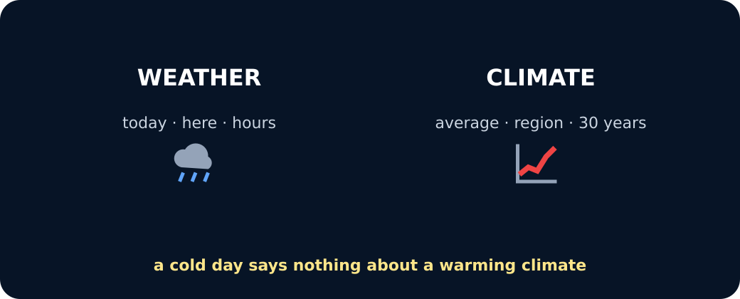
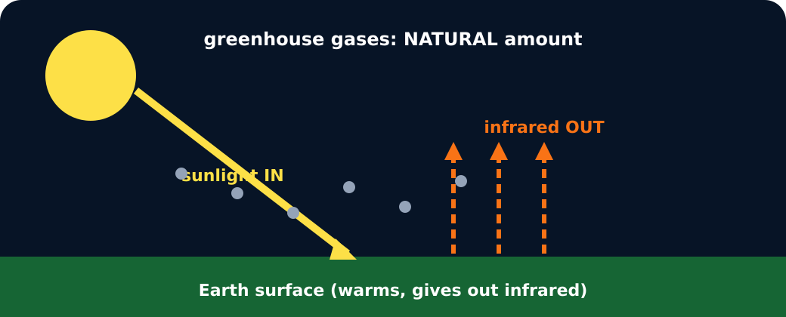
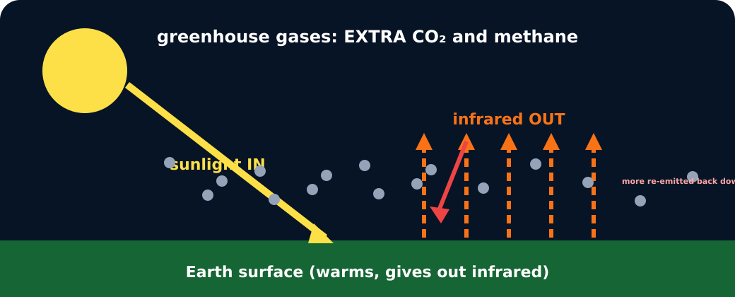
GROW / SCIENCE
STARTER
Look closely · what is the evidence?
Weather versus climate
Natural greenhouse effect
Enhanced greenhouse effect
STARTER · 4 min across this stage
6 / 18
Notes:
Companion for SCI_G_W11A_Global_Warming_Explore.html. Starter: 4 minutes TOTAL across all slides in this stage.
Protect curiosity: receive every first idea without judgement.
Ask ‘What makes you think that?’ and preserve the prediction for later evidence.
Model limit: The arrows show direction, not real amounts, times or the full climate system. Greenhouse gases are not a solid lid and do not create energy.
Full source-stage teaching text:
LOCAL VISUAL HOOK · FRAME 1
WEATHER · what happens now
Weather is today. Climate is the average over decades.
LOCAL VISUAL HOOK · FRAME 2
ENERGY · in, out, and re-emitted
Sunlight in. Infrared out. Gases absorb some and send it back: Earth is warm enough for life.
LOCAL VISUAL HOOK · FRAME 3
EXTRA gases · a stronger effect
More CO₂ and methane absorb more outgoing infrared. The average rises. Not a lid — a thicker blanket.
Commit one first idea. Predictions are held, not marked. Pointing, selecting, saying or signing all count.
Today's temperature at one place
A long record of averages from many places
One photograph of snow
HTML controls remain in the original HTML file. PowerPoint contains editable teaching text and static source visuals; use the paper response route for sorting and investigation.
[Sources]
Uploaded lesson: SCI_G_W11A_Global_Warming_Explore.html
[/Sources]

Slide 7
GROW / SCIENCE
I DO
Words we will use
• climate — weather pattern over time
• greenhouse gas — gas that affects heat flow
• average — one value for a set
I DO · 5 min across this stage
7 / 18
Notes:
Companion for SCI_G_W11A_Global_Warming_Explore.html. I do: 5 minutes TOTAL across all slides in this stage.
Let the teacher/model carry the explanation; pupils watch, point or track.
Use a visual cue only if access is the barrier, then fade it.
Model limit: The arrows show direction, not real amounts, times or the full climate system. Greenhouse gases are not a solid lid and do not create energy.
Full source-stage teaching text:
CLIMATE weather pattern over time the usual weather pattern over many years
GREENHOUSE GAS gas that affects heat flow a gas that absorbs and re-emits infrared energy
AVERAGE one value for a set one value used to describe a group of measurements
Energy-arrow model · natural and enhanced greenhouse effects
Natural effect · useful warming
Sunlight ↓ Surface warms ↑ Infrared leaves ↘ Some is re-emitted towards the surface
Enough natural warming for life; energy still leaves to space.
Extra greenhouse gases · enhanced effect
Sunlight ↓ Surface gives out infrared ↑ More is absorbed ↘ Some is re-emitted towards the surface
Net energy loss slows → the global average temperature rises.
WHAT THIS MODEL HELPS US SEE
The step-by-step energy route makes invisible transfers visible and separates the useful natural greenhouse effect from the enhanced effect caused by extra gases.
WHAT THIS MODEL DOES NOT SHOW
The arrows show direction, not real amounts, times or the full climate system. Greenhouse gases are not a solid lid and do not create energy.
Step 1
Sunlight passes through the atmosphere and transfers energy to Earth's surface.
Step 2
The warm surface gives out infrared energy. Naturally occurring greenhouse gases absorb and re-emit some of it; this natural effect keeps Earth warm enough for life.
Step 3
Extra carbon dioxide and methane enhance the effect: more outgoing infrared is absorbed and some is re-emitted towards the surface, slowing net energy loss until the global average temperature rises.
Energy balance model · add greenhouse gas
Press the buttons and watch the outgoing infrared. Nothing changes about the Sun.
natural gases
＋ extra CO₂ & methane
Natural greenhouse effect: some infrared is absorbed and re-emitted. Without it Earth would average about −18 °C.
“It’s a solid lid that traps all the heat”
“Every single day gets hotter”
“The average rises; extremes become more likely”
Which statement is the science?
HTML controls remain in the original HTML file. PowerPoint contains editable teaching text and static source visuals; use the paper response route for sorting and investigation.
[Sources]
Uploaded lesson: SCI_G_W11A_Global_Warming_Explore.html
[/Sources]

Slide 8
GROW / SCIENCE
I DO
Watch the model
• Sunlight passes through the atmosphere and transfers energy to Earth's surface.
• The warm surface gives out infrared energy. Naturally occurring greenhouse gases absorb and re-emit some of it; this natural effect keeps Earth warm enough for life.
• Extra carbon dioxide and methane enhance the effect: more outgoing infrared is absorbed and some is re-emitted towards the surface, slowing net energy loss until the global average temperature rises.
I DO · 5 min across this stage
8 / 18
Notes:
Companion for SCI_G_W11A_Global_Warming_Explore.html. I do: 5 minutes TOTAL across all slides in this stage.
Let the teacher/model carry the explanation; pupils watch, point or track.
Use a visual cue only if access is the barrier, then fade it.
Model limit: The arrows show direction, not real amounts, times or the full climate system. Greenhouse gases are not a solid lid and do not create energy.
Full source-stage teaching text:
CLIMATE weather pattern over time the usual weather pattern over many years
GREENHOUSE GAS gas that affects heat flow a gas that absorbs and re-emits infrared energy
AVERAGE one value for a set one value used to describe a group of measurements
Energy-arrow model · natural and enhanced greenhouse effects
Natural effect · useful warming
Sunlight ↓ Surface warms ↑ Infrared leaves ↘ Some is re-emitted towards the surface
Enough natural warming for life; energy still leaves to space.
Extra greenhouse gases · enhanced effect
Sunlight ↓ Surface gives out infrared ↑ More is absorbed ↘ Some is re-emitted towards the surface
Net energy loss slows → the global average temperature rises.
WHAT THIS MODEL HELPS US SEE
The step-by-step energy route makes invisible transfers visible and separates the useful natural greenhouse effect from the enhanced effect caused by extra gases.
WHAT THIS MODEL DOES NOT SHOW
The arrows show direction, not real amounts, times or the full climate system. Greenhouse gases are not a solid lid and do not create energy.
Step 1
Sunlight passes through the atmosphere and transfers energy to Earth's surface.
Step 2
The warm surface gives out infrared energy. Naturally occurring greenhouse gases absorb and re-emit some of it; this natural effect keeps Earth warm enough for life.
Step 3
Extra carbon dioxide and methane enhance the effect: more outgoing infrared is absorbed and some is re-emitted towards the surface, slowing net energy loss until the global average temperature rises.
Energy balance model · add greenhouse gas
Press the buttons and watch the outgoing infrared. Nothing changes about the Sun.
natural gases
＋ extra CO₂ & methane
Natural greenhouse effect: some infrared is absorbed and re-emitted. Without it Earth would average about −18 °C.
“It’s a solid lid that traps all the heat”
“Every single day gets hotter”
“The average rises; extremes become more likely”
Which statement is the science?
HTML controls remain in the original HTML file. PowerPoint contains editable teaching text and static source visuals; use the paper response route for sorting and investigation.
[Sources]
Uploaded lesson: SCI_G_W11A_Global_Warming_Explore.html
[/Sources]

Slide 9
GROW / SCIENCE
I DO
Watch the model
Greenhouse effect model
I DO · 5 min across this stage
9 / 18
Notes:
Companion for SCI_G_W11A_Global_Warming_Explore.html. I do: 5 minutes TOTAL across all slides in this stage.
Let the teacher/model carry the explanation; pupils watch, point or track.
Use a visual cue only if access is the barrier, then fade it.
Model limit: The arrows show direction, not real amounts, times or the full climate system. Greenhouse gases are not a solid lid and do not create energy.
Full source-stage teaching text:
CLIMATE weather pattern over time the usual weather pattern over many years
GREENHOUSE GAS gas that affects heat flow a gas that absorbs and re-emits infrared energy
AVERAGE one value for a set one value used to describe a group of measurements
Energy-arrow model · natural and enhanced greenhouse effects
Natural effect · useful warming
Sunlight ↓ Surface warms ↑ Infrared leaves ↘ Some is re-emitted towards the surface
Enough natural warming for life; energy still leaves to space.
Extra greenhouse gases · enhanced effect
Sunlight ↓ Surface gives out infrared ↑ More is absorbed ↘ Some is re-emitted towards the surface
Net energy loss slows → the global average temperature rises.
WHAT THIS MODEL HELPS US SEE
The step-by-step energy route makes invisible transfers visible and separates the useful natural greenhouse effect from the enhanced effect caused by extra gases.
WHAT THIS MODEL DOES NOT SHOW
The arrows show direction, not real amounts, times or the full climate system. Greenhouse gases are not a solid lid and do not create energy.
Step 1
Sunlight passes through the atmosphere and transfers energy to Earth's surface.
Step 2
The warm surface gives out infrared energy. Naturally occurring greenhouse gases absorb and re-emit some of it; this natural effect keeps Earth warm enough for life.
Step 3
Extra carbon dioxide and methane enhance the effect: more outgoing infrared is absorbed and some is re-emitted towards the surface, slowing net energy loss until the global average temperature rises.
Energy balance model · add greenhouse gas
Press the buttons and watch the outgoing infrared. Nothing changes about the Sun.
natural gases
＋ extra CO₂ & methane
Natural greenhouse effect: some infrared is absorbed and re-emitted. Without it Earth would average about −18 °C.
“It’s a solid lid that traps all the heat”
“Every single day gets hotter”
“The average rises; extremes become more likely”
Which statement is the science?
HTML controls remain in the original HTML file. PowerPoint contains editable teaching text and static source visuals; use the paper response route for sorting and investigation.
[Sources]
Uploaded lesson: SCI_G_W11A_Global_Warming_Explore.html
[/Sources]

Slide 10
GROW / SCIENCE
WE DO
Which statement is scientific?
A. Climate is the usual pattern over many years; one cold day is weather.
B. Global warming means every place becomes hotter every day.
C. The ozone hole is the main cause of global warming.
Commit to an answer. Show the evidence you used. Listen, then revise if needed.
WE DO · 5 min across this stage
10 / 18
Notes:
Companion for SCI_G_W11A_Global_Warming_Explore.html. We do: 5 minutes TOTAL across all slides in this stage.
Scan every response mode. Do not infer understanding from handwriting or confidence.
Secure: transfer. Mixed: contrast. Misconception: counterexample then a fresh question.
Ask every learner to commit privately before feedback. Use the pupil cards, table or evidence sheet; pointing, saying, signing and directing a partner are valid routes.
Model limit: The arrows show direction, not real amounts, times or the full climate system. Greenhouse gases are not a solid lid and do not create energy.
Full source-stage teaching text:
Everyone commits before explanation.
Use a button, point, say/sign or let an adult operate the chosen button. A retry is information, not a penalty.
Audience move:
Climate is the usual pattern over many years; one cold day is weather.
Global warming means every place becomes hotter every day.
The ozone hole is the main cause of global warming.
HTML controls remain in the original HTML file. PowerPoint contains editable teaching text and static source visuals; use the paper response route for sorting and investigation.
[Sources]
Uploaded lesson: SCI_G_W11A_Global_Warming_Explore.html
[/Sources]

Slide 11
GROW / SCIENCE
I DO 2
Build the explanation
• Human activities such as burning coal, oil and gas, plus deforestation, add greenhouse gases.
• A stronger greenhouse effect raises the global average; it does not make every day or place equally hot.
• This changes risks: heat extremes, rainfall patterns, melting land ice, sea-level rise and habitat stress.
I DO 2 · 4 min across this stage
11 / 18
Notes:
Companion for SCI_G_W11A_Global_Warming_Explore.html. I do 2: 4 minutes TOTAL across all slides in this stage.
Model one complete evidence-to-explanation sentence, then pause.
Keep the science words; change density, modality or adult role before changing the goal.
Model limit: The arrows show direction, not real amounts, times or the full climate system. Greenhouse gases are not a solid lid and do not create energy.
Full source-stage teaching text:
Connection: the model is useful when its visible pattern is translated into a scientific explanation.
Connection 1
Human activities such as burning coal, oil and gas, plus deforestation, add greenhouse gases.
Connection 2
A stronger greenhouse effect raises the global average; it does not make every day or place equally hot.
Connection 3
This changes risks: heat extremes, rainfall patterns, melting land ice, sea-level rise and habitat stress.
MODEL STRENGTH
The step-by-step energy route makes invisible transfers visible and separates the useful natural greenhouse effect from the enhanced effect caused by extra gases.
MODEL LIMIT
The arrows show direction, not real amounts, times or the full climate system. Greenhouse gases are not a solid lid and do not create energy.
HTML controls remain in the original HTML file. PowerPoint contains editable teaching text and static source visuals; use the paper response route for sorting and investigation.
[Sources]
Uploaded lesson: SCI_G_W11A_Global_Warming_Explore.html
[/Sources]

Slide 12
GROW / SCIENCE
I DO 2
Find and repair the misconception
One cold week disproves global warming.
A. Keep it: one week shows the whole climate.
B. Repair it: a short weather event cannot overturn a long-term global pattern.
C. Swap it: global warming means every day must be hot.
I DO 2 · 4 min across this stage
12 / 18
Notes:
Companion for SCI_G_W11A_Global_Warming_Explore.html. I do 2: 4 minutes TOTAL across all slides in this stage.
Model one complete evidence-to-explanation sentence, then pause.
Keep the science words; change density, modality or adult role before changing the goal.
Model limit: The arrows show direction, not real amounts, times or the full climate system. Greenhouse gases are not a solid lid and do not create energy.
Full source-stage teaching text:
Connection: the model is useful when its visible pattern is translated into a scientific explanation.
Connection 1
Human activities such as burning coal, oil and gas, plus deforestation, add greenhouse gases.
Connection 2
A stronger greenhouse effect raises the global average; it does not make every day or place equally hot.
Connection 3
This changes risks: heat extremes, rainfall patterns, melting land ice, sea-level rise and habitat stress.
MODEL STRENGTH
The step-by-step energy route makes invisible transfers visible and separates the useful natural greenhouse effect from the enhanced effect caused by extra gases.
MODEL LIMIT
The arrows show direction, not real amounts, times or the full climate system. Greenhouse gases are not a solid lid and do not create energy.
HTML controls remain in the original HTML file. PowerPoint contains editable teaching text and static source visuals; use the paper response route for sorting and investigation.
[Sources]
Uploaded lesson: SCI_G_W11A_Global_Warming_Explore.html
[/Sources]

Slide 13
GROW / SCIENCE
WE DO 2
Climate Chain Lab
Order one genuine five-link chain from a human activity to one likely effect. Say why each link follows the one before it.
• Human activity
• More greenhouse gas
• Energy loss slows
• Average temperature rises
• One likely effect
WE DO 2 · 4 min across this stage
13 / 18
Notes:
Companion for SCI_G_W11A_Global_Warming_Explore.html. We do 2: 4 minutes TOTAL across all slides in this stage.
Protect pupil operation and thinking; support handling only where needed.
Ask what changed and what stayed the same before supplying a scientific word.
Ask every learner to commit privately before feedback. Use the pupil cards, table or evidence sheet; pointing, saying, signing and directing a partner are valid routes.
Model limit: The arrows show direction, not real amounts, times or the full climate system. Greenhouse gases are not a solid lid and do not create energy.
Full source-stage teaching text:
Order one genuine five-link chain from a human activity to one likely effect. Say why each link follows the one before it.
Human activity More greenhouse gas Energy loss slows Average temperature rises One likely effect
Cards to place
Burning fossil fuels Coal, oil and gas release extra carbon dioxide when burned.
More greenhouse gas in the atmosphere The amount of carbon dioxide in the atmosphere increases.
Net energy loss slows More outgoing infrared is absorbed; some is re-emitted towards the surface, so energy leaves Earth more slowly.
Global average temperature rises Earth warms until incoming and outgoing energy balance again at a higher average temperature.
Land ice melts Warming increases melting of glaciers and ice sheets, contributing to sea-level rise.
Matching groups
1 · HUMAN ACTIVITY
2 · MORE GREENHOUSE GAS
3 · ENERGY CHANGE
4 · GLOBAL WARMING
5 · LIKELY EFFECT
Freeze evidence
↺ Reset and retry
Science glitch · find and repair it
Claim: One cold week disproves global warming.
Keep it: one week shows the whole climate.
Repair it: a short weather event cannot overturn a long-term global pattern.
Swap it: global warming means every day must be hot.
HTML controls remain in the original HTML file. PowerPoint contains editable teaching text and static source visuals; use the paper response route for sorting and investigation.
[Sources]
Uploaded lesson: SCI_G_W11A_Global_Warming_Explore.html
[/Sources]

Slide 14
GROW / SCIENCE
WE DO 2
Climate Chain Lab
Use the numbered cards in your pupil pack. Take turns to choose, justify and check. You may direct a partner to move a card.
WE DO 2 · 4 min across this stage
14 / 18
Notes:
Companion for SCI_G_W11A_Global_Warming_Explore.html. We do 2: 4 minutes TOTAL across all slides in this stage.
Protect pupil operation and thinking; support handling only where needed.
Ask what changed and what stayed the same before supplying a scientific word.
Ask every learner to commit privately before feedback. Use the pupil cards, table or evidence sheet; pointing, saying, signing and directing a partner are valid routes.
Model limit: The arrows show direction, not real amounts, times or the full climate system. Greenhouse gases are not a solid lid and do not create energy.
Full source-stage teaching text:
Order one genuine five-link chain from a human activity to one likely effect. Say why each link follows the one before it.
Human activity More greenhouse gas Energy loss slows Average temperature rises One likely effect
Cards to place
Burning fossil fuels Coal, oil and gas release extra carbon dioxide when burned.
More greenhouse gas in the atmosphere The amount of carbon dioxide in the atmosphere increases.
Net energy loss slows More outgoing infrared is absorbed; some is re-emitted towards the surface, so energy leaves Earth more slowly.
Global average temperature rises Earth warms until incoming and outgoing energy balance again at a higher average temperature.
Land ice melts Warming increases melting of glaciers and ice sheets, contributing to sea-level rise.
Matching groups
1 · HUMAN ACTIVITY
2 · MORE GREENHOUSE GAS
3 · ENERGY CHANGE
4 · GLOBAL WARMING
5 · LIKELY EFFECT
Freeze evidence
↺ Reset and retry
Science glitch · find and repair it
Claim: One cold week disproves global warming.
Keep it: one week shows the whole climate.
Repair it: a short weather event cannot overturn a long-term global pattern.
Swap it: global warming means every day must be hot.
HTML controls remain in the original HTML file. PowerPoint contains editable teaching text and static source visuals; use the paper response route for sorting and investigation.
[Sources]
Uploaded lesson: SCI_G_W11A_Global_Warming_Explore.html
[/Sources]

Slide 15
GROW / SCIENCE
WE DO 2
Choose a group · defend your placement
• 1 · HUMAN ACTIVITY
• 2 · MORE GREENHOUSE GAS
• 3 · ENERGY CHANGE
• 4 · GLOBAL WARMING
• 5 · LIKELY EFFECT
Read all five links with because and can lead to. Keep the effect likely, not guaranteed everywhere.
WE DO 2 · 4 min across this stage
15 / 18
Notes:
Companion for SCI_G_W11A_Global_Warming_Explore.html. We do 2: 4 minutes TOTAL across all slides in this stage.
Protect pupil operation and thinking; support handling only where needed.
Ask what changed and what stayed the same before supplying a scientific word.
Ask every learner to commit privately before feedback. Use the pupil cards, table or evidence sheet; pointing, saying, signing and directing a partner are valid routes.
Model limit: The arrows show direction, not real amounts, times or the full climate system. Greenhouse gases are not a solid lid and do not create energy.
Full source-stage teaching text:
Order one genuine five-link chain from a human activity to one likely effect. Say why each link follows the one before it.
Human activity More greenhouse gas Energy loss slows Average temperature rises One likely effect
Cards to place
Burning fossil fuels Coal, oil and gas release extra carbon dioxide when burned.
More greenhouse gas in the atmosphere The amount of carbon dioxide in the atmosphere increases.
Net energy loss slows More outgoing infrared is absorbed; some is re-emitted towards the surface, so energy leaves Earth more slowly.
Global average temperature rises Earth warms until incoming and outgoing energy balance again at a higher average temperature.
Land ice melts Warming increases melting of glaciers and ice sheets, contributing to sea-level rise.
Matching groups
1 · HUMAN ACTIVITY
2 · MORE GREENHOUSE GAS
3 · ENERGY CHANGE
4 · GLOBAL WARMING
5 · LIKELY EFFECT
Freeze evidence
↺ Reset and retry
Science glitch · find and repair it
Claim: One cold week disproves global warming.
Keep it: one week shows the whole climate.
Repair it: a short weather event cannot overturn a long-term global pattern.
Swap it: global warming means every day must be hot.
HTML controls remain in the original HTML file. PowerPoint contains editable teaching text and static source visuals; use the paper response route for sorting and investigation.
[Sources]
Uploaded lesson: SCI_G_W11A_Global_Warming_Explore.html
[/Sources]

Slide 16
GROW / SCIENCE
INDEPENDENT
Your independent mission
Create the five-link chain activity → more greenhouse gas → slower net energy loss → higher global average → one likely effect, then explain it aloud, by pointing or in writing.
Record: One ordered causal chain, one explained effect and one honest model limitation.
INDEPENDENT · 10 min across this stage
16 / 18
Notes:
Companion for SCI_G_W11A_Global_Warming_Explore.html. Independent: 10 minutes TOTAL across all slides in this stage.
Protect independence. Accept equivalent evidence routes and scribe exact meaning.
Prompt only as much as needed; fade as soon as the pupil continues.
Model limit: The arrows show direction, not real amounts, times or the full climate system. Greenhouse gases are not a solid lid and do not create energy.
Full source-stage teaching text:
Physical route
Cause, energy and effect cards; arrow strip; pencil; optional calm digital card route.
Same outcome: I can explain how extra greenhouse gases raise Earth's average temperature and connect warming to wider climate effects.
Offline digital / director route
Sort the same local cards, freeze the chain and print only when chosen. No account or internet is needed.
Same evidence: One ordered causal chain, one explained effect and one honest model limitation.
Equipment / setup Cause, energy and effect cards; arrow strip; pencil; optional calm digital card route.
Safety / sensory Use calm, solution-aware language. Do not ask for family carbon data or use frightening imagery.
Offline parity Sort the same local cards, freeze the chain and print only when chosen. No account or internet is needed.
No-equipment/access route: Order printed cards or direct an adult to move them. A scribed exact response is equivalent evidence.
▲ Standard
Draw or order the full chain and explain one effect using because.
Scaffold
Use the three headings Cause, Energy mechanism and Effect, then remove the sentence frame.
Evidence gate
HTML controls remain in the original HTML file. PowerPoint contains editable teaching text and static source visuals; use the paper response route for sorting and investigation.
[Sources]
Uploaded lesson: SCI_G_W11A_Global_Warming_Explore.html
[/Sources]

Slide 17
GROW / SCIENCE
INDEPENDENT
Choose your support and challenge
• Supported: Order the five icon-backed links and complete: More greenhouse gas slows ___. The higher global average can lead to ___.
• Standard: Draw or order the full chain and explain one effect using because.
• Stretch: Contrast the natural and enhanced greenhouse effects, then explain why one weather event is weak evidence.
INDEPENDENT · 10 min across this stage
17 / 18
Notes:
Companion for SCI_G_W11A_Global_Warming_Explore.html. Independent: 10 minutes TOTAL across all slides in this stage.
Protect independence. Accept equivalent evidence routes and scribe exact meaning.
Prompt only as much as needed; fade as soon as the pupil continues.
Model limit: The arrows show direction, not real amounts, times or the full climate system. Greenhouse gases are not a solid lid and do not create energy.
Full source-stage teaching text:
Physical route
Cause, energy and effect cards; arrow strip; pencil; optional calm digital card route.
Same outcome: I can explain how extra greenhouse gases raise Earth's average temperature and connect warming to wider climate effects.
Offline digital / director route
Sort the same local cards, freeze the chain and print only when chosen. No account or internet is needed.
Same evidence: One ordered causal chain, one explained effect and one honest model limitation.
Equipment / setup Cause, energy and effect cards; arrow strip; pencil; optional calm digital card route.
Safety / sensory Use calm, solution-aware language. Do not ask for family carbon data or use frightening imagery.
Offline parity Sort the same local cards, freeze the chain and print only when chosen. No account or internet is needed.
No-equipment/access route: Order printed cards or direct an adult to move them. A scribed exact response is equivalent evidence.
▲ Standard
Draw or order the full chain and explain one effect using because.
Scaffold
Use the three headings Cause, Energy mechanism and Effect, then remove the sentence frame.
Evidence gate
HTML controls remain in the original HTML file. PowerPoint contains editable teaching text and static source visuals; use the paper response route for sorting and investigation.
[Sources]
Uploaded lesson: SCI_G_W11A_Global_Warming_Explore.html
[/Sources]

Slide 18
GROW / SCIENCE
EXIT
Show what you know
What changes in the energy route when extra greenhouse gas is added?
Point to, read or explain the evidence you made. Choose one next step after the adult has listened.
EXIT · 4 min across this stage
18 / 18
Notes:
Companion for SCI_G_W11A_Global_Warming_Explore.html. Exit: 4 minutes TOTAL across all slides in this stage.
Genuinely receive one final response and name back the Science heard or seen.
Choose one visible next move. The pupil writes what they said and what changed.
Model limit: The arrows show direction, not real amounts, times or the full climate system. Greenhouse gases are not a solid lid and do not create energy.
Full source-stage teaching text:
Standard
What changes in the energy route when extra greenhouse gas is added?
Adult Audience
The familiar adult genuinely receives the pupil response, then says back the Science they heard or saw. The adult does not add a score or rewrite the pupil.
What I said, and what it changed:
Next I will ______. One next step chosen after the adult listened.
HTML controls remain in the original HTML file. PowerPoint contains editable teaching text and static source visuals; use the paper response route for sorting and investigation.
[Sources]
Uploaded lesson: SCI_G_W11A_Global_Warming_Explore.html
[/Sources]

