Slide 1
GROW / SCIENCE
OVERVIEW
Rover Rescue: Plan a Fair Test
I can plan a fair investigation of how surface type affects a rover's travel distance.
CHANGE
use evidence
MEASURE
use evidence
KEEP
use evidence
Open the original interactive lesson
40 MINUTES
1 / 16
Notes:
Companion for SCI_G_W13A_Rover_Rescue_Plan_Explore.html. Overview: 0 minutes TOTAL across all slides in this stage.
Read setup, safety and sensory notes before pupils enter.
Set predictable Space and keep the learning goal visible.
Model limit: The classroom rover, surfaces and short ramp simplify a real planetary rover. The model can compare friction here, not copy every real condition.
Full source-stage teaching text:
GROW · Science · Week 13A · Explore
Learning objective: I can plan a fair investigation of how surface type affects a rover's travel distance.
Success criteria
I can name surface type as the independent variable and compare smooth with fabric.
I can measure travel distance and keep other variables controlled.
I can plan three repeats for each condition and state a safe method.
HTML controls remain in the original HTML file. PowerPoint contains editable teaching text and static source visuals; use the paper response route for sorting and investigation.
[Sources]
Uploaded lesson: SCI_G_W13A_Rover_Rescue_Plan_Explore.html
[/Sources]

Slide 2
GROW / SCIENCE
OVERVIEW
What success looks like
• I can name surface type as the independent variable and compare smooth with fabric.
• I can measure travel distance and keep other variables controlled.
• I can plan three repeats for each condition and state a safe method.
40 MINUTES
2 / 16
Notes:
Companion for SCI_G_W13A_Rover_Rescue_Plan_Explore.html. Overview: 0 minutes TOTAL across all slides in this stage.
Read setup, safety and sensory notes before pupils enter.
Set predictable Space and keep the learning goal visible.
Model limit: The classroom rover, surfaces and short ramp simplify a real planetary rover. The model can compare friction here, not copy every real condition.
Full source-stage teaching text:
GROW · Science · Week 13A · Explore
Learning objective: I can plan a fair investigation of how surface type affects a rover's travel distance.
Success criteria
I can name surface type as the independent variable and compare smooth with fabric.
I can measure travel distance and keep other variables controlled.
I can plan three repeats for each condition and state a safe method.
HTML controls remain in the original HTML file. PowerPoint contains editable teaching text and static source visuals; use the paper response route for sorting and investigation.
[Sources]
Uploaded lesson: SCI_G_W13A_Rover_Rescue_Plan_Explore.html
[/Sources]

Slide 3
GROW / SCIENCE
ARRIVAL
Retrieve and reconnect
• Name the independent variable in a surface test.
• Name the dependent variable and its unit.
• List two variables to control.
• Explain why each condition needs repeats.
ARRIVAL · 4 min across this stage
3 / 16
Notes:
Companion for SCI_G_W13A_Rover_Rescue_Plan_Explore.html. Arrival: 4 minutes TOTAL across all slides in this stage.
Wait, regulate and retrieve through the lightest workable route.
If recall is inaccessible, point to one retrieval sentence; do not teach today’s answer.
Model limit: The classroom rover, surfaces and short ramp simplify a real planetary rover. The model can compare friction here, not copy every real condition.
Full source-stage teaching text:
Retrieve only what has already been taught
W12: a conclusion needs relevant repeated evidence.
W11: decide the measure before claiming success.
W5: a fair test changes one variable at a time.
W4: mechanisms and friction change how objects move.
New to this class, absent, or not sure? Everything needed is in the retrieval box above. Read it, point to it or ask a familiar adult to read it exactly.
▲ Standard
Name the independent variable in a surface test.
Name the dependent variable and its unit.
List two variables to control.
Explain why each condition needs repeats.
Read-aloud route: a familiar adult may read the task exactly while the text remains visible. No device voice or media permission is required.
HTML controls remain in the original HTML file. PowerPoint contains editable teaching text and static source visuals; use the paper response route for sorting and investigation.
[Sources]
Uploaded lesson: SCI_G_W13A_Rover_Rescue_Plan_Explore.html
[/Sources]

Slide 4
GROW / SCIENCE
STARTER
Which plan lets us find out whether surface type affects rover travel distance?
Think first. Point, say, sign or write your choice. Give one reason.
A. Change surface only; keep ramp and release the same
B. Change surface and ramp height together
C. Push the rover differently each time
STARTER · 4 min across this stage
4 / 16
Notes:
Companion for SCI_G_W13A_Rover_Rescue_Plan_Explore.html. Starter: 4 minutes TOTAL across all slides in this stage.
Protect curiosity: receive every first idea without judgement.
Ask ‘What makes you think that?’ and preserve the prediction for later evidence.
Model limit: The classroom rover, surfaces and short ramp simplify a real planetary rover. The model can compare friction here, not copy every real condition.
Full source-stage teaching text:
LOCAL VISUAL HOOK · FRAME 1
CHANGE · one independent variable
Only the surface changes.
LOCAL VISUAL HOOK · FRAME 2
MEASURE · distance in centimetres
Same line, same end of the rover, same unit.
LOCAL VISUAL HOOK · FRAME 3
KEEP · controls and repeat
Three repeats per surface. A six-row table before you start.
Commit one first idea. Predictions are held, not marked. Pointing, selecting, saying or signing all count.
Change surface only; keep ramp and release the same
Change surface and ramp height together
Push the rover differently each time
HTML controls remain in the original HTML file. PowerPoint contains editable teaching text and static source visuals; use the paper response route for sorting and investigation.
[Sources]
Uploaded lesson: SCI_G_W13A_Rover_Rescue_Plan_Explore.html
[/Sources]

Slide 5
GROW / SCIENCE
STARTER
Look closely · what is the evidence?
CHANGE · one independent variable
MEASURE · distance in centimetres
KEEP · controls and repeat
STARTER · 4 min across this stage
5 / 16
Notes:
Companion for SCI_G_W13A_Rover_Rescue_Plan_Explore.html. Starter: 4 minutes TOTAL across all slides in this stage.
Protect curiosity: receive every first idea without judgement.
Ask ‘What makes you think that?’ and preserve the prediction for later evidence.
Model limit: The classroom rover, surfaces and short ramp simplify a real planetary rover. The model can compare friction here, not copy every real condition.
Full source-stage teaching text:
LOCAL VISUAL HOOK · FRAME 1
CHANGE · one independent variable
Only the surface changes.
LOCAL VISUAL HOOK · FRAME 2
MEASURE · distance in centimetres
Same line, same end of the rover, same unit.
LOCAL VISUAL HOOK · FRAME 3
KEEP · controls and repeat
Three repeats per surface. A six-row table before you start.
Commit one first idea. Predictions are held, not marked. Pointing, selecting, saying or signing all count.
Change surface only; keep ramp and release the same
Change surface and ramp height together
Push the rover differently each time
HTML controls remain in the original HTML file. PowerPoint contains editable teaching text and static source visuals; use the paper response route for sorting and investigation.
[Sources]
Uploaded lesson: SCI_G_W13A_Rover_Rescue_Plan_Explore.html
[/Sources]

Slide 6
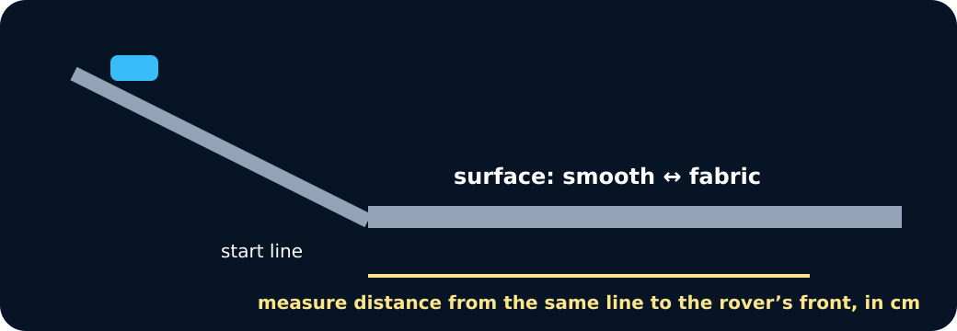
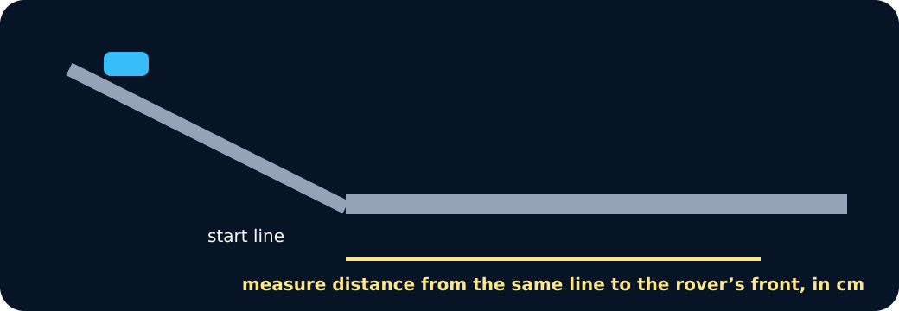
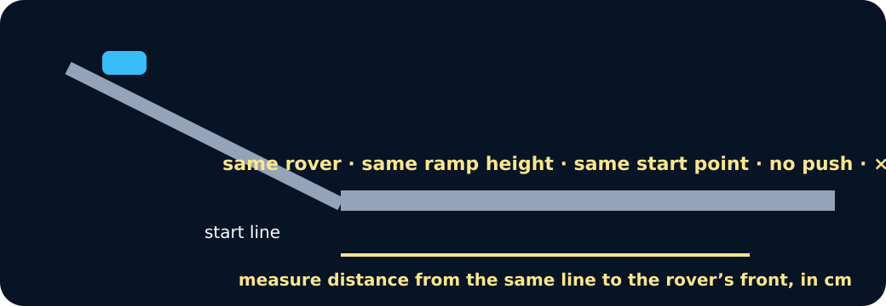
GROW / SCIENCE
STARTER
Look closely · what is the evidence?
Ramp and surface
Measuring distance
Controls
STARTER · 4 min across this stage
6 / 16
Notes:
Companion for SCI_G_W13A_Rover_Rescue_Plan_Explore.html. Starter: 4 minutes TOTAL across all slides in this stage.
Protect curiosity: receive every first idea without judgement.
Ask ‘What makes you think that?’ and preserve the prediction for later evidence.
Model limit: The classroom rover, surfaces and short ramp simplify a real planetary rover. The model can compare friction here, not copy every real condition.
Full source-stage teaching text:
LOCAL VISUAL HOOK · FRAME 1
CHANGE · one independent variable
Only the surface changes.
LOCAL VISUAL HOOK · FRAME 2
MEASURE · distance in centimetres
Same line, same end of the rover, same unit.
LOCAL VISUAL HOOK · FRAME 3
KEEP · controls and repeat
Three repeats per surface. A six-row table before you start.
Commit one first idea. Predictions are held, not marked. Pointing, selecting, saying or signing all count.
Change surface only; keep ramp and release the same
Change surface and ramp height together
Push the rover differently each time
HTML controls remain in the original HTML file. PowerPoint contains editable teaching text and static source visuals; use the paper response route for sorting and investigation.
[Sources]
Uploaded lesson: SCI_G_W13A_Rover_Rescue_Plan_Explore.html
[/Sources]

Slide 7
GROW / SCIENCE
I DO
Words we will use
• independent variable — what I change
• dependent variable — what I measure
• control variable — what I keep the same
I DO · 5 min across this stage
7 / 16
Notes:
Companion for SCI_G_W13A_Rover_Rescue_Plan_Explore.html. I do: 5 minutes TOTAL across all slides in this stage.
Let the teacher/model carry the explanation; pupils watch, point or track.
Use a visual cue only if access is the barrier, then fade it.
Model limit: The classroom rover, surfaces and short ramp simplify a real planetary rover. The model can compare friction here, not copy every real condition.
Full source-stage teaching text:
INDEPENDENT VARIABLE what I change the one factor deliberately changed in a fair test
DEPENDENT VARIABLE what I measure the result measured after the change
CONTROL VARIABLE what I keep the same a factor kept the same so the comparison is fair
WHAT THIS MODEL HELPS US SEE
The change–measure–keep board makes variable roles visible before equipment is touched.
WHAT THIS MODEL DOES NOT SHOW
The classroom rover, surfaces and short ramp simplify a real planetary rover. The model can compare friction here, not copy every real condition.
Step 1
Choose one question: How does surface type affect rover travel distance? Conditions: smooth and fabric.
Step 2
Measure the distance from the same finish line to the rover's front in centimetres.
Step 3
Keep the rover, low ramp height, start point and no-push release the same; plan three repeats per condition.
Rover plan · CHANGE, MEASURE, KEEP
ramp height
surface type
distance travelled (cm)
the rover used
release without a push
number of repeats (3 each)
1⃣ CHANGE
MEASURE
KEEP
Press a card.
CHANGE: — · MEASURE: — · KEEP: —
Build the six-row table
HTML controls remain in the original HTML file. PowerPoint contains editable teaching text and static source visuals; use the paper response route for sorting and investigation.
[Sources]
Uploaded lesson: SCI_G_W13A_Rover_Rescue_Plan_Explore.html
[/Sources]

Slide 8
GROW / SCIENCE
I DO
Watch the model
• Choose one question: How does surface type affect rover travel distance? Conditions: smooth and fabric.
• Measure the distance from the same finish line to the rover's front in centimetres.
• Keep the rover, low ramp height, start point and no-push release the same; plan three repeats per condition.
I DO · 5 min across this stage
8 / 16
Notes:
Companion for SCI_G_W13A_Rover_Rescue_Plan_Explore.html. I do: 5 minutes TOTAL across all slides in this stage.
Let the teacher/model carry the explanation; pupils watch, point or track.
Use a visual cue only if access is the barrier, then fade it.
Model limit: The classroom rover, surfaces and short ramp simplify a real planetary rover. The model can compare friction here, not copy every real condition.
Full source-stage teaching text:
INDEPENDENT VARIABLE what I change the one factor deliberately changed in a fair test
DEPENDENT VARIABLE what I measure the result measured after the change
CONTROL VARIABLE what I keep the same a factor kept the same so the comparison is fair
WHAT THIS MODEL HELPS US SEE
The change–measure–keep board makes variable roles visible before equipment is touched.
WHAT THIS MODEL DOES NOT SHOW
The classroom rover, surfaces and short ramp simplify a real planetary rover. The model can compare friction here, not copy every real condition.
Step 1
Choose one question: How does surface type affect rover travel distance? Conditions: smooth and fabric.
Step 2
Measure the distance from the same finish line to the rover's front in centimetres.
Step 3
Keep the rover, low ramp height, start point and no-push release the same; plan three repeats per condition.
Rover plan · CHANGE, MEASURE, KEEP
ramp height
surface type
distance travelled (cm)
the rover used
release without a push
number of repeats (3 each)
1⃣ CHANGE
MEASURE
KEEP
Press a card.
CHANGE: — · MEASURE: — · KEEP: —
Build the six-row table
HTML controls remain in the original HTML file. PowerPoint contains editable teaching text and static source visuals; use the paper response route for sorting and investigation.
[Sources]
Uploaded lesson: SCI_G_W13A_Rover_Rescue_Plan_Explore.html
[/Sources]

Slide 9
GROW / SCIENCE
WE DO
Which is the fairest rover test question?
A. How does surface type affect travel distance when ramp height and release stay the same?
B. What happens when surface and ramp height both change?
C. Which rover looks fastest after a different push each time?
Commit to an answer. Show the evidence you used. Listen, then revise if needed.
WE DO · 5 min across this stage
9 / 16
Notes:
Companion for SCI_G_W13A_Rover_Rescue_Plan_Explore.html. We do: 5 minutes TOTAL across all slides in this stage.
Scan every response mode. Do not infer understanding from handwriting or confidence.
Secure: transfer. Mixed: contrast. Misconception: counterexample then a fresh question.
Ask every learner to commit privately before feedback. Use the pupil cards, table or evidence sheet; pointing, saying, signing and directing a partner are valid routes.
Model limit: The classroom rover, surfaces and short ramp simplify a real planetary rover. The model can compare friction here, not copy every real condition.
Full source-stage teaching text:
Everyone commits before explanation.
Use a button, point, say/sign or let an adult operate the chosen button. A retry is information, not a penalty.
Audience move:
How does surface type affect travel distance when ramp height and release stay the same?
What happens when surface and ramp height both change?
Which rover looks fastest after a different push each time?
HTML controls remain in the original HTML file. PowerPoint contains editable teaching text and static source visuals; use the paper response route for sorting and investigation.
[Sources]
Uploaded lesson: SCI_G_W13A_Rover_Rescue_Plan_Explore.html
[/Sources]

Slide 10
GROW / SCIENCE
I DO 2
Build the explanation
• Safety first: use a stable low ramp in a clear tray or lane. Release without pushing and keep hands out of the travel path.
• Create a six-row table before testing: two conditions with three blank repeat rows each.
• Make a prediction with a reason, but record what happens rather than changing results to fit it.
I DO 2 · 4 min across this stage
10 / 16
Notes:
Companion for SCI_G_W13A_Rover_Rescue_Plan_Explore.html. I do 2: 4 minutes TOTAL across all slides in this stage.
Model one complete evidence-to-explanation sentence, then pause.
Keep the science words; change density, modality or adult role before changing the goal.
Model limit: The classroom rover, surfaces and short ramp simplify a real planetary rover. The model can compare friction here, not copy every real condition.
Full source-stage teaching text:
Connection: the model is useful when its visible pattern is translated into a scientific explanation.
Connection 1
Safety first: use a stable low ramp in a clear tray or lane. Release without pushing and keep hands out of the travel path.
Connection 2
Create a six-row table before testing: two conditions with three blank repeat rows each.
Connection 3
Make a prediction with a reason, but record what happens rather than changing results to fit it.
MODEL STRENGTH
The change–measure–keep board makes variable roles visible before equipment is touched.
MODEL LIMIT
The classroom rover, surfaces and short ramp simplify a real planetary rover. The model can compare friction here, not copy every real condition.
HTML controls remain in the original HTML file. PowerPoint contains editable teaching text and static source visuals; use the paper response route for sorting and investigation.
[Sources]
Uploaded lesson: SCI_G_W13A_Rover_Rescue_Plan_Explore.html
[/Sources]

Slide 11
GROW / SCIENCE
I DO 2
Find and repair the misconception
For a clearer result, change the surface and ramp height together.
A. Keep it: two changes give twice as much evidence.
B. Repair it: change one variable so the cause of any difference is clearer.
C. Change it: add a different push on every run.
I DO 2 · 4 min across this stage
11 / 16
Notes:
Companion for SCI_G_W13A_Rover_Rescue_Plan_Explore.html. I do 2: 4 minutes TOTAL across all slides in this stage.
Model one complete evidence-to-explanation sentence, then pause.
Keep the science words; change density, modality or adult role before changing the goal.
Model limit: The classroom rover, surfaces and short ramp simplify a real planetary rover. The model can compare friction here, not copy every real condition.
Full source-stage teaching text:
Connection: the model is useful when its visible pattern is translated into a scientific explanation.
Connection 1
Safety first: use a stable low ramp in a clear tray or lane. Release without pushing and keep hands out of the travel path.
Connection 2
Create a six-row table before testing: two conditions with three blank repeat rows each.
Connection 3
Make a prediction with a reason, but record what happens rather than changing results to fit it.
MODEL STRENGTH
The change–measure–keep board makes variable roles visible before equipment is touched.
MODEL LIMIT
The classroom rover, surfaces and short ramp simplify a real planetary rover. The model can compare friction here, not copy every real condition.
HTML controls remain in the original HTML file. PowerPoint contains editable teaching text and static source visuals; use the paper response route for sorting and investigation.
[Sources]
Uploaded lesson: SCI_G_W13A_Rover_Rescue_Plan_Explore.html
[/Sources]

Slide 12
GROW / SCIENCE
WE DO 2
Fair-Test Control Board
Place each method card under Change, Measure or Keep the same. Reject any plan that changes two variables.
• Choose one question
• Name two conditions
• Set measure and controls
• Plan three repeats
Use the numbered cards in your pupil pack. Take turns to choose, justify and check. You may direct a partner to move a card.
WE DO 2 · 4 min across this stage
12 / 16
Notes:
Companion for SCI_G_W13A_Rover_Rescue_Plan_Explore.html. We do 2: 4 minutes TOTAL across all slides in this stage.
Protect pupil operation and thinking; support handling only where needed.
Ask what changed and what stayed the same before supplying a scientific word.
Ask every learner to commit privately before feedback. Use the pupil cards, table or evidence sheet; pointing, saying, signing and directing a partner are valid routes.
Model limit: The classroom rover, surfaces and short ramp simplify a real planetary rover. The model can compare friction here, not copy every real condition.
Full source-stage teaching text:
Place each method card under Change, Measure or Keep the same. Reject any plan that changes two variables.
Choose one question Name two conditions Set measure and controls Plan three repeats
Cards to place
Surface type Use smooth and fabric as the two conditions.
Travel distance in cm Measure from the same line to the rover's front.
Low ramp height Use the same safe height for every surface run.
Same rover Use the same trolley or rover for all six runs.
Same no-push release Release from one marked start point without adding a push.
Three results per condition Record every run, including an unexpected result.
Matching groups
CHANGE
MEASURE
KEEP THE SAME
REPEAT / RECORD
Freeze evidence
↺ Reset and retry
Science glitch · find and repair it
Claim: For a clearer result, change the surface and ramp height together.
Keep it: two changes give twice as much evidence.
Repair it: change one variable so the cause of any difference is clearer.
Change it: add a different push on every run.
HTML controls remain in the original HTML file. PowerPoint contains editable teaching text and static source visuals; use the paper response route for sorting and investigation.
[Sources]
Uploaded lesson: SCI_G_W13A_Rover_Rescue_Plan_Explore.html
[/Sources]

Slide 13
GROW / SCIENCE
WE DO 2
Choose a group · defend your placement
• CHANGE
• MEASURE
• KEEP THE SAME
• REPEAT / RECORD
Read the frozen plan as a method: We change surface. We measure ___. We keep ___ the same. We repeat ___.
WE DO 2 · 4 min across this stage
13 / 16
Notes:
Companion for SCI_G_W13A_Rover_Rescue_Plan_Explore.html. We do 2: 4 minutes TOTAL across all slides in this stage.
Protect pupil operation and thinking; support handling only where needed.
Ask what changed and what stayed the same before supplying a scientific word.
Ask every learner to commit privately before feedback. Use the pupil cards, table or evidence sheet; pointing, saying, signing and directing a partner are valid routes.
Model limit: The classroom rover, surfaces and short ramp simplify a real planetary rover. The model can compare friction here, not copy every real condition.
Full source-stage teaching text:
Place each method card under Change, Measure or Keep the same. Reject any plan that changes two variables.
Choose one question Name two conditions Set measure and controls Plan three repeats
Cards to place
Surface type Use smooth and fabric as the two conditions.
Travel distance in cm Measure from the same line to the rover's front.
Low ramp height Use the same safe height for every surface run.
Same rover Use the same trolley or rover for all six runs.
Same no-push release Release from one marked start point without adding a push.
Three results per condition Record every run, including an unexpected result.
Matching groups
CHANGE
MEASURE
KEEP THE SAME
REPEAT / RECORD
Freeze evidence
↺ Reset and retry
Science glitch · find and repair it
Claim: For a clearer result, change the surface and ramp height together.
Keep it: two changes give twice as much evidence.
Repair it: change one variable so the cause of any difference is clearer.
Change it: add a different push on every run.
HTML controls remain in the original HTML file. PowerPoint contains editable teaching text and static source visuals; use the paper response route for sorting and investigation.
[Sources]
Uploaded lesson: SCI_G_W13A_Rover_Rescue_Plan_Explore.html
[/Sources]

Slide 14
GROW / SCIENCE
INDEPENDENT
Your independent mission
Produce a safe fair-test plan comparing smooth and fabric surfaces, with three repeats per condition.
Record: Question, prediction, variable table, safe numbered method, two conditions, six result spaces and one model limitation.
INDEPENDENT · 10 min across this stage
14 / 16
Notes:
Companion for SCI_G_W13A_Rover_Rescue_Plan_Explore.html. Independent: 10 minutes TOTAL across all slides in this stage.
Protect independence. Accept equivalent evidence routes and scribe exact meaning.
Prompt only as much as needed; fade as soon as the pupil continues.
Model limit: The classroom rover, surfaces and short ramp simplify a real planetary rover. The model can compare friction here, not copy every real condition.
Full source-stage teaching text:
Physical route
Planning mat; low ramp; trolley or rover; smooth and fabric surfaces; metre rule or tape; start and finish markers.
Same outcome: I can plan a fair investigation of how surface type affects a rover's travel distance.
Offline digital / director route
Use the same two-condition plan and six blank result rows with a local rover representation; no results are saved.
Same evidence: Question, prediction, variable table, safe numbered method, two conditions, six result spaces and one model limitation.
Equipment / setup Planning mat; low ramp; trolley or rover; smooth and fabric surfaces; metre rule or tape; start and finish markers.
Safety / sensory Teacher checks a stable low ramp and clear lane. Do not push the rover, chase it or place hands in its path.
Offline parity Use the same two-condition plan and six blank result rows with a local rover representation; no results are saved.
No-equipment/access route: Plan with cards only or direct an adult to place every method card. No equipment handling is required.
▲ Standard
Write a fair question, prediction, variable table and numbered method for two conditions with three repeats.
Scaffold
Use the check: one change, one measured outcome, same release and safe low ramp.
Evidence gate
HTML controls remain in the original HTML file. PowerPoint contains editable teaching text and static source visuals; use the paper response route for sorting and investigation.
[Sources]
Uploaded lesson: SCI_G_W13A_Rover_Rescue_Plan_Explore.html
[/Sources]

Slide 15
GROW / SCIENCE
INDEPENDENT
Choose your support and challenge
• Supported: Use the prepared surface question and complete Change, Measure, Keep and Repeat with icon-backed cards.
• Standard: Write a fair question, prediction, variable table and numbered method for two conditions with three repeats.
• Stretch: Justify the controls, predict random variation and explain one limitation of transfer to a real rover.
INDEPENDENT · 10 min across this stage
15 / 16
Notes:
Companion for SCI_G_W13A_Rover_Rescue_Plan_Explore.html. Independent: 10 minutes TOTAL across all slides in this stage.
Protect independence. Accept equivalent evidence routes and scribe exact meaning.
Prompt only as much as needed; fade as soon as the pupil continues.
Model limit: The classroom rover, surfaces and short ramp simplify a real planetary rover. The model can compare friction here, not copy every real condition.
Full source-stage teaching text:
Physical route
Planning mat; low ramp; trolley or rover; smooth and fabric surfaces; metre rule or tape; start and finish markers.
Same outcome: I can plan a fair investigation of how surface type affects a rover's travel distance.
Offline digital / director route
Use the same two-condition plan and six blank result rows with a local rover representation; no results are saved.
Same evidence: Question, prediction, variable table, safe numbered method, two conditions, six result spaces and one model limitation.
Equipment / setup Planning mat; low ramp; trolley or rover; smooth and fabric surfaces; metre rule or tape; start and finish markers.
Safety / sensory Teacher checks a stable low ramp and clear lane. Do not push the rover, chase it or place hands in its path.
Offline parity Use the same two-condition plan and six blank result rows with a local rover representation; no results are saved.
No-equipment/access route: Plan with cards only or direct an adult to place every method card. No equipment handling is required.
▲ Standard
Write a fair question, prediction, variable table and numbered method for two conditions with three repeats.
Scaffold
Use the check: one change, one measured outcome, same release and safe low ramp.
Evidence gate
HTML controls remain in the original HTML file. PowerPoint contains editable teaching text and static source visuals; use the paper response route for sorting and investigation.
[Sources]
Uploaded lesson: SCI_G_W13A_Rover_Rescue_Plan_Explore.html
[/Sources]

Slide 16
GROW / SCIENCE
EXIT
Show what you know
Name the dependent variable and two controls.
Point to, read or explain the evidence you made. Choose one next step after the adult has listened.
EXIT · 4 min across this stage
16 / 16
Notes:
Companion for SCI_G_W13A_Rover_Rescue_Plan_Explore.html. Exit: 4 minutes TOTAL across all slides in this stage.
Genuinely receive one final response and name back the Science heard or seen.
Choose one visible next move. The pupil writes what they said and what changed.
Model limit: The classroom rover, surfaces and short ramp simplify a real planetary rover. The model can compare friction here, not copy every real condition.
Full source-stage teaching text:
Standard
Name the dependent variable and two controls.
Adult Audience
The familiar adult genuinely receives the pupil response, then says back the Science they heard or saw. The adult does not add a score or rewrite the pupil.
What I said, and what it changed:
Next I will ______. One next step chosen after the adult listened.
HTML controls remain in the original HTML file. PowerPoint contains editable teaching text and static source visuals; use the paper response route for sorting and investigation.
[Sources]
Uploaded lesson: SCI_G_W13A_Rover_Rescue_Plan_Explore.html
[/Sources]

