Slide 1
GROW / SCIENCE
OVERVIEW
Day and Night: Sky Shift
I can explain that Earth's rotation causes day and night and makes the Sun appear to move across our sky.
A fixed Sun
use evidence
A rotating Earth
use evidence
One place moving into and out of light
use evidence
Open the original interactive lesson
40 MINUTES
1 / 17
Notes:
Companion for SCI_G_W8A_Day_And_Night_Explore-1.html. Overview: 0 minutes TOTAL across all slides in this stage.
Read setup, safety and sensory notes before pupils enter.
Set predictable Space and keep the learning goal visible.
Model limit: The lamp and globe are not to scale, the axis angle is simplified, and a quick turn represents about 24 hours.
Full source-stage teaching text:
GROW · Science · Week 8A · Explore
Learning objective: I can explain that Earth's rotation causes day and night and makes the Sun appear to move across our sky.
Success criteria
Identify the lit side of Earth as day and the unlit side as night.
Sequence one place on Earth through a full rotation.
Use rotate and apparent to explain what an observer sees.
HTML controls remain in the original HTML file. PowerPoint contains editable teaching text and static source visuals; use the paper response route for sorting and investigation.
[Sources]
Uploaded lesson: SCI_G_W8A_Day_And_Night_Explore-1.html
[/Sources]

Slide 2
GROW / SCIENCE
OVERVIEW
What success looks like
• Identify the lit side of Earth as day and the unlit side as night.
• Sequence one place on Earth through a full rotation.
• Use rotate and apparent to explain what an observer sees.
40 MINUTES
2 / 17
Notes:
Companion for SCI_G_W8A_Day_And_Night_Explore-1.html. Overview: 0 minutes TOTAL across all slides in this stage.
Read setup, safety and sensory notes before pupils enter.
Set predictable Space and keep the learning goal visible.
Model limit: The lamp and globe are not to scale, the axis angle is simplified, and a quick turn represents about 24 hours.
Full source-stage teaching text:
GROW · Science · Week 8A · Explore
Learning objective: I can explain that Earth's rotation causes day and night and makes the Sun appear to move across our sky.
Success criteria
Identify the lit side of Earth as day and the unlit side as night.
Sequence one place on Earth through a full rotation.
Use rotate and apparent to explain what an observer sees.
HTML controls remain in the original HTML file. PowerPoint contains editable teaching text and static source visuals; use the paper response route for sorting and investigation.
[Sources]
Uploaded lesson: SCI_G_W8A_Day_And_Night_Explore-1.html
[/Sources]

Slide 3
GROW / SCIENCE
ARRIVAL
Retrieve and reconnect
• Last lesson: why can the Moon look different even though it stays spherical?
• Last week: state one way Earth moves in space.
• Older learning: why should one factor change at a time in a fair comparison?
• Lead-in: what might cause one place to move from day into night?
ARRIVAL · 4 min across this stage
3 / 17
Notes:
Companion for SCI_G_W8A_Day_And_Night_Explore-1.html. Arrival: 4 minutes TOTAL across all slides in this stage.
Wait, regulate and retrieve through the lightest workable route.
If recall is inaccessible, point to one retrieval sentence; do not teach today’s answer.
Model limit: The lamp and globe are not to scale, the axis angle is simplified, and a quick turn represents about 24 hours.
Full source-stage teaching text:
Retrieve only what has already been taught
Last lesson, the Moon model separated what is lit from what an observer can see.
Prior week: point to or describe one useful model.
Older learning: what makes an observation useful as evidence?
Lead-in: what do you notice in today’s first picture?
New to this class, absent, or not sure? Everything needed is in the retrieval box above. Read it, point to it or ask a familiar adult to read it exactly.
▲ Standard
Last lesson: why can the Moon look different even though it stays spherical?
Last week: state one way Earth moves in space.
Older learning: why should one factor change at a time in a fair comparison?
Lead-in: what might cause one place to move from day into night?
Read-aloud route: a familiar adult may read the task exactly while the text remains visible. No device voice or media permission is required.
HTML controls remain in the original HTML file. PowerPoint contains editable teaching text and static source visuals; use the paper response route for sorting and investigation.
[Sources]
Uploaded lesson: SCI_G_W8A_Day_And_Night_Explore-1.html
[/Sources]

Slide 4
GROW / SCIENCE
STARTER
At sunset, what do you predict is really moving? Commit to a first idea; it is not marked.
Think first. Point, say, sign or write your choice. Give one reason.
A. The Sun travels around Earth once each day.
B. Earth turns while the Sun stays in the model's fixed position.
C. Clouds carry daylight away.
STARTER · 4 min across this stage
4 / 17
Notes:
Companion for SCI_G_W8A_Day_And_Night_Explore-1.html. Starter: 4 minutes TOTAL across all slides in this stage.
Protect curiosity: receive every first idea without judgement.
Ask ‘What makes you think that?’ and preserve the prediction for later evidence.
Model limit: The lamp and globe are not to scale, the axis angle is simplified, and a quick turn represents about 24 hours.
Full source-stage teaching text:
LOCAL VISUAL HOOK · FRAME 1
Observation 1: our place is at the light–dark boundary.
Half of Earth is lit. Our place is just entering the light.
LOCAL VISUAL HOOK · FRAME 2
Observation 2: the same place is in the middle of the lit half.
Earth has turned a quarter. Our place faces the lamp: noon .
LOCAL VISUAL HOOK · FRAME 3
Observation 3: the lamp is still on, and our place is on the unlit half.
The lamp never switched off. Our place turned away from it: night .
Commit one first idea. Predictions are held, not marked. Pointing, selecting, saying or signing all count.
The Sun travels around Earth once each day.
Earth turns while the Sun stays in the model's fixed position.
Clouds carry daylight away.
HTML controls remain in the original HTML file. PowerPoint contains editable teaching text and static source visuals; use the paper response route for sorting and investigation.
[Sources]
Uploaded lesson: SCI_G_W8A_Day_And_Night_Explore-1.html
[/Sources]

Slide 5
GROW / SCIENCE
STARTER
Look closely · what is the evidence?
Observation 1: the marked place is beside the light-dark boundary.
Observation 2: the same place is near the centre of the lit half.
Observation 3: the lamp is still on and the same place is on the unlit half.
STARTER · 4 min across this stage
5 / 17
Notes:
Companion for SCI_G_W8A_Day_And_Night_Explore-1.html. Starter: 4 minutes TOTAL across all slides in this stage.
Protect curiosity: receive every first idea without judgement.
Ask ‘What makes you think that?’ and preserve the prediction for later evidence.
Model limit: The lamp and globe are not to scale, the axis angle is simplified, and a quick turn represents about 24 hours.
Full source-stage teaching text:
LOCAL VISUAL HOOK · FRAME 1
Observation 1: our place is at the light–dark boundary.
Half of Earth is lit. Our place is just entering the light.
LOCAL VISUAL HOOK · FRAME 2
Observation 2: the same place is in the middle of the lit half.
Earth has turned a quarter. Our place faces the lamp: noon .
LOCAL VISUAL HOOK · FRAME 3
Observation 3: the lamp is still on, and our place is on the unlit half.
The lamp never switched off. Our place turned away from it: night .
Commit one first idea. Predictions are held, not marked. Pointing, selecting, saying or signing all count.
The Sun travels around Earth once each day.
Earth turns while the Sun stays in the model's fixed position.
Clouds carry daylight away.
HTML controls remain in the original HTML file. PowerPoint contains editable teaching text and static source visuals; use the paper response route for sorting and investigation.
[Sources]
Uploaded lesson: SCI_G_W8A_Day_And_Night_Explore-1.html
[/Sources]

Slide 6
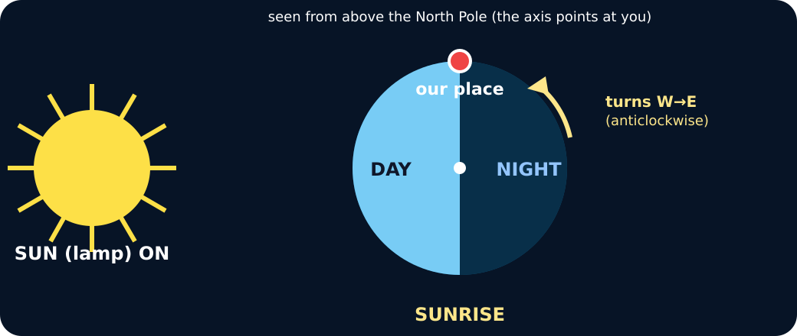
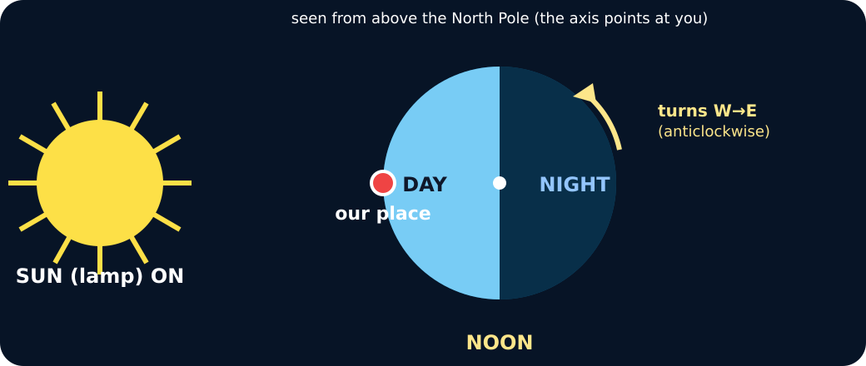
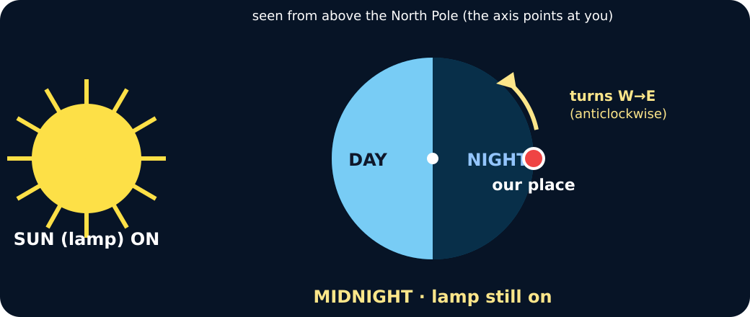
GROW / SCIENCE
STARTER
Look closely · what is the evidence?
Earth beside a lamp; the marked place is at the edge of the lit half
The marked place is facing the lamp
The marked place is on the dark half; the lamp is still on
STARTER · 4 min across this stage
6 / 17
Notes:
Companion for SCI_G_W8A_Day_And_Night_Explore-1.html. Starter: 4 minutes TOTAL across all slides in this stage.
Protect curiosity: receive every first idea without judgement.
Ask ‘What makes you think that?’ and preserve the prediction for later evidence.
Model limit: The lamp and globe are not to scale, the axis angle is simplified, and a quick turn represents about 24 hours.
Full source-stage teaching text:
LOCAL VISUAL HOOK · FRAME 1
Observation 1: our place is at the light–dark boundary.
Half of Earth is lit. Our place is just entering the light.
LOCAL VISUAL HOOK · FRAME 2
Observation 2: the same place is in the middle of the lit half.
Earth has turned a quarter. Our place faces the lamp: noon .
LOCAL VISUAL HOOK · FRAME 3
Observation 3: the lamp is still on, and our place is on the unlit half.
The lamp never switched off. Our place turned away from it: night .
Commit one first idea. Predictions are held, not marked. Pointing, selecting, saying or signing all count.
The Sun travels around Earth once each day.
Earth turns while the Sun stays in the model's fixed position.
Clouds carry daylight away.
HTML controls remain in the original HTML file. PowerPoint contains editable teaching text and static source visuals; use the paper response route for sorting and investigation.
[Sources]
Uploaded lesson: SCI_G_W8A_Day_And_Night_Explore-1.html
[/Sources]

Slide 7
GROW / SCIENCE
I DO
Words we will use
• rotate — turn
• axis — turning line
• apparent — seems to
I DO · 5 min across this stage
7 / 17
Notes:
Companion for SCI_G_W8A_Day_And_Night_Explore-1.html. I do: 5 minutes TOTAL across all slides in this stage.
Let the teacher/model carry the explanation; pupils watch, point or track.
Use a visual cue only if access is the barrier, then fade it.
Model limit: The lamp and globe are not to scale, the axis angle is simplified, and a quick turn represents about 24 hours.
Full source-stage teaching text:
ROTATE turn to spin around an axis
AXIS turning line an imaginary line through a rotating body
APPARENT seems to what seems to happen from an observer's position
WHAT THIS MODEL HELPS US SEE
Trace the marker with one finger. Say: facing the Sun means day; facing away means night.
WHAT THIS MODEL DOES NOT SHOW
The lamp and globe are not to scale, the axis angle is simplified, and a quick turn represents about 24 hours.
Step 1
Fix a cool lamp as the Sun. Put one visible marker on a globe as our place.
Step 2
Notice that only the half facing the lamp is lit. Label that half day and the other half night.
Step 3
Turn the globe west to east on its axis. Track the marker as it enters and leaves the light.
Rotating Earth · press to turn a quarter
The lamp stays where it is. Only Earth turns, west to east. Watch where our place goes.
↺ Start at sunrise
SUNRISE · entering the light. The Sun appears to rise in the east. Our place is turning towards it.
Turns: 0 · Log: sunrise
Key words: Earth rotates on its axis . The Sun only appears to move. One full turn ≈ 24 hours.
HTML controls remain in the original HTML file. PowerPoint contains editable teaching text and static source visuals; use the paper response route for sorting and investigation.
[Sources]
Uploaded lesson: SCI_G_W8A_Day_And_Night_Explore-1.html
[/Sources]

Slide 8
GROW / SCIENCE
I DO
Watch the model
• Fix a cool lamp as the Sun. Put one visible marker on a globe as our place.
• Notice that only the half facing the lamp is lit. Label that half day and the other half night.
• Turn the globe west to east on its axis. Track the marker as it enters and leaves the light.
I DO · 5 min across this stage
8 / 17
Notes:
Companion for SCI_G_W8A_Day_And_Night_Explore-1.html. I do: 5 minutes TOTAL across all slides in this stage.
Let the teacher/model carry the explanation; pupils watch, point or track.
Use a visual cue only if access is the barrier, then fade it.
Model limit: The lamp and globe are not to scale, the axis angle is simplified, and a quick turn represents about 24 hours.
Full source-stage teaching text:
ROTATE turn to spin around an axis
AXIS turning line an imaginary line through a rotating body
APPARENT seems to what seems to happen from an observer's position
WHAT THIS MODEL HELPS US SEE
Trace the marker with one finger. Say: facing the Sun means day; facing away means night.
WHAT THIS MODEL DOES NOT SHOW
The lamp and globe are not to scale, the axis angle is simplified, and a quick turn represents about 24 hours.
Step 1
Fix a cool lamp as the Sun. Put one visible marker on a globe as our place.
Step 2
Notice that only the half facing the lamp is lit. Label that half day and the other half night.
Step 3
Turn the globe west to east on its axis. Track the marker as it enters and leaves the light.
Rotating Earth · press to turn a quarter
The lamp stays where it is. Only Earth turns, west to east. Watch where our place goes.
↺ Start at sunrise
SUNRISE · entering the light. The Sun appears to rise in the east. Our place is turning towards it.
Turns: 0 · Log: sunrise
Key words: Earth rotates on its axis . The Sun only appears to move. One full turn ≈ 24 hours.
HTML controls remain in the original HTML file. PowerPoint contains editable teaching text and static source visuals; use the paper response route for sorting and investigation.
[Sources]
Uploaded lesson: SCI_G_W8A_Day_And_Night_Explore-1.html
[/Sources]

Slide 9
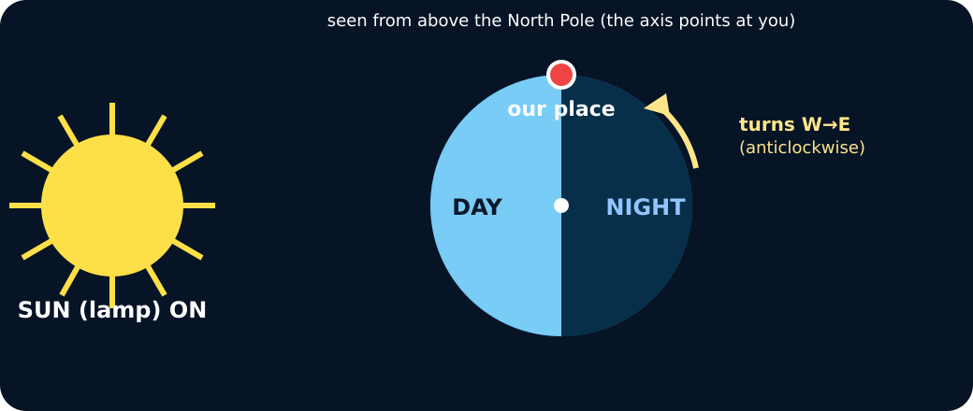
GROW / SCIENCE
I DO
Watch the model
Rotating Earth model with a lamp as the Sun
I DO · 5 min across this stage
9 / 17
Notes:
Companion for SCI_G_W8A_Day_And_Night_Explore-1.html. I do: 5 minutes TOTAL across all slides in this stage.
Let the teacher/model carry the explanation; pupils watch, point or track.
Use a visual cue only if access is the barrier, then fade it.
Model limit: The lamp and globe are not to scale, the axis angle is simplified, and a quick turn represents about 24 hours.
Full source-stage teaching text:
ROTATE turn to spin around an axis
AXIS turning line an imaginary line through a rotating body
APPARENT seems to what seems to happen from an observer's position
WHAT THIS MODEL HELPS US SEE
Trace the marker with one finger. Say: facing the Sun means day; facing away means night.
WHAT THIS MODEL DOES NOT SHOW
The lamp and globe are not to scale, the axis angle is simplified, and a quick turn represents about 24 hours.
Step 1
Fix a cool lamp as the Sun. Put one visible marker on a globe as our place.
Step 2
Notice that only the half facing the lamp is lit. Label that half day and the other half night.
Step 3
Turn the globe west to east on its axis. Track the marker as it enters and leaves the light.
Rotating Earth · press to turn a quarter
The lamp stays where it is. Only Earth turns, west to east. Watch where our place goes.
↺ Start at sunrise
SUNRISE · entering the light. The Sun appears to rise in the east. Our place is turning towards it.
Turns: 0 · Log: sunrise
Key words: Earth rotates on its axis . The Sun only appears to move. One full turn ≈ 24 hours.
HTML controls remain in the original HTML file. PowerPoint contains editable teaching text and static source visuals; use the paper response route for sorting and investigation.
[Sources]
Uploaded lesson: SCI_G_W8A_Day_And_Night_Explore-1.html
[/Sources]

Slide 10
GROW / SCIENCE
WE DO
The marked place is on the dark side and rotates towards the lamp. What comes next there?
A. Morning, because the place is entering the lit half.
B. Night, because the lamp has switched off.
C. A season, because one turn takes a year.
Commit to an answer. Show the evidence you used. Listen, then revise if needed.
WE DO · 5 min across this stage
10 / 17
Notes:
Companion for SCI_G_W8A_Day_And_Night_Explore-1.html. We do: 5 minutes TOTAL across all slides in this stage.
Scan every response mode. Do not infer understanding from handwriting or confidence.
Secure: transfer. Mixed: contrast. Misconception: counterexample then a fresh question.
Ask every learner to commit privately before feedback. Use the pupil cards, table or evidence sheet; pointing, saying, signing and directing a partner are valid routes.
Model limit: The lamp and globe are not to scale, the axis angle is simplified, and a quick turn represents about 24 hours.
Full source-stage teaching text:
Everyone commits before explanation.
Use a button, point, say/sign or let an adult operate the chosen button. A retry is information, not a penalty.
Audience move:
Morning, because the place is entering the lit half.
Night, because the lamp has switched off.
A season, because one turn takes a year.
HTML controls remain in the original HTML file. PowerPoint contains editable teaching text and static source visuals; use the paper response route for sorting and investigation.
[Sources]
Uploaded lesson: SCI_G_W8A_Day_And_Night_Explore-1.html
[/Sources]

Slide 11
GROW / SCIENCE
I DO 2
Build the explanation
• Stand at the marked place in the model and describe the lamp's position from that viewpoint.
• As Earth rotates west to east, the observer turns with it. The Sun therefore appears to move east to west: it seems to rise, cross the sky and set.
• Say the full link: Earth rotates west to east, so day and night repeat and the Sun's east-to-west daily movement is apparent.
I DO 2 · 4 min across this stage
11 / 17
Notes:
Companion for SCI_G_W8A_Day_And_Night_Explore-1.html. I do 2: 4 minutes TOTAL across all slides in this stage.
Model one complete evidence-to-explanation sentence, then pause.
Keep the science words; change density, modality or adult role before changing the goal.
Model limit: The lamp and globe are not to scale, the axis angle is simplified, and a quick turn represents about 24 hours.
Full source-stage teaching text:
Connection: the model is useful when its visible pattern is translated into a scientific explanation.
Connection 1
Stand at the marked place in the model and describe the lamp's position from that viewpoint.
Connection 2
As Earth rotates west to east, the observer turns with it. The Sun therefore appears to move east to west: it seems to rise, cross the sky and set.
Connection 3
Say the full link: Earth rotates west to east, so day and night repeat and the Sun's east-to-west daily movement is apparent.
MODEL STRENGTH
Trace the marker with one finger. Say: facing the Sun means day; facing away means night.
MODEL LIMIT
The lamp and globe are not to scale, the axis angle is simplified, and a quick turn represents about 24 hours.
HTML controls remain in the original HTML file. PowerPoint contains editable teaching text and static source visuals; use the paper response route for sorting and investigation.
[Sources]
Uploaded lesson: SCI_G_W8A_Day_And_Night_Explore-1.html
[/Sources]

Slide 12
GROW / SCIENCE
I DO 2
Find and repair the misconception
Model glitch: the Sun travels around Earth once every day.
A. Keep it: a daily Sun orbit explains sunrise.
B. Repair it: Earth rotates, so the Sun only appears to cross our sky.
C. Repair it: clouds move the Sun from east to west.
I DO 2 · 4 min across this stage
12 / 17
Notes:
Companion for SCI_G_W8A_Day_And_Night_Explore-1.html. I do 2: 4 minutes TOTAL across all slides in this stage.
Model one complete evidence-to-explanation sentence, then pause.
Keep the science words; change density, modality or adult role before changing the goal.
Model limit: The lamp and globe are not to scale, the axis angle is simplified, and a quick turn represents about 24 hours.
Full source-stage teaching text:
Connection: the model is useful when its visible pattern is translated into a scientific explanation.
Connection 1
Stand at the marked place in the model and describe the lamp's position from that viewpoint.
Connection 2
As Earth rotates west to east, the observer turns with it. The Sun therefore appears to move east to west: it seems to rise, cross the sky and set.
Connection 3
Say the full link: Earth rotates west to east, so day and night repeat and the Sun's east-to-west daily movement is apparent.
MODEL STRENGTH
Trace the marker with one finger. Say: facing the Sun means day; facing away means night.
MODEL LIMIT
The lamp and globe are not to scale, the axis angle is simplified, and a quick turn represents about 24 hours.
HTML controls remain in the original HTML file. PowerPoint contains editable teaching text and static source visuals; use the paper response route for sorting and investigation.
[Sources]
Uploaded lesson: SCI_G_W8A_Day_And_Night_Explore-1.html
[/Sources]

Slide 13
GROW / SCIENCE
WE DO 2
Four-position sky lab
Match each observation at the marked place to its position in one rotation.
• Choose one evidence card.
• Commit it to one sky position.
• Use the feedback to repair any mismatch.
• Freeze at least two results, then explain the pattern.
Use the numbered cards in your pupil pack. Take turns to choose, justify and check. You may direct a partner to move a card.
WE DO 2 · 4 min across this stage
13 / 17
Notes:
Companion for SCI_G_W8A_Day_And_Night_Explore-1.html. We do 2: 4 minutes TOTAL across all slides in this stage.
Protect pupil operation and thinking; support handling only where needed.
Ask what changed and what stayed the same before supplying a scientific word.
Ask every learner to commit privately before feedback. Use the pupil cards, table or evidence sheet; pointing, saying, signing and directing a partner are valid routes.
Model limit: The lamp and globe are not to scale, the axis angle is simplified, and a quick turn represents about 24 hours.
Full source-stage teaching text:
Match each observation at the marked place to its position in one rotation.
Choose one evidence card. Commit it to one sky position. Use the feedback to repair any mismatch. Freeze at least two results, then explain the pattern.
Cards to place
Entering light The marked place crosses from the unlit half into the lit half.
Facing the lamp The marked place is near the centre of the lit half and faces the lamp.
Leaving light The marked place crosses from the lit half into the unlit half.
Facing away The marked place is near the centre of the unlit half and faces away from the lamp.
Matching groups
Sunrise
Middle of the day
Sunset
Night
Freeze evidence
↺ Reset and retry
Science glitch · find and repair it
Claim: Model glitch: the Sun travels around Earth once every day.
Keep it: a daily Sun orbit explains sunrise.
Repair it: Earth rotates, so the Sun only appears to cross our sky.
Repair it: clouds move the Sun from east to west.
HTML controls remain in the original HTML file. PowerPoint contains editable teaching text and static source visuals; use the paper response route for sorting and investigation.
[Sources]
Uploaded lesson: SCI_G_W8A_Day_And_Night_Explore-1.html
[/Sources]

Slide 14
GROW / SCIENCE
WE DO 2
Choose a group · defend your placement
• Sunrise
• Middle of the day
• Sunset
• Night
Use the frozen evidence to say what moved, what stayed fixed and why the Sun appeared to move.
WE DO 2 · 4 min across this stage
14 / 17
Notes:
Companion for SCI_G_W8A_Day_And_Night_Explore-1.html. We do 2: 4 minutes TOTAL across all slides in this stage.
Protect pupil operation and thinking; support handling only where needed.
Ask what changed and what stayed the same before supplying a scientific word.
Ask every learner to commit privately before feedback. Use the pupil cards, table or evidence sheet; pointing, saying, signing and directing a partner are valid routes.
Model limit: The lamp and globe are not to scale, the axis angle is simplified, and a quick turn represents about 24 hours.
Full source-stage teaching text:
Match each observation at the marked place to its position in one rotation.
Choose one evidence card. Commit it to one sky position. Use the feedback to repair any mismatch. Freeze at least two results, then explain the pattern.
Cards to place
Entering light The marked place crosses from the unlit half into the lit half.
Facing the lamp The marked place is near the centre of the lit half and faces the lamp.
Leaving light The marked place crosses from the lit half into the unlit half.
Facing away The marked place is near the centre of the unlit half and faces away from the lamp.
Matching groups
Sunrise
Middle of the day
Sunset
Night
Freeze evidence
↺ Reset and retry
Science glitch · find and repair it
Claim: Model glitch: the Sun travels around Earth once every day.
Keep it: a daily Sun orbit explains sunrise.
Repair it: Earth rotates, so the Sun only appears to cross our sky.
Repair it: clouds move the Sun from east to west.
HTML controls remain in the original HTML file. PowerPoint contains editable teaching text and static source visuals; use the paper response route for sorting and investigation.
[Sources]
Uploaded lesson: SCI_G_W8A_Day_And_Night_Explore-1.html
[/Sources]

Slide 15
GROW / SCIENCE
INDEPENDENT
Your independent mission
Create a four-position explanation of day, night and the Sun's apparent movement for one marked place.
Record: One saved or paper sequence with four positions, rotation arrows and a because sentence using apparent.
INDEPENDENT · 10 min across this stage
15 / 17
Notes:
Companion for SCI_G_W8A_Day_And_Night_Explore-1.html. Independent: 10 minutes TOTAL across all slides in this stage.
Protect independence. Accept equivalent evidence routes and scribe exact meaning.
Prompt only as much as needed; fade as soon as the pupil continues.
Model limit: The lamp and globe are not to scale, the axis angle is simplified, and a quick turn represents about 24 hours.
Full source-stage teaching text:
Physical route
Cool LED lamp, globe or ball with a removable marker, four-position evidence sheet and pencil.
Same outcome: I can explain that Earth's rotation causes day and night and makes the Sun appear to move across our sky.
Offline digital / director route
Use the included four-frame sequence. Add arrows for Earth's rotation and captions for what the observer sees.
Same evidence: One saved or paper sequence with four positions, rotation arrows and a because sentence using apparent.
Equipment / setup Cool LED lamp, globe or ball with a removable marker, four-position evidence sheet and pencil.
Safety / sensory Use a cool LED light only. Never stare into a bright lamp. Keep cables still and let an adult move powered equipment.
Offline parity Use the included four-frame sequence. Add arrows for Earth's rotation and captions for what the observer sees.
No-equipment/access route: Use a fixed Sun card and a marked paper Earth. One pupil directs the paper Earth through four west-to-east quarter turns.
▲ Standard
Draw and label four positions in one rotation, then explain day, night, sunrise and sunset.
Scaffold
Use: Earth rotates, therefore our place…, so the Sun appears to….
Evidence gate
HTML controls remain in the original HTML file. PowerPoint contains editable teaching text and static source visuals; use the paper response route for sorting and investigation.
[Sources]
Uploaded lesson: SCI_G_W8A_Day_And_Night_Explore-1.html
[/Sources]

Slide 16
GROW / SCIENCE
INDEPENDENT
Choose your support and challenge
• Supported: Order four picture cards and complete: When our place faces the Sun it is __. When it faces away it is __.
• Standard: Draw and label four positions in one rotation, then explain day, night, sunrise and sunset.
• Stretch: Explain the same four positions to someone who thinks the Sun orbits Earth each day.
INDEPENDENT · 10 min across this stage
16 / 17
Notes:
Companion for SCI_G_W8A_Day_And_Night_Explore-1.html. Independent: 10 minutes TOTAL across all slides in this stage.
Protect independence. Accept equivalent evidence routes and scribe exact meaning.
Prompt only as much as needed; fade as soon as the pupil continues.
Model limit: The lamp and globe are not to scale, the axis angle is simplified, and a quick turn represents about 24 hours.
Full source-stage teaching text:
Physical route
Cool LED lamp, globe or ball with a removable marker, four-position evidence sheet and pencil.
Same outcome: I can explain that Earth's rotation causes day and night and makes the Sun appear to move across our sky.
Offline digital / director route
Use the included four-frame sequence. Add arrows for Earth's rotation and captions for what the observer sees.
Same evidence: One saved or paper sequence with four positions, rotation arrows and a because sentence using apparent.
Equipment / setup Cool LED lamp, globe or ball with a removable marker, four-position evidence sheet and pencil.
Safety / sensory Use a cool LED light only. Never stare into a bright lamp. Keep cables still and let an adult move powered equipment.
Offline parity Use the included four-frame sequence. Add arrows for Earth's rotation and captions for what the observer sees.
No-equipment/access route: Use a fixed Sun card and a marked paper Earth. One pupil directs the paper Earth through four west-to-east quarter turns.
▲ Standard
Draw and label four positions in one rotation, then explain day, night, sunrise and sunset.
Scaffold
Use: Earth rotates, therefore our place…, so the Sun appears to….
Evidence gate
HTML controls remain in the original HTML file. PowerPoint contains editable teaching text and static source visuals; use the paper response route for sorting and investigation.
[Sources]
Uploaded lesson: SCI_G_W8A_Day_And_Night_Explore-1.html
[/Sources]

Slide 17
GROW / SCIENCE
EXIT
Show what you know
Explain why day and night happen and why the Sun appears to move across our sky.
Point to, read or explain the evidence you made. Choose one next step after the adult has listened.
EXIT · 4 min across this stage
17 / 17
Notes:
Companion for SCI_G_W8A_Day_And_Night_Explore-1.html. Exit: 4 minutes TOTAL across all slides in this stage.
Genuinely receive one final response and name back the Science heard or seen.
Choose one visible next move. The pupil writes what they said and what changed.
Model limit: The lamp and globe are not to scale, the axis angle is simplified, and a quick turn represents about 24 hours.
Full source-stage teaching text:
Standard
Explain why day and night happen and why the Sun appears to move across our sky.
Adult Audience
The familiar adult genuinely receives the pupil response, then says back the Science they heard or saw. The adult does not add a score or rewrite the pupil.
What I said, and what it changed:
Next I will ______. One next step chosen after the adult listened.
HTML controls remain in the original HTML file. PowerPoint contains editable teaching text and static source visuals; use the paper response route for sorting and investigation.
[Sources]
Uploaded lesson: SCI_G_W8A_Day_And_Night_Explore-1.html
[/Sources]

