Slide 1
GROW / SCIENCE
OVERVIEW
Day and Night: 24-Hour Control Room
I can use a rotating-Earth model to collect and explain evidence across one complete day-night cycle.
Four quarter turns
use evidence
A complete evidence record
use evidence
An explanation tested against a misconception
use evidence
Open the original interactive lesson
40 MINUTES
1 / 17
Notes:
Companion for SCI_G_W8B_Day_And_Night_Do.html. Overview: 0 minutes TOTAL across all slides in this stage.
Read setup, safety and sensory notes before pupils enter.
Set predictable Space and keep the learning goal visible.
Model limit: Quarter turns compress continuous rotation and do not show exact local times, seasons, weather or Earth's scale.
Full source-stage teaching text:
GROW · Science · Week 8B · Do
Learning objective: I can use a rotating-Earth model to collect and explain evidence across one complete day-night cycle.
Success criteria
Record four clear positions for one place on Earth.
Link each position to light, darkness and the observer's view.
Use the evidence to show how rotation explains the observed day-night pattern without changing the lamp.
HTML controls remain in the original HTML file. PowerPoint contains editable teaching text and static source visuals; use the paper response route for sorting and investigation.
[Sources]
Uploaded lesson: SCI_G_W8B_Day_And_Night_Do.html
[/Sources]

Slide 2
GROW / SCIENCE
OVERVIEW
What success looks like
• Record four clear positions for one place on Earth.
• Link each position to light, darkness and the observer's view.
• Use the evidence to show how rotation explains the observed day-night pattern without changing the lamp.
40 MINUTES
2 / 17
Notes:
Companion for SCI_G_W8B_Day_And_Night_Do.html. Overview: 0 minutes TOTAL across all slides in this stage.
Read setup, safety and sensory notes before pupils enter.
Set predictable Space and keep the learning goal visible.
Model limit: Quarter turns compress continuous rotation and do not show exact local times, seasons, weather or Earth's scale.
Full source-stage teaching text:
GROW · Science · Week 8B · Do
Learning objective: I can use a rotating-Earth model to collect and explain evidence across one complete day-night cycle.
Success criteria
Record four clear positions for one place on Earth.
Link each position to light, darkness and the observer's view.
Use the evidence to show how rotation explains the observed day-night pattern without changing the lamp.
HTML controls remain in the original HTML file. PowerPoint contains editable teaching text and static source visuals; use the paper response route for sorting and investigation.
[Sources]
Uploaded lesson: SCI_G_W8B_Day_And_Night_Do.html
[/Sources]

Slide 3
GROW / SCIENCE
ARRIVAL
Retrieve and reconnect
• Last lesson: what moved in our model and what stayed fixed?
• Last lesson: why does the Sun appear to cross the sky?
• Last week: how did observer position matter in the Moon model?
• Lead-in: what evidence would prove that a whole cycle was observed?
ARRIVAL · 3 min across this stage
3 / 17
Notes:
Companion for SCI_G_W8B_Day_And_Night_Do.html. Arrival: 3 minutes TOTAL across all slides in this stage.
Wait, regulate and retrieve through the lightest workable route.
If recall is inaccessible, point to one retrieval sentence; do not teach today’s answer.
Model limit: Quarter turns compress continuous rotation and do not show exact local times, seasons, weather or Earth's scale.
Full source-stage teaching text:
Retrieve only what has already been taught
In Explore, Earth rotated while the model Sun stayed fixed, creating day, night and apparent solar movement.
Prior week: point to or describe one useful model.
Older learning: what makes an observation useful as evidence?
Lead-in: what do you notice in today’s first picture?
New to this class, absent, or not sure? Everything needed is in the retrieval box above. Read it, point to it or ask a familiar adult to read it exactly.
▲ Standard
Last lesson: what moved in our model and what stayed fixed?
Last lesson: why does the Sun appear to cross the sky?
Last week: how did observer position matter in the Moon model?
Lead-in: what evidence would prove that a whole cycle was observed?
Read-aloud route: a familiar adult may read the task exactly while the text remains visible. No device voice or media permission is required.
HTML controls remain in the original HTML file. PowerPoint contains editable teaching text and static source visuals; use the paper response route for sorting and investigation.
[Sources]
Uploaded lesson: SCI_G_W8B_Day_And_Night_Do.html
[/Sources]

Slide 4
GROW / SCIENCE
STARTER
A pupil says, ‘Clouds make night because they hide the Sun.’ Which first response would you test?
Think first. Point, say, sign or write your choice. Give one reason.
A. Agree: thick clouds create night.
B. Track a marked place as Earth turns, with the lamp kept on.
C. Use a brighter lamp so night disappears.
STARTER · 3 min across this stage
4 / 17
Notes:
Companion for SCI_G_W8B_Day_And_Night_Do.html. Starter: 3 minutes TOTAL across all slides in this stage.
Protect curiosity: receive every first idea without judgement.
Ask ‘What makes you think that?’ and preserve the prediction for later evidence.
Model limit: Quarter turns compress continuous rotation and do not show exact local times, seasons, weather or Earth's scale.
Full source-stage teaching text:
LOCAL VISUAL HOOK · FRAME 1
Observation 1: lamp on, marker at the light–dark boundary.
Record: boundary . Lamp on.
LOCAL VISUAL HOOK · FRAME 2
Observation 2: lamp still on, marker fully lit.
Record: lit . Lamp on.
LOCAL VISUAL HOOK · FRAME 3
Observation 3: lamp remains on, marker unlit.
Record: unlit . Lamp still on. So what made it dark?
Commit one first idea. Predictions are held, not marked. Pointing, selecting, saying or signing all count.
Agree: thick clouds create night.
Track a marked place as Earth turns, with the lamp kept on.
Use a brighter lamp so night disappears.
HTML controls remain in the original HTML file. PowerPoint contains editable teaching text and static source visuals; use the paper response route for sorting and investigation.
[Sources]
Uploaded lesson: SCI_G_W8B_Day_And_Night_Do.html
[/Sources]

Slide 5
GROW / SCIENCE
STARTER
Look closely · what is the evidence?
Observation 1: the lamp is on and the marker is at the light-dark boundary.
Observation 2: the lamp is still on and the marker is fully lit.
Observation 3: the lamp remains on and the marker is unlit.
STARTER · 3 min across this stage
5 / 17
Notes:
Companion for SCI_G_W8B_Day_And_Night_Do.html. Starter: 3 minutes TOTAL across all slides in this stage.
Protect curiosity: receive every first idea without judgement.
Ask ‘What makes you think that?’ and preserve the prediction for later evidence.
Model limit: Quarter turns compress continuous rotation and do not show exact local times, seasons, weather or Earth's scale.
Full source-stage teaching text:
LOCAL VISUAL HOOK · FRAME 1
Observation 1: lamp on, marker at the light–dark boundary.
Record: boundary . Lamp on.
LOCAL VISUAL HOOK · FRAME 2
Observation 2: lamp still on, marker fully lit.
Record: lit . Lamp on.
LOCAL VISUAL HOOK · FRAME 3
Observation 3: lamp remains on, marker unlit.
Record: unlit . Lamp still on. So what made it dark?
Commit one first idea. Predictions are held, not marked. Pointing, selecting, saying or signing all count.
Agree: thick clouds create night.
Track a marked place as Earth turns, with the lamp kept on.
Use a brighter lamp so night disappears.
HTML controls remain in the original HTML file. PowerPoint contains editable teaching text and static source visuals; use the paper response route for sorting and investigation.
[Sources]
Uploaded lesson: SCI_G_W8B_Day_And_Night_Do.html
[/Sources]

Slide 6
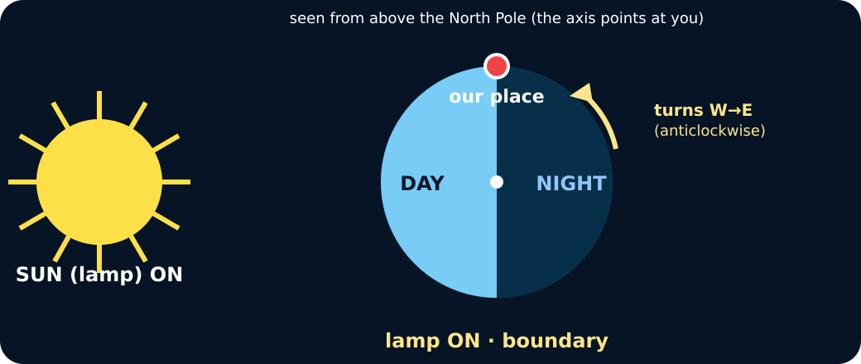
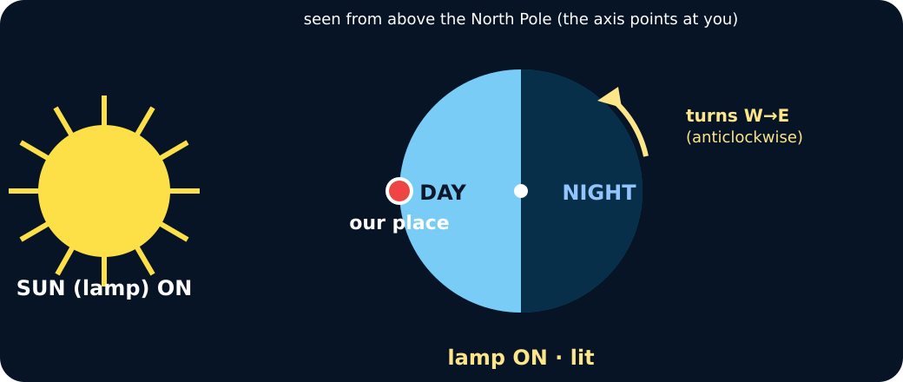
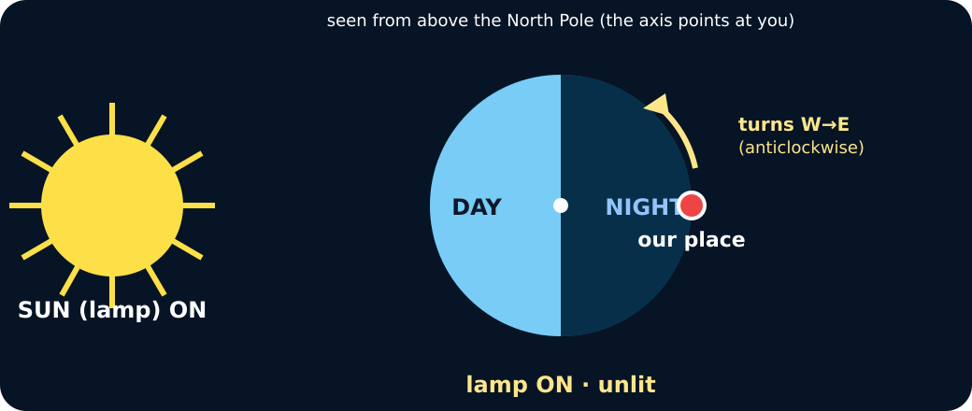
GROW / SCIENCE
STARTER
Look closely · what is the evidence?
Marker at the boundary, lamp on
Marker fully lit, lamp on
Marker unlit, lamp still on
STARTER · 3 min across this stage
6 / 17
Notes:
Companion for SCI_G_W8B_Day_And_Night_Do.html. Starter: 3 minutes TOTAL across all slides in this stage.
Protect curiosity: receive every first idea without judgement.
Ask ‘What makes you think that?’ and preserve the prediction for later evidence.
Model limit: Quarter turns compress continuous rotation and do not show exact local times, seasons, weather or Earth's scale.
Full source-stage teaching text:
LOCAL VISUAL HOOK · FRAME 1
Observation 1: lamp on, marker at the light–dark boundary.
Record: boundary . Lamp on.
LOCAL VISUAL HOOK · FRAME 2
Observation 2: lamp still on, marker fully lit.
Record: lit . Lamp on.
LOCAL VISUAL HOOK · FRAME 3
Observation 3: lamp remains on, marker unlit.
Record: unlit . Lamp still on. So what made it dark?
Commit one first idea. Predictions are held, not marked. Pointing, selecting, saying or signing all count.
Agree: thick clouds create night.
Track a marked place as Earth turns, with the lamp kept on.
Use a brighter lamp so night disappears.
HTML controls remain in the original HTML file. PowerPoint contains editable teaching text and static source visuals; use the paper response route for sorting and investigation.
[Sources]
Uploaded lesson: SCI_G_W8B_Day_And_Night_Do.html
[/Sources]

Slide 7
GROW / SCIENCE
I DO
Words we will use
• cycle — repeating sequence
• rotation — one full turn
• evidence — what we observed
I DO · 4 min across this stage
7 / 17
Notes:
Companion for SCI_G_W8B_Day_And_Night_Do.html. I do: 4 minutes TOTAL across all slides in this stage.
Let the teacher/model carry the explanation; pupils watch, point or track.
Use a visual cue only if access is the barrier, then fade it.
Model limit: Quarter turns compress continuous rotation and do not show exact local times, seasons, weather or Earth's scale.
Full source-stage teaching text:
CYCLE repeating sequence a sequence that returns to its starting point
ROTATION one full turn the movement of a body turning on its axis
EVIDENCE what we observed information used to support or challenge an explanation
WHAT THIS MODEL HELPS US SEE
Keep one finger on the marker. At each pause say lit or unlit first, then name the time position.
WHAT THIS MODEL DOES NOT SHOW
Quarter turns compress continuous rotation and do not show exact local times, seasons, weather or Earth's scale.
Step 1
Place one marker on the globe and start it at sunrise, where it crosses into the lit half.
Step 2
Turn the globe west to east in equal quarter turns. Pause and record whether the marker is lit and which way it faces.
Step 3
Return the marker to the start. Four ordered observations now represent one simplified 24-hour cycle.
24-hour control room · turn, record, test
Turn a quarter at a time. Each stop writes one row of evidence. Then run the two tests.
Cloud test: OFF
Lamp: ON
↺ Reset
Stop 1 logged: boundary · entering light · sunrise.
Cloud test: a cloud over our place at noon does NOT make night — it is still on the lit half. Lamp test: turn the lamp off and the whole Earth is dark — that is not what night is.
HTML controls remain in the original HTML file. PowerPoint contains editable teaching text and static source visuals; use the paper response route for sorting and investigation.
[Sources]
Uploaded lesson: SCI_G_W8B_Day_And_Night_Do.html
[/Sources]

Slide 8
GROW / SCIENCE
I DO
Watch the model
• Place one marker on the globe and start it at sunrise, where it crosses into the lit half.
• Turn the globe west to east in equal quarter turns. Pause and record whether the marker is lit and which way it faces.
• Return the marker to the start. Four ordered observations now represent one simplified 24-hour cycle.
I DO · 4 min across this stage
8 / 17
Notes:
Companion for SCI_G_W8B_Day_And_Night_Do.html. I do: 4 minutes TOTAL across all slides in this stage.
Let the teacher/model carry the explanation; pupils watch, point or track.
Use a visual cue only if access is the barrier, then fade it.
Model limit: Quarter turns compress continuous rotation and do not show exact local times, seasons, weather or Earth's scale.
Full source-stage teaching text:
CYCLE repeating sequence a sequence that returns to its starting point
ROTATION one full turn the movement of a body turning on its axis
EVIDENCE what we observed information used to support or challenge an explanation
WHAT THIS MODEL HELPS US SEE
Keep one finger on the marker. At each pause say lit or unlit first, then name the time position.
WHAT THIS MODEL DOES NOT SHOW
Quarter turns compress continuous rotation and do not show exact local times, seasons, weather or Earth's scale.
Step 1
Place one marker on the globe and start it at sunrise, where it crosses into the lit half.
Step 2
Turn the globe west to east in equal quarter turns. Pause and record whether the marker is lit and which way it faces.
Step 3
Return the marker to the start. Four ordered observations now represent one simplified 24-hour cycle.
24-hour control room · turn, record, test
Turn a quarter at a time. Each stop writes one row of evidence. Then run the two tests.
Cloud test: OFF
Lamp: ON
↺ Reset
Stop 1 logged: boundary · entering light · sunrise.
Cloud test: a cloud over our place at noon does NOT make night — it is still on the lit half. Lamp test: turn the lamp off and the whole Earth is dark — that is not what night is.
HTML controls remain in the original HTML file. PowerPoint contains editable teaching text and static source visuals; use the paper response route for sorting and investigation.
[Sources]
Uploaded lesson: SCI_G_W8B_Day_And_Night_Do.html
[/Sources]

Slide 9
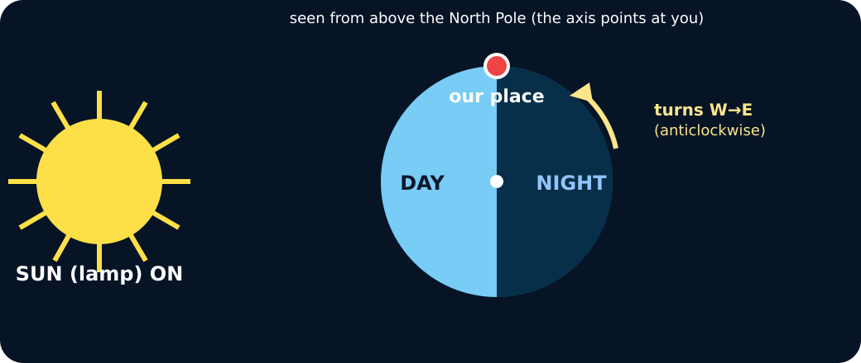
GROW / SCIENCE
I DO
Watch the model
Rotating Earth model with lamp, cloud test and lamp test
I DO · 4 min across this stage
9 / 17
Notes:
Companion for SCI_G_W8B_Day_And_Night_Do.html. I do: 4 minutes TOTAL across all slides in this stage.
Let the teacher/model carry the explanation; pupils watch, point or track.
Use a visual cue only if access is the barrier, then fade it.
Model limit: Quarter turns compress continuous rotation and do not show exact local times, seasons, weather or Earth's scale.
Full source-stage teaching text:
CYCLE repeating sequence a sequence that returns to its starting point
ROTATION one full turn the movement of a body turning on its axis
EVIDENCE what we observed information used to support or challenge an explanation
WHAT THIS MODEL HELPS US SEE
Keep one finger on the marker. At each pause say lit or unlit first, then name the time position.
WHAT THIS MODEL DOES NOT SHOW
Quarter turns compress continuous rotation and do not show exact local times, seasons, weather or Earth's scale.
Step 1
Place one marker on the globe and start it at sunrise, where it crosses into the lit half.
Step 2
Turn the globe west to east in equal quarter turns. Pause and record whether the marker is lit and which way it faces.
Step 3
Return the marker to the start. Four ordered observations now represent one simplified 24-hour cycle.
24-hour control room · turn, record, test
Turn a quarter at a time. Each stop writes one row of evidence. Then run the two tests.
Cloud test: OFF
Lamp: ON
↺ Reset
Stop 1 logged: boundary · entering light · sunrise.
Cloud test: a cloud over our place at noon does NOT make night — it is still on the lit half. Lamp test: turn the lamp off and the whole Earth is dark — that is not what night is.
HTML controls remain in the original HTML file. PowerPoint contains editable teaching text and static source visuals; use the paper response route for sorting and investigation.
[Sources]
Uploaded lesson: SCI_G_W8B_Day_And_Night_Do.html
[/Sources]

Slide 10
GROW / SCIENCE
WE DO
The lamp stayed on throughout, but the marker became dark. Which evidence explains this?
A. The marker rotated onto the side facing away from the lamp.
B. The lamp stopped producing light for half the turn.
C. Clouds formed on the globe during the turn.
Commit to an answer. Show the evidence you used. Listen, then revise if needed.
WE DO · 4 min across this stage
10 / 17
Notes:
Companion for SCI_G_W8B_Day_And_Night_Do.html. We do: 4 minutes TOTAL across all slides in this stage.
Scan every response mode. Do not infer understanding from handwriting or confidence.
Secure: transfer. Mixed: contrast. Misconception: counterexample then a fresh question.
Ask every learner to commit privately before feedback. Use the pupil cards, table or evidence sheet; pointing, saying, signing and directing a partner are valid routes.
Model limit: Quarter turns compress continuous rotation and do not show exact local times, seasons, weather or Earth's scale.
Full source-stage teaching text:
Everyone commits before explanation.
Use a button, point, say/sign or let an adult operate the chosen button. A retry is information, not a penalty.
Audience move:
The marker rotated onto the side facing away from the lamp.
The lamp stopped producing light for half the turn.
Clouds formed on the globe during the turn.
HTML controls remain in the original HTML file. PowerPoint contains editable teaching text and static source visuals; use the paper response route for sorting and investigation.
[Sources]
Uploaded lesson: SCI_G_W8B_Day_And_Night_Do.html
[/Sources]

Slide 11
GROW / SCIENCE
I DO 2
Build the explanation
• Add an observer arrow at each marker position to show which way the local person faces.
• Describe the Sun's apparent east-to-west position without claiming that the lamp moved; west-to-east Earth rotation creates that observed direction.
• Link all four rows: because Earth rotated, the observer experienced sunrise, day, sunset and night.
I DO 2 · 3 min across this stage
11 / 17
Notes:
Companion for SCI_G_W8B_Day_And_Night_Do.html. I do 2: 3 minutes TOTAL across all slides in this stage.
Model one complete evidence-to-explanation sentence, then pause.
Keep the science words; change density, modality or adult role before changing the goal.
Model limit: Quarter turns compress continuous rotation and do not show exact local times, seasons, weather or Earth's scale.
Full source-stage teaching text:
Connection: the model is useful when its visible pattern is translated into a scientific explanation.
Connection 1
Add an observer arrow at each marker position to show which way the local person faces.
Connection 2
Describe the Sun's apparent east-to-west position without claiming that the lamp moved; west-to-east Earth rotation creates that observed direction.
Connection 3
Link all four rows: because Earth rotated, the observer experienced sunrise, day, sunset and night.
MODEL STRENGTH
Keep one finger on the marker. At each pause say lit or unlit first, then name the time position.
MODEL LIMIT
Quarter turns compress continuous rotation and do not show exact local times, seasons, weather or Earth's scale.
HTML controls remain in the original HTML file. PowerPoint contains editable teaching text and static source visuals; use the paper response route for sorting and investigation.
[Sources]
Uploaded lesson: SCI_G_W8B_Day_And_Night_Do.html
[/Sources]

Slide 12
GROW / SCIENCE
I DO 2
Find and repair the misconception
Model glitch: clouds make night by covering the Sun.
A. Keep it: darkness always means cloud cover.
B. Repair it: rotation moves a place onto Earth's unlit side.
C. Repair it: the Sun switches off each night.
I DO 2 · 3 min across this stage
12 / 17
Notes:
Companion for SCI_G_W8B_Day_And_Night_Do.html. I do 2: 3 minutes TOTAL across all slides in this stage.
Model one complete evidence-to-explanation sentence, then pause.
Keep the science words; change density, modality or adult role before changing the goal.
Model limit: Quarter turns compress continuous rotation and do not show exact local times, seasons, weather or Earth's scale.
Full source-stage teaching text:
Connection: the model is useful when its visible pattern is translated into a scientific explanation.
Connection 1
Add an observer arrow at each marker position to show which way the local person faces.
Connection 2
Describe the Sun's apparent east-to-west position without claiming that the lamp moved; west-to-east Earth rotation creates that observed direction.
Connection 3
Link all four rows: because Earth rotated, the observer experienced sunrise, day, sunset and night.
MODEL STRENGTH
Keep one finger on the marker. At each pause say lit or unlit first, then name the time position.
MODEL LIMIT
Quarter turns compress continuous rotation and do not show exact local times, seasons, weather or Earth's scale.
HTML controls remain in the original HTML file. PowerPoint contains editable teaching text and static source visuals; use the paper response route for sorting and investigation.
[Sources]
Uploaded lesson: SCI_G_W8B_Day_And_Night_Do.html
[/Sources]

Slide 13
GROW / SCIENCE
WE DO 2
24-hour evidence console
Commit each control-room observation to the correct point in the cycle.
• Select one observation.
• Place it at the matching cycle point.
• Repair any mismatch using lit or unlit evidence.
• Freeze the record and state the repeating pattern.
Use the numbered cards in your pupil pack. Take turns to choose, justify and check. You may direct a partner to move a card.
WE DO 2 · 4 min across this stage
13 / 17
Notes:
Companion for SCI_G_W8B_Day_And_Night_Do.html. We do 2: 4 minutes TOTAL across all slides in this stage.
Protect pupil operation and thinking; support handling only where needed.
Ask what changed and what stayed the same before supplying a scientific word.
Ask every learner to commit privately before feedback. Use the pupil cards, table or evidence sheet; pointing, saying, signing and directing a partner are valid routes.
Model limit: Quarter turns compress continuous rotation and do not show exact local times, seasons, weather or Earth's scale.
Full source-stage teaching text:
Commit each control-room observation to the correct point in the cycle.
Select one observation. Place it at the matching cycle point. Repair any mismatch using lit or unlit evidence. Freeze the record and state the repeating pattern.
Cards to place
Control row 1 Marker crosses the boundary from unlit to lit; the model Sun seems low in the east.
Control row 2 Marker faces the lamp and is well inside the lit half; the model Sun seems high.
Control row 3 Marker crosses from lit to unlit; the model Sun seems low in the west.
Control row 4 Marker faces directly away from the lamp and is well inside the unlit half.
Matching groups
Sunrise
Middle of the day
Sunset
Middle of the night
Freeze evidence
↺ Reset and retry
Science glitch · find and repair it
Claim: Model glitch: clouds make night by covering the Sun.
Keep it: darkness always means cloud cover.
Repair it: rotation moves a place onto Earth's unlit side.
Repair it: the Sun switches off each night.
HTML controls remain in the original HTML file. PowerPoint contains editable teaching text and static source visuals; use the paper response route for sorting and investigation.
[Sources]
Uploaded lesson: SCI_G_W8B_Day_And_Night_Do.html
[/Sources]

Slide 14
GROW / SCIENCE
WE DO 2
Choose a group · defend your placement
• Sunrise
• Middle of the day
• Sunset
• Middle of the night
Use two frozen rows to show how rotation explains night while the lamp remains on and no cloud is present.
WE DO 2 · 4 min across this stage
14 / 17
Notes:
Companion for SCI_G_W8B_Day_And_Night_Do.html. We do 2: 4 minutes TOTAL across all slides in this stage.
Protect pupil operation and thinking; support handling only where needed.
Ask what changed and what stayed the same before supplying a scientific word.
Ask every learner to commit privately before feedback. Use the pupil cards, table or evidence sheet; pointing, saying, signing and directing a partner are valid routes.
Model limit: Quarter turns compress continuous rotation and do not show exact local times, seasons, weather or Earth's scale.
Full source-stage teaching text:
Commit each control-room observation to the correct point in the cycle.
Select one observation. Place it at the matching cycle point. Repair any mismatch using lit or unlit evidence. Freeze the record and state the repeating pattern.
Cards to place
Control row 1 Marker crosses the boundary from unlit to lit; the model Sun seems low in the east.
Control row 2 Marker faces the lamp and is well inside the lit half; the model Sun seems high.
Control row 3 Marker crosses from lit to unlit; the model Sun seems low in the west.
Control row 4 Marker faces directly away from the lamp and is well inside the unlit half.
Matching groups
Sunrise
Middle of the day
Sunset
Middle of the night
Freeze evidence
↺ Reset and retry
Science glitch · find and repair it
Claim: Model glitch: clouds make night by covering the Sun.
Keep it: darkness always means cloud cover.
Repair it: rotation moves a place onto Earth's unlit side.
Repair it: the Sun switches off each night.
HTML controls remain in the original HTML file. PowerPoint contains editable teaching text and static source visuals; use the paper response route for sorting and investigation.
[Sources]
Uploaded lesson: SCI_G_W8B_Day_And_Night_Do.html
[/Sources]

Slide 15
GROW / SCIENCE
INDEPENDENT
Your independent mission
Run or represent one complete four-position rotation and produce a control-room evidence record.
Record: Four ordered rows recording marker position, light state, apparent Sun position and one final because conclusion.
INDEPENDENT · 15 min across this stage
15 / 17
Notes:
Companion for SCI_G_W8B_Day_And_Night_Do.html. Independent: 15 minutes TOTAL across all slides in this stage.
Protect independence. Accept equivalent evidence routes and scribe exact meaning.
Prompt only as much as needed; fade as soon as the pupil continues.
Model limit: Quarter turns compress continuous rotation and do not show exact local times, seasons, weather or Earth's scale.
Full source-stage teaching text:
Physical route
Cool LED lamp, marked globe or ball, four-row evidence sheet, arrows and pencil.
Same outcome: I can use a rotating-Earth model to collect and explain evidence across one complete day-night cycle.
Offline digital / director route
Advance the included sequence one frame at a time and capture four labelled observations before writing the conclusion.
Same evidence: Four ordered rows recording marker position, light state, apparent Sun position and one final because conclusion.
Equipment / setup Cool LED lamp, marked globe or ball, four-row evidence sheet, arrows and pencil.
Safety / sensory Do not stare into the lamp. Use a cool LED only, keep hands off plugs and keep movement clear of cables.
Offline parity Advance the included sequence one frame at a time and capture four labelled observations before writing the conclusion.
No-equipment/access route: Turn a marked paper Earth beside a fixed Sun card, or use four prepared diagrams and order them.
▲ Standard
Record four quarter turns and explain the complete cycle using rotation and apparent movement.
Scaffold
Include what stayed fixed, what moved and two linked observations.
Evidence gate
HTML controls remain in the original HTML file. PowerPoint contains editable teaching text and static source visuals; use the paper response route for sorting and investigation.
[Sources]
Uploaded lesson: SCI_G_W8B_Day_And_Night_Do.html
[/Sources]

Slide 16
GROW / SCIENCE
INDEPENDENT
Choose your support and challenge
• Supported: Complete four rows using picture choices for sunrise, day, sunset and night.
• Standard: Record four quarter turns and explain the complete cycle using rotation and apparent movement.
• Stretch: Use the four rows to show how west-to-east rotation explains the pattern. Compare this explanation with the cloud and daily-Sun-orbit ideas without claiming the model alone decides between every possible sky model.
INDEPENDENT · 15 min across this stage
16 / 17
Notes:
Companion for SCI_G_W8B_Day_And_Night_Do.html. Independent: 15 minutes TOTAL across all slides in this stage.
Protect independence. Accept equivalent evidence routes and scribe exact meaning.
Prompt only as much as needed; fade as soon as the pupil continues.
Model limit: Quarter turns compress continuous rotation and do not show exact local times, seasons, weather or Earth's scale.
Full source-stage teaching text:
Physical route
Cool LED lamp, marked globe or ball, four-row evidence sheet, arrows and pencil.
Same outcome: I can use a rotating-Earth model to collect and explain evidence across one complete day-night cycle.
Offline digital / director route
Advance the included sequence one frame at a time and capture four labelled observations before writing the conclusion.
Same evidence: Four ordered rows recording marker position, light state, apparent Sun position and one final because conclusion.
Equipment / setup Cool LED lamp, marked globe or ball, four-row evidence sheet, arrows and pencil.
Safety / sensory Do not stare into the lamp. Use a cool LED only, keep hands off plugs and keep movement clear of cables.
Offline parity Advance the included sequence one frame at a time and capture four labelled observations before writing the conclusion.
No-equipment/access route: Turn a marked paper Earth beside a fixed Sun card, or use four prepared diagrams and order them.
▲ Standard
Record four quarter turns and explain the complete cycle using rotation and apparent movement.
Scaffold
Include what stayed fixed, what moved and two linked observations.
Evidence gate
HTML controls remain in the original HTML file. PowerPoint contains editable teaching text and static source visuals; use the paper response route for sorting and investigation.
[Sources]
Uploaded lesson: SCI_G_W8B_Day_And_Night_Do.html
[/Sources]

Slide 17
GROW / SCIENCE
EXIT
Show what you know
Use two evidence rows to explain one full day-night cycle.
Point to, read or explain the evidence you made. Choose one next step after the adult has listened.
EXIT · 4 min across this stage
17 / 17
Notes:
Companion for SCI_G_W8B_Day_And_Night_Do.html. Exit: 4 minutes TOTAL across all slides in this stage.
Genuinely receive one final response and name back the Science heard or seen.
Choose one visible next move. The pupil writes what they said and what changed.
Model limit: Quarter turns compress continuous rotation and do not show exact local times, seasons, weather or Earth's scale.
Full source-stage teaching text:
Standard
Use two evidence rows to explain one full day-night cycle.
Adult Audience
The familiar adult genuinely receives the pupil response, then says back the Science they heard or saw. The adult does not add a score or rewrite the pupil.
What I said, and what it changed:
Next I will ______. One next step chosen after the adult listened.
HTML controls remain in the original HTML file. PowerPoint contains editable teaching text and static source visuals; use the paper response route for sorting and investigation.
[Sources]
Uploaded lesson: SCI_G_W8B_Day_And_Night_Do.html
[/Sources]

